Slide 1
Lecture 14 of 41
Surface Detail 5 of 5: Shading Languages
OGLSL, Direct3D Shading
William H. Hsu
Department of Computing and Information Sciences, KSU
KSOL course pages: http://bit.ly/hGvXlH / http://bit.ly/eVizrE
Public mirror web site: http://www.kddresearch.org/Courses/CIS636
Instructor home page: http://www.cis.ksu.edu/~bhsu
Readings:
Today: Section 3.2 – 3.4, Eberly 2e – see http://bit.ly/ieUq45; Direct3D handout
Next class: §4.1 – 4.3, Eberly 2e; Computer-Generated Animation handout
Reference – Christen tutorials: http://www.clockworkcoders.com/oglsl/
NeHe article #21 (NB: not an old lesson): http://bit.ly/gi9g47
Toymaker shading tutorial, K. Ditchburn: http://bit.ly/gBScYK

Slide 2
Lecture Outline
Reading for Last Class: §3.1, Eberly 2e
Reading for Today: §3.2 – 3.4, Eberly 2e; Direct3D handout
Reading for Next Class: §4.1 – 4.3, Eberly 2e; CGA handout
Last Time: Shaders and Programmable Hardware
Hardware rendering & APIs for programmable hardware
Vertex shaders: vertex attributes to illumination at vertices
Pixel shaders: lit vertices to pixel colors, transparency
Today: Shader Languages, Especially OGLSL
OpenGL Shading Language (OGLSL or GLSL) – main topic
High-Level Shading Language (HLSL) & Direct3D
Pixar’s RenderMan
Shading in Direct3D
Tutorials from K. Ditchburn based on Direct3D 10, HLSL
For more info, see Toymaker site: http://bit.ly/gBScYK
Coming Up: Computer-Generated Animation Demos, Videos

Slide 3
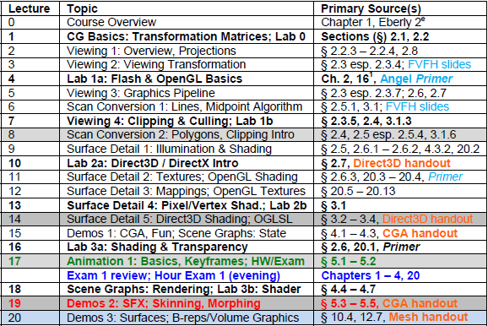
Where We Are

Slide 4
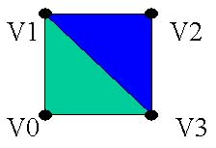
Review: Drawing in Direct3D
Specify the material we wish to use for the following triangles
Specify the texture we wish to use (if we want one or NULL if not)
Set the stream source to our vertex buffer
Set the FVF we will be using
Set the index buffer we will be using
Call the required DrawPrimitive function
void CGfxEntityCube::Render() {
gD3dDevice->SetMaterial( &m_material ); gD3dDevice->SetTexture(0,NULL); gD3dDevice->SetStreamSource( 0, m_vb,0, sizeof(CUBEVERTEX) ); gD3dDevice->SetFVF( D3DFVF_CUBEVERTEX ); gD3dDevice->SetIndices( m_ib); // draw a triangle list using 24 vertices and 12 triangles gD3dDevice->DrawIndexedPrimitive( D3DPT_TRIANGLELIST,0,0,24,0,12);
}
Toymaker © 2004 – 2010 K. Ditchburn, Teesside University
http://bit.ly/hMqxMl

Slide 5
Acknowledgements
Nathan H. Bean
Instructor
Outreach Coordinator
Department of Computing and Information Sciences
Kansas State University
http://bit.ly/gC3vwH
Direct3D material from slides © 2006 – 2010 N. Bean, Kansas State University
http://bit.ly/gC3vwH
Andy van Dam
T. J. Watson University Professor of Technology and Education & Professor of Computer Science
Brown University
http://www.cs.brown.edu/~avd/
Martin Christen, ClockworkCoders.com
http://bit.ly/et5qOp
Wolfgang Engel, http://www.wolfgang-engel.info
Visiondays 2003, http://bit.ly/hhkANP
Florian Rudolf, NeHe Productions
http://bit.ly/gi9g47
Koen Samyn
http://knol.google.com/k/hlsl-shaders
Keith Ditchburn, Teesside University
http://bit.ly/hMqxMl

Slide 6
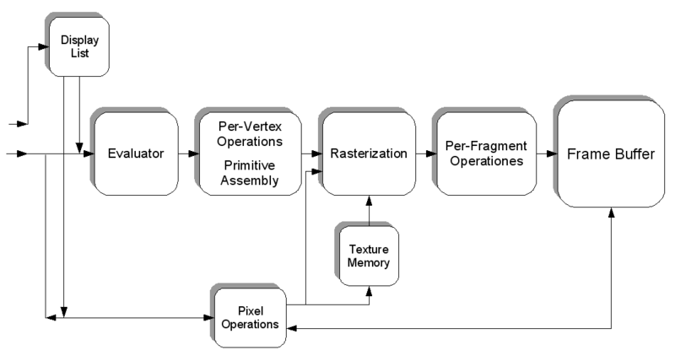
Review:
Shader Languages Overview
OpenGL State Machine (Simplified) from Wikipedia: Shader
http://bit.ly/fi8tBP
• HLSL: Shader language and API developed by Microsoft, only usable from within a DirectX application.
• Cg: Shader language and API developed by Nvidia, usable from within a DirectX and OpenGL application. Cg has a stark resemblance to HLSL.
• GLSL: Shader language and API developed by the OpenGL consortium and usable from withing an OpenGL application.
© 2009 Koen Samyn
http://knol.google.com/k/hlsl-shaders

Slide 7
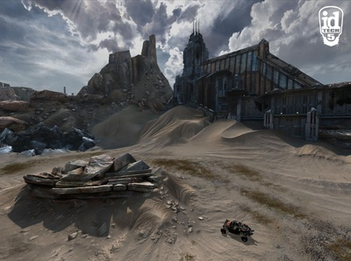
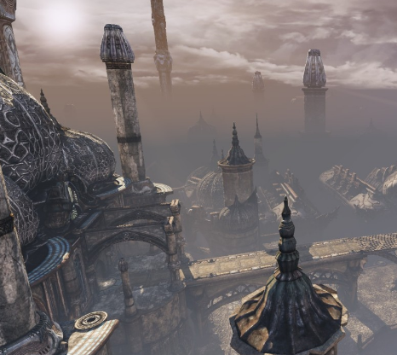
Review:
Programmable Hardware
Crysis 2
© 2011 Electronic Arts, Inc. – http://bit.ly/idNET9
Starcraft II: Wings of Liberty
© 2010 Blizzard Entertainment, Inc. – http://bit.ly/9B1qZp
Rage & id Tech 5
© 2011 id Software, Inc. – http://bit.ly/eR0m2B
Unreal Tournament 3 & Steamworks
© 2010 Epic Games & Valve – http://bit.ly/9QKAS7
Inspired by slides © 2002 – 2003 van Dam et al., Brown University
http://bit.ly/fiYmje Reused with permission.

Slide 8
Review:
HLSL Overview
High-Level Shader Language (HLSL) is Microsoft‘s language for programming GPUs
Looks like C
Example vertex and pixel shader for projective texturing (texture should appear to be projected onto the scene, as if from a slide projector)
struct VS_OUTPUTPROJTEX // output structure
{
float4 Pos : POSITION;
float4 Tex : TEXCOORD0;
};
VS_OUTPUTPROJTEX VSProjTexture(float4 Pos : POSITION, float3 Normal : NORMAL)
{
VS_OUTPUTPROJTEX Out = (VS_OUTPUTPROJTEX)0;
Out.Pos = mul(Pos, matWorldViewProj); // transform Position
Out.Tex = mul(ProjTextureMatrix, Pos); // project texture coordinates
return Out;
}
float4 PSProjTexture(float4 Tex: TEXCOORD0) : COLOR
{
return tex2Dproj(ProjTexMapSampler, Tex);
}
Adapted from slide 2003 Wolfgang Engel, http://www.wolfgang-engel.info
Visiondays 2003, http://bit.ly/hhkANP

Slide 9
Review:
HLSL Vertex Shader Example
// This is used by 3dsmax to load the correct parser string ParamID = "0x0"; // DxMaterial specific float4x4 wvp : WORLDVIEWPROJ; struct VS_OUTPUT { float4 Pos : POSITION; float4 Col : COLOR0; }; VS_OUTPUT VS( float3 Pos : POSITION ) { VS_OUTPUT Out = (VS_OUTPUT)0; float4 hPos = float4( Pos, 1); Out.Pos = mul( hPos, wvp); Out.Col = float4( 1, 1, 1, 1); return Out; } technique Default { pass P0 { // shaders CullMode = None; VertexShader = compile vs_2_0 VS(); } }
© 2009 Koen Samyn
http://knol.google.com/k/hlsl-shaders

Slide 10
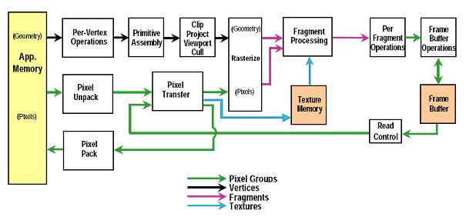
Review: OpenGL
Fixed Function Pipeline
OpenGL FFP Diagram (for v1.5)
New Function: Fragment (Pixel-Level) Shaders
Programmable pipeline – like HLSL, Cg
Compiles to shader objects
Runs on hardware: ATI Radeon 9x00+, nVidia GeForce 5x00+
OpenGL 1.5 Fixed Function Pipeline (see OpenGL Reference Manual)
“GLSL: An Introduction” © 2004 F. Rudolf, NeHe Productions – http://bit.ly/gi9g47

Slide 11
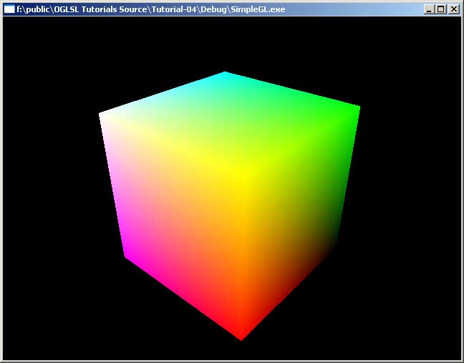
Review:
GLSL Hybrid Shader Example
Vertex Shader
varying float xpos;
varying float ypos;
varying float zpos;
void main(void)
{
xpos = clamp(gl_Vertex.x,0.0,1.0);
ypos = clamp(gl_Vertex.y,0.0,1.0);
zpos = clamp(gl_Vertex.z,0.0,1.0);
gl_Position = gl_ModelViewProjectionMatrix * gl_Vertex;
}
Fragment Shader
varying float xpos;
varying float ypos;
varying float zpos;
void main (void)
{
gl_FragColor = vec4 (xpos, ypos, zpos, 1.0);
}
© 2003 – 2005 M. Christen, ClockworkCoders.com
http://bit.ly/et5qOp

Slide 12
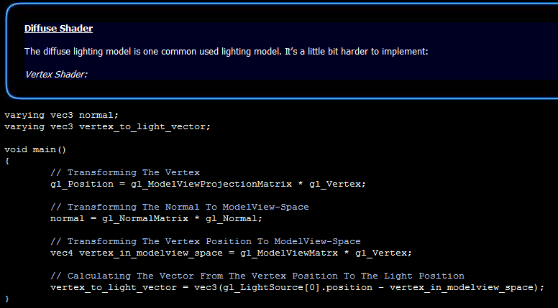
Review:
GLSL Vertex Shader Example
Diffuse Shader (NeHe GLSL Example)
Machine Problems, Projects: Will Use Combination of Shaders
© 2004 F. Rudolf, NeHe Productions
http://bit.ly/gi9g47

Slide 13
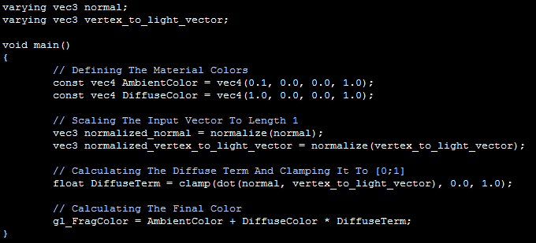
Review:
GLSL Pixel Shader Example
Consider BRDF (Especially N ⋅ L) From Last Lecture
Result: Diffuse Term for Phong Shading (One Light, No Specular)
© 2004 F. Rudolf, NeHe Productions
http://bit.ly/gi9g47

Slide 14
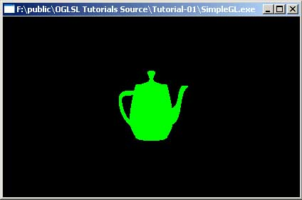
Tutorial 1: Loading, Compiling, & Linking OGLSL Programs [1]
Vertex Shader
void main(void)
{
vec4 a = gl_Vertex;
a.x = a.x * 0.5;
a.y = a.y * 0.5;
gl_Position = gl_ModelViewProjectionMatrix * a;
}
Q: What does this do?
A:
Incoming x and y components are scaled with a factor 0.5
Scaled vertex is transformed with concatenated modelview and projection matrix.
Fragment Shader
void main (void)
{
gl_FragColor = vec4 (0.0, 1.0, 0.0, 1.0);
}
Q: What does this do?
A: Makes everything green!
© 2003 – 2005 M. Christen, ClockworkCoders.com
http://bit.ly/et5qOp

Slide 15
Tutorial 1: Loading, Compiling, & Linking OGLSL Programs [2]
aShaderManager Class (Christen, 2003)
// globals:
aShaderManager shadermanager;
aShaderObject* shader;
// init:
shader = shadermanager.loadfromFile("test.vert","test.frag");
// draw:
shader->begin()
glutSolidSphere(1.0,32,32);
shader->end();
Methods
// load vertex/fragment shader from file
aShaderObject* loadfromFile(char* vertexFile, char* fragmentFile);
aShaderObject* loadfromMemory(const char* vertexMem, const char* fragmentMem);
bool free(aShaderObject* o);
loadFromFile: loads shader source code from file, compiles, links and returns a shader object.
loadfromMemory: instead of using files you can specify memory addresses containing a null terminated char array of the program string.
free: if you don't need a shader anymore you can free it. Usually this function isn't needed, the destructor of the ShaderManager frees memory.
}
This is the easy way!
Without this framework:
http://bit.ly/ePRyXN
… see next slide (Christen, 2003)
© 2003 – 2005 M. Christen, ClockworkCoders.com
http://bit.ly/et5qOp

Slide 16
Tutorial 1: Loading, Compiling, & Linking OGLSL Programs [3]
AppInit Function (Christen, 2003) – Part 1 of 3
#include "../cwc/aGLSL.h”
#include <GL/glut.h>
#include <iostream>
using namespace std;
// Shader and Program Objects:
aShaderObject* myShader = 0;
aVertexShader* myVertexShader = 0;
aFragmentShader* myFragmentShader = 0;
void AppInit(void)
{
// it is important a GL context is availble before creating
// shader and Program objects.
myShader = new aShaderObject;
myVertexShader = new aVertexShader;
myFragmentShader = new aFragmentShader;
© 2003 – 2005 M. Christen, ClockworkCoders.com
http://bit.ly/et5qOp

Slide 17
Tutorial 1: Loading, Compiling, & Linking OGLSL Programs [4]
AppInit Function (Christen, 2003) – Part 2 of 3
// Load Vertex Program
if (myVertexShader->load("simple.vert") != 0)
{
cout << "can't load vertex shader!\n“;
exit(-1); // if file is missing: major error, better exit
}
// Load Fragment Program
if (myFragmentShader->load("simple.frag") != 0)
{
cout << "can't load fragment shader!\n“;
exit(-1); // if file is missing: major error, better exit
}
// Compile Vertex Program, if it fails output log
if (!myVertexShader->compile())
{
cout << "***COMPILER ERROR:\n";
cout << myVertexShader->getCompilerLog() << endl;
}
© 2003 – 2005 M. Christen, ClockworkCoders.com
http://bit.ly/et5qOp

Slide 18
Tutorial 1: Loading, Compiling, & Linking OGLSL Programs [5]
AppInit Function (Christen, 2003) – Part 3 of 3
// Compile fragment Program, if it fails output log
if (!myFragmentShader->compile())
{
cout << "***COMPILER ERROR:\n";
cout << myFragmentShader->getCompilerLog() << endl;
}
// Add (compiled Programs) to object
myShader->addShader(myVertexShader);
myShader->addShader(myFragmentShader);
// Link the Program
if (!myShader->link())
{
cout << "**LINKER ERROR\n";
cout << myShader->getLinkerLog() << endl;
}
} // AppInit()
© 2003 – 2005 M. Christen, ClockworkCoders.com
http://bit.ly/et5qOp

Slide 19
Tutorial 1: Loading, Compiling, & Linking OGLSL Programs [6]
DrawFrame & AppExit (Christen, 2003)
//*************************************************************
// Draw one Frame (don't swap buffers)
void DrawFrame(void)
{
myShader->begin();
glutSolidTeapot(1.0);
myShader->end();
}
//*************************************************************
// use AppExit to clean up
void AppExit(void)
{
if (myShader!=0) delete myShader;
if (myVertexShader!=0) delete myVertexShader;
if (myFragmentShader!=0) delete myFragmentShader;
}
//***********************************************************
© 2003 – 2005 M. Christen, ClockworkCoders.com
http://bit.ly/et5qOp

Slide 20
Tutorial 1: Loading, Compiling, & Linking OGLSL Programs [7]
Loading Programs without aShaderManager class (Steps 1 – 2a of 3)
aGLSL.h defines:
aVertexShader: Class to manage vertex shader programs
aFragmentShader: Class to manage fragment shader programs
aShaderObject: Class to manage shader objects
Step 1: Declare shader programs and shader objects
aShaderObject* myShader = 0;
aVertexShader* myVertexShader = 0;
aFragmentShader* myFragmentShader = 0;
Step 2: Load, add and compile/link programs in AppInit()
Reserve memory and initialize objects (it is important an OpenGL context already exists when you do this)
myShader = new aShaderObject;
myVertexShader = new aVertexShader;
myFragmentShader = new aFragmentShader;
© 2003 – 2005 M. Christen, ClockworkCoders.com
http://bit.ly/et5qOp

Slide 21
Tutorial 1: Loading, Compiling, & Linking OGLSL Programs [8]
Loading Programs without aShaderManager class (Steps 2b – 2d of 3)
Step 2: Load, add and compile/link programs in AppInit() (continued)
Load:
myVertexShader->load("simple.vert");
myFragmentShader->load("simple.frag");
Compile:
myVertexShader->compile();
myFragmentShader->compile();
You can access compiler errors with:
char* getCompilerLog(void);
(getCompilerLog is defined in aVertexShader and aFragmentShader )
Add (compiled) programs to the object and link it:
myShader->addShader(myVertexShader);
myShader->addShader(myFragmentShader);
myShader->link();
You can access linker errors with "myShader->getLinkerLog()" similar to compilerLog.
© 2003 – 2005 M. Christen, ClockworkCoders.com
http://bit.ly/et5qOp

Slide 22
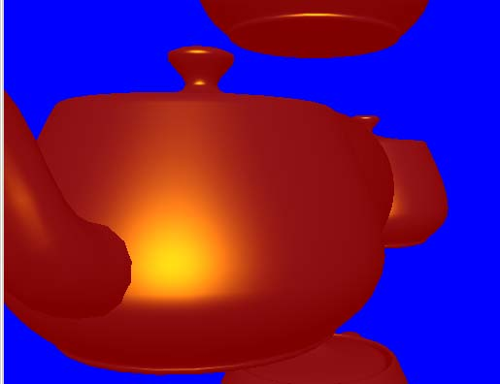
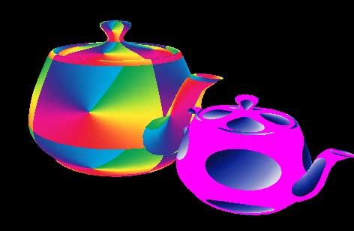
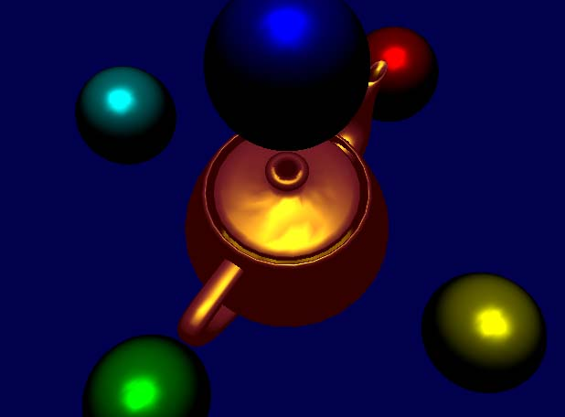
Tutorial 1: Loading, Compiling, & Linking OGLSL Programs [9]
Loading Programs without aShaderManager class (Step 3 of 3)
Step 3: Use shader (see rest of Tutorials, #2 – 10!)
myShader->begin();
... {draw something with GL} ...
myShader->end();
#5 Phong shading in OpenGL
http://bit.ly/i5IFL0
#6 Texture Mapping
http://bit.ly/hRhFQD
#7 Color Keys (Transparency Masks)
http://bit.ly/hUEi62
#8 Multitexturing
http://bit.ly/glaYoY
#9 Procedural Texture (Procedural Materials)
http://bit.ly/ieeER5
#10 Cartoon Shading
http://bit.ly/gR5EH3
Adapted from material © 2003 – 2005 M. Christen, ClockworkCoders.com
http://bit.ly/et5qOp

Slide 23
Shading in Direct3D [1]:
Writing Vertex Shaders
Defining TVertex data structure: position/normal/texture tuple:
struct TVertex { D3DXVECTOR3 position; D3DXVECTOR3 Normal; D3DXVECTOR3 Tex; };
Vertex declaration to describe this structure:
const D3DVERTEXELEMENT9 dec[4] = { {0, 0, D3DDECLTYPE_FLOAT3, D3DDECLMETHOD_DEFAULT, D3DDECLUSAGE_POSITION,0}, {0, 12, D3DDECLTYPE_FLOAT3, D3DDECLMETHOD_DEFAULT, D3DDECLUSAGE_NORMAL, 0}, {0, 24, D3DDECLTYPE_FLOAT2, D3DDECLMETHOD_DEFAULT, D3DDECLUSAGE_TEXCOORD,0}, D3DDECL_END() };
Each line corresponds to one of the elements in TVertex. The data in each line is:
WORD Stream; WORD Offset; BYTE Type; BYTE Method; BYTE Usage; BYTE UsageIndex
We need to tell Direct3D about our vertex declaration using the following call:
IDirect3DVertexDeclaration9 m_vertexDeclaration; gDevice->CreateVertexDeclaration(dec,&m_vertexDeclaration);
To render:
gDevice->SetStreamSource( 0, m_vb,0, sizeof(TVertex )); gDevice->SetVertexDeclaration(m_vertexDeclaration);
Adapted from Toymaker © 2004 – 2010 K. Ditchburn, Teesside University
http://bit.ly/g8Q8hC

Slide 24
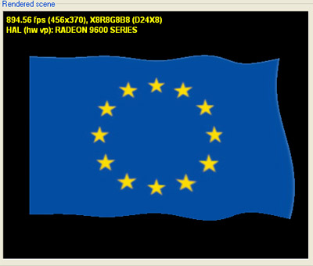
Shading in Direct3D [2]:
Using Vertex Shaders
This example shows how to manipulate the vertex position data to create the effect of a fluttering flag.
Global:
float4x4 matWorld : WORLD;
In application:
dxEffect->SetMatrix("matWorld",&mat))).
Shader output structure: transformed vertex position & texture coordinate
struct VS_OUTPUT
{
float4 Pos : POSITION;
float2 tex : TEXCOORD0;
};
VS_OUTPUT VS(float4 Pos : POSITION,float2 tex : TEXCOORD0)
float angle=(time%360)*2; // angle to use for sine wave
Pos.z = sin( Pos.x+angle); // wave effect
// take y position of vertex into account
Pos.z += sin( Pos.y/2+angle);
// make left edge look as if it is attached to a flagpole
Pos.z *= Pos.x * 0.09f;
Adapted from Toymaker © 2004 – 2010 K. Ditchburn, Teesside University
http://bit.ly/g8Q8hC

Slide 25
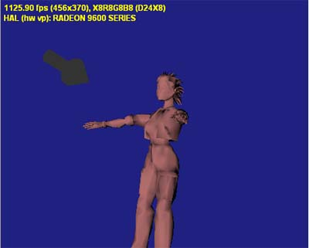
Shading in Direct3D:
Pixel Shading & Rest of Pipeline
Application
Scene management
Vertices, tessellation
Vertex Operations
Transformation and Lighting (T&L)
Culling, Clipping
Pixel Operations
Triangle setup and rasterization
Shading, multitexturing
Fog, alpha test, depth buffering, antialiasing
Display
Per-Pixel Shader for Diffuse Lighting
http://bit.ly/hVQcnY
Adapted from Toymaker © 2004 – 2010 K. Ditchburn, Teesside University
http://bit.ly/gBScYK

Slide 26
Next: CGA Videos (Demos & Trailers)
Monsters Inc. (2001)
Monsters Inc. 2 (2012)
© Disney/Pixar
Tron: Legacy
© 2010
Walt Disney Pictures
Toy Story (1995)
Toy Story 2 (1999)
Toy Story 3 (2010)
© Disney/Pixar
Kung-Fu Panda
© 2008 DreamWorks
Animation SKG
Wall-E
© 2008 Disney/Pixar
Happy Feet
© 2006
Warner Brothers
Shrek (2001)
Shrek 2 (2004)
Shrek the Third (2007)
Shrek Forever After (2010)
© DreamWorks Animation SKG
Luxo Jr.
© 1986 Pixar Animation Studios

Slide 27
Summary
Last Time: Shaders and Programmable Hardware
Hardware rendering & APIs for programmable hardware
Vertex shaders: vertex attributes to illumination at vertices
Pixel shaders: lit vertices to pixel colors, transparency
Shader Languages, Especially OGLSL
OpenGL Shading Language (OGLSL or GLSL) – main topic
High-Level Shading Language (HLSL) & Direct3D
Shading in Direct3D
Tutorials from K. Ditchburn based on Direct3D 10, HLSL
For more info, see Toymaker site: http://bit.ly/gBScYK
Still to Come: Pixar’s RenderMan Specification, Renderer, SL
Many More Shading Techniques: Explore for Yourself!
References: GLSL, HLSL/D3D, Cg, Renderman (Apodaca & Gritz)
Graphics Gems & GPU Gems series (some chapters online)
Shader books by Wolfgang Engels

Slide 28
Terminology
OpenGL Architecture Review Board – Standards Committee 2002 - 2006
OpenGL Shading Language (OGLSL aka GLSL)
Introduced in 2002 by OpenGL ARB, part of OpenGL since v1.4
GLSL compiler builds programs to load on OpenGL graphics cards
AppInit(): function to compile(), addShader(), and link()
High-Level Shading Language
Microsoft’s programmable pipeline
Used in tandem with Direct3D
Shader Model n: used with D3D version (SM5 = Direct3D 11, etc.)
Other Shader Languages (SLs)
Cg – Nvidia’s general-purpose SL (surveyed in Lecture 13)
Gelato – Nvidia’s production render farm SL (not covered)
RenderMan – Pixar’s specification, renderer, or SL (surveyed later)

