Slide 1
Lecture 2
Inductive Bias and PAC Learning
Tuesday, August 31, 1999
William H. Hsu
Department of Computing and Information Sciences, KSU
http://www.cis.ksu.edu/~bhsu
Readings:
Sections 2.7-2.8, Sections 7.1-7.3, Mitchell
Sections 2.4.1-2.4.3, Shavlik and Dietterich

Slide 2
Lecture Outline
Read 2.7-2.8, 7.1-7.3, Mitchell; 2.4.1-2.4.3 S&D
Homework 1: Due Thursday, September 16, 1999 (before 5 PM CST)
Paper Commentary 1: Due This Thursday
  L. G. Valiant, “A Theory of the Learnable” (Communications of the ACM, 1984)
  See guidelines in course notes
The Need for Inductive Bias
  Representations (hypothesis languages): a worst-case scenario
  Change of representation
Computational Learning Theory
  Setting 1: learner poses queries to teacher
  Setting 2: teacher chooses examples
  Setting 3: randomly generated instances, labeled by teacher
Probably Approximately Correct (PAC) Learning
  Motivation
  Introduction to PAC framework

Slide 3
An Unbiased Learner
Example of A Biased H
  Conjunctive concepts with don’t cares
  What concepts can H not express? (Hint: what are its syntactic limitations?)
Idea
  Choose H’ that expresses every teachable concept
  i.e., H’ is the power set of X
  Recall: | A → B | = | B | ^{| A |} (A = X; B = {labels}; H’ = A → B)
  {{Rainy, Sunny} × {Warm, Cold} × {Normal, High} × {None, Mild, Strong} × {Cool, Warm} × {Same, Change}} → {0, 1}
An Exhaustive Hypothesis Language
  Consider: H’ = disjunctions (∨), conjunctions (∧), negations (¬) over previous H
  | H’ | = 2^{(2 • 2 • 2 • 3 • 2 • 2)} = 2⁹⁶; | H | = 1 + (3 • 3 • 3 • 4 • 3 • 3) = 973
What Are S, G For The Hypothesis Language H’?
  S ← disjunction of all positive examples
  G ← conjunction of all negated negative examples

Slide 4
Inductive Bias
Components of An Inductive Bias Definition
  Concept learning algorithm L
  Instances X, target concept c
  Training examples D_{c} = {<x, c(x)>}
  L(x_{i}, D_{c}) = classification assigned to instance x_{i} by L after training on D_{c}
Definition
  The inductive bias of L is any minimal set of assertions B such that, for any target concept c and corresponding training examples D_{c}, ∀ x_{i} ∈ X . [(B ∧ D_{c} ∧ x_{i}) |⎯ L(x_{i}, D_{c})] where A |⎯ B means A logically entails B
  Informal idea: preference for (i.e., restriction to) certain hypotheses by structural (syntactic) means
Rationale
  Prior assumptions regarding target concept
  Basis for inductive generalization

Slide 5
Inductive Systems
and Equivalent Deductive Systems
Inductive System
Candidate Elimination
Algorithm
Using Hypothesis
Space H
Training Examples
Classification of New Instance
(or “Don’t Know”)
New Instance
Equivalent Deductive System
Training Examples
Theorem Prover
Classification of New Instance
(or “Don’t Know”)
New Instance
Assertion { c ∈ H }
Inductive bias made explicit

Slide 6
Three Learners with Different Biases
Rote Learner
  Weakest bias: anything seen before, i.e., no bias
  Store examples
  Classify x if and only if it matches previously observed example
Version Space Candidate Elimination Algorithm
  Stronger bias: concepts belonging to conjunctive H
  Store extremal generalizations and specializations
  Classify x if and only if it “falls within” S and G boundaries (all members agree)
Find-S
  Even stronger bias: most specific hypothesis
  Prior assumption: any instance not observed to be positive is negative
  Classify x based on S set

Slide 7
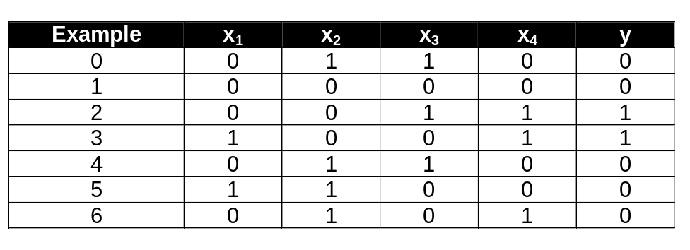
Hypothesis Space:
A Syntactic Restriction
Recall: 4-Variable Concept Learning Problem
Bias: Simple Conjunctive Rules
  Only 16 simple conjunctive rules of the form y = x_{i} ∧ x_{j} ∧ x_{k}
  y = Ø, x₁, …, x₄, x₁ ∧ x₂, …, x₃ ∧ x₄, x₁ ∧ x₂ ∧ x₃, …, x₂ ∧ x₃ ∧ x₄, x₁ ∧ x₂ ∧ x₃ ∧ x₄
  Example above: no simple rule explains the data (counterexamples?)
  Similarly for simple clauses (conjunction and disjunction allowed)
x₁
Unknown
Function
x₂
y = f (x₁, x₂, x₃, x₄ )
x₃
x₄

Slide 8
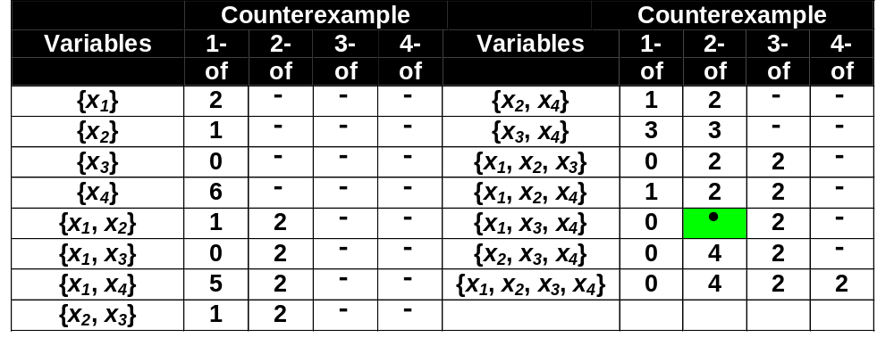
Hypothesis Space:
m-of-n Rules
m-of-n Rules
  32 possible rules of the form: “y = 1 iff at least m of the following n variables are 1”
Found A Consistent Hypothesis!

Slide 9
Views of Learning
Removal of (Remaining) Uncertainty
  Suppose unknown function was known to be m-of-n Boolean function
  Could use training data to infer the function
Learning and Hypothesis Languages
  Possible approach to guess a good, small hypothesis language:
    Start with a very small language
    Enlarge until it contains a hypothesis that fits the data
  Inductive bias
    Preference for certain languages
    Analogous to data compression (removal of redundancy)
    Later: coding the “model” versus coding the “uncertainty” (error)
We Could Be Wrong!
  Prior knowledge could be wrong (e.g., y = x₄ ∧ one-of (x₁, x₃) also consistent)
  If guessed language was wrong, errors will occur on new cases

Slide 10
Two Strategies for Machine Learning
Develop Ways to Express Prior Knowledge
  Role of prior knowledge: guides search for hypotheses / hypothesis languages
  Expression languages for prior knowledge
    Rule grammars; stochastic models; etc.
    Restrictions on computational models; other (formal) specification methods
Develop Flexible Hypothesis Spaces
  Structured collections of hypotheses
    Agglomeration: nested collections (hierarchies)
    Partitioning: decision trees, lists, rules
    Neural networks; cases, etc.
  Hypothesis spaces of adaptive size
Either Case: Develop Algorithms for Finding A Hypothesis That Fits Well
  Ideally, will generalize well
Later: Bias Optimization (Meta-Learning, Wrappers)

Slide 11
Computational Learning Theory
What General Laws Constrain Inductive Learning?
What Learning Problems Can Be Solved?
When Can We Trust The Output of A Learning Algorithm?
We Seek Theory To Relate:
  Probability of successful learning
  Number of training examples
  Complexity of hypothesis space
  Accuracy to which target concept is approximated
  Manner in which training examples are presented

Slide 12
Prototypical Concept Learning Task
Given
  Instances X: possible days, each described by attributes Sky, AirTemp, Humidity, Wind, Water, Forecast
  Target function c ≡ EnjoySport: X → H
  Hypotheses H: conjunctions of literals, e.g.,
    <?, Cold, High, ?, ?, ?>
  Training examples D: positive and negative examples of the target function
    <x₁, c(x₁)>, <x₂, c(x₂)>, …, <x_{m}, c(x_{m})>
Determine
  A hypothesis h in H such that h(x) = c(x) for all x in D?
  A hypothesis h in H such that h(x) = c(x) for all x in X?

Slide 13
Sample Complexity
How Many Training Examples Sufficient To Learn Target Concept?
Scenario 1: Active Learning
  Learner proposes instances, as queries to teacher
  Query (learner): instance x
  Answer (teacher): c(x)
Scenario 2: Passive Learning from Teacher-Selected Examples
  Teacher (who knows c) provides training examples
  Sequence of examples (teacher): {<x_{i}, c(x_{i})>}
  Teacher may or may not be helpful, optimal
Scenario 3: Passive Learning from Teacher-Annotated Examples
  Random process (e.g., nature) proposes instances
  Instance x generated randomly, teacher provides c(x)

Slide 14

Sample Complexity:
Scenario 1
Learner Proposes Instance x
Teacher Provides c(x)
  Comprehensibility: assume c is in learner’s hypothesis space H
  A form of inductive bias (sometimes nontrivial!)
Optimal Query Strategy: Play 20 Questions
  Pick instance x such that half of hypotheses in VS classify x positive, half classify x negative
  When this is possible, need queries to learn c
  When not possible, need even more

Slide 15
Sample Complexity:
Scenario 2
Teacher Provides Training Examples
  Teacher: agent who knows c
  Assume c is in learner’s hypothesis space H (as in Scenario 1)
Optimal Teaching Strategy: Depends upon H Used by Learner
  Consider case: H = conjunctions of up to n boolean literals and their negations
  e.g., (AirTemp = Warm) ∧ (Wind = Strong), where AirTemp, Wind, … each have 2 possible values
  Complexity
    If n possible boolean attributes in H, n + 1 examples suffice
    Why?

Slide 16
Sample Complexity:
Scenario 3
Given
  Set of instances X
  Set of hypotheses H
  Set of possible target concepts C
  Training instances generated by a fixed, unknown probability distribution D over X
Learner Observes Sequence D
  D: training examples of form <x, c(x)> for target concept c ∈ C
  Instances x are drawn from distribution D
  Teacher provides target value c(x) for each
Learner Must Output Hypothesis h Estimating c
  h evaluated on performance on subsequent instances
  Instances still drawn according to D
Note: Probabilistic Instances, Noise-Free Classifications

Slide 17

True Error of A Hypothesis
Definition
  The true error (denoted error_{D}(h)) of hypothesis h with respect to target concept c and distribution D is the probability that h will misclassify an instance drawn at random according to D.
Two Notions of Error
  Training error of hypothesis h with respect to target concept c: how often h(x) ≠ c(x) over training instances
  True error of hypothesis h with respect to target concept c: how often h(x) ≠ c(x) over future random instances
Our Concern
  Can we bound true error of h (given training error of h)?
  First consider when training error of h is zero (i.e, h ∈ VS_{H,D} )
Instance Space X
c
h
-
-
+
+
-
Where c
and h disagree

Slide 18
Exhausting The Version Space
Hypothesis Space H
error = 0.3
r = 0.4
error = 0.1
r = 0.2
error = 0.2
r = 0.0
VS_{H,D}
error = 0.2
r = 0.3
error = 0.3
r = 0.1
error = 0.1
r = 0.0
(r = training error, error = true error)
Definition
  The version space VS_{H,D} is said to be ε-exhausted with respect to c and D, if every hypothesis h in VS_{H,D} has error less than ε with respect to c and D.
  ∀ h ∈ VS_{H,D} . error_{D}(h) < ε

Slide 19
Number of Examples Required to
Exhaust The Version Space
How Many Examples Will ε–Exhaust The Version Space?
Theorem [Haussler, 1988]
  If the hypothesis space H is finite, and D is a sequence of m ≥ 1 independent random examples of some target concept c, then for any 0 ≤ ε ≤ 1, the probability that the version space with respect to H and D is not ε-exhausted (with respect to c) is less than or equal to | H | e ^{- ε m}
Important Result!
  Bounds the probability that any consistent learner will output a hypothesis h with error(h) ≥ ε
  Want this probability to be below a specified threshold δ | H | e ^{- ε m} ≤ δ
  To achieve, solve inequality for m: let m ≥ 1/ε (ln |H| + ln (1/δ))
  Need to see at least this many examples

Slide 20
Learning Conjunctions of Boolean Literals
How Many Examples Are Sufficient?
  Specification - ensure that with probability at least (1 - δ): Every h in VS_{H,D} satisfies error_{D}(h) < ε
  “The probability of an ε-bad hypothesis (error_{D}(h) ≥ ε) is no more than δ”
  Use our theorem: m ≥ 1/ε (ln |H| + ln (1/δ))
  H: conjunctions of constraints on up to n boolean attributes (n boolean literals)
  | H | = 3^{n}, m ≥ 1/ε (ln 3^{n} + ln (1/δ)) = 1/ε (n ln 3 + ln (1/δ))
How About EnjoySport?
  H as given in EnjoySport (conjunctive concepts with don’t cares)
    | H | = 973
    m ≥ 1/ε (ln |H| + ln (1/δ))
  Example goal: probability 1 - δ = 95% of hypotheses with error_{D}(h) < 0.1
  m ≥ 1/0.1 (ln 973 + ln (1/0.05)) ≈ 98.8

Slide 21
PAC Learning
Terms Considered
  Class C of possible concepts
  Set of instances X
  Length n (in attributes) of each instance
  Learner L
  Hypothesis space H
  Error parameter (error bound) ε
  Confidence parameter (excess error probability bound) δ
  size(c) = the encoding length of c, assuming some representation
Definition
  C is PAC-learnable by L using H if for all c ∈ C, distributions D over X, ε such that 0 < ε < 1/2, and δ such that 0 < δ < 1/2, learner L will, with probability at least (1 - δ), output a hypothesis h ∈ H such that error_{D}(h) ≤ ε
  C is efficiently PAC-learnable if L runs in time polynomial in 1/ε, 1/δ, n, size(c)

Slide 22
Agnostic Learning
Assumption of “Knowable” Concept
  So far, assumed c ∈ H
  Agnostic learning environment: don’t assume c ∈ H
What Do We Want Then?
  The “closest hypothesis we can get”
  Hypothesis h that makes the fewest errors on training data
How Hard Is This?
  Sample complexity: m ≥ 1/2ε² (ln |H| + ln (1/δ))
  Derived from Hoeffding bounds: P [error_{D}(h) > error_{D}(h) + ε] ≤ e^{-2mε2}

Slide 23
Terminology
Inductive Bias
  Strength of inductive bias: how few hypotheses?
  Specific biases: based on specific languages
Hypothesis Language
  “Searchable subset” of the space of possible descriptors
  m-of-n, conjunctive, disjunctive, clauses
  Ability to represent a concept
PAC Learning
  Probably Approximately Correct
  Computational Learning Theory (COLT)
  True error versus training error
  Notation: distribution D, error_{D}(h), ε-bad with probability δ
  ε-exhaustion: every hypothesis in VS_{H,D} has error_{D}(h) < ε
  PAC-learnability: for c ∈ C, X, n, L, H, ε, δ

Slide 24
Summary Points
Inductive Leaps Possible Only if Learner Is Biased
  Futility of learning without bias
  Strength of inductive bias: proportional to restrictions on hypotheses
Modeling Inductive Learners with Equivalent Deductive Systems
  Representing inductive learning as theorem proving
  Equivalent learning and inference problems
Syntactic Restrictions
  Example: m-of-n concept
Views of Learning and Strategies
  Removing uncertainty (“data compression”)
  Role of knowledge
Introduction to Computational Learning Theory (COLT)
  Things COLT attempts to measure
  Probably-Approximately-Correct (PAC) learning framework
Next Lecture: Occam’s Razor, VC Dimension, and Error Bounds

