Slide 1
CG Basics 1 of 10
Mathematical Foundations:
Vectors, Matrices, & Parametric Equations
William H. Hsu
Department of Computing and Information Sciences, KSU
KSOL course page: http://bit.ly/hGvXlH
Course web site: http://www.kddresearch.org/Courses/CIS636
Instructor home page: http://www.cis.ksu.edu/~bhsu
Readings:
Sections 2.1 – 2.2, 13.2, 14.1 – 14.4, 17.1, Eberly 2e – see http://bit.ly/ieUq45
Appendices 1-4, Foley, J. D., VanDam, A., Feiner, S. K., & Hughes, J. F. (1991). Computer Graphics, Principles and Practice, Second Edition in C.
McCauley (Senocular.com) tutorial: http://bit.ly/2yNPD

Slide 2
Lecture Outline
Quick Review: Basic Precalculus and Linear Algebra for CG
Matrix and Vector Notation, Operations
Precalculus: Analytic Geometry and Trigonometry
  Dot products and distance measures (norms, equations)
  Review of some basic trigonometry concepts
Vector Spaces and Affine Spaces
  Subspaces
  Linear systems, linear independence, bases, orthonormality
  Equations for objects in affine spaces
Cumulative Transformation Matrices (CTM) aka “Composite”, “Current”
  Translation
  Rotation
  Scale
Parametric Equation of Line Segment

Slide 3
Online Recorded Lectures
for CIS 536/636 (Intro to CG)
Project Topics for CIS 536/636
Computer Graphics Basics (10)
  1. Mathematical Foundations – Week 1 - 2
  2. Graphics Pipeline – Week 2
  3. Detailed Introduction to Projections and 3-D Viewing – Week 3
  4. OpenGL Primer 1 of 3: Basic Primitives and 3-D – Weeks 3-4
  5. Rasterizing (Lines, Polygons, Circles, Ellipses) and Clipping – Week 4
  6. Lighting and Shading – Week 5
  7. OpenGL Primer 2 of 3: Boundaries (Meshes), Transformations – Weeks 5-6
  8. Texture Mapping – Week 6
  9. OpenGL Primer 3 of 3: Shading and Texturing, VBOs – Weeks 6-7
  10. Visible Surface Determination – Week 8
Recommended Background Reading for CIS 636
Shared Lectures with CIS 736 (Computer Graphics)
  Regular in-class lectures (30) and labs (7)
  Guidelines for paper reviews – Week 6
  Preparing term project presentations, CG demos – Weeks 11-12

Slide 4
Background Expected
Both Courses
  Proficiency in C/C++ or strong proficiency in Java and ability to learn
  Strongly recommended: matrix theory or linear algebra (e.g., Math 551)
  At least 120 hours for semester (up to 150 depending on term project)
  Textbook: 3D Game Engine Design, Second Edition (2006), Eberly
  Angel’s OpenGL: A Primer recommended
CIS 536 & 636 Introduction to Computer Graphics
  Fresh background in precalculus: Algebra 1-2, Analytic Geometry
  Linear algebra basics: matrices, linear bases, vector spaces
  Watch background lectures
CIS 736 Computer Graphics
  Recommended: first course in graphics (background lectures as needed)
  OpenGL experience helps
  Read up on shaders and shading languages
  Watch advanced topics lectures; see list before choosing project topic

Slide 5
Math Review for CIS 636
Overview: First Month (Weeks 2-5 of Course)
  Review of mathematical foundations of CG: analytic geometry, linear algebra
  Line and polygon rendering
  Matrix transformations
  Graphical interfaces
Line and Polygon Rendering (Week 3)
  Basic line drawing and 2-D clipping
  Bresenham’s algorithm
  Follow-up: 3-D clipping, z-buffering (painter’s algorithm)
Matrix Transformations (Week 4)
  Application of linear transformations to rendering
  Basic operations: translation, rotation, scaling, shearing
  Follow-up: review of standard graphics libraries (e.g., OpenGL)
Graphical Interfaces
  Brief overview
  Survey of windowing environments (MFC, Java AWT)

Slide 6
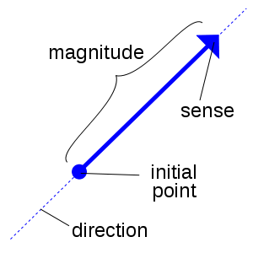
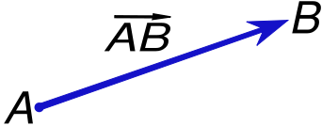

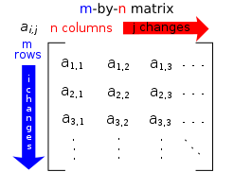

Matrix and Vector Notation
Vector: Geometric Object with Length (Magnitude), Direction
Vector Notation (General Form)
  Row vector
  Column vector
Coordinates in ℝ³ (Euclidean Space)
  Cartesian (see http://bit.ly/f5z1UC)
  Cylindrical (see http://bit.ly/gt5v3u)
  Spherical (see http://bit.ly/f4CvMZ)
Matrix: Rectangular Array of Numbers
Wikipedia: Vector
http://bit.ly/eBrI09
Wikipedia: Matrix (mathematics)
http://bit.ly/fwpDwd
Wikimedia Commons, 2011 – Creative Commons License

Slide 7


Determinants
What Are Determinants?
  Scalars associated with any square (k × k) matrix M, k ≥ 1
  Fundamental meaning: scale coefficient where M is linear transformation
Definitions
  2 × 2 matrix
  2 × 2 determinant
  3 × 3 matrix
  3 × 3 determinant
  General case (recursive definition): see http://mathworld.wolfram.com/Determinant.html
= a(ei – fh) – b(di – fg) + c(dh - eg)
Wikimedia Commons, 2011 – Creative Commons License

Slide 8

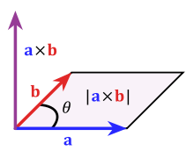

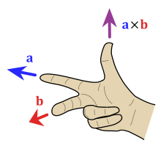

Vector Operations:
Dot & Cross Product, Arithmetic
Dot Product aka Inner Product aka Scalar Product
Cross Product
Vector Arithmetic
  Scalar multiplication
  Vector addition
Wikimedia Commons, 2011 – Creative Commons License

Slide 9

Matrix Operations [1]:
Scalar Multiplication & Transpose
Scalar-Matrix Multiplication
Transpose
Wikimedia Commons, 2011 – Creative Commons License

Slide 10
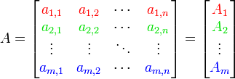
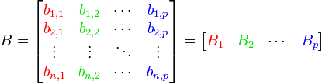
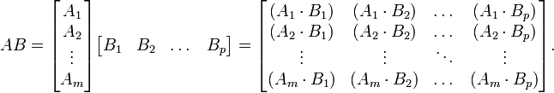
Matrix Operations [2]:
Addition & Multiplication
Matrix Addition
Matrix Multiplication
Wikimedia Commons, 2011 – Creative Commons License

Slide 11
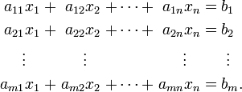
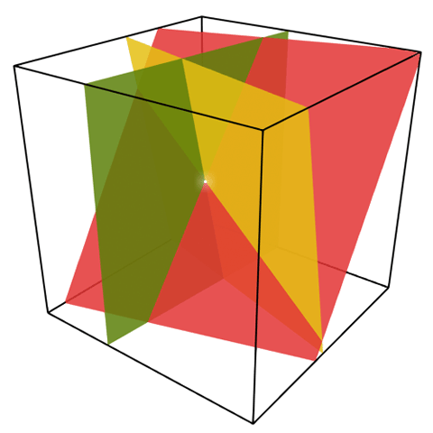


Linear Systems of Equations
Definition: Linear System of Equations (LSE)
  Collection of linear equations (see http://bit.ly/dNa2MO)
  Each of form
  System shares same set of variables x_{i}
Example
  3 equations in 3 unknowns
  Solution
Wikimedia Commons, 2011 – Creative Commons License

Slide 12
Cumulative Transformation
Matrices: Basic T, R, S
T: Translation (see http://en.wikipedia.org/wiki/Translation_matrix)
  Given
    Point to be moved – e.g., vertex of polygon or polyhedron
    Displacement vector (also represented as point)
  Return: new, displaced (translated) point of rigid body
R: Rotation (see http://en.wikipedia.org/wiki/Rotation_matrix)
  Given
    Point to be rotated about axis
    Axis of rotation
    Degrees to be rotated
  Return: new, displaced (rotated) point of rigid body
S: Scaling (see http://en.wikipedia.org/wiki/Scaling_matrix)
  Given
    Set of points centered at origin
    Scaling factor
  Return: new, displaced (scaled) point
General: http://en.wikipedia.org/wiki/Transformation_matrix

Slide 13

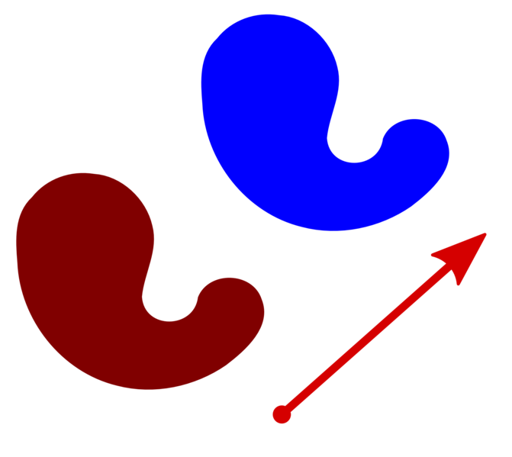
Translation
Rigid Body Transformation
To Move p Distance and Magnitude of Vector v:
Invertibility
Compositionality
Wikimedia Commons, 2008 – Creative Commons License

Slide 14
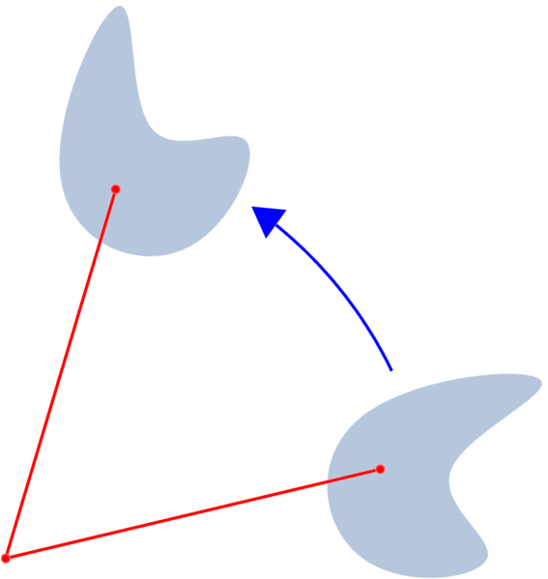





Rotation
Rigid Body Transformation
Properties: Inverse ≡ Transpose
Idea: Define New (Relative) Coordinate System
Example
Rotations about x, y, and z Axes (using Plain 3-D Coordinates)
Wikimedia Commons, 2008 – Creative Commons License

Slide 15

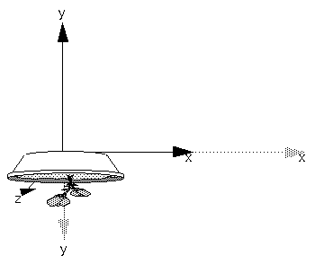


Scaling
Not Rigid Body Transformation
Idea: Move Points Toward/Away from Origin
Homogeneous Coordinates Make It Easier
Result
Ratio Need Not Be Uniform in x, y, z
Results of glScalef(2.0, -0.5, 1.0)
© 1993 Neider, Davis, Woo
http://fly.cc.fer.hr/~unreal/theredbook/
Wikimedia Commons, 2008 – Creative Commons License

Slide 16
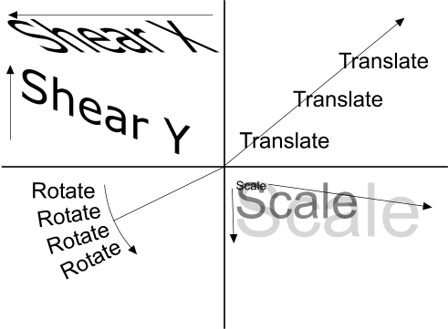
Other Transformations
Shear: Used with Oblique Projections
Perspective to Parallel View Volume (“D” in Foley et al.)
See also
  http://en.wikipedia.org/wiki/Transformation_matrix
  http://www.senocular.com/flash/tutorials/transformmatrix/
© Ramuseco Limited 2004-2005 All Rights Reserved.
http://www.bobpowell.net/transformations.htm

Slide 17

Quick Review:
Basic Linear Algebra for CG
Reference: Appendix A.1 – A.4, Foley et al.
A.1 Vector Spaces and Affine Spaces
  Equations of lines, planes
  Vector subspaces and affine subspaces
A.2 Standard Constructions in Vector Spaces
  Linear independence and spans
  Coordinate systems and bases
A.3 Dot Products and Distances
  Dot product in ℝ^{n}
  Norms in ℝ^{n}
A.4 Matrices
  Binary matrix operations: basic arithmetic
  Unary matrix operations: transpose and inverse
Application: Transformations and Change of Coordinate Systems
Affine transformations
© 2005 Trevor McCauley
(Senocular)

Slide 18
Vector Spaces and
Affine Spaces
Vector Space: Set of Points with Addition, Multiplication by Constant
  Components
    Set V (of vectors u, v, w) over which addition, scalar multiplication defined
    Vector addition: v + w
    Scalar multiplication: αv
  Properties (necessary and sufficient conditions)
    Addition: associative, commutative, identity (0 vector such that ∀ v . 0 + v = v), admits inverses (∀ v . ∃w . v + w = 0)
    Scalar multiplication: satisfies ∀ α, β, v . (αβ)v = α(βv), ∀v . 1v = v, ∀ α, β, v . (α + β)v = αv + βv, ∀ α, β, v . α(v + w) = αv + αw
  Linear combination: α₁v₁ + α₂v₂ + … + α_{n}v_{n}
Affine Space: Set of Points with Geometric Operations (No “Origin”)
  Components
    Set V (of points P, Q, R) and associated vector space
    Operators: vector difference, point-vector addition
  Affine combination (of P and Q by t ∈ ℝ): P + t(Q – P)
  NB: for any vector space (V, +, ·) there exists affine space (points(V), V)

Slide 19
Linear and Planar Equations
in Affine Spaces
Equation of Line in Affine Space
  Let P, Q be points in affine space
  Parametric form (real-valued parameter t)
    Set of points of form (1 – t)P + tQ
    Forms line passing through P and Q
  Example
    Cartesian plane of points (x, y) is an affine space
    Parametric line between (a, b) and (c, d):
    L = {((1 – t)a + tc, (1 – t)b + td) | t ∈R}
Equation of Plane in Affine Space
  Let P, Q, R be points in affine space
  Parametric form (real-valued parameters s, t)
    Set of points of form (1 – s)((1 – t)P + tQ) + sR
    Forms plane containing P, Q, R

Slide 20
Vector Space Spans and
Affine Spans
Vector Space Span
  Definition – set of all linear combinations of a set of vectors
  Example: vectors in ℝ³
    Span of single (nonzero) vector v: line through the origin containing v
    Span of pair of (nonzero, noncollinear) vectors: plane through the origin containing both
    Span of 3 of vectors in general position: all of ℝ³
Affine Span
  Definition – set of all affine combinations of a set of points P₁, P₂, …, P_{n} in an affine space
  Example: vectors, points in ℝ³
    Standard affine plan of points (x, y, 1)^{T}
    Consider points P, Q
    Affine span: line containing P, Q
    Also intersection of span, affine space
Span
of u and v
P
Q
Affine span
of P and Q
u
v
0

Slide 21
Independence
Linear Independence
  Definition: (linearly) dependent vectors
    Set of vectors {v₁, v₂, …, v_{n}} such that one lies in the span of the rest
    ∃ v_{i} ∈ {v₁, v₂, …, v_{n}} . v_{i} ∈ Span ({v₁, v₂, …, v_{n}} ~ {v_{i}})
  (Linearly) independent: {v₁, v₂, …, v_{n}} not dependent
Affine Independence
  Definition: (affinely) dependent points
    Set of points {v₁, v₂, …, v_{n}} such that one lies in the (affine) span of the rest
    ∃ P_{i} ∈ {P₁, P₂, …, P_{n}} . P_{i} ∈ Span ({P₁, P₂, …, P_{n}} ~ {P_{i}})
  (Affinely) independent: {P₁, P₂, …, P_{n}} not dependent
Consequences of Linear Independence
  Equivalent condition: α₁v₁ + α₂v₂ + … + α_{n}v_{n} = 0 ⇔ α₁ = α₂ = … = α_{n} = 0
  Dimension of span is equal to the number of vectors

Slide 22
Subspaces
Intuitive Idea
  ℝ^{n}: vector or affine space of “equal or lower dimension”
  Closed under constructive operator for space
Linear Subspace
  Definition
    Subset S of vector space (V, +, ·)
    Closed under addition (+) and scalar multiplication (·)
  Examples
    Subspaces of ℝ³: origin (0, 0, 0), line through the origin, plane containing origin, ℝ³ itself
    For vector v, {αv | α ∈ ℝ} is a subspace (why?)
Affine Subspace
  Definition
    Nonempty subset S of vector space (V, +, ·)
    Closure S’ of S under point subtraction is a linear subspace of V
  Important affine subspace of ℝ⁴: {(x, y, z, 1)}
  Foundation of homogeneous coordinates, 3-D transformations

Slide 23
Bases
Spanning Set (of Set S of Vectors)
  Definition: set of vectors for which any vector in Span(S) can be expressed as linear combination of vectors in spanning set
  Intuitive idea: spanning set “covers” Span(S)
Basis (of Set S of Vectors)
  Definition
    Minimal spanning set of S
    Minimal: any smaller set of vectors has smaller span
  Alternative definition: linearly independent spanning set
Exercise
  Claim: basis of subspace of vector space is always linearly independent
  Proof: by contradiction (suppose basis is dependent… not minimal)
Standard Basis for ℝ³: i, j, k
  E = {e₁, e₂, e₃}, e₁ = (1, 0, 0)^{T}, e₂ = (0, 1, 0)^{T}, e₃ = (0, 0, 1)^{T}
  How to use this as coordinate system?

Slide 24
Coordinates
and Coordinate Systems
Coordinates Using Bases
  Coordinates
    Consider basis B = {v₁, v₂, …, v_{n}} for vector space
    Any vector v in the vector space can be expressed as linear combination of vectors in B
    Definition: coefficients of linear combination are coordinates
  Example
    E = {e₁, e₂, e₃}, i ≡ e₁ = (1, 0, 0)^{T}, j ≡ e₂ = (0, 1, 0)^{T}, k ≡ e₃ = (0, 0, 1)^{T}
    Coordinates of (a, b, c) with respect to E: (a, b, c)^{T}
Coordinate System
  Definition: set of independent points in affine space
  Affine span of coordinate system is entire affine space
Exercise
  Derive basis for associated vector space of arbitrary coordinate system
  (Hint: consider definition of affine span…)

Slide 25
Dot Products and Distances
Dot Product in ℝ^{n}
  Given: vectors u = (u₁, u₂, …, u_{n})^{T}, v = (v₁, v₂, …, v_{n})^{T}
  Definition
    Dot product u • v ≡ u₁v₁ + u₂v₂ + … + u_{n}v_{n}
    Also known as inner product
    In ℝ^{n}, called scalar product
Applications of the Dot Product
  Normalization of vectors
  Distances
  Generating equations
  See Appendix A.3, Foley et al. (FVFH aka FVD)

Slide 26
Norms and Distance Formulas
Length
  Definition
    v • v = ∑_{i} v_{i}²
  aka Euclidean norm
Applications of the Dot Product
  Normalization of vectors: division by scalar length || v || converts to unit vector
  Distances
    Between points: || Q – P ||
    From points to planes
  Generating equations (e.g., point loci): circles, hollow cylinders, etc.
  Ray / object intersection equations
  See A.3.5, FVD

Slide 27
Orthonormal Bases
Orthogonality
  Given: vectors u = (u₁, u₂, …, u_{n})^{T}, v = (v₁, v₂, …, v_{n})^{T}
  Definition
    u, v are orthogonal if u • v = 0
    In R², angle between orthogonal vectors is 90º
Orthonormal Bases
  Necessary and sufficient conditions
    B = {b₁, b₂, …, b_{n}} is basis for given vector space
    Every pair (b_{i}, b_{j}) is orthogonal
    Every vector b_{i} is of unit magnitude (|| v_{i} || = 1)
  Convenient property: can just take dot product v • b_{i} to find coefficients in linear combination (coordinates with respect to B) for vector v

Slide 28
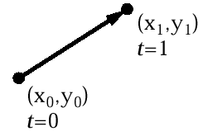
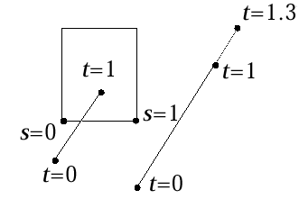
Parametric Equation of a
Line Segment
Parametric form for line segment
  X = x₀ + t(x₁ – x₀) 0 ≤ t ≤ 1
  Y = y₀ + t(y₁ – y₀)
  P(t) = P₀ + t(P₁ – P₀)
“true,” i.e., interior intersection, if sedge and tline in [0,1]
© 2003 – 2008 A. van Dam, Brown University

Slide 29
Rotation as Change of Basis
3 x 3 rotation matrices
We learned about 3 x 3 matrices that “rotate” the world (we’re leaving out the homogeneous coordinate for simplicity)
When they do, the three unit vectors that used to point along the x, y, and z axes are moved to new positions
Because it is a rigid-body rotation
  the new vectors are still unit vectors
  the new vectors are still perpendicular to each other
  the new vectors still satisfy the “right hand rule”
Any matrix transformation that has these three properties is a rotation about some axis by some amount!
Let’s call three x-axis, y-axis, and z-axis-aligned unit vectors e₁, e₂, e₃
Writing out:
© 2003 – 2008 A. van Dam, Brown University

Slide 30
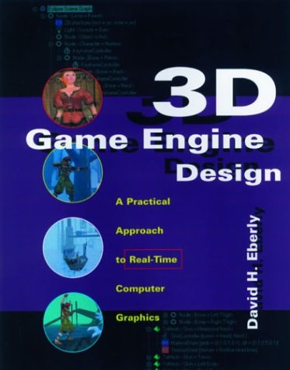
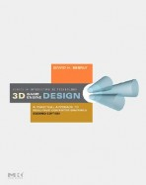

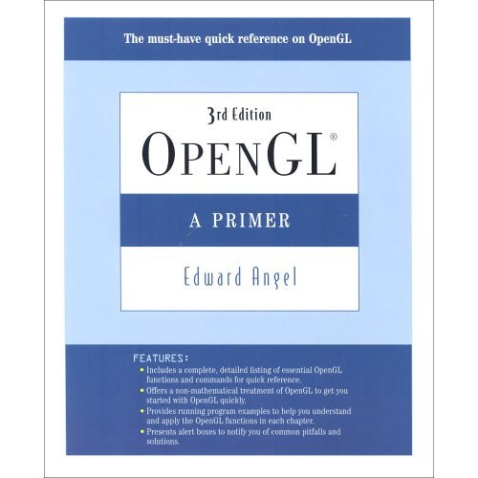
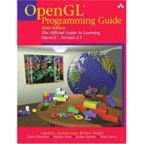
Textbook and Recommended Books
Required Textbook
Eberly, D. H. (2006). 3D Game Engine Design: A Practical Approach to Real-Time Computer Graphics, second edition. San Francisco, CA: Morgan Kauffman.
Recommended References
Angel, E. O. (2007). OpenGL: A Primer, third edition. Reading, MA: Addison-Wesley. [2nd edition on reserve]
Shreiner, D., Woo, M., Neider, J., & Davis, T. (2007). OpenGL® Programming Guide: The Official Guide to Learning OpenGL®, Version 2.1, sixth edition.
[“The Red Book”: use 5th ed. or later]
1st edition (outdated)
2nd edition
2nd edition (OK to use)
3rd edition

Slide 31
Summary
Cumulative Transformation Matrices (CTM): T, R, S
  Translation
  Rotation
  Scaling
  Setup for Shear, Perspective to Parallel – see Eberly, Foley et al.
“Matrix Stack” in OpenGL: Premultiplication of Matrices
Coming Up
  Parametric equations in clipping
  Intersection testing: ray-cube, ray-sphere, implicit equations (ray tracing)
Homogeneous Coordinates: What Is That 4th Coordinate?
  http://en.wikipedia.org/wiki/Homogeneous_coordinates
  Crucial for ease of normalizing T, R, S transformations in graphics
  See: Slide 22 of this lecture
  Note: Slides 13 & 15 (T, S) versus 14 (R)
  Read about them in Eberly 2e, Angel 3e
  Special case: barycentric coordinates

Slide 32
Terminology
Cumulative Transformation Matrices (CTM): Translation, Rotation, Scaling
Some Basic Analytic Geometry and Linear Algebra for CG
  Vector space (VS) – set of vectors admitting addition, scalar multiplication and observing VS axioms
  Affine space (AS) – set of points with associated vector space admitting vector difference, point-vector addition and observing AS axioms
  Linear subspace – nonempty subset S of VS (V, +, ·) closed under + and ·
  Affine subspace – nonempty subset S of VS (V, +, ·) such that closure S’ of S under point subtraction is a linear subspace of V
  Span – set of all linear combinations of set of vectors
  Linear independence – property of set of vectors that none lies in span of others
  Basis – minimal spanning set of set of vectors
  Dot product – scalar-valued inner product <u, v> ≡ u • v ≡ u₁v₁ + u₂v₂ + … + u_{n}v_{n}
  Orthogonality – property of vectors u, v that u • v = 0
  Orthonormality – basis containing pairwise-orthogonal unit vectors
  Length (Euclidean norm) –

