Slide 1
Lecture 12 of 41
Surface Detail 3 of 5: Mappings
OpenGL Textures
William H. Hsu
Department of Computing and Information Sciences, KSU
KSOL course pages: http://bit.ly/hGvXlH / http://bit.ly/eVizrE
Public mirror web site: http://www.kddresearch.org/Courses/CIS636
Instructor home page: http://www.cis.ksu.edu/~bhsu
Readings:
Today: Sections 20.5 – 20.13, Eberly 2e – see http://bit.ly/ieUq45
Next class: Section 3.1, Eberly 2e
Brown CS123 slides on Polygons/Texture Mapping – http://bit.ly/h2VZn8
Wayback Machine archive of Brown CS123 slides: http://bit.ly/gAhJbh
Gröller & Jeschke slides on Texturing – http://bit.ly/dJFYq9

Slide 2
Lecture Outline
Reading for Last Class: §2.6.3, 20.3 – 20.4, Eberly 2e
Reading for Today: §20.5 – 20.13, Eberly 2e (Many Mappings)
Reading for Next Class: §3.1, Eberly 2e
Last Time: Texture Mapping Explained
  Definitions and design principles
  Enclosing volumes: cylinder, sphere, box
  Mapping methods
    reflected ray – bounce ray off object O
    object normal – ray from face normal of object (polygon mesh)
    object center – ray from center of object
    intermediate surface normal – ray from inside of enclosing S
Today: Mappings, OpenGL Texturing
  Shadow, reflection/environment, transparency, bump, displacement
  Other mappings: gloss, volumetric fog, skins, rainbows, water
  OpenGL texture mapping how-to

Slide 3
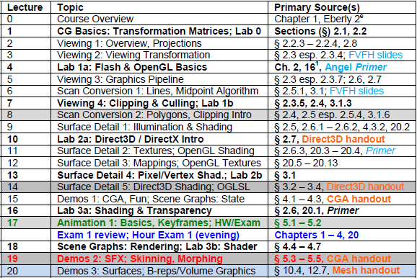

Where We Are

Slide 4
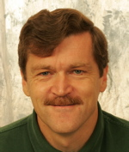
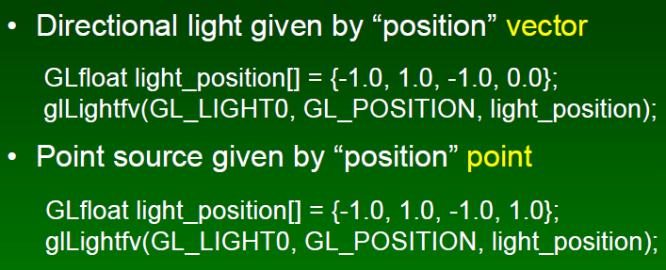
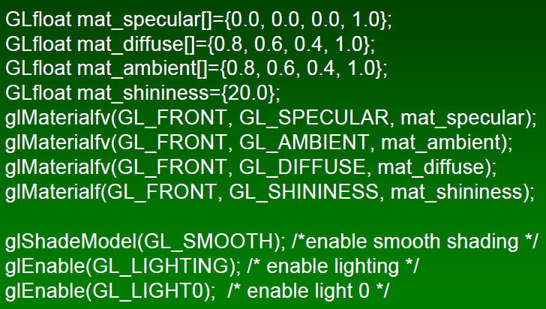
Review:
OpenGL Shading (Overview)
Set Up Point Light Sources
Set Up Materials, Turn Lights On
Start Drawing (glBegin … glEnd)
Frank Pfenning
Professor of Computer Science
School of Computer Science
Carnegie Mellon University
http://www.cs.cmu.edu/~fp/
See also: OpenGL: A Primer, 3e (Angel)
http://bit.ly/hVcVWN
Adapted from slides © 2003 F. Pfenning, Carnegie Mellon University
http://bit.ly/g1J2nj

Slide 5



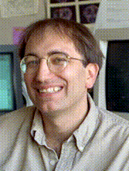

Acknowledgements:
Many Mappings
Stefan Jeschke
Research Assistant
http://bit.ly/hUUM94
Eduard Gröller
Associate Professor
Director, Visualization Working Group
http://bit.ly/hUUM94
Institute of Computer Graphics and Algorithms
Technical University of Vienna
Texturing material from slides © 2002 E. Gröller & S. Jeschke, Vienna University of Technology
http://bit.ly/dJFYq9
Pat Hanrahan
CANON USA Professor
Director, Computer Graphics Laboratory
Computer Science and Electrical Engineering Departments
Stanford University
http://graphics.stanford.edu/~hanrahan/
Mapping material from slides © 1995 – 2009 P. Hanrahan, Stanford University
http://bit.ly/hZfsjZ (CS 348B, Computer Graphics: Image Synthesis Techniques)

Slide 6
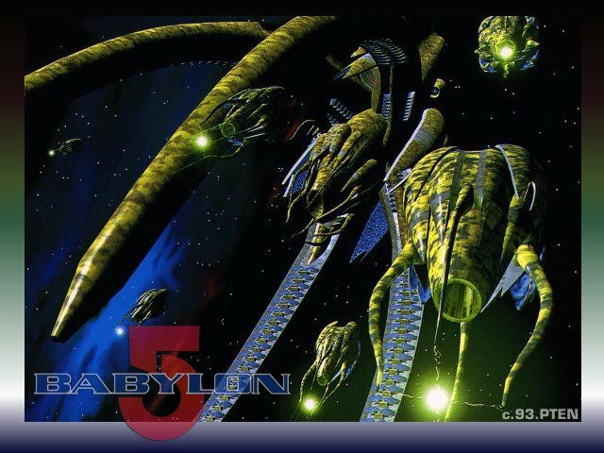
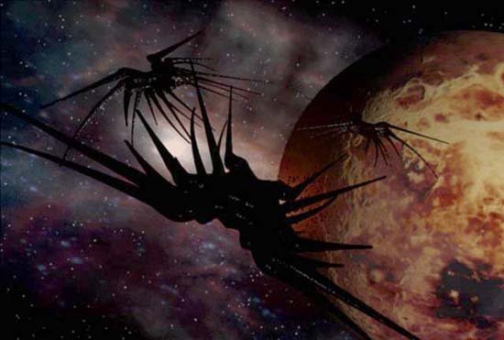
Overview of Mappings:
Eberly 2e Chapter 20 Sections
Fine Surface Detail: Bump (§20.5 Eberly 2e)
Material Effects: Gloss (§20.6)
Enclosing Volumes
  Sphere (§20.7)
  Cube (§20.8)
Light
  Refraction for Transparency (§20.9)
  Reflection aka Environment (§20.10)
Shadow
  Shadow Maps (§20.11, 20.13)
  Projective Textures (§20.12)
More Special Effects (SFX)
  Fog (§20.14)
  Skinning (§20.15)
  Iridescence (§20.16), Water (§20.17)
Babylon 5
© 1993 – 1998 Warner Brothers Entertainment, Inc.

Slide 7
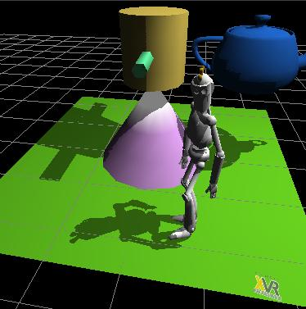
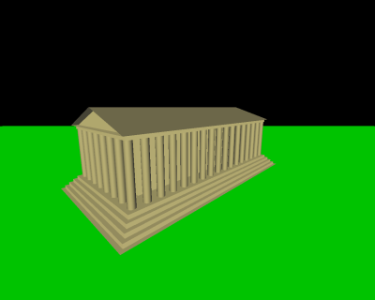
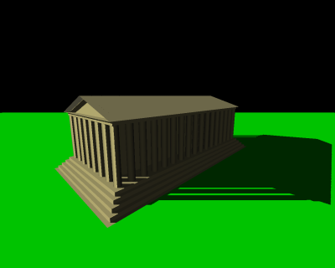
Shadow Mapping [1]:
Basic Concept
Process for Adding Shadows in 3-D CG
Compatible with Local Illumination
  Global method: shadow rays
  Not needed here as in raytracing
  Instead, use decaling
Decals
  “Paste” surface detail onto model
  Semi-transparent: alpha blending
  Can simulate many attributes
Shadow Mapping © 2007 XVR Wiki
http://wiki.vrmedia.it/index.php?title=Shadow_Mapping
Shadow Mapping © 2005 Wikipedia
http://en.wikipedia.org/wiki/Shadow_mapping
Without shadow map
With shadow map

Slide 8
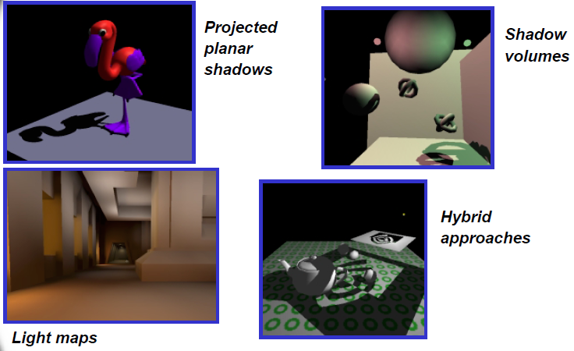
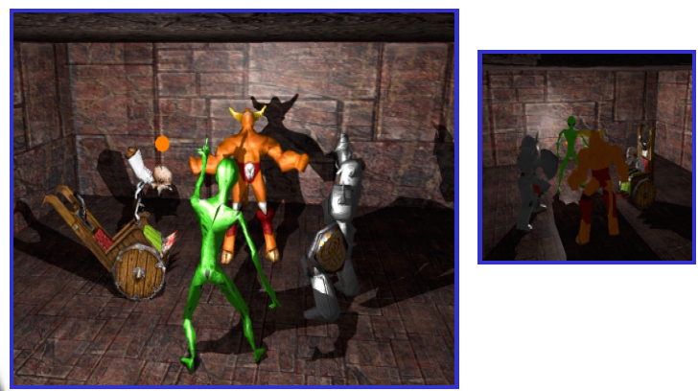
Shadow Mapping [2]:
Techniques
Ways to Handle Shadows
  Projected planar shadows: works well on flat surfaces only
  Shadow stencil buffer: powerful, excellent results possible; hard!
OpenGL Shadow Mapping Tutorials
  Beginner/Intermediate (Baker, 2003): http://bit.ly/e1LA2N
  Advanced (Octavian et al., 2000): http://bit.ly/f1iRYB (old NeHe #27)
Shadow Stencil Buffer
Adapted from “Shadow Mapping” © 2001 C. Everitt, nVidia
http://developer.nvidia.com/object/shadow_mapping.html

Slide 9
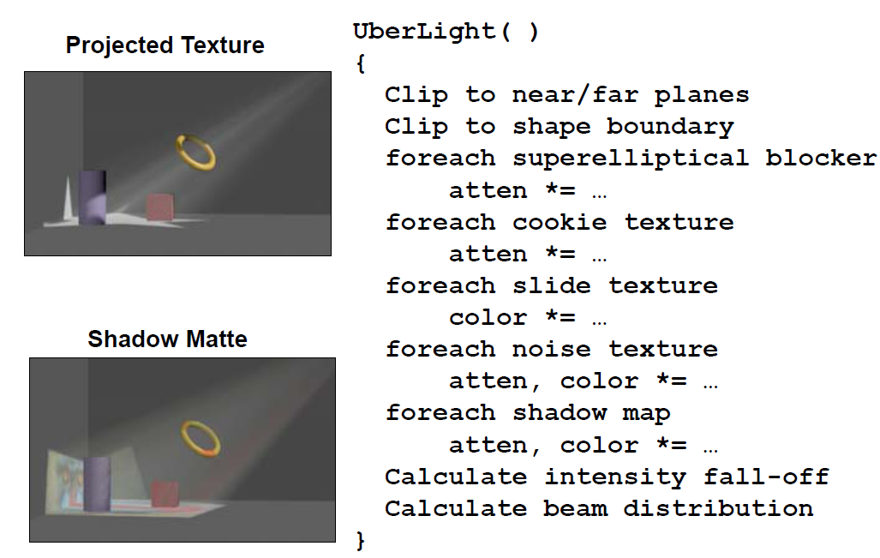
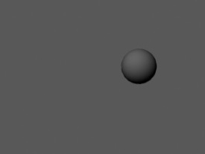
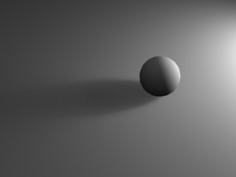
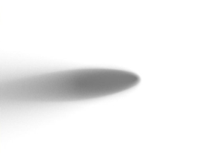
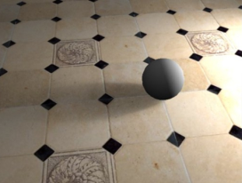
Shadow Mapping [3]:
Advanced Methods & Research
Shadow Mattes (Hanrahan)
Can Be Layered (See Maya 2011 Tutorial by Maciek Gryka)
© 2010 M. Gryka
http://bit.ly/hJlfps
Adapted from slides © 1995 – 2009 P. Hanrahan, Stanford University
http://bit.ly/hZfsjZ (CS 348B)

Slide 10
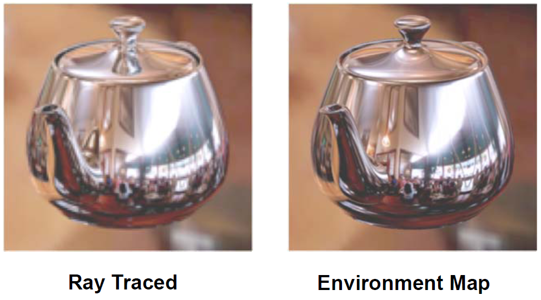
Reflection/Environment Mapping [1]:
Basic Concept
Reflection Maps (Special Type) ~ Environment Maps (General Case)
  For a given viewing direction
    For each normal direction
      For each incoming direction (hemispherical integral)
        Evaluate reflection equation
Idea: Take Picture of Scene Faced by Object, Apply as Map to Object
Requirements: Need to Take Account of Projective Distortions
Adapted from slides © 1995 – 2009 P. Hanrahan, Stanford University
http://bit.ly/hZfsjZ (CS 348B)

Slide 11
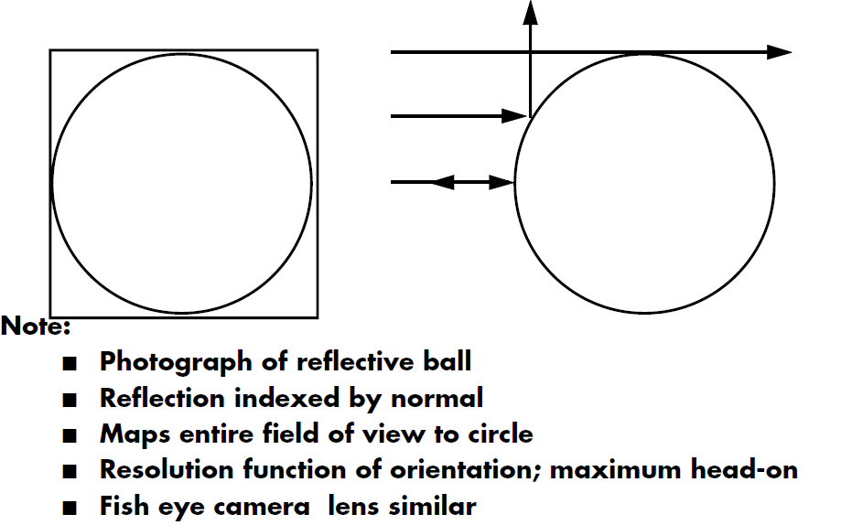
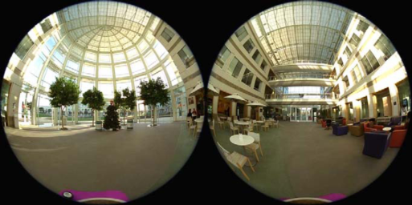
Reflection/Environment Mapping [2]:
Techniques
Gazing Ball (Mirrorball)
Reflection Functions
  Diffuse: irradiance map
  Glossy: radiance map
  Anisotropic: for each tangent direction
  Mirror: reflection map (related to environment map)
Illumination Functions: Environment Map or Procedural Light Sources
Photo © 2009 K. Turkowski
Adapted from slides © 1995 – 2009 P. Hanrahan, Stanford University
http://bit.ly/hZfsjZ (CS 348B)

Slide 12
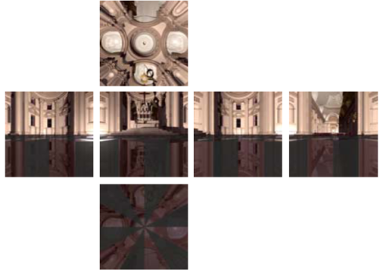
Reflection/Environment Mapping [3]:
Advanced Methods & Research
How To Create Direction Maps
  Latitude-Longitude (Map Projections) - paint
  Gazing Ball - photograph reflective sphere
  Fisheye Lens - standard (wide-angle) camera lens
  Cubical Environment Map - rendering program or photography
    Easy to produce
    "Uniform" resolution
    Simple texture coordinates calculation
Old NeHe OpenGL Mapping Tutorials (2000)
  #6 (texture map onto cube) – Beginner (Molofee): http://bit.ly/gKj2Nb
  #23 (sphere) – Intermediate (Schmick & Molofee): http://bit.ly/e3Zb8h
nVidia Tutorial: OpenGL Cube Map (1999): http://bit.ly/eJEdAM
Issues: Non-Linear Mapping, Area Distortion, Converting Between Maps
Adapted from slides © 1995 – 2009 P. Hanrahan, Stanford University
http://bit.ly/hZfsjZ (CS 348B)

Slide 13
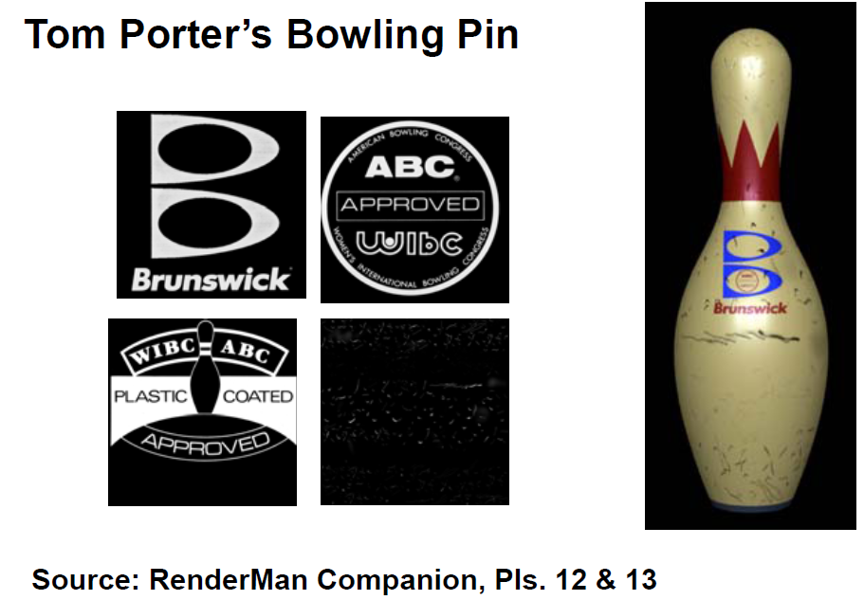
Transparency Mapping [1]:
Basic Concept
Transparency: One Term for Many Techniques
Goal: “See Through” Objects (Could Be Real Decals)
Ideas: Render Background Object, Then Foreground Object or Material
  Blend in color of (semi-)transparent/translucent foreground object
  Simulate little holes in foreground material (screen door)
Adapted from slides © 1995 – 2009 P. Hanrahan, Stanford University
http://bit.ly/hZfsjZ (CS 348B)

Slide 14
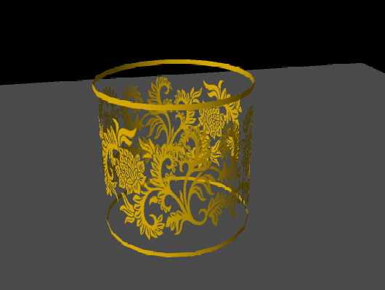
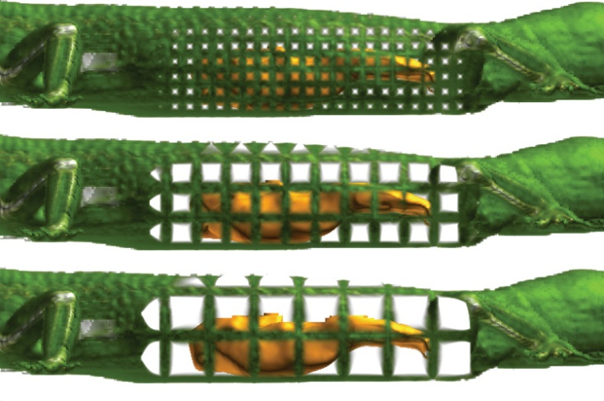
Transparency Mapping [2]:
Techniques
Alpha Compositing aka Alpha Blending
  Combine colors of transparent foreground, opaque background
  Uses alpha channel A of (R, G, B, A) – think “% transparency”
  Wikipedia: http://bit.ly/ePpwoh (see also RGBA, http://bit.ly/ePpwoh)
Screen Door Transparency
  Simulate little holes in foreground material (screen door)
  Result: visual effect of being able to see through foreground
Alpha blending: Lim (2010), http://bit.ly/6TsJrb
Goon Creative, Maya Transparency Tutorial
Screen door: Viola et al. (2004), http://bit.ly/dVEa7l
Technical University of Vienna, IEEE Vis 2004

Slide 15
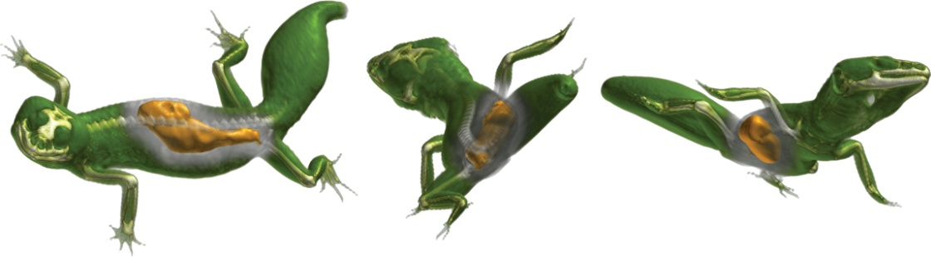
Transparency Mapping [3]:
Advanced Methods & Research
OpenGL Transparency How-To at OpenGL.org: http://bit.ly/hRaQgk
Screen Door Transparency
  Use glPolygonStipple(), glEnable(GL_POLYGON_STIPPLE)
  See http://bit.ly/g1hQpJ
Glass-Like Transparency using Alpha Blending
  Use glEnable(GL_BLEND), glBlendFunc(…)
  See http://bit.ly/hs82Za
Viola et al. (2004), http://bit.ly/dVEa7l
Technical University of Vienna, IEEE Vis 2004

Slide 16
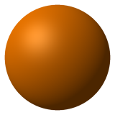
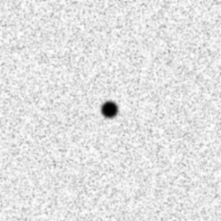
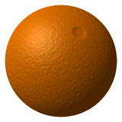
Bump Mapping [1]:
Basic Concept
Goal: Create Illusion of Textured Surface
Idea
  Start with regular smooth object
  Make height map (by hand and/or using program, i.e., procedurally)
  Use map to perturb surface normals
  Plug new normals into illumination equation
Will This Look Realistic? Why/Why Not?
+
=
Bump Mapping © 2010 Wikipedia
http://en.wikipedia.org/wiki/Bump_mapping

Slide 17
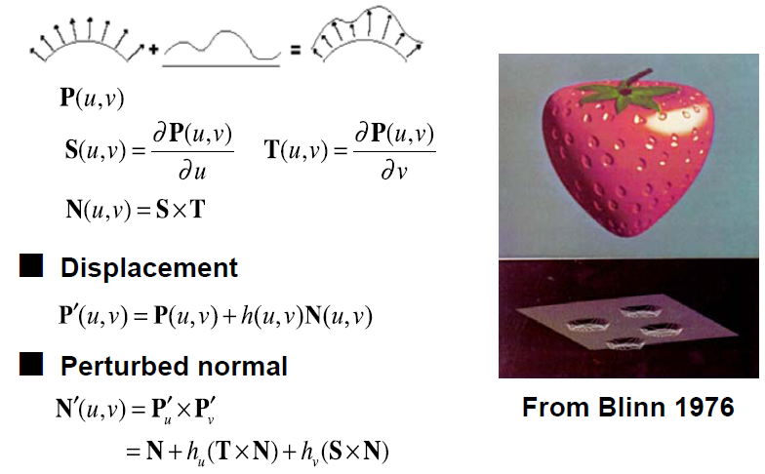
Bump Mapping [2]:
Techniques
Adapted from slides © 1995 – 2009 P. Hanrahan, Stanford University
http://bit.ly/hZfsjZ (CS 348B)

Slide 18

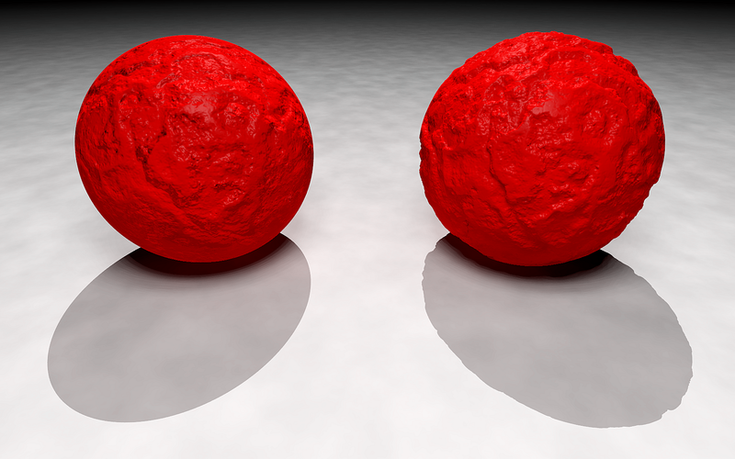
Bump Mapping [3]:
Advanced Methods & Research
Bump Mapping Tutorial for OpenGL (Baker, 2003): http://bit.ly/fun4a5
Right Ball (Displacement Mapped) Casts Rough Shadow
Left Ball (Bump Mapped) Casts Smooth Shadow – Why?
Bump Mapping Only Perturbs Normals (Surface Only!)
Hey, wait a minute!
… what’s wrong with the one on the left?

Slide 19
Displacement Mapping [1]:
Basic Concept
Remember What We Did to Perform Bump Mapping?
Q: Can We Make This Permanent? How?
A: Sure! Let Perturbed Normals Define New Surface; Save Out Vertices
Adapted from slides © 1995 – 2009 P. Hanrahan, Stanford University
http://bit.ly/hZfsjZ (CS 348B)

Slide 20
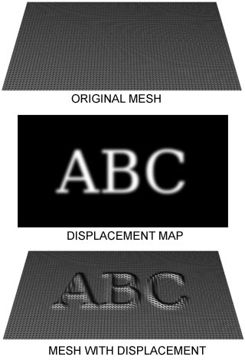

Displacement Mapping [2]:
Techniques
Displacement Map: Similar to Bump Map – Contains Delta Values
Displacement Mapping: Uses Open GL Shading Language (GLSL)
Tutorial using GLSL (Guinot, 2006): http://bit.ly/dWXNya
Displacement Mapping:
For Real!
Displacement Mapping © 2005 Wikipedia
http://en.wikipedia.org/wiki/Displacement_mapping

Slide 21
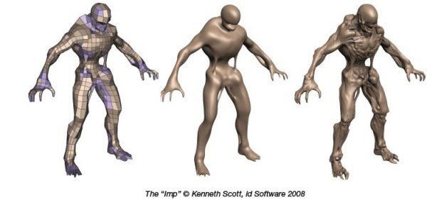
Displacement Mapping [3]:
Advanced Methods & Research
When To Consider Using Displacement Mapping
  Very “deep” texture effect: veins, ridges, etc.
  Shadows expected
Like Many Mappings and Other Effects, Wanted In Hardware!
The “Imp” © 2008 K. Scott, id Software
Bjorn3D, http://bit.ly/i78SiP

Slide 22
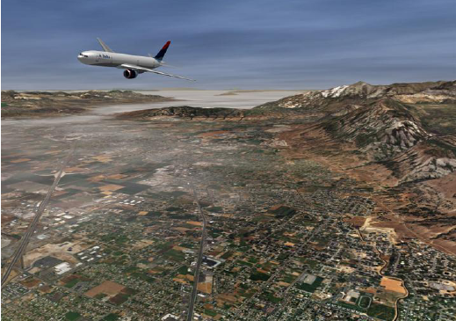

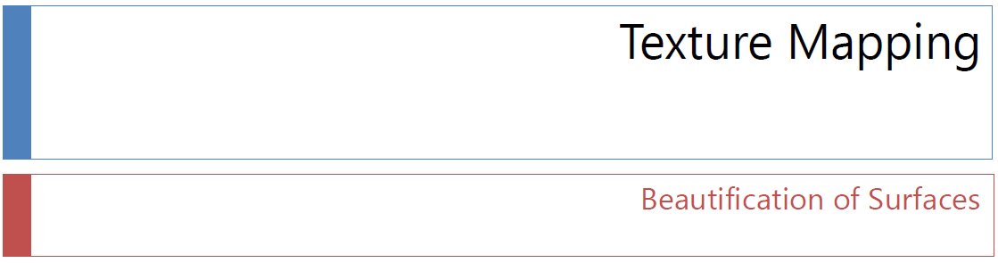
Acknowledgements:
Texture Mapping Slides
Andy van Dam
T. J. Watson University Professor of Technology and Education & Professor of Computer Science
Brown University
http://www.cs.brown.edu/~avd/
Adapted from slides © 1997 – 2010 van Dam et al., Brown University
http://bit.ly/hiSt0f Reused with permission.

Slide 23
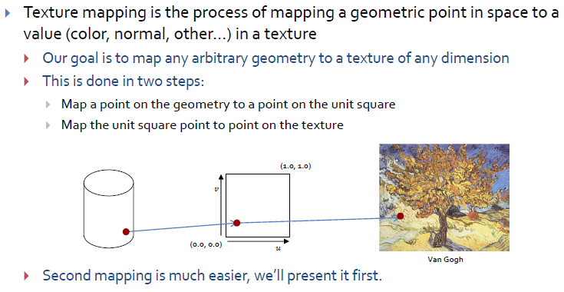
Texture Mapping Technique [1]
Adapted from slides © 2010 van Dam et al., Brown University
http://bit.ly/hiSt0f Reused with permission.

Slide 24
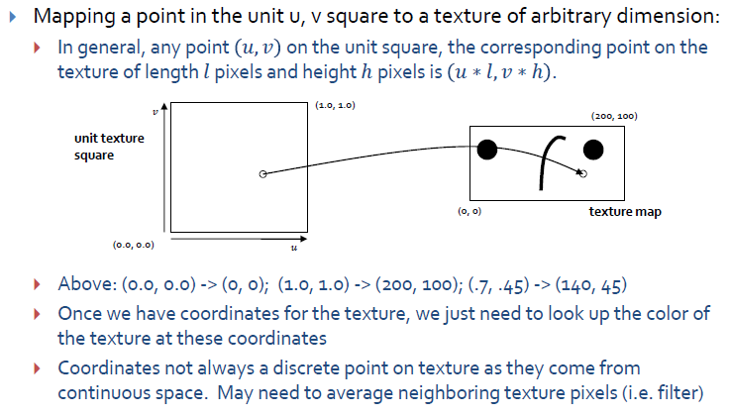
Texture Mapping Technique [2]
Adapted from slides © 2010 van Dam et al., Brown University
http://bit.ly/hiSt0f Reused with permission.

Slide 25
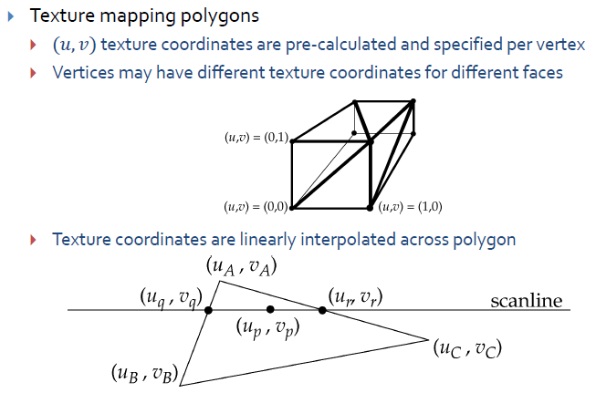
Texture Mapping Technique [3]
Adapted from slides © 2010 van Dam et al., Brown University
http://bit.ly/hiSt0f Reused with permission.

Slide 26
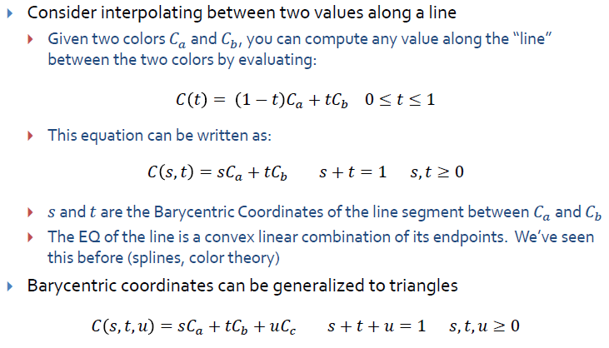
Interpolation Trick:
Barycentric Coordinates
Adapted from slides © 2010 van Dam et al., Brown University
http://bit.ly/hiSt0f Reused with permission.

Slide 27
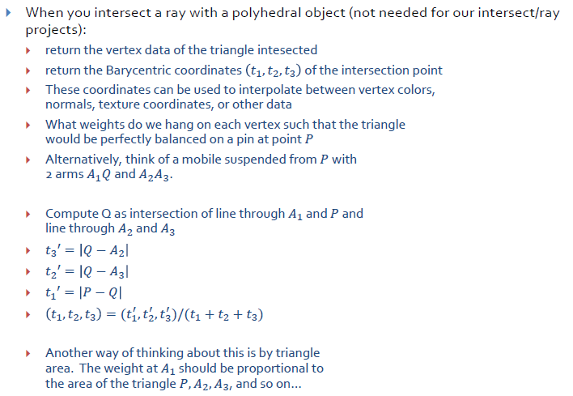
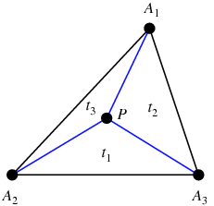
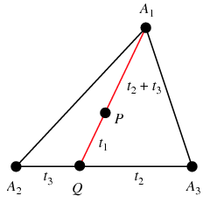
Applying Barycentric Coordinates
© 1999 – 2011 Wolfram Research
http://bit.ly/dGGdlc
Adapted from slides © 2010 van Dam et al., Brown University
http://bit.ly/hiSt0f Reused with permission.

Slide 28
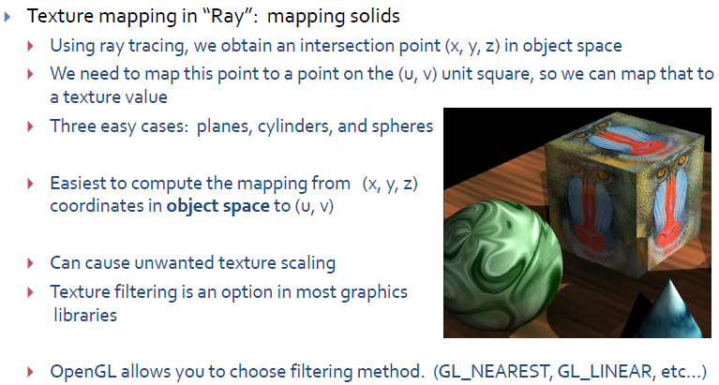
Texture Mapping Technique [4]:
Map Point to Object on (u, v) Square
Adapted from slides © 2010 van Dam et al., Brown University
http://bit.ly/hiSt0f Reused with permission.

Slide 29
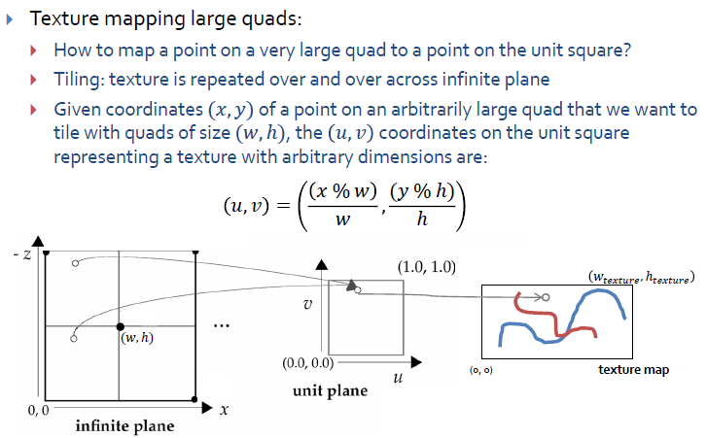
Texture Mapping Technique [5]
Adapted from slides © 2010 van Dam et al., Brown University
http://bit.ly/hiSt0f Reused with permission.

Slide 30
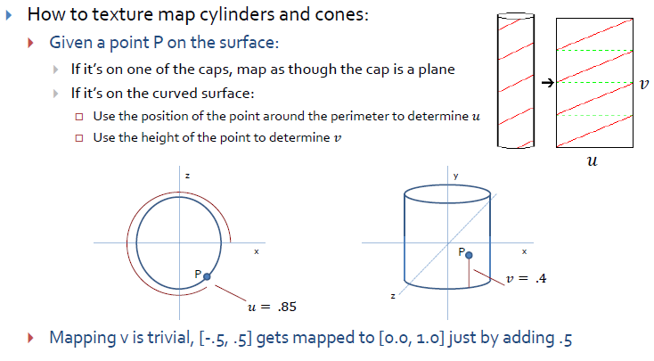
Texture Mapping Technique [6]
Adapted from slides © 2010 van Dam et al., Brown University
http://bit.ly/hiSt0f Reused with permission.

Slide 31
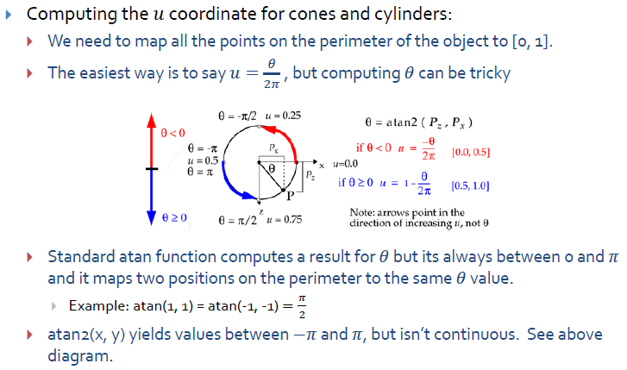
Texture Mapping Technique [7]
Adapted from slides © 2010 van Dam et al., Brown University
http://bit.ly/hiSt0f Reused with permission.

Slide 32
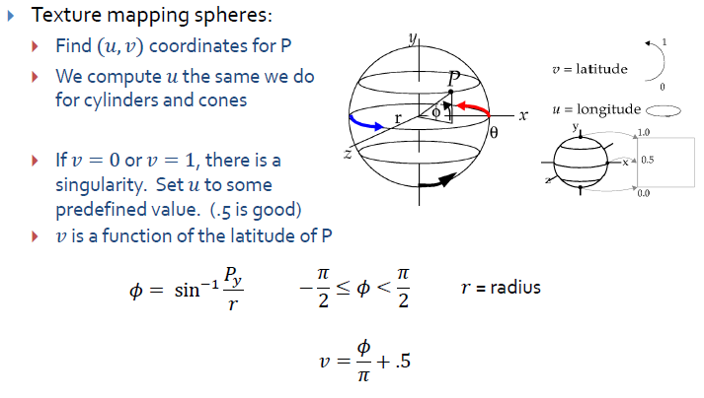
Texture Mapping Technique [8]
Adapted from slides © 2010 van Dam et al., Brown University
http://bit.ly/hiSt0f Reused with permission.

Slide 33
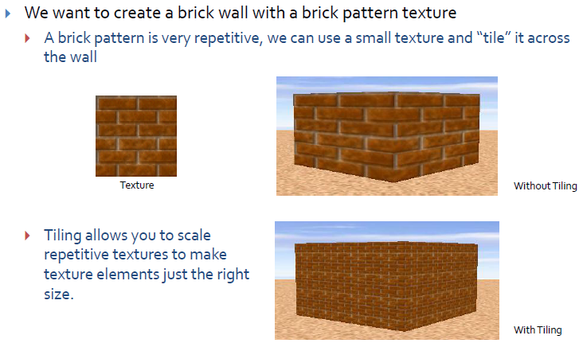
Texture Mapping Style [1]:
Tiling
Adapted from slides © 2010 van Dam et al., Brown University
http://bit.ly/hiSt0f Reused with permission.

Slide 34
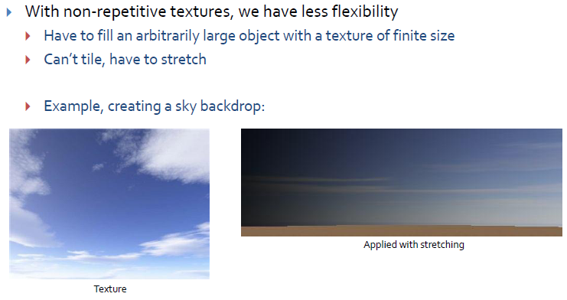
Texture Mapping Style [2]:
Stretching
Adapted from slides © 2010 van Dam et al., Brown University
http://bit.ly/hiSt0f Reused with permission.

Slide 35
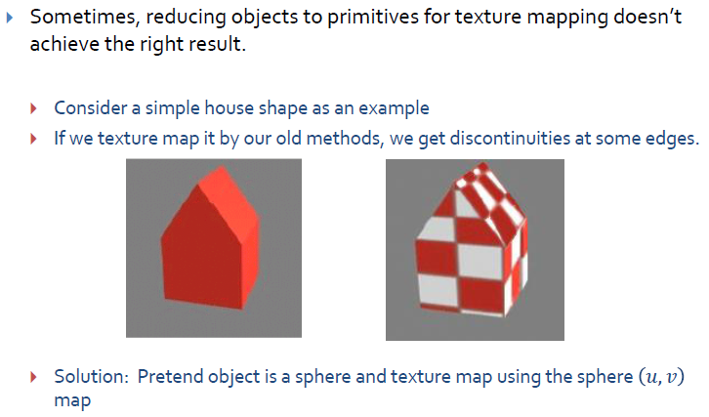
Texture Mapping
Complex Geometry [1]
Adapted from slides © 2010 van Dam et al., Brown University
http://bit.ly/hiSt0f Reused with permission.

Slide 36
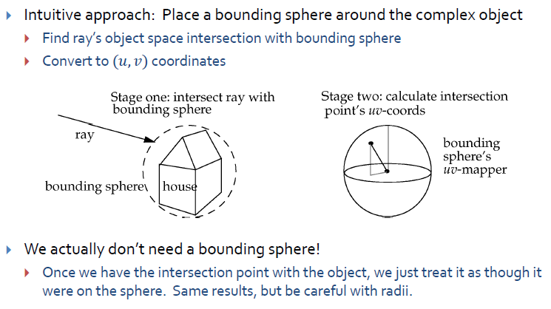
Texture Mapping
Complex Geometry [2]
Adapted from slides © 2010 van Dam et al., Brown University
http://bit.ly/hiSt0f Reused with permission.

Slide 37

Texture Mapping
Complex Geometry [3]
Adapted from slides © 2010 van Dam et al., Brown University
http://bit.ly/hiSt0f Reused with permission.

Slide 38

Texture Mapping
Complex Geometry [4]
Adapted from slides © 2010 van Dam et al., Brown University
http://bit.ly/hiSt0f Reused with permission.

Slide 39

OpenGL Texturing [1]:
Steps
Adapted from slides
© 2007 Jacobs, D. W., University of Maryland

Slide 40

OpenGL Texturing [2]:
Specify 2-D Texture Object
Adapted from slides
© 2007 Jacobs, D. W., University of Maryland

Slide 41

OpenGL Texturing [3]:
Specify How Texture Is Applied
Adapted from slides
© 2007 Jacobs, D. W., University of Maryland

Slide 42

OpenGL Texturing [4]:
Enable Texture and Draw
Adapted from slides
© 2007 Jacobs, D. W., University of Maryland

Slide 43

OpenGL Texturing [5]:
Create Texture Object
Adapted from slides
© 2007 Jacobs, D. W., University of Maryland

Slide 44

OpenGL Texturing [6]:
Putting It All Together
Adapted from slides
© 2007 Jacobs, D. W., University of Maryland

Slide 45

Preview:
Texturing with Blocks
Adapted from slides
© 2007 Jacobs, D. W., University of Maryland

Slide 46




Preview:
Mipmapping
Adapted from slides
© 1999 – 2007 van Dam, A., Brown University

Slide 47

Summary
Last Time: Texture Mapping Explained
  Definitions and design principles
  Enclosing volumes: cylinder, sphere, box
  Mapping methods
    reflected ray
    object normal
    object center
    intermediate surface normal
Today: Mappings, OpenGL Texturing
  Idea: define “texture” to simulate surface detail
  Shadow, reflection/environment, transparency, bump, displacement
  Other mappings: gloss, volumetric fog, skins, rainbows, water
  OpenGL texture mapping how-to
The Lord of the Rings: The Fellowship of the Ring
© 2001 New Line Cinema

Slide 48
Terminology
Texture Mapping - Adding Detail, Raster Image, Color, etc. to CG Model
  Planar projection: apply flat texture to flat surface(s)
  Enclosing volumes: cylinder, sphere, box
  Mapping methods
    reflected ray – bounce ray off object O
    object normal – ray from face normal of object (polygon mesh)
    object center – ray from center of object
    intermediate surface normal – ray from inside of enclosing S
Mappings: Apply Image or Simulated Surface Detail to Object
  Shadow: cast planar projective shadows or calculate volume
  Reflection/environment: take picture of scene from “inside” object
  Transparency: take picture of scene “behind” object; refract
  Bump: perturb color based on height map
  Displacement: perturb face normals, recalculate lighting

