Slide 1
Lecture 27 of 41
Interaction Handling
Lab 5: Using Particle Systems
William H. Hsu
Department of Computing and Information Sciences, KSU
KSOL course pages: http://bit.ly/hGvXlH / http://bit.ly/eVizrE
Public mirror web site: http://www.kddresearch.org/Courses/CIS636
Instructor home page: http://www.cis.ksu.edu/~bhsu
Readings:
Today: §8.3 – 8.4, 4.2, 5.0, 5.6, 9.1, Eberly 2e – see http://bit.ly/ieUq45
Next class: §9.1, Particle System Handout
Wikipedia, Human-Computer Interaction: http://bit.ly/bqrQTg
Wikipedia, User Interface: http://bit.ly/eaTY7u
Wikipedia, Particle System: http://bit.ly/hzZofI

Slide 2
Lecture Outline
Reading for Last Class: Chapter 7, §8.4, Eberly 2e
Reading for Today: §8.3 – 8.4, 4.2, 5.0, 5.6, 9.1, Eberly 2e
Reading for Next Class: §9.1, Particle System Handout
Last Time: Picking
OpenGL modes: rendering (default), feedback, selection
Name stack, hit records, rendering in selection mode
Selection buffer and other buffers with color coding
Today: Interaction Handling
Human-Computer Interaction (HCI)
Perceptual Principles: Legibility, Consistency, Redundancy
Mental Models: Realism, User Expectations
Attention: Access Cost/Benefit, Multiple Sources, Sensory Modes
Memory: Self-Explanatory GUIs, Predictive Aids, Reusable Skills
Next Class: Particle Systems

Slide 3
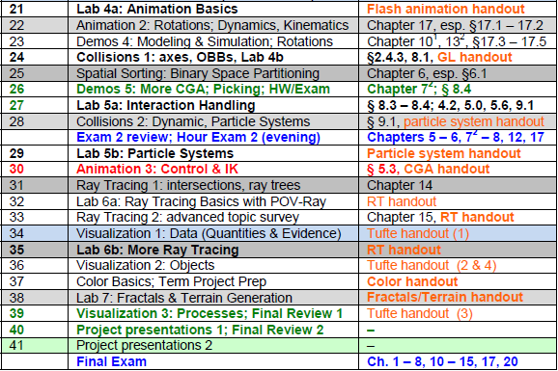
Where We Are

Slide 4
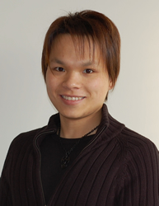
Acknowledgements:
Picking, Interaction, Particles
Edward Angel
Professor Emeritus of Computer Science
Founding Director, ARTS Lab
University of New Mexico
http://www.cs.unm.edu/~angel/
François Guimbretière
Associate Professor
Department of Computer Science
Cornell University
http://www.cs.cornell.edu/~francois/
Hubert Pak Ho Shum
Postdoctoral Researcher
Advanced Science Institute
RIKEN (理研)
http://hubertshum.com/info/

Slide 5
Review [1]:
Interactive Computer Graphics
More Sophisticated Interactive Programs
Modes of interaction
Tools for building
Techniques
Picking: select objects from display (three methods covered)
Rubberbanding: interactive drawing of lines, rectangles
Display lists: retained mode graphics
Adapted from slides © 2005-2008 E. Angel, University of New Mexico
Interactive Computer Graphics, 4th & 5th edition slides, http://bit.ly/gvxfPV

Slide 6
Review [2]:
Picking – Three Approaches
1. Hit List
Most general approach
Difficult to implement
2. Buffered Object IDs
Write to back buffer or some other buffer
Store object IDs as objects rendered
3. Rectangular Maps
Easy to implement for many applications
e.g., simple paint programs
Adapted from slides © 2005-2008 E. Angel, University of New Mexico
Interactive Computer Graphics, 4th & 5th edition slides, http://bit.ly/gvxfPV

Slide 7
Review [3]:
OpenGL Rendering Modes
OpenGL: Can Render in One of Three Modes
GL_RENDER
Normal rendering to frame buffer
Default
GL_FEEDBACK
Provides list of primitives rendered
No output to frame buffer
GL_SELECTION
Each primitive in view volume generates hit record
Record placed in name stack
Stack can be examined later
Mode Selected by glRenderMode(mode)
Adapted from slides © 2005-2008 E. Angel, University of New Mexico
Interactive Computer Graphics, 4th & 5th edition slides, http://bit.ly/gvxfPV

Slide 8
Review [4]:
OpenGL Name Stack Functions
void glInitNames(void);
Creates empty name stack
Must call to initialize stack prior to pushing names
void glPushName(GLuint name);
Adds name to top of stack
Maximum dimension: implementation-dependent
Must contain at least 64 names
Can query state variable GL_NAME_STACK_DEPTH
Pushing too many values causes GL_STACK_OVERFLOW
void glPopName();
Removes name from top of stack
Popping value from empty stack causes GL_STACK_UNDERFLOW
void glLoadName(GLunit name);
Replaces top of stack with name
Same as calling glPopName(); glPushName(name);
Adapted from tutorial © 2001-2009 A. R. Fernandes
Lighthouse 3D, http://www.lighthouse3d.com

Slide 9
Review [5]:
Example – OpenGL Selection Mode
#define BODY 1
#define HEAD 2
…
void renderInSelectionMode()
{
glInitNames(); // 1. create empty name stack (NS)
glPushName(BODY); // 2. push first name
// 3. hit record (HR) for each primitive intersecting view volume
drawBody();
// 4. empty stack & save HRs to selection buffer (SB)
glPopName();
glPushName(HEAD); // 5. new name; no HR, same SB
drawHead(); // 6. new HR for each primitive in VV
drawEyes(); // 7. update HR with new max/min depths
glPopName(); // 8. empty NS; write HRs to SB
drawGround(); // 9. new HRs; empty NS, depth update only
}
Same as
glLoadName(HEAD);
Adapted from tutorial © 2001-2009 A. R. Fernandes
Lighthouse 3D, http://www.lighthouse3d.com

Slide 10
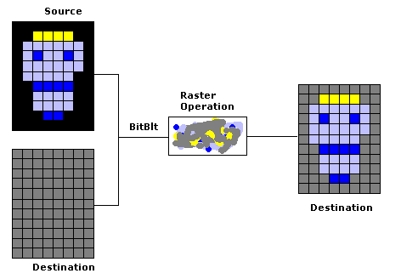
Review [6]:
BitBlitting, Sprites, & XOR Write
Usual (Default) Mode
Source replaces destination: d’ = s
Cannot write temporary lines this way – why?
Cannot recover what was “under” line in fast, simple way
Consequence: cannot deselect (toggle select) easily
Solution: Exclusive OR Mode (XOR)
d’ = d ⊕ s
Suppose we use XOR mode to scan convert line
Can draw it again to erase it!
Visual Basic Explorer © 2002 S. Christensen & B. Abreu
http://bit.ly/gXstAM
Adapted from slides © 2005-2008 E. Angel, University of New Mexico
Interactive Computer Graphics, 4th & 5th edition slides, http://bit.ly/gvxfPV

Slide 11
Review [7]:
Example – Rubberband Lines
second point
first point
Draw line with mouse
in XOR mode
Initial display
Mouse moved to
new position
Original line redrawn
with XOR
New line drawn
with XOR
Adapted from slides © 2005-2008 E. Angel, University of New Mexico
Interactive Computer Graphics, 4th & 5th edition slides, http://bit.ly/gvxfPV

Slide 12
Review [8]:
OpenGL Display List Functions
Creating Display List
GLuint id;
void init()
{
id = glGenLists( 1 );
glNewList( id, GL_COMPILE );
/* other OpenGL routines */
glEndList();
}
Calling Created List
void display()
{
glCallList(id);
}
Documentation: http://bit.ly/gJYana
Tutorial © 2005 S. H. Ahn: http://bit.ly/eN3R8c
Adapted from slides © 2005-2008 E. Angel, University of New Mexico
Interactive Computer Graphics, 4th & 5th edition slides, http://bit.ly/gvxfPV

Slide 13
Human-Computer Interaction (HCI)
Study, Planning, & Design of Interaction between People, Computers
Study: intersection of computer science, behavioral science, design
Planning: information management tasks, media
Design: graphical user interfaces, displays, algorithms, systems
Related Areas
Cognitive Science & Cognitive Modeling
Ergonomics & Human Factors
HCI: more emphasis on computers (vs. other artifacts)
Some overlap within information technology
Computational Information & Knowledge Management (CIKM)
Software Engineering: Operating Systems
Computer Graphics
Wearable Computers & Ubiquitous Communication/Computing
Adapted from Wikipedia, Human-Computer Interaction
http://bit.ly/bqrQTg

Slide 14
Interaction Spectrum
for HCI & Print Media
Adapted from slide © 2004 F. Guimbretière, Cornell University
Stanford CS448B: Visualization, Fall 2004, http://bit.ly/h0hRzU

Slide 15
HCI Design [1]:
Perceptual Principles
1. Make Displays Perceivable (Legible, Audible, etc.)
User must discern characters, objects, processes to interact
Usual sense of perceivability: legibility (readability)
2. Avoid Absolute Judgment Limits
Don’t ask user to sense level of variable based on one channel
Examples: color, size, (audio) volume
3. Use Top-Down Processing: Be Consistent with Past Experience
4. Exploit Redundancy
Present signal in alternative forms: color & shape, voice & print, etc.
Example: traffic light (color & position, sometimes sound)
5. Use Discriminable Elements to Minimize Confusion
Allow visual elements to overlap only when necessary
Example: A423B9 more similar to A423B8 than 92 to 93
Adapted from material © 2008 Wikimedia Foundation (from Wickens et al., 2004)
Human-Computer Interaction, http://bit.ly/bqrQTg

Slide 16
HCI Design [2]:
Mental Models Principles
6. Maintain Pictorial Realism
UI elements should match real-world elements
Organization & layout should match those of real-world
7. Follow User’s Expectations Regarding Moving Parts
Motion paths should follow behavior of processes they model
Example: mark on altimeter should move up as altitude increases
Adapted from material © 2008 Wikimedia Foundation (from Wickens et al., 2004)
Human-Computer Interaction, http://bit.ly/bqrQTg

Slide 17
HCI Design [3]:
Principles Based on Attention
8. Minimize Information Access Cost
Reduce cognitive load, especially time/effort overhead
Make convenience/accessibility proportional to frequency of access
9. Place Multiple Information Sources Close Together & Integrate Them
Ensure design compatibility (layout, style, symbols, controls, etc.)
Tradeoff: usability aspects – understandability vs. efficiency
Use convenient shortcuts in proportion to frequency of need
User education needs
10. Multiple Information Channels
Multisensory channels and integration (e.g., audio-visual)
Take advantage of brain’s ability to merge senses
Adapted from material © 2008 Wikimedia Foundation (from Wickens et al., 2004)
Human-Computer Interaction, http://bit.ly/bqrQTg

Slide 18
HCI Design [4]:
Memory Principles
11. Replace Memory with Visual Information: Knowledge in The World
Don’t rely on user to remember menus, shortcuts & macros
Present GUI elements in self-explanatory way to user
Balance usability for new users and experienced users
12. Develop Methods for Predictive Aiding
Proactive (as opposed to reactive) user feedback
Example: road signs depicting km to destination, progress bars
13. Ensure Consistency
Fulfill user’s expectations of similarity towards lookalike GUIs
Maximize skill transfer
Adapted from material © 2008 Wikimedia Foundation (from Wickens et al., 2004)
Human-Computer Interaction, http://bit.ly/bqrQTg

Slide 19
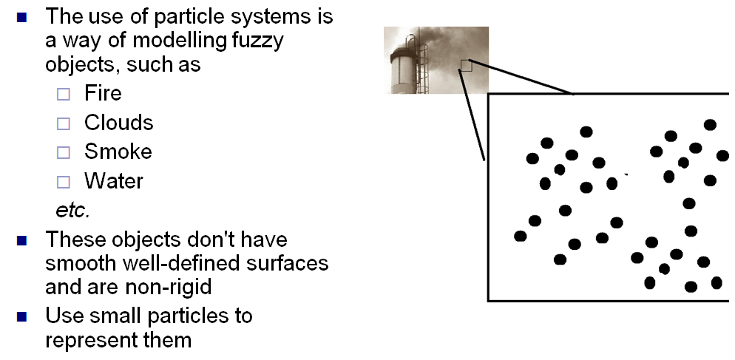
Particle Systems [1]:
Natural Effects
Adapted from slide © 2008 H. P. H. Shum, RIKEN (理研)
Computer Animation, http://bit.ly/ig6KTK

Slide 20
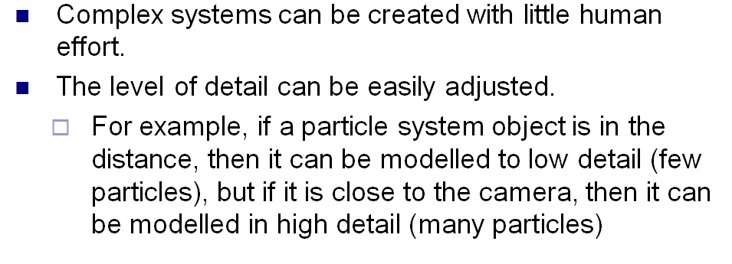
Particle Systems [2]:
Advantages
Adapted from slide © 2008 H. P. H. Shum, RIKEN (理研)
Computer Animation, http://bit.ly/ig6KTK

Slide 21
Particle Systems [3]:
Basic Model
Adapted from slide © 2008 H. P. H. Shum, RIKEN (理研)
Computer Animation, http://bit.ly/ig6KTK

Slide 22
Particle Generation
Adapted from slide © 2008 H. P. H. Shum, RIKEN (理研)
Computer Animation, http://bit.ly/ig6KTK

Slide 23
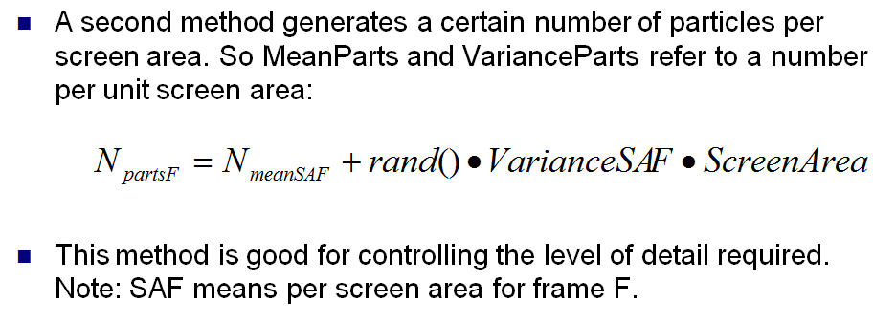
Particles per Area
Adapted from slide © 2008 H. P. H. Shum, RIKEN (理研)
Computer Animation, http://bit.ly/ig6KTK

Slide 24
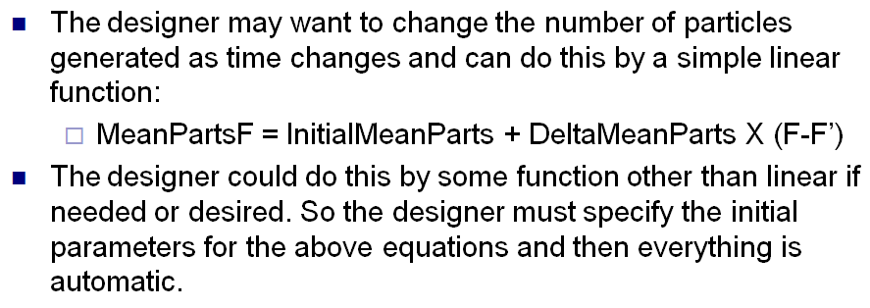
Particle Emission Rate
as a Function of Time
Adapted from slide © 2008 H. P. H. Shum, RIKEN (理研)
Computer Animation, http://bit.ly/ig6KTK

Slide 25
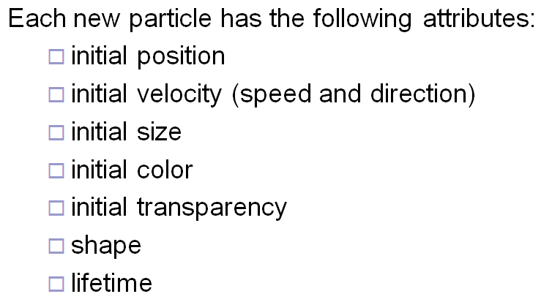
Particle Attributes
Adapted from slide © 2008 H. P. H. Shum, RIKEN (理研)
Computer Animation, http://bit.ly/ig6KTK

Slide 26
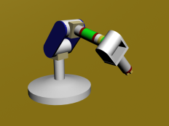
Review:
Dynamics & Kinematics
Dynamics: Study of Motion & Changes in Motion
Forward: model forces over time to find state, e.g.,
Given: initial position p₀ , velocity v₀, gravitational constants
Calculate: position p_{t} at time t
Inverse: given state and constraints, calculate forces, e.g.,
Given: desired position p_{t} at time t, gravitational constants
Calculate: position p₀ , velocity v₀ needed
Wikipedia: http://bit.ly/hH43dX (see also: “Analytical dynamics”)
For non-particle objects: rigid-body dynamics (http://bit.ly/dLvejg)
Kinematics: Study of Motion without Regard to Causative Forces
Modeling systems – e.g., articulated figure
Forward: from angles to position (http://bit.ly/eh2d1c)
Inverse: finding angles given desired position (http://bit.ly/hsyTb0)
Wikipedia: http://bit.ly/hr8r2u
Forward Kinematics
© 2009 Wikipedia

Slide 27
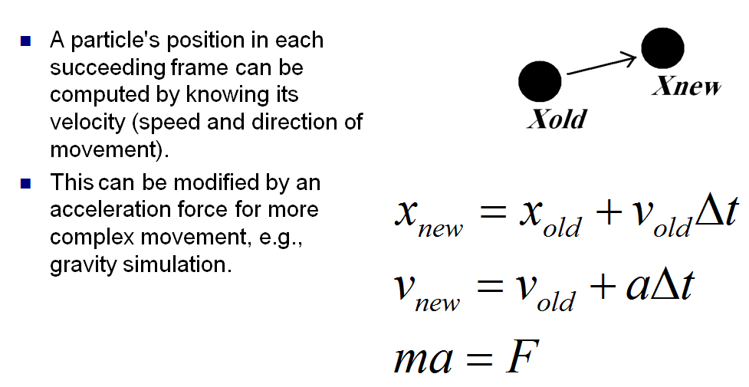
Particle Dynamics
Adapted from slide © 2008 H. P. H. Shum, RIKEN (理研)
Computer Animation, http://bit.ly/ig6KTK

Slide 28
Particle Extinction
Adapted from slide © 2008 H. P. H. Shum, RIKEN (理研)
Computer Animation, http://bit.ly/ig6KTK

Slide 29
Modeling Water
Adapted from slide © 2008 H. P. H. Shum, RIKEN (理研)
Computer Animation, http://bit.ly/ig6KTK

Slide 30
Particle Systems [2]:
Adapted from slide © 2008 H. P. H. Shum, RIKEN (理研)
Computer Animation, http://bit.ly/ig6KTK

Slide 31
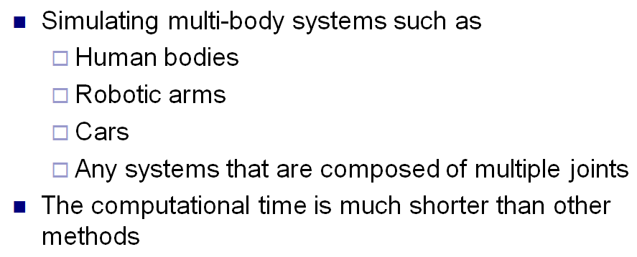
Particle Systems for
Multi-Body Systems
Adapted from slide © 2008 H. P. H. Shum, RIKEN (理研)
Computer Animation, http://bit.ly/ig6KTK

Slide 32
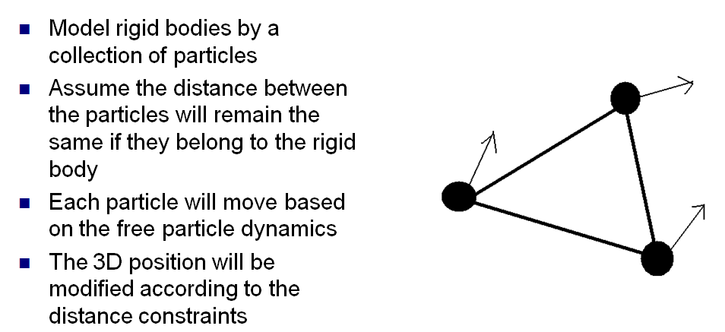
Rigid Body Dynamics:
How to Do It?
Adapted from slide © 2008 H. P. H. Shum, RIKEN (理研)
Computer Animation, http://bit.ly/ig6KTK

Slide 33
Distance between Particles:
Keep Constant
Adapted from slide © 2008 H. P. H. Shum, RIKEN (理研)
Computer Animation, http://bit.ly/ig6KTK

Slide 34
Verlet Integration
Adapted from slide © 2008 H. P. H. Shum, RIKEN (理研)
Computer Animation, http://bit.ly/ig6KTK

Slide 35
Modeling Joints
Adapted from slide © 2008 H. P. H. Shum, RIKEN (理研)
Computer Animation, http://bit.ly/ig6KTK

Slide 36
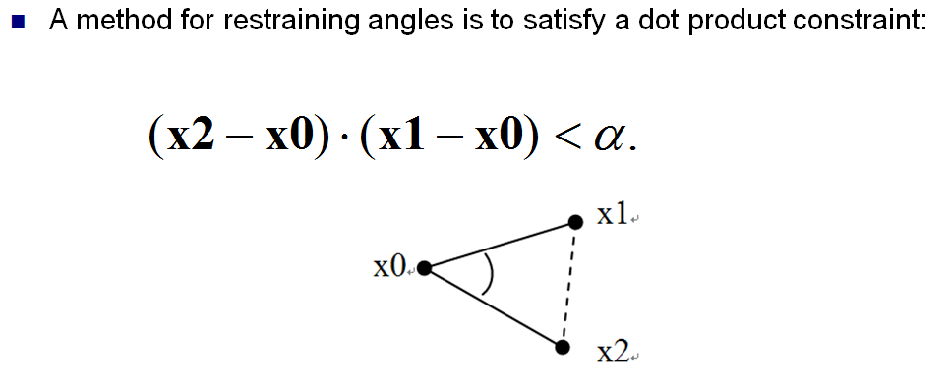
Setting Joint Limits
Adapted from slide © 2008 H. P. H. Shum, RIKEN (理研)
Computer Animation, http://bit.ly/ig6KTK

Slide 37
Collision Detection Redux
Adapted from slide © 2008 H. P. H. Shum, RIKEN (理研)
Computer Animation, http://bit.ly/ig6KTK

Slide 38
Friction Force
Adapted from slide © 2008 H. P. H. Shum, RIKEN (理研)
Computer Animation, http://bit.ly/ig6KTK

Slide 39
Summary
Reading for Last Class: Chapter 7, §8.4, Eberly 2e
Reading for Today: §8.3 – 8.4, 4.2, 5.0, 5.6, 9.1, Eberly 2e
Reading for Next Class: §9.1, Particle System Handout
Last Time: Picking
OpenGL modes: rendering (default), feedback, selection
Name stack
Hit records
Rendering in selection mode using selection buffer
Color coding of pickable objects
Today: Interaction Handling & Human Computer Interaction (HCI)
Spectrum of interaction
Kinds of interaction
User input: selection, control
Stimuli: much more when we cover visualization, color
Next: Particle Systems, Collision Response

Slide 40
Terminology
Picking: Allowing User to Select Objects in Scene
Selection mode: mode when cursor (“mouse”) is active
Name stack: last in, first out data structure holding object names
Hit records: ID, depth info for intersections with view volume
Selection buffer: holds hits, depth (compare: frame/z-buffer)
Color coding: using color to represent pickable object ID
Human-Computer Interaction (HCI)
aka Man-Machine Interaction (archaic), Computer-Human Interaction
Study, planning, design of interaction between humans & computers
User interface
Operation and control of machine
Feedback to human
Particle Systems – Simulation of Processes, Simple Physical Bodies
Events: birth (emission), collision, death
Properties: mass, initial velocity, lifetime

