Slide 1
Lecture 1 of 41
Computer Graphics (CG) Basics:
Transformation Matrices & Coordinate Systems
William H. Hsu
Department of Computing and Information Sciences, KSU
KSOL course pages: http://bit.ly/hGvXlH / http://bit.ly/eVizrE
Public mirror web site: http://www.kddresearch.org/Courses/CIS636
Instructor home page: http://www.cis.ksu.edu/~bhsu
Readings:
Wikipedia: vectors (http://bit.ly/eBrI09), matrices (http://bit.ly/fwpDwd)
Sections 2.1 – 2.2, 13.2, 14.1 – 14.4, 17.1, Eberly 2e – see http://bit.ly/ieUq45
Appendices 1-4, Foley, J. D., VanDam, A., Feiner, S. K., & Hughes, J. F. (1991). Computer Graphics, Principles and Practice, Second Edition in C.
McCauley (Senocular.com) tutorial: http://bit.ly/2yNPD

Slide 2
Lecture Outline
CG Basics 1: Basic Precalculus and Linear Algebra for CG
Matrices and vectors: definitions, basic operations
Vector spaces and affine spaces
Translation, Rotation, Scaling aka T, R, S transformations
Parametric equations (of lines, rays, line segments)
Importance to Computer Graphics
Points as vectors, transformation matrices
Homogeneous coordinates
TRS in viewing/normalizing transformation
Intersections: clipping, ray tracing, etc.
Looking Forward
The week ahead: Viewing (Part 1 of 4), Lab 0
Lab exercise: C/Linux, basic OpenGL setup (see KSOL)

Slide 3
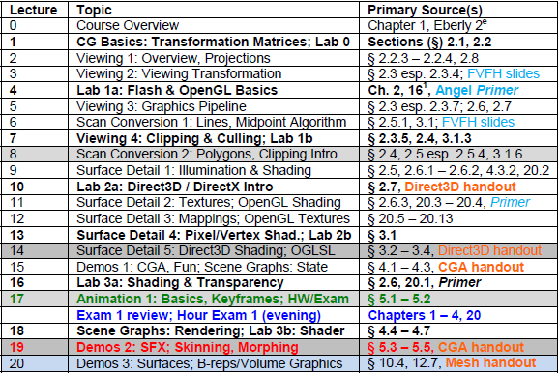
Where We Are

Slide 4
Online Recorded Lectures
for CIS 536/636 (Intro to CG)
Project Topics for CIS 536/636
Computer Graphics Basics (10)
1. Mathematical Foundations – Week 1 - 2
2. OpenGL Primer 1 of 3: Basic Primitives and 3-D – Weeks 2-3
3. Detailed Introduction to Projections and 3-D Viewing – Week 3
4. Fixed-Function Graphics Pipeline – Weeks 3-4
5. Rasterizing (Lines, Polygons, Circles, Ellipses) and Clipping – Week 4
6. Lighting and Shading – Week 5
7. OpenGL Primer 2 of 3: Boundaries (Meshes), Transformations – Weeks 5-6
8. Texture Mapping – Week 6
9. OpenGL Primer 3 of 3: Shading and Texturing, VBOs – Weeks 6-7
10. Visible Surface Determination – Week 8
Recommended Background Reading for CIS 636
Shared Lectures with CIS 736 (Computer Graphics)
Regular in-class lectures (30) and labs (7)
Guidelines for paper reviews – Week 6
Preparing term project presentations, CG demos – Weeks 11-12

Slide 5
Background Expected
Both Courses
Proficiency in C/C++ or strong proficiency in Java and ability to learn
Strongly recommended: matrix theory or linear algebra (e.g., Math 551)
At least 120 hours for semester (up to 150 depending on term project)
Textbook: 3D Game Engine Design, Second Edition (2006), Eberly
Angel’s OpenGL: A Primer recommended
CIS 536 & 636 Introduction to Computer Graphics
Fresh background in precalculus: Algebra 1-2, Analytic Geometry
Linear algebra basics: matrices, linear bases, vector spaces
Watch background lectures
CIS 736 Computer Graphics
Recommended: first course in graphics (background lectures as needed)
OpenGL experience helps
Read up on shaders and shading languages
Watch advanced topics lectures; see list before choosing project topic

Slide 6
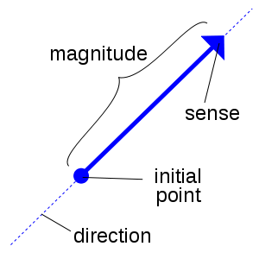
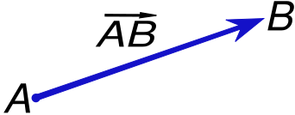
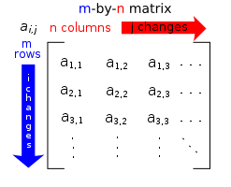
Matrix and Vector Notation
Vector: Geometric Object with Length (Magnitude), Direction
Vector Notation (General Form)
Row vector
Column vector
Coordinates in ℝ³ (Euclidean Space)
Cartesian (see http://bit.ly/f5z1UC)
Cylindrical (see http://bit.ly/gt5v3u)
Spherical (see http://bit.ly/f4CvMZ)
Matrix: Rectangular Array of Numbers
Wikipedia: Vector
http://bit.ly/eBrI09
Wikipedia: Matrix (mathematics)
http://bit.ly/fwpDwd
Wikimedia Commons, 2011 – Creative Commons License

Slide 7
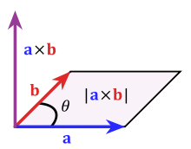
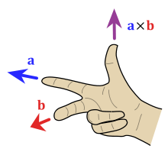
Vector Operations:
Dot & Cross Product, Arithmetic
Dot Product aka Inner Product aka Scalar Product
Cross Product
Vector Arithmetic
Scalar multiplication
Vector addition
Wikimedia Commons, 2011 – Creative Commons License

Slide 8
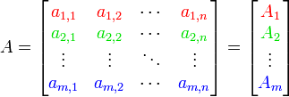
Matrix Operations [2]:
Addition & Multiplication
Scalar Multiplication, Transpose
Matrix Addition
Matrix Multiplication
Wikimedia Commons, 2011 – Creative Commons License

Slide 9
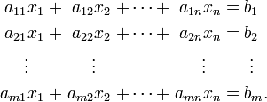
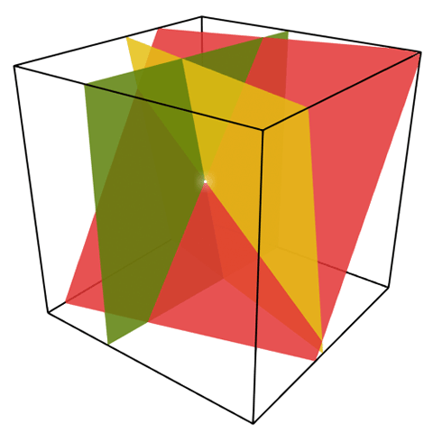
Linear Systems of Equations
Definition: Linear System of Equations (LSE)
Collection of linear equations (see http://bit.ly/dNa2MO)
Each of form
System shares same set of variables x_{i}
Example
3 equations in 3 unknowns
Solution
Wikimedia Commons, 2011 – Creative Commons License

Slide 10
Vector Spaces and
Affine Spaces
Vector Space: Set of Points with Addition, Multiplication by Constant
Components
Set V (of vectors u, v, w) over which addition, scalar multiplication defined
Vector addition: v + w
Scalar multiplication: αv
Properties (necessary and sufficient conditions)
Addition: associative, commutative, identity (0 vector such that ∀ v . 0 + v = v), admits inverses (∀ v . ∃w . v + w = 0)
Scalar multiplication: satisfies ∀ α, β, v . (αβ)v = α(βv), ∀v . 1v = v, ∀ α, β, v . (α + β)v = αv + βv, ∀ α, β, v . α(v + w) = αv + αw
Linear combination: α₁v₁ + α₂v₂ + … + α_{n}v_{n}
Affine Space: Set of Points with Geometric Operations (No “Origin”)
Components
Set V (of points P, Q, R) and associated vector space
Operators: vector difference, point-vector addition
Affine combination (of P and Q by t ∈ ℝ): P + t(Q – P)
NB: for any vector space (V, +, ·) there exists affine space (points(V), V)

Slide 11
Linear and Planar Equations in Affine Spaces
Equation of Line in Affine Space
Let P, Q be points in affine space
Parametric form (real-valued parameter t)
Set of points of form (1 – t)P + tQ
Forms line passing through P and Q
Example
Cartesian plane of points (x, y) is an affine space
Parametric line between (a, b) and (c, d):
L = {((1 – t)a + tc, (1 – t)b + td) | t ∈R}
Equation of Plane in Affine Space
Let P, Q, R be points in affine space
Parametric form (real-valued parameters s, t)
Set of points of form (1 – s)((1 – t)P + tQ) + sR
Forms plane containing P, Q, R

Slide 12
Vector Space Spans and
Affine Spans
Vector Space Span
Definition – set of all linear combinations of a set of vectors
Example: vectors in ℝ³
Span of single (nonzero) vector v: line through the origin containing v
Span of pair of (nonzero, noncollinear) vectors: plane through the origin containing both
Span of 3 of vectors in general position: all of ℝ³
Affine Span
Definition – set of all affine combinations of a set of points P₁, P₂, …, P_{n} in an affine space
Example: vectors, points in ℝ³
Standard affine plan of points (x, y, 1)^{T}
Consider points P, Q
Affine span: line containing P, Q
Also intersection of span, affine space
Span
of u and v
P
Q
Affine span
of P and Q
u
v
0

Slide 13
Subspaces
Intuitive Idea
ℝ^{n}: vector or affine space of “equal or lower dimension”
Closed under constructive operator for space
Linear Subspace
Definition
Subset S of vector space (V, +, ·)
Closed under addition (+) and scalar multiplication (·)
Examples
Subspaces of ℝ³: origin (0, 0, 0), line through the origin, plane containing origin, ℝ³ itself
For vector v, {αv | α ∈ ℝ} is a subspace (why?)
Affine Subspace
Definition
Nonempty subset S of vector space (V, +, ·)
Closure S’ of S under point subtraction is a linear subspace of V
Important affine subspace of ℝ⁴: {(x, y, z, 1)}
Foundation of homogeneous coordinates, 3-D transformations

Slide 14
Bases
Spanning Set (of Set S of Vectors)
Definition: set of vectors for which any vector in Span(S) can be expressed as linear combination of vectors in spanning set
Intuitive idea: spanning set “covers” Span(S)
Basis (of Set S of Vectors)
Definition
Minimal spanning set of S
Minimal: any smaller set of vectors has smaller span
Alternative definition: linearly independent spanning set
Exercise
Claim: basis of subspace of vector space is always linearly independent
Proof: by contradiction (suppose basis is dependent… not minimal)
Standard Basis for ℝ³: i, j, k
E = {e₁, e₂, e₃}, e₁ = (1, 0, 0)^{T}, e₂ = (0, 1, 0)^{T}, e₃ = (0, 0, 1)^{T}
How to use this as coordinate system?

Slide 15
Coordinates and Coordinate Systems
Coordinates Using Bases
Coordinates
Consider basis B = {v₁, v₂, …, v_{n}} for vector space
Any vector v in the vector space can be expressed as linear combination of vectors in B
Definition: coefficients of linear combination are coordinates
Example
E = {e₁, e₂, e₃}, i ≡ e₁ = (1, 0, 0)^{T}, j ≡ e₂ = (0, 1, 0)^{T}, k ≡ e₃ = (0, 0, 1)^{T}
Coordinates of (a, b, c) with respect to E: (a, b, c)^{T}
Coordinate System
Definition: set of independent points in affine space
Affine span of coordinate system is entire affine space
Exercise
Derive basis for associated vector space of arbitrary coordinate system
(Hint: consider definition of affine span…)

Slide 16
Using the Dot Product:
Length/Norm & Distance
Length
Definition
v • v = ∑_{i} v_{i}²
aka Euclidean norm
Applications of the Dot Product
Normalization of vectors: division by scalar length || v || converts to unit vector
Distances
Between points: || Q – P ||
From points to planes
Generating equations (e.g., point loci): circles, hollow cylinders, etc.
Ray / object intersection equations
See A.3.5, FVD

Slide 17
Orthonormal Bases
Orthogonality
Given: vectors u = (u₁, u₂, …, u_{n})^{T}, v = (v₁, v₂, …, v_{n})^{T}
Definition
u, v are orthogonal if u • v = 0
In R², angle between orthogonal vectors is 90º
Orthonormal Bases
Necessary and sufficient conditions
B = {b₁, b₂, …, b_{n}} is basis for given vector space
Every pair (b_{i}, b_{j}) is orthogonal
Every vector b_{i} is of unit magnitude (|| v_{i} || = 1)
Convenient property: can just take dot product v • b_{i} to find coefficients in linear combination (coordinates with respect to B) for vector v

Slide 18
Cumulative Transformation
Matrices: Basic T, R, S
T: Translation (see http://en.wikipedia.org/wiki/Translation_matrix)
Given
Point to be moved – e.g., vertex of polygon or polyhedron
Displacement vector (also represented as point)
Return: new, displaced (translated) point of rigid body
R: Rotation (see http://en.wikipedia.org/wiki/Rotation_matrix)
Given
Point to be rotated about axis
Axis of rotation
Degrees to be rotated
Return: new, displaced (rotated) point of rigid body
S: Scaling (see http://en.wikipedia.org/wiki/Scaling_matrix)
Given
Set of points centered at origin
Scaling factor
Return: new, displaced (scaled) point
General: http://en.wikipedia.org/wiki/Transformation_matrix

Slide 19
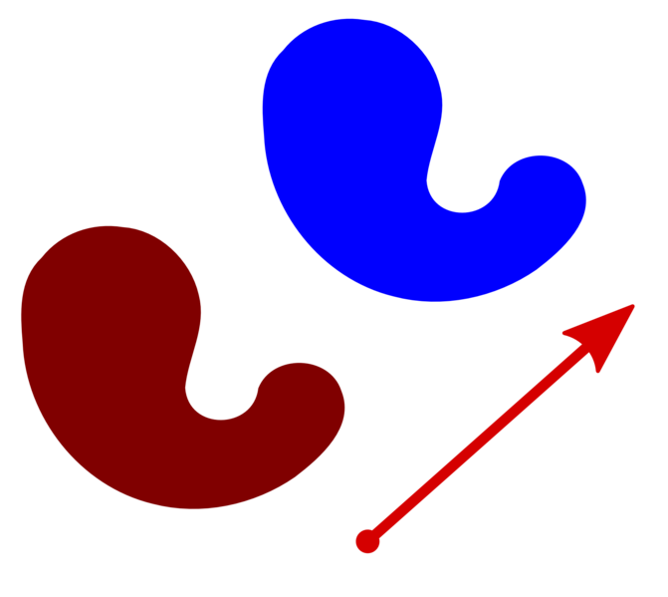
Translation
Rigid Body Transformation
To Move p Distance and Magnitude of Vector v:
Invertibility
Compositionality
Wikimedia Commons, 2008 – Creative Commons License

Slide 20
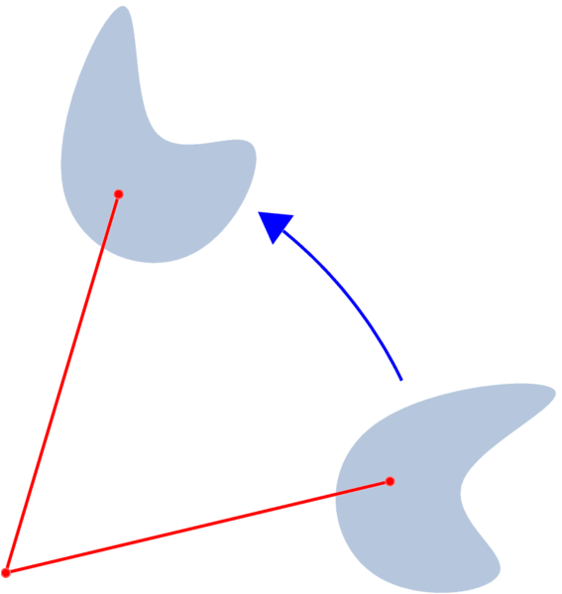
Rotation
Rigid Body Transformation
Properties: Inverse ≡ Transpose
Idea: Define New (Relative) Coordinate System
Example
Rotations about x, y, and z Axes (using Plain 3-D Coordinates)
Wikimedia Commons, 2008 – Creative Commons License

Slide 21
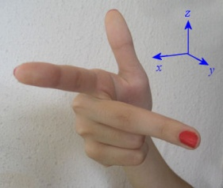
Rotation as Change of Basis
3 x 3 rotation matrices
3 x 3 matrices that “rotate” world (leaving out w for simplicity)
3 unit vectors originally along x, y, z axes: moved to new positions
Because of rigid-body rotation, new vectors are still:
unit vectors
perpendicular to each other
compliant with “right hand rule”
Any such matrix transformation = rotation
about some axis
by some amount
Let’s call these x, y, and z-axis-aligned unit vectors e₁, e₂, e₃
Writing out (these are also called i, j, k):
© 1997 - 2011 Murray Bourne
http://bit.ly/fcIjLB
Adapted from slide © 2003 – 2008 A. van Dam, Brown University

Slide 22
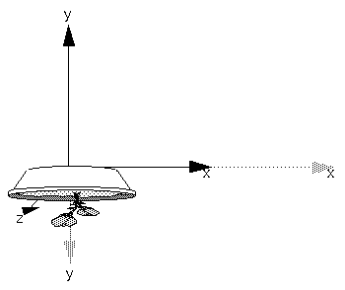
Scaling
Not Rigid Body Transformation
Idea: Move Points Toward/Away from Origin
Homogeneous Coordinates Make It Easier
Result
Ratio Need Not Be Uniform in x, y, z
Results of glScalef(2.0, -0.5, 1.0)
© 1993 Neider, Davis, Woo
http://fly.cc.fer.hr/~unreal/theredbook/
Wikimedia Commons, 2008 – Creative Commons License

Slide 23
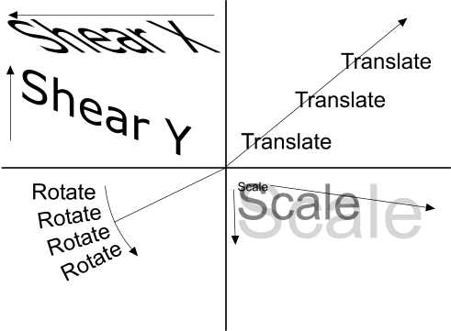
Other Transformations
Shear aka Skew (http://bit.ly/hZfx3W): “Tilting”, Oblique Projection
Perspective to Parallel View Volume (“D” in Foley et al.)
See also
http://en.wikipedia.org/wiki/Transformation_matrix
http://www.senocular.com/flash/tutorials/transformmatrix/
© Ramuseco Limited 2004-2005 All Rights Reserved.
http://www.bobpowell.net/transformations.htm

Slide 24
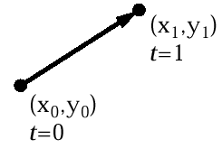
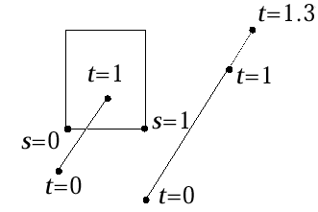
Parametric Equation of a
Line Segment
Parametric form for line segment
X = x₀ + t(x₁ – x₀) 0 ≤ t ≤ 1
Y = y₀ + t(y₁ – y₀)
P(t) = P₀ + t(P₁ – P₀)
Line in general: t ∈ [-∞, ∞]
Later: used for clipping (other intersection calculations)
© 2003 – 2008 A. van Dam, Brown University

Slide 25
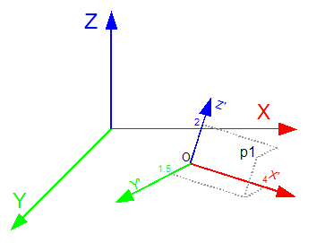
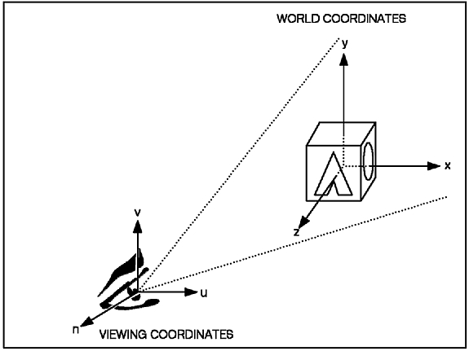
Importance to CG [1]:
Vectors and Matrices
Points as Vectors (w.r.t. Origin)
Local Coordinate Systems (Spaces)
Modelview transformation (MVT): model coordinates to world coordinates
Viewing transformation: world coordinates to camera coordinates
Several more to be covered in this course
a
b
© 2009 Koen Samyn
http://knol.google.com/k/matrices-for-3d-applications-view-transformation
© 2007 IBM
http://bit.ly/cS4h7g

Slide 26
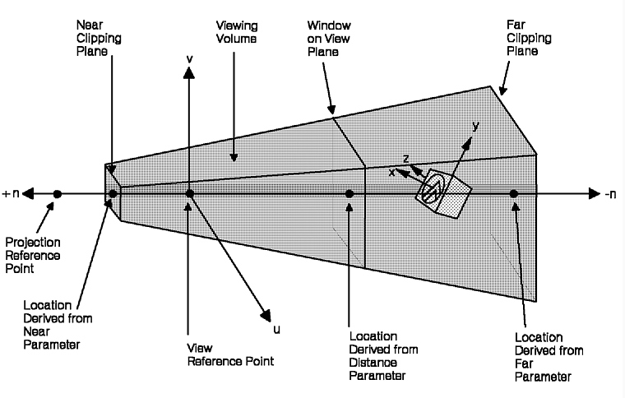
Importance to CG [2]:
Homogeneous Coordinates
Problem: Need to Support Non-Linear Transformations
Affine but not linear: e.g., translation
Non-affine projections: e.g., perspective
Solution: Use 4th Coordinate w
Coordinates look like: (x, y, z, w)^{T} with w kept normalized to 1
Homogeneous coordinates (Wikipedia: http://bit.ly/fG7RSk)
Specific case: barycentric (defined w.r.t. simplex, e.g., polygon) http://en.wikipedia.org/wiki/Barycentric_coordinates_(mathematics)
The GraPHIGS Programming Interface:
Understanding Concepts
© 2007 IBM
http://bit.ly/cS4h7g

Slide 27
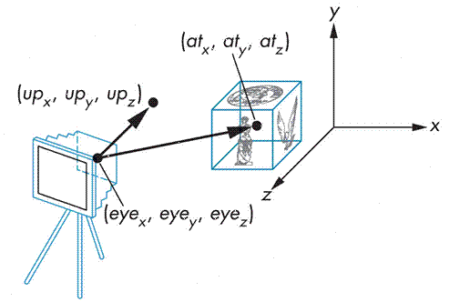
Importance to CG [3]:
T, R, S in Viewing Transformation
Want to
Specify arbitrary (user-defined) camera view (camera space aka CS)
Take picture of standard world space (WS), from eye point towards at point
Need to: Map CS to WS (Normalizing Transformation)
© 2009 Roberto Toldo
http://bit.ly/hvAZAe

Slide 28
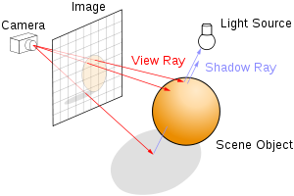
Importance to CG [4]:
Intersections, Clipping
Problem: Need to Find Intersection between Objects
Clipping: line segments – edge of polygon (model) with clip edge
Ray tracing: ray – from eye, through “screen” pixel, into scene
Many other intersections in computer graphics!
Solution: Represent Objects using Parametric Equations
Moving object or object being traced (e.g., ray): P(t)
Find point where P(t) = Q (boundary of second object)
May have multiple solutions (as polynomials may have > 1 zero)
Usually want closest one
© 2011 Wikipedia
http://en.wikipedia.org/wiki/Ray_tracing_(graphics)

Slide 29
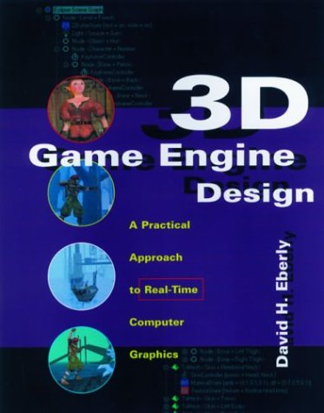
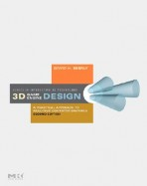
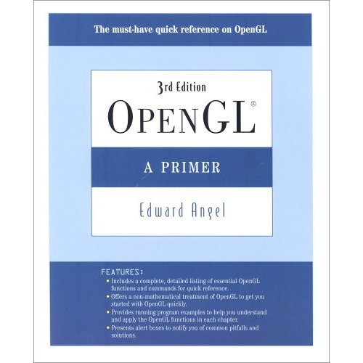
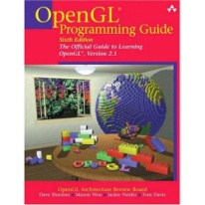
Textbook and Recommended Books
Required Textbook
Eberly, D. H. (2006). 3D Game Engine Design: A Practical Approach to Real-Time Computer Graphics, second edition. San Francisco, CA: Morgan Kauffman.
Recommended References
Angel, E. O. (2007). OpenGL: A Primer, third edition. Reading, MA: Addison-Wesley. [2nd edition on reserve]
Shreiner, D., Woo, M., Neider, J., & Davis, T. (2009). OpenGL® Programming Guide: The Official Guide to Learning OpenGL®, Versions 3.0 and 3.1, seventh edition.
[“The Red Book”: use 7th ed. or later]
1st edition (outdated)
2nd edition
2nd edition (OK to use)
3rd edition

Slide 30
Lab 0
Warm-Up Lab
Account set-up
Linux environment
Simple OpenGL exercise
Basic Account Set-Up
See http://support.cis.ksu.edu to understand KSU Department of CIS setup
Make sure your CIS department account is set up
If not, use SelfServ: https://selfserv.cis.ksu.edu/selfserv/requestAccount
Linux Environment
Make sure your CIS department account is set up
Learn how to navigate, set your shell (see KSOL, http://unixhelp.ed.ac.uk)
Lab 1 and first homeworks will ask you to render to local XWindows server
Simple OpenGL exercise
Watch OpenGL Primer Part 1 as needed
Follow intro tutorials on “NeHe” (http://nehe.gamedev.net) as instructed
Turn in: source code, screenshot as instructed in Lab 0 handout

Slide 31
Summary
Cumulative Transformation Matrices (CTM): T, R, S
Translation
Rotation
Scaling
Setup for Shear/Skew, Perspective to Parallel – see Eberly, Foley et al.
“Matrix Stack” in OpenGL: Premultiplication of Matrices
Coming Up
Parametric equations in clipping
Intersection testing: ray-cube, ray-sphere, implicit equations (ray tracing)
Homogeneous Coordinates: What Is That 4th Coordinate?
http://en.wikipedia.org/wiki/Homogeneous_coordinates
Crucial for ease of normalizing T, R, S transformations in graphics
See: Slide 14 of this lecture
Note: Slides 20 & 23 (T, S) versus 21 (R)
Read about them in Eberly 2e, Angel 3e
Special case: barycentric coordinates

Slide 32
Terminology
Cumulative Transformation Matrices (CTM): Translation, Rotation, Scaling
Some Basic Analytic Geometry and Linear Algebra for CG
Vector space (VS) – set of vectors: addition, scalar multiplication; VS axioms
Affine space (AS) – set of points with associated VS: vector difference, point-vector addition; AS axioms
Linear subspace – nonempty subset S of VS (V, +, ·) closed under + and ·
Affine subspace – nonempty subset S of VS (V, +, ·) such that closure S’ of S under point subtraction is a linear subspace of V
Dot product – scalar-valued inner product <u, v> ≡ u • v ≡ u₁v₁ + u₂v₂ + … + u_{n}v_{n}
Orthogonality – property of vectors u, v that u • v = 0
Orthonormality – basis containing pairwise-orthogonal unit vectors
Length (Euclidean norm) –
Rigid body transformation – one that preserves distance between points
Homogeneous coordinates (esp. barycentric coordinates) – allow affine, projective transformations; “4-D” space for 3-D CG

