Slide 1
Lecture 9 of 41
Surface Detail 1 of 5:
Illumination and Shading
William H. Hsu
Department of Computing and Information Sciences, KSU
KSOL course pages: http://bit.ly/hGvXlH / http://bit.ly/eVizrE
Public mirror web site: http://www.kddresearch.org/Courses/CIS636
Instructor home page: http://www.cis.ksu.edu/~bhsu
Readings:
Today: Sections 2.5, 2.6.1-2.6.2, 4.3.2, 20.2, Eberly 2e – see http://bit.ly/ieUq45
Next class: Section 2.7, Eberly 2e, Direct3D handout
Brown CS123 slides on Illumination – http://bit.ly/fGWndj
Wayback Machine archive of Brown CS123 slides: http://bit.ly/gAhJbh

Slide 2
Lecture Outline
Reading for Last Class: §2.4, 2.5 (Especially 2.5.4), 3.1.6, Eberly 2e
Reading for Today: §2.5, 2.6.1 – 2.6.2, 4.3.2, 20.2, Eberly 2e
Reading for Next Class: §2.7, Eberly 2e; Direct 3D Handout
Last Time: Scan Conversion, Concluded
Circles and ellipses
Polygons: scan line interpolation (for flat/constant shading)
Later: Gouraud & Phong shading, z-buffering, texture mapping
Today: Intro to Illumination and Shading
Views of light: microscopic vs. macroscopic
Local vs. global models
Illumination (vertex shaders) vs. shading (fragment/pixel shaders)
Light transport: Kajiya’s equation, Lambert’s cosine law
Bidirectional reflectance distribution function (BRDF) ρ(p, ω _{i}, ω_{o}, λ)
Lambertian reflectance
Phong illumination equation: introduction to shading

Slide 3
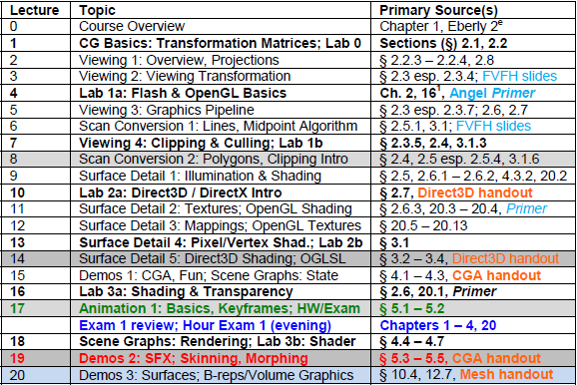
Where We Are

Slide 4
Acknowledgements
Andy van Dam
T. J. Watson University Professor of Technology and Education & Professor of Computer Science
Brown University
http://www.cs.brown.edu/~avd/
Adapted from slides © 1997 – 2010 van Dam et al., Brown University
http://bit.ly/hiSt0f Reused with permission.

Slide 5
Outline
Adapted from slides © 2010 van Dam et al., Brown University
http://bit.ly/hiSt0f Reused with permission.

Slide 6
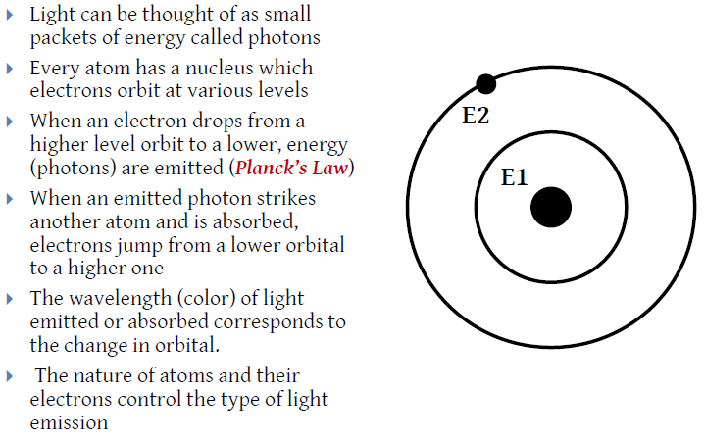
Microscopic View of Light [1]:
Photons & Planck’s Law
Adapted from slides © 2010 van Dam et al., Brown University
http://bit.ly/hiSt0f Reused with permission.

Slide 7
Microscopic View of Light [2]:
Energy, Conductivity & Reflectivity
Adapted from slides © 2010 van Dam et al., Brown University
http://bit.ly/hiSt0f Reused with permission.

Slide 8
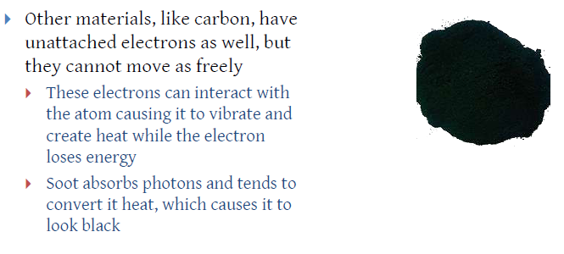
Microscopic View of Light [3]:
Photon Absorption
Adapted from slides © 2010 van Dam et al., Brown University
http://bit.ly/hiSt0f Reused with permission.

Slide 9
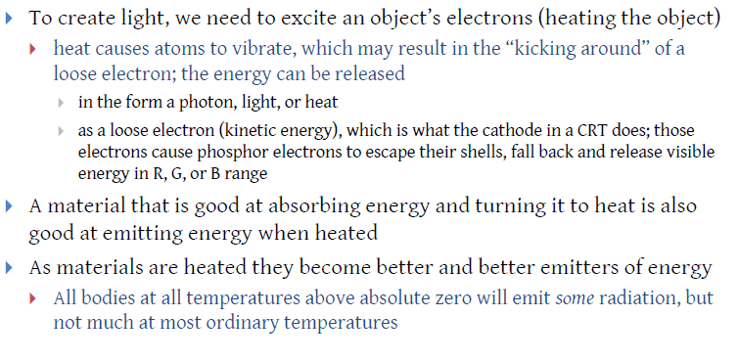
Microscopic View of Light [4]:
Light Emission
Adapted from slides © 2010 van Dam et al., Brown University
http://bit.ly/hiSt0f Reused with permission.

Slide 10
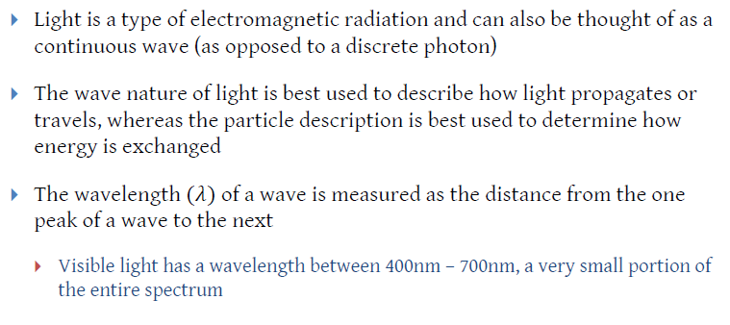
Macroscopic View of Light [1]:
Radiation & Wave/Particle Duality
Adapted from slides © 2010 van Dam et al., Brown University
http://bit.ly/hiSt0f Reused with permission.

Slide 11
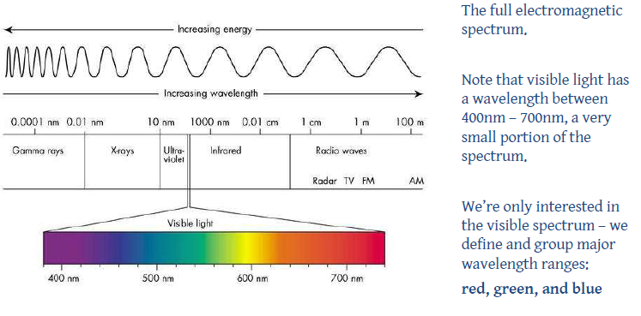
Macroscopic View of Light [2]:
Electromagnetic Spectrum
Adapted from slides © 2010 van Dam et al., Brown University
http://bit.ly/hiSt0f Reused with permission.

Slide 12
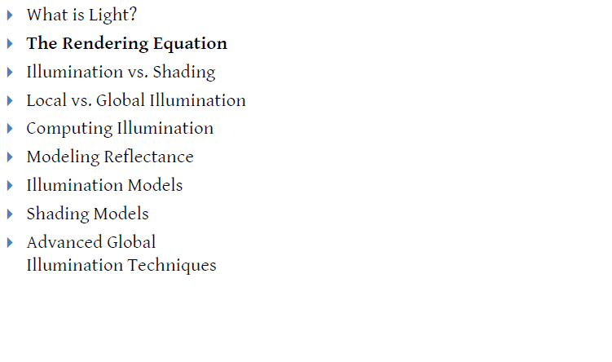
Outline
Adapted from slides © 2010 van Dam et al., Brown University
http://bit.ly/hiSt0f Reused with permission.

Slide 13
Rendering Equation [1]:
(Kajiya, 1986)
Adapted from slides © 2010 van Dam et al., Brown University
http://bit.ly/hiSt0f Reused with permission.

Slide 14
Rendering Equation [2]:
Geometry, Luminance, BRDF
Adapted from slides © 2010 van Dam et al., Brown University
http://bit.ly/hiSt0f Reused with permission.

Slide 15
Illumination & Shading
Adapted from slides © 2010 van Dam et al., Brown University
http://bit.ly/hiSt0f Reused with permission.

Slide 16
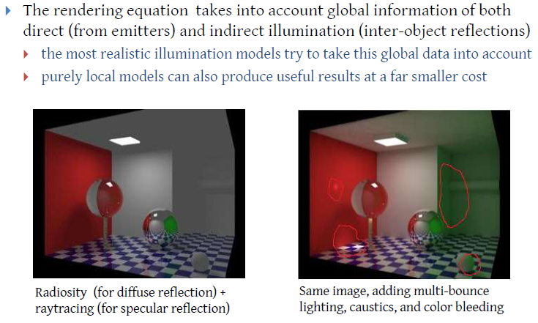
Illumination Models [1]:
Local vs. Global Models
Adapted from slides © 2010 van Dam et al., Brown University
http://bit.ly/hiSt0f Reused with permission.

Slide 17
Illumination Models [2]:
Local Illumination
Adapted from slides © 2010 van Dam et al., Brown University
http://bit.ly/hiSt0f Reused with permission.

Slide 18
Illumination Models [3]:
Global Illumination
Adapted from slides © 1997 – 2010 van Dam et al., Brown University
http://bit.ly/hiSt0f Reused with permission.

Slide 19
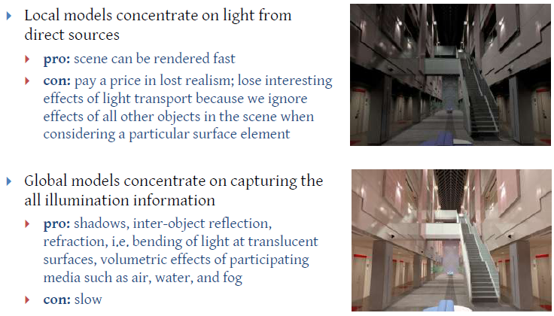
Illumination Models [4]:
Tradeoffs (Pros & Cons)
Frederic Drago and Karol Myszkowski, Validation Proposal for Global Illumination and Rendering Techniques
http://www.mpi-sb.mpg.de/resources/atrium/
Adapted from slides © 2002 – 2010 van Dam et al., Brown University
http://bit.ly/hiSt0f Reused with permission.

Slide 20
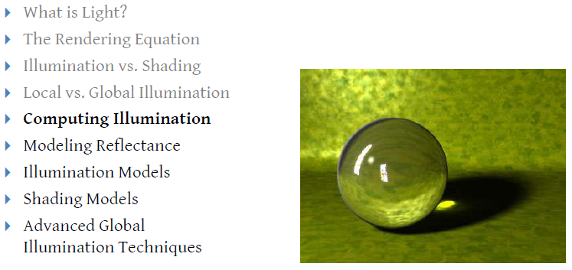
Outline
Adapted from slides © 2010 van Dam et al., Brown University
http://bit.ly/hiSt0f Reused with permission.

Slide 21
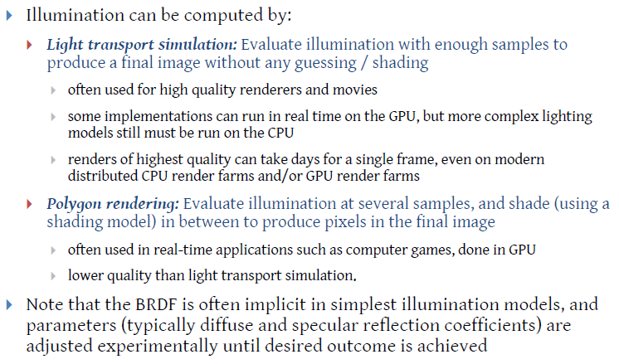
Illumination Models [5]:
Computing Illumination
Adapted from slides © 2010 van Dam et al., Brown University
http://bit.ly/hiSt0f Reused with permission.

Slide 22
Computing Illumination:
Light Transport [1]
Adapted from slides © 2010 van Dam et al., Brown University
http://bit.ly/hiSt0f Reused with permission.

Slide 23
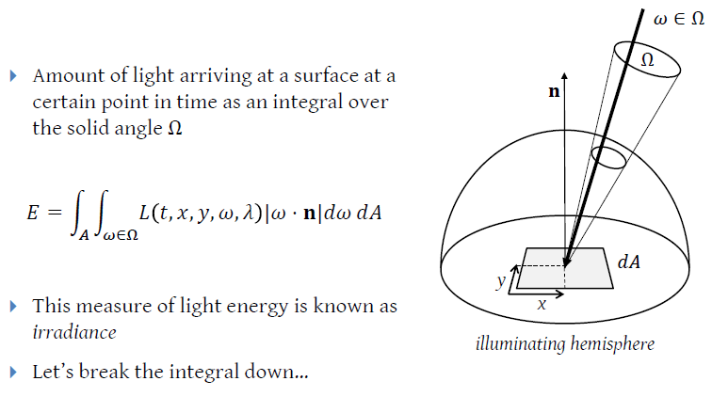
Computing Illumination:
Light Transport [2]
Adapted from slides © 2010 van Dam et al., Brown University
http://bit.ly/hiSt0f Reused with permission.

Slide 24
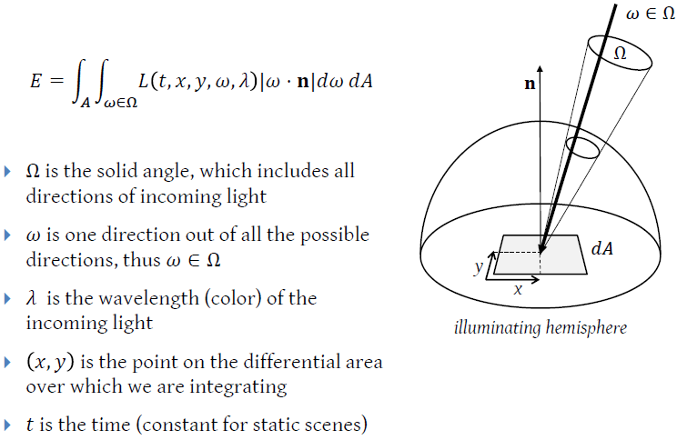
Computing Illumination:
Light Transport [3]
Adapted from slides © 2010 van Dam et al., Brown University
http://bit.ly/hiSt0f Reused with permission.

Slide 25
Computing Illumination:
Light Transport [4]
Adapted from slides © 2010 van Dam et al., Brown University
http://bit.ly/hiSt0f Reused with permission.

Slide 26
Outline
Adapted from slides © 2010 van Dam et al., Brown University
http://bit.ly/hiSt0f Reused with permission.

Slide 27
Modeling Reflectance:
BRDF [1]
Adapted from slides © 2010 van Dam et al., Brown University
http://bit.ly/hiSt0f Reused with permission.

Slide 28
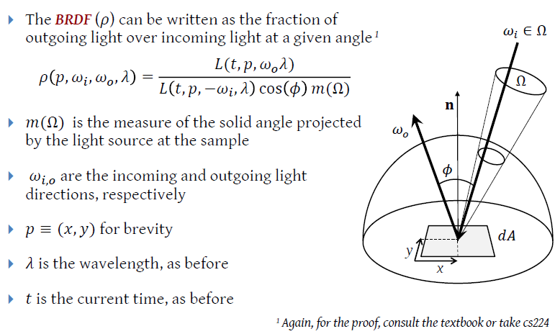
Modeling Reflectance:
BRDF [2]
Adapted from slides © 2010 van Dam et al., Brown University
http://bit.ly/hiSt0f Reused with permission.

Slide 29
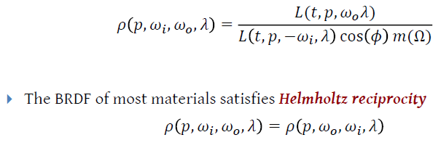
Modeling Reflectance:
BRDF [3]
Adapted from slides © 2010 van Dam et al., Brown University
http://bit.ly/hiSt0f Reused with permission.

Slide 30
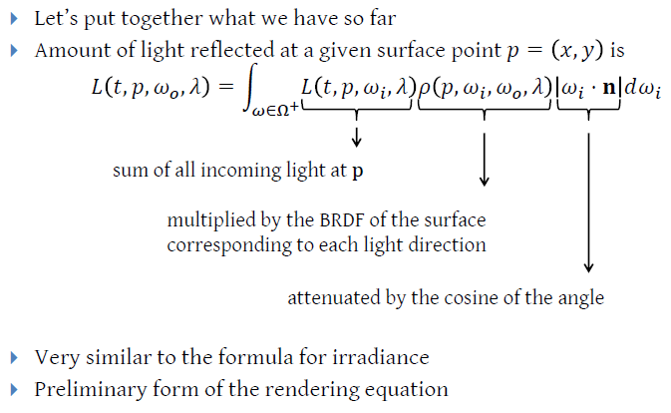
Modeling Reflectance:
Deriving Rendering Equation
Adapted from slides © 2010 van Dam et al., Brown University
http://bit.ly/hiSt0f Reused with permission.

Slide 31
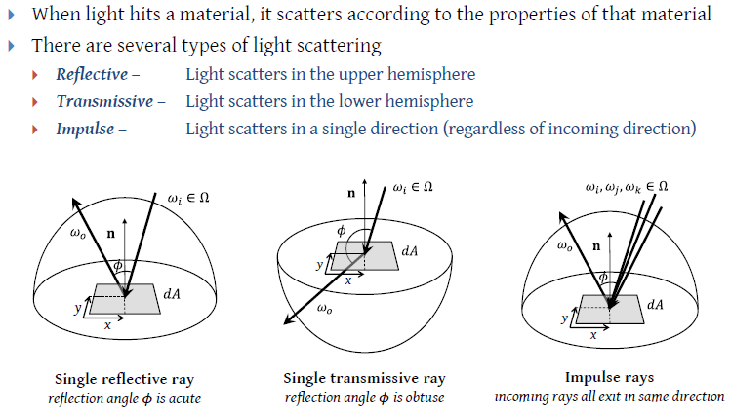
Modeling Reflectance:
Materials [1]
Adapted from slides © 2010 van Dam et al., Brown University
http://bit.ly/hiSt0f Reused with permission.

Slide 32
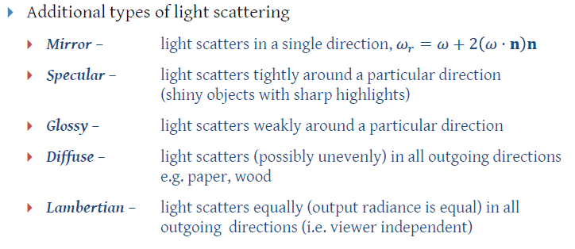
Modeling Reflectance:
Materials [2]
Adapted from slides © 2010 van Dam et al., Brown University
http://bit.ly/hiSt0f Reused with permission.

Slide 33
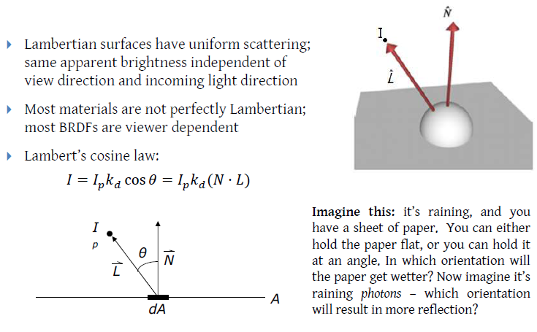
Modeling Reflectance:
Lambertian (Diffuse) [1]
Adapted from slides © 2010 van Dam et al., Brown University
http://bit.ly/hiSt0f Reused with permission.

Slide 34
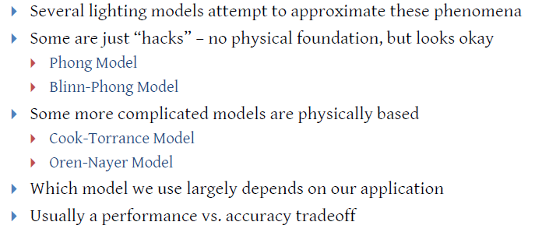
Modeling Reflectance:
Lambertian (Diffuse) [2]
Adapted from slides © 2010 van Dam et al., Brown University
http://bit.ly/hiSt0f Reused with permission.

Slide 35
Modeling Reflectance:
Specular
Adapted from slides © 1997 – 2010 van Dam et al., Brown University
http://bit.ly/hiSt0f Reused with permission.

Slide 36
Modeling Reflectance:
BSSRDF
Adapted from slides © 2010 van Dam et al., Brown University
http://bit.ly/hiSt0f Reused with permission.

Slide 37
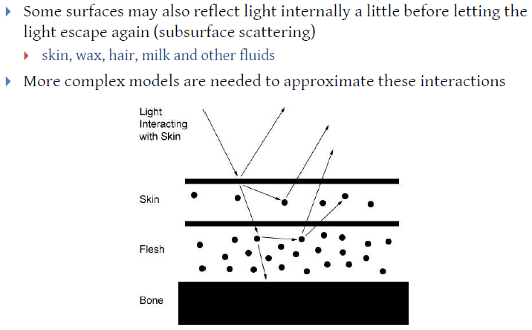
Modeling Reflectance:
Subsurface Scattering
Adapted from slides © 2010 van Dam et al., Brown University
http://bit.ly/hiSt0f Reused with permission.

Slide 38
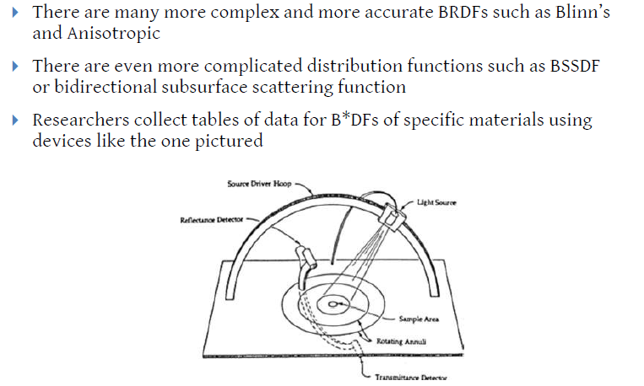
Modeling Reflectance:
Advanced Techniques
Adapted from slides © 2010 van Dam et al., Brown University
http://bit.ly/hiSt0f Reused with permission.

Slide 39
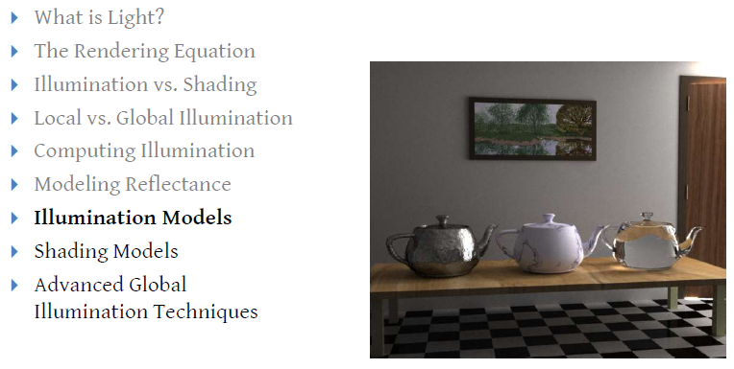
Outline
Adapted from slides © 2010 van Dam et al., Brown University
http://bit.ly/hiSt0f Reused with permission.

Slide 40
Illumination Models:
Lambertian [1]
Adapted from slides © 2010 van Dam et al., Brown University
http://bit.ly/hiSt0f Reused with permission.

Slide 41
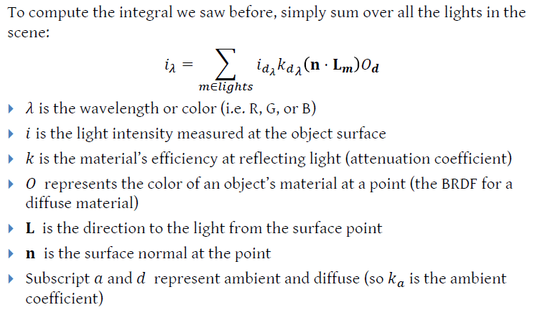
Illumination Models:
Lambertian [2]
Adapted from slides © 2010 van Dam et al., Brown University
http://bit.ly/hiSt0f Reused with permission.

Slide 42
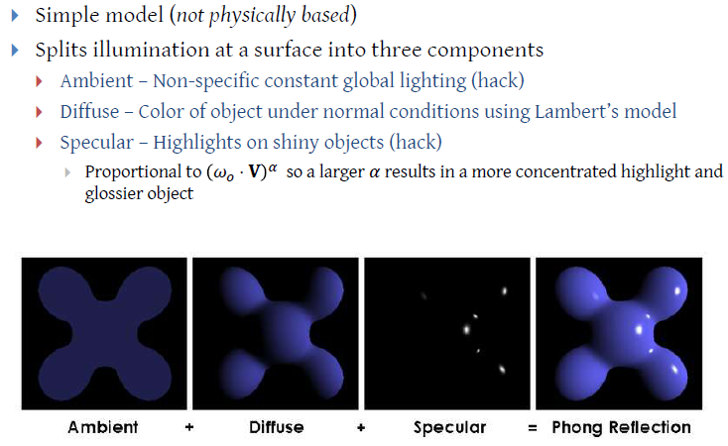
Illumination Models:
Phong [1]
Adapted from slides © 2010 van Dam et al., Brown University
http://bit.ly/hiSt0f Reused with permission.

Slide 43
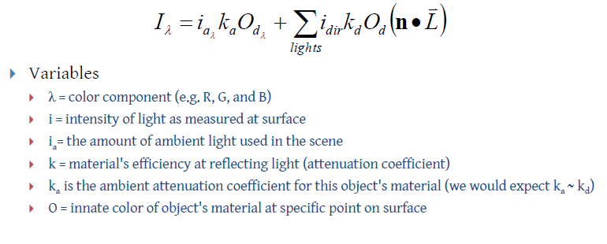
Illumination Models:
Phong [2]
Adapted from slides © 2010 van Dam et al., Brown University
http://bit.ly/hiSt0f Reused with permission.

Slide 44
Illumination Models:
Phong [3]
Adapted from slides © 2010 van Dam et al., Brown University
http://bit.ly/hiSt0f Reused with permission.

Slide 45
Illumination Models:
Phong [4]
Adapted from slides © 1997 – 2010 van Dam et al., Brown University
http://bit.ly/hiSt0f Reused with permission.

Slide 46
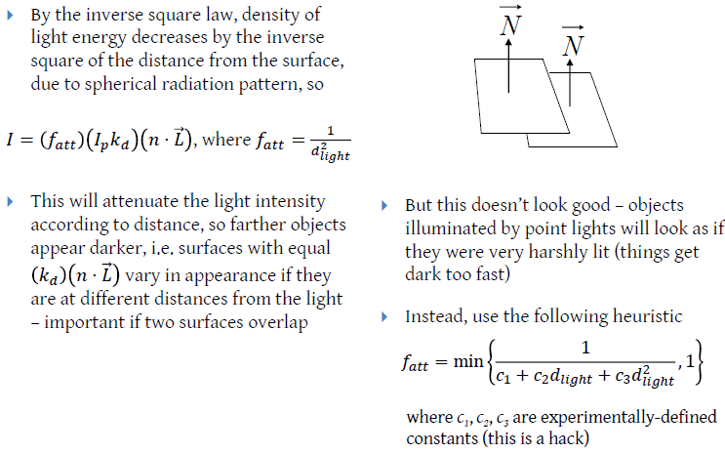
Illumination Models:
Phong [5]
Adapted from slides © 1997 – 2010 van Dam et al., Brown University
http://bit.ly/hiSt0f Reused with permission.

Slide 47
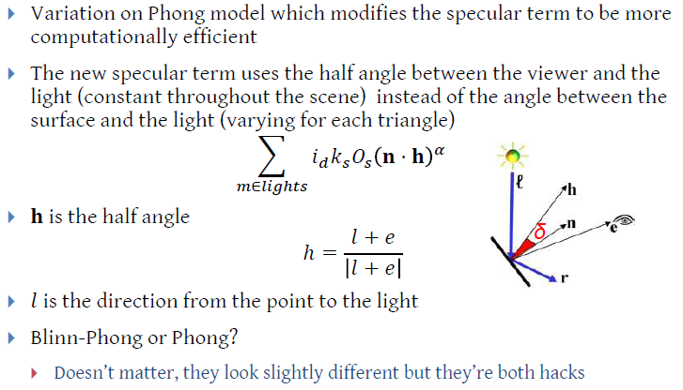
Illumination Models:
Blinn-Phong (See Eberly 2e)
Adapted from slides © 2010 van Dam et al., Brown University
http://bit.ly/hiSt0f Reused with permission.

Slide 48
Illumination Models:
Computing Results
Adapted from slides © 2010 van Dam et al., Brown University
http://bit.ly/hiSt0f Reused with permission.

Slide 49
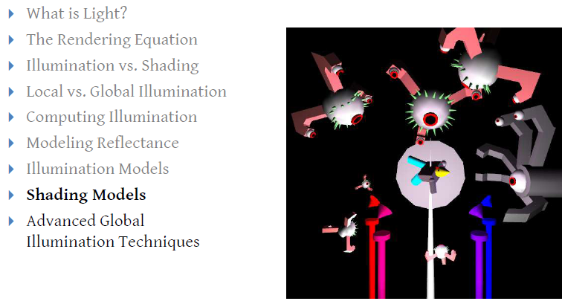
Outline
Adapted from slides © 2010 van Dam et al., Brown University
http://bit.ly/hiSt0f Reused with permission.

Slide 50
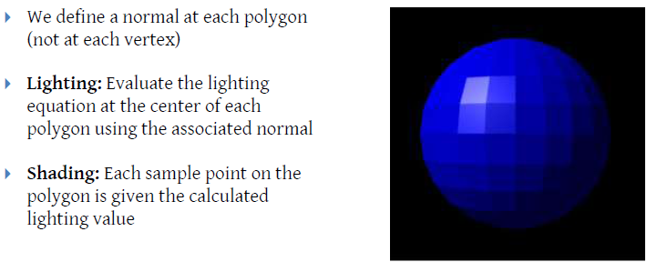
Shading Models:
Flat/Constant (No Interpolation)
GL_CONSTANT
Adapted from slides © 2010 van Dam et al., Brown University
http://bit.ly/hiSt0f Reused with permission.

Slide 51
Shading Models:
Gouraud (Color Interpolation)
GL_SMOOTH
Adapted from slides © 2010 van Dam et al., Brown University
http://bit.ly/hiSt0f Reused with permission.

Slide 52
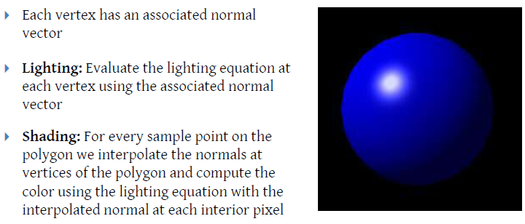
Shading Models:
Phong (Vertex Normal Interpolation)
OpenGL implementation?
Stay tuned…
Adapted from slides © 2010 van Dam et al., Brown University
http://bit.ly/hiSt0f Reused with permission.

Slide 53
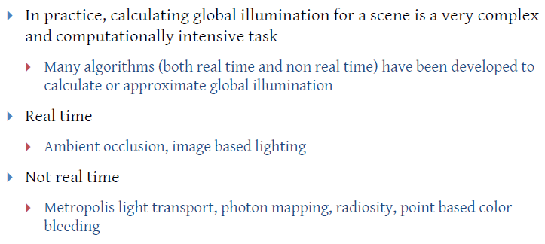
Preview: Advanced Global Illumination
(GI) Techniques
Adapted from slides © 2010 van Dam et al., Brown University
http://bit.ly/hiSt0f Reused with permission.

Slide 54
Preview: More on Shading
(Surface Detail 2, 4, 5)
Shading in OpenGL
Flat/constant: GL_CONSTANT
Gouraud: GL_SMOOTH
Shading Languages
Renderman Shading Language (RSL) – http://bit.ly/g229q4
OpenGL Shading Language (OGLSL or GLSL) – http://bit.ly/fX8V0Y
Microsoft High-Level Shading Language (HLSL) – http://bit.ly/eVnjp5
nVidia Cg – http://bit.ly/ewoRic
Vertex vs. Pixel Shaders
How to Write Shaders
Adapted from slides © 2010 van Dam et al., Brown University
http://bit.ly/hiSt0f Reused with permission.

Slide 55
Summary
Last Time: Scan Conversion, Concluded
Circles and ellipses
Polygons: scan line interpolation (for flat/constant shading)
Today: Intro to Illumination and Shading
Local illumination (Phong, etc.) vs. global (ray tracing, radiosity)
Illumination (vertex shaders) vs. shading (fragment/pixel shaders)
Light transport
Kajiya’s equation
Lambertian reflectance: cosine law
Bidirectional reflectance distribution function (BRDF) ρ(p, ω _{i}, ω_{o}, λ)
Phong illumination equation
Shading
Gouraud: color interpolation (per-vertex Phong illumination)
Phong: normal interpolation (per-pixel Phong illumination)
Next: Direct3D Tutorial

Slide 56
Terminology
Illumination – Computing Light that Reaches a Surface Patch
Local – based on computations over surface patch, light direction
Global – based on interobject reflectance and transmission
Inputs
Light properties – point light source vs. emissive light source
Reflectance properties – how light is reflected back into scene
Diffuse: omnidirectional
Specular: directed, based on highlights
Computations
Lambertian reflectance – based on cosine law
Bidirectional reflectance distribution function (BRDF) ρ
Measurement of reflectance
ρ(p, ω _{in}, ω_{out}, λ) where p ≡ (x, y), λ is wavelength
Phong illumination equation – ambient, diffuse, specular
Shading – Application of Illumination to Find/Interpolate Color

