Slide 1
Lecture 30 of 41
Animation 3 of 3: Inverse Kinematics
Control & Ragdoll Physics
William H. Hsu
Department of Computing and Information Sciences, KSU
KSOL course pages: http://bit.ly/hGvXlH / http://bit.ly/eVizrE
Public mirror web site: http://www.kddresearch.org/Courses/CIS636
Instructor home page: http://www.cis.ksu.edu/~bhsu
Readings:
Last class: Particle System Handout
Today: §5.3, Eberly 2e – see http://bit.ly/ieUq45; CGA Handout
Next class: Chapter 14, Eberly 2e
Reference: Wikipedia, Inverse Kinematics, http://bit.ly/hr8r2u
Reference: Wikipedia, Ragdoll Physics, http://bit.ly/3oggUZ

Slide 2
Lecture Outline
Reading for Last Class: Particle System Handout
Reading for Today: §5.3, Eberly 2e; CGA Handout
Reading for Next Class: Chapter 14, Eberly 2e
Last Time: Lab on Particle Systems; Dissection of Working Program
Today: Animation Part 3 of 3 – Inverse Kinematics
Autonomous agents (robots, swarms) vs. hand-animated movement
Forward kinematics and control
Inverse kinematics for autonomous movement in robotics
Jacobians and iterative minimization models
Rag doll physics
End of Material on: Particle Systems, Collisions, CGA
Also Conclusion of Physically-Based Modeling (PBM)
Next Class: Ray Tracing, Part 1 of 2
Vectors: light/shadow (L), reflected (R), transmitted/refracted (T)
Basic recursive ray tracing: ray trees

Slide 3
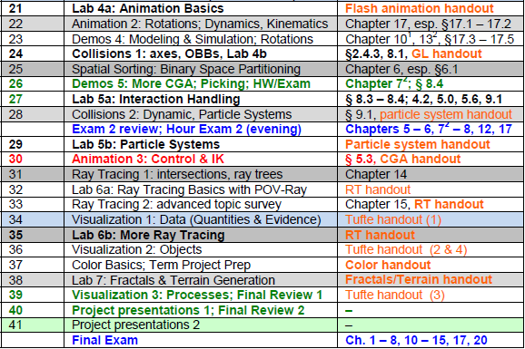
Where We Are

Slide 4
Acknowledgements:
Inverse Kinematics
David C. Brogan
Visiting Assistant Professor, Computer Science Department, University of Virginia
http://www.cs.virginia.edu/~dbrogan/
Susquehanna International Group (SIG)
http://www.sig.com
Steve Rotenberg
Visiting Lecturer
Graphics Lab
University of California – San Diego
CEO/Chief Scientist, PixelActive
http://graphics.ucsd.edu
Renata Melamud
Ph.D. Candidate
Mechanical Engineering Department
Stanford University
http://micromachine.stanford.edu/~rmelamud/

Slide 5
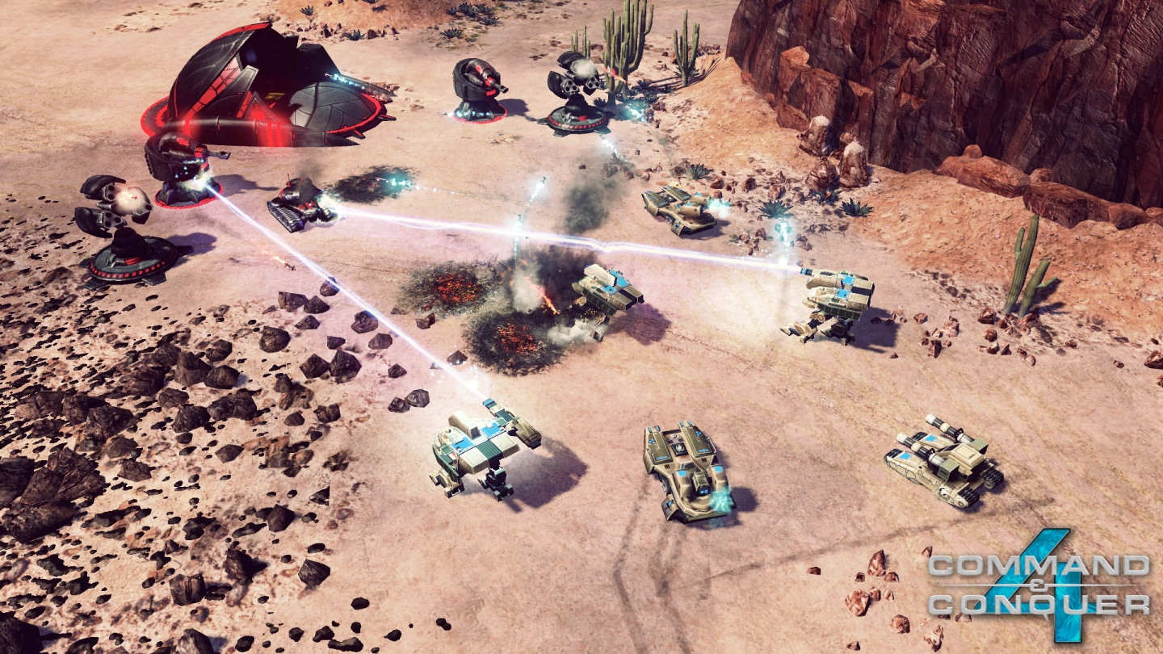
Review [1]:
Uses of Particle Systems
Explosions
Large
Fireworks
Fire
Vapor
Clouds
Dust
Fog
Smoke
Contrails
Water
Waterfalls
Streams
Plants
Command & Conquer 4: Tiberian Twilight
© 2010 Electronic Arts, Inc.
Wikipedia: http://bit.ly/gFGMjO
Adapted from slides © 2008 R. Malhotra, CSU San Marcos
CS 536 Intro to 3-D Game Graphics, Spring 2008 – http://bit.ly/hNhUuE

Slide 6
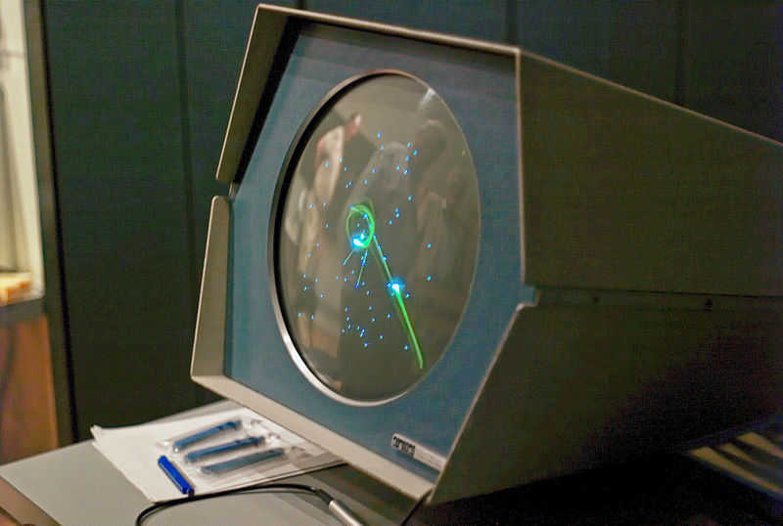
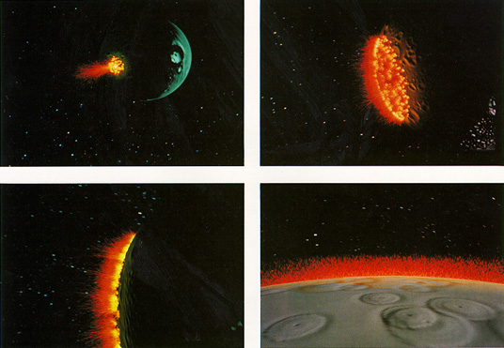
Review [2]:
History of Particle Systems
Spacewar! (1962) Used Pixel Clouds as Explosions
Asteroids (1979) First “Physically-Based” PS/Collision Model in Games
Star Trek II (1983) Particle Fountain: http://youtu.be/Qe9qSLYK5q4
Hey, Hey, 16K © 2000 M. J. Hibbett, Video © 2004 R. Manuel http://youtu.be/Ts96J7HhO28
Spacewar! © 1962 S. Russell et al.
Wikipedia: http://bit.ly/eaiWUW
Asteroids © 1979 L. Rains & E. Logg
Wikipedia: http://bit.ly/hwfEQk
Star Trek II © 1983 Paramount
Wikipedia: http://bit.ly/eXwrhb
Adapted from slides © 2008 R. Malhotra, CSU San Marcos
CS 536 Intro to 3-D Game Graphics, Spring 2008 – http://bit.ly/hNhUuE

Slide 7
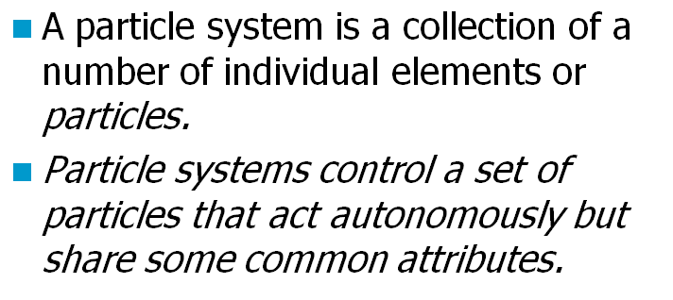
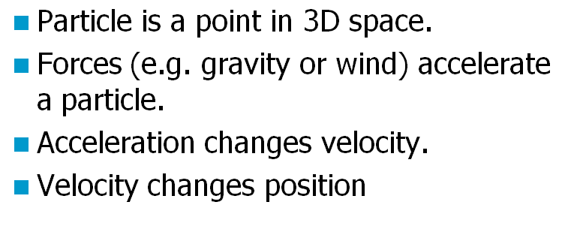
Review [3]:
Definition & Physically-Based Model
Adapted from slides © 2008 R. Malhotra, CSU San Marcos
CS 536 Intro to 3-D Game Graphics, Spring 2008 – http://bit.ly/hNhUuE

Slide 8
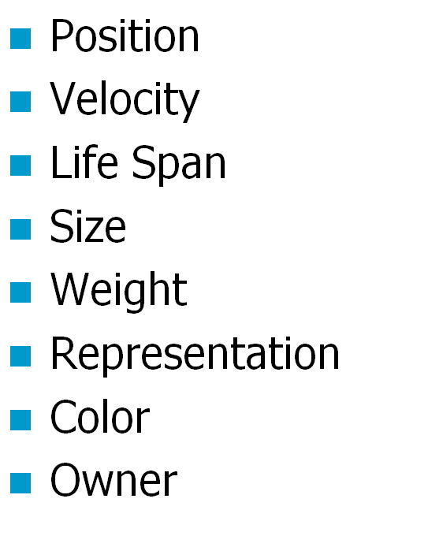
Review [4]:
More Attributes of Particles
Adapted from slides © 2008 R. Malhotra, CSU San Marcos
CS 536 Intro to 3-D Game Graphics, Spring 2008 – http://bit.ly/hNhUuE

Slide 9
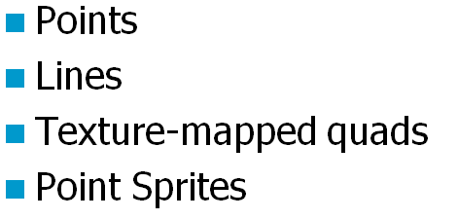
Review [5]:
Four Ways to Represent Particles
Adapted from slides © 2008 R. Malhotra, CSU San Marcos
CS 536 Intro to 3-D Game Graphics, Spring 2008 – http://bit.ly/hNhUuE

Slide 10
Kinematics
Adapted from slides © 2000 – 2005 D. Brogan, University of Virginia
CS 551, Advanced CG & Animation – http://bit.ly/hUXrqd

Slide 11
Degrees of Freedom (DOFs) [1]:
Translational & Rotational
Adapted from slides © 2000 – 2005 D. Brogan, University of Virginia
CS 551, Advanced CG & Animation – http://bit.ly/hUXrqd

Slide 12
Degrees of Freedom (DOFs) [2]:
Robot Arm
Adapted from slides © 2000 – 2005 D. Brogan, University of Virginia
CS 551, Advanced CG & Animation – http://bit.ly/hUXrqd

Slide 13
Configuration Space
Adapted from slides © 2000 – 2005 D. Brogan, University of Virginia
CS 551, Advanced CG & Animation – http://bit.ly/hUXrqd

Slide 14
Work Space
vs. Configuration Space
Adapted from slides © 2000 – 2005 D. Brogan, University of Virginia
CS 551, Advanced CG & Animation – http://bit.ly/hUXrqd

Slide 15
More Examples
Adapted from slides © 2000 – 2005 D. Brogan, University of Virginia
CS 551, Advanced CG & Animation – http://bit.ly/hUXrqd

Slide 16
Controlled DOFs
Adapted from slides © 2000 – 2005 D. Brogan, University of Virginia
CS 551, Advanced CG & Animation – http://bit.ly/hUXrqd

Slide 17
Hierarchical Kinetic Modeling
Adapted from slides © 2000 – 2005 D. Brogan, University of Virginia
CS 551, Advanced CG & Animation – http://bit.ly/hUXrqd

Slide 18
Robot Parts & Terms
Adapted from slides © 2000 – 2005 D. Brogan, University of Virginia
CS 551, Advanced CG & Animation – http://bit.ly/hUXrqd

Slide 19
Example:
Puma 560 Robot
Wikipedia, Programmable Universal Machine for Assembly (PUMA): http://bit.ly/fBMRaM
Adapted from slides © 2002 R. Melamud, Stanford University
Mirrored at CMU 16-311 Introduction to Robotics, http://generalrobotics.org

Slide 20
Joint Types:
Revolute, Prismatic, Spherical
Adapted from slides © 2002 R. Melamud, Stanford University
Mirrored at CMU 16-311 Introduction to Robotics, http://generalrobotics.org

Slide 21
More Complex Joints
Adapted from slides © 2000 – 2005 D. Brogan, University of Virginia
CS 551, Advanced CG & Animation – http://bit.ly/hUXrqd

Slide 22
Hierarchical Representation
Adapted from slides © 2000 – 2005 D. Brogan, University of Virginia
CS 551, Advanced CG & Animation – http://bit.ly/hUXrqd

Slide 23
Forward vs. Inverse Kinematics
Adapted from slides © 2000 – 2005 D. Brogan, University of Virginia
CS 551, Advanced CG & Animation – http://bit.ly/hUXrqd

Slide 24
Forward Kinematics [1]:
Definition & General Approach
Adapted from slides © 2000 – 2005 D. Brogan, University of Virginia
CS 551, Advanced CG & Animation – http://bit.ly/hUXrqd

Slide 25
Forward Kinematics [2]:
Illustration
?
End Effector
Base
Choi
Rotenberg
Adapted from slides © 2002 K. J. Choi, Seoul National University
Graphics and Media Lab (http://graphics.snu.ac.kr) – mirrored at: http://bit.ly/hnzSAN

Slide 26
Forward Kinematics [3]:
Joint Angles to Bone Coordinates
Adapted from slides © 2004 – 2005 S. Rotenberg, UCSD
CSE169: Computer Animation, Winter 2005 – http://bit.ly/f0ViAN

Slide 27
Inverse Kinematics [1]:
Definition & General Approach
Adapted from slides © 2000 – 2005 D. Brogan, University of Virginia
CS 551, Advanced CG & Animation – http://bit.ly/hUXrqd

Slide 28
Inverse Kinematics [2]:
Illustration
For more on characters & IK, see:
Advanced Topics in CG Lecture 05
?
?
End Effector
Base
Choi
Rotenberg
Adapted from slides © 2002 K. J. Choi, Seoul National University
Graphics and Media Lab (http://graphics.snu.ac.kr) – mirrored at: http://bit.ly/hnzSAN

Slide 29
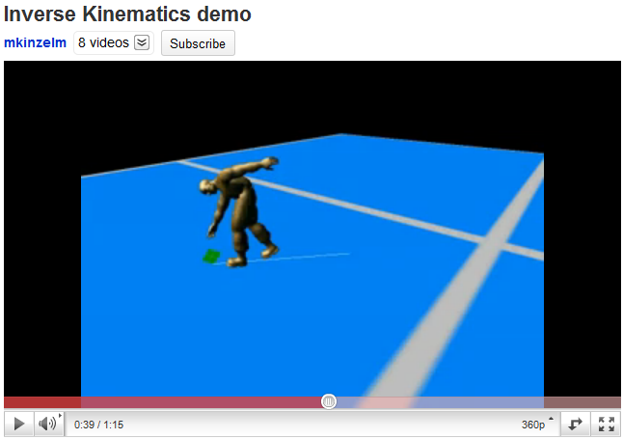
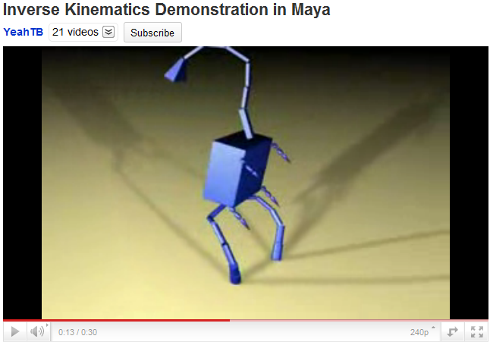
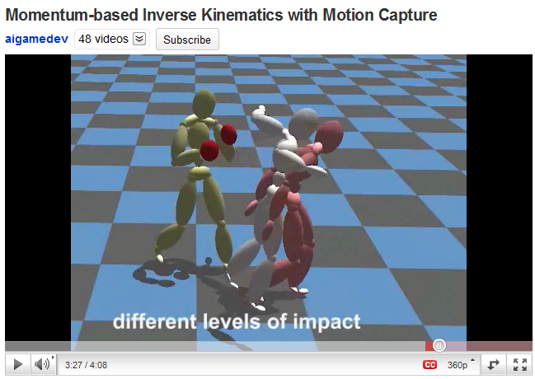
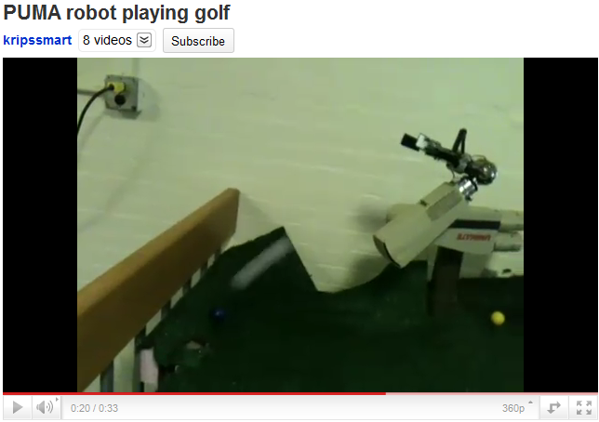
Inverse Kinematics [3]:
Demos
© 2008 M. Kinzelman http://youtu.be/l52yZ491kPo
© 2007 A. Brown http://youtu.be/6JdLOLazJJ0
© 2008 T. Komura, H. S. Lim, & R. W. H. Lau http://youtu.be/FJTBMnP6oCM
© 2011 K. Iyer
http://youtu.be/YvRBWIRAPsE

Slide 30
Inverse Kinematics [4]:
Analytic Solution for 2-Link Case
x₂
y₂
(x,y)
O₂
θ₂
y₀
y₁
a₂
θ₂
x₁
ψ
a₁
O₁
φ
θ₁
x₀
Two solutions: elbow up & elbow down
O₀
Adapted from slides © 2000 – 2005 D. Brogan, University of Virginia
CS 551, Advanced CG & Animation – http://bit.ly/hUXrqd

Slide 31
Inverse Kinematics [5]:
Iterative IK Solutions
Adapted from slides © 2000 – 2005 D. Brogan, University of Virginia
CS 551, Advanced CG & Animation – http://bit.ly/hUXrqd

Slide 32
Jacobian [1]:
6x6 DOF Case
Adapted from slides © 2000 – 2005 D. Brogan, University of Virginia
CS 551, Advanced CG & Animation – http://bit.ly/hUXrqd

Slide 33
Jacobian [2]:
Solution
Adapted from slides © 2000 – 2005 D. Brogan, University of Virginia
CS 551, Advanced CG & Animation – http://bit.ly/hUXrqd

Slide 34
Another IK Problem:
Revolute & Prismatic Joints Combined
Finding :
(x , y)
More Specifically:
arctan2() specifies that it’s in the first quadrant
Y
S
₁
Finding S:
X
Adapted from slides © 2002 R. Melamud, Stanford University
Mirrored at CMU 16-311 Introduction to Robotics, http://generalrobotics.org

Slide 35
Ragdoll Physics [1]:
Definition
Type of Procedural Animation
Automatically generates CGA directives (rotations)
Based on simulation
Rigid-body dynamics
Articulated Figure
Gravity
No autonomous movement
Used for inert body
Usually: character death (car impact, falling body, etc.)
Less often: unconscious, paralyzed character
Collisions with Multiple Bodies
Inter-character
Character-object
Falling Bodies © 1997 – 2001 Animats http://www.animats.com

Slide 36
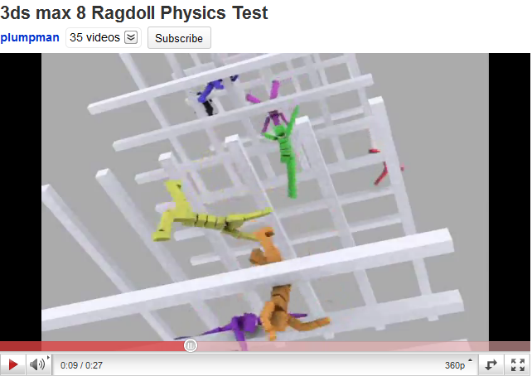
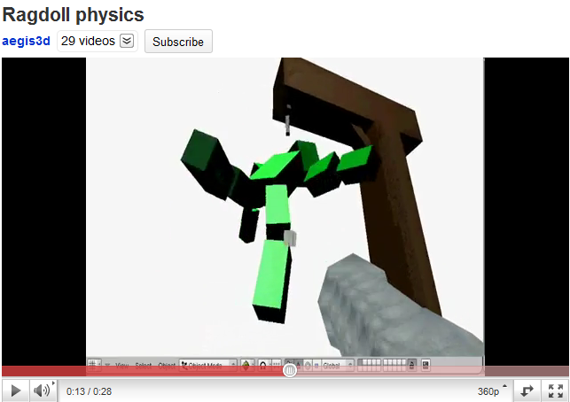
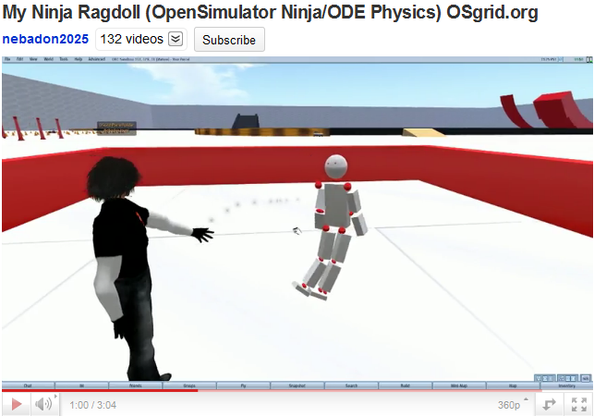
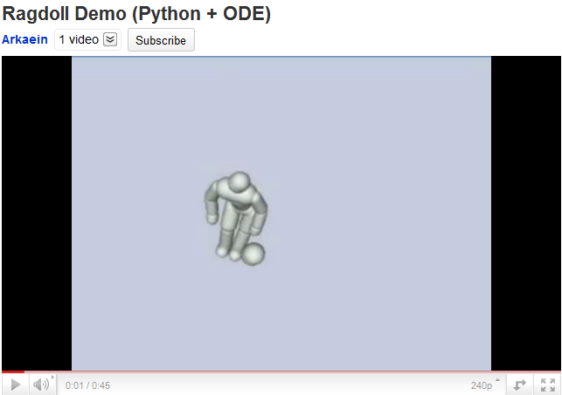
Ragdoll Physics [2]:
Demos
© 2007 N. Picouet http://youtu.be/ohNqCb--aSs
© 2006 P. Pelt http://youtu.be/6JdLOLazJJ0
See also: http://youtu.be/5_QIsI0fyaU
© 2009 M. E. Cerquoni
http://youtu.be/uW_DK2qvKv8
© 2010 M. Heinzen (Arkaein) http://bit.ly/gUj9Su / http://youtu.be/FJTBMnP6oCM

Slide 37
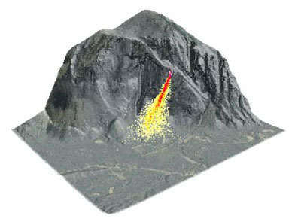
Physically-Based Modeling (PBM) [1]:
Looking Back
Particle Dynamics
Emitters
0-D (points), 1-D (lines), 2-D (planes, discs, cross-sections)
e.g., fireworks (0-D); fountains (0/1/2-D); smokestacks, jets (2-D)
Simulation: birth-death process, functions of particle age/trajectory
Rigid-Body Dynamics
Constrained systems of connected parts
Examples: falling rocks, colliding vehicles, rag dolls
Articulated Figures
More References
ACM, Intro to Physically-Based Modeling: http://bit.ly/hhQvXd
Wikipedia, Physics Engine: http://bit.ly/h4PIRt
Wikipedia, N-Body Problem: http://bit.ly/1ayWwe
Rocks fall
Everyone dies

Slide 38
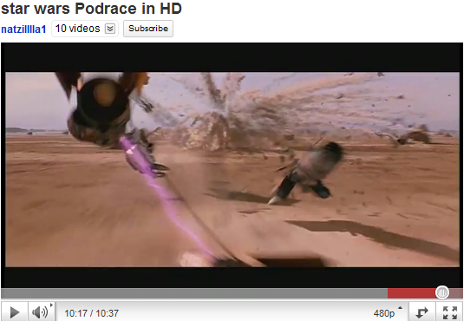
Physically-Based Modeling (PBM) [2]:
Applications in Movies & Games
Star Wars Episode I: The Phantom Menace © 1999 Lucasfilm, Inc. http://youtu.be/d4PSMXUCi-0

Slide 39
Summary
Reading for Today: §5.3, Eberly 2e; CGA Handout
Reading for Next Class: Chapter 14, Eberly 2e
Last Class: Lab on Particle Systems; Dissection of Working Program
Today: Computer-Generated Animation Concluded
CGA of autonomous agents (robots, swarms) vs. animation by hand
Degrees of freedom (DOFs) and kinds of joints
Forward kinematics (FK)
Forward problem illustrated
Control problem
Inverse kinematics (IK)
IK (finding angles) vs. mechanical problem of finding forces
Analytical models
Iterative models (Jacobian-based)
Ragdoll physics
Next Class: Ray Tracing, Part 1 of 2

Slide 40
Terminology
Emitter – Point, Line, Plane or Region from which Particles Originate
Particle Fountain – Particle System with Directional Emitter
Sprite (Wikipedia: http://bit.ly/gyInPg)
Definition: 2-D image or animation made part of larger scene
Point sprite (Saar & Rotzler, 2008): http://bit.ly/fkjBPY
Joints: Parts of Robot / Articulated Figure That Turn, Slide
Revolute: able to turn (rotate), forming angle between bones
Prismatic (aka slider): “bone” slides through – http://bit.ly/hScjoe
Spherical (aka ball joint): “bone” rotates around socket
Cylindrical (aka hinge): flaps wrap around joint, joined to surfaces
Effectors: Parts of Robot / Articulated Figure That Act (e.g., Hand, Foot)
Bones: Effectors, Other Parts That Rotate about, Slide through Joints
Procedural Animation: Automatic Generation of Motion via Simulation
Ragdoll physics: procedural animation for inert characters
Other types: particle systems, N-body dynamics

