Slide 1
Lecture 0 of 41:
Part A – Course Organization
Introduction to Computer Graphics:
Course Organization and Survey
William H. Hsu
Department of Computing and Information Sciences, KSU
KSOL course page: http://bit.ly/hGvXlH
Course web site: http://www.kddresearch.org/Courses/CIS636
Instructor home page: http://www.cis.ksu.edu/~bhsu
Reading for Next Class:
Syllabus and Introductory Handouts
CIS 536 & CIS 636 students: CG Basics 1 slides
Chapter 1, Eberly (2006) 3D Game Engine Design, 2e

Slide 2
Course Administration
Course Pages (KSOL): http://bit.ly/hGvXlH / http://bit.ly/eVizrE
Class Web Page: www.kddresearch.org/Courses/CIS636
Instructional E-Mail Addresses – Best Way to Reach Instructor
CIS736TA-L@listserv.ksu.edu (always use this to reach instructor and TA)
CIS636-L@listserv.ksu.edu (everyone; substitute “736” for Advanced CG)
Instructor: William Hsu, Nichols 324C
Google Voice (cell/office/home): +1 785 236 8247; office: +1 785 532 7905
IM: AIM/MSN/YIM hsuwh/rizanabsith, ICQ 28651394/191317559, Google banazir
Office hours: after class Mon/Wed/Fri; Tue AM; other times by appointment
Graduate Teaching Assistant: To Be Announced
Office location: Nichols 124 (CIS Visualization Lab) & Nichols 218
Office hours: to be announced on class web board
Grading Policy: Overview
Exams: 45%
Homework: 23% (5 written, 5 programming, drop lowest 2; 7 labs)
Term project: 20%
Paper/peer reviews and class participation: 12% (Q&A)

Slide 3
Course Policies
Letter Grades
15% graduations (85+%: A, 70+%: B, etc.)
Cutoffs may be more lenient, but a) never higher and b) seldom much lower
Grading Policy
Hour exams: 10% each (in-class, with notes); final (open-book): 25%
Machine problems, problem sets (8 of 10): 16%; labs: 7%; term project: 20%
Reviews: paper critiques (2): 4%; peer review: 2%
Class participation: 6% (HW, Q&A)
Late Homework Policy
Allowed only in case of medical excusal
All other late homework: see drop policy
Attendance Policy
Absence due to travel or personal reasons: e-mail CIS736TA-L in advance
See instructor, Office of the Dean of Student Life as needed
Honor System Policy: http://www.ksu.edu/honor/
On plagiarism: cite sources, use quotes if verbatim, includes textbooks
OK to discuss work, but turn in your own work only
When in doubt, ask instructor

Slide 4
Class Resources
Course Content Management System (CMS): K-State Online (KSOL)
Official course page: http://bit.ly/hGvXlH
Mirror: http://www.kddresearch.org/Courses/CIS636
Lecture notes (MS PowerPoint 97-2010, PDF)
Homeworks (MS Word 97-2010, PDF)
Exam and homework solutions (MS PowerPoint 97-2010, PDF)
Class announcements (students’ responsibility) and grade postings
Course Notes On KSOL and Public Mirror
Mailing List (Automatic): CIS636-L@listserv.ksu.edu
Homework/exams (before uploading to CMS, KSOL), sample data, solutions
Use KSOL “File Dropbox”
Class participation
Project info, course calendar reminders
Dated research announcements (seminars, conferences, calls for papers)
LISTSERV Web Archive
http://listserv.ksu.edu/archives/cis636-l.html
Stores e-mails to class mailing list as browsable/searchable posts

Slide 5
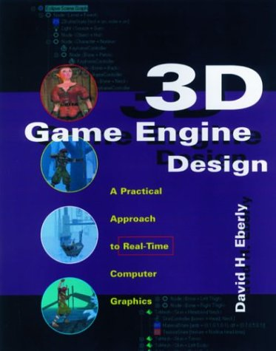
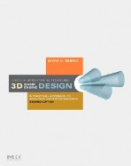
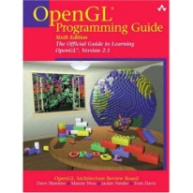
Textbook
and Recommended References
Required Textbook
Eberly, D. H. (2006). 3D Game Engine Design: A Practical Approach to Real-Time Computer Graphics, second edition. San Francisco, CA: Morgan Kauffman.
Recommended References
Angel, E. O. (2007). OpenGL: A Primer, third edition. Reading, MA: Addison-Wesley. [2nd edition on reserve]
Shreiner, D., Woo, M., Neider, J., & Davis, T. (2009). OpenGL® Programming Guide: The Official Guide to Learning OpenGL®, Versions 3.0 and 3.1, seventh edition.
[“The Red Book”: use 7th ed. or later]
1st edition (outdated)
2nd edition
2nd edition (OK to use)
3rd edition

Slide 6
Background Expected
Both Courses
Proficiency in C/C++ or strong proficiency in Java and ability to learn
Strongly recommended: matrix theory or linear algebra (e.g., Math 551)
At least 120 hours for semester (up to 150 depending on term project)
Textbook: 3D Game Engine Design, Second Edition (2006), Eberly
Angel’s OpenGL: A Primer recommended
CIS 636 Introduction to Computer Graphics
Fresh background in precalculus: Algebra 1-2, Analytic Geometry
Linear algebra basics: matrices, linear bases, vector spaces
Watch background lectures
CIS 736 Computer Graphics
Recommended: first course in graphics (background lectures as needed)
OpenGL experience helps
Read up on shaders and shading languages
Watch advanced topics lectures; see list before choosing project topic

Slide 7
Online Recorded Lectures
for CIS 536/636 (Intro to CG)
Project Topics for CIS 536/636
Computer Graphics Basics (10)
1. Mathematical Foundations – Week 1 - 2
2. OpenGL Primer 1 of 3: Basic Primitives and 3-D – Weeks 2-3
3. Detailed Introduction to Projections and 3-D Viewing – Week 3
4. Fixed-Function Graphics Pipeline – Weeks 3-4
5. Rasterizing (Lines, Polygons, Circles, Ellipses) and Clipping – Week 4
6. Lighting and Shading – Week 5
7. OpenGL Primer 2 of 3: Boundaries (Meshes), Transformations – Weeks 5-6
8. Texture Mapping – Week 6
9. OpenGL Primer 3 of 3: Shading and Texturing, VBOs – Weeks 6-7
10. Visible Surface Determination – Week 8
Recommended Background Reading for CIS 636
Shared Lectures with CIS 736 (Computer Graphics)
Regular in-class lectures (30) and labs (7)
Guidelines for paper reviews – Week 6
Preparing term project presentations, CG demos – Weeks 11-12

Slide 8
Online Recorded Lectures
for CIS 736 (Computer Graphics)
Project Topics for CIS 736
Advanced Topics in Computer Graphics (10)
1. Filters for Texturing – Week 2
2. Level-of-Detail Algorithms and Terrain – Week 3
3. More Mappings – Week 6
4. More on Animation – Week 8
5. Character Modeling and IK – Week 9
6. Global Illumination: Photon Maps (Radiosity) – Week 10
7. Advanced Lighting Models – Week 11
8. Advanced Ray-Tracing – Week 12
9. More on Scientific, Data, Info Visualization – Week 13
10. Fractals and L-Systems – Week 14
Recommended Background Reading for CIS 736
Shared Lectures with CIS 536/636 (Introduction to Computer Graphics)
Regular in-class lectures (30) and labs (7)
Guidelines for paper reviews – Week 6
Preparing term project presentations, CG demos – Weeks 11-12

Slide 9
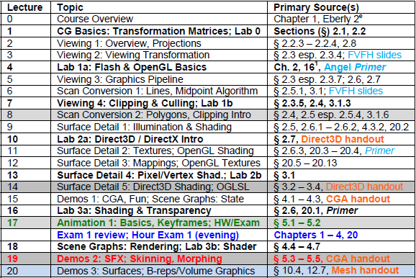
Syllabus [1]:
First Half of Course

Slide 10
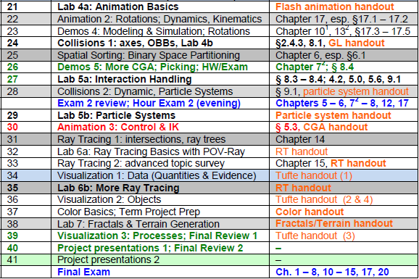
Syllabus [2]:
Second Half of Course

Slide 11
Math Review for CIS 536 / 636
Overview: First Month (Weeks 2-5 of Course)
Review of mathematical foundations of CG: analytic geometry, linear algebra
Line and polygon rendering
Matrix transformations
Graphical interfaces
Line and Polygon Rendering (Week 3)
Basic line drawing and 2-D clipping
Bresenham’s algorithm
Follow-up: 3-D clipping, z-buffering (painter’s algorithm)
Matrix Transformations (Week 4)
Application of linear transformations to rendering
Basic operations: translation, rotation, scaling, shearing
Follow-up: review of standard graphics libraries (starting with OpenGL)
Weeks 5 – 6: More OpenGL and Direct3D
Graphical Interfaces
Brief overview
Survey of windowing environments (SDL in OpenGL, DirectX)

Slide 12
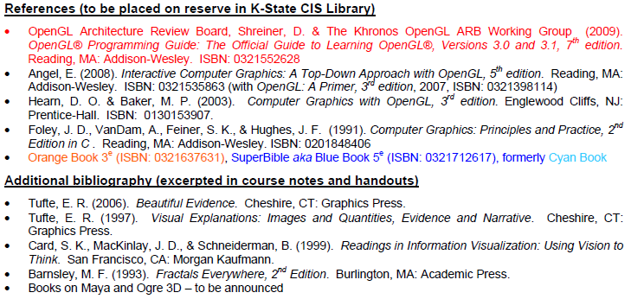
References and Outside Reading
OpenGL Tutorials (GameDev aka Nehe): http://nehe.gamedev.net
Andy vanDam’s Lectures @ Brown: http://bit.ly/cWUxBz

