Slide 1
Lecture 0 of 41:
Part B – Course Content
Advanced Computer Graphics:
Course Organization and Survey
William H. Hsu
Department of Computing and Information Sciences, KSU
KSOL course page:
Course web site: http://www.kddresearch.org/Courses/CIS736
Instructor home page: http://www.cis.ksu.edu/~bhsu
Reading for Next Class:
Syllabus and Introductory Handouts
CIS 736 students: Advanced CG Topics 1 slides
Chapter 1, Eberly (2006) 3D Game Engine Design, 2e

Slide 2
Course Overview
Graphics Systems and Techniques
  Main emphasis: shaders, lighting, mappings (textures, etc.) in OpenGL
  Photorealistic rendering and animation (Maya 2011, Blender; Ogre3D)
  2-D, 3-D models: curves, surfaces, visible surface identification, illumination
  Special topics: global illumination (ray tracing, radiosity), particle systems, fractals, scientific visualization (sciviz) and information visualization (infoviz)
Operations
  Surface modeling, mapping
  Pipelines for display, transformation, illumination, animation
Computer Graphics (CG): Duality with Computer Vision
Visualization and User Interfaces
Applications
  CAD/CAM/CAE: object transformations, surface/solid modeling, animation
  Entertainment: 3-D games, photorealistic animation, etc.
  Analysis: info visualization, decision support, intelligent displays

Slide 3
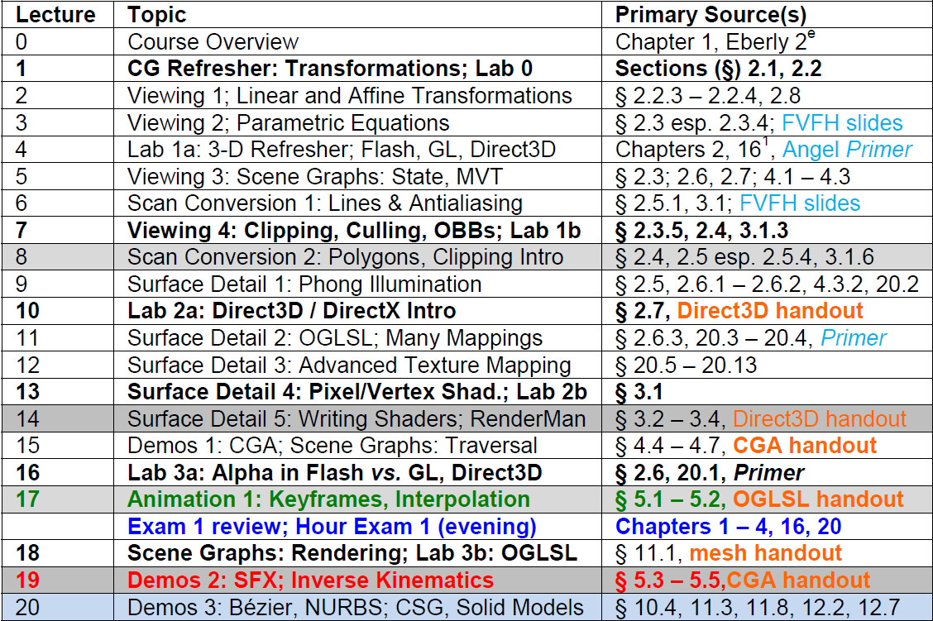

Advanced CG Syllabus,
Part 1 of 2

Slide 4
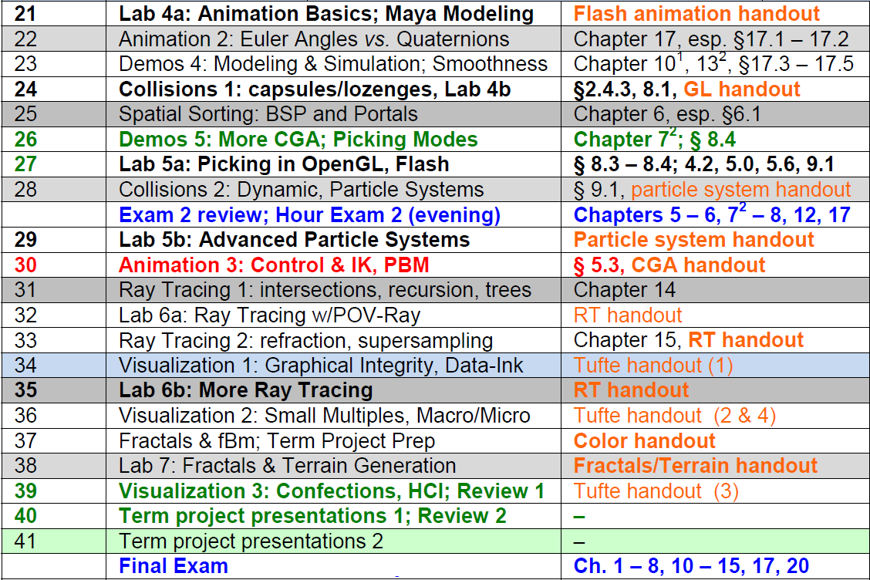
Advanced CG Syllabus,
Part 2 of 2

Slide 5
Online Recorded Lectures
for CIS 736 (Computer Graphics)
Project Topics for CIS 736
Advanced Topics in Computer Graphics (10)
  1. Filters for Texturing – Week 2
  2. Level-of-Detail Algorithms and Terrain – Week 3
  3. More Mappings – Week 6
  4. More on Animation – Week 8
  5. Character Modeling and IK – Week 9
  6. Global Illumination: Photon Maps (Radiosity) – Week 10
  7. Advanced Lighting Models – Week 11
  8. Advanced Ray-Tracing – Week 12
  9. More on Scientific, Data, Info Visualization – Week 13
  10. Fractals and L-Systems – Week 14
Recommended Background Reading for CIS 736
Shared Lectures with CIS 536/636 (Introduction to Computer Graphics)
  Regular in-class lectures (30) and labs (7)
  Guidelines for paper reviews – Week 6
  Preparing term project presentations, CG demos – Weeks 11-12

Slide 6
Why Computer Graphics?
Developing Computational Capability
  Rendering: synthesizing realistic-looking, useful, or interesting images
  Animation: creating visual impression of motion
  Image processing: analyzing, transforming, displaying images efficiently
Better Understanding of Data, Objects, Processes through Visualization
  Visual summarization, description, manipulation
  Virtual environments (VR), visual monitoring, interactivity
  Human-computer intelligent interaction (HCII): training, tutoring, analysis, control systems
Time is Right
  Recent progress in algorithms and theory
  Rapidly emergence of new I/O (display and data acquisition) technologies
  Available computational power, improving price-performance-ratio of hardware
  Growth and interest of graphics industries (e.g., games, entertainment, computer-aided design, visualization in science and business)

Slide 7

Rendering (Image Synthesis)
Pipeline
Graphics
Database
Editing
Front-End
(Geometry Processing)
Graphics
Database
Back-End
(Rasterization)
Display
Traversal
Modeling
Transformation
Viewing
Operation
Visible-Surface
Determination
Scan Conversion
Shading /
Illumination
Image
“Polygons-to-Pixels” Pipeline

Slide 8
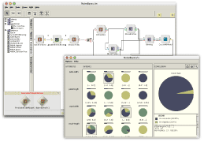
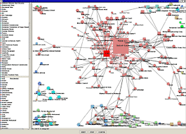
User Interfaces
& Hypermedia
NCSA SEASR/MEANDRE (2008 – present): http://seasr.org
Visual programming systems for high-performance knowledge discovery in databases (KDD), cloud computing, and more
D2K © 1999-2004 National Center for Supercomputing Applications
http://alg.ncsa.uiuc.edu/do/tools/d2k
Hypermedia & Web 2.0
  Web 2.0: SLATES (search, links, authoring, tags, extensions, signals)
  Database format (similar to hypertext): internetworked multimedia
  Display-based access to text, image, audio, video, etc.
Virtual Environments
  Immersion: interactive training, tutoring systems
  Entertainment hypermedia
Graphical User Interfaces (GUIs)
  Visualization: scientific, data/information, statistics
  GUIs: Computer-Aided Design/Engineering (CAD/CAE/CAM/CASE), etc.

Slide 9
Relevant Topic Areas
Analytic Geometry
Art and Graphic Design
Cognitive Science
Computer Engineering
Engineering Design
Education
Film
Human Factors
Linear Algebra
Numerical Analysis
Rendering Hardware
VR Systems
Portable/Embedded CG
CAD
CAE / CASE
CAM
Immersive Training
Tutoring Interfaces
Color/Optical Models
CG/Vision Duality
Interface Design
Computer
Graphics
(CG)
Layout
CG Design
Visualization
Parametric Equations
Conics
Polygon Rendering
Surface Modeling
Physically-Based Modeling
Stat/Info Visualization
Transformations
Change of Coordinate Systems
User Modeling
Ergonomic Interfaces, I/O
Animation
Large-Scale CG

Slide 10
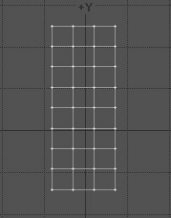

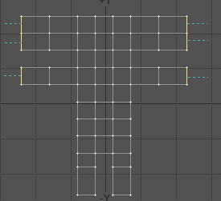
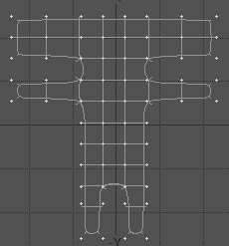
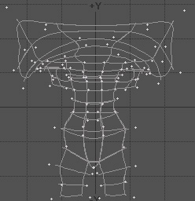
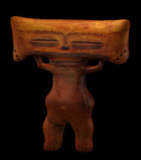
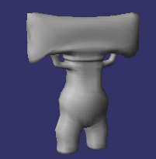
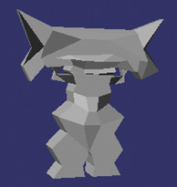
Shading Pipeline & Surface Modeling (Boundary Representations)
1
http://bit.ly/aagZJn
2
3
4
5
8
7
6

Slide 11



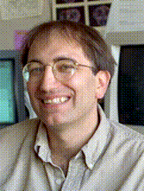

Special Topics:
Multitexturing & Mappings
Stefan Jeschke
Research Assistant
http://bit.ly/hUUM94
Eduard Gröller
Associate Professor
Director, Visualization Working Group
http://bit.ly/hUUM94
Institute of Computer Graphics and Algorithms
Technical University of Vienna
Texturing material from slides © 2002 E. Gröller & S. Jeschke, Vienna University of Technology
http://bit.ly/dJFYq9
Pat Hanrahan
CANON USA Professor
Director, Computer Graphics Laboratory
Computer Science and Electrical Engineering Departments
Stanford University
http://graphics.stanford.edu/~hanrahan/
Mapping material from slides © 1995 – 2009 P. Hanrahan, Stanford University
http://bit.ly/hZfsjZ (CS 348B, Computer Graphics: Image Synthesis Techniques)

Slide 12








Computer-Generated Animation (CGA)
Monsters Inc. (2001)
Monsters Inc. 2 (2012)
© Disney/Pixar
Tron: Legacy
© 2010
Walt Disney Pictures
Toy Story (1995)
Toy Story 2 (1999)
Toy Story 3 (2010)
© Disney/Pixar
Kung-Fu Panda
© 2008 DreamWorks
Animation SKG
Wall-E
© 2008 Disney/Pixar
Happy Feet
© 2006
Warner Brothers
Shrek (2001)
Shrek 2 (2004)
Shrek the Third (2007)
Shrek Forever After (2010)
© DreamWorks Animation SKG
Luxo Jr.
© 1986 Pixar Animation Studios

Slide 13




Special Topics:
Computer-Generated Animation (CGA)
Jason Lawrence
Assistant Professor
Department of Computer Science
University of Virginia
http://www.cs.virginia.edu/~jdl/
Acknowledgment: slides by Misha Kazhdan, Allison Klein, Tom Funkhouser, Adam Finkelstein and David Dobkin
http://bit.ly/eB1Oj4
Thomas A. Funkhouser
Professor
Department of Computer Science
Computer Graphics Group
Princeton University
http://www.cs.princeton.edu/~funk/

Slide 14
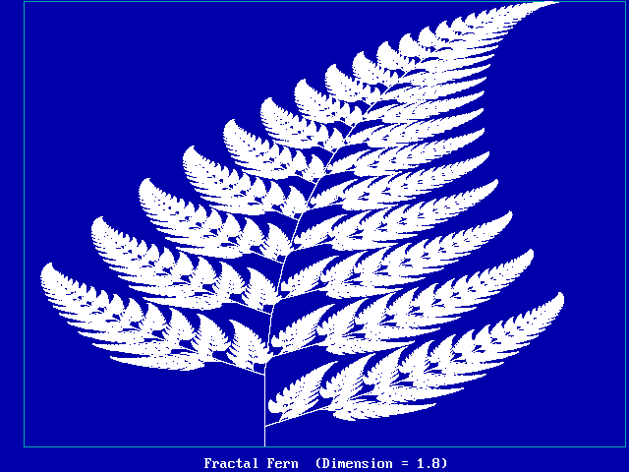
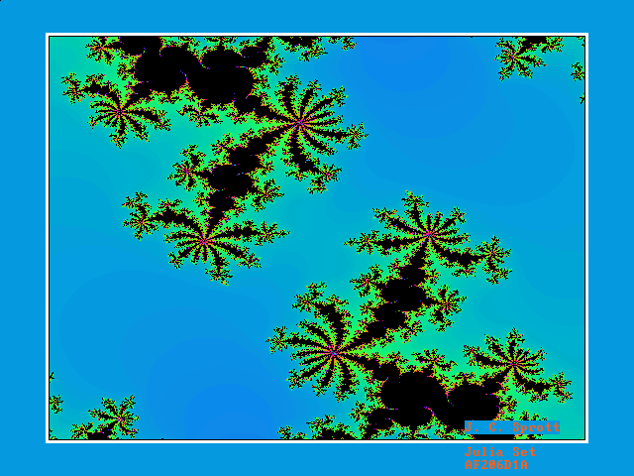
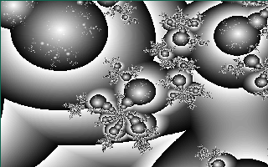
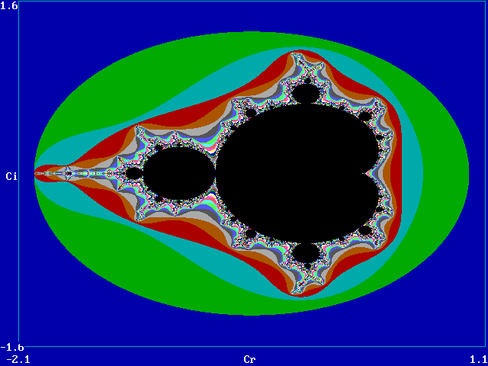
Fractals :
Iterated Function Systems (IFSs)
Fractal of the Day: http://sprott.physics.wisc.edu/fractals.htm

Slide 15
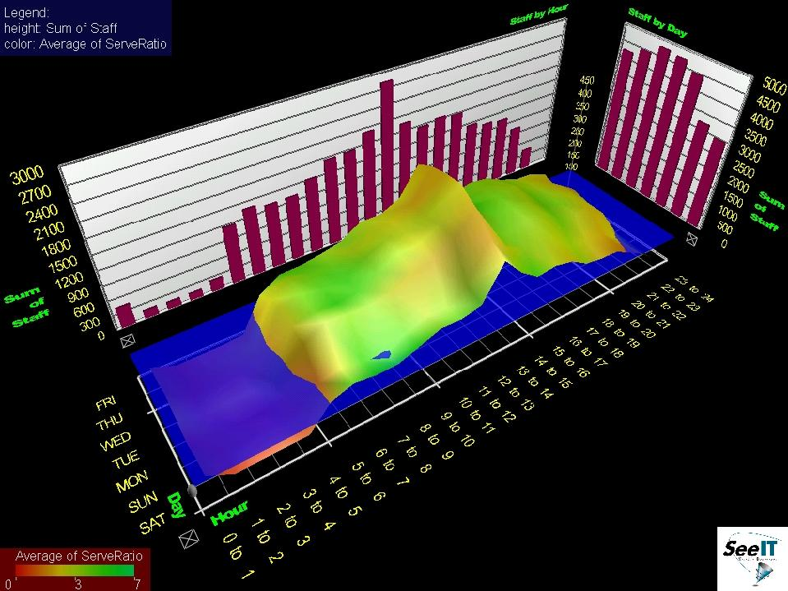
Information Visualization
Visible Decisions SeeIT © 1999 VDI http://www.advizorsolutions.com

Slide 16
Design Choices & Issues
In Computer Graphics
Determine Objectives of
Graphics System
Entertainment
Decision
Support
Education
Control
Interface
Determine
Display Objective
Interactively
Analyze
Data / Documents
Visualize Physical
Objects
Monitor
Process
Determine Representations
In Graphics Database
Solid Geometric
Model
Wireframe /
Polygon Mesh
NURBS
Fractal
System
Determine and Implement
Rendering Pipeline
Shaded-Polygon
Rendering
Ray Tracing
Radiosity and
Polygon Shading
Completed Design

Slide 17
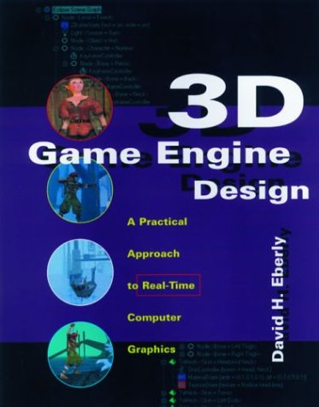
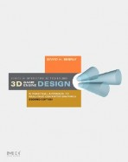



Textbook
and Recommended References
Required Textbook
Eberly, D. H. (2006). 3D Game Engine Design: A Practical Approach to Real-Time Computer Graphics, second edition. San Francisco, CA: Morgan Kauffman.
Recommended References
Angel, E. O. (2007). OpenGL: A Primer, third edition. Reading, MA: Addison-Wesley. [2nd edition on reserve]
Shreiner, D., Woo, M., Neider, J., & Davis, T. (2009). OpenGL® Programming Guide: The Official Guide to Learning OpenGL®, Versions 3.0 and 3.1, seventh edition.
[“The Red Book”: use 7th ed. or later]
1st edition (outdated)
2nd edition
2nd edition (OK to use)
3rd edition

Slide 18

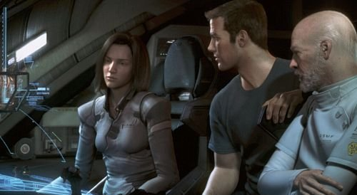
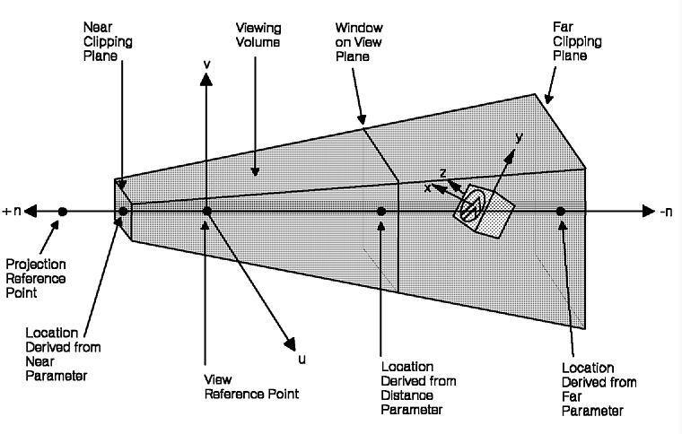
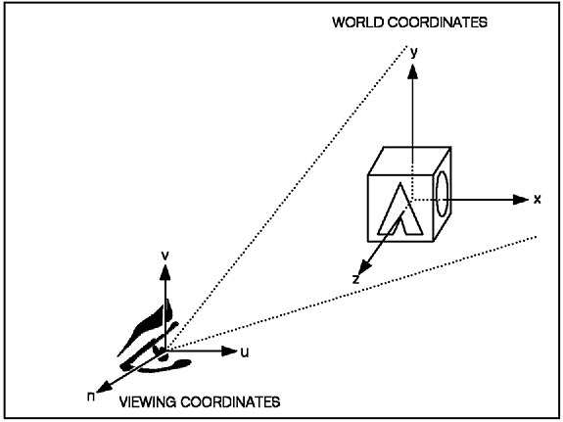
Next Class
Photorealism
3-D Camera Model
http://realismstudio.com
Final Fantasy: The Spirits Within
© 2001 Square Enix Studios http://bit.ly/9YzCZy
Canonical View
(x, y, z)
Arbitrary View
(u, v, n)
The GraPHIGS Programming Interface:
Understanding Concepts
© 2007 IBM
http://bit.ly/cS4h7g

Slide 19
Summary
This course is a lot of work
  Reading: Eberly 2e – big book, like Foley et al.
  Programming assignments (4): expect to spend 10+ hours on each
  Written assignments (4): about 6-10 hours
  Term project: at least 30 hours (people have spent up to 60 or more)
… but it can also be fun
  Visible results
  Nifty algorithms, high-performance hardware
  “Putting it all together”: very interdisciplinary field
  Decent job market for people with right development skills, ideas
  Applicable to many other areas of CS and IT
Emphasis
  “Polygons to pixels pipeline”: viewing, VSD, lighting, shading, texturing
  Other topics to be covered: animation, curves and surfaces, collisions
  Brief survey of: ray tracing, visualization and color, fractals
Tutorials (GameDev aka Nehe): http://nehe.gamedev.net

Slide 20
Terminology
Computer Graphics: Digital Synthesis, Manipulation of Visual Content
Graphics Problems (see “Computer Graphics”, Wikipedia)
  Geometry: representation and processing of surfaces
  Animation: representation and manipulation of motion
  Rendering: computationally reproducing appearance of light in scenes
  Imaging: image acquisition, editing, processing
Different Approaches to Graphics
  Raster (bitmaps, picture elements aka pixels) vs. vector (lines)
  Sample-based (cf. Photoshop) vs. geometry-based (cf. OpenGL, Direct3D)
Purpose of Graphics
  Entertainment – games, visual effects in movies and television
  Communications – advertising, journalism
  Modeling / simulation – displaying objects, events via graphical user interfaces (GUIs)
  Visualization – displaying events for analysis and understanding
Dual Problem: Inverse Input and Output
  Graphics (rendering): geometry to sample (image)
  Vision: sample to geometry

