Slide 1
Lecture 0 of 41:
Part B – Course Content
Introduction to Computer Graphics:
Course Organization and Survey
William H. Hsu
Department of Computing and Information Sciences, KSU
KSOL course page: http://bit.ly/hGvXlH
Course web site: http://www.kddresearch.org/Courses/CIS636
Instructor home page: http://www.cis.ksu.edu/~bhsu
Reading for Next Class:
Syllabus and Introductory Handouts
CIS 536 & 636 students: CG Basics 1 slides
Chapter 1, Eberly (2006) 3D Game Engine Design, 2e

Slide 2
Course Overview
Graphics Systems and Techniques
  Main emphasis: shaders, lighting, mappings (textures, etc.) in OpenGL
  Photorealistic rendering and animation (Maya 2010, Blender; Ogre3D)
  2-D, 3-D models: curves, surfaces, visible surface identification, illumination
  Special topics: global illumination (ray tracing, radiosity), particle systems, fractals, scientific visualization (sciviz) and information visualization (infoviz)
Operations
  Surface modeling, mapping
  Pipelines for display, transformation, illumination, animation
Computer Graphics (CG): Duality with Computer Vision
Visualization and User Interfaces
Applications
  CAD/CAM/CAE: object transformations, surface/solid modeling, animation
  Entertainment: 3-D games, photorealistic animation, etc.
  Analysis: info visualization, decision support, intelligent displays

Slide 3
Why Computer Graphics?
Developing Computational Capability
  Rendering: synthesizing realistic-looking, useful, or interesting images
  Animation: creating visual impression of motion
  Image processing: analyzing, transforming, displaying images efficiently
Better Understanding of Data, Objects, Processes through Visualization
  Visual summarization, description, manipulation
  Virtual environments (VR), visual monitoring, interactivity
  Human-computer intelligent interaction (HCII): training, tutoring, analysis, control systems
Time is Right
  Recent progress in algorithms and theory
  Rapidly emergence of new I/O (display and data acquisition) technologies
  Available computational power, improving price-performance-ratio of hardware
  Growth and interest of graphics industries (e.g., games, entertainment, computer-aided design, visualization in science and business)

Slide 4

Rendering (Image Synthesis)
Pipeline
Graphics
Database
Editing
Front-End
(Geometry Processing)
Graphics
Database
Back-End
(Rasterization)
Display
Traversal
Modeling
Transformation
Viewing
Operation
Visible-Surface
Determination
Scan Conversion
Shading /
Illumination
Image
“Polygons-to-Pixels” Pipeline

Slide 5
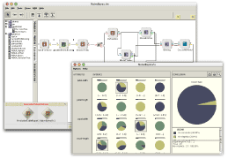
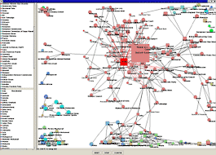
User Interfaces
& Hypermedia
NCSA SEASR/MEANDRE (2008 – present): http://seasr.org
Visual programming systems for high-performance knowledge discovery in databases (KDD), cloud computing, and more
D2K © 1999-2004 National Center for Supercomputing Applications
http://alg.ncsa.uiuc.edu/do/tools/d2k
Hypermedia & Web 2.0
  Web 2.0: SLATES (search, links, authoring, tags, extensions, signals)
  Database format (similar to hypertext): internetworked multimedia
  Display-based access to text, image, audio, video, etc.
Virtual Environments
  Immersion: interactive training, tutoring systems
  Entertainment hypermedia
Graphical User Interfaces (GUIs)
  Visualization: scientific, data/information, statistics
  GUIs: Computer-Aided Design/Engineering (CAD/CAE/CAM/CASE), etc.

Slide 6
Relevant Topic Areas
Analytic Geometry
Art and Graphic Design
Cognitive Science
Computer Engineering
Engineering Design
Education
Film
Human Factors
Linear Algebra
Numerical Analysis
Rendering Hardware
VR Systems
Portable/Embedded CG
CAD
CAE / CASE
CAM
Immersive Training
Tutoring Interfaces
Color/Optical Models
CG/Vision Duality
Interface Design
Computer
Graphics
(CG)
Layout
CG Design
Visualization
Parametric Equations
Conics
Polygon Rendering
Surface Modeling
Physically-Based Modeling
Stat/Info Visualization
Transformations
Change of Coordinate Systems
User Modeling
Ergonomic Interfaces, I/O
Animation
Large-Scale CG

Slide 7
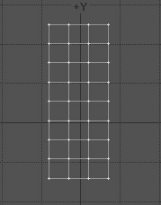

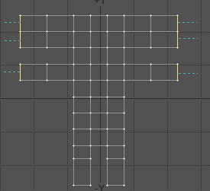
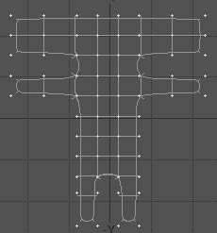
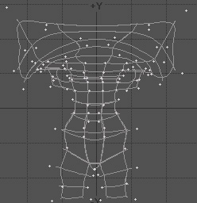
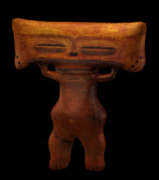
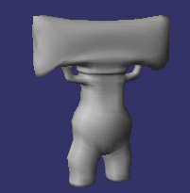
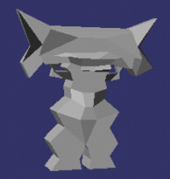
Shading Pipeline & Surface Modeling (Boundary Representations)
1
http://bit.ly/aagZJn
2
3
4
5
8
7
6

Slide 8








Computer-Generated Animation (CGA)
Monsters Inc. (2001)
Monsters Inc. 2 (2012)
© Disney/Pixar
Tron: Legacy
© 2010
Walt Disney Pictures
Toy Story (1995)
Toy Story 2 (1999)
Toy Story 3 (2010)
© Disney/Pixar
Kung-Fu Panda
© 2008 DreamWorks
Animation SKG
Wall-E
© 2008 Disney/Pixar
Happy Feet
© 2006
Warner Brothers
Shrek (2001)
Shrek 2 (2004)
Shrek the Third (2007)
Shrek Forever After (2010)
© DreamWorks Animation SKG
Luxo Jr.
© 1986 Pixar Animation Studios

Slide 9
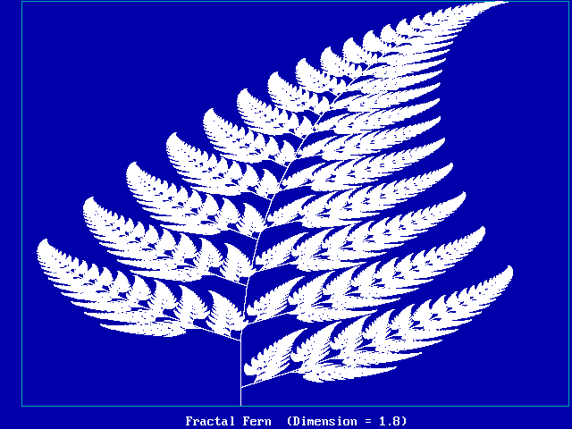
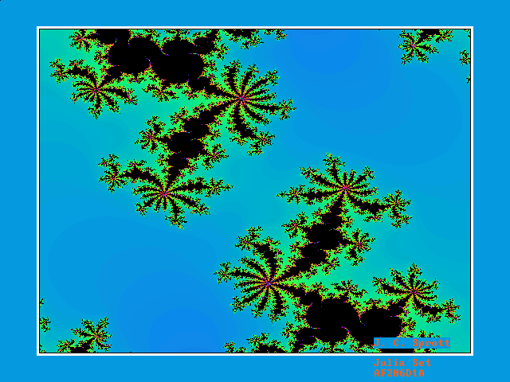
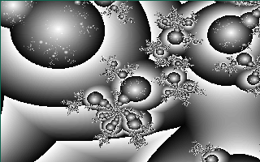
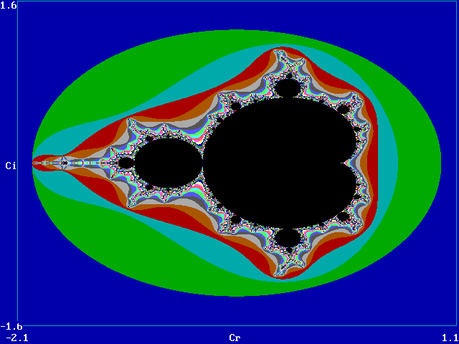
Fractals :
Iterated Function Systems (IFSs)
Fractal of the Day: http://sprott.physics.wisc.edu/fractals.htm

Slide 10
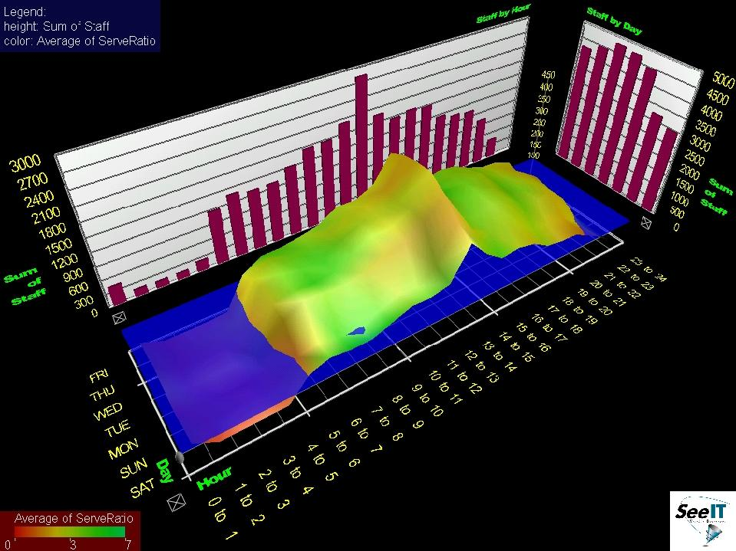
Information Visualization
Visible Decisions SeeIT © 1999 VDI http://www.advizorsolutions.com

Slide 11
Design Choices & Issues
In Computer Graphics
Determine Objectives of
Graphics System
Entertainment
Decision
Support
Education
Control
Interface
Determine
Display Objective
Interactively
Analyze
Data / Documents
Visualize Physical
Objects
Monitor
Process
Determine Representations
In Graphics Database
Solid Geometric
Model
Wireframe /
Polygon Mesh
NURBS
Fractal
System
Determine and Implement
Rendering Pipeline
Shaded-Polygon
Rendering
Ray Tracing
Radiosity and
Polygon Shading
Completed Design

Slide 12
Math Review for CIS 536 / 636
Overview: First Month (Weeks 2-5 of Course)
  Review of mathematical foundations of CG: analytic geometry, linear algebra
  Line and polygon rendering
  Matrix transformations
  Graphical interfaces
Line and Polygon Rendering (Week 3)
  Basic line drawing and 2-D clipping
  Bresenham’s algorithm
  Follow-up: 3-D clipping, z-buffering (painter’s algorithm)
Matrix Transformations (Week 4)
  Application of linear transformations to rendering
  Basic operations: translation, rotation, scaling, shearing
  Follow-up: review of standard graphics libraries (starting with OpenGL)
Weeks 5 – 6: More OpenGL and Direct3D
Graphical Interfaces
  Brief overview
  Survey of windowing environments (SDL in OpenGL, DirectX)

Slide 13
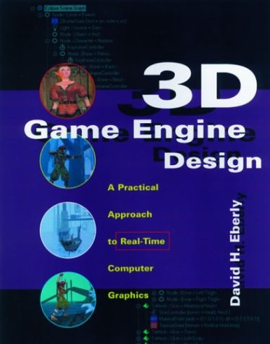
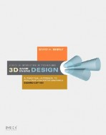



Textbook
and Recommended References
Required Textbook
Eberly, D. H. (2006). 3D Game Engine Design: A Practical Approach to Real-Time Computer Graphics, second edition. San Francisco, CA: Morgan Kauffman.
Recommended References
Angel, E. O. (2007). OpenGL: A Primer, third edition. Reading, MA: Addison-Wesley. [2nd edition on reserve]
Shreiner, D., Woo, M., Neider, J., & Davis, T. (2009). OpenGL® Programming Guide: The Official Guide to Learning OpenGL®, Versions 3.0 and 3.1, seventh edition.
[“The Red Book”: use 7th ed. or later]
1st edition (outdated)
2nd edition
2nd edition (OK to use)
3rd edition

Slide 14

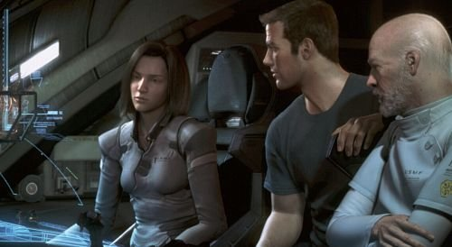
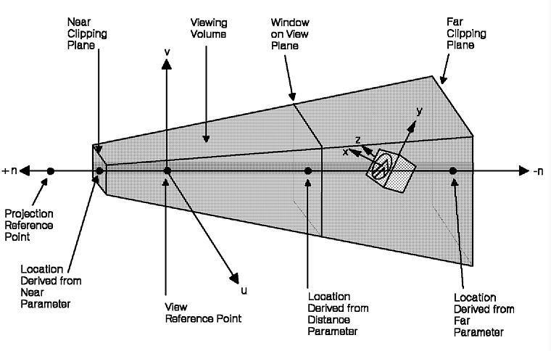
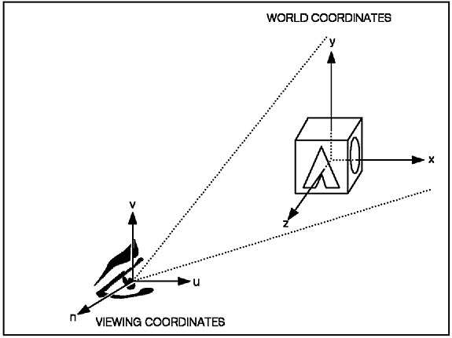
Next Class
Photorealism
3-D Camera Model
http://realismstudio.com
Final Fantasy: The Spirits Within
© 2001 Square Enix Studios http://bit.ly/9YzCZy
Canonical View
(x, y, z)
Arbitrary View
(u, v, n)
The GraPHIGS Programming Interface:
Understanding Concepts
© 2007 IBM
http://bit.ly/cS4h7g

Slide 15
Summary
This course is a lot of work
  Reading: Eberly 2e – big book, like Foley et al.
  Programming assignments (4): expect to spend 10+ hours on each
  Written assignments (4): about 6-10 hours
  Term project: at least 20 hours (people have spent up to 50 or more)
… but it can also be fun
  Visible results
  Nifty algorithms, high-performance hardware
  “Putting it all together”: very interdisciplinary field
  Decent job market for people with right development skills, ideas
  Applicable to many other areas of CS and IT
Emphasis
  “Polygons to pixels pipeline”: viewing, VSD, lighting, shading, texturing
  Other topics to be covered: animation, curves and surfaces, collisions
  Brief survey of: ray tracing, visualization and color, fractals
Tutorials (GameDev aka Nehe): http://nehe.gamedev.net

Slide 16
Terminology
Computer Graphics: Digital Synthesis, Manipulation of Visual Content
Graphics Problems (see “Computer Graphics”, Wikipedia)
  Geometry: representation and processing of surfaces
  Animation: representation and manipulation of motion
  Rendering: computationally reproducing appearance of light in scenes
  Imaging: image acquisition, editing, processing
Different Approaches to Graphics
  Raster (bitmaps, picture elements aka pixels) vs. vector (lines)
  Sample-based (cf. Photoshop) vs. geometry-based (cf. OpenGL, Direct3D)
Purpose of Graphics
  Entertainment – games, visual effects in movies and television
  Communications – advertising, journalism
  Modeling / simulation – displaying objects, events via graphical user interfaces (GUIs)
  Visualization – displaying events for analysis and understanding
Dual Problem: Inverse Input and Output
  Graphics (rendering): geometry to sample (image)
  Vision: sample to geometry

