Slide 1
Lecture 2 of 41
Viewing 1 of 4:
Overview, Projections
William H. Hsu
Department of Computing and Information Sciences, KSU
KSOL course pages: http://bit.ly/hGvXlH / http://bit.ly/eVizrE
Public mirror web site: http://www.kddresearch.org/Courses/CIS636
Instructor home page: http://www.cis.ksu.edu/~bhsu
Readings:
Today: Sections 2.2.3 – 2.2.4, 2.8, Eberly 2e – see http://bit.ly/ieUq45
Next class: Section 2.3 (esp. 2.3.4), FVFH slides
Appendices 1-4, Foley, J. D., VanDam, A., Feiner, S. K., & Hughes, J. F. (1991). Computer Graphics, Principles and Practice, Second Edition in C.

Slide 2
Lecture Outline
Reading for Last Class: Sections 2.1, 2.2.1 – 2.2.2, Eberly 2e
Reading for Today: Sections 2.2.3 – 2.2.4, 2.8 Eberly 2e
Reading for Next Class: Section 2.3 (esp. 2.3.4), Foley et al. Slides
Last Time: Math Foundations, Matrix Transformations
Precalculus review: parametric equations of lines
Vector spaces and affine spaces
Linear systems, linear independence, bases, orthonormality
Cumulative Transformation Matrices (CTMs)
Translation
Rotation
Scaling
Today: Basic Viewing Principles
Projections: definitions, history
Perspective: optical principles, terminology
Next Class: Viewing and Normalizing Transformations (VT/NT)

Slide 3
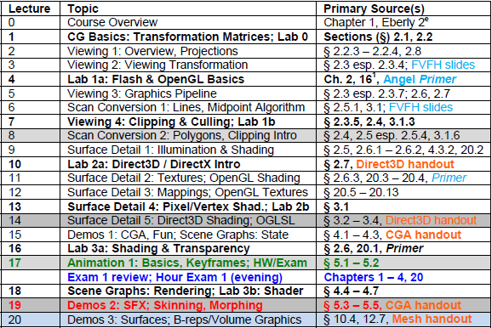
Where We Are

Slide 4
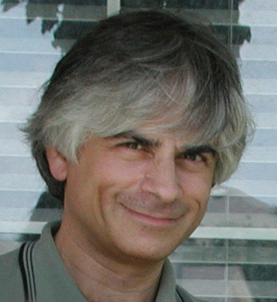
Acknowledgements
Jim Foley
Professor, College of Computing & Stephen Fleming Chair in Telecommunications
Georgia Institute of Technology
James D. Foley
Georgia Tech
http://bit.ly/ajYf2Q
Andries van Dam
Brown University
http://www.cs.brown.edu/~avd/
Steven K. Feiner
Columbia University
http://www.cs.columbia.edu/~feiner/
John F. Hughes
Brown University
http://www.cs.brown.edu/~jfh/
Andy van Dam
T. J. Watson University Professor of Technology and Education & Professor of Computer Science
Brown University
Steve Feiner
Professor of Computer Science & Director, Computer Graphics and User Interfaces Laboratory
Columbia University
John F. Hughes
Associate Professor of Computer Science
Brown University

Slide 5
Background:
Basic Linear Algebra for CG
Reference: Appendix A.1 – A.4, Foley et al
A.1 Vector Spaces and Affine Spaces
Equations of lines, planes
Vector subspaces and affine subspaces
A.2 Standard Constructions in Vector Spaces
Linear independence and spans
Coordinate systems and bases
A.3 Dot Products and Distances
Dot product in R^{n}
Norms in R^{n}
A.4 Matrices
Binary matrix operations: basic arithmetic
Unary matrix operations: transpose and inverse
Application: Transformations and Change of Coordinate Systems
Affine transformations
© 2005 Trevor McCauley
(Senocular)

Slide 6
Review:
Basic T, R, S Transformations
T: Translation (see http://en.wikipedia.org/wiki/Translation_matrix)
Given
Point to be moved – e.g., vertex of polygon or polyhedron
Displacement vector (also represented as point)
Return: new, displaced (translated) point of rigid body
R: Rotation (see http://en.wikipedia.org/wiki/Rotation_matrix)
Given
Point to be rotated about axis
Axis of rotation
Degrees to be rotated
Return: new, displaced (rotated) point of rigid body
S: Scaling (see http://en.wikipedia.org/wiki/Scaling_matrix)
Given
Set of points centered at origin
Scaling factor
Return: new, displaced (scaled) point
General: http://en.wikipedia.org/wiki/Transformation_matrix

Slide 7
Review:
Lab 0
Warm-Up Lab
Account set-up
Linux environment
Simple OpenGL exercise
Basic Account Set-Up
See http://support.cis.ksu.edu to understand KSU Department of CIS setup
Make sure your CIS department account is set up
If not, use SelfServ: https://selfserv.cis.ksu.edu/selfserv/requestAccount
Linux Environment
Make sure your CIS department account is set up
Learn how to navigate, set your shell (see KSOL, http://unixhelp.ed.ac.uk)
Lab 1 and first homeworks will ask you to render to local XWindows server
Simple OpenGL exercise
Watch OpenGL Primer Part 1 as needed
Follow intro tutorials on “NeHe” (http://nehe.gamedev.net) as instructed
Turn in: source code, screenshot as instructed in Lab 0 handout

Slide 8
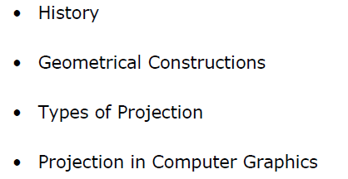
Projections From 3-D to 2-D:
Orthographic & Perspective
Adapted from slides © 1997 – 2010 van Dam et al., Brown University
http://bit.ly/hiSt0f Reused with permission.

Slide 9
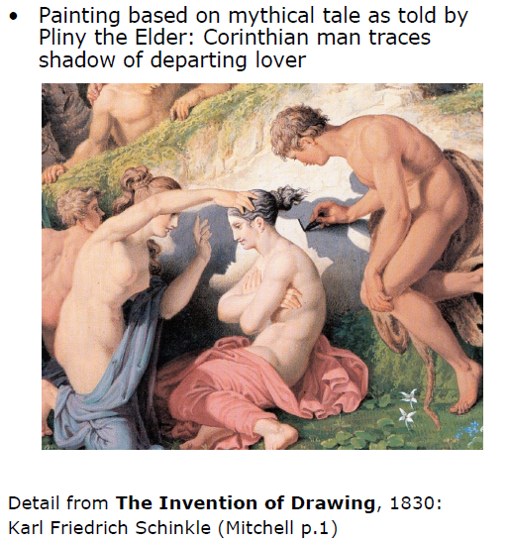
Drawing as Projection
Adapted from slides © 1997 – 2010 van Dam et al., Brown University
http://bit.ly/hiSt0f Reused with permission.

Slide 10
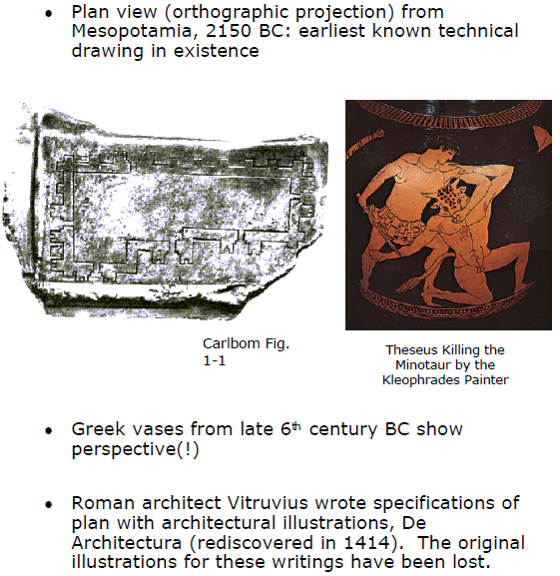
Early Examples of Perspective
Adapted from slides © 1997 – 2010 van Dam et al., Brown University
http://bit.ly/hiSt0f Reused with permission.

Slide 11
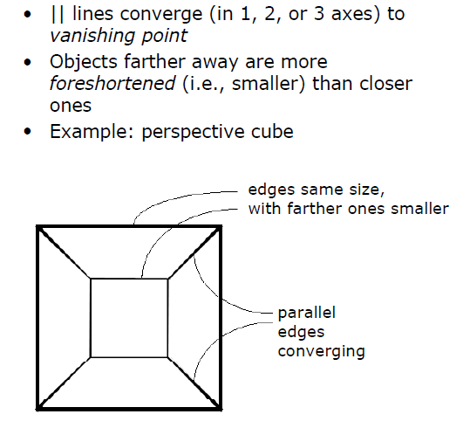
Key Features of Linear Perspective
Adapted from slides © 1997 – 2010 van Dam et al., Brown University
http://bit.ly/hiSt0f Reused with permission.

Slide 12
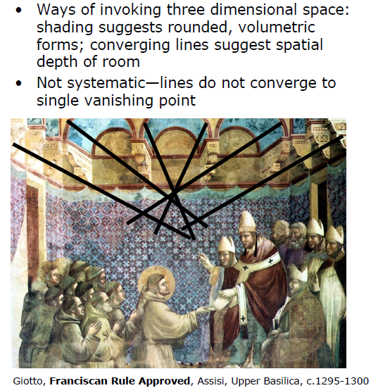
Early Perspective: Ad Hoc
Adapted from slides © 1997 – 2010 van Dam et al., Brown University
http://bit.ly/hiSt0f Reused with permission.

Slide 13
Historical Setting for
Invention of Perspective
Adapted from slides © 1997 – 2010 van Dam et al., Brown University
http://bit.ly/hiSt0f Reused with permission.

Slide 14
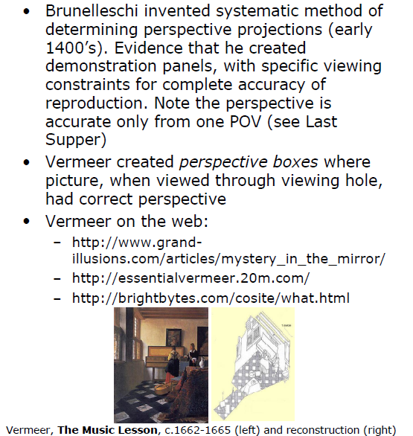
Brunelleschi and Vermeer
Adapted from slides © 1997 – 2010 van Dam et al., Brown University
http://bit.ly/hiSt0f Reused with permission.

Slide 15
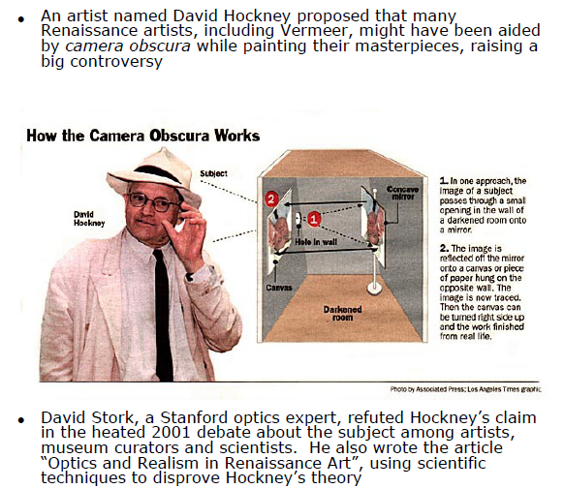
Stork vs. Hockney
Adapted from slides © 1997 – 2010 van Dam et al., Brown University
http://bit.ly/hiSt0f Reused with permission.

Slide 16
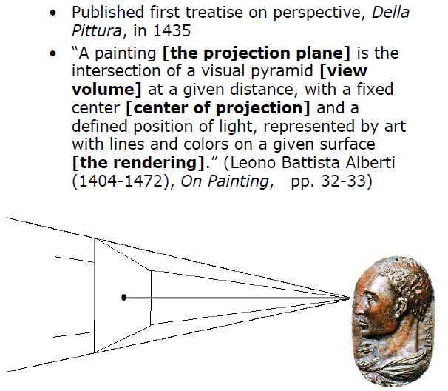
Alberti
Adapted from slides © 1997 – 2010 van Dam et al., Brown University
http://bit.ly/hiSt0f Reused with permission.

Slide 17
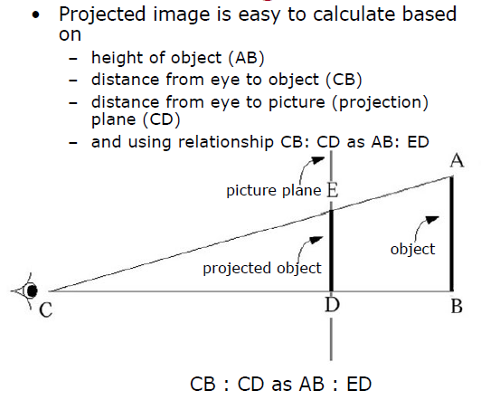
Visual Pyramid and
Similar Triangles [1]
Adapted from slides © 1997 – 2010 van Dam et al., Brown University
http://bit.ly/hiSt0f Reused with permission.

Slide 18
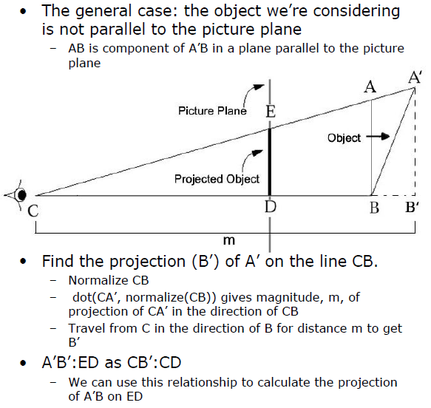
Visual Pyramid and
Similar Triangles [2]
Adapted from slides © 1997 – 2010 van Dam et al., Brown University
http://bit.ly/hiSt0f Reused with permission.

Slide 19
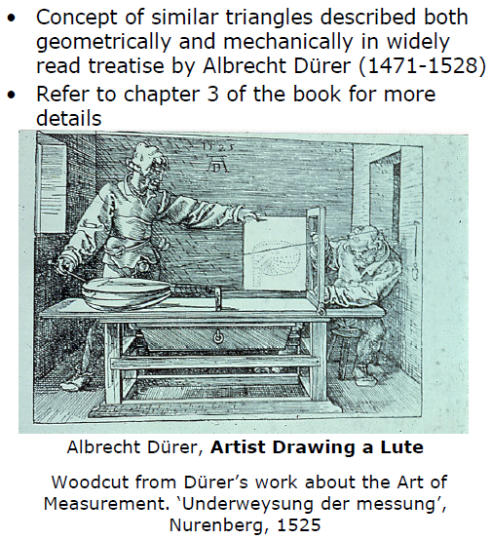
Dürer
Adapted from slides © 1997 – 2010 van Dam et al., Brown University
http://bit.ly/hiSt0f Reused with permission.

Slide 20
Las Meninas (1656)
By Diego Velàzquez
Adapted from slides © 1997 – 2010 van Dam et al., Brown University
http://bit.ly/hiSt0f Reused with permission.

Slide 21
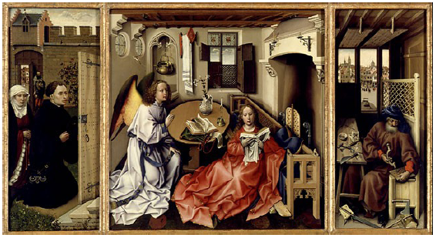
Robert Campin
The Annunciation Triptych (c. 1425)
Adapted from slides © 1997 – 2010 van Dam et al., Brown University
http://bit.ly/hiSt0f Reused with permission.

Slide 22
Piero della Francesca
The Resurrection (1460)
Adapted from slides © 1997 – 2010 van Dam et al., Brown University
http://bit.ly/hiSt0f Reused with permission.

Slide 23
Leonardo da Vinci
The Last Supper (1495)
Adapted from slides © 1997 – 2010 van Dam et al., Brown University
http://bit.ly/hiSt0f Reused with permission.

Slide 24
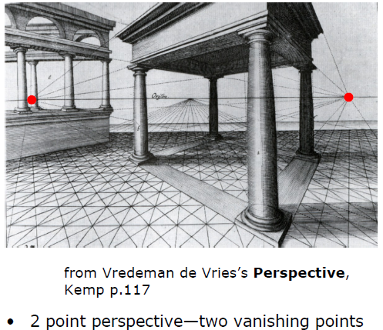
Geometrical Construction
Of Projections
Adapted from slides © 1997 – 2010 van Dam et al., Brown University
http://bit.ly/hiSt0f Reused with permission.

Slide 25
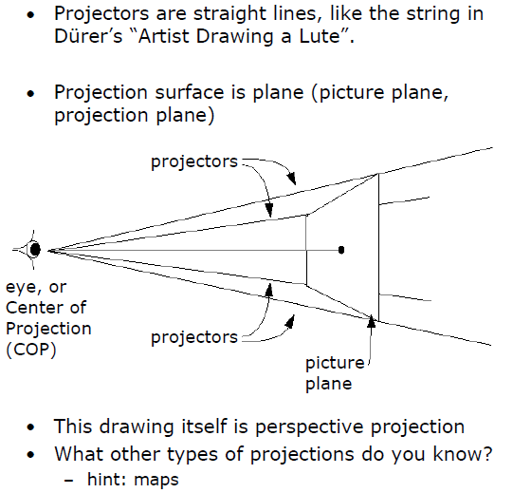
Planar Geometric Projection
Adapted from slides © 1997 – 2010 van Dam et al., Brown University
http://bit.ly/hiSt0f Reused with permission.

Slide 26
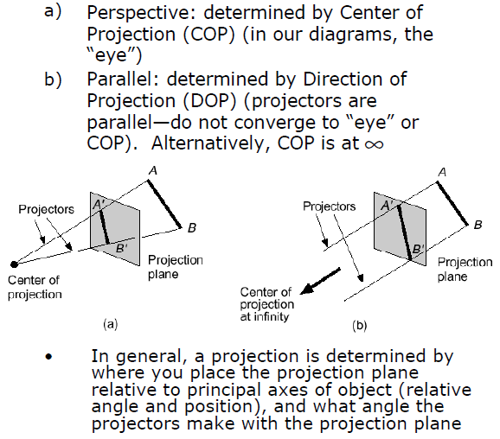
Planar Geometric Projection
Adapted from slides © 1997 – 2010 van Dam et al., Brown University
http://bit.ly/hiSt0f Reused with permission.

Slide 27
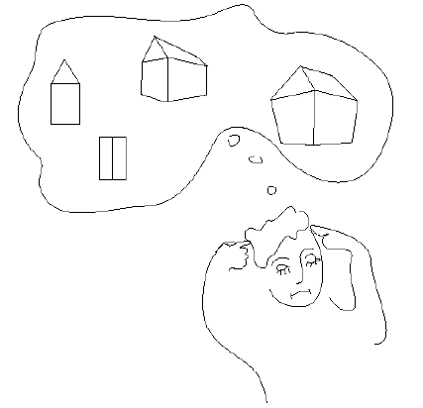
Types of Projection
Adapted from slides © 1997 – 2010 van Dam et al., Brown University
http://bit.ly/hiSt0f Reused with permission.

Slide 28
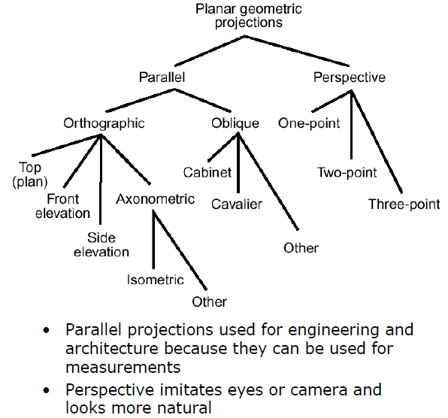
Logical Relationships Among
Types of Projections
Adapted from slides © 1997 – 2010 van Dam et al., Brown University
http://bit.ly/hiSt0f Reused with permission.

Slide 29
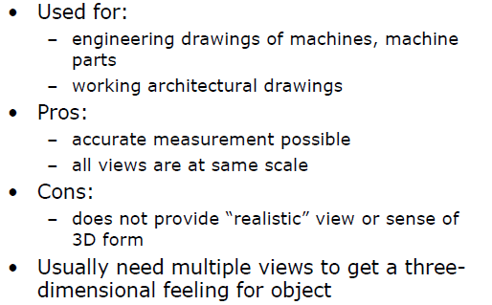
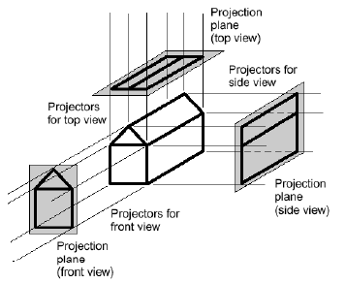
Multiview Orthographic
Adapted from slides © 1997 – 2010 van Dam et al., Brown University
http://bit.ly/hiSt0f Reused with permission.

Slide 30
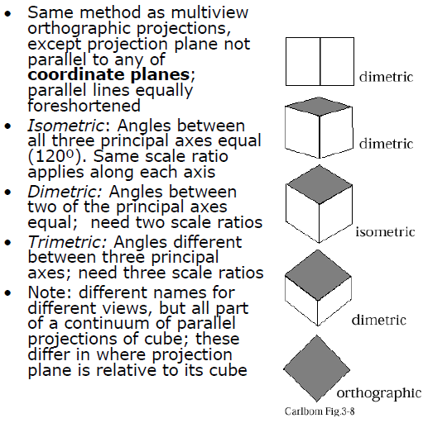
Axonometric Projections
Adapted from slides © 1997 – 2010 van Dam et al., Brown University
http://bit.ly/hiSt0f Reused with permission.

Slide 31
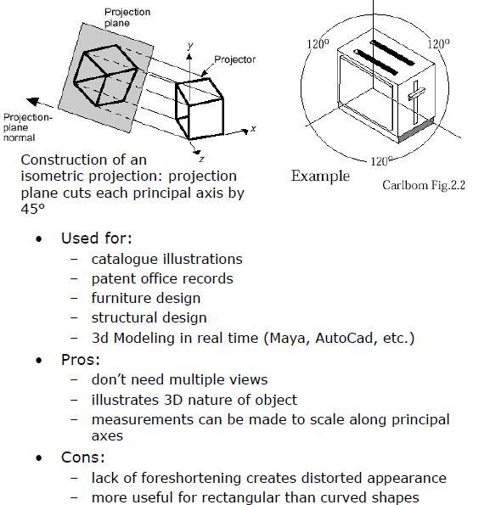
Isometric Projection [1]
Adapted from slides © 1997 – 2010 van Dam et al., Brown University
http://bit.ly/hiSt0f Reused with permission.

Slide 32
Isometric Projection [2]
Adapted from slides © 1997 – 2010 van Dam et al., Brown University
http://bit.ly/hiSt0f Reused with permission.

Slide 33
Oblique Projections
Adapted from slides © 1997 – 2010 van Dam et al., Brown University
http://bit.ly/hiSt0f Reused with permission.

Slide 34
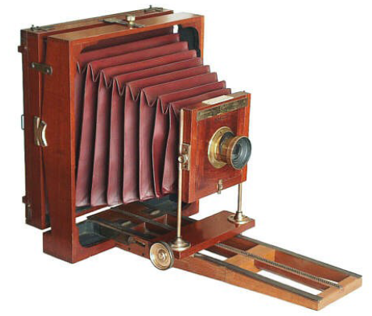
View Camera
Source: http://users.usinternet.com/rniederman/star01.htm
Adapted from slides © 1997 – 2010 van Dam et al., Brown University
http://bit.ly/hiSt0f Reused with permission.

Slide 35
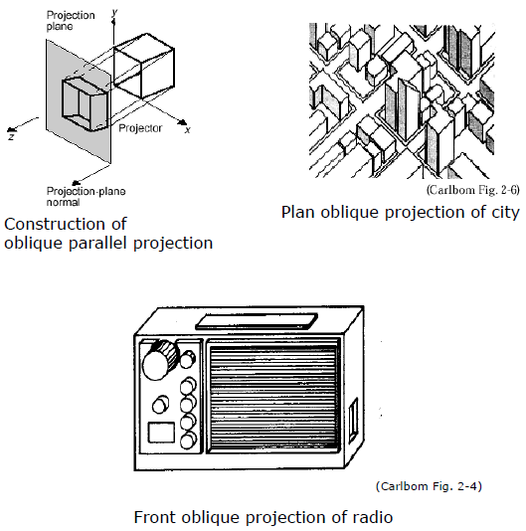
Examples of Oblique Projections
Adapted from slides © 1997 – 2010 van Dam et al., Brown University
http://bit.ly/hiSt0f Reused with permission.

Slide 36
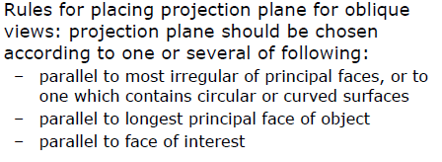
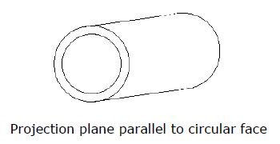
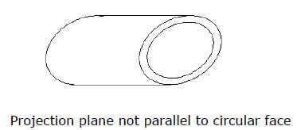
Examples of Oblique Projections
Adapted from slides © 1997 – 2010 van Dam et al., Brown University
http://bit.ly/hiSt0f Reused with permission.

Slide 37
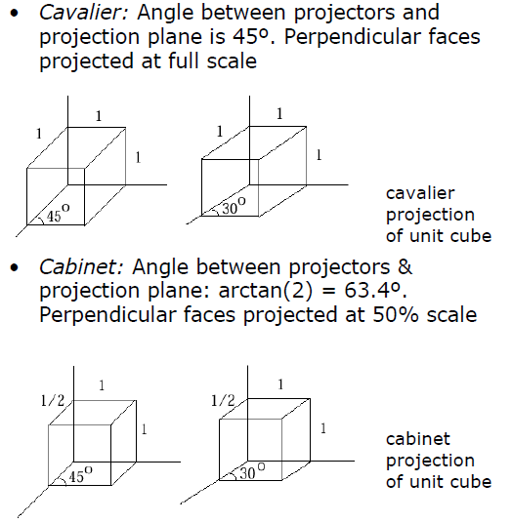
Main Types of Oblique Projections
Adapted from slides © 1997 – 2010 van Dam et al., Brown University
http://bit.ly/hiSt0f Reused with permission.

Slide 38
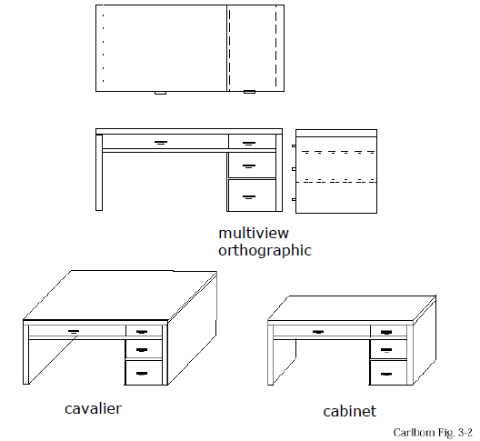
Examples of Orthographic
And Oblique Projections
Adapted from slides © 1997 – 2010 van Dam et al., Brown University
http://bit.ly/hiSt0f Reused with permission.

Slide 39
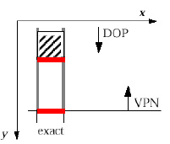
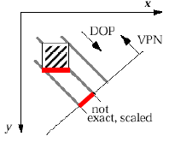
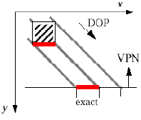
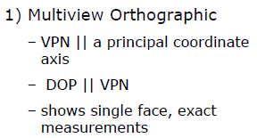
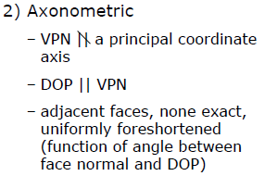
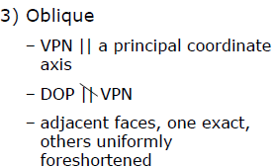
Summary of
Parallel Projections
Adapted from slides © 1997 – 2010 van Dam et al., Brown University
http://bit.ly/hiSt0f Reused with permission.

Slide 40
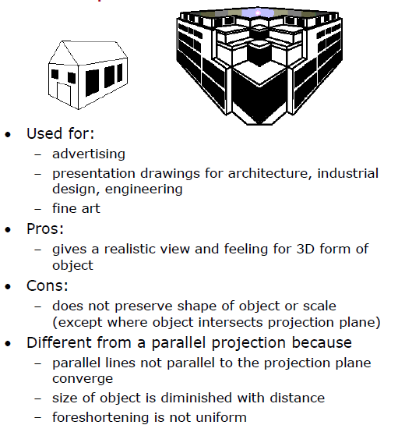
Perspective Projections
Adapted from slides © 1997 – 2010 van Dam et al., Brown University
http://bit.ly/hiSt0f Reused with permission.

Slide 41
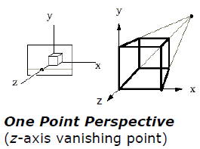
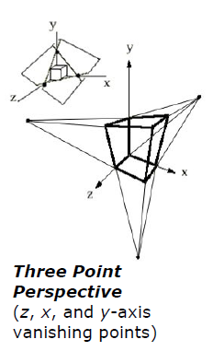
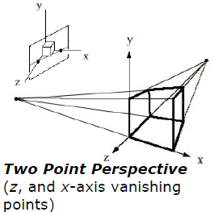
Vanishing Points [1]
Adapted from slides © 1997 – 2010 van Dam et al., Brown University
http://bit.ly/hiSt0f Reused with permission.

Slide 42
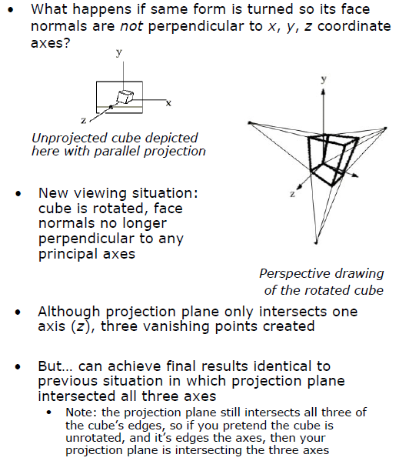
Vanishing Points [2]
Adapted from slides © 1997 – 2010 van Dam et al., Brown University
http://bit.ly/hiSt0f Reused with permission.

Slide 43
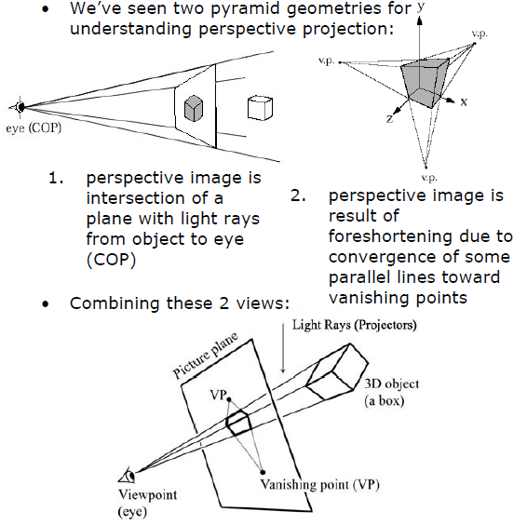
Vanishing Points and
The View Point [1]
Adapted from slides © 1997 – 2010 van Dam et al., Brown University
http://bit.ly/hiSt0f Reused with permission.

Slide 44
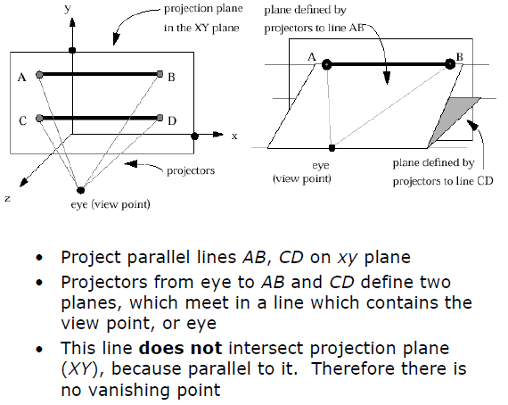
Vanishing Points and
The View Point [2]
Adapted from slides © 1997 – 2010 van Dam et al., Brown University
http://bit.ly/hiSt0f Reused with permission.

Slide 45
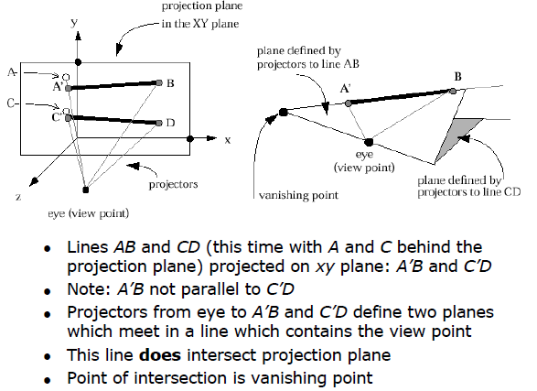
Vanishing Points and
The View Point [3]
Adapted from slides © 1997 – 2010 van Dam et al., Brown University
http://bit.ly/hiSt0f Reused with permission.

Slide 46
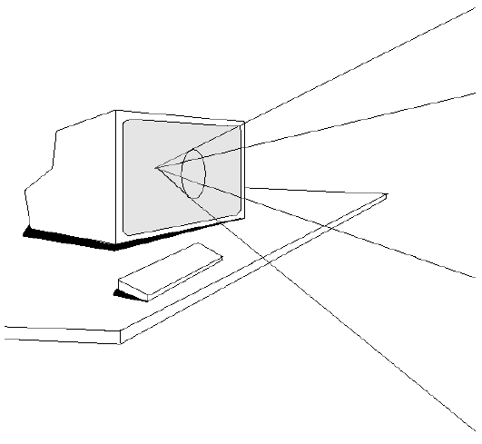
Next Time:
Projection in Computer Graphics
Adapted from slides © 1997 – 2010 van Dam et al., Brown University
http://bit.ly/hiSt0f Reused with permission.

Slide 47
Summary
A Brief History of Viewing
Ancient and classical views of projections: orthographic, pseudo-perspective
Perspective and the Renaissance
The Enlightenment and optics
Taxonomy of Projections
Multiview orthographic
Parallel
Orthographic: top, front, side; axonometric (iso- di-, tri-metric)
Oblique: cabinet, cavalier
Perspective: one-, two-, three-point
Projections and Viewing
Projectors
Vanishing points
Center of projection (COP = eye/camera)
Direction of projection (DOP) vs. view plane normal (VPN)
Next: View Volumes, Viewing and Normalizing Transformations

Slide 48
Terminology
Points and Vectors
Center of projection (COP = eye/camera)
Direction of projection (DOP) vs. view plane normal (VPN)
Kinds of Projections
Parallel – no foreshortening, projectors stay parallel
Perspective – foreshortening, projectors converge on vanishing point(s)
Parallel Projections
Orthographic: “dead on”, i.e., (DOP || VPN)
Oblique: “at an angle” , i.e., ¬ (DOP || VPN)
Orthographic Projections
Multiview: top, front, side
Isometric (one measure): 120° angles among each pair of axes
Other axonometic: dimetric (two different angles), trimetric (three different)
Perspective Projection
Projectors – lines running parallel to DOP (enclosing view volume)
Vanishing point(s) – intersection(s) of COP baseline & projection plane

