Slide 1
Lecture 3 of 41
Viewing 2 of 4:
Viewing Transformation
William H. Hsu
Department of Computing and Information Sciences, KSU
KSOL course pages: http://bit.ly/hGvXlH / http://bit.ly/eVizrE
Public mirror web site: http://www.kddresearch.org/Courses/CIS636
Instructor home page: http://www.cis.ksu.edu/~bhsu
Readings:
Today: Section 2.3 (esp. 2.3.4), Eberly 2e – see http://bit.ly/ieUq45
Next class: Section 2.3 (esp. 2.3.7), 2.6, 2.7
This week: FVFH slides on Viewing

Slide 2
Lecture Outline
Reading for Last Class: Sections 2.2.3 – 2.2.4, 2.8 Eberly 2e
Reading for Today: Section 2.3 (esp. 2.3.4), Foley et al. Slides
Reading for Next Class: Section 2.3 (esp. 2.3.7), 2.6, 2.7
Last Time: Basic Viewing Principles
  Projections: definitions, history
  Perspective: optical principles, terminology
Today: View Volume Specification and Viewing Transformation
  View volumes: ideal vs. approximated
  Frustum in computer graphics (CG)
  Specifying view volume in CG: Look and Up vectors
  Aspect ratio, view angle, front/back clipping planes
  Focal length
  Parallel (cuboid) view volume & perspective frustum
  Normalizing transformation (NT) & viewing transformation (VT)
Next Time: Fixed-Function Graphics Pipeline

Slide 3
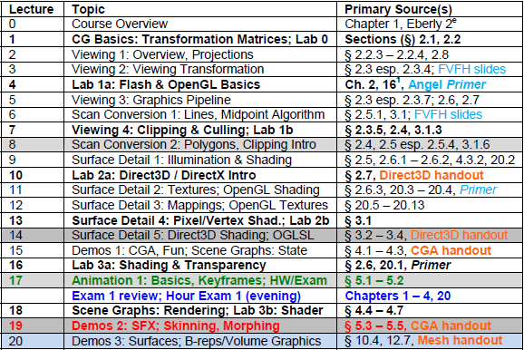

Where We Are

Slide 4


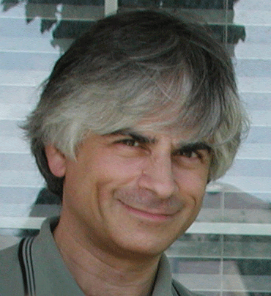

Acknowledgements
Jim Foley
Professor, College of Computing & Stephen Fleming Chair in Telecommunications
Georgia Institute of Technology
James D. Foley
Georgia Tech
http://bit.ly/ajYf2Q
Andries van Dam
Brown University
http://www.cs.brown.edu/~avd/
Steven K. Feiner
Columbia University
http://www.cs.columbia.edu/~feiner/
John F. Hughes
Brown University
http://www.cs.brown.edu/~jfh/
Andy van Dam
T. J. Watson University Professor of Technology and Education & Professor of Computer Science
Brown University
Steve Feiner
Professor of Computer Science & Director, Computer Graphics and User Interfaces Laboratory
Columbia University
John F. Hughes
Associate Professor of Computer Science
Brown University

Slide 5
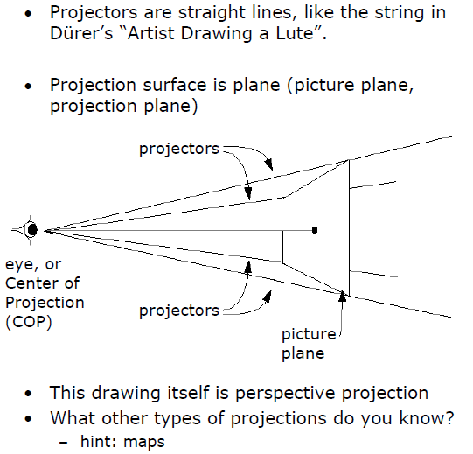
Review:
Planar Geometric Projection
Adapted from slides © 1997 – 2010 van Dam et al., Brown University
http://bit.ly/hiSt0f Reused with permission.

Slide 6
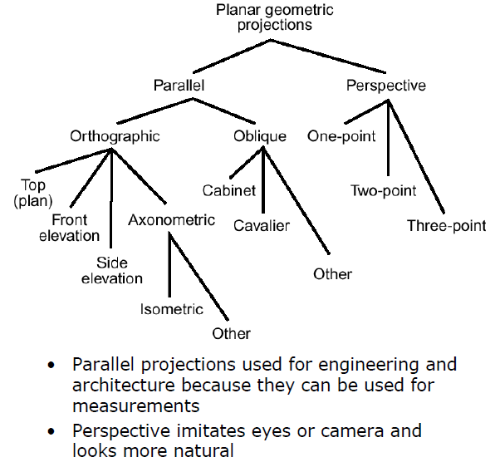
Review:
Types of Projections
Adapted from slides © 1997 – 2010 van Dam et al., Brown University
http://bit.ly/hiSt0f Reused with permission.

Slide 7
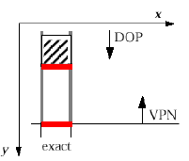
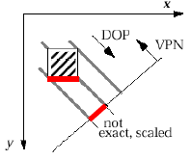
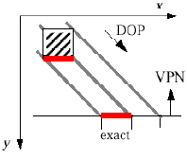
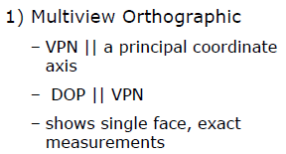
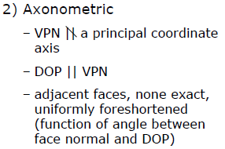
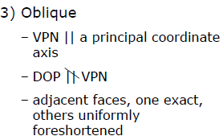

Review:
Parallel Projections
Adapted from slides © 1997 – 2010 van Dam et al., Brown University
http://bit.ly/hiSt0f Reused with permission.

Slide 8
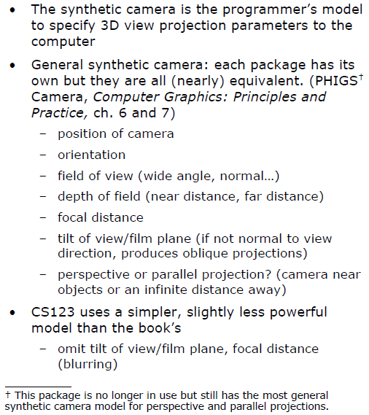
3-D Viewing:
Synthetic Camera
Adapted from slides © 1997 – 2010 van Dam et al., Brown University
http://bit.ly/hiSt0f Reused with permission.

Slide 9
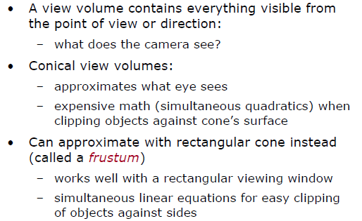
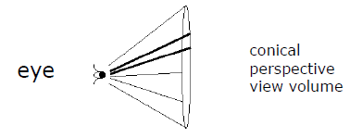
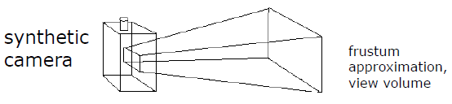
View Volumes
Adapted from slides © 1997 – 2010 van Dam et al., Brown University
http://bit.ly/hiSt0f Reused with permission.

Slide 10
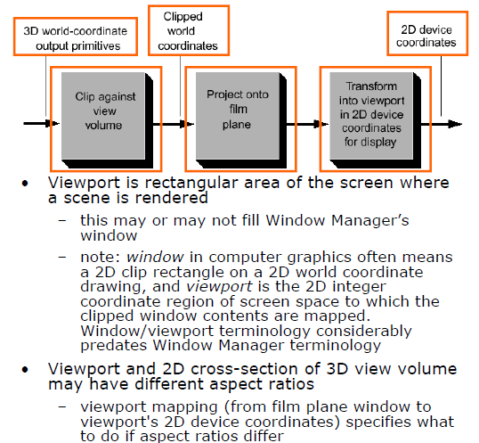
Conceptual Model of
3-D Viewing Process (for Wireframe)
Adapted from slides © 1997 – 2010 van Dam et al., Brown University
http://bit.ly/hiSt0f Reused with permission.

Slide 11
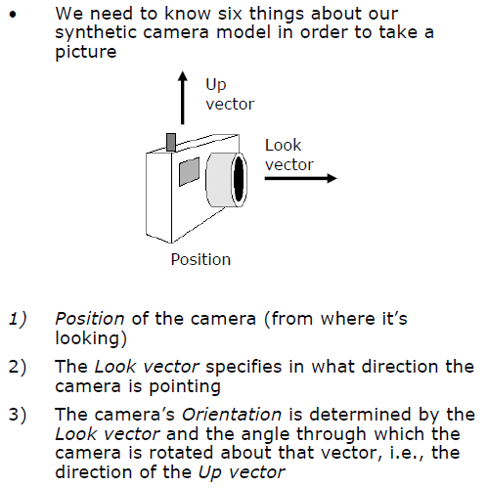
View Volume Specification [1]
Adapted from slides © 1997 – 2010 van Dam et al., Brown University
http://bit.ly/hiSt0f Reused with permission.

Slide 12
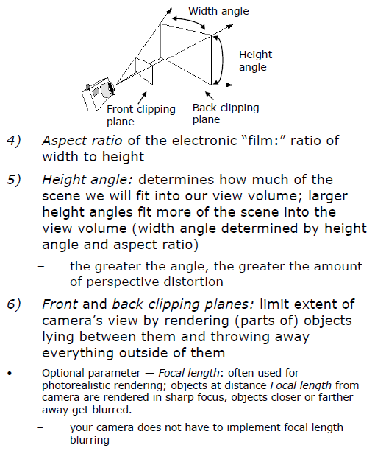
View Volume Specification [2]
Adapted from slides © 1997 – 2010 van Dam et al., Brown University
http://bit.ly/hiSt0f Reused with permission.

Slide 13
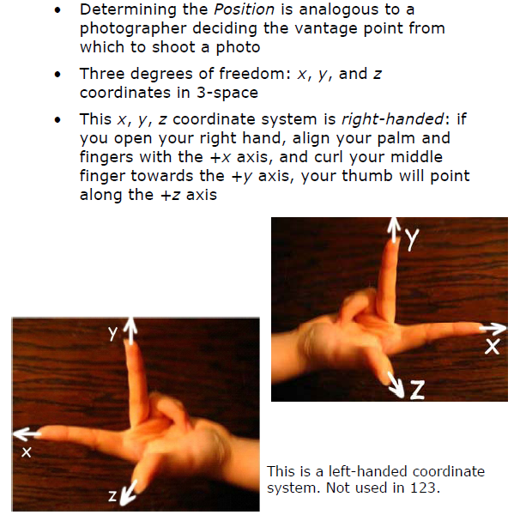
Position
Adapted from slides © 1997 – 2010 van Dam et al., Brown University
http://bit.ly/hiSt0f Reused with permission.

Slide 14
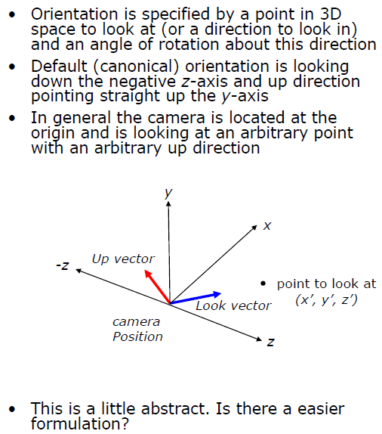
Orientation
Adapted from slides © 1997 – 2010 van Dam et al., Brown University
http://bit.ly/hiSt0f Reused with permission.

Slide 15
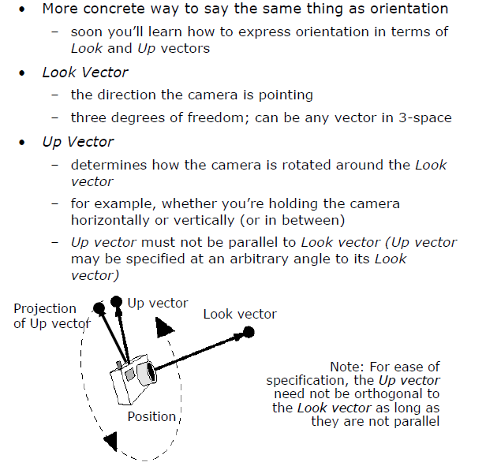
Look and Up Vectors
Adapted from slides © 1997 – 2010 van Dam et al., Brown University
http://bit.ly/hiSt0f Reused with permission.

Slide 16
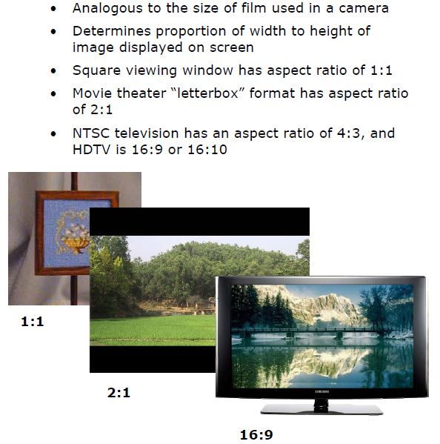
Aspect Ratio
Adapted from slides © 1997 – 2010 van Dam et al., Brown University
http://bit.ly/hiSt0f Reused with permission.

Slide 17
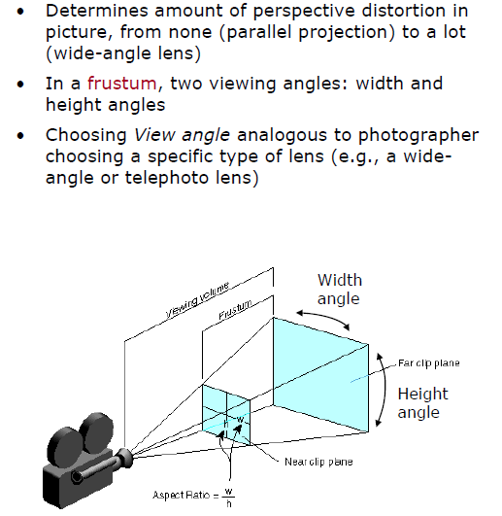
View Angle [1]
Adapted from slides © 1997 – 2010 van Dam et al., Brown University
http://bit.ly/hiSt0f Reused with permission.

Slide 18
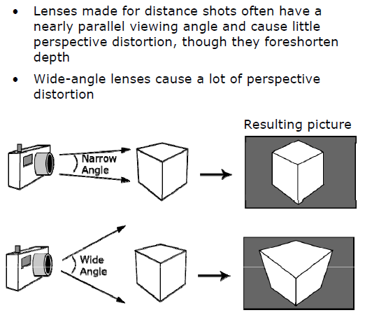
View Angle [2]
Adapted from slides © 1997 – 2010 van Dam et al., Brown University
http://bit.ly/hiSt0f Reused with permission.

Slide 19
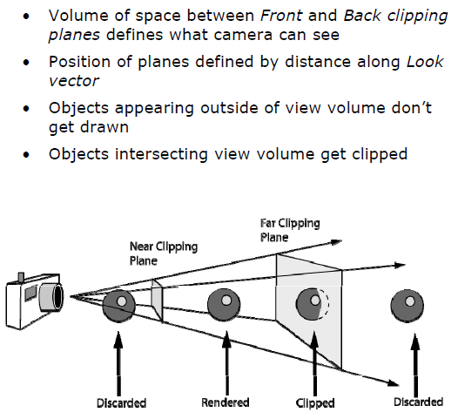
Front and Back Clipping Planes [1]
Adapted from slides © 1997 – 2010 van Dam et al., Brown University
http://bit.ly/hiSt0f Reused with permission.

Slide 20
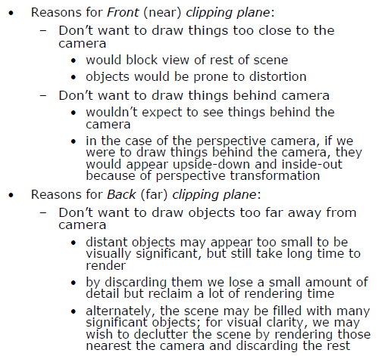
Front and Back Clipping Planes [2]
Adapted from slides © 1997 – 2010 van Dam et al., Brown University
http://bit.ly/hiSt0f Reused with permission.

Slide 21
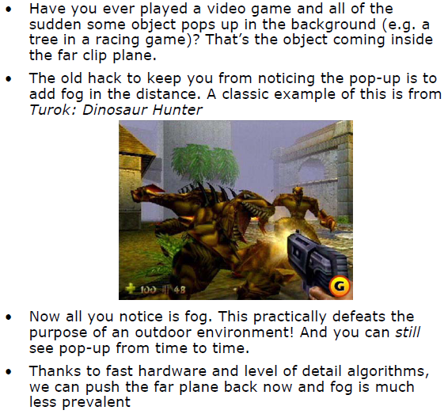
Front and Back Clipping Planes [3]
Adapted from slides © 1997 – 2010 van Dam et al., Brown University
http://bit.ly/hiSt0f Reused with permission.

Slide 22
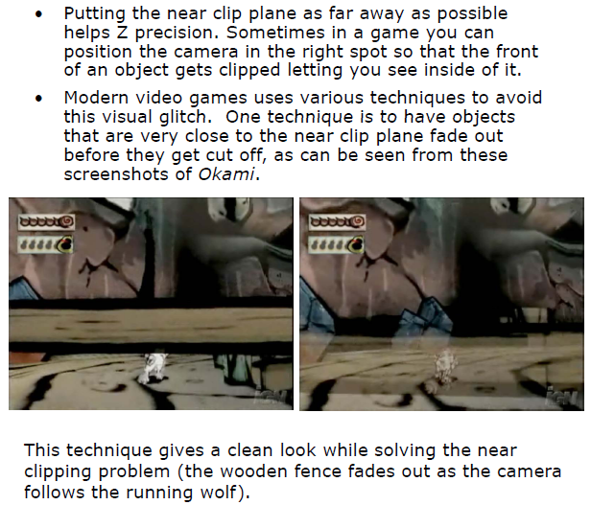
Front and Back Clipping Planes [4]
Adapted from slides © 1997 – 2010 van Dam et al., Brown University
http://bit.ly/hiSt0f Reused with permission.

Slide 23
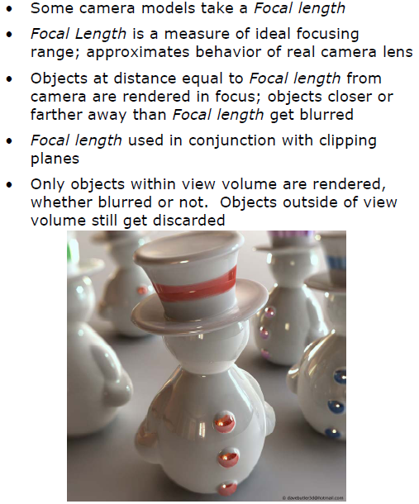
Focal Length
Adapted from slides © 1997 – 2010 van Dam et al., Brown University
http://bit.ly/hiSt0f Reused with permission.

Slide 24
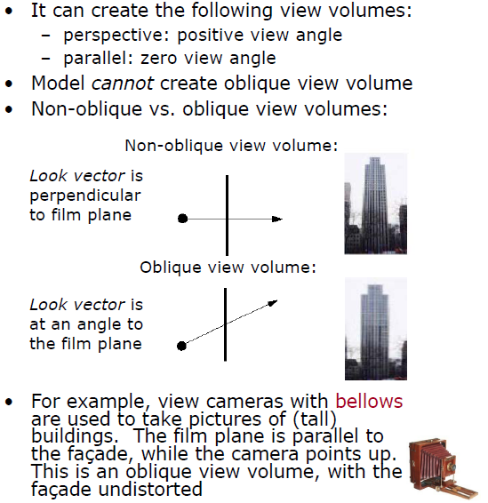
What This Model Can and Cannot Do
Adapted from slides © 1997 – 2010 van Dam et al., Brown University
http://bit.ly/hiSt0f Reused with permission.

Slide 25
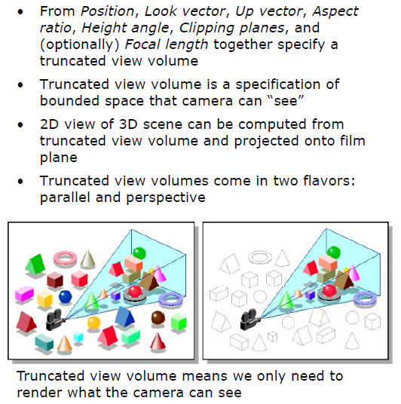
View volume Specification
Adapted from slides © 1997 – 2010 van Dam et al., Brown University
http://bit.ly/hiSt0f Reused with permission.

Slide 26
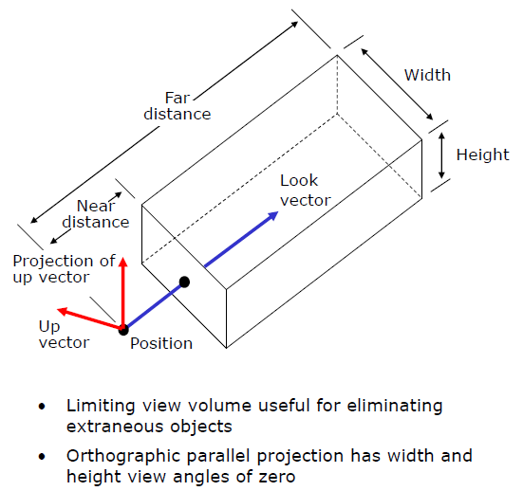
Truncated View Volume for Orthographic Parallel Projection
Adapted from slides © 1997 – 2010 van Dam et al., Brown University
http://bit.ly/hiSt0f Reused with permission.

Slide 27
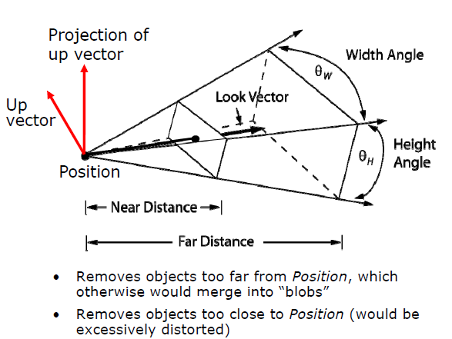
Truncated View Volume (Frustum) for
Perspective Projection
Adapted from slides © 1997 – 2010 van Dam et al., Brown University
http://bit.ly/hiSt0f Reused with permission.

Slide 28
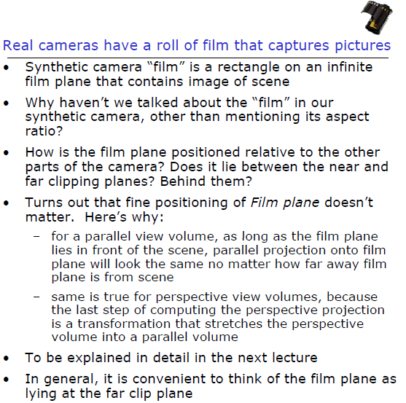
Where’s My Film?
Adapted from slides © 1997 – 2010 van Dam et al., Brown University
http://bit.ly/hiSt0f Reused with permission.

Slide 29
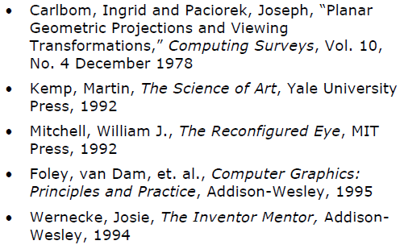
Sources
Adapted from slides © 1997 – 2010 van Dam et al., Brown University
http://bit.ly/hiSt0f Reused with permission.

Slide 30
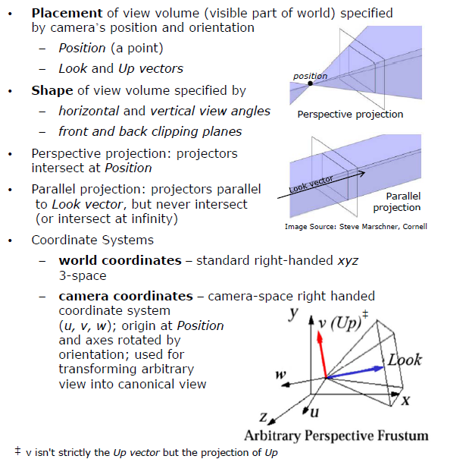
Viewing Transformation:
World (x, y, z) to Camera (u, v, w)
Adapted from slides © 1997 – 2010 van Dam et al., Brown University
http://bit.ly/hiSt0f Reused with permission.

Slide 31
Summary
Last Time: Taxonomy of Projections
  Parallel: orthographic (multiview, axonometric), oblique
  Perspective: one-, two-, three-point
Today: View Volume Specification and Viewing Transformation
  View volumes: ideal vs. approximated
  Frustum in computer graphics (CG)
  Specifying view volume in CG: Look and Up vectors
  Aspect ratio, view angle, front/back clipping planes
  Focal length
  Parallel (cuboid) view volume & perspective frustum
  Viewing transformation (VT) preview
Next Time
  Normalizing transformation (NT)
  Fixed-function pipeline

Slide 32
Terminology
Parallel Projections
  Orthographic: “dead on”, i.e., (DOP || VPN)
  Oblique: “at an angle” , i.e., ¬ (DOP || VPN)
Perspective Projection
  One-point: one vanishing point, one axis cut by view plane (WOLOG, z axis)
  Two-point: two vanishing points, two axes cut (WOLOG, x & z axes)
  Three-point: three vanishing points, three axes cut (or object rotated freely)
Today: View Volumes, Viewing Transformation
  Parallel projection (cuboid) view volume vs. perspective projection frustum
  Look vector (DOP): Eye (COP) to At
  Up vector: with Look, forms plane perpendicular (orthogonal) to view plane
  Aspect ratio: width to height (of viewport)
  View angle: wide angle (fisheye lens) vs. nearly-parallel (telephoto)
  Front/back (near/far) clipping planes
  World coordinates (canonical): (x, y, z)
  User coordinates (arbitary): (u, v, w), aka (u, v, n) or (R, U, D) in Eberly

