Slide 1
Lecture 4 of 41
Lab 1a:
OpenGL Basics
William H. Hsu
Department of Computing and Information Sciences, KSU
KSOL course pages: http://snipurl.com/1y5gc
Course web site: http://www.kddresearch.org/Courses/CIS636
Instructor home page: http://www.cis.ksu.edu/~bhsu
Readings:
SIGGRAPH 2000 OpenGL tutorial (Shreiner, Angel, Shreiner): http://bit.ly/fVBjk8
Today: Chapter 2 (review), Chapter 16, Eberly 2e – see http://snurl.com/1ye72
Next class: Section 2.3 (esp. 2.3.7), 2.6, 2.7, Eberly 2e
Angel, OpenGL: A Primer, 3e
This week: FVFH slides on Viewing

Slide 2
Lecture Outline
Reading for Last Class: §2.3 (esp. 2.3.4), Eberly 2e; Foley et al. Slides
Reading for Today: Chapters 2, 16, Eberly 2e; Foley et al. Slides
Reading for Next Class: §2.3 (esp. 2.3.7), 2.6, 2.7, Eberly 2e
Last Time: Matrix Stack for 3-D Viewing Transformation
N = D_{Persp} S_{Far} S_{xy} M_{Rot} T_{Trans}
Perspective: optical principles, terminology
Today: Highlights from First of Three Tutorials on OpenGL (Three Parts)
1. OpenGL and GL Utility Toolkit (GLUT) – V. Shreiner
2. Basic rendering – V. Shreiner
3. 3-D viewing setup – E. Angel
Next Class: Scan Conversion (Rasterization) of Lines, Polygons

Slide 3
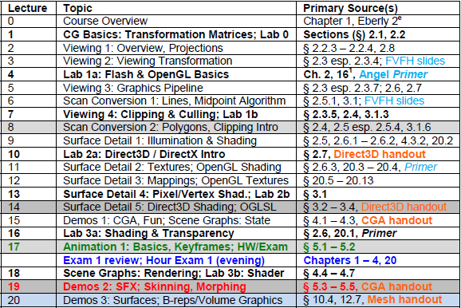
Where We Are

Slide 4
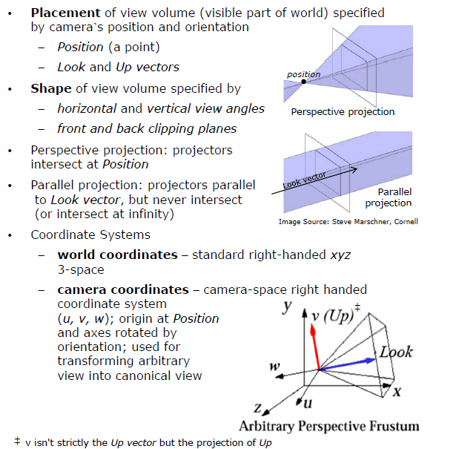
Review:
Viewing Transformation
Adapted from slides © 1997 – 2010 van Dam et al., Brown University
http://bit.ly/hiSt0f Reused with permission.

Slide 5
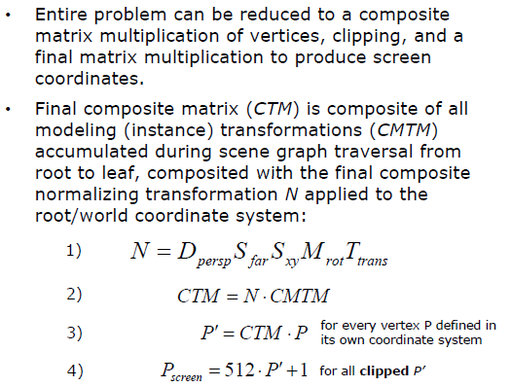
Review:
CTM for “Polygons-to-Pixels” Pipeline
Adapted from slides © 1997 – 2010 van Dam et al., Brown University
http://bit.ly/hiSt0f Reused with permission.

Slide 6
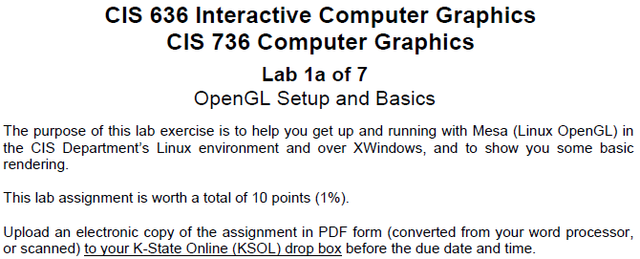
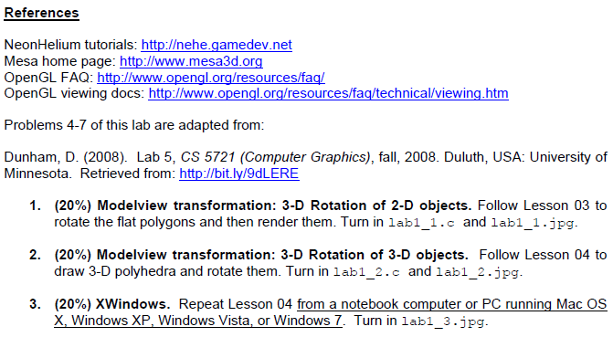
Lab 1 of 7, Part A [1]:
Setup, OpenGL/Mesa, & XWindows

Slide 7
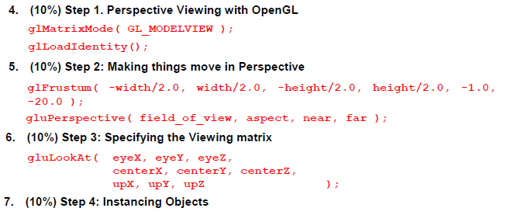
Lab 1 of 7, Part A [2]:
Perspective View Volume Specification

Slide 8
OpenGL Architecture
Per Vertex
Operations &
Primitive
Assembly
Polynomial
Evaluator
CPU
Display List
Rasterization
Per Fragment
Operations
Frame
Buffer
Texture
Memory
Pixel
Operations
© 2000 Shreiner, D., Angel, E., Shreiner, V.
Notes:
This is the most important diagram you will see today, representing the flow of graphical information, as it is processed from CPU to the frame buffer.
There are two pipelines of data flow. The upper pipeline is for geometric, vertex-based primitives. The lower pipeline is for pixel-based, image primitives. Texturing combines the two types of primitives together.
There is a pull-out poster in the back of the OpenGL Reference Manual (“Blue Book”), which shows this diagram in more detail.

Slide 9
OpenGL Rendering
Application Programmer Interface
Geometric primitives
points, lines and polygons
Image Primitives
images and bitmaps
separate pipeline for images and geometry
linked through texture mapping
Rendering depends on state
colors, materials, light sources, etc.
© 2000 Shreiner, D., Angel, E., Shreiner, V.
Notes:
As mentioned, OpenGL is a library for rendering computer graphics. Generally, there are two operations that you do with OpenGL:
draw something
change the state of how OpenGL draws
OpenGL has two types of things that it can render: geometric primitives and image primitives. Geometric primitives are points, lines and polygons. Image primitives are bitmaps and graphics images (i.e. the pixels that you might extract from a JPEG image after you’ve read it into your program.) Additionally, OpenGL links image and geometric primitives together using texture mapping, which is an advanced topic we’ll discuss this afternoon.
The other common operation that you do with OpenGL is setting state. “Setting state” is the process of initializing the internal data that OpenGL uses to render your primitives. It can be as simple as setting up the size of points and color that you want a vertex to be, to initializing multiple mipmap levels for texture mapping.

Slide 10
OpenGL & Related APIs
AGL, GLX, WGL
glue between OpenGL and windowing systems
GLU (OpenGL Utility Library)
part of OpenGL
NURBS, tessellators, quadric shapes, etc.
GLUT (OpenGL Utility Toolkit)
portable windowing API
not officially part of OpenGL
application program
OpenGL Motif
widget or similar
GLUT
GLX, AGL or WGL
GLU
X, Win32, Mac O/S
GL
software and/or hardware
Adapted from slides © 2000 Shreiner, D., Angel, E., Shreiner, V.
Notes:
As mentioned, OpenGL is window and operating system independent. To integrate it into various window systems, additional libraries are used to modify a native window into an OpenGL capable window. Every window system has its own unique library and functions to do this. Some examples are:
GLX for the X Windows system, common on Unix platforms
AGL for the Apple Macintosh
WGL for Microsoft Windows
OpenGL also includes a utility library, GLU, to simplify common tasks such as: rendering quadric surfaces (i.e. spheres, cones, cylinders, etc. ), working with NURBS and curves, and concave polygon tessellation.
Finally to simplify programming and window system dependence, we’ll be using the freeware library, GLUT. GLUT, written by Mark Kilgard, is a public domain window system independent toolkit for making simple OpenGL applications. It simplifies the process of creating windows, working with events in the window system and handling animation.

Slide 11
Preliminaries
Headers Files
#include <GL/gl.h>
#include <GL/glu.h>
#include <GL/glut.h>
Libraries
Enumerated Types
OpenGL defines numerous types for compatibility
GLfloat
GLint
Glenum
etc.
© 2000 Shreiner, D., Angel, E., Shreiner, V.
Notes:
All of our discussions today will be presented in the C computer language.
For C, there are a few required elements which an application must do:
Header files describe all of the function calls, their parameters and defined constant values to the compiler. OpenGL has header files for GL (the core library), GLU (the utility library), and GLUT (freeware windowing toolkit).
Note: glut.h includes gl.h and glu.h. On Microsoft Windows, including only glut.h is recommended to avoid warnings about redefining Windows macros.
Libraries are the operating system dependent implementation of OpenGL on the system you’re using. Each operating system has its own set of libraries. For Unix systems, the OpenGL library is commonly named libGL.so and for Microsoft Windows, it’s named opengl32.lib.
Finally, enumerated types are definitions for the basic types (i.e. float, double, int, etc.) which your program uses to store variables. To simplify platform independence for OpenGL programs, a complete set of enumerated types are defined. Use them to simplify transferring your programs to other operating systems.

Slide 12
GLUT Callback Functions
Application Structure
Configure and open window
Initialize OpenGL state
Register input callback functions
render
resize
input: keyboard, mouse, etc.
Enter event processing loop
© 2000 Shreiner, D., Angel, E., Shreiner, V.
Notes:
Here’s the basic structure that we’ll be using in our applications. This is generally what you’d do in your own OpenGL applications.
The steps are:
1) Choose the type of window that you need for your application and initialize it.
2) Initialize any OpenGL state that you don’t need to change every frame of your program. This might include things like the background color, light positions and texture maps.
3) Register the callback functions that you’ll need. Callbacks are routines you write that GLUT calls when a certain sequence of events occurs, like the window needing to be refreshed, or the user moving the mouse. The most important callback function is the one to render your scene, which we’ll discuss in a few slides.
4) Enter the main event processing loop. This is where your application receives events, and schedules when callback functions are called.

Slide 13
Sample Program
void main( int argc, char** argv )
{
int mode = GLUT_RGB|GLUT_DOUBLE;
glutInitDisplayMode( mode );
glutCreateWindow( argv[0] );
init();
glutDisplayFunc( display );
glutReshapeFunc( resize );
glutKeyboardFunc( key );
glutIdleFunc( idle );
glutMainLoop();
}
© 2000 Shreiner, D., Angel, E., Shreiner, V.
Notes:
Here’s an example of the main part of a GLUT based OpenGL application. This is the model that we’ll use for most of our programs in the course.
The glutInitDisplayMode() and glutCreateWindow() functions compose the window configuration step.
We then call the init() routine, which contains our one-time initialization. Here we initialize any OpenGL state and other program variables that we might need to use during our program that remain constant throughout the program’s execution.
Next, we register the callback routines that we’re going to use during our program.
Finally, we enter the event processing loop, which interprets events and calls our respective callback routines.

Slide 14
OpenGL Initialization
Set up whatever state you’re going to use
void init( void )
{
glClearColor( 0.0, 0.0, 0.0, 1.0 );
glClearDepth( 1.0 );
glEnable( GL_LIGHT0 );
glEnable( GL_LIGHTING );
glEnable( GL_DEPTH_TEST );
}
© 2000 Shreiner, D., Angel, E., Shreiner, V.
Notes:
Here’s the internals of our initialization routine, init(). Over the course of the day, you’ll learn what each of the above OpenGL calls do.

Slide 15
GLUT Callback Functions
Routine to call when something happens
window resize or redraw
user input
animation
“Register” callbacks with GLUT
glutDisplayFunc( display );
glutIdleFunc( idle );
glutKeyboardFunc( keyboard );
© 2000 Shreiner, D., Angel, E., Shreiner, V.
Notes:
GLUT uses a callback mechanism to do its event processing. Callbacks simplify event processing for the application developer. As compared to more traditional event driven programming, where the author must receive and process each event, and call whatever actions are necessary, callbacks simplify the process by defining what actions are supported, and automatically handling the user events. All the author must do is fill in what should happen when.
GLUT supports many different callback actions, including:
glutDisplayFunc() - called when pixels in the window need to be refreshed.
glutReshapeFunc() - called when the window changes size
glutKeyboardFunc() - called when a key is struck on the keyboard
glutMouseFunc() - called when the user presses a mouse button on the mouse
glutMotionFunc() - called when the user moves the mouse while a mouse button is pressed
glutPassiveMouseFunc() - called when the mouse is moved regardless of mouse button state
glutIdleFunc() - a callback function called when nothing else is going on. Very useful for animations.

Slide 16
Rendering Callback
Do all of your drawing here
glutDisplayFunc( display );
void display( void )
{
glClear( GL_COLOR_BUFFER_BIT );
glBegin( GL_TRIANGLE_STRIP );
glVertex3fv( v[0] );
glVertex3fv( v[1] );
glVertex3fv( v[2] );
glVertex3fv( v[3] );
glEnd();
glutSwapBuffers();
}
© 2000 Shreiner, D., Angel, E., Shreiner, V.
Notes:
One of the most important callbacks is the glutDisplayFunc() callback. This callback is called when the window needs to be refreshed. It’s here that you’d do all of your OpenGL rendering.
The above routine merely clears the window, and renders a triangle strip and then swaps the buffers for smooth animation transition. You’ll learn more about what each of these calls do during the day.

Slide 17
Elementary Rendering
Geometric Primitives
Managing OpenGL State
OpenGL Buffers
© 2000 Shreiner, D., Angel, E., Shreiner, V.
Notes:
In this section, we’ll be discussing the basic geometric primitives that OpenGL uses for rendering, as well as how to manage the OpenGL state which controls the appearance of those primitives.
OpenGL also supports the rendering of bitmaps and images, which is discussed in a later section.
Additionally, we’ll discuss the different types of OpenGL buffers, and what each can be used for.

Slide 18
OpenGL Geometric Primitives
All geometric primitives are specified by vertices
GL_LINES
GL_POLYGON
GL_POINTS
GL_LINE_STRIP
GL_LINE_LOOP
GL_TRIANGLES
GL_QUADS
GL_QUAD_STRIP
GL_TRIANGLE_STRIP
GL_TRIANGLE_FAN
© 2000 Shreiner, D., Angel, E., Shreiner, V.
Notes:
Every OpenGL geometric primitive is specified by its vertices, which are homogenous coordinates. Homogenous coordinates are of the form ( x, y, z, w ). Depending on how vertices are organized, OpenGL can render any of the shown primitives.

Slide 19
Simple Example
void drawRhombus( GLfloat color[] )
{
glBegin( GL_QUADS );
glColor3fv( color );
glVertex2f( 0.0, 0.0 );
glVertex2f( 1.0, 0.0 );
glVertex2f( 1.5, 1.118 );
glVertex2f( 0.5, 1.118 );
glEnd();
}
© 2000 Shreiner, D., Angel, E., Shreiner, V.
Notes:
The drawRhombus() routine causes OpenGL to render a single quadrilateral in a single color. The rhombus is planar, since the z value is automatically set to 0.0 by glVertex2f().

Slide 20
OpenGL Command Formats
glVertex3fv( v )
Number of
components
Data Type
Vector
b - byte
ub - unsigned byte
s - short
us - unsigned short
i - int
ui - unsigned int
f - float
d - double
omit “v” for
scalar form
glVertex2f( x, y )
2 - (x,y)
3 - (x,y,z)
4 - (x,y,z,w)
© 2000 Shreiner, D., Angel, E., Shreiner, V.
Notes:
The OpenGL API calls are designed to accept almost any basic data type, which is reflected in the calls name. Knowing how the calls are structured makes it easy to determine which call should be used for a particular data format and size.
For instance, vertices from most commercial models are stored as three component floating point vectors. As such, the appropriate OpenGL command to use is glVertex3fv( coords ).
As mentioned before, OpenGL uses homogenous coordinates to specify vertices. For glVertex*() calls which don’t specify all the coordinates ( i.e. glVertex2f()), OpenGL will default z = 0.0, and w = 1.0 .

Slide 21
Specifying Geometric Primitives
Primitives are specified using
glBegin( primType );
glEnd();
primType determines how vertices are combined
GLfloat red, green, blue;
Glfloat coords[3];
glBegin( primType );
for ( i = 0; i < nVerts; ++i ) {
glColor3f( red, green, blue );
glVertex3fv( coords );
}
glEnd();
© 2000 Shreiner, D., Angel, E., Shreiner, V.
Notes:
OpenGL organizes vertices into primitives based upon which type is passed into glBegin(). The possible types are:
GL_POINTS GL_LINE_STRIP
GL_LINES GL_LINE_LOOP
GL_POLYGON GL_TRIANGLE_STRIP
GL_TRIANGLES GL_TRIANGLE_FAN
GL_QUADS GL_QUAD_STRIP

Slide 22
Transformations in OpenGL
Modeling
Viewing
orient camera
projection
Animation
Map to screen
© 2000 Shreiner, D., Angel, E., Shreiner, V.
Notes:
Transformations are used both by the applications programmer to move and orient objects (either statically or dynamically) and by OpenGL to implement the viewing pipeline.
Three transformations (model-view, perspective, texture) are part of the state. Their matrices can be set by application programs but the operations are carried out within the viewing pipeline.

Slide 23
Camera Analogy
3D is just like taking a photograph (lots of photographs!)
viewing
volume
camera
model
tripod
© 2000 Shreiner, D., Angel, E., Shreiner, V.
Notes:
This model has become know as the synthetic camera model.
Note that both the objects to be viewed and the camera are three-dimensional while the resulting image is two dimensional.

Slide 24
Camera Analogy & Transformations
Projection transformations
adjust the lens of the camera
Viewing transformations
tripod–define position and orientation of the viewing volume in the world
Modeling transformations
moving the model
Viewport transformations
enlarge or reduce the physical photograph
© 2000 Shreiner, D., Angel, E., Shreiner, V.
Notes:
Note that human vision and a camera lens have cone-shaped viewing volumes. OpenGL (and almost all computer graphics APIs) describe a pyramid-shaped viewing volume. Therefore, the computer will “see” differently from the natural viewpoints, especially along the edges of viewing volumes. This is particularly pronounced for wide-angle “fish-eye” camera lenses.

Slide 25
Coordinate Systems &
Transformation Steps
Steps in Forming an Image
specify geometry (world coordinates)
specify camera (camera coordinates)
project (window coordinates)
map to viewport (screen coordinates)
Each step uses transformations
Every transformation is equivalent to a change in coordinate systems (frames)
© 2000 Shreiner, D., Angel, E., Shreiner, V.
Notes:
Every transformation can be thought of as changing the representation of a vertex from one coordinate system or frame to another. Thus, initially vertices are specified in world or application coordinates. However, to view them, OpenGL must convert these representations to ones in the reference system of the camera. This change of representations is described by a transformation matrix (the model-view matrix). Similarly, the projection matrix converts from camera coordinates to window coordinates.

Slide 26
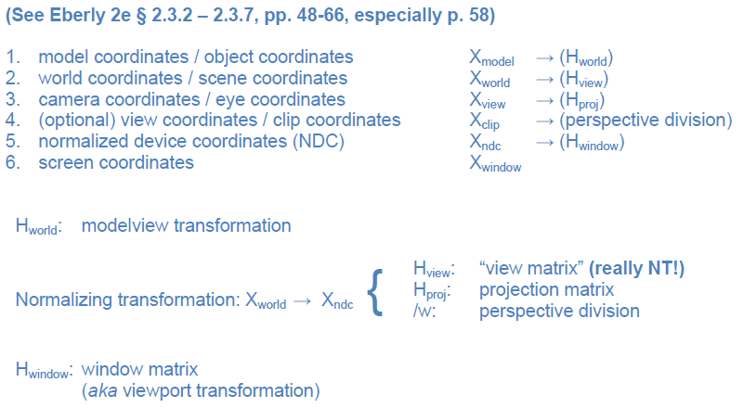
Preview: Fixed Function Pipeline,
Spaces & Matrices
Notes:
Every transformation can be thought of as changing the representation of a vertex from one coordinate system or frame to another. Thus, initially vertices are specified in world or application coordinates. However, to view them, OpenGL must convert these representations to ones in the reference system of the camera. This change of representations is described by a transformation matrix (the model-view matrix). Similarly, the projection matrix converts from camera coordinates to window coordinates.

Slide 27
Matrix Operations
Specify Current Matrix Stack
glMatrixMode( GL_MODELVIEW or GL_PROJECTION )
Other Matrix or Stack Operations
glLoadIdentity() glPushMatrix()
glPopMatrix()
Viewport
usually same as window size
viewport aspect ratio should be same as projection transformation or resulting image may be distorted
glViewport( x, y, width, height )
© 2000 Shreiner, D., Angel, E., Shreiner, V.
Notes:
glLoadMatrix*() replaces the matrix on the top of the current matrix stack. glMultMatrix*(), post-multiples the matrix on the top of the current matrix stack. The matrix argument is a column-major 4 x 4 double or single precision floating point matrix.
Matrix stacks are used because it is more efficient to save and restore matrices than to calculate and multiply new matrices. Popping a matrix stack can be said to “jump back” to a previous location or orientation.
glViewport() clips the vertex or raster position. For geometric primitives, a new vertex may be created. For raster primitives, the raster position is completely clipped.
There is a per-fragment operation, the scissor test, which works in situations where viewport clipping doesn’t. The scissor operation is particularly good for fine clipping raster (bitmap or image) primitives.

Slide 28
Projection Transformation
Shape of viewing frustum
Perspective projection
gluPerspective( fovy, aspect, zNear, zFar )
glFrustum( left, right, bottom, top, zNear, zFar )
Orthographic parallel projection
glOrtho( left, right, bottom, top, zNear, zFar )
gluOrtho2D( left, right, bottom, top )
calls glOrtho with z values near zero
© 2000 Shreiner, D., Angel, E., Shreiner, V.
Notes:
For perspective projections, the viewing volume is shaped like a truncated pyramid (frustum). There is a distinct camera (eye) position, and vertexes of objects are “projected” to camera. Objects which are further from the camera appear smaller. The default camera position at (0, 0, 0), looks down the z-axis, although the camera can be moved by other transformations.
For gluPerspective(), fovy is the angle of field of view (in degrees) in the y direction. fovy must be between 0.0 and 180.0, exclusive. aspect is x/y and should be same as the viewport to avoid distortion. zNear and zFar define the distance to the near and far clipping planes.
glFrustum() is rarely used.
Warning: for gluPerspective() or glFrustum(), don’t use zero for zNear!
For glOrtho(), the viewing volume is shaped like a rectangular parallelepiped (a box). Vertexes of an object are “projected” towards infinity. Distance does not change the apparent size of an object. Orthographic projection is used for drafting and design (such as blueprints).

Slide 29
Applying Projection Transformations
Typical use (orthographic projection)
glMatrixMode( GL_PROJECTION );
glLoadIdentity();
glOrtho( left, right, bottom, top, zNear, zFar );
© 2000 Shreiner, D., Angel, E., Shreiner, V.
Notes:
Many users would follow the demonstrated sequence of commands with a glMatrixMode(GL_MODELVIEW) call to return to modelview stack.
In this example, the red line segment is inside the view volume and is projected (with parallel projectors) to the green line on the view surface. The blue line segment lies outside the volume specified by glOrtho() and is clipped.

Slide 30
Viewing Transformations
Position the camera/eye in the scene
place the tripod down; aim camera
To “fly through” a scene
change viewing transformation and redraw scene
gluLookAt( eye_{x}, eye_{y}, eye_{z}, aim_{x}, aim_{y}, aim_{z}, up_{x}, up_{y}, up_{z} )
up vector determines unique orientation
careful of degenerate positions
tripod
© 2000 Shreiner, D., Angel, E., Shreiner, V.
Notes:
gluLookAt() multiplies itself onto the current matrix, so it usually comes after glMatrixMode(GL_MODELVIEW) and glLoadIdentity().
Because of degenerate positions, gluLookAt() is not recommended for most animated fly-over applications.
An alternative is to specify a sequence of rotations and translations that are concatenated with an initial identity matrix.
Note: that the name modelview matrix is appropriate since moving objects in the model front of the camera is equivalent to moving the camera to view a set of objects.

Slide 31
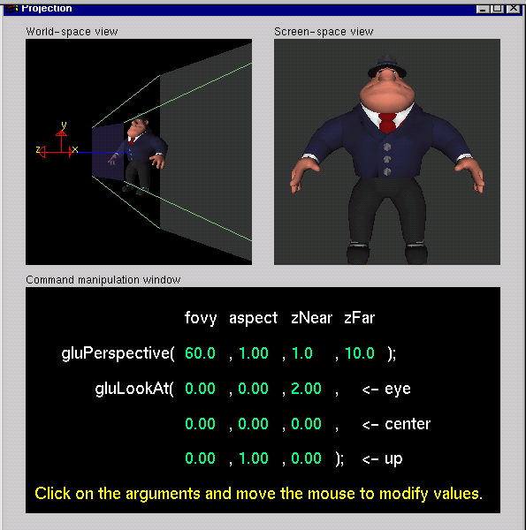
Projection Tutorial
© 2000 Shreiner, D., Angel, E., Shreiner, V.
Notes:
The RIGHT mouse button controls different menus. The screen-space view menu allows you to choose different models. The command-manipulation menu allows you to select different projection commands (including glOrtho and glFrustum).

Slide 32
Modeling Transformations
Move object
glTranslate{fd}( x, y, z )
Rotate object around arbitrary axis
glRotate{fd}( angle, x, y, z )
angle is in degrees
Dilate (stretch or shrink) or mirror object
glScale{fd}( x, y, z )
© 2000 Shreiner, D., Angel, E., Shreiner, V.
Notes:
glTranslate(), glRotate(), and glScale() multiplies itself onto the current matrix, so it usually comes after glMatrixMode(GL_MODELVIEW). There are many situations where the modeling transformation is multiplied onto a non-identity matrix.
A vertex’s distance from the origin changes the effect of glRotate() or glScale(). These operations have a fixed point for the origin. Generally, the further from the origin, the more pronounced the effect. To rotate (or scale) with a different fixed point, we must first translate, then rotate (or scale) and then undo the translation with another translation.

Slide 33
Transformation Tutorial
© 2000 Shreiner, D., Angel, E., Shreiner, V.
Notes:
For right now, concentrate on changing the effect of one command at a time. After each time that you change one command, you may want to reset the values before continuing on to the next command.
The RIGHT mouse button controls different menus. The screen-space view menu allows you to choose different models. The command-manipulation menu allows you to change the order of the glTranslatef() and glRotatef() commands. Later, we will see the effect of changing the order of modeling commands.

Slide 34
Connection: Viewing and Modeling
Moving camera is equivalent to moving every object in the world towards a stationary camera
Viewing transformations are equivalent to several modeling transformations
gluLookAt() has its own command
can make your own polar view or pilot view
© 2000 Shreiner, D., Angel, E., Shreiner, V.
Notes:
Instead of gluLookAt(, one can use the following combinations of glTranslate() and glRotate() to achieve a viewing transformation. Like gluLookAt(), these transformations should be multiplied onto the ModelView matrix, which should have an initial identity matrix.
To create a viewing transformation in which the viewer orbits an object, use this sequence (which is known as “polar view”):
glTranslated(0, 0, -distance)
glRotated(-twist, 0, 0, 1)
glRotated(-incidence, 1, 0, 0)
glRotated(azimuth, 0, 0, 1)
To create a viewing transformation which orients the viewer (roll, pitch, and heading) at position (x, y, z), use this sequence (known as “pilot view”):
glRotated(roll, 0, 0, 1)
glRotated(pitch, 0, 1, 0)
glRotated(heading, 1, 0, 0)
glTranslated(-x, -y, -z)

Slide 35
Projection is Left-Handed
Projection transformations (gluPerspective, glOrtho) are left handed
think of zNear and zFar as distance from view point
Everything else is right handed, including the vertices to be rendered
y
y
z+
left handed
right handed
x
x
z+
© 2000 Shreiner, D., Angel, E., Shreiner, V.
Notes:
If you get this wrong, you may see nothing in your image. Switching from right to left handed coordinates is equivalent to rotating the camera 180 degrees!
One way to think of problem is that the viewing system is left-handed so distances from the camera are measured from the camera to the object.

Slide 36
resize(): Perspective & LookAt
void resize( int w, int h )
{
glViewport( 0, 0, (GLsizei) w, (GLsizei) h );
glMatrixMode( GL_PROJECTION );
glLoadIdentity();
gluPerspective( 65.0, (GLfloat) w / h, 1.0, 100.0 );
glMatrixMode( GL_MODELVIEW );
glLoadIdentity();
gluLookAt( 0.0, 0.0, 5.0, 0.0, 0.0, 0.0, 0.0, 1.0, 0.0 );
}
© 2000 Shreiner, D., Angel, E., Shreiner, V.
Notes:
Using the viewport width and height as the aspect ratio for gluPerspective eliminates distortion.

Slide 37
resize(): Ortho (part 1)
void resize( int width, int height )
{
GLdouble aspect = (GLdouble) width / height;
GLdouble left = -2.5, right = 2.5;
GLdouble bottom = -2.5, top = 2.5;
glViewport( 0, 0, (GLsizei) w, (GLsizei) h );
glMatrixMode( GL_PROJECTION );
glLoadIdentity();
… continued …
© 2000 Shreiner, D., Angel, E., Shreiner, V.
Notes:
In this routine, we first compute the aspect ratio (aspect) of the new viewing area. We’ll use this value to modify the world space values (left, right, bottom, top) of the viewing frustum depending on the new shape of the viewing volume

Slide 38
resize(): Ortho (part 2)
if ( aspect < 1.0 ) {
left /= aspect;
right /= aspect;
} else {
bottom *= aspect;
top *= aspect;
}
glOrtho( left, right, bottom, top, near, far );
glMatrixMode( GL_MODELVIEW );
glLoadIdentity();
}
© 2000 Shreiner, D., Angel, E., Shreiner, V.
Notes:
Continuing from the previous page, we determine how to modify the viewing volume based on the computed aspect ratio. After we compute the new world space values, we call glOrtho()to modify the viewing volume.

Slide 39
Summary
Three Tutorials from SIGGRAPH 2000
Today (Part 1): OpenGL and GL Utility Toolkit (GLUT) – Vicki Shreiner
Overall architecture
Initialization
Viewport management
Part 2: Basic Rendering – Vicki Shreiner
Part 3: 3-D Viewing – Edward Angel
Math background (see CG Basics 1)
Viewing and normalization transformations (see CG Basics 4)
More on viewing in CG Basics 4
View volume specification
Automated part: clipping

Slide 40
Terminology
OpenGL and GL Utility Toolkit (GLUT)
State machine
Using GLUT
Specifying perspective, parallel projections
Transformations
Fixed function pipeline: modelview, normalizing, viewing
Rigid body: preserves distance (e.g., translation, rotation)
Linear
Preserves vector addition, scalar multiplication
e.g., rotation, scaling
Affine: linear transformation followed by translation
Non-affine: all others (e.g., perspective-to-parallel transformation)

