Slide 1
Lecture 5 of 41
Viewing 3 of 4:
Normalizing Transformation and
Fixed-Function Graphics Pipeline
William H. Hsu
Department of Computing and Information Sciences, KSU
KSOL course pages: http://bit.ly/hGvXlH / http://bit.ly/eVizrE
Public mirror web site: http://www.kddresearch.org/Courses/CIS636
Instructor home page: http://www.cis.ksu.edu/~bhsu
Readings:
Today: Section 2.3 (esp. 2.3.7), 2.6, 2.7, Eberly 2e – see http://bit.ly/ieUq45
Next class:
This week: FVFH slides on Viewing

Slide 2
Lecture Outline
Reading for Last Class: Chapters 2, 16, Eberly 2e; Foley et al. Slides
Reading for Today: Section 2.3 (esp. 2.3.7), 2.6, 2.7, Eberly 2e
Reading for Next Class: §2.5.1, 3.1 Eberly 2e
Last Time: Basic Viewing Principles
Projections: definitions, history
Perspective: optical principles, terminology
Today: View Volume Specification and Viewing Transformation
View volumes: ideal vs. approximated
Frustum in computer graphics (CG)
Specifying view volume in CG: Look and Up vectors
Aspect ratio, view angle, front/back clipping planes
Focal length
Parallel (cuboid) view volume & perspective frustum
Normalizing transformation (NT) & viewing transformation (VT)
Next Time: Fixed-Function Graphics Pipeline

Slide 3
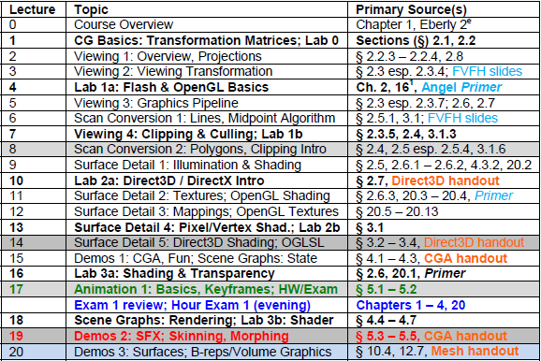
Where We Are

Slide 4
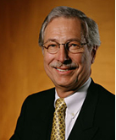
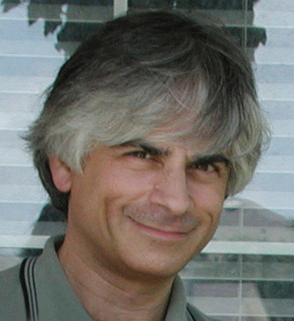
Acknowledgements
Jim Foley
Professor, College of Computing & Stephen Fleming Chair in Telecommunications
Georgia Institute of Technology
James D. Foley
Georgia Tech
http://bit.ly/ajYf2Q
Andries van Dam
Brown University
http://www.cs.brown.edu/~avd/
Steven K. Feiner
Columbia University
http://www.cs.columbia.edu/~feiner/
John F. Hughes
Brown University
http://www.cs.brown.edu/~jfh/
Andy van Dam
T. J. Watson University Professor of Technology and Education & Professor of Computer Science
Brown University
Steve Feiner
Professor of Computer Science & Director, Computer Graphics and User Interfaces Laboratory
Columbia University
John F. Hughes
Associate Professor of Computer Science
Brown University

Slide 5
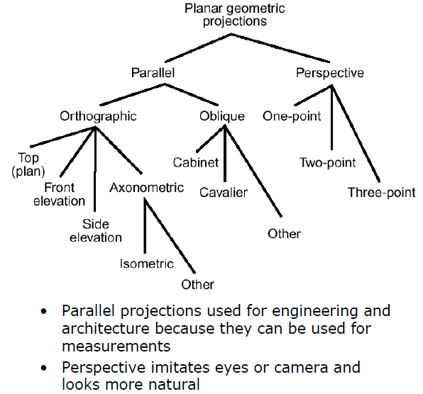
Review:
Types of Projections
Adapted from slides © 1997 – 2010 van Dam et al., Brown University
http://bit.ly/hiSt0f Reused with permission.

Slide 6
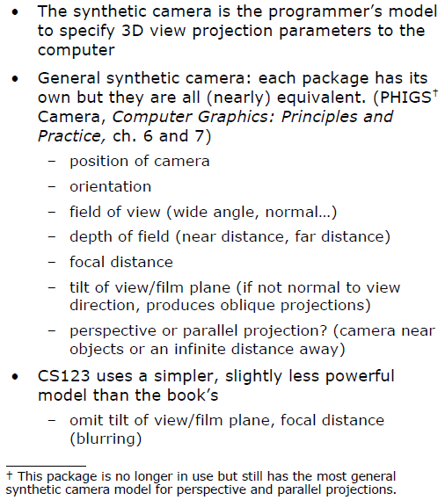
Review:
Synthetic Camera for 3-D Viewing
Adapted from slides © 1997 – 2010 van Dam et al., Brown University
http://bit.ly/hiSt0f Reused with permission.

Slide 7
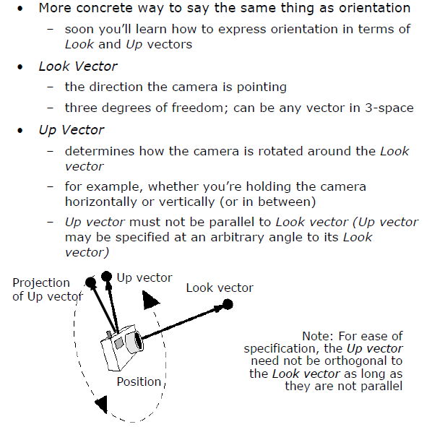
Review:
Look and Up Vectors
Adapted from slides © 1997 – 2010 van Dam et al., Brown University
http://bit.ly/hiSt0f Reused with permission.

Slide 8
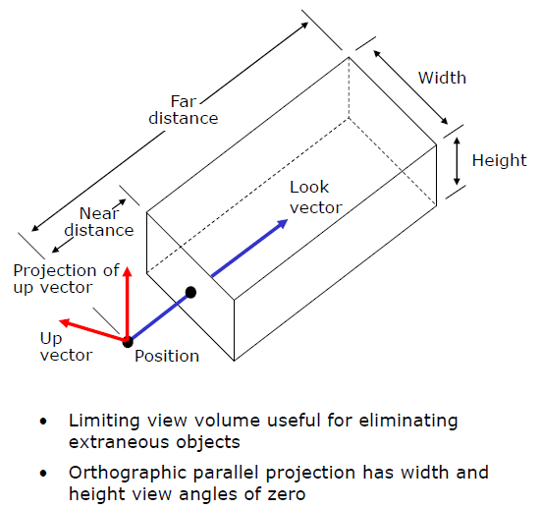
Review: View Volume for
Parallel Projection
Adapted from slides © 1997 – 2010 van Dam et al., Brown University
http://bit.ly/hiSt0f Reused with permission.

Slide 9
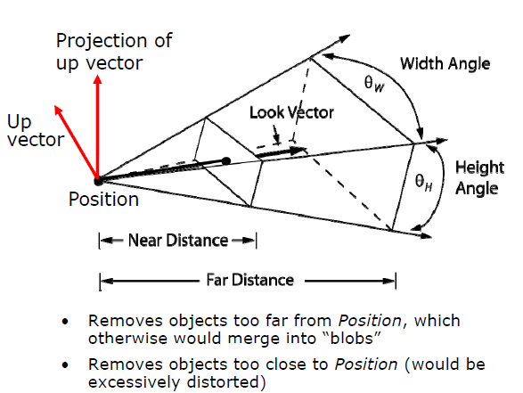
Review: View Volume for
Perspective Projection
Adapted from slides © 1997 – 2010 van Dam et al., Brown University
http://bit.ly/hiSt0f Reused with permission.

Slide 10
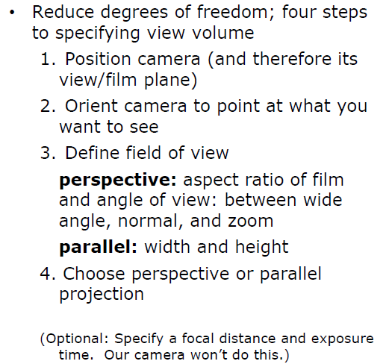
Viewing in Three Dimensions:
Mathematics of Projections
Adapted from slides © 1997 – 2010 van Dam et al., Brown University
http://bit.ly/hiSt0f Reused with permission.

Slide 11
Stage 1:
Specifying View Volume
Adapted from slides © 1997 – 2010 van Dam et al., Brown University
http://bit.ly/hiSt0f Reused with permission.

Slide 12
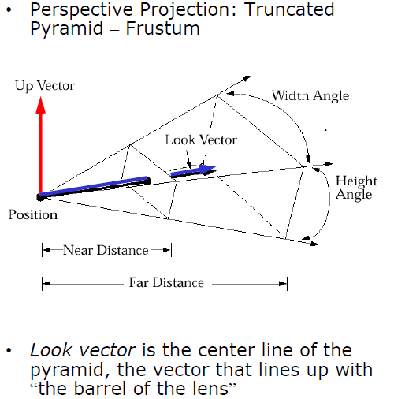
Examples of View Volume [1]:
Perspective (Frustum)
Adapted from slides © 1997 – 2010 van Dam et al., Brown University
http://bit.ly/hiSt0f Reused with permission.

Slide 13
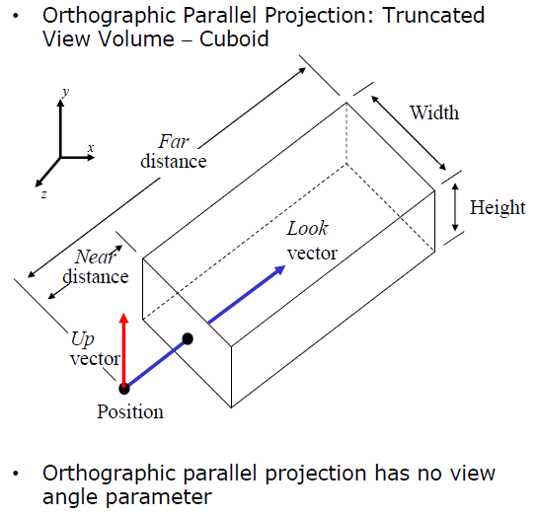
Examples of View Volume [2]:
Parallel (Cuboid)
Adapted from slides © 1997 – 2010 van Dam et al., Brown University
http://bit.ly/hiSt0f Reused with permission.

Slide 14
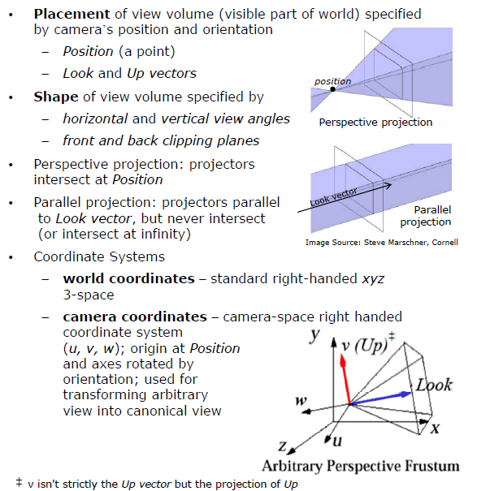
Viewing Transformation:
World (x, y, z) to Camera (u, v, w)
Adapted from slides © 1997 – 2010 van Dam et al., Brown University
http://bit.ly/hiSt0f Reused with permission.

Slide 15
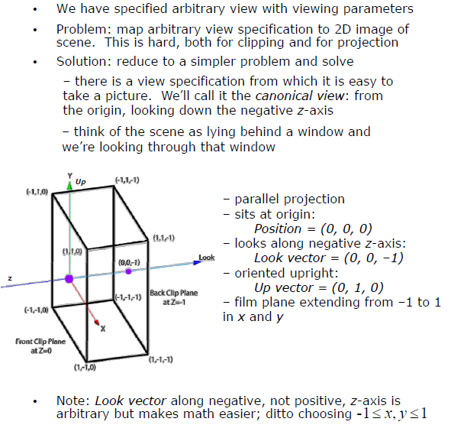
Arbitrary View Volume
Too Complex
Adapted from slides © 1997 – 2010 van Dam et al., Brown University
http://bit.ly/hiSt0f Reused with permission.

Slide 16
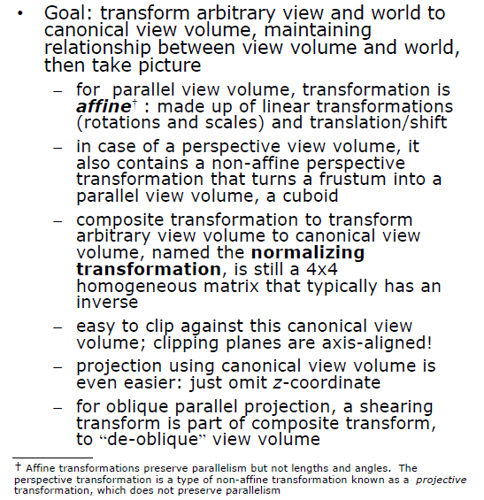
Stage 2:
Normalizing to Canonical View Volume
Adapted from slides © 1997 – 2010 van Dam et al., Brown University
http://bit.ly/hiSt0f Reused with permission.

Slide 17
Viewing Transformation ↔
Normalizing Transformation
Adapted from slides © 1997 – 2010 van Dam et al., Brown University
http://bit.ly/hiSt0f Reused with permission.

Slide 18
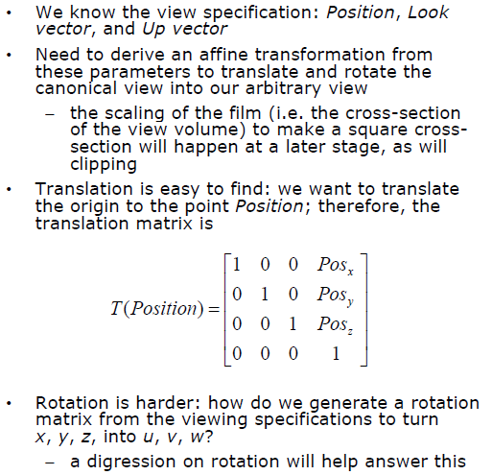
Building Viewing Transformation
From View Specification
Adapted from slides © 1997 – 2010 van Dam et al., Brown University
http://bit.ly/hiSt0f Reused with permission.

Slide 19
Rotation [1]
Adapted from slides © 1997 – 2010 van Dam et al., Brown University
http://bit.ly/hiSt0f Reused with permission.

Slide 20
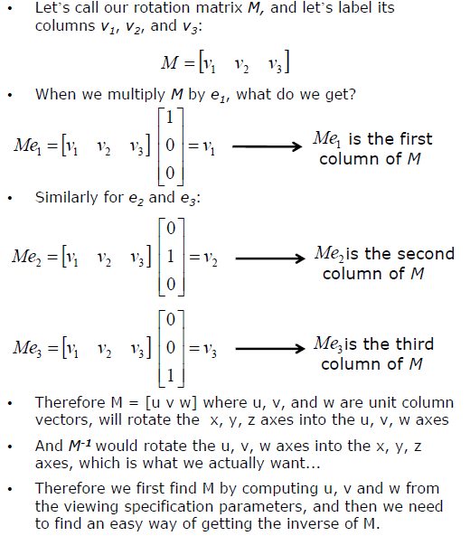
Rotation [2]
Adapted from slides © 1997 – 2010 van Dam et al., Brown University
http://bit.ly/hiSt0f Reused with permission.

Slide 21
Rotation [3]
Adapted from slides © 1997 – 2010 van Dam et al., Brown University
http://bit.ly/hiSt0f Reused with permission.

Slide 22
Rotation [4]
Adapted from slides © 1997 – 2010 van Dam et al., Brown University
http://bit.ly/hiSt0f Reused with permission.

Slide 23
Construction of Orientation Matrix
Adapted from slides © 1997 – 2010 van Dam et al., Brown University
http://bit.ly/hiSt0f Reused with permission.

Slide 24
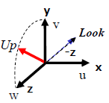
Finding (u, v, w) from
Position, Look, and Up [1]
Adapted from slides © 1997 – 2010 van Dam et al., Brown University
http://bit.ly/hiSt0f Reused with permission.

Slide 25
Finding (u, v, w) from
Position, Look, and Up [2]
Adapted from slides © 1997 – 2010 van Dam et al., Brown University
http://bit.ly/hiSt0f Reused with permission.

Slide 26
Finding (u, v, w) from
Position, Look, and Up [3]
Adapted from slides © 1997 – 2010 van Dam et al., Brown University
http://bit.ly/hiSt0f Reused with permission.

Slide 27
Finding (u, v, w) from
Position, Look, and Up [4]
Adapted from slides © 1997 – 2010 van Dam et al., Brown University
http://bit.ly/hiSt0f Reused with permission.

Slide 28
Finding (u, v, w) from
Position, Look, and Up [5]
Adapted from slides © 1997 – 2010 van Dam et al., Brown University
http://bit.ly/hiSt0f Reused with permission.

Slide 29
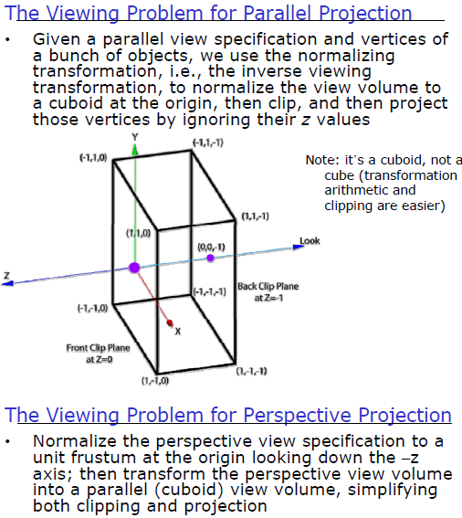
Transforming to Canonical View
Adapted from slides © 1997 – 2010 van Dam et al., Brown University
http://bit.ly/hiSt0f Reused with permission.

Slide 30
Normalizing View Volume:
Overview
Adapted from slides © 1997 – 2010 van Dam et al., Brown University
http://bit.ly/hiSt0f Reused with permission.

Slide 31
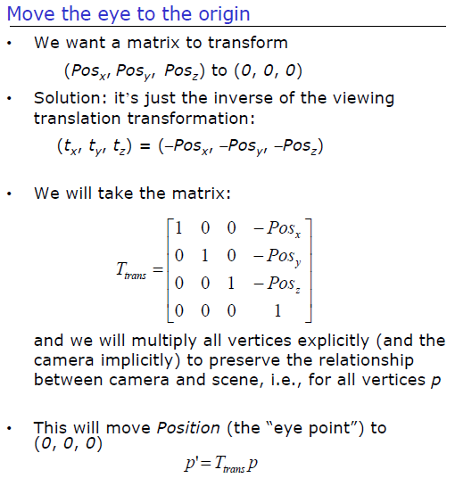
Normalizing View Volume:
Step 1
Adapted from slides © 1997 – 2010 van Dam et al., Brown University
http://bit.ly/hiSt0f Reused with permission.

Slide 32
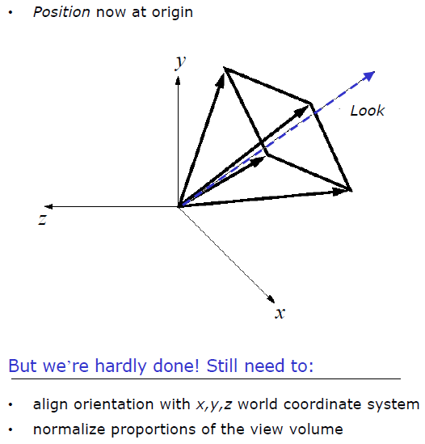
Normalizing View Volume:
Step 2
Adapted from slides © 1997 – 2010 van Dam et al., Brown University
http://bit.ly/hiSt0f Reused with permission.

Slide 33
Normalizing View Volume:
Step 3
Adapted from slides © 1997 – 2010 van Dam et al., Brown University
http://bit.ly/hiSt0f Reused with permission.

Slide 34
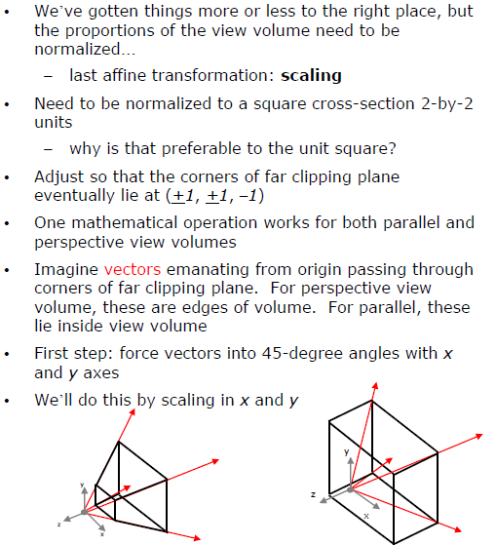
Normalizing View Volume:
Step 4
Adapted from slides © 1997 – 2010 van Dam et al., Brown University
http://bit.ly/hiSt0f Reused with permission.

Slide 35
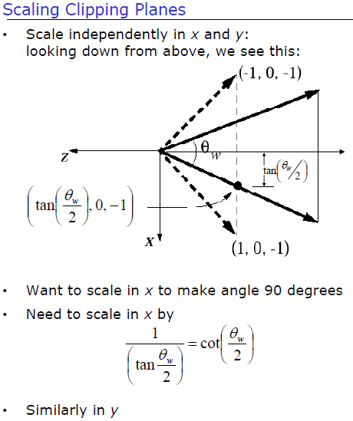
Normalizing View Volume:
Step 5
Adapted from slides © 1997 – 2010 van Dam et al., Brown University
http://bit.ly/hiSt0f Reused with permission.

Slide 36
Normalizing View Volume:
Step 6
Adapted from slides © 1997 – 2010 van Dam et al., Brown University
http://bit.ly/hiSt0f Reused with permission.

Slide 37
Normalizing View Volume:
Step 7
Adapted from slides © 1997 – 2010 van Dam et al., Brown University
http://bit.ly/hiSt0f Reused with permission.

Slide 38
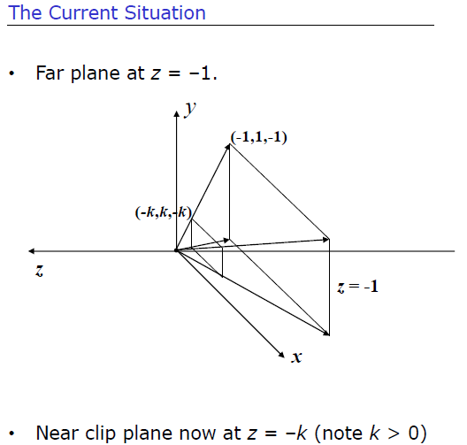
Normalizing View Volume:
Step 8
Adapted from slides © 1997 – 2010 van Dam et al., Brown University
http://bit.ly/hiSt0f Reused with permission.

Slide 39
Normalizing View Volume:
Results
Adapted from slides © 1997 – 2010 van Dam et al., Brown University
http://bit.ly/hiSt0f Reused with permission.

Slide 40
Perspective Transformation [1]
Adapted from slides © 1997 – 2010 van Dam et al., Brown University
http://bit.ly/hiSt0f Reused with permission.

Slide 41
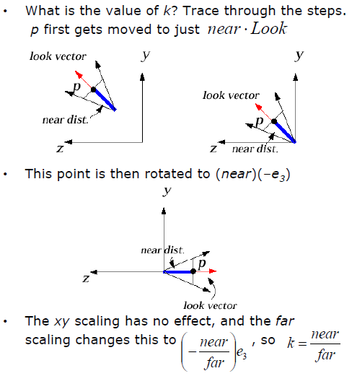
Perspective Transformation [2]
Adapted from slides © 1997 – 2010 van Dam et al., Brown University
http://bit.ly/hiSt0f Reused with permission.

Slide 42
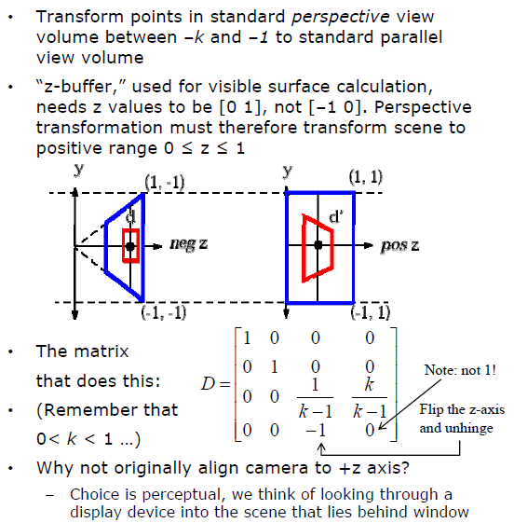
Perspective Transformation [3]
Adapted from slides © 1997 – 2010 van Dam et al., Brown University
http://bit.ly/hiSt0f Reused with permission.

Slide 43
Perspective Transformation [4]
Adapted from slides © 1997 – 2010 van Dam et al., Brown University
http://bit.ly/hiSt0f Reused with permission.

Slide 44
Perspective Transformation [5]
Adapted from slides © 1997 – 2010 van Dam et al., Brown University
http://bit.ly/hiSt0f Reused with permission.

Slide 45
Perspective Transformation:
End Result
Adapted from slides © 1997 – 2010 van Dam et al., Brown University
http://bit.ly/hiSt0f Reused with permission.

Slide 46
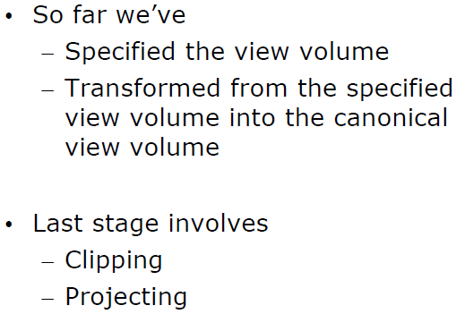
Stage 3:
Making 2-D Image
Adapted from slides © 1997 – 2010 van Dam et al., Brown University
http://bit.ly/hiSt0f Reused with permission.

Slide 47
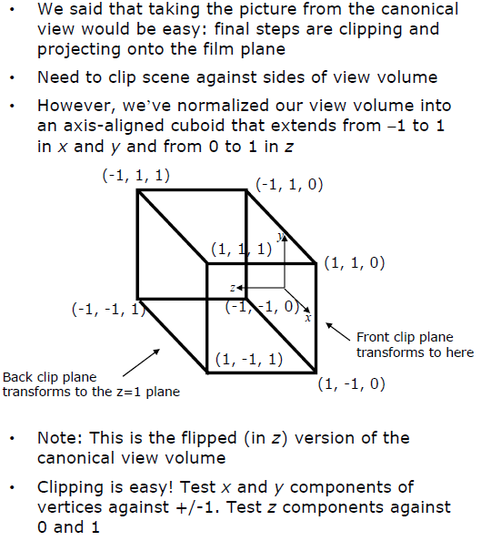
Clipping
Adapted from slides © 1997 – 2010 van Dam et al., Brown University
http://bit.ly/hiSt0f Reused with permission.

Slide 48
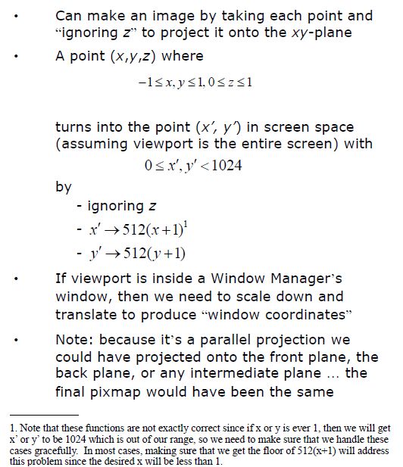
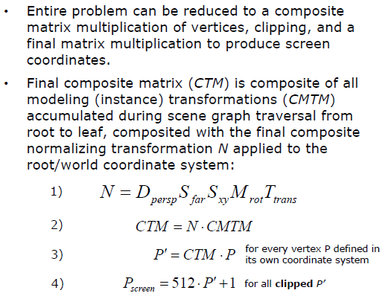
Final Projection:
Viewport Mapping
Adapted from slides © 1997 – 2010 van Dam et al., Brown University
http://bit.ly/hiSt0f Reused with permission.

Slide 49
Fixed Function Graphics Pipeline:
Composite Transformation Matrix
Adapted from slides © 1997 – 2010 van Dam et al., Brown University
http://bit.ly/hiSt0f Reused with permission.

Slide 50
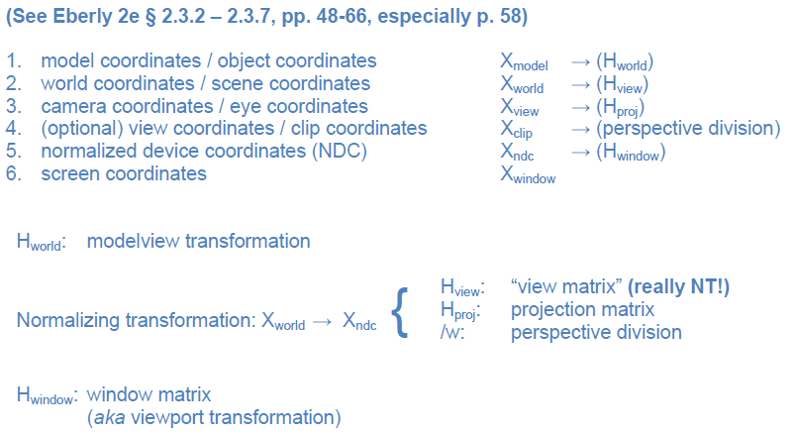
Putting It All Together:
Coordinate Spaces & Transformations
Notes:
Every transformation can be thought of as changing the representation of a vertex from one coordinate system or frame to another. Thus, initially vertices are specified in world or application coordinates. However, to view them, OpenGL must convert these representations to ones in the reference system of the camera. This change of representations is described by a transformation matrix (the model-view matrix). Similarly, the projection matrix converts from camera coordinates to window coordinates.

Slide 51
Summary
Last Time: View Volume Specification and Viewing Transformation
View volumes: ideal vs. approximated
Specifying view volume in CG: Look and Up vectors
Aspect ratio, view angle, front/back clipping planes, focal length
Today
Viewing transformation (NT)
Rotation
Finding camera coordinates (u, v, w) from Look, Up
Normalizing transformation (NT)
Perspective transformation D
Overall CTM of fixed-function pipeline
Intro to clipping
Coming Week
Lab: OpenGL basics
Drawing lines, polygons
Parametric clipping

Slide 52
Terminology
Today: View Volumes, Viewing Transformation
Parallel projection (cuboid) view volume vs. perspective projection frustum
Front/back (near/far) clipping planes
World coordinates (canonical): (x, y, z)
User coordinates (arbitary): (u, v, w), aka (u, v, n) or (R, U, D) in Eberly
Perspective transformation D: “morphs” frustum into cuboid
Normalizing transformation: inverse of viewing transformation (easier)
Other Topics
Clipping
Given view volume
Problem of determining visible elements of scene
Cumulative Transformation Matrices (CTM)
Translation, Rotation, Scaling (TRS)
Used to map arbitrary view to canonical view
Then “ready to take picture”

