Slide 1
Lecture 6 of 41
Scan Conversion 1 of 2:
Midpoint Algorithm for Lines and Ellipses
William H. Hsu
Department of Computing and Information Sciences, KSU
KSOL course pages: http://bit.ly/hGvXlH / http://bit.ly/eVizrE
Public mirror web site: http://www.kddresearch.org/Courses/CIS636
Instructor home page: http://www.cis.ksu.edu/~bhsu
Readings:
Today: Sections 2.5.1, 3.1, Eberly 2e – see http://bit.ly/ieUq45
This week: Brown CS123 slides on Scan Conversion – http://bit.ly/hfbF0D
Wayback Machine archive of Brown CS123 slides: http://bit.ly/gAhJbh

Slide 2
Lecture Outline
Reading for Last Class: Section 2.3 (esp. 2.3.7), 2.6, 2.7, Eberly 2e
Reading for Today: §2.5.1, 3.1 Eberly 2e
Reading for Next Class: §2.3.5, 2.4, 3.1.3, Eberly 2e
Last Time: View Volume Specification and Viewing Transformation
CG Basics: First of Three Tutorials on OpenGL (Three Parts)
1. OpenGL & GL Utility Toolkit (GLUT) – V. Shreiner
2. Basic rendering – V. Shreiner
3. 3-D viewing setup – E. Angel
Today: Scan Conversion (aka Rasterization)
Lines
Incremental algorithm
Bresenham’s algorithm & midpoint line algorithm
Circles and Ellipses
Next Time: More Scan Conversion & Intro to Clipping

Slide 3
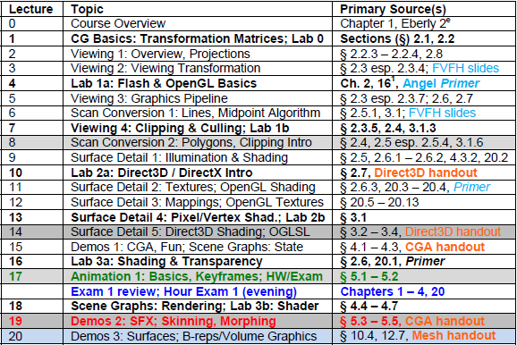
Where We Are

Slide 4
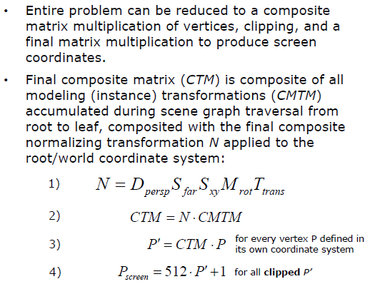
Review:
CTM for “Polygons-to-Pixels” Pipeline
Adapted from slides © 1997 – 2010 van Dam et al., Brown University
http://bit.ly/hiSt0f Reused with permission.

Slide 5
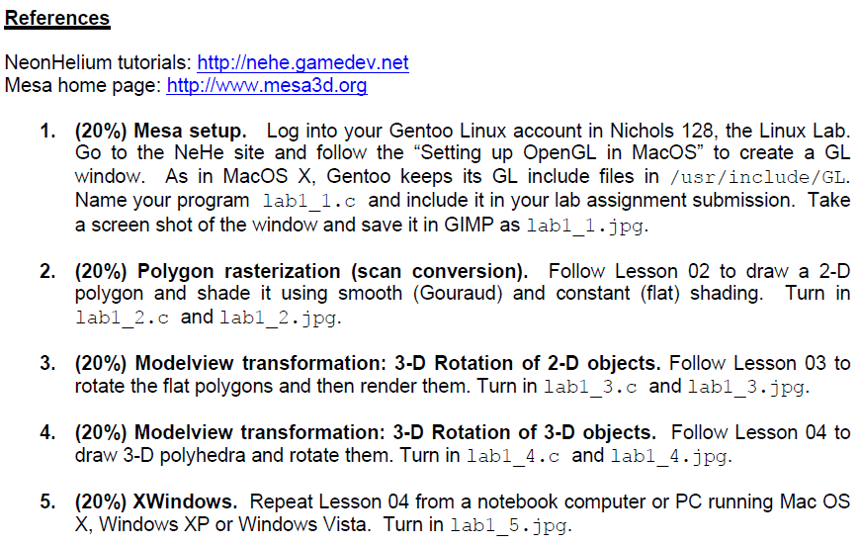
Review:
Lab 1a & NeHe Tutorials on GameDev

Slide 6
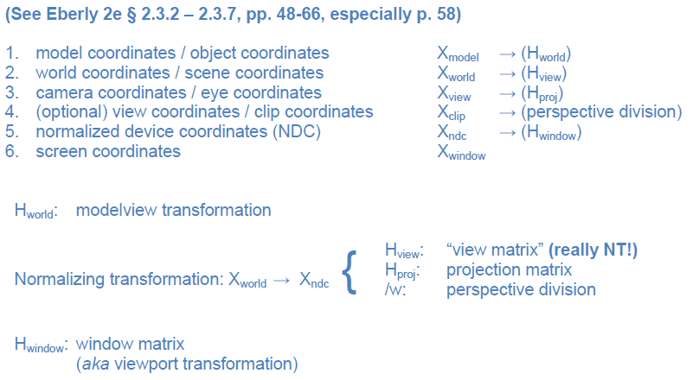
Review: Coordinate Spaces & Transformation Matrices
Notes:
Every transformation can be thought of as changing the representation of a vertex from one coordinate system or frame to another. Thus, initially vertices are specified in world or application coordinates. However, to view them, OpenGL must convert these representations to ones in the reference system of the camera. This change of representations is described by a transformation matrix (the model-view matrix). Similarly, the projection matrix converts from camera coordinates to window coordinates.

Slide 7
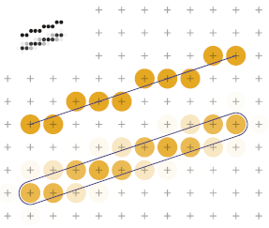
Scan Converting Lines
Adapted from slides © 1997 – 2010 van Dam et al., Brown University
http://bit.ly/hiSt0f Reused with permission.

Slide 8
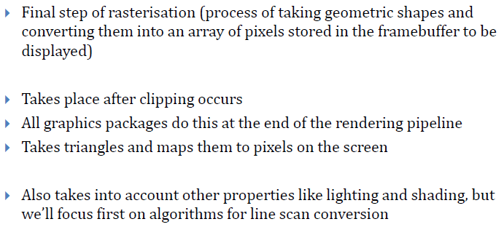
What Is Scan Conversion?
Adapted from slides © 1997 – 2010 van Dam et al., Brown University
http://bit.ly/hiSt0f Reused with permission.

Slide 9
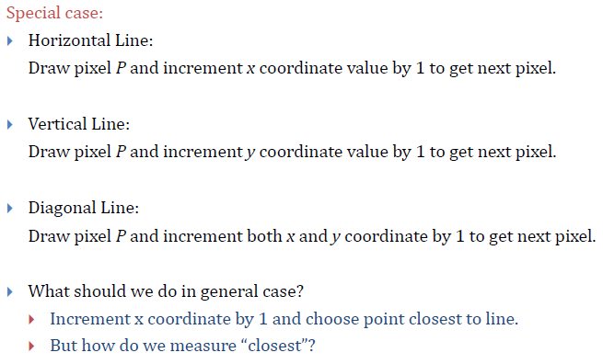
Finding Next Pixel
Adapted from slides © 1997 – 2010 van Dam et al., Brown University
http://bit.ly/hiSt0f Reused with permission.

Slide 10
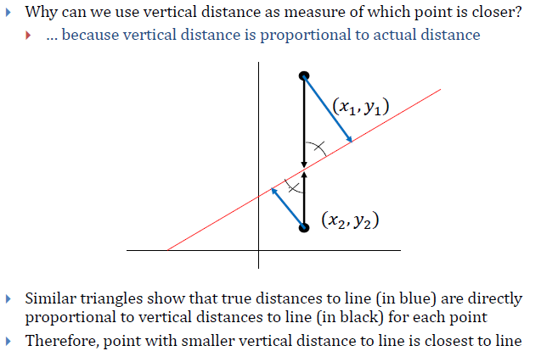
Vertical Distance
Adapted from slides © 1997 – 2010 van Dam et al., Brown University
http://bit.ly/hiSt0f Reused with permission.

Slide 11
Strategy 1: Incremental Algorithm [1]
Adapted from slides © 1997 – 2010 van Dam et al., Brown University
http://bit.ly/hiSt0f Reused with permission.

Slide 12
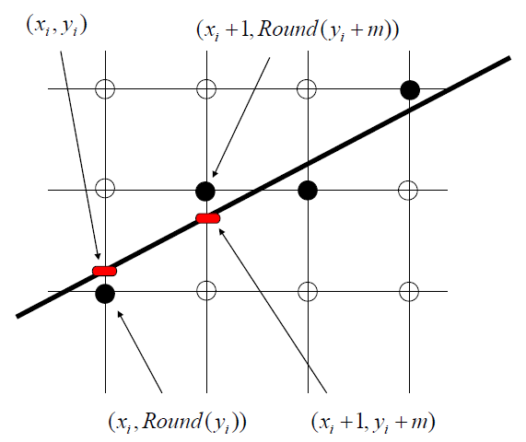
Strategy 1: Incremental Algorithm [2]
Adapted from slides © 1997 – 2010 van Dam et al., Brown University
http://bit.ly/hiSt0f Reused with permission.

Slide 13
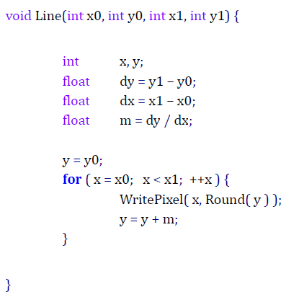
Strategy 1: Incremental Algorithm [3]
Example Code & Problems
Adapted from slides © 1997 – 2010 van Dam et al., Brown University
http://bit.ly/hiSt0f Reused with permission.

Slide 14
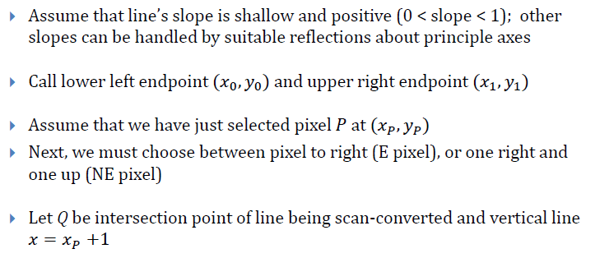
Strategy 2: Midpoint Line Algorithm [1]
Adapted from slides © 1997 – 2010 van Dam et al., Brown University
http://bit.ly/hiSt0f Reused with permission.

Slide 15
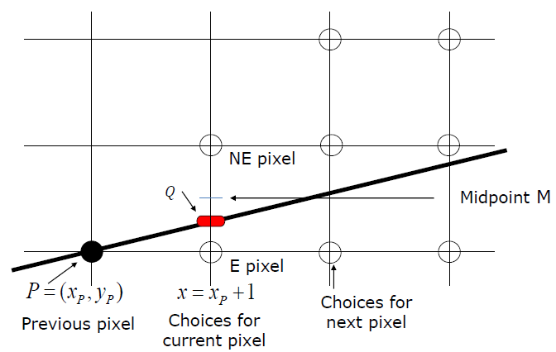
Strategy 2: Midpoint Line Algorithm [2]
Adapted from slides © 1997 – 2010 van Dam et al., Brown University
http://bit.ly/hiSt0f Reused with permission.

Slide 16
Strategy 2: Midpoint Line Algorithm [3]
Adapted from slides © 1997 – 2010 van Dam et al., Brown University
http://bit.ly/hiSt0f Reused with permission.

Slide 17
Line Equations and Properties
Adapted from slides © 1997 – 2010 van Dam et al., Brown University
http://bit.ly/hiSt0f Reused with permission.

Slide 18
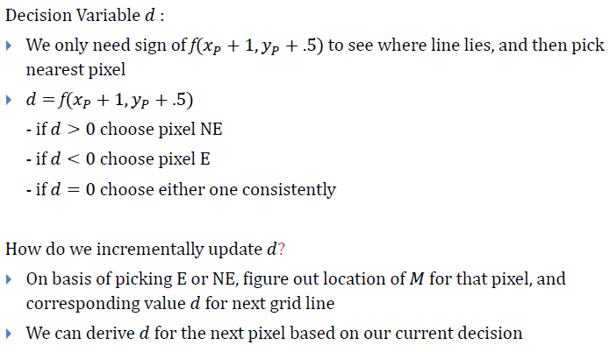
Decision Variable
Adapted from slides © 1997 – 2010 van Dam et al., Brown University
http://bit.ly/hiSt0f Reused with permission.

Slide 19
East Neighbor (E) Case
Adapted from slides © 1997 – 2010 van Dam et al., Brown University
http://bit.ly/hiSt0f Reused with permission.

Slide 20
Northeast Neighbor (NE) Case
Adapted from slides © 1997 – 2010 van Dam et al., Brown University
http://bit.ly/hiSt0f Reused with permission.

Slide 21
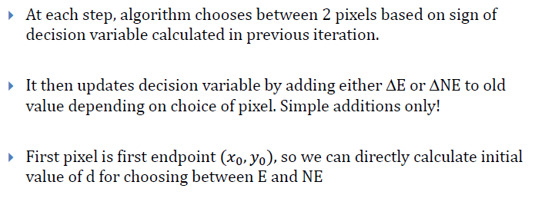
Midpoint Algorithm [1]:
Forward Differences
Adapted from slides © 1997 – 2010 van Dam et al., Brown University
http://bit.ly/hiSt0f Reused with permission.

Slide 22
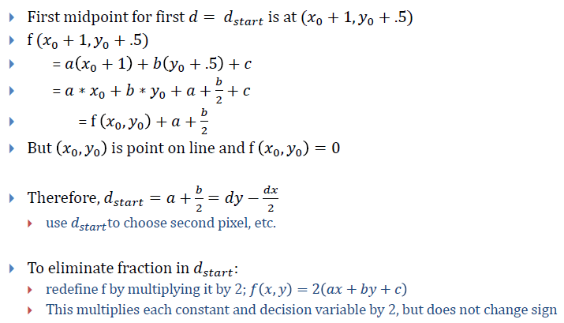
Midpoint Algorithm [2]:
Initialization and Normalization
Adapted from slides © 1997 – 2010 van Dam et al., Brown University
http://bit.ly/hiSt0f Reused with permission.

Slide 23
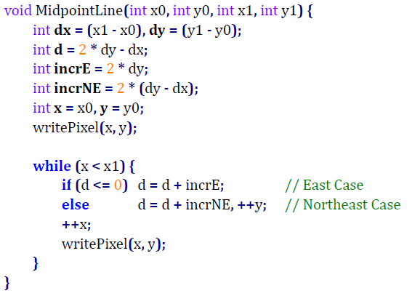
Bresenham’s Midpoint Line Algorithm:
Pseudocode
Adapted from slides © 1997 – 2010 van Dam et al., Brown University
http://bit.ly/hiSt0f Reused with permission.

Slide 24
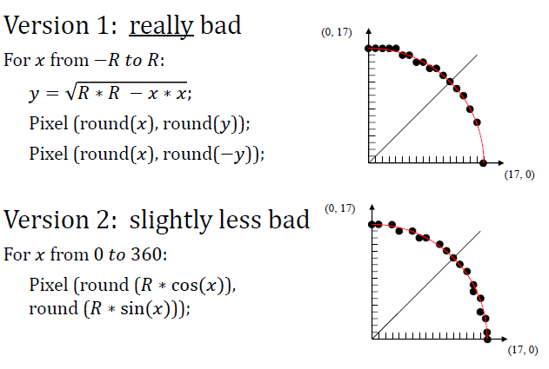
Preview:
Drawing Circles, Versions1 & 2
Adapted from slides © 1997 – 2010 van Dam et al., Brown University
http://bit.ly/hiSt0f Reused with permission.

Slide 25
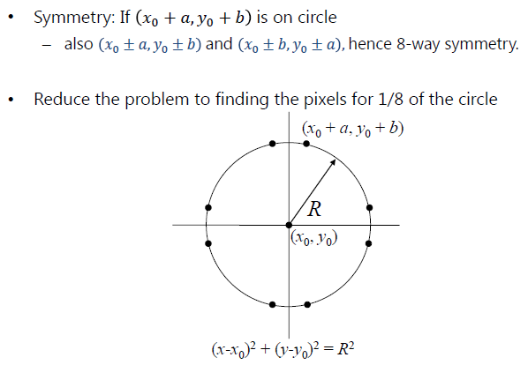
Preview:
Drawing Circles, Version 3
Adapted from slides © 1997 – 2010 van Dam et al., Brown University
http://bit.ly/hiSt0f Reused with permission.

Slide 26
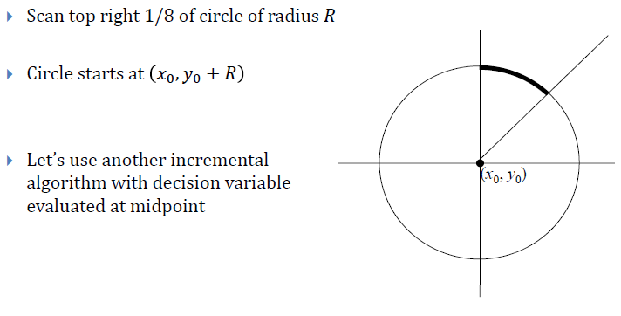
Preview:
Using The Symmetry
Adapted from slides © 1997 – 2010 van Dam et al., Brown University
http://bit.ly/hiSt0f Reused with permission.

Slide 27
Summary
Lab 1a: Based on First of Three Tutorials on OpenGL (Three Parts)
Lecture 5: Viewing 3 of 4 – Graphics Pipeline (§2.3.2 - 2.3.7, pp. 48-66)
See Also: CG Basics 1-2
CG Basics 1: Mathematical Foundations
CG Basics 2: OpenGL Primer 1 of 3 (in greater detail)
Today: Scan Conversion (aka Rasterization)
Lines
Incremental algorithm
Symmetries (8) and reduction to two-case analysis: E vs. NE
Decision variable and method of forward differences
(Bresenham’s) midpoint line algorithm
Circles and Ellipses
Next Time: More Scan Conversion & Intro to Clipping
Polygons: scan line interpolation
Clipping basics: 2-D problem definition and examples

Slide 28
Terminology
Picture elements (pixels)
Scan Conversion (aka Rasterization)
Given: geometric object (e.g., line segment, projected polygon)
Decide: what pixels to light (turn on; later, color/shade)
Basis: what part of pixels crossed by object
Issues (Reasons why Scan Conversion is Nontrivial Problem)
Aliasing (e.g., jaggies) – discontinuities in lines
Cracks: discontinuities in “polygon” mesh
Line Drawing
Incremental algorithm – uses rounding, floating point arithmetic
Forward differences – precalculated amounts to add to running total
Midpoint line algorithm – uses forward differences
For lines: Bresenham’s algorithm
For circles and ellipses

