Slide 1
Lecture 7 of 41
Viewing 4 of 4: Culling and Clipping
Lab 1b: Flash Intro
William H. Hsu
Department of Computing and Information Sciences, KSU
KSOL course pages: http://bit.ly/hGvXlH / http://bit.ly/eVizrE
Public mirror web site: http://www.kddresearch.org/Courses/CIS636
Instructor home page: http://www.cis.ksu.edu/~bhsu
Readings:
Today: Sections 2.3.5, 2.4, 3.1.3, Eberly 2e – see http://bit.ly/ieUq45
Next class: Sections 2.4, 2.5, 3.1.6, Eberly 2e
Brown CS123 slides on Clipping – http://bit.ly/eWU7i1
Wayback Machine archive of Brown CS123 slides: http://bit.ly/gAhJbh

Slide 2
Lecture Outline
Reading for Last Class: Sections 2.5.1, 3.1 Eberly 2e
Reading for Today: §2.3.5, 2.4, 3.1.3, Eberly 2e
Reading for Next Class: §2.4, 2.5 (Especially 2.5.4), 3.1.6, Eberly 2e
Last Time: Scan Conversion (aka Rasterization) of Lines
Incremental algorithm
Bresenham’s algorithm & midpoint line algorithm
Preview: Circles and Ellipses (Lecture 8)
Today: Intro to Clipping and Culling
Clipping
2-D derivation: clip edges
Algorithms: Cohen-Sutherland, Liang-Barsky/Cyrus-Beck
3-D derivation: clip faces
Culling
Back face culling
Occlusion culling

Slide 3
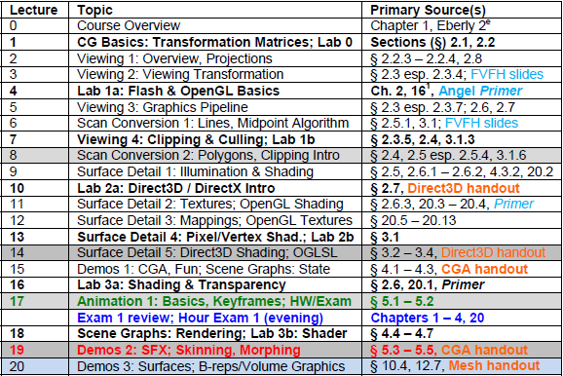
Where We Are

Slide 4
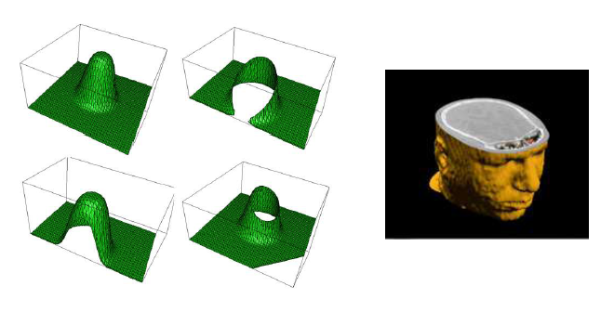
Clipping
Adapted from slides © 1997 – 2010 van Dam et al., Brown University
http://bit.ly/hiSt0f Reused with permission.

Slide 5
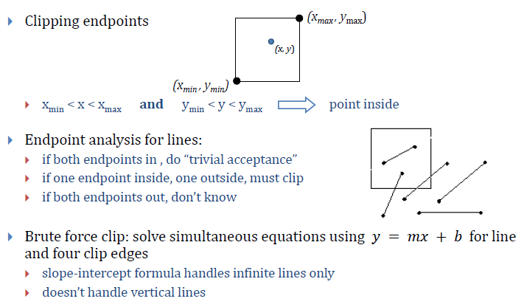
Line Clipping
Adapted from slides © 1997 – 2010 van Dam et al., Brown University
http://bit.ly/hiSt0f Reused with permission.

Slide 6
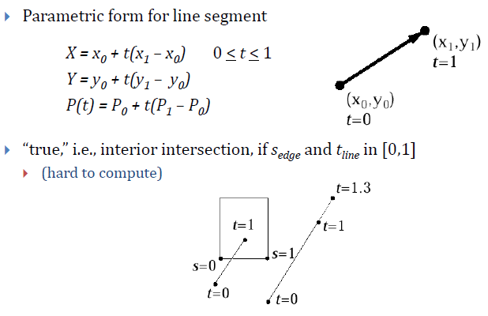
Parametric Line Formulation
For Clipping
Adapted from slides © 1997 – 2010 van Dam et al., Brown University
http://bit.ly/hiSt0f Reused with permission.

Slide 7
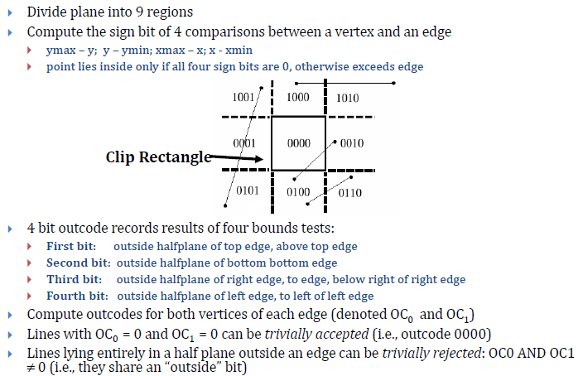
Cohen-Sutherland 2-D Clipping:
Outcodes [1]
Adapted from slides © 1997 – 2010 van Dam et al., Brown University
http://bit.ly/hiSt0f Reused with permission.

Slide 8
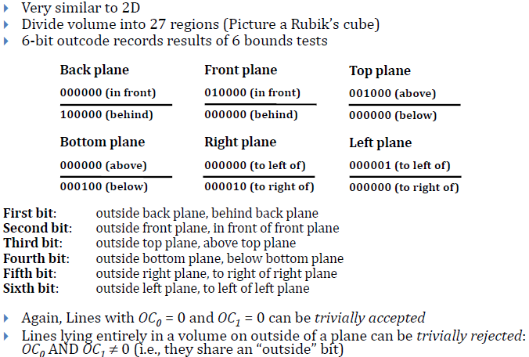
Cohen-Sutherland 2-D Clipping:
Outcodes [2]
Adapted from slides © 1997 – 2010 van Dam et al., Brown University
http://bit.ly/hiSt0f Reused with permission.

Slide 9
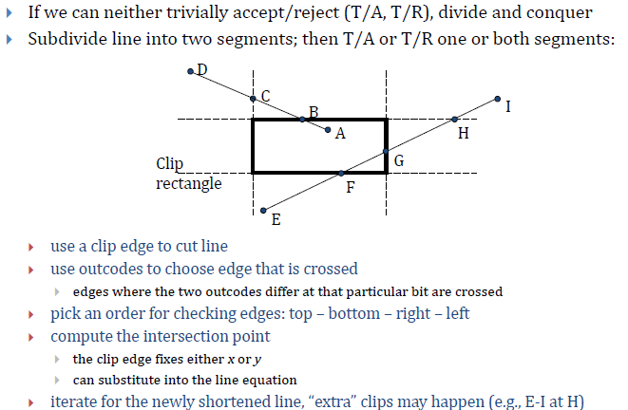
Cohen-Sutherland Algorithm [1]
Adapted from slides © 1997 – 2010 van Dam et al., Brown University
http://bit.ly/hiSt0f Reused with permission.

Slide 10
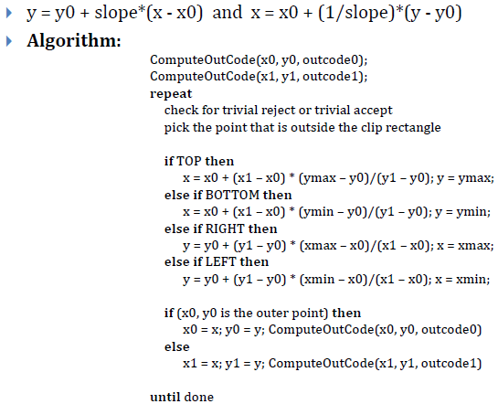
Cohen-Sutherland Algorithm [2]
Adapted from slides © 1997 – 2010 van Dam et al., Brown University
http://bit.ly/hiSt0f Reused with permission.

Slide 11
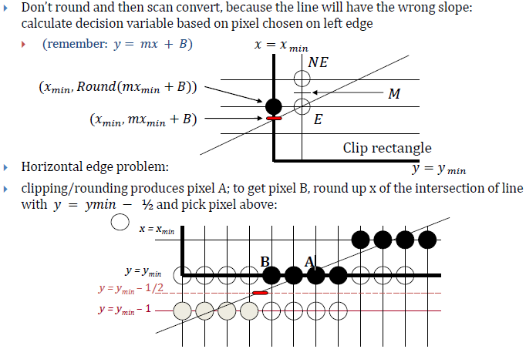
Scan Conversion after Clipping
Adapted from slides © 1997 – 2010 van Dam et al., Brown University
http://bit.ly/hiSt0f Reused with permission.

Slide 12
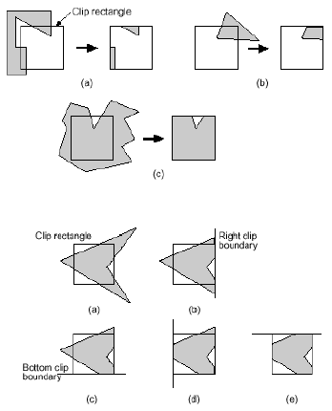
Sutherland-Hodgman
Polygon Clipping
Adapted from slides © 1997 – 2010 van Dam et al., Brown University
http://bit.ly/hiSt0f Reused with permission.

Slide 13
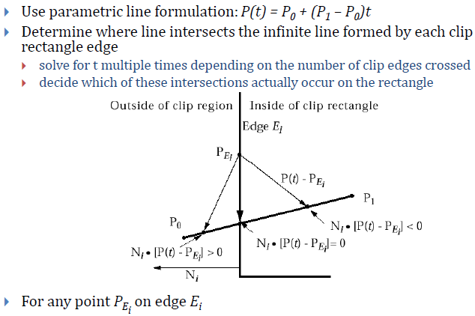
Cyrus-Beck / Liang-Barsky
Parametric Line Clipping [1]
Adapted from slides © 1997 – 2010 van Dam et al., Brown University
http://bit.ly/hiSt0f Reused with permission.

Slide 14
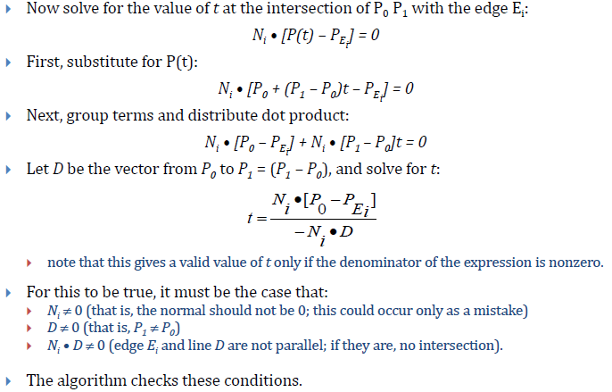
Cyrus-Beck / Liang-Barsky
Parametric Line Clipping [2]
Adapted from slides © 1997 – 2010 van Dam et al., Brown University
http://bit.ly/hiSt0f Reused with permission.

Slide 15
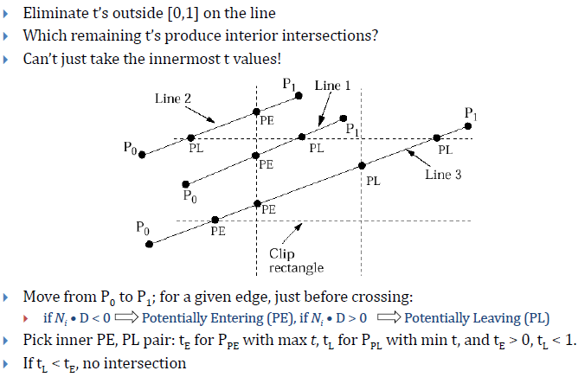
Cyrus-Beck / Liang-Barsky
Parametric Line Clipping [3]
Adapted from slides © 1997 – 2010 van Dam et al., Brown University
http://bit.ly/hiSt0f Reused with permission.

Slide 16
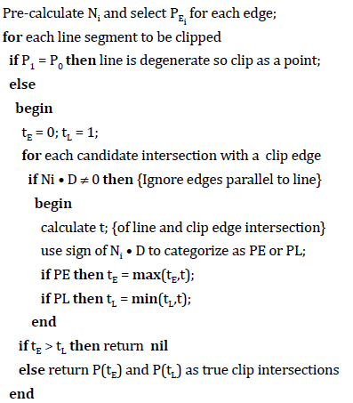
Cyrus-Beck / Liang-Barsky
Line Clipping Algorithm
Adapted from slides © 1997 – 2010 van Dam et al., Brown University
http://bit.ly/hiSt0f Reused with permission.

Slide 17
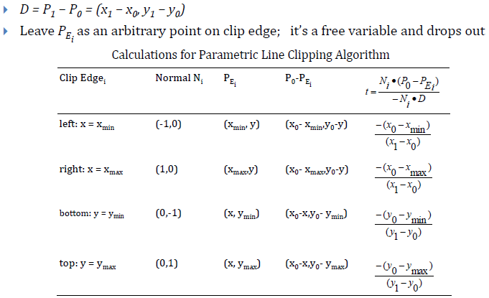
Parametric Line Clipping
For Upright Clip Rectangle [1]
Adapted from slides © 1997 – 2010 van Dam et al., Brown University
http://bit.ly/hiSt0f Reused with permission.

Slide 18
Parametric Line Clipping
For Upright Clip Rectangle [2]
Adapted from slides © 1997 – 2010 van Dam et al., Brown University
http://bit.ly/hiSt0f Reused with permission.

Slide 19
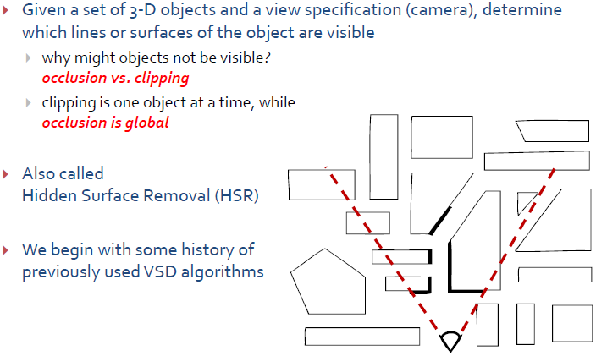
Culling: A Form of
Visible Surface Determination
Adapted from slides © 1997 – 2010 van Dam et al., Brown University
http://bit.ly/hiSt0f Reused with permission.

Slide 20
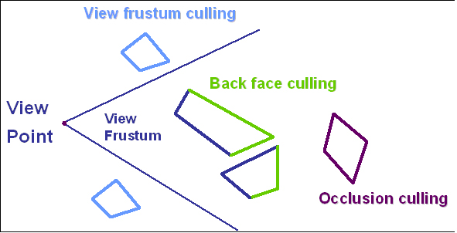
Visibility Culling:
View Frustum, Back Face, Occlusion
© 1998 – 2004 Kim et al., KAIST VR Lab
http://bit.ly/e3wRRN

Slide 21
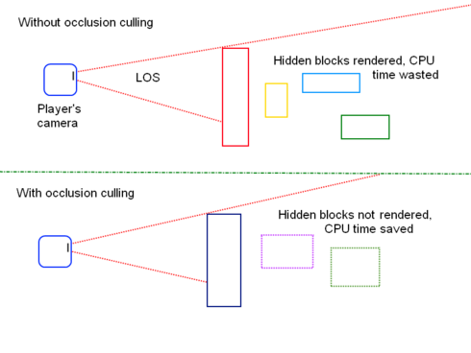
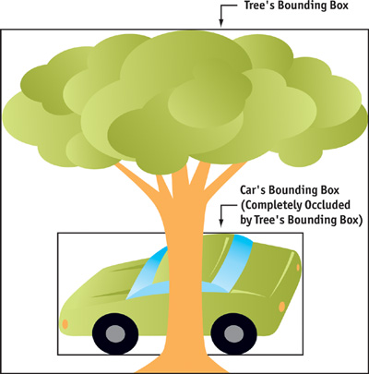
Occlusion Culling
© 2004 Sekulic, D. Chapter 29: Efficient Occlusion Culling. In Fernando, R., ed., GPU Gems. Reading, MA: Addison-Wesley.
http://bit.ly/edQt9N
© 2010 Kwoon, J. (Jakkor), Roblox.com
http://bit.ly/hAL7U5

Slide 22
Lab 1B
Adobe Flash
Basic 2-D (up to Flash v9)
3-D: Flash 10+
Simple Flash animation exercise
Animation Ideas
Animate: to “bring to life”
From still frames to animations
Incremental change and smoothness
Using Culling
Back faces illustrated
What to do besides cull
Simple Flash Animation Exercise
Watch Senocular.com tutorial(s) as needed (http://bit.ly/hhlgtk)
Turn in
ActionScript source code
Screenshot(s) as instructed in Lab 1 handout

Slide 23
Summary
Last Time: Scan Conversion (aka Rasterization)
Lines: incremental algorithm vs. (Bresenham’s) midpoint algorithm
Decision variables and forward differences
Circles and Ellipses (preview)
See Also: CG Basics 3 - 4
CG Basics 3: Projections and 3-D Viewing (in detail)
CG Basics 4: Fixed-Function Graphics Pipeline
Today: Clipping and Culling
What parts of scene to clip: edges vs. polygons of model
What parts of viewport to clip against: clip faces vs. clip edges
Clipping techniques
Cohen-Sutherland: outcodes (quick rejection), test intersections
Liang-Barsky / Cyrus-Beck: solve for t, find innermost PE/PL
Visibility culling: view frustum, back face, occlusion
Next: More Scan Conversion (Polygons, Scan Line Interpolation)

Slide 24
Terminology
Fixed Function Pipeline
Modelview transformation
Normalizing transformation (inverse of viewing transformation)
Coordinate Spaces
Model space – absolute w.r.t. model
World space aka scene space – absolute w.r.t. scene, canonical
Camera / Eye / View space – relative, user-defined, arbitrary
Clip space – before perspective division
Normalized device coordinates – after perspective division
Clipping and Culling
Clip faces/edges – clip region (screen, view volume) boundaries
Clipping techniques
Cohen-Sutherland: outcodes (quick rejection), test intersections
Liang-Barsky / Cyrus-Beck: solve for t, innermost PE/PL
Visibility culling: view frustum, back face, occlusion

