Slide 1
Lecture 8 of 41
Scan Conversion 2 of 2:
Circles/Ellipses and Polygons
William H. Hsu
Department of Computing and Information Sciences, KSU
KSOL course pages: http://bit.ly/hGvXlH / http://bit.ly/eVizrE
Public mirror web site: http://www.kddresearch.org/Courses/CIS636
Instructor home page: http://www.cis.ksu.edu/~bhsu
Readings:
Today: Sections 2.4, 2.5 esp. 2.5.4, 3.1.6, Eberly 2e – see http://bit.ly/ieUq45
Next class: Sections 2.5, 2.6.1-2.6.2, 4.3.2, 20.2, Eberly 2e
Brown CS123: Scan Conversion (http://bit.ly/hfbF0D), Shapes (http://bit.ly/hatPSi), Polygons/Texture Mapping (http://bit.ly/h2VZn8)
Wayback Machine archive of Brown CS123 slides: http://bit.ly/gAhJbh

Slide 2
Lecture Outline
Readings
  Last class: §2.3.5, 2.4, 3.1.3, Eberly 2e
  Today’s class: §2.4, 2.5 (Especially 2.5.4), 3.1.6, Eberly 2e
  Next class: §2.5, 2.6.1-2.6.2, 4.3.2, 20.2, Eberly 2e
Excerpts from Van Dam notes, Brown CS123
  Scan converting circles/ellipses (starting from 19 in fall, 2010 notes)
  Polygons (Shapes 2-4)
  Triangle meshes (Shapes 13-14)
  Scan line interpolation (Polygons 7; Shading 14, 2005 – 2009 notes)
Last Time: Intro to Clipping and Culling
  Clipping: Cohen-Sutherland, Cyrus-Beck / Liang-Barsky
  Visibility Culling: view frustum, back face, occlusion
Today: Scan Conversion, Concluded
  Circles and ellipses
  Polygons

Slide 3
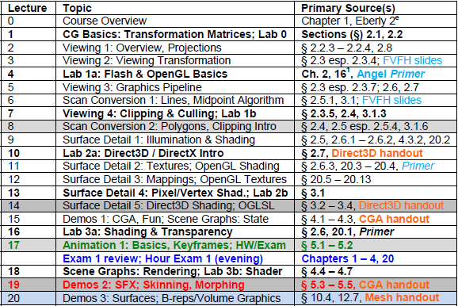

Where We Are

Slide 4
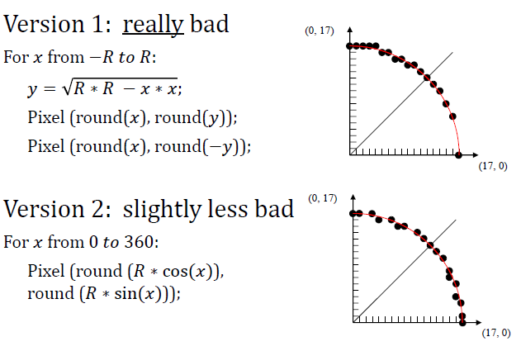
Drawing Circles, Versions1 & 2
Adapted from slides © 1997 – 2010 van Dam et al., Brown University
http://bit.ly/hiSt0f Reused with permission.

Slide 5
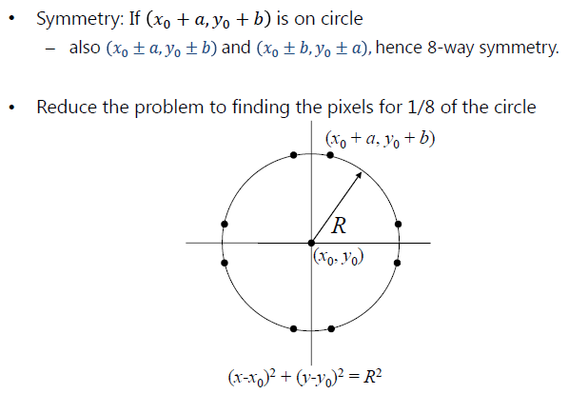
Drawing Circles, Version 3
Adapted from slides © 1997 – 2010 van Dam et al., Brown University
http://bit.ly/hiSt0f Reused with permission.

Slide 6
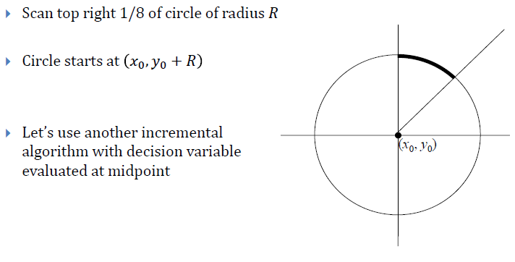
Using The Symmetry
Adapted from slides © 1997 – 2010 van Dam et al., Brown University
http://bit.ly/hiSt0f Reused with permission.

Slide 7
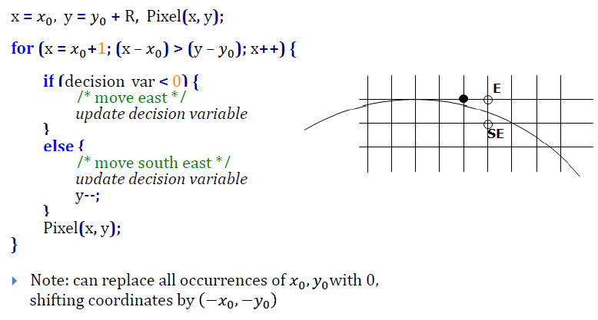
Incremental Algorithm [1]:
Sketch
Adapted from slides © 1997 – 2010 van Dam et al., Brown University
http://bit.ly/hiSt0f Reused with permission.

Slide 8
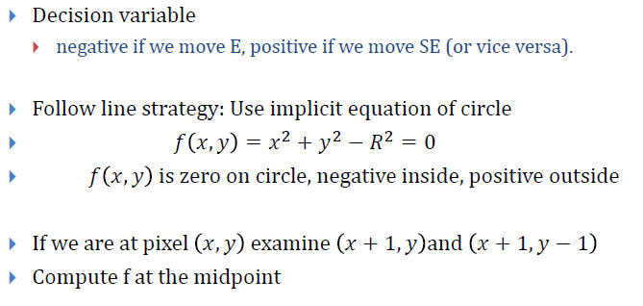
Incremental Algorithm [2]:
Computations needed
Adapted from slides © 1997 – 2010 van Dam et al., Brown University
http://bit.ly/hiSt0f Reused with permission.

Slide 9
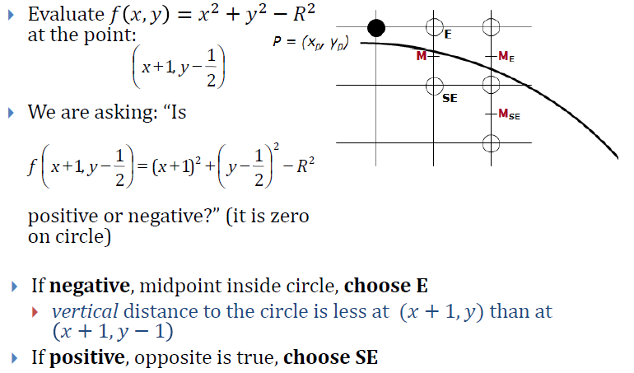
Decision Variable
Adapted from slides © 1997 – 2010 van Dam et al., Brown University
http://bit.ly/hiSt0f Reused with permission.

Slide 10
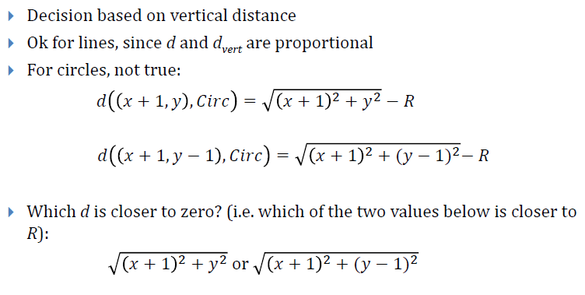
Right Decision Variable?
Adapted from slides © 1997 – 2010 van Dam et al., Brown University
http://bit.ly/hiSt0f Reused with permission.

Slide 11
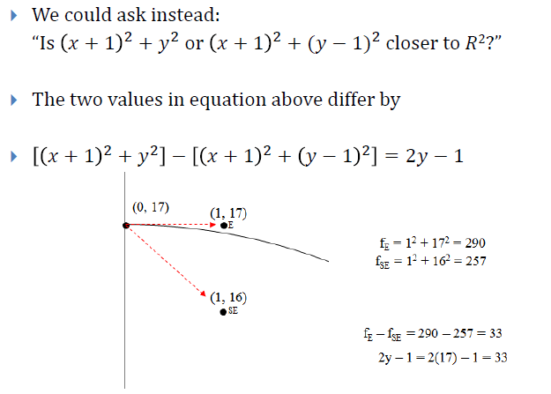
Alternate Phrasing [1]
Adapted from slides © 1997 – 2010 van Dam et al., Brown University
http://bit.ly/hiSt0f Reused with permission.

Slide 12
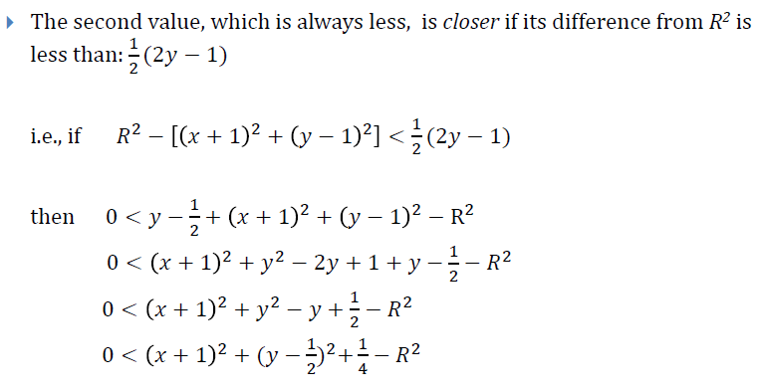
Alternate Phrasing [2]
Adapted from slides © 1997 – 2010 van Dam et al., Brown University
http://bit.ly/hiSt0f Reused with permission.

Slide 13
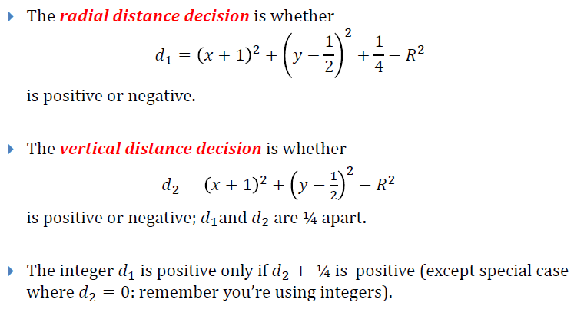
Alternate Phrasing [3]
Adapted from slides © 1997 – 2010 van Dam et al., Brown University
http://bit.ly/hiSt0f Reused with permission.

Slide 14
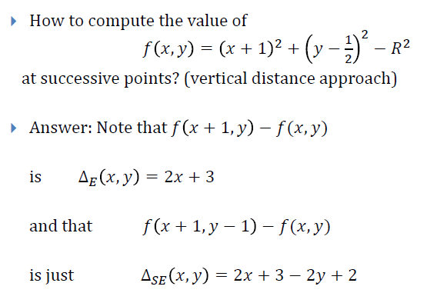
Incremental Algorithm Revisited [1]
Adapted from slides © 1997 – 2010 van Dam et al., Brown University
http://bit.ly/hiSt0f Reused with permission.

Slide 15
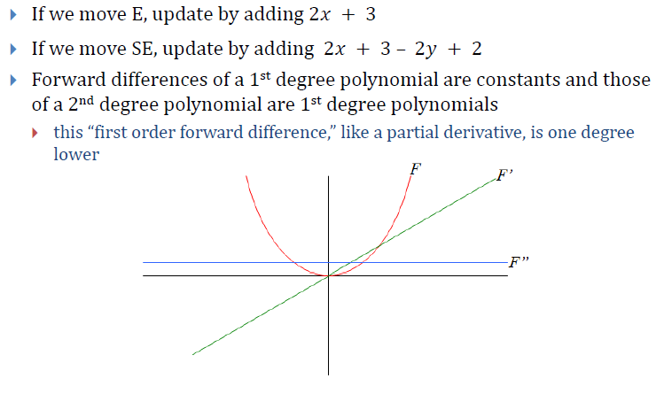
Incremental Algorithm Revisited [2]
Adapted from slides © 1997 – 2010 van Dam et al., Brown University
http://bit.ly/hiSt0f Reused with permission.

Slide 16
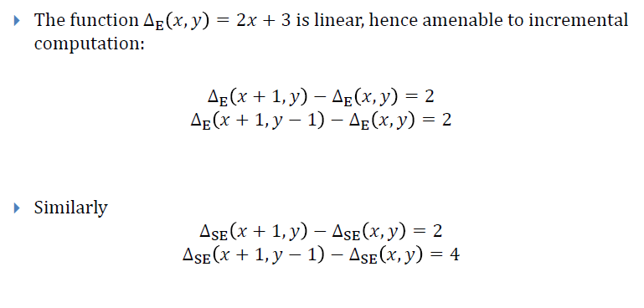
Second Differences [1]
Adapted from slides © 1997 – 2010 van Dam et al., Brown University
http://bit.ly/hiSt0f Reused with permission.

Slide 17
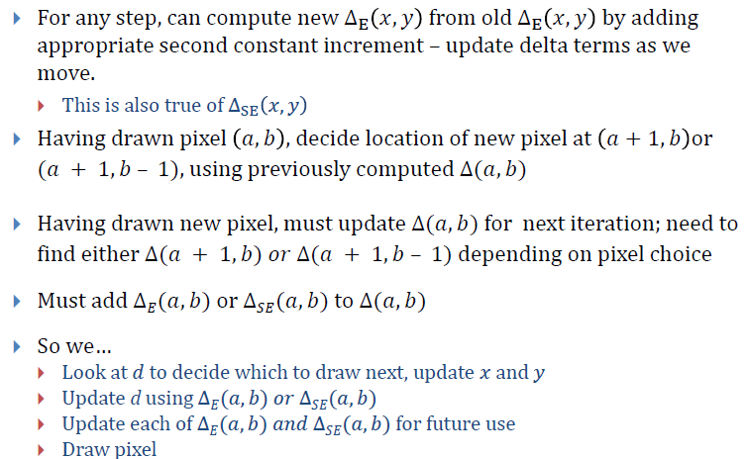
Second Differences [2]
Adapted from slides © 1997 – 2010 van Dam et al., Brown University
http://bit.ly/hiSt0f Reused with permission.

Slide 18
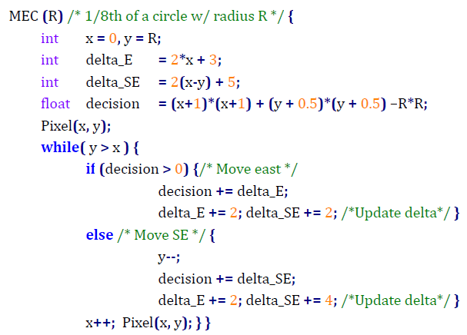
Midpoint Eighth Circle Algorithm
Adapted from slides © 1997 – 2010 van Dam et al., Brown University
http://bit.ly/hiSt0f Reused with permission.

Slide 19
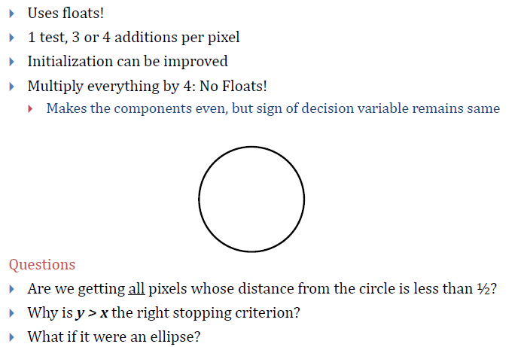
Analysis
Adapted from slides © 1997 – 2010 van Dam et al., Brown University
http://bit.ly/hiSt0f Reused with permission.

Slide 20
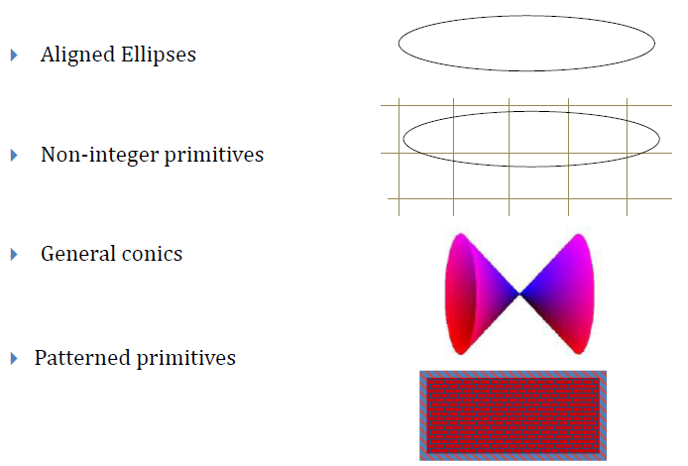
Other Scan Conversion Problems
Adapted from slides © 1997 – 2010 van Dam et al., Brown University
http://bit.ly/hiSt0f Reused with permission.

Slide 21
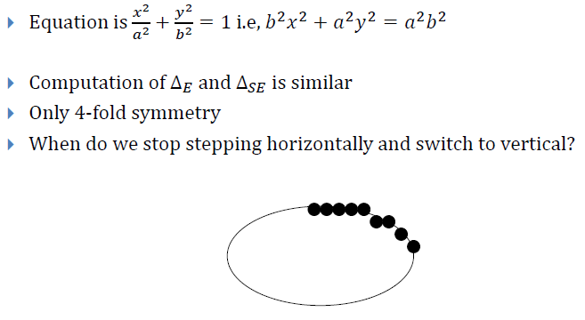
Aligned Ellipses
Adapted from slides © 1997 – 2010 van Dam et al., Brown University
http://bit.ly/hiSt0f Reused with permission.

Slide 22
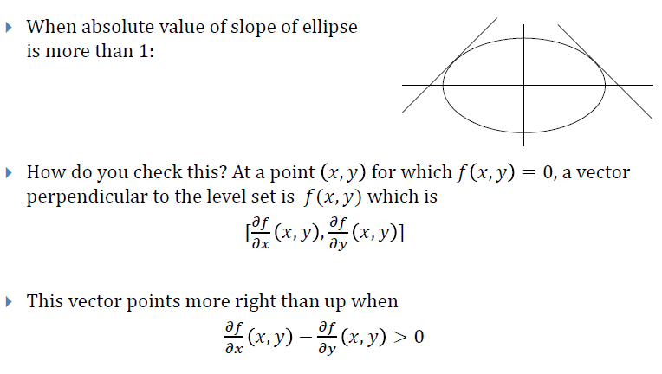
Direction-Changing Criterion [1]
Adapted from slides © 1997 – 2010 van Dam et al., Brown University
http://bit.ly/hiSt0f Reused with permission.

Slide 23
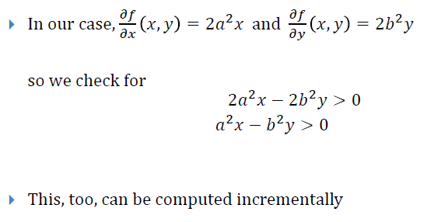
Direction-Changing Criterion [2]
Adapted from slides © 1997 – 2010 van Dam et al., Brown University
http://bit.ly/hiSt0f Reused with permission.

Slide 24
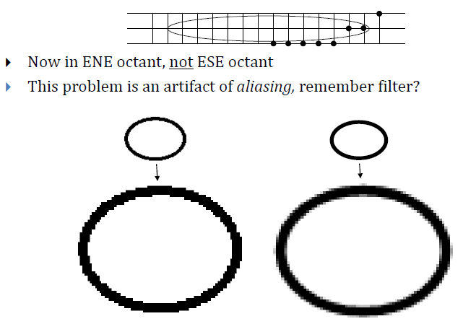
Problems with Aligned Ellipses
Adapted from slides © 1997 – 2010 van Dam et al., Brown University
http://bit.ly/hiSt0f Reused with permission.

Slide 25
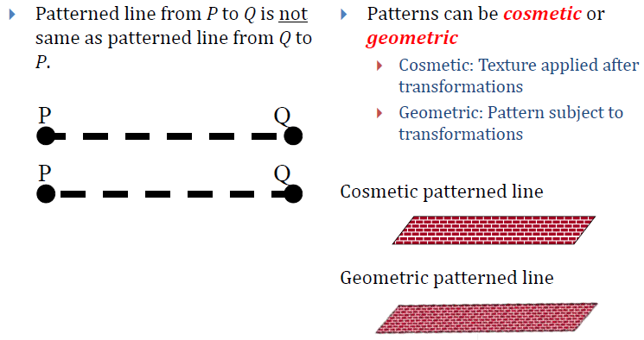
Patterned Lines
Adapted from slides © 1997 – 2010 van Dam et al., Brown University
http://bit.ly/hiSt0f Reused with permission.

Slide 26
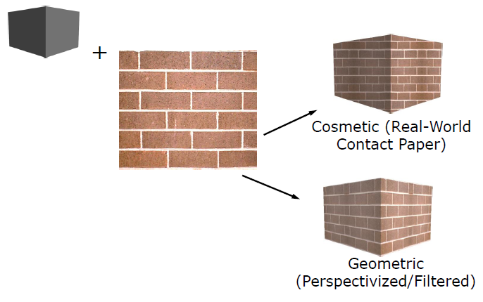
Geometric vs. Cosmetic
Adapted from slides © 1997 – 2010 van Dam et al., Brown University
http://bit.ly/hiSt0f Reused with permission.

Slide 27
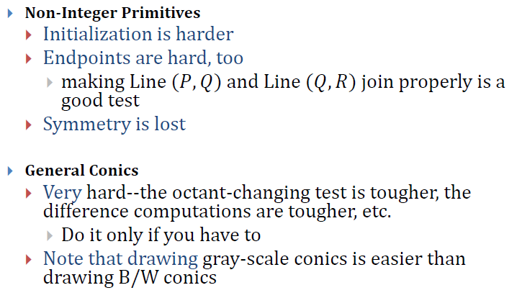
Non-Integer Primitives &
General Conics
Adapted from slides © 1997 – 2010 van Dam et al., Brown University
http://bit.ly/hiSt0f Reused with permission.

Slide 28
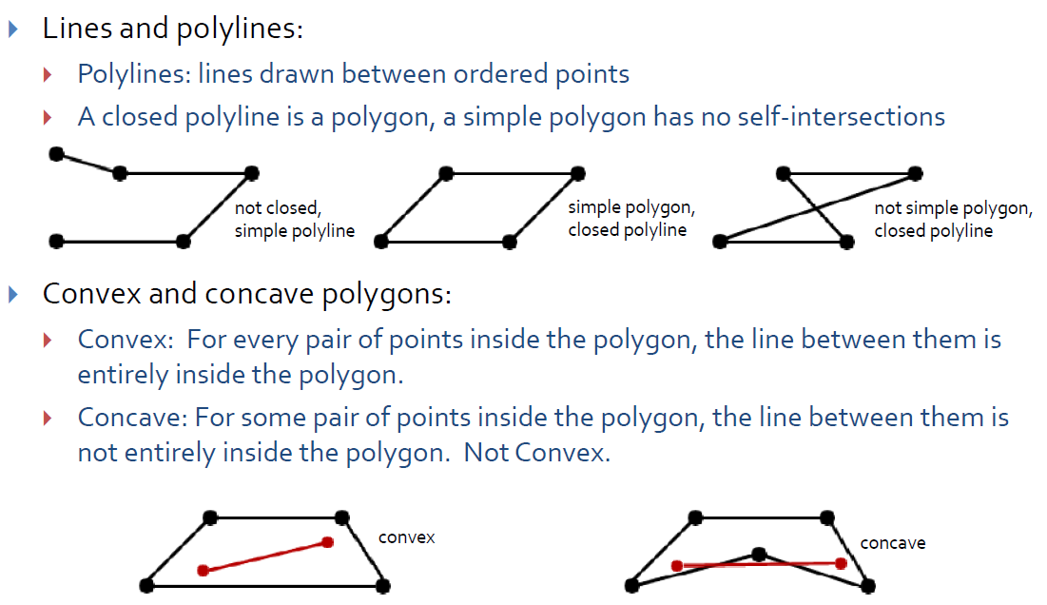
2-D Object Definition [1]
Brown University CS123
Shapes
Slide 2 (fall, 2010)
http://bit.ly/h2VZn8
Adapted from slides © 1997 – 2010 van Dam et al., Brown University
http://bit.ly/hiSt0f Reused with permission.

Slide 29
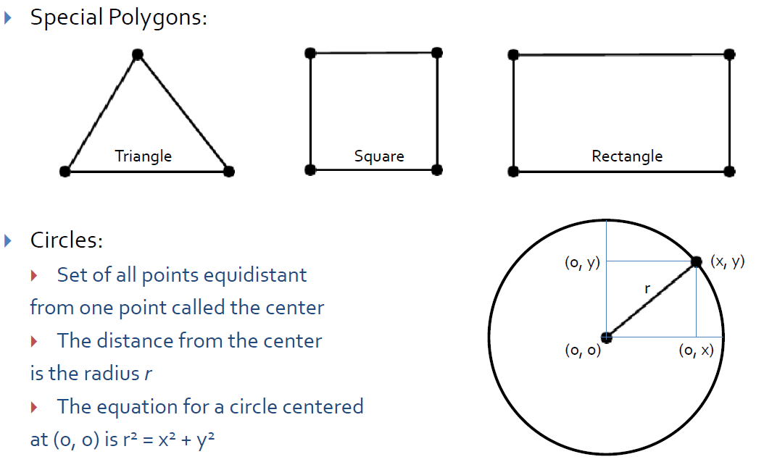
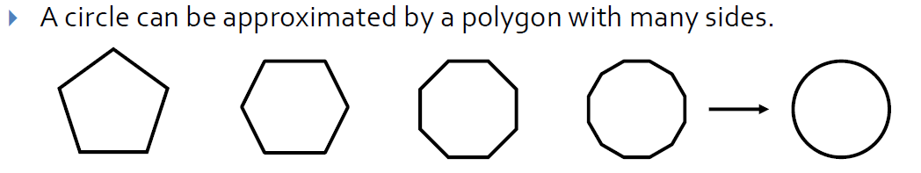
2-D Object Definition [2]
Brown University CS123
Shapes
Slides 3-4 (fall, 2010)
http://bit.ly/h2VZn8
Adapted from slides © 1997 – 2010 van Dam et al., Brown University
http://bit.ly/hiSt0f Reused with permission.

Slide 30
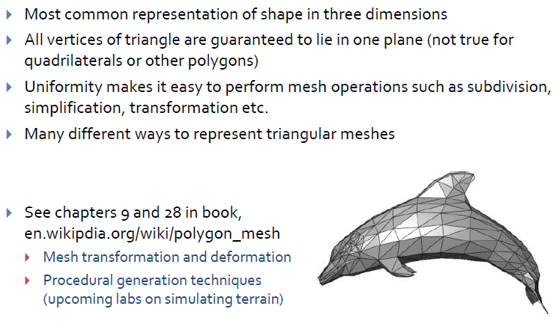
Triangle Meshes
Brown University CS123
Shapes
Slide 13 (fall, 2010)
http://bit.ly/h2VZn8
Adapted from slides © 1997 – 2010 van Dam et al., Brown University
http://bit.ly/hiSt0f Reused with permission.

Slide 31
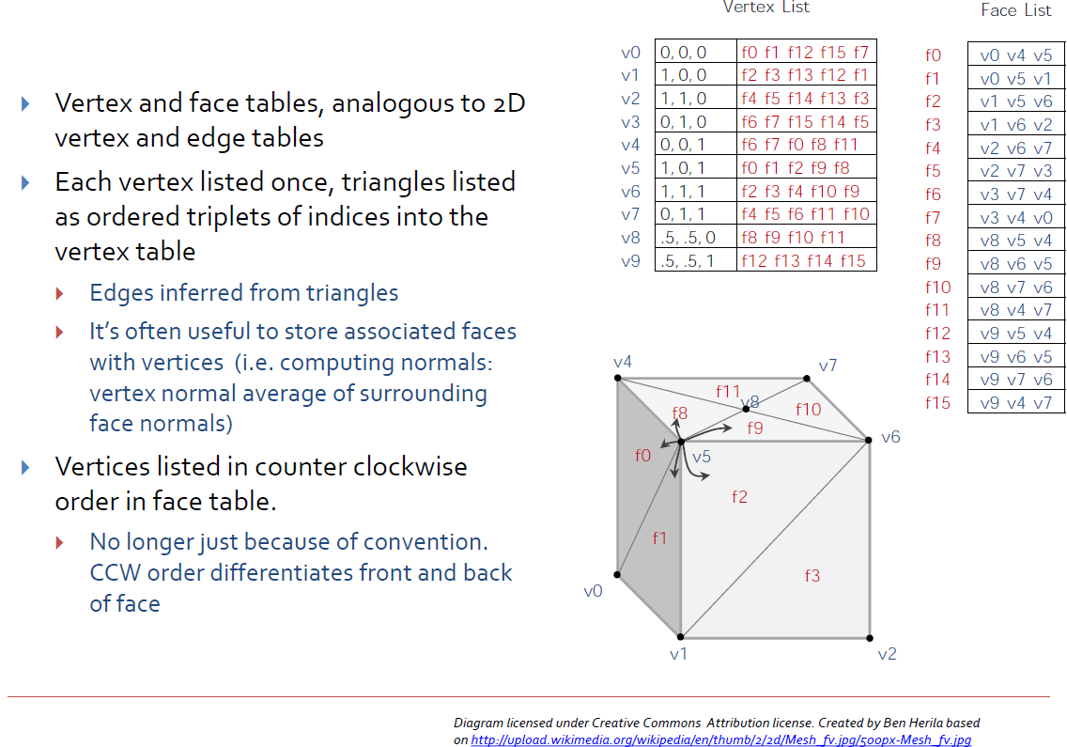
Triangular Mesh Representation
Brown University CS123
Shapes
Slide 14 (fall, 2010)
http://bit.ly/h2VZn8
Adapted from slides © 1997 – 2010 van Dam et al., Brown University
http://bit.ly/hiSt0f Reused with permission.

Slide 32
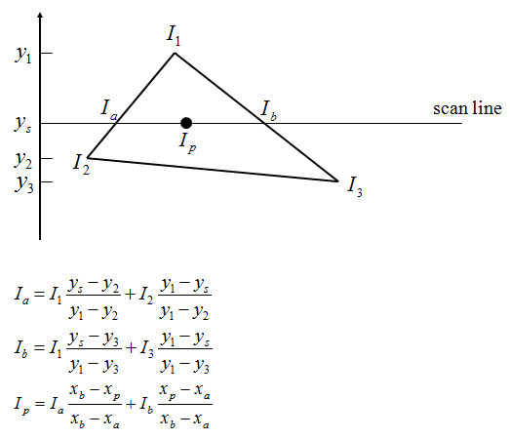
General Polygons [1]:
Scan Line Interpolation
1. Interpolate Value Along Polygon Edges to Get I_{a}, I_{b}
2. Interpolate Value Along Scan Lines to Get I_{p}
Adapted from slides © 1997 – 2010 van Dam et al., Brown University
http://bit.ly/hiSt0f Reused with permission.

Slide 33
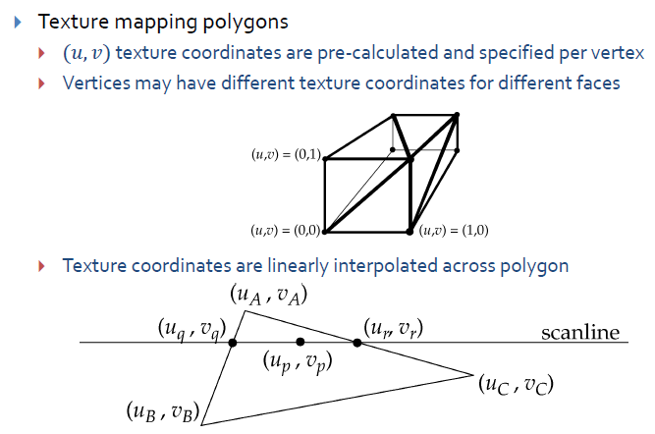
General Polygons [2]:
Texture Mapping Preview
Brown University CS123
(Polygons &) Texture Mapping
Slide 7 (fall, 2010)
http://bit.ly/h2VZn8
Adapted from slides © 1997 – 2010 van Dam et al., Brown University
http://bit.ly/hiSt0f Reused with permission.

Slide 34
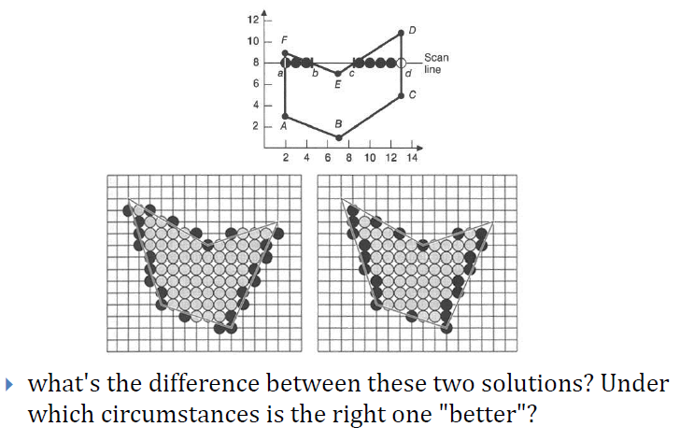
General Polygons [3]:
Continuity and Scan Line Interpolation
Brown University CS123
Scan Conversion
Slide 43 (fall, 2010)
http://bit.ly/hfbF0D
Adapted from slides © 1997 – 2010 van Dam et al., Brown University
http://bit.ly/hiSt0f Reused with permission.

Slide 35
Summary
Last Time: Clipping and Culling
  What parts of scene to clip: edges vs. polygons of model
  What parts of viewport to clip against: clip faces vs. clip edges
  Cohen-Sutherland clipping: outcodes, simultaneous equations
  Liang-Barsky / Cyrus-Beck clipping: parametric equations
  Visibility culling: view frustum, back face, occlusion
Today: Scan Conversion, Concluded
  Circles and ellipses
  Polygons: scan line interpolation (for flat/constant shading)
  Later: Gouraud & Phong shading, z-buffering, texture mapping
Excerpts from Van Dam notes, Brown CS123
  Scan converting circles/ellipses
  Polygons
  Triangle meshes
  Scan line interpolation

Slide 36
Terminology
Scan Conversion (aka Rasterization)
  Given: geometric object (e.g., circle, ellipse, projected polygon)
  Decide: what pixels to light (turn on; later, color/shade)
  Basis: what part of pixels crossed by object
Issues (Reasons why Scan Conversion is Nontrivial Problem)
  Aliasing (e.g., jaggies) – discontinuities in lines
  Cracks: discontinuities in “polygon” mesh
Drawing Circles & Ellipses
  Incremental algorithm – uses rounding, floating point arithmetic
  Forward differences – precalculated amounts to add to running total
  Decision variable – value whose sign indicates which pixel is next
Drawing Polygons
  Texture mapping – finding pixels of image (texture) to put in polygon
  Scan line interpolation – procedure for filling in closed curves

