Slide 1
Lecture 10 of 41
Introduction to DirectX & Direct3D
Lab 2a: Direct3D Basics
William H. Hsu
Department of Computing and Information Sciences, KSU
KSOL course pages: http://bit.ly/hGvXlH / http://bit.ly/eVizrE
Public mirror web site: http://www.kddresearch.org/Courses/CIS636
Instructor home page: http://www.cis.ksu.edu/~bhsu
Readings:
Today: Section 2.7, Eberly 2e – see http://bit.ly/ieUq45; Direct3D handout
Handout based on material © 2004 – 2010 K. Ditchburn: http://bit.ly/hMqxMl
Next class: Sections 2.6.3, 20.3 – 20.4, Eberly 2e
Wikipedia article: http://en.wikipedia.org/wiki/Shader

Slide 2
Lecture Outline
Reading for Last Class: §2.5, 2.6.1 – 2.6.2, 4.3.2, 20.2, Eberly 2e
Reading for Today: §2.7, Eberly 2e; Direct3D handout
Reading for Next Class: §2.6.3, 20.3 – 20.4, Eberly 2e
Last Time: Intro to Illumination and Shading
Local vs. global models
Illumination (vertex shaders) vs. shading (fragment/pixel shaders)
Phong illumination equation: introduction to shading
Previously: Projections, Modelview, Viewing, Clipping & Culling
Today: Direct3D Design Overview, Programming Intro
Hardware Rendering: Application Programmer Interfaces (APIs)
Shaders in Modern Pipeline
Vertex shaders: vertex attributes to illumination at vertices
Pixel shaders: lit vertices to pixel colors, transparency
Next: Texture Mapping Explained; Shading in OpenGL

Slide 3
Vertex Shaders vs.
Pixel Shaders
Classical Fixed-Function Pipeline (FFP): Per-Vertex Lighting, MVT + VT
Largely superseded on desktop by programmable pipeline
Still used in mobile computing
Modern Programmable Pipeline: Per-Pixel Lighting
Vertex Shaders (FFP and Programmable)
Input: per-vertex attributes (e.g., object space position, normal)
Output: lighting model terms (e.g., diffuse, specular, etc.)
Pixel Shaders (Programmable Only)
Input: output of vertex shaders (lighting aka illumination)
Output: pixel color, transparency (R, G, B, A)
Brief Digression
Note: vertices are lit, pixels are shaded
“Pixel shader”: well-defined (iff “pixel” is)
“Vertex shader”: misnomer (somewhat)
Most people refer to both as “shaders”

Slide 4
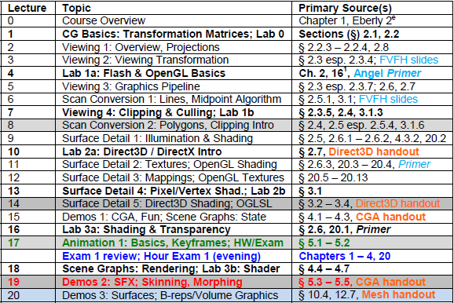
Where We Are

Slide 5
Acknowledgements
Nathan H. Bean
Instructor
Outreach Coordinator
Department of Computing and Information Sciences
Kansas State University
http://bit.ly/gC3vwH
Direct3D material from slides © 2006 – 2010 N. Bean, Kansas State University
http://bit.ly/gC3vwH
Randy Fernando
Executive Director
Mindful Schools
http://www.randima.com
Andy van Dam
T. J. Watson University Professor of Technology and Education & Professor of Computer Science
Brown University
http://www.cs.brown.edu/~avd/
Mark Kilgard
Principal System Software Engineer
Nvidia
http://bit.ly/gdjLzR
Cg material from figures © 2003 R. Fernando & M. Kilgard, Nvidia, from The Cg Tutorial
http://bit.ly/59ffSR

Slide 6
Direct3D
Popular 3-D Graphics Library of DirectX (Sometimes Called “DirectX”)
Top market share due to Windows & Xbox platforms
Many developers (has overtaken OpenGL except on smartphones)
Can Implement Many Effects We Have Studied/Will Study Such As:
Cube map (Lecture 12)
Particle system (Lecture 28)
Instancing (Lecture 20 & Advanced CG)
Shadow volume (Lecture 12)
Displacement Mapping (Lecture 12)
© 2006 D. Blythe, “The Direct3D® 10 System”.
http://bit.ly/i33uMv

Slide 7
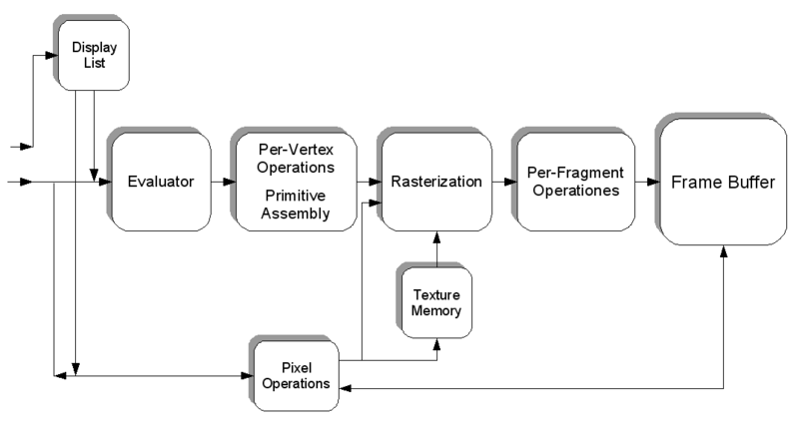
Preview:
Shader Languages
}
Remember this
from Lecture 04?
OpenGL State Machine (Simplified) from Wikipedia: Shader
http://bit.ly/fi8tBP
• HLSL: Shader language and API developed by Microsoft, only usable from within a DirectX application.
• Cg: Shader language and API developed by Nvidia, usable from within a DirectX and OpenGL application. Cg has a stark resemblance to HLSL.
• GLSL: Shader language and API developed by the OpenGL consortium and usable from within an OpenGL application.
© 2009 Koen Samyn
http://knol.google.com/k/hlsl-shaders

Slide 8
DirectX
DirectX is a collection of APIs developed by Microsoft for multimedia and game applications
They utilize the Component Object Model (COM), allowing you to use them across a wide variety of languages
The entire DirectX API is available freely from Microsoft, and works with any current Visual Studio compiler (and many others)
Today we’ll be focusing on the API for 3D rendering, Direct3D
Direct3D material from slides © 2006 – 2010 N. Bean, Kansas State University
http://bit.ly/gC3vwH

Slide 9
Abstraction
The primary purpose of Direct3D is to provide a uniform interface for working directly with the graphics hardware without having to go through windows.
Direct3D applications actually render to a display surface within the confines of a window – they don’t use the Window API
For best performance, you want to use full-screen, exclusive mode. In this mode, Windows does no rendering whatsoever, allowing you to leverage the full resources of the computer
Direct3D material from slides © 2006 – 2010 N. Bean, Kansas State University
http://bit.ly/gC3vwH

Slide 10
Rendering Basics
Like OpenGL, Direct3D uses vertex-based polygon mesh data to render 3D Data
All 3D graphics are composed of triangles, usually these triangles share sides in what we refer to as a triangle mesh, or mesh.
Each triangle is defined by its three corners, which we refer to as vertices
We can store more data on vertices than just their position in 3D space – texture coordinates, normal vectors, and ambient colors for example
Direct3D material from slides © 2006 – 2010 N. Bean, Kansas State University
http://bit.ly/gC3vwH

Slide 11
Direct3D Device
Direct 3D places most of its rendering control in a Direct3D Device object.
Essentially, the Direct3D Device is a wrapper around the graphics hardware, and exposes most of its functionality to the programmer through a common interface.
You can poll the Direct3D Device to learn of the graphics hardware’s capabilities
Direct3D material from slides © 2006 – 2010 N. Bean, Kansas State University
http://bit.ly/gC3vwH

Slide 12
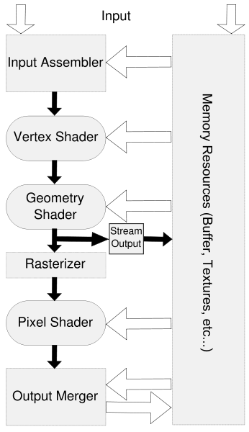
Direct3D Rendering Pipeline
The process of transforming model geometry into on-screen images is called the rendering pipeline
In DirectX, the pipeline runs entirely on the graphics hardware – there is no software fallback
Other than that difference, it shares many characteristics with other 3D rendering libraries
Direct3D material from slides © 2006 – 2010 N. Bean, Kansas State University
http://bit.ly/gC3vwH

Slide 13
Input Assembly
Input is sent from the DirectX application in the form of Vertex data (both buffered and unbuffered), shader code and variables, and textures
When possible, these sources are stored in the on-board graphics card memory
Direct3D material from slides © 2006 – 2010 N. Bean, Kansas State University
http://bit.ly/gC3vwH

Slide 14
Vertex Formats [1]:
Flexible Vertex Format (FVF)
You also will define the format of vertices that you will send to the graphics card.
We use the Flexible Vertex Format (FVF) to do this
FVF is a two part process – we define a struct representing our vertex format, and define a constant describing the structure of the format.
Direct3D material from slides © 2006 – 2010 N. Bean, Kansas State University
http://bit.ly/gC3vwH

Slide 15
Vertex Formats [2]:
Using FVF
#define POSITION_NORMAL_TEXTURE_FVF(D3DFVF_XYZ | D3DFVF_NORMAL | D3DFVF_TEX1)
struct PositionNormalTextureVertex
{
float x,y,z;
float nx, ny, nz;
float tu, tv;
};
Direct3D material from slides © 2006 – 2010 N. Bean, Kansas State University
http://bit.ly/gC3vwH

Slide 16
Vertex Formats [3]:
For More Details on FVF
Flexible Vertex Formats allow us to send the bare minimum of vertex data for our needs to the graphics card.
Since the pipeline from our CPU to the graphics hardware tends to be a bottleneck, this is a must when speed is a concern.
More detail on what flags exist for the Direct3D FVF can be found in the DirectX API documentation
Direct3D material from slides © 2006 – 2010 N. Bean, Kansas State University
http://bit.ly/gC3vwH

Slide 17
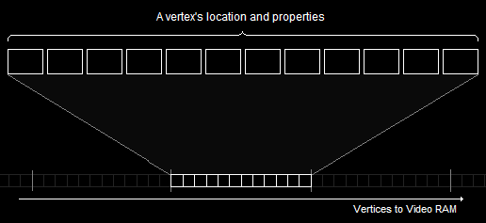
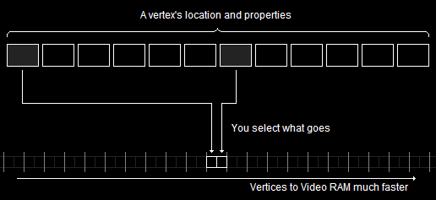
FVF Graphically Expressed
Graphics courtesy of http://www.directxtutorial.com
Direct3D material from slides © 2006 – 2010 N. Bean, Kansas State University
http://bit.ly/gC3vwH

Slide 18
Vertex Buffers
Vertex Buffers are used to hold vertex data and to stream this data to the graphics card
Buffers may be located in Video memory or in RAM, depending on your device setup
Buffers are a shared resource – both the CPU and the GPU will be accessing them at times. Because of this, we will need to lock the buffer before we place our data into it.
To minimize overhead, it is common practice to create your vertex data in CPU-only memory, then do a fast copy (memcpy) into a locked Vertex buffer
Direct3D material from slides © 2006 – 2010 N. Bean, Kansas State University
http://bit.ly/gC3vwH

Slide 19
Rendering Vertex Buffers
First, you need to set it as a stream source on your Direct3D Device
Then you can call DrawPrimitive on your device, indicating what portion of the Vertex Buffer should be drawn, along with what kind of primitive you are rendering
This starts the vertex data on the Rendering Pipeline
Direct3D material from slides © 2006 – 2010 N. Bean, Kansas State University
http://bit.ly/gC3vwH

Slide 20
Index Buffers
Index Buffers are an array of indices which reference an associated Vertex Buffer
Index Buffers allow us to re-use Vertex data elements when creating meshes – this is especially useful because triangles in most meshes are sharing their vertices with adjacent triangles.
By using an index buffer, we only have to define a vertex once, then we can define the triangle by indices; and since an index is usually quite a bit smaller than a vertex’s data, we send less data into our pipeline.
Direct3D material from slides © 2006 – 2010 N. Bean, Kansas State University
http://bit.ly/gC3vwH

Slide 21
Rasterization
Rasterization
process by which geometry is converted into pixels for rendering
much the same with any rendering process
In general, refers to all vector-to-raster stages
transformations
clipping
scan conversion
Sometimes equated with scan conversion (final step)
Direct3D maintains useful buffers for it
depth buffers
stencil buffers
Direct3D material from slides © 2006 – 2010 N. Bean, Kansas State University
http://bit.ly/gC3vwH

Slide 22
Vertex Shaders [1]
The next step down the pipeline are the Vertex Shaders
Vertex shaders allow us to manipulate our vertex data on the graphics card
This is important, because it means we’ll be using the GPU
Direct3D material from slides © 2006 – 2010 N. Bean, Kansas State University
http://bit.ly/gC3vwH

Slide 23
Vertex Shaders [2]
There are a number of reasons we want to manipulate our vertex data on the GPU rather than the CPU:
The GPU is highly optimized for Vector- and Matrix-based operations. The CPU is not.
Because these operations operate independently from the CPU, our CPU is now free for other operations
Vertex Shaders are essentially little programs that run against every vertex in the data we’ve sent down the rendering pipleline
We write vertex shaders using Microsoft’s High-Level Shader Language
Direct3D material from slides © 2006 – 2010 N. Bean, Kansas State University
http://bit.ly/gC3vwH

Slide 24
High-Level Shader Language [1]
HLSL was originally developed as part of a joint partnership between Nvidia and Microsoft, which also was responsible for Cg
It sports a very C-like syntax, but also supports arbitrary sized vectors and matrices
e.g., 4x4 matrix of floats can be defined by float4x4
3-element vector of floats can be defined by float3
We can also pass variables into our shaders from DirectX as externs
Direct3D material from slides © 2006 – 2010 N. Bean, Kansas State University
http://bit.ly/gC3vwH

Slide 25
High-Level Shader Language [2]
HLSL also sports two vector component namespaces, which provide helpful a helpful shorthand when dealing with postitions and colors: xyzw and rgba
e.g., color.r is equivalent to color[0]
position.y is equivalent to position[1]
We can also swizzle our vectors – access more than one component in a single call
e.g., color.gb += 0.5f; adds 0.5 to both the green and blue components of the vector color
Finally, HLSL provides a lot of useful functions – you can read the API documentation for more
Direct3D material from slides © 2006 – 2010 N. Bean, Kansas State University
http://bit.ly/gC3vwH

Slide 26
Uses for Vertex Shaders
Vertex shaders are primarily used to transform our vertices. Some Examples:
Dynamic deformation of models
Displacement Mapping
Billboards
Fluid modeling
Particles
Vertex shaders can be further combined with other shader types for a wide variety of possible effects
Direct3D material from slides © 2006 – 2010 N. Bean, Kansas State University
http://bit.ly/gC3vwH

Slide 27
Geometry Shaders [1] :
Implementation
Geometry Shaders are a new feature for DirectX 10
They aren’t supported by the Xbox 360, and most computers at the moment
But they offer some exciting possibilities for the near future
Direct3D material from slides © 2006 – 2010 N. Bean, Kansas State University
http://bit.ly/gC3vwH

Slide 28
Geometry Shaders [2]:
Uses
The primary purpose of a Geometry Shader is to create new geometry using the vector data supplied from the Vector Shader
This means they can be used for
Generating point sprites
Extruding shadow volumes (to use in the pixel shader)
Further tessellation operations – i.e. increasing the level of tessellation in models (more triangles == smother models)
Subdivision surfaces (e.g., terrain)
Single-pass cube map generation
Direct3D material from slides © 2006 – 2010 N. Bean, Kansas State University
http://bit.ly/gC3vwH

Slide 29
Rasterization Revisited:
Per-Pixel Operations
Recall: Definition
Conversion of geometry into pixels for rendering
Common/similar step across rendering pipelines
Input Assembler Takes Care of Viewing Transformation (VT)
Per-Vertex Operations
Clipping
Culling
Lighting (for flat or Gouraud shading; not Phong shading)
Per-Pixel Operations
Scan conversion of primitives
Pixel shading
Direct3D material from slides © 2006 – 2010 N. Bean, Kansas State University
http://bit.ly/gC3vwH

Slide 30
Pixel Shaders [1]:
Implementation
Pixel Shaders allow further transformation on the rasterized pixel data
Like Vertex Shaders, Pixel Shaders are written in HLSL, use the same syntax and function libraries, and can have variables set by Direct3D
Direct3D material from slides © 2006 – 2010 N. Bean, Kansas State University
http://bit.ly/gC3vwH

Slide 31
Pixel Shaders [2]:
Uses
Pixel Shaders can be used in a number of ways:
To control how multiple textures are blended when texturing a surface
To alter the color of a material
For customized lighting
To apply specular highlights
Direct3D material from slides © 2006 – 2010 N. Bean, Kansas State University
http://bit.ly/gC3vwH

Slide 32
“Managed” Direct3D
Direct3D offers the programmer a lot of control, but careful attention must be paid to memory and resource management
Microsoft piloted a “Managed” DirectX effort at one point. This, combined with the library they developed for the original X-Box, developed into XNA, a shared library, framework, and IDE for building game applications in C#
Direct3D material from slides © 2006 – 2010 N. Bean, Kansas State University
http://bit.ly/gC3vwH

Slide 33
Drawing in Direct3D [1]:
Defining Flexible Vertex Formats
Position & Normal Only vs. Position & Color Only
With Textures
Components
≡
D3DFVF_XYZ - position in 3-D space D3DFVF_XYZRHW - already transformed co-ordinate (2-D space) D3DFVF_NORMAL - normal D3DFVF_DIFFUSE - diffuse colour D3DFVF_SPECULAR - specular colour D3DFVF_TEX1 - one texture co-ordinate D3DFVF_TEX2 - two texture co-ordinates
Toymaker © 2004 – 2010 K. Ditchburn, Teesside University
http://bit.ly/hMqxMl

Slide 34
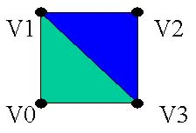
Drawing in Direct3D [2]:
Steps & Example
Specify the material we wish to use for the following triangles
Specify the texture we wish to use (if we want one or NULL if not)
Set the stream source to our vertex buffer
Set the FVF we will be using
Set the index buffer we will be using
Call the required DrawPrimitive function
void CGfxEntityCube::Render() {
gD3dDevice->SetMaterial( &m_material ); gD3dDevice->SetTexture(0,NULL); gD3dDevice->SetStreamSource( 0, m_vb,0, sizeof(CUBEVERTEX) ); gD3dDevice->SetFVF( D3DFVF_CUBEVERTEX ); gD3dDevice->SetIndices( m_ib); // draw a triangle list using 24 vertices and 12 triangles gD3dDevice->DrawIndexedPrimitive( D3DPT_TRIANGLELIST,0,0,24,0,12);
}
Toymaker © 2004 – 2010 K. Ditchburn, Teesside University
http://bit.ly/hMqxMl

Slide 35
Direct3D vs. OpenGL
Most people find OpenGL easier to learn to start with
OpenGL uses standard C interfaces.
Direct3D has a steeper initial learning curve and is based on C++ interfaces (COM).
It is more difficult using OpenGL to do lower level operations than Direct3D, however this does mean you are less likely to crash an OpenGL app than a Direct3D one.
The vast majority of PC games are written using Direct3D.
OpenGL can run on multiple platforms where as Direct3D is Windows based.
Direct3D is updated frequently (every 2 months), allowing a standard interface to new features sooner than they appear in core OpenGL. However, OpenGL has an extension mechanism allowing immediate access to new features as graphics manufacturers create them, rather than having to wait for a new API version to appear.
Direct3D has a lot of helper functions for common game coding issues (the D3DX set of functions)
In terms of performance there is little difference between the two.
Toymaker © 2004 – 2010 K. Ditchburn, Teesside University
http://bit.ly/hMqxMl

Slide 36
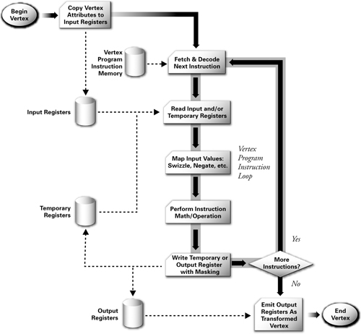
Preview:
Vertex Shaders
© 2003 R. Fernando & M. Kilgard. The Cg Tutorial.
http://bit.ly/59ffSR

Slide 37
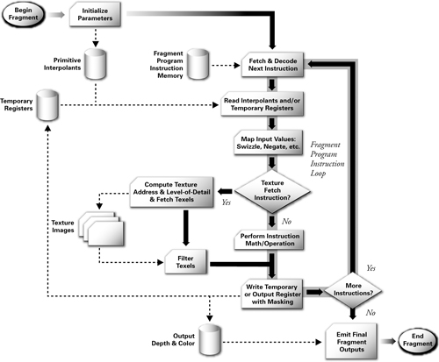
Preview: Pixel & Fragment Shaders
© 2003 R. Fernando & M. Kilgard. The Cg Tutorial.
http://bit.ly/59ffSR

Slide 38
Next Time: Texture Mapping!
Adapted from slides
© 2002 Gröller, E. & Jeschke, S. Vienna Institute of Technology

Slide 39
Summary
Last Time: Intro to Illumination and Shading
Local vs. global models
Illumination (vertex shaders) vs. shading (fragment/pixel shaders)
Phong illumination equation: introduction to shading
Previously: Classical Fixed-Function Pipeline
Today: Shaders in Modern Pipeline
Vertex shaders
Input: per-vertex attributes (e.g., object space position, normal)
Output: lighting model terms (e.g., diffuse, specular, etc.)
Pixel shaders
Input: output of vertex shaders (lighting aka illumination)
Output: pixel color, transparency (R, G, B, A)
Hardware Rendering: Application Programmer Interfaces (APIs)
Drawing in Direct3D: See Toymaker Site – http://bit.ly/hMqxMl
Next: Shader Languages – (O)GLSL, HLSL / Direct3D, Renderman

Slide 40
Terminology
Direct3D: Graphics Component of Microsoft DirectX Library
Similarities to OpenGL: C/C++, 3-D polygons-to-pixels pipeline
Differences vs. OpenGL: Windows, COM, some lower-level ops
Classical Fixed-Function Pipeline (FFP): Per-Vertex Lighting, MVT + VT
Modern Programmable Pipeline: Per-Pixel Lighting
Vertex Shaders (FFP and Programmable)
Input: per-vertex attributes (e.g., object space position, normal)
Output: lighting model terms (e.g., diffuse, specular, etc.)
Pixel Shaders (Programmable Only)
Input: output of vertex shaders (lighting aka illumination)
Output: pixel color, transparency (R, G, B, A)
Shader Languages
Domain-specific programming languages
Geared towards hardware rendering
(O)GLSL, HLSL / Direct3D, Renderman

