Slide 1
Lecture 11of 41
Surface Detail 2 of 5: Textures
OpenGL Shading
William H. Hsu
Department of Computing and Information Sciences, KSU
KSOL course pages: http://bit.ly/hGvXlH / http://bit.ly/eVizrE
Public mirror web site: http://www.kddresearch.org/Courses/CIS636
Instructor home page: http://www.cis.ksu.edu/~bhsu
Readings:
Today: Sections 2.6.3, 20.3 – 20.4, Eberly 2e – see http://bit.ly/ieUq45
Next class: Sections 20.5 – 20.13, Eberly 2e
Brown CS123 slides on Polygons/Texture Mapping – http://bit.ly/h2VZn8
Wayback Machine archive of Brown CS123 slides: http://bit.ly/gAhJbh\
CMU 15-462 slides on OpenGL Shading – http://bit.ly/g1J2nj

Slide 2
Lecture Outline
Reading for Last Class: §2.7, Eberly 2e; Direct 3D Handout
Reading for Today: §2.6.3, 20.3 – 20.4, Eberly 2e
References: Gröller & Jeschke (2002), Isenberg (2005), Jacobs (2007)
Reading for Next Class: §20.5 – 20.13, Eberly 2e
Last Time: Intro to Illumination and Shading
  Local vs. global models
  Illumination (vertex shaders) vs. shading (fragment/pixel shaders)
  Bidirectional reflectance distribution function (BRDF) ρ(p, ω _{i}, ω_{o}, λ)
  Phong illumination equation: introduction to shading
Texture Mapping Explained
  Definitions
  Design principles
Texture Pipeline
Using Simple Intermediate Surfaces (Cylinder, Sphere, Plane, Box)
OpenGL Shading: Flat Shading, Smooth Shading (Gouraud)

Slide 3
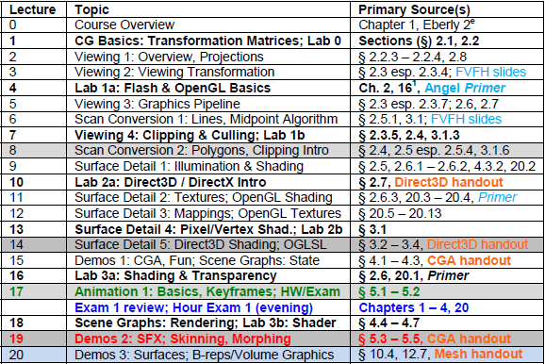

Where We Are

Slide 4
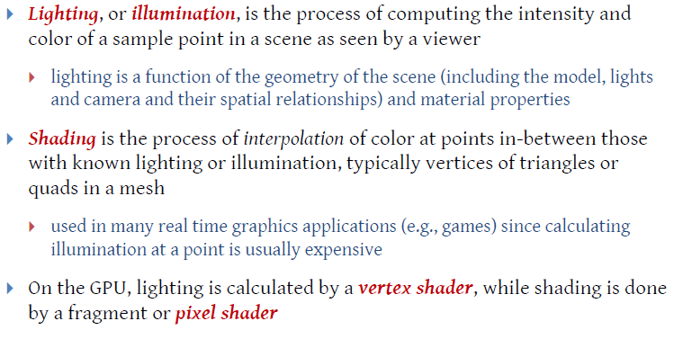
Review:
Illumination & Shading
Adapted from slides © 2010 van Dam et al., Brown University
http://bit.ly/hiSt0f Reused with permission.

Slide 5
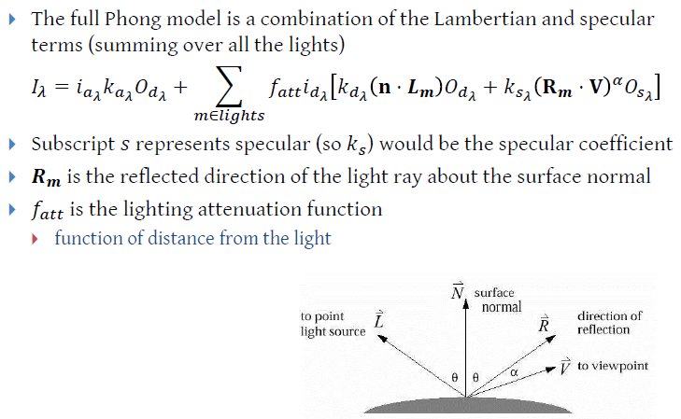
Review:
Phong Illumination Equation
Adapted from slides © 1997 – 2010 van Dam et al., Brown University
http://bit.ly/hiSt0f Reused with permission.

Slide 6
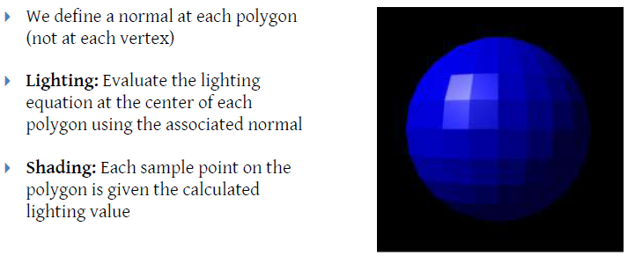
Review:
Flat/Constant Shading
GL_CONSTANT
Adapted from slides © 2010 van Dam et al., Brown University
http://bit.ly/hiSt0f Reused with permission.

Slide 7
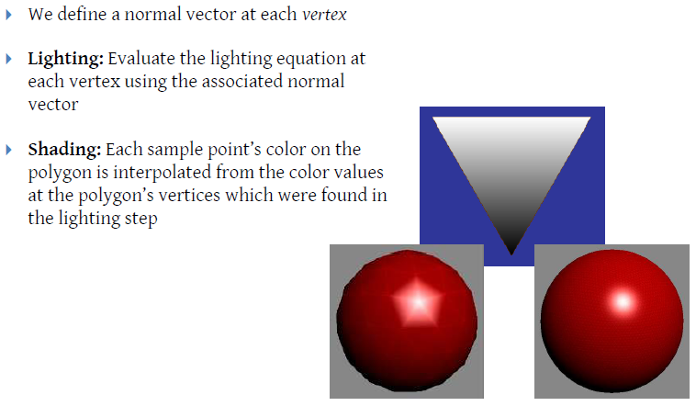
Review:
Gouraud Shading
GL_SMOOTH
Adapted from slides © 2010 van Dam et al., Brown University
http://bit.ly/hiSt0f Reused with permission.

Slide 8
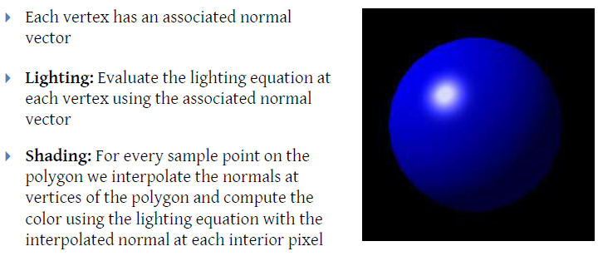
Review:
Phong Shading
OpenGL implementation?
Stay tuned…
Adapted from slides © 2010 van Dam et al., Brown University
http://bit.ly/hiSt0f Reused with permission.

Slide 9
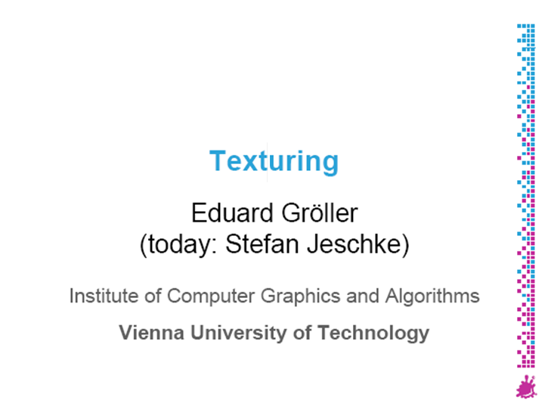
Source Material on Texturing:
Gröller & Jeschke (Vienna Tech)
Adapted from slides
© 2002 Gröller, E. & Jeschke, S. Vienna Institute of Technology

Slide 10
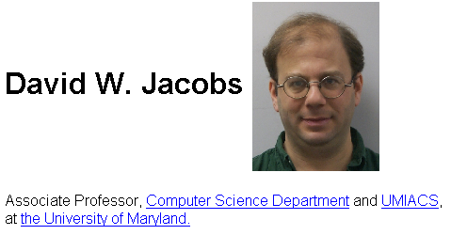
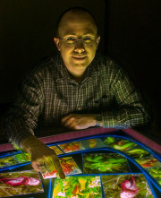
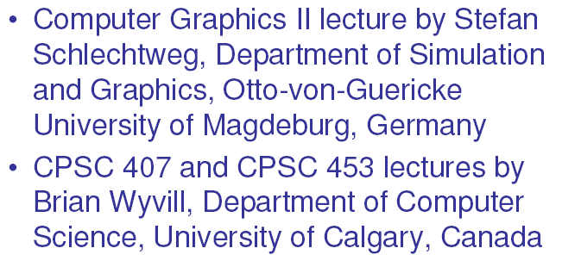
Other Source Material on
Texture Mapping
CMSC 427 Computer Graphics
University of Maryland – College Park (UMD)
Fall 2007
Course: http://bit.ly/fXVA1A
Instructor: http://www.cs.umd.edu/~djacobs
Tobias Isenberg
Scientific Visualization and Computer Graphics Group
Department of Mathematics and Computing Science
University of Groningen
Formerly
Graphics Jungle Lab
Department of Computer Science
University of Calgary
CPSC 599.64/601.64 Computer Graphics
Fall 2005
Course: http://bit.ly/idD2qX
Instructor: http://www.cs.rug.nl/~isenberg

Slide 11
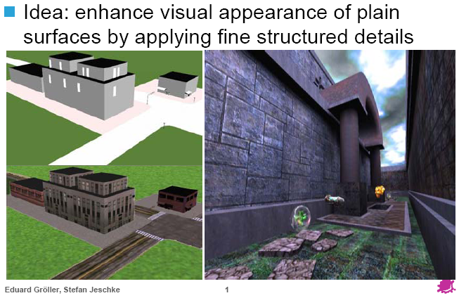
Why Texturing?
Adapted from slides
© 2002 Gröller, E. & Jeschke, S. Vienna Institute of Technology

Slide 12
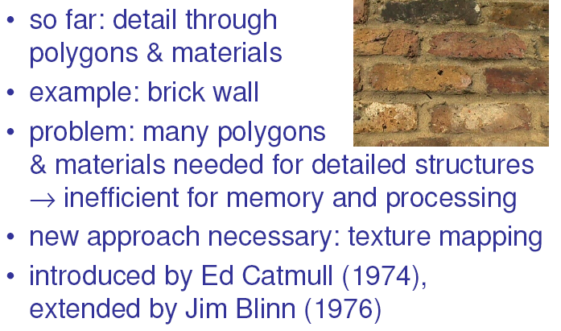
Introduction [1]:
Motivation
Adapted from slides
© 2005 Isenberg, T., University of Calgary (now at U. Groningen)

Slide 13
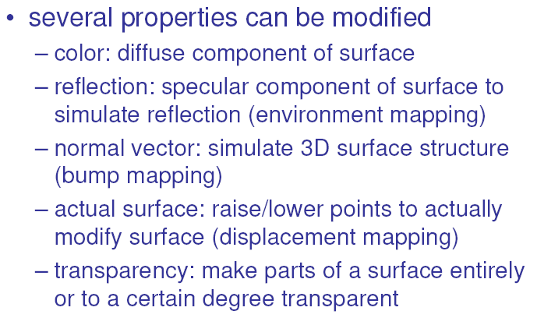
Introduction [2]:
Properties and their Mappings
Adapted from slides
© 2005 Isenberg, T., University of Calgary (now at U. Groningen)

Slide 14
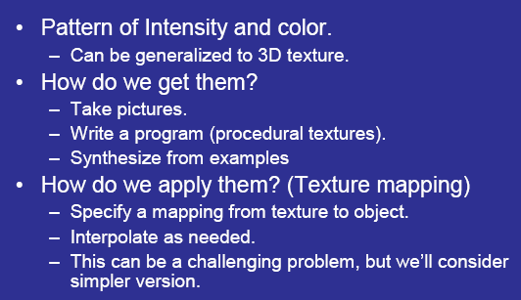
Concerning Textures
Adapted from slides
© 2007 Jacobs, D. W., University of Maryland

Slide 15
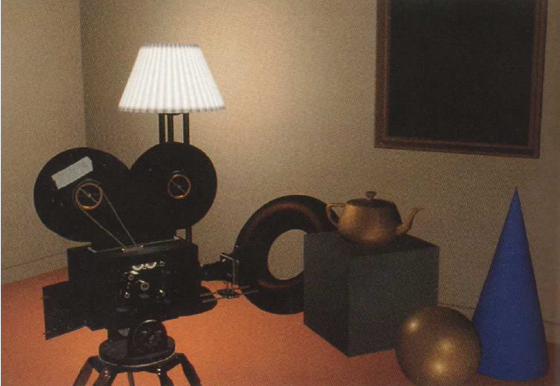
Without Textures
Adapted from slides
© 2007 Jacobs, D. W., University of Maryland
From Computer Graphics: Principles and Practice
© 1991 Foley, van Dam, Feiner, Hughes

Slide 16
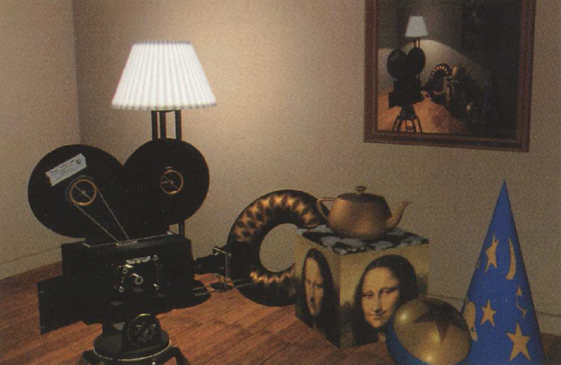
With Textures
Adapted from slides
© 2007 Jacobs, D. W., University of Maryland
From Computer Graphics: Principles and Practice
© 1991 Foley, van Dam, Feiner, Hughes

Slide 17
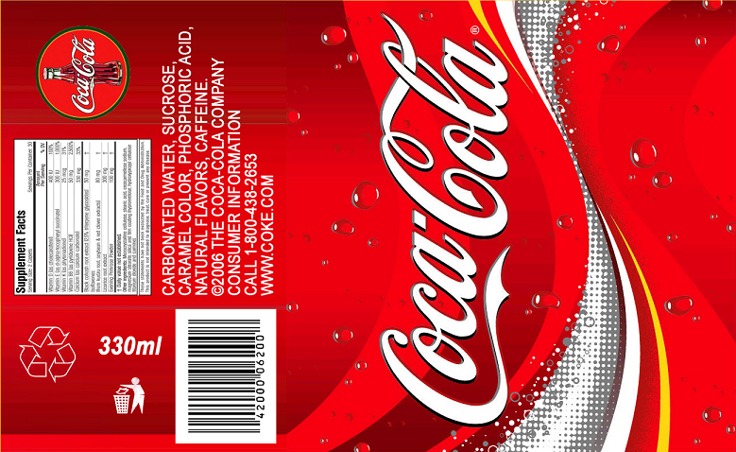
Texture Image
v
u
Adapted from slides
© 2007 Jacobs, D. W., University of Maryland

Slide 18
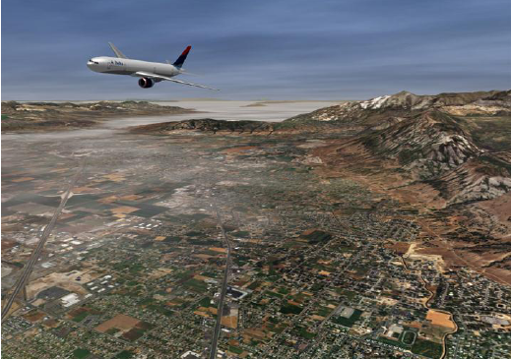

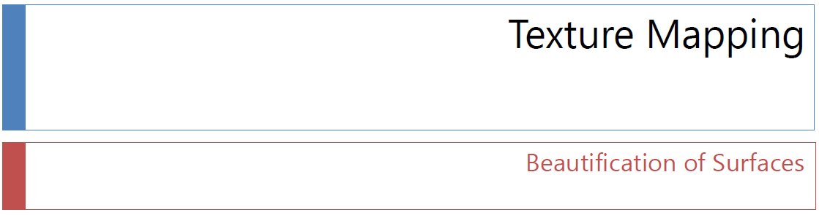
Acknowledgements
Andy van Dam
T. J. Watson University Professor of Technology and Education & Professor of Computer Science
Brown University
http://www.cs.brown.edu/~avd/
Adapted from slides © 1997 – 2010 van Dam et al., Brown University
http://bit.ly/hiSt0f Reused with permission.

Slide 19
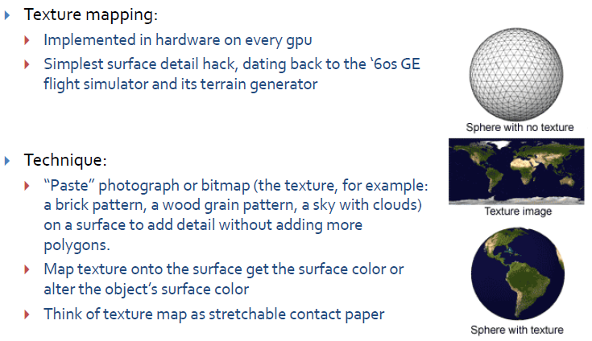
Texture Mapping Overview [1]:
Technique
Adapted from slides © 2010 van Dam et al., Brown University
http://bit.ly/hiSt0f Reused with permission.

Slide 20
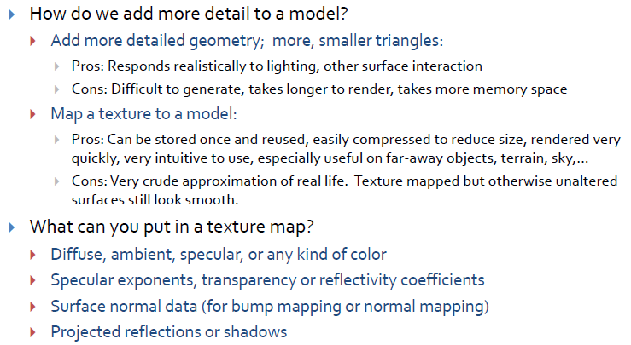
Texture Mapping Overview [2]:
Motivation
Adapted from slides © 2010 van Dam et al., Brown University
http://bit.ly/hiSt0f Reused with permission.

Slide 21
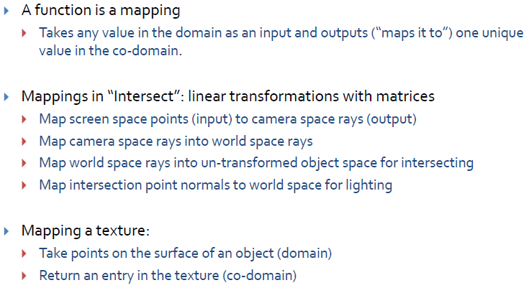
Texture Mapping Overview [3]:
Mappings
Adapted from slides © 2010 van Dam et al., Brown University
http://bit.ly/hiSt0f Reused with permission.

Slide 22
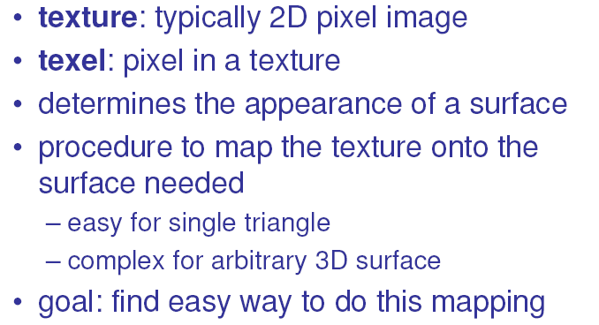
Texture Mapping How-To [1]:
Goals and Texture Elements (Texels)
Adapted from slides
© 2005 Isenberg, T., University of Calgary (now at U. Groningen)

Slide 23
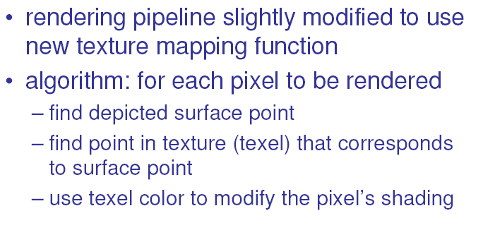
Texture Mapping How-To [2]:
Adapting Polygons-to-Pixels Pipeline
Adapted from slides
© 2005 Isenberg, T., University of Calgary (now at U. Groningen)

Slide 24
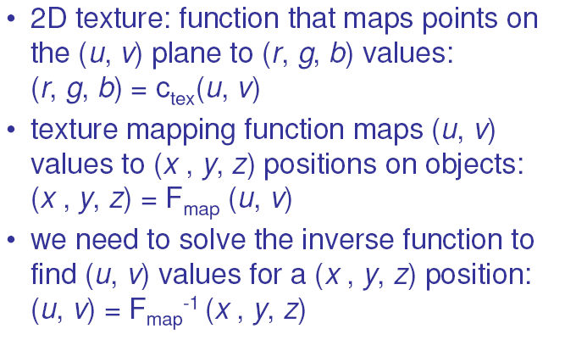
Texture Mapping How-To [3]:
Mapping Definition
u = s(x, y, z)
v = t(x, y, z)
Adapted from slides
© 2005 Isenberg, T., University of Calgary (now at U. Groningen)

Slide 25
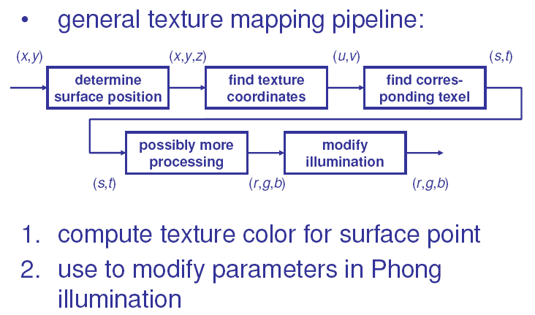
Texture Mapping How-To [4]:
General Procedure
Adapted from slides
© 2005 Isenberg, T., University of Calgary (now at U. Groningen)

Slide 26
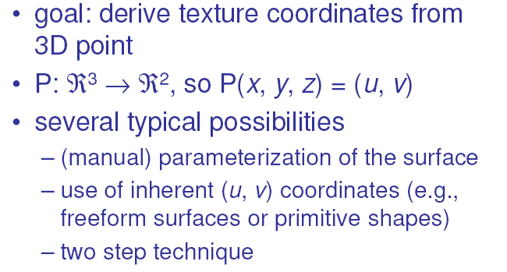
Texture Mapping How-To [5]:
Projective Textures, Functions
Adapted from slides
© 2005 Isenberg, T., University of Calgary (now at U. Groningen)

Slide 27
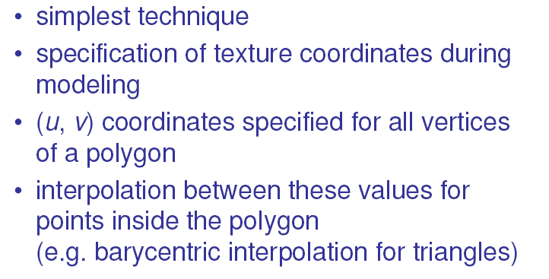
Texture Mapping How-To [6]:
(Manual) Surface Parameterization
Adapted from slides
© 2005 Isenberg, T., University of Calgary (now at U. Groningen)

Slide 28
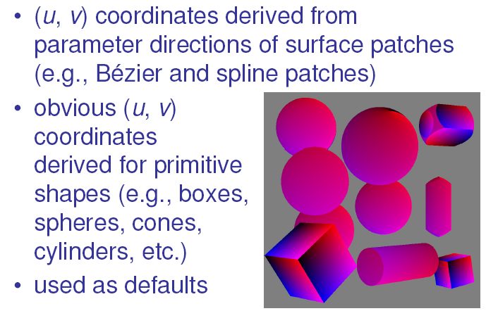
Texture Mapping How-To [7]:
Inherent (u, v) Coordinates
Adapted from slides
© 2005 Isenberg, T., University of Calgary (now at U. Groningen)

Slide 29
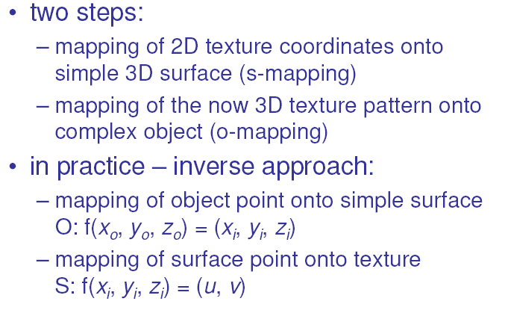
Two-Step Approach [1]:
Duality (Again)

Slide 30
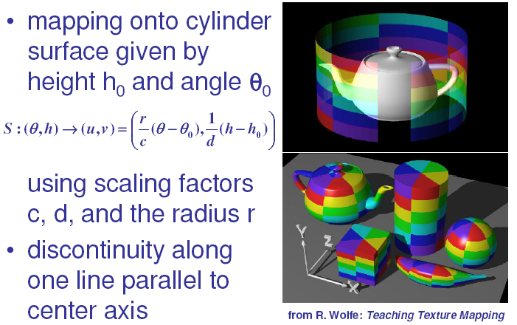
Two-Step Approach [2]:
Example – Cylindrical Mapping
Adapted from slides
© 2005 Isenberg, T., University of Calgary (now at U. Groningen)

Slide 31
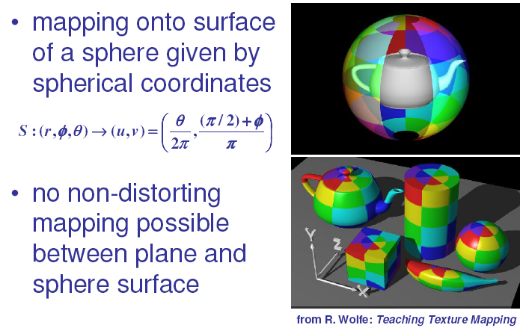
Two-Step Approach [3]:
Example – Spherical Mapping
Adapted from slides
© 2005 Isenberg, T., University of Calgary (now at U. Groningen)

Slide 32
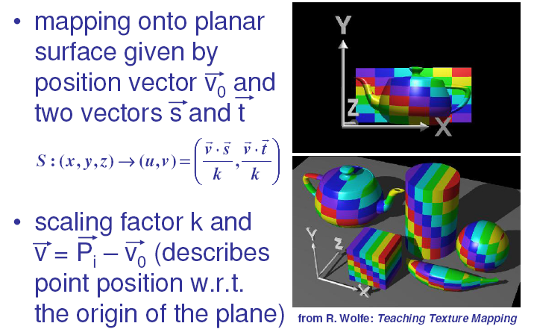
Two-Step Approach [4]:
Example – Planar Mapping

Slide 33
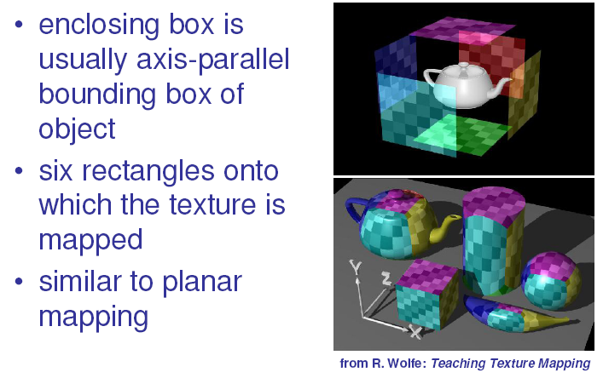
Two-Step Approach [5]:
Example – Cuboid/Box Mapping
Adapted from slides
© 2005 Isenberg, T., University of Calgary (now at U. Groningen)

Slide 34
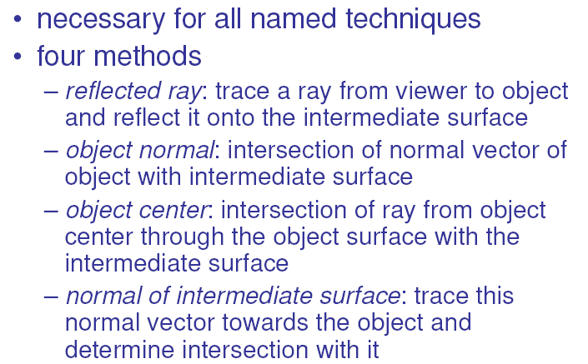
O Mapping [1]:
Object-to-Surface
Adapted from slides
© 2005 Isenberg, T., University of Calgary (now at U. Groningen)

Slide 35
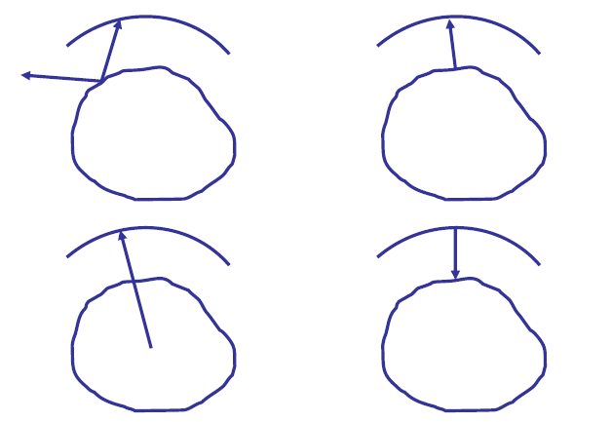
O Mapping [2]:
Illustrations
1. Reflected Ray
2. Object Normal
3. Object Center
4. Normal of Intermediate Surface
Adapted from slides
© 2005 Isenberg, T., University of Calgary (now at U. Groningen)

Slide 36
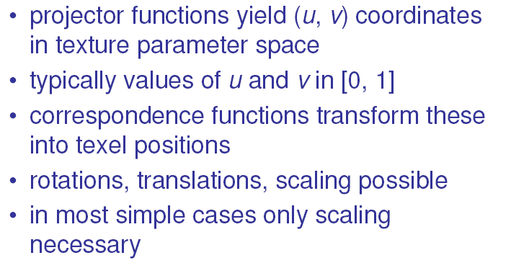
Correspondence Functions [1]:
Texture Coordinates
u = s(x, y, z)
v = t(x, y, z)
Adapted from slides
© 2005 Isenberg, T., University of Calgary (now at U. Groningen)

Slide 37
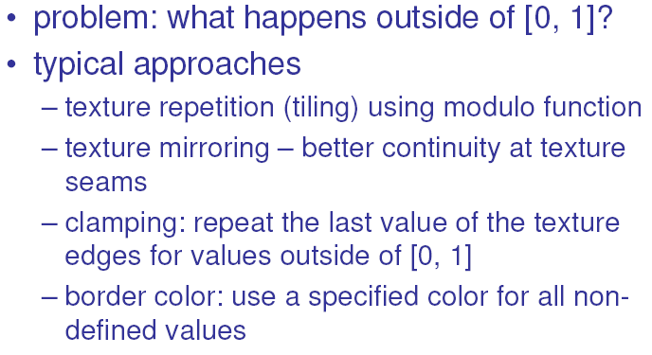
Correspondence Functions [2]:
Tiling, Mirroring, Clamping, Borders
Adapted from slides
© 2005 Isenberg, T., University of Calgary (now at U. Groningen)

Slide 38
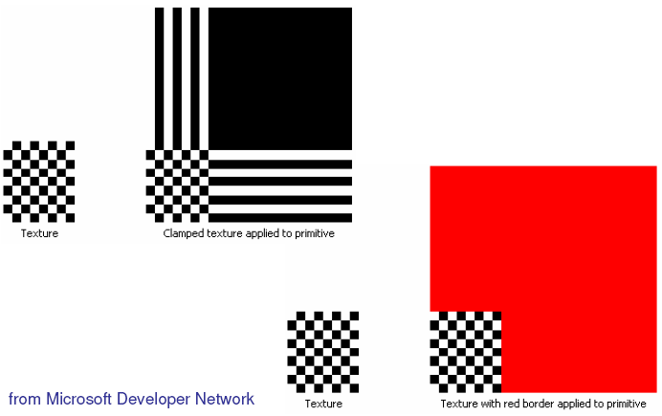
Correspondence Functions [3]:
Clamping and Borders Illustrated
Adapted from slides
© 2005 Isenberg, T., University of Calgary (now at U. Groningen)

Slide 39
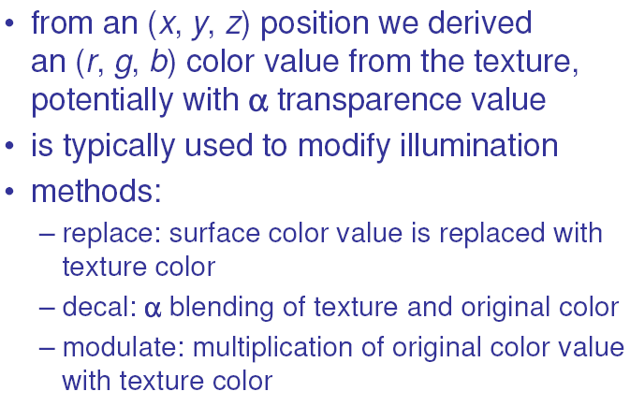
Application of Texture Values:
Combining Texturing and Lighting
Adapted from slides
© 2005 Isenberg, T., University of Calgary (now at U. Groningen)

Slide 40
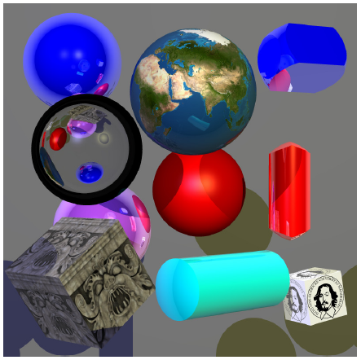
The End…?
Done! … well, almost
Adapted from slides
© 2005 Isenberg, T., University of Calgary (now at U. Groningen)

Slide 41
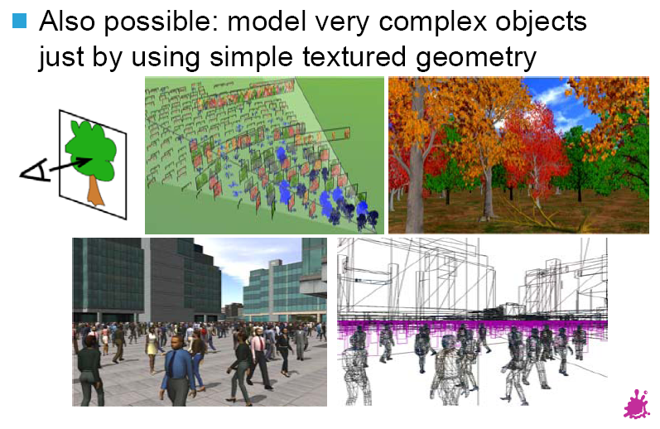
Surface Detail: Imitating Complexity by Texturing Smooth Objects
Adapted from slides
© 2002 Gröller, E. & Jeschke, S. Vienna Institute of Technology

Slide 42
More on Shading
(Surface Detail 2, 4, 5)
Shading in OpenGL
  Flat/constant: GL_CONSTANT
  Gouraud: GL_SMOOTH
Shading Languages
  Renderman Shading Language (RSL) – http://bit.ly/g229q4
  OpenGL Shading Language (OGLSL or GLSL) – http://bit.ly/fX8V0Y
  Microsoft High-Level Shading Language (HLSL) – http://bit.ly/eVnjp5
  nVidia Cg – http://bit.ly/ewoRic
Vertex vs. Pixel Shaders
How to Write Shaders

Slide 43
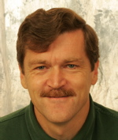
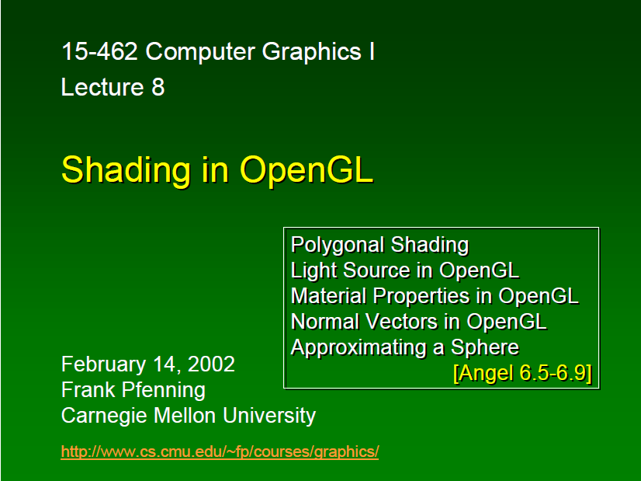
Source Material on
OpenGL Shading
Frank Pfenning
Professor of Computer Science
School of Computer Science
Carnegie Mellon University
http://www.cs.cmu.edu/~fp/
Adapted from slides © 2003 F. Pfenning, Carnegie Mellon University.
http://bit.ly/g1J2nj

Slide 44
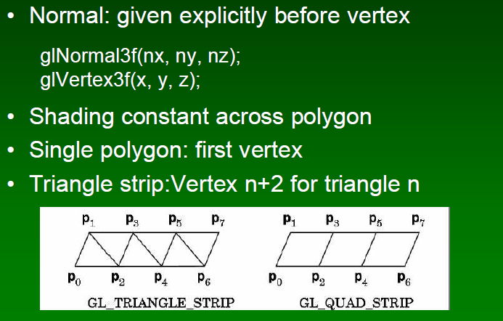
Shading in OpenGL [1]:
Flat Shading
Adapted from slides © 2003 F. Pfenning, Carnegie Mellon University.
http://bit.ly/g1J2nj

Slide 45
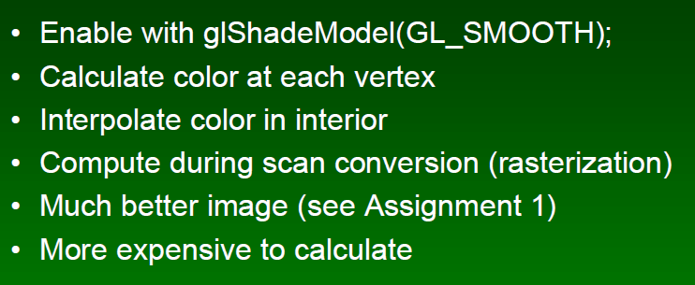
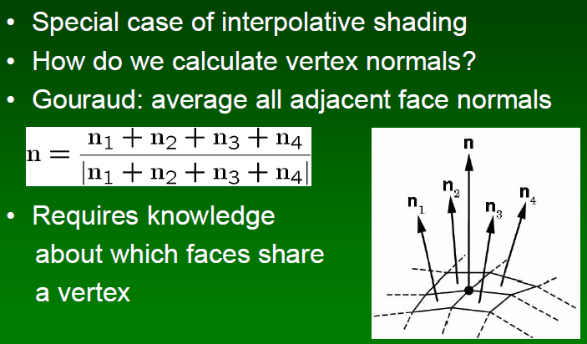
Shading in OpenGL [2]:
Interpolative (aka Smooth), Gouraud
Interpolative Shading
Gouraud Shading
Adapted from slides © 2003 F. Pfenning, Carnegie Mellon University.
http://bit.ly/g1J2nj

Slide 46
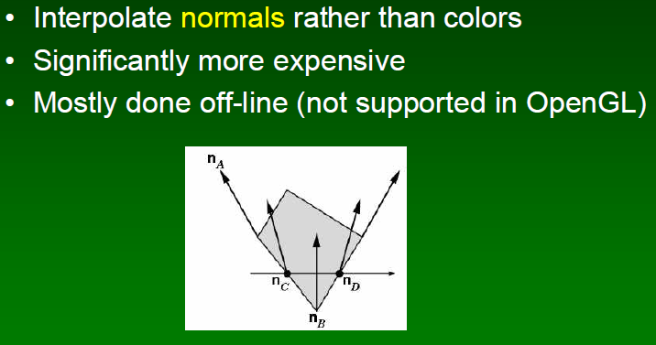
Shading in OpenGL [3]:
Phong Shading
... kind of
-WHH
Adapted from slides © 2003 F. Pfenning, Carnegie Mellon University.
http://bit.ly/g1J2nj

Slide 47
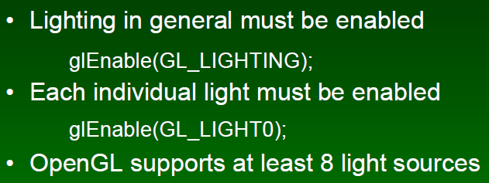
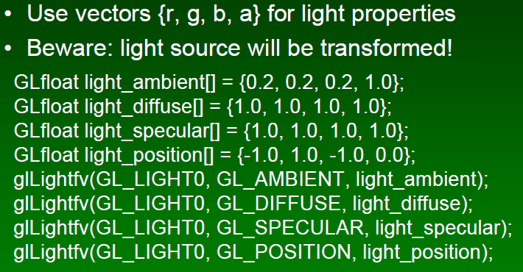
Shading in OpenGL [5]:
Specifying & Enabling Light Sources
Enabling Light Sources
Specifying Point Light Source
Adapted from slides © 2003 F. Pfenning, Carnegie Mellon University.
http://bit.ly/g1J2nj

Slide 48

Shading in OpenGL [6]:
Global Ambient Light
Adapted from slides © 2003 F. Pfenning, Carnegie Mellon University.
http://bit.ly/g1J2nj

Slide 49


Shading in OpenGL [7]:
Point Sourcesvs. Directional
Directional Lights versus Point Lights
Spotlights: Special Case of Point Lights
Adapted from slides © 2003 F. Pfenning, Carnegie Mellon University.
http://bit.ly/g1J2nj

Slide 50

Shading in OpenGL [8]:
Example Material Properties
Adapted from slides © 2003 F. Pfenning, Carnegie Mellon University.
http://bit.ly/g1J2nj

Slide 51
Summary
Last Time: Intro to Illumination and Shading
  Local vs. global models
  Illumination (vertex shaders) vs. shading (fragment/pixel shaders)
  Phong illumination: derivation of ambient, diffuse, specular terms
  Introduction to shading
Texturing: Adding Detail, Raster Image, Color, etc. to CG Model
Texture Pipeline
  Part of polygons-to-pixels
  Uses same spaces (coordinate systems) and more
Using Simple Intermediate Surfaces (Cylinder, Sphere, Plane, Box)
OpenGL Shading: Flat aka Constant, Interpolative (Specifically, Gouraud)
Next: Patterns, Procedural Textures, Anisotropic Filtering
References: Gröller & Jeschke (2002), Isenberg (2005), Jacobs (2007)

Slide 52
Terminology
Texture Map / Texture Mapping
  Method of adding surface detail to CGI or 3-D model (Wikipedia)
  Kinds of surface detail
    Detail: roughness, grain, bumps/dimples, etc.
    Surface texture: finish, veneer, etc. (represented by raster image)
    Color: monochrome, patterns, polychromatic
Coordinate Systems (Spaces)
  Model / Object: 3-D (x, y, z)
  World / Scene: 3-D (x, y, z)
  Camera / Eye: 3-D (u, v, n)
  Window / Screen: 2-D (u, v)
  Texture: 1-D, 2-D, or 3-D; (s, t) for 2-D
Texture Pipeline – End-to-End System for Calculating, Applying Textures
Gouraud Shading – Interpolative Shading with Color Interpolation

