Slide 1
Lecture 13 of 41
Surface Detail 4 of 5: Pixel & Vertex Shaders
Lab 2b: Shading in Direct3D
William H. Hsu
Department of Computing and Information Sciences, KSU
KSOL course pages: http://bit.ly/hGvXlH / http://bit.ly/eVizrE
Public mirror web site: http://www.kddresearch.org/Courses/CIS636
Instructor home page: http://www.cis.ksu.edu/~bhsu
Readings:
Today: Section 3.1, Eberly 2e – see http://bit.ly/ieUq45
Next class: Section 3.2 – 3.4, Eberly 2e; Direct3D handout *
* Toymaker tutorials, K. Ditchburn: http://bit.ly/hMqxMl
NeHe article #21 (NB: not an old lesson): http://bit.ly/gi9g47

Slide 2
Lecture Outline
Reading for Last Class: §20.5 – 20.13, Eberly 2e (Many Mappings)
Reading for Today: §3.1, Eberly 2e
Reading for Next Class: §3.2 – 3.4, Eberly 2e; Direct3D handout
Last Time: Mappings, OpenGL Texturing
  Shadow, reflection/environment, transparency, bump, displacement
  Other mappings: gloss, volumetric fog, skins, rainbows, water
  OpenGL texture mapping how-to
Previously: Classical Fixed-Function Pipeline, Drawing in Direct3D
Today: Shaders in Modern Pipeline
  Vertex shaders: vertex attributes to illumination at vertices
  Pixel shaders: lit vertices to pixel colors, transparency
Hardware Rendering: Application Programmer Interfaces (APIs)
Next: Shader Languages – (O)GLSL, HLSL / Direct3D, Renderman

Slide 3
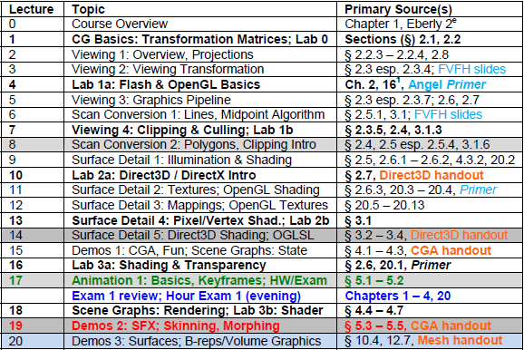

Where We Are

Slide 4
Review:
Vertex Shaders vs. Pixel Shaders
Classical Fixed-Function Pipeline (FFP): Per-Vertex Lighting, MVT + VT
  Largely superseded on desktop by programmable pipeline
  Still used in mobile computing
Modern Programmable Pipeline: Per-Pixel Lighting
Vertex Shaders (FFP and Programmable)
  Input: per-vertex attributes (e.g., object space position, normal
  Output: lighting model terms (e.g., diffuse, specular, etc.)
Pixel Shaders (Programmable Only)
  Input: output of vertex shaders (lighting aka illumination)
  Output: pixel color, transparency (R, G, B, A)
Brief Digression
  Note: vertices are lit, pixels are shaded
    “Pixel shader”: well-defined (iff “pixel” is)
    “Vertex shader”: misnomer (somewhat)
  Most people refer to both as “shaders”

Slide 5



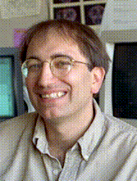

Acknowledgements:
Many Mappings
Stefan Jeschke
Research Assistant
http://bit.ly/hUUM94
Eduard Gröller
Associate Professor
Director, Visualization Working Group
http://bit.ly/hUUM94
Institute of Computer Graphics and Algorithms
Technical University of Vienna
Texturing material from slides © 2002 E. Gröller & S. Jeschke, Vienna University of Technology
http://bit.ly/dJFYq9
Pat Hanrahan
CANON USA Professor
Director, Computer Graphics Laboratory
Computer Science and Electrical Engineering Departments
Stanford University
http://graphics.stanford.edu/~hanrahan/
Mapping material from slides © 1995 – 2009 P. Hanrahan, Stanford University
http://bit.ly/hZfsjZ (CS 348B, Computer Graphics: Image Synthesis Techniques)

Slide 6
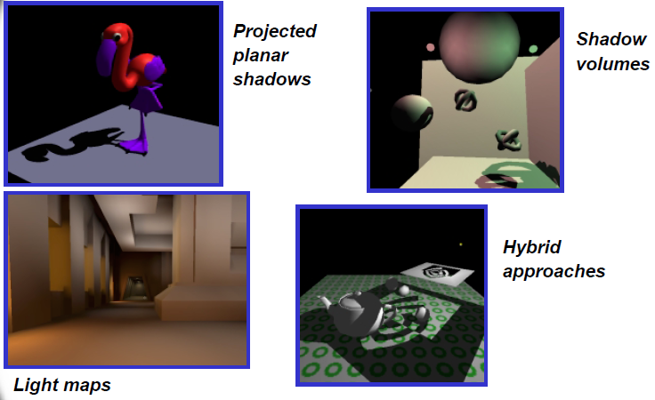
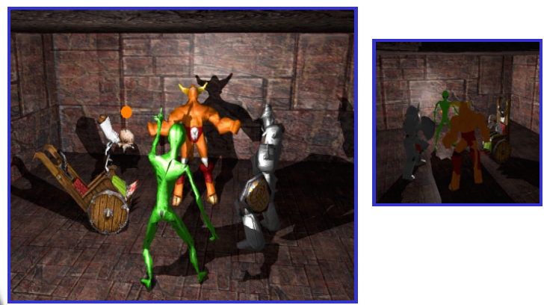
Review [1]:
Shadow Mapping
Ways to Handle Shadows
  Projected planar shadows: works well on flat surfaces only
  Shadow stencil buffer: powerful, excellent results possible; hard!
OpenGL Shadow Mapping Tutorials
  Beginner/Intermediate (Baker, 2003): http://bit.ly/e1LA2N
  Advanced (Octavian et al., 2000): http://bit.ly/f1iRYB (old NeHe #27)
Shadow Stencil Buffer
Adapted from “Shadow Mapping” © 2001 C. Everitt, nVidia
http://developer.nvidia.com/object/shadow_mapping.html

Slide 7
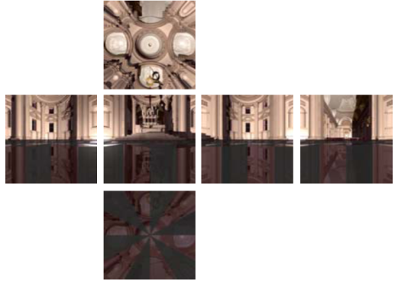
Review [2]:
Reflection/Environment Mapping
How To Create Direction Maps
  Latitude-Longitude (Map Projections) - paint
  Gazing Ball - photograph reflective sphere
  Fisheye Lens - standard (wide-angle) camera lens
  Cubical Environment Map - rendering program or photography
    Easy to produce
    "Uniform" resolution
    Simple texture coordinates calculation
Old NeHe OpenGL Mapping Tutorials (2000)
  #6 (texture map onto cube) – Beginner (Molofee): http://bit.ly/gKj2Nb
  #23 (sphere) – Intermediate (Schmick & Molofee): http://bit.ly/e3Zb8h
nVidia Tutorial: OpenGL Sphere Map (1999): http://bit.ly/eJEdAM
Issues: Non-Linear Mapping, Area Distortion, Converting Between Maps
Adapted from slides © 1995 – 2009 P. Hanrahan, Stanford University
http://bit.ly/hZfsjZ (CS 348B)

Slide 8
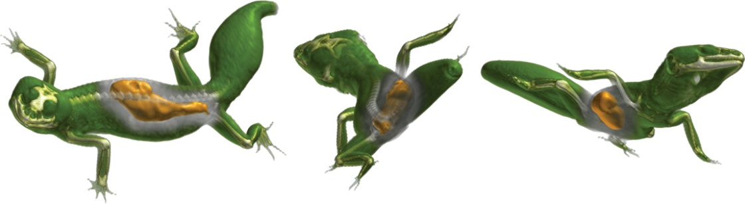
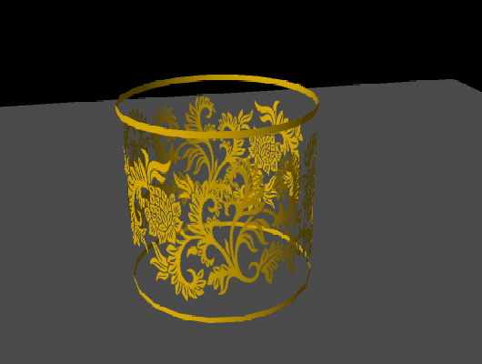
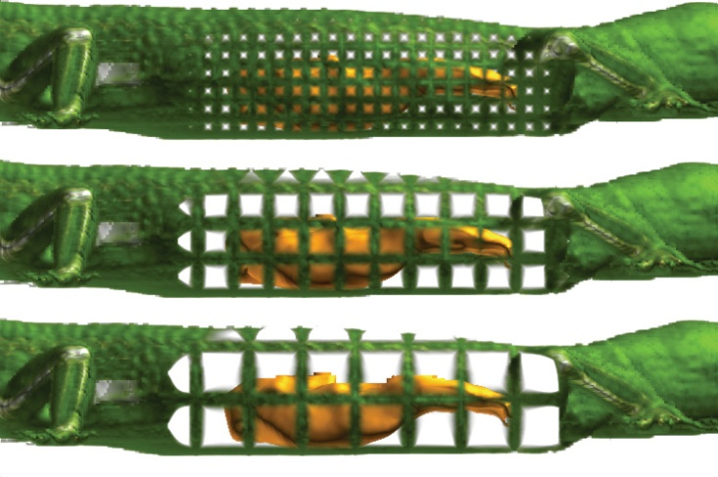
Review [3]:
Transparency Mapping
OpenGL Transparency How-To at OpenGL.org: http://bit.ly/hRaQgk
Screen Door Transparency
  Use glPolygonStipple(), glEnable(GL_POLYGON_STIPPLE)
  See http://bit.ly/g1hQpJ
Glass-Like Transparency using Alpha Blending
  Use glEnable(GL_BLEND), glBlendFunc(…)
  See http://bit.ly/hs82Za
Viola et al. (2004), http://bit.ly/dVEa7l
Technical University of Vienna, IEEE Vis 2004
Alpha blending: Lim (2010), http://bit.ly/6TsJrb
Goon Creative, Maya Transparency Tutorial

Slide 9
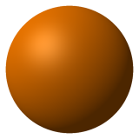
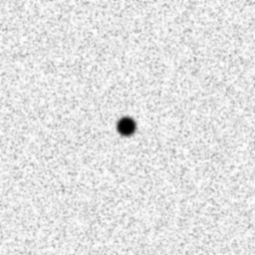
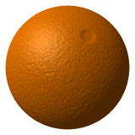
Review [4]:
Bump Mapping
Goal: Create Illusion of Textured Surface
Idea
  Start with regular smooth object
  Make height map (by hand and/or using program, i.e., procedurally)
  Use map to perturb surface normals
  Plug new normals into illumination equation
Tutorial for OpenGL (Baker, 2003): http://bit.ly/fun4a5
+
=
Bump Mapping © 2010 Wikipedia
http://en.wikipedia.org/wiki/Bump_mapping

Slide 10
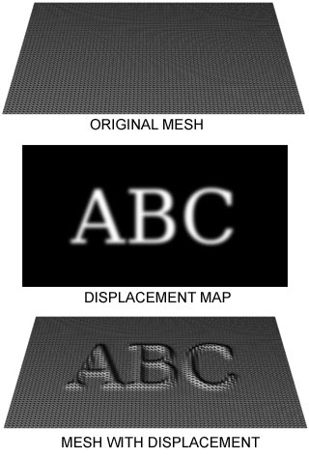
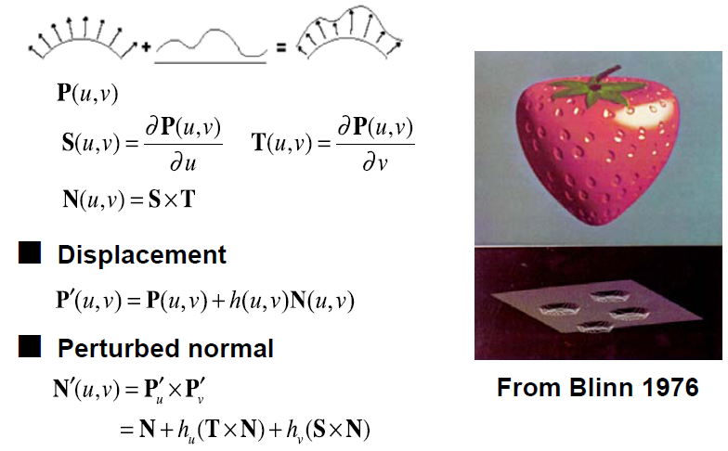
Review [5]:
Displacement Mapping
Displacement Map: Similar to Bump Map – Contains Delta Values
Displacement Mapping: Uses Open GL Shading Language (GLSL)
Tutorial using GLSL (Guinot, 2006): http://bit.ly/dWXNya
Displacement Mapping © 2005 Wikipedia
http://en.wikipedia.org/wiki/Displacement_mapping
Adapted from slides © 1995 – 2009 P. Hanrahan, Stanford University
http://bit.ly/hZfsjZ (CS 348B)

Slide 11
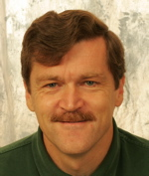
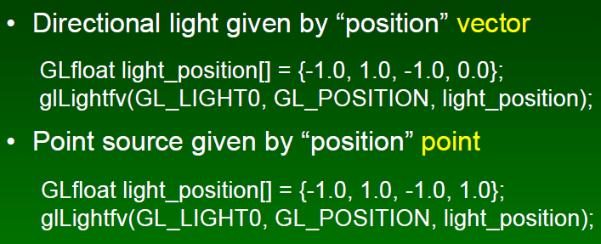
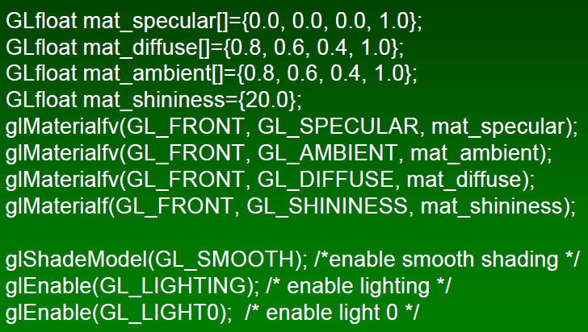
Review [6]:
OpenGL Shading (Overview)
Set Up Point Light Sources
Set Up Materials, Turn Lights On
Start Drawing (glBegin … glEnd)
Frank Pfenning
Professor of Computer Science
School of Computer Science
Carnegie Mellon University
http://www.cs.cmu.edu/~fp/
See also: OpenGL: A Primer, 3e (Angel)
http://bit.ly/hVcVWN
Adapted from slides © 2003 F. Pfenning, Carnegie Mellon University
http://bit.ly/g1J2nj

Slide 12
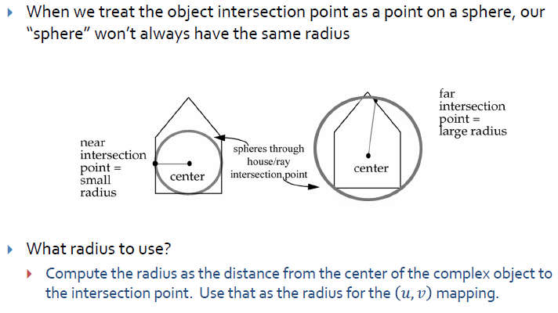
Review [7]:
Texturing – Object Center Method
Adapted from slides © 2010 van Dam et al., Brown University
http://bit.ly/hiSt0f Reused with permission.

Slide 13
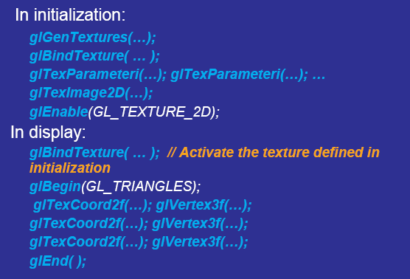
Review [8]:
OpenGL Texturing
Adapted from slides
© 2007 Jacobs, D. W., University of Maryland

Slide 14
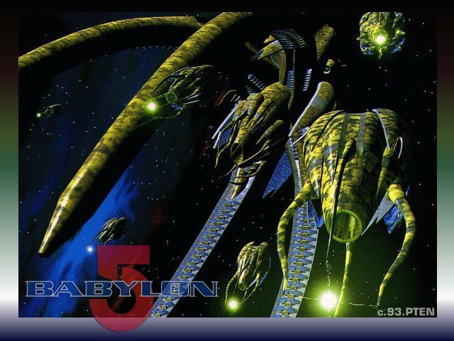
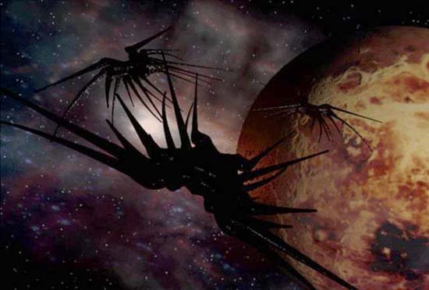
Review [9]:
Mappings, Eberly 2e
Fine Surface Detail: Bump (§20.5 Eberly 2e)
Material Effects: Gloss (§20.6)
Enclosing Volumes
  Sphere (§20.7)
  Cube (§20.8)
Light
  Refraction for Transparency (§20.9)
  Reflection aka Environment (§20.10)
Shadow
  Shadow Maps (§20.11, 20.13)
  Projective Textures (§20.12)
More Special Effects (SFX)
  Fog (§20.14)
  Skinning (§20.15)
  Iridescence (§20.16), Water (§20.17)
Babylon 5
© 1993 – 1998 Warner Brothers Entertainment, Inc.

Slide 15




Acknowledgements
Nathan H. Bean
Instructor
Outreach Coordinator
Department of Computing and Information Sciences
Kansas State University
http://bit.ly/gC3vwH
Direct3D material from slides © 2006 – 2010 N. Bean, Kansas State University
http://bit.ly/gC3vwH
Randy Fernando
Executive Director
Mindful Schools
http://www.randima.com
Andy van Dam
T. J. Watson University Professor of Technology and Education & Professor of Computer Science
Brown University
http://www.cs.brown.edu/~avd/
Mark Kilgard
Principal System Software Engineer
Nvidia
http://bit.ly/gdjLzR
Cg material from figures © 2003 R. Fernando & M. Kilgard, Nvidia, from The Cg Tutorial
http://bit.ly/59ffSR

Slide 16
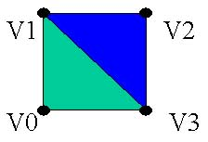

Review:
Drawing in Direct3D
Specify the material we wish to use for the following triangles
Specify the texture we wish to use (if we want one or NULL if not)
Set the stream source to our vertex buffer
Set the FVF we will be using
Set the index buffer we will be using
Call the required DrawPrimitive function
void CGfxEntityCube::Render()
{
gD3dDevice->SetMaterial( &m_material );
gD3dDevice->SetTexture(0,NULL);
gD3dDevice->SetStreamSource( 0, m_vb,0, sizeof(CUBEVERTEX) );
gD3dDevice->SetFVF( D3DFVF_CUBEVERTEX );
gD3dDevice->SetIndices( m_ib);
// draw a triangle list using 24 vertices and 12 triangles
gD3dDevice->DrawIndexedPrimitive( D3DPT_TRIANGLELIST,0,0,24,0,12);
}
Toymaker © 2004 – 2010 K. Ditchburn, Teesside University
http://bit.ly/hMqxMl

Slide 17
History
1992 - id’s Wolfenstein 3D video game rocks gaming world, all objects are billboards (flat planes) and rendered in software
1996 - id’s Quake introduces a full 3D polygonal game, lighting vertices and shading pixels is still done in software
1996 - Voodoo 3Dfx graphics card released, does shading operations (such as texturing) in hardware. QuakeWorld brings hardware acceleration to Quake
1999 - Geforce 256 graphics card released, now transform and lighting (T&L) of vertices is done in hardware as well (uses the fixed function pipeline)
2001 – Geforce 3 graphics card lets programmers download assembly programs to control vertex lighting and pixel shading keeping the speed of the fixed function pipeline with none of the restrictions
Future – Expanded features and high level API’s for vertex and pixel shaders, increased use of lighting effects such as bump mapping and shadowing, higher resolution color values. Doom III and Half-Life 2 usher in a new era of realism
2004
Adapted from slides © 2002 – 2003 van Dam et al., Brown University
http://bit.ly/fiYmje Reused with permission.

Slide 18
Fixed Function Pipeline
Starting in 1999 some graphics cards began to do the standard lighting model and transformations in hardware (T&L). CPUs everywhere sighed in relief.
  Hardware T&L existed in the 60s and 70s, it was just really slow and really expensive.
Implementing the pipeline in hardware made processing polygons much faster, but the developer could not modify the pipeline (hence “fixed function pipeline”). The fixed function pipeline dates back to the first SGI workstations.
New programmable hardware allows programmers to write vertex and pixel programs to change the pipeline
  Vertex and pixel programs aren’t necessarily slower than the fixed function alternative
Note that the common term “vertex shader” to describe a vertex program is misleading: vertices are lit and pixels are shaded
Adapted from slides © 2002 – 2003 van Dam et al., Brown University
http://bit.ly/fiYmje Reused with permission.

Slide 19
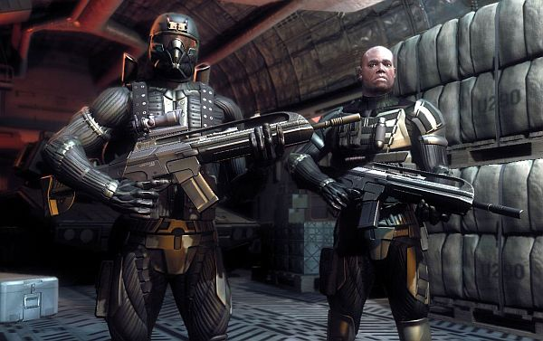
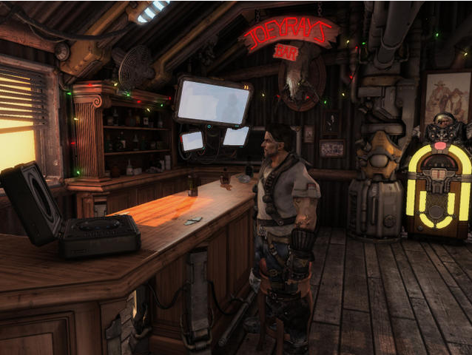
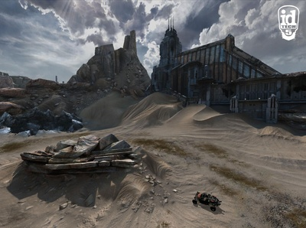
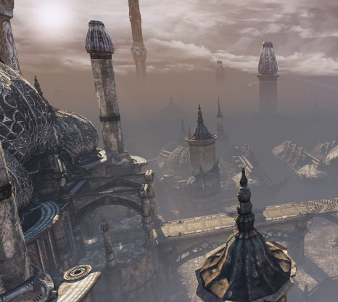
Programmable Hardware
Crysis 2
© 2011 Electronic Arts, Inc. – http://bit.ly/idNET9
Starcraft II: Wings of Liberty
© 2010 Blizzard Entertainment, Inc. – http://bit.ly/9B1qZp
Rage & id Tech 5
© 2011 id Software, Inc. – http://bit.ly/eR0m2B
Unreal Tournament 3 & Steamworks
© 2010 Epic Games & Valve – http://bit.ly/9QKAS7
Inspired by slides © 2002 – 2003 van Dam et al., Brown University
http://bit.ly/fiYmje Reused with permission.

Slide 20
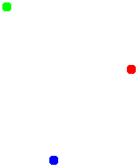
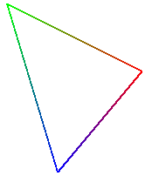
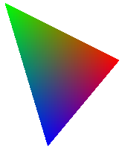
Quick Review:
Interpolative Shading in OpenGL
By default, GL will do the following:
  Take as input various per-vertex quantities (color, light source, eye point, texture coordinates, etc.)
  Calculate a final color for each vertex using a basic lighting model (OpenGL uses Phong lighting)
  For each pixel, linearly interpolate the three surrounding vertex colors to shade the pixel (OpenGL uses Gouraud shading)
  Write the pixel color value to the frame buffer
Adapted from slides © 2002 – 2003 van Dam et al., Brown University
http://bit.ly/fiYmje Reused with permission.

Slide 21
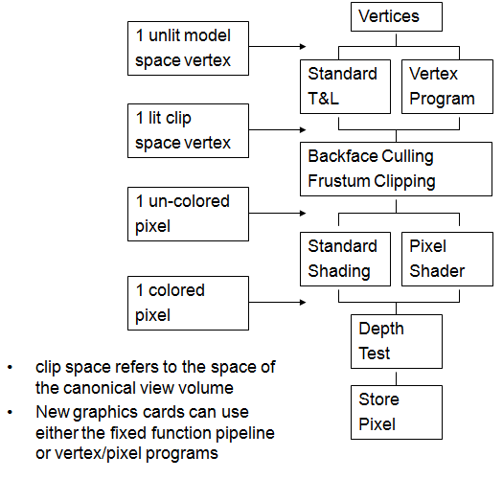
Programmable Hardware Pipeline
Adapted from slides © 2002 – 2003 van Dam et al., Brown University
http://bit.ly/fiYmje Reused with permission.

Slide 22
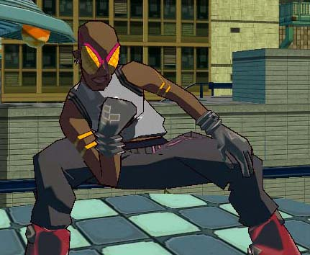
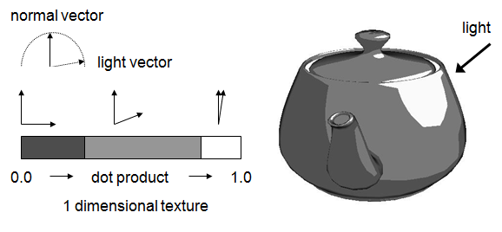
Example:
Cartoon Shader & Utah Teapot
Cartoon shading is a cheap and neat looking effect used in video games such as Jet Set Radio Future
Instead of using traditional methods to light a vertex, use the dot product of the light vector and the normal of the vertex to index into a 1 dimensional “texture” (A texture is simply a lookup function for colors – nothing more and nothing less)
Instead of a smooth transition from low intensity light (small dot product) to high intensity light (large dot product) make the 1 dimensional texture have sharp transitions
Textures aren’t just for “wrapping” 2D images on 3D geometry!
Viola! Cartoon Teapot
JSRF © 2002 SEGA Games, Inc.
http://youtu.be/-J3bmKLw5hw
Adapted from slides © 2002 – 2003 van Dam et al., Brown University
http://bit.ly/fiYmje Reused with permission.

Slide 23
What is Cg?
Cg is a C-like language that the graphics card compiles in to a program
  The program is run once per-vertex and/or per-pixel on the graphics card
Cg does not have all the functionality of C
  Different type systems
  Can’t include standard system headers
  No malloc
  http://www.cgshaders.org/articles/ has the technical documentation for Cg
Cg is actually an abstraction of the more primitive assembly language that the programmable hardware originally supported
Adapted from slides © 2002 – 2003 van Dam et al., Brown University
http://bit.ly/fiYmje Reused with permission.

Slide 24
Cg Tips
Understand the different spaces your vertices may exist in
  model space: the space in which your input vertex positions exist, in this space the center of the model is at the origin
  world space: the space in which you will do most of your calculations
  clip space: the space in which your output vertex positions must exist, this space represents the canonical view volume
If you want a vector to have length 1 make sure to normalize the vector, this often happens when you want to use a vector to represent a direction
When writing a Cg program try to go one step at a time, one sequence of steps might be
  Make sure the model vertex positions are being calculated correctly
  set the color or texture coordinates to an arbitrary value, verify that you are changing the surface color
  Calculate the color or texture coordinates correctly
Check out http://cgshaders.org/articles/ for some helpful documents
Adapted from slides © 2002 – 2003 van Dam et al., Brown University
http://bit.ly/fiYmje Reused with permission.

Slide 25
Cg: Big Picture
Write a .cg file. This will invariably take some sort of information as a parameter to its “main()” function
  Note that this main() is not compiled by gcc (or any C/C++ compiler). That would generate a symbol conflict, among other things. It is only processed by NVidia’s Cg compiler
Write a class that extends CGEffect. This is cs123’s object-oriented wrapper around the basic C interface provided by Nvidia
  The CGEffect subclass allows you to bind data from your .C files to variables in your .cg vertex program
Make that CGEffect the IScene’s current CGEffect by calling IScene::setCGEffect(). IScene will take ownership of the CGEffect* at this point, so you will not be deleting the memory you allocated yourself. Rendering will now be done using your vertex shader
Call IScene::removeCGEffect() if you want to turn vertex shaders off again
Adapted from slides © 2002 – 2003 van Dam et al., Brown University
http://bit.ly/fiYmje Reused with permission.

Slide 26
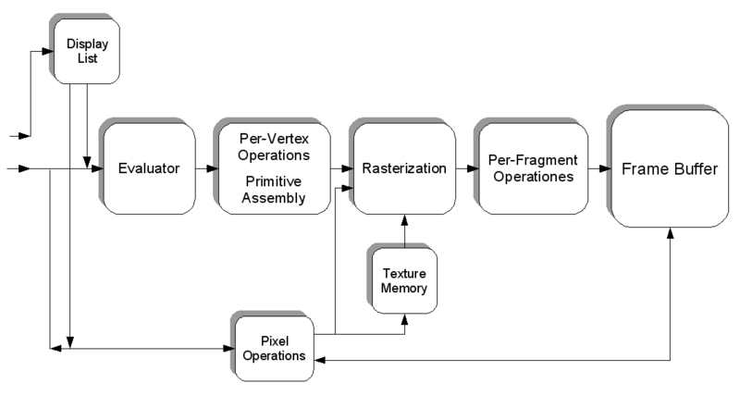
Shader Languages Overview
OpenGL State Machine (Simplified) from Wikipedia: Shader
http://bit.ly/fi8tBP
• HLSL: Shader language and API developed by Microsoft, only usable from within a DirectX application.
• Cg: Shader language and API developed by Nvidia, usable from within a DirectX and OpenGL application. Cg has a stark resemblance to HLSL.
• GLSL: Shader language and API developed by the OpenGL consortium and usable from withing an OpenGL application.
© 2009 Koen Samyn
http://knol.google.com/k/hlsl-shaders

Slide 27
HLSL [1]
High-Level Shader Language (HLSL) is Microsoft‘s language for programming GPUs
Looks like C
Example vertex and pixel shader for projective texturing (texture should appear to be projected onto the scene, as if from a slide projector)
struct VS_OUTPUTPROJTEX // output structure
{
float4 Pos : POSITION;
float4 Tex : TEXCOORD0;
};
VS_OUTPUTPROJTEX VSProjTexture(float4 Pos : POSITION, float3 Normal : NORMAL)
{
VS_OUTPUTPROJTEX Out = (VS_OUTPUTPROJTEX)0;
Out.Pos = mul(Pos, matWorldViewProj); // transform Position
Out.Tex = mul(ProjTextureMatrix, Pos); // project texture coordinates
return Out;
}
float4 PSProjTexture(float4 Tex: TEXCOORD0) : COLOR
{
return tex2Dproj(ProjTexMapSampler, Tex);
}
Adapted from slide 2003 Wolfgang Engel, http://www.wolfgang-engel.info
Visiondays 2003, http://bit.ly/hhkANP

Slide 28
HLSL [2]:
Code Example
// This is used by 3dsmax to load the correct parser
string ParamID = "0x0";
// DxMaterial specific
float4x4 wvp : WORLDVIEWPROJ;
struct VS_OUTPUT
{
float4 Pos : POSITION;
float4 Col : COLOR0;
};
VS_OUTPUT VS( float3 Pos : POSITION )
{
VS_OUTPUT Out = (VS_OUTPUT)0;
float4 hPos = float4( Pos, 1);
Out.Pos = mul( hPos, wvp);
Out.Col = float4( 1, 1, 1, 1);
return Out;
}
technique Default
{
pass P0
{
// shaders
CullMode = None;
VertexShader = compile vs_2_0 VS();
}
}
© 2009 Koen Samyn
http://knol.google.com/k/hlsl-shaders

Slide 29

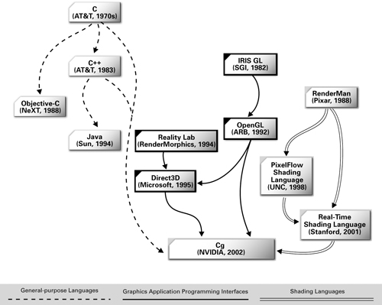
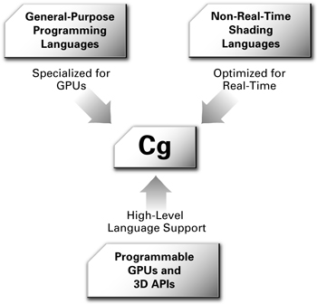
Cg [1]
Q: What Is Cg?
  A1: Nvidia’s high-level shading language
  A2: An OpenGL, Direct3D, RenderMan descendant…
Intro Slides for Cg Tutorial (Online Book): http://bit.ly/59ffSR
Figure 1-10, Fernando & Kilgard (2003)
Figure 1-11, Fernando & Kilgard (2003)
© 2003 R. Fernando & M. Kilgard. The Cg Tutorial.
http://bit.ly/59ffSR

Slide 30
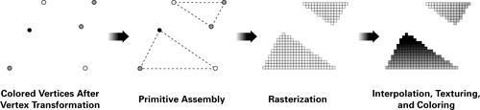
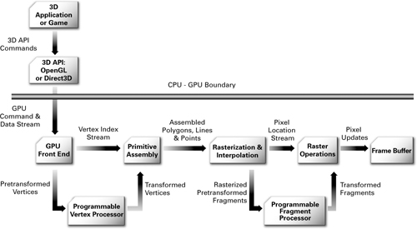
Cg [2]
Polygons-to-Pixels Pipeline (Fixed-Function & Programmable) in Action
Programmable Graphics Pipeline
Figure 1-6, Fernando & Kilgard (2003)
Figure 1-7, Fernando & Kilgard (2003)
© 2003 R. Fernando & M. Kilgard. The Cg Tutorial.
http://bit.ly/59ffSR

Slide 31
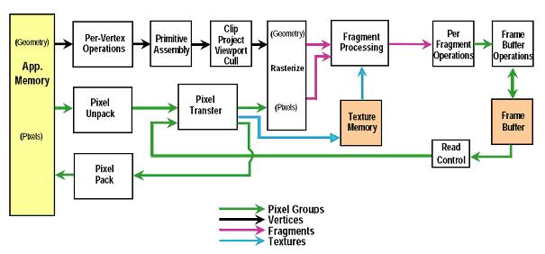
GLSL [1]:
Building on Top of OpenGL
How It Used to Be (in OpenGL)
New Function: Fragment (Pixel-Level) Shaders
  Programmable pipeline – like HLSL, Cg
  Compiles to shader objects
  Runs on hardware: ATI Radeon 9x00+, nVidia GeForce 5x00+
OpenGL 1.5 Fixed Function Pipeline (see OpenGL Reference Manual)
“GLSL: An Introduction” © 2004 F. Rudolf, NeHe Productions – http://bit.ly/gi9g47

Slide 32
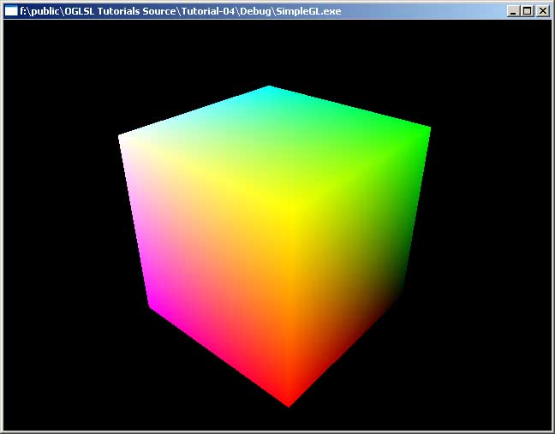
GLSL [2]:
Hybrid Shader Example – Color Cube
Vertex Shader
varying float xpos;
varying float ypos;
varying float zpos;
void main(void)
{
xpos = clamp(gl_Vertex.x,0.0,1.0);
ypos = clamp(gl_Vertex.y,0.0,1.0);
zpos = clamp(gl_Vertex.z,0.0,1.0);
gl_Position = gl_ModelViewProjectionMatrix * gl_Vertex;
}
Fragment Shader
varying float xpos;
varying float ypos;
varying float zpos;
void main (void)
{
gl_FragColor = vec4 (xpos, ypos, zpos, 1.0);
}
© 2003 – 2005 M. Christen, ClockworkCoders.com
http://bit.ly/et5qOp

Slide 33
Vertex Shaders [1]
“Fixed-Function”
  Standard pipeline
  Typical examples include simple “my first shader” definitions
    Constant (flat) shading
    Smooth (Gouraud) shading
Brief Digression: Sample-Based vs. Geometry-Based Graphics
  Sample-based: image manipulation
    Not rendered from (3-D) model
    Examples: Photoshop, GIMP
  Geometry-based: transform and render representations of objects
Programmable
  Fixed material properties selected by user
  Procedural material properties
  Gradients
  Lots of other things you see in sample-based graphics

Slide 34
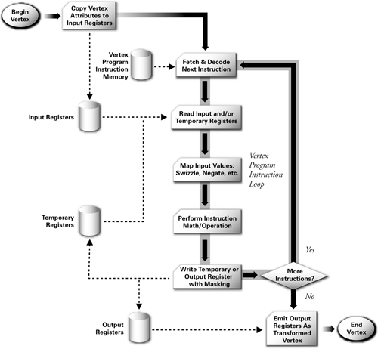
Vertex Shaders [2]:
Cg/HLSL-Style Pipeline
© 2003 R. Fernando & M. Kilgard. The Cg Tutorial.
http://bit.ly/59ffSR

Slide 35
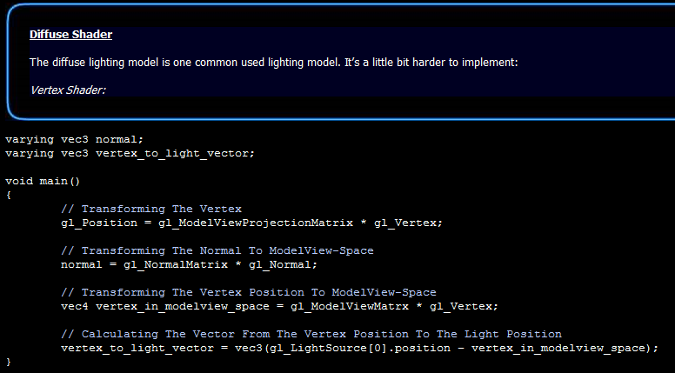
Vertex Shaders [3]:
GLSL Example
Diffuse Shader (NeHe GLSL Example)
Machine Problems, Projects: Will Use Combination of Shaders
© 2004 F. Rudolf, NeHe Productions
http://bit.ly/gi9g47

Slide 36
Pixel & Fragment Shaders [1]
Fragments: Pixels Plus Properties
  Everything needed to shade pixel
  Coordinates
  Normals
  Object colors: diffuse, specular
  Other properties
  May involve local computation of lighting (local to pixel)
  Typical example: Phong-like shading (normal interpolation)
Programmable
  Use fragment data
  Combine it with lights, textures, etc.
Hybridization: Combine Vertex and Pixel Shading
  Varying attributes for vertex (basis for fragment shading)
  Interpolating value from vertex shader across fragments

Slide 37
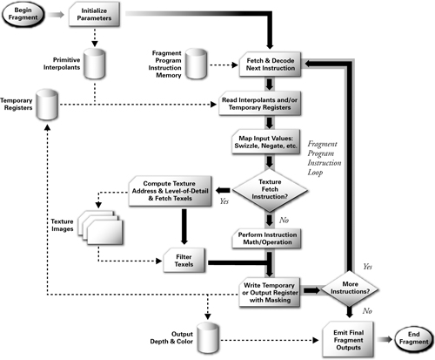
Pixel & Fragment Shaders [2]:
Cg/HLSL-Style Pipeline
© 2003 R. Fernando & M. Kilgard. The Cg Tutorial.
http://bit.ly/59ffSR

Slide 38
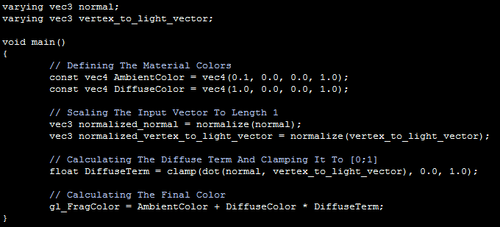
Pixel & Fragment Shaders [3]:
GLSL Example
Consider BRDF (Especially N ⋅ L) From Last Lecture
Result: Diffuse Term for Phong Shading (One Light, No Specular)
© 2004 F. Rudolf, NeHe Productions
http://bit.ly/gi9g47

Slide 39
Summary
Last Time: Mappings, OpenGL Texturing
  Shadow, reflection/environment, transparency, bump, displacement
  Other mappings: gloss, volumetric fog, skins, rainbows, water
  OpenGL texture mapping how-to
Previously: Basic Drawing in Direct3D, Shading & Texturing in OpenGL
Today: Shaders in Modern Pipeline
  Vertex shaders
    Input: per-vertex attributes (e.g., object space position, normal)
    Output: lighting model terms (e.g., diffuse, specular, etc.)
  Pixel shaders
    Input: output of vertex shaders (lighting aka illumination)
    Output: pixel color, transparency (R, G, B, A)
Shader Languages – (O)GLSL, HLSL / Direct3D, Renderman
Next: Using Shader Languages

Slide 40
Terminology
Mappings
  Shadow, reflection/environment, transparency, bump, displacement
  Other mappings: gloss, volumetric fog, skins, rainbows, water
Classical Fixed-Function Pipeline (FFP): Per-Vertex Lighting, MVT + VT
Modern Programmable Pipeline: Per-Pixel Lighting
Shader Languages (SLs)
  Domain-specific programming languages
  Geared towards hardware rendering
Specific SLs Covered
  HLSL / Direct3D – Microsoft’s programmable pipeline; overview
  Cg – Nvidia’s OpenGL / Direct3D descendant
  (O)GLSL – OpenGL shading language, covered in more detail
Other Shader Languages Beyond Scope of This Course
  Gelato – Nvidia’s production render farm SL
  Renderman – Pixar’s specification, renderer, or SL

