Slide 1
Lecture 15 of 41
Scene Graphs: State
Videos 1: CGA Shorts, Demos
William H. Hsu
Department of Computing and Information Sciences, KSU
KSOL course pages: http://bit.ly/hGvXlH / http://bit.ly/eVizrE
Public mirror web site: http://www.kddresearch.org/Courses/CIS636
Instructor home page: http://www.cis.ksu.edu/~bhsu
Readings:
Today: §4.1 – 4.3, Eberly 2e; Computer-Generated Animation handout
List of videos (trailers, shorts, etc.): http://bit.ly/i2e2gg
List of software demos: http://bit.ly/gDWqUb
A Long Ray’s Journey into Light: http://youtu.be/b_UqzLBFz4Y
Wikipedia, Scene Graph: http://en.wikipedia.org/wiki/Scene_graph

Slide 2
Lecture Outline
Reading for Last Class: §3.2 – 3.4, Eberly 2e; Direct3D handout
Reading for Today: §4.1 – 4.3, Eberly 2e; CGA handout
Reading for Next Class: §2.6, 20.1, Eberly 2e; OpenGL primer material
Last Time: Shader Languages – OGLSL & Direct3D
  OpenGL Shading Language (OGLSL or GLSL) – main topic
  High-Level Shading Language (HLSL) & Direct3D
  Tutorials from K. Ditchburn based on Direct3D 10, HLSL
  More on pixel shading on Toymaker site: http://bit.ly/gBScYK
  Pixar’s RenderMan – preview
Today: Scene Graphs; Computer-Generated Animation Demos, Videos
  Scene graphs and state – main topic
  State of CGA: videos and discussion
  Demos to download
    Adobe Maya: http://students.autodesk.com
    NewTek Lightwave: http://www.newtek.com/lightwave/

Slide 3
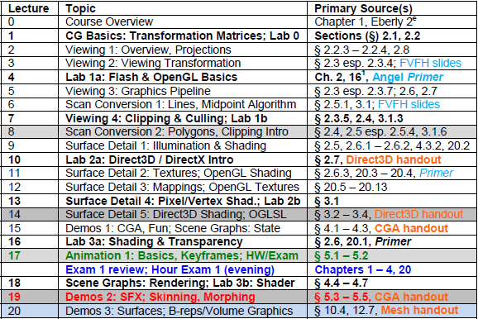

Where We Are

Slide 4
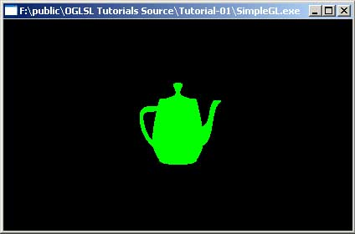
Review [1]:
Simple OGLSL Vertex & Pixel Shaders
Vertex Shader
void main(void)
{
vec4 a = gl_Vertex;
a.x = a.x * 0.5;
a.y = a.y * 0.5;
gl_Position = gl_ModelViewProjectionMatrix * a;
}
Q: What does this do?
A:
  Incoming x and y components are scaled with a factor 0.5
  Scaled vertex is transformed with concatenated modelview and projection matrix.
Fragment Shader
void main (void)
{
gl_FragColor = vec4 (0.0, 1.0, 0.0, 1.0);
}
Q: What does this do?
A: Makes everything green!
© 2003 – 2005 M. Christen, ClockworkCoders.com
http://bit.ly/et5qOp

Slide 5
Review [2]:
OGLSL Loading, Compiling, Linking
Loading Programs without aShaderManager class
Step 1: Declare shader programs and shader objects
Step 2: Load, add and compile/link programs in AppInit()
  Reserve memory and initialize objects
    myShader = new aShaderObject;
    myVertexShader = new aVertexShader;
    myFragmentShader = new aFragmentShader;
  Load:
    myVertexShader->load("simple.vert");
    myFragmentShader->load("simple.frag");
  Compile:
    myVertexShader->compile();
    myFragmentShader->compile();
  Add (compiled) programs to the object and link it:
myShader->addShader(myVertexShader);
myShader->addShader(myFragmentShader);
myShader->link();
© 2003 – 2005 M. Christen, ClockworkCoders.com
http://bit.ly/et5qOp

Slide 6
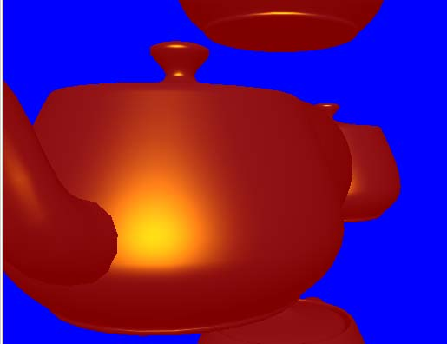
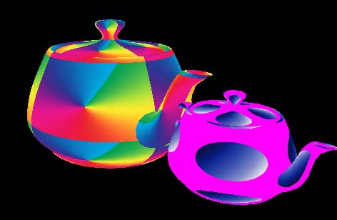

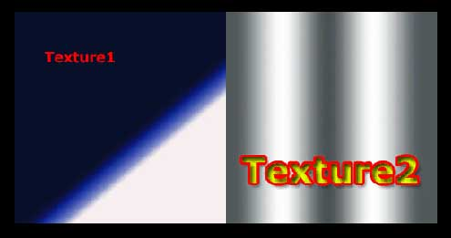
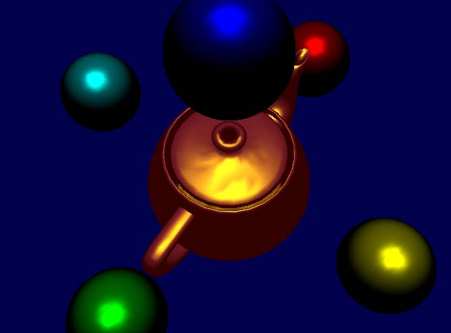

Review [3]:
OGLSL Shader Application
Loading Programs without aShaderManager class (Step 3 of 3)
Step 3: Use shader (see rest of Tutorials, #2 – 10!)
  myShader->begin();
  ... {draw something with GL} ...
  myShader->end();
#5 Phong shading in OpenGL
http://bit.ly/i5IFL0
#6 Texture Mapping
http://bit.ly/hRhFQD
#7 Color Keys (Transparency Masks)
http://bit.ly/hUEi62
#8 Multitexturing
http://bit.ly/glaYoY
#9 Procedural Texture (Procedural Materials)
http://bit.ly/ieeER5
#10 Cartoon Shading
http://bit.ly/gR5EH3
Adapted from material © 2003 – 2005 M. Christen, ClockworkCoders.com
http://bit.ly/et5qOp

Slide 7

Review [4]
Vertex Shaders in Direct3D & HLSL
Defining TVertex data structure: position/normal/texture tuple:
struct TVertex
{
D3DXVECTOR3 position;
D3DXVECTOR3 Normal;
D3DXVECTOR3 Tex;
};
Vertex declaration to describe this structure:
const D3DVERTEXELEMENT9 dec[4] =
{
{0, 0, D3DDECLTYPE_FLOAT3, D3DDECLMETHOD_DEFAULT, D3DDECLUSAGE_POSITION,0},
{0, 12, D3DDECLTYPE_FLOAT3, D3DDECLMETHOD_DEFAULT, D3DDECLUSAGE_NORMAL, 0},
{0, 24, D3DDECLTYPE_FLOAT2, D3DDECLMETHOD_DEFAULT, D3DDECLUSAGE_TEXCOORD,0},
D3DDECL_END()
};
Each line corresponds to one of the elements in TVertex. The data in each line is:
WORD Stream; WORD Offset; BYTE Type; BYTE Method; BYTE Usage; BYTE UsageIndex
We need to tell Direct3D about our vertex declaration using the following call:
IDirect3DVertexDeclaration9 m_vertexDeclaration;
gDevice->CreateVertexDeclaration(dec,&m_vertexDeclaration);
To render:
gDevice->SetStreamSource( 0, m_vb,0, sizeof(TVertex ));
gDevice->SetVertexDeclaration(m_vertexDeclaration);
Adapted from Toymaker © 2004 – 2010 K. Ditchburn, Teesside University
http://bit.ly/g8Q8hC

Slide 8
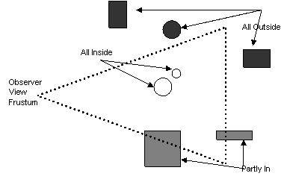
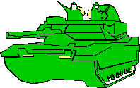
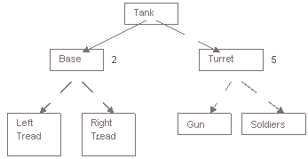
Scene Graphs: State
Scene Graph: General Data Structure used in CG
  Used to: compute visibility, set up rendering pipeline
  Nodes
    Leaves: primitive components
    Interior: assembly operations, modelview transformations
    Root(s): scene or major objects
Scene Graph Traversal: Initial Step – Drives Rendering
Images © 2007 A. Bar-Zeev
http://bit.ly/gxy9ed

Slide 9
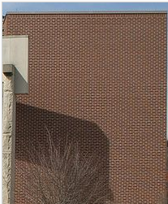
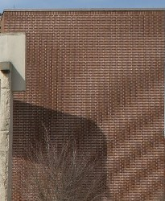
Aesthetics:
Non-Photorealistic Shading, Aliasing
Non-Photorealistic Rendering: Aimed at Achieving Natural Aesthetic
  Cartoon shaders: use sharp gradient (thresholded)
  Pencil shaders: blurring, stippling
CGA and Realism
Aliasing (see Wikipedia: http://bit.ly/fIkCkr)
  Term from signal processing
  Two sampled signals indistinguishable from (aliases of) one another
  Examples: jaggies, Moiré vibration
  Anti-aliasing: operations to prevent such effects
Temporal Aliasing
  Similar effect in animation
  Small artifact can be much more jarring!
  Example: think of flecks in traditional film reels
© 2004 – 2009 Wikipedia, Aliasing
http://bit.ly/fIkCkr

Slide 10

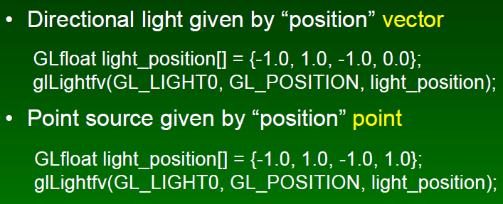
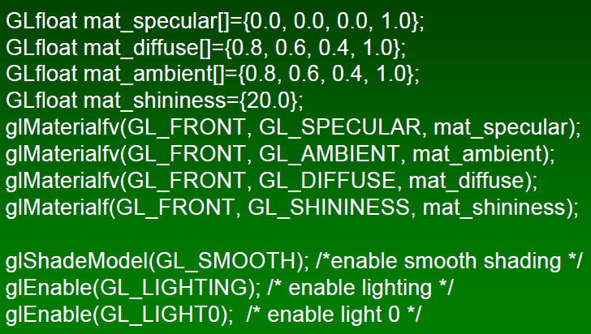
Next Time: Lab 3
OpenGL Shading & Transparency
Set Up Point Light Sources
Set Up Materials, Turn Lights On
Start Drawing (glBegin … glEnd)
Frank Pfenning
Professor of Computer Science
School of Computer Science
Carnegie Mellon University
http://www.cs.cmu.edu/~fp/
See also: OpenGL: A Primer, 3e (Angel)
http://bit.ly/hVcVWN
Adapted from slides © 2003 F. Pfenning, Carnegie Mellon University
http://bit.ly/g1J2nj

Slide 11
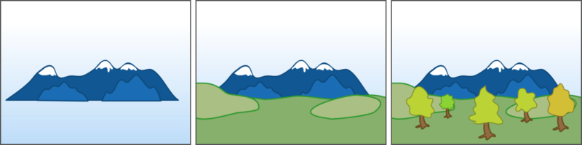
Preview:
Painter’s Algorithm
© 2004 – 2009 Wikipedia, Painter’s Algorithm
http://bit.ly/eeebCN

Slide 12
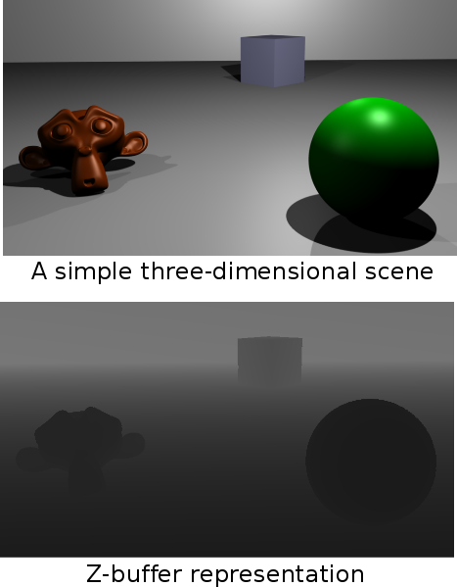
Preview:
Z-buffering
© 2009 Wikipedia, Z-buffering
http://bit.ly/gGRFMA

Slide 13
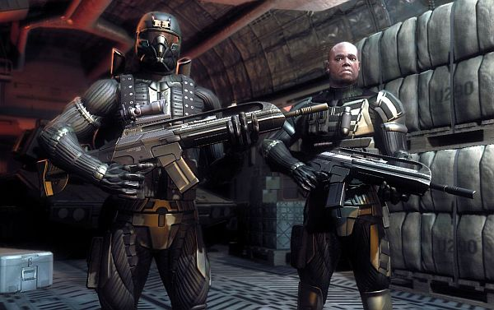
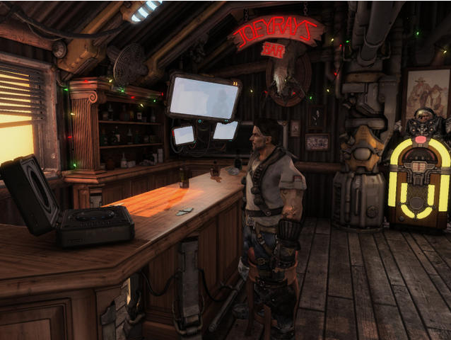
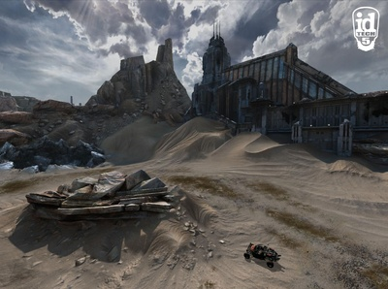
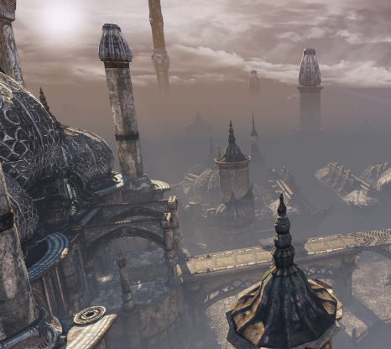
Trailers:
Video Games
Crysis 2 © 2011 Electronic Arts http://youtu.be/j4mOGhWSXYQ
Starcraft II: Wings of Liberty © 2010 Blizzard
http://youtu.be/rgyL08nhtkw
Rage & id Tech 5 © 2011 id Software
http://youtu.be/vzZPjYPDBvY
Unreal Engine 3 © 2004-2011 Epic/Valve
http://youtu.be/MGf0oGGGQqQ
Inspired by slides © 2002 – 2003 van Dam et al., Brown University
http://bit.ly/fiYmje Reused with permission.

Slide 14





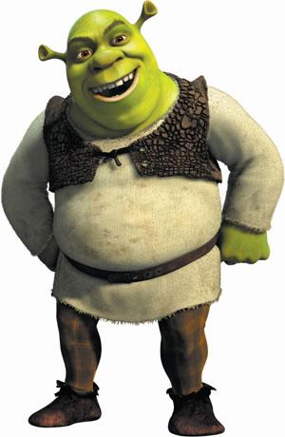


Videos: CG Feature Films & Shorts
Monsters Inc.
© 2001 Disney/Pixar
http://youtu.be/cvOQeozL4S0
Tron: Legacy
© 2010 Walt Disney Pictures
http://youtu.be/pIwXwVJZ3BY
Toy Story 3
© 2010 Disney/Pixar
http://youtu.be/JcpWXaA2qeg
Happy Feet
© 2006
Warner Brothers
http://bit.ly/gTnp2V
Kung-Fu Panda
© 2008 DreamWorks
Animation SKG
http://bit.ly/h8krLv
Wall-E
© 2008 Disney/Pixar
http://bit.ly/eKDwkk
Shrek Forever After
© 2010 DreamWorks
Animation SKG
http://youtu.be/u7__TG7swg0
Luxo Jr.
© 1986 Pixar Animation Studios
http://youtu.be/L_oL_27KqgU

Slide 15
Summary
Last Time: Shader Languages – OGLSL & Direct3D
  OpenGL Shading Language (OGLSL or GLSL) – main topic
  High-Level Shading Language (HLSL) & Direct3D
Today: Scene Graphs; Computer-Generated Animation Demos, Videos
  Scene graphs and state – main topic
  State of CGA: videos
  Issues
    Photorealism and non-photorealistic rendering (NPR)
    Making most of hardware
    Role of animators (see CNBC’s Pixar Story, http://bit.ly/gShkXL)
  Techniques showcased
    Multipass texturing
    Alpha compositing/blending
    Portals and binary space partitioning
  Demos to download: Maya, LightWave

Slide 16
Terminology
Scene Graph: General Data Structure used in CG
  Used to: compute visibility, set up rendering pipeline
  Actual graph: general graph, forest, or rooted tree
Scene Graph Traversal: Initial Step – Drives Rendering
Features of Scene Graphs
  Spatial partitioning: e.g., using bounding volume hierarchies
  Leaves: primitive components
  Interior nodes: assembly operations, modelview transformations
  Root(s): scene or major objects
Non-Photorealistic Rendering: Aimed at Achieving Natural Aesthetic
  Cartoon shaders: use sharp gradient (thresholded)
  Pencil shaders: blurring, stippling
CGA and Realism
  Aliasing & anti-aliasing
  Temporal aliasing & temporal anti-aliasing

