Slide 1
Lecture 16 of 41
Transparency, Painter’s Algorithm, & Z-Buffer
Lab 3a: Shading & Transparency
William H. Hsu
Department of Computing and Information Sciences, KSU
KSOL course pages: http://bit.ly/hGvXlH / http://bit.ly/eVizrE
Public mirror web site: http://www.kddresearch.org/Courses/CIS636
Instructor home page: http://www.cis.ksu.edu/~bhsu
Readings:
Today: §2.6, 20.1 Eberly 2e
OpenGL: A Primer on shading, alpha blending
Khronos Group docs on transparency: http://bit.ly/hRaQgk
Wikipedia, Painter’s Algorithm: http://bit.ly/eeebCN
Wikipedia, Z-buffering: http://bit.ly/gGRFMA

Slide 2
Lecture Outline
Reading for Last Class: §4.1 – 4.3, Eberly 2e; CGA handout
Reading for Today: §2.6, 20.1, Eberly 2e; OpenGL primer material
Reading for Next Class: §5.1 – 5.2, Eberly 2e
Last Time: Scene Graphs; CGA Demos, Videos
  Scene graphs and state – main topic
  State of CGA: videos and discussion
  Demos to download
    Adobe Maya: http://students.autodesk.com
    NewTek Lightwave: http://www.newtek.com/lightwave/
Today: Shading and Transparency in OpenGL
  Transparency revisited
  OpenGL how-to: http://bit.ly/hRaQgk
    Alpha blending (15.020, 15.040)
    Screen-door transparency (15.030)
  Painter’s algorithm & depth buffering (z-buffering)

Slide 3
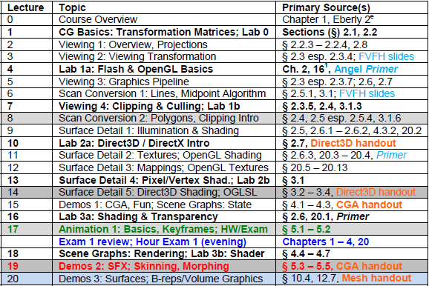

Where We Are

Slide 4
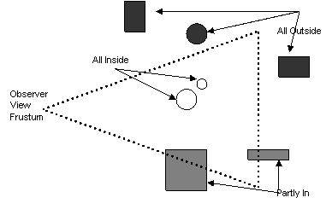
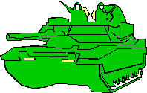
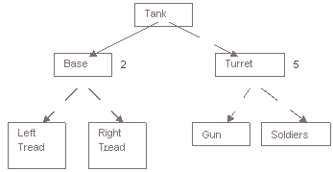
Review [1]:
Scene Graphs
Scene Graph: General Data Structure used in CG
  Used to: compute visibility, set up rendering pipeline
  Actual graph: general graph, forest, or rooted tree
Scene Graph Traversal: Initial Step – Drives Rendering
Features of Scene Graphs
  Spatial partitioning: e.g., using bounding volume hierarchies
  Leaves: primitive components
  Interior nodes: assembly operations, modelview transformations
  Root(s): scene or major objects
Images © 2007 A. Bar-Zeev
http://bit.ly/gxy9ed

Slide 5
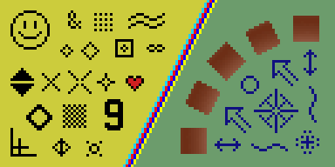
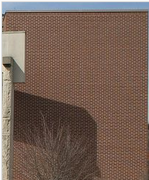
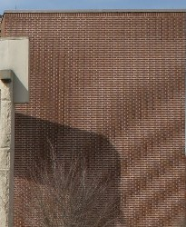
Review [2]:
Aesthetic Considerations
Non-Photorealistic Rendering: Aimed at Achieving Natural Aesthetic
  Cartoon shaders: use sharp gradient (thresholded)
  Pencil shaders: blurring, stippling
CGA and Realism
Aliasing (see Wikipedia: http://bit.ly/fIkCkr)
  Term from signal processing
  Two sampled signals indistinguishable from (aliases of) one another
  Examples: jaggies, Moiré vibration (Moiré pattern)
  Anti-aliasing: operations to prevent such effects
Temporal Aliasing
  Similar effect in animation
  Small artifact can be much more jarring!
  Example: think of flecks in traditional film reels
© 2004 – 2009 Wikipedia, Jaggies
http://bit.ly/fIkCkr
© 2004 – 2009 Wikipedia, Aliasing
http://bit.ly/fIkCkr

Slide 6

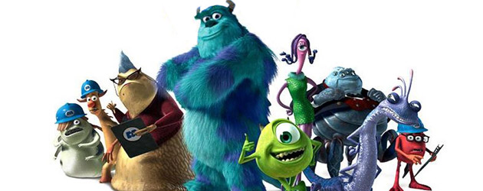



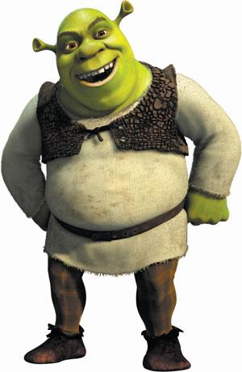
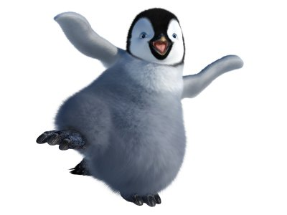

Review[3]: CG Feature Films & Shorts
Monsters Inc. 2
© 2012 Disney/Pixar
http://youtu.be/cJHU9IYvWUg
Tron: Legacy
© 2010 Walt Disney Pictures
http://youtu.be/pIwXwVJZ3BY
Toy Story 3
© 2010 Disney/Pixar
http://youtu.be/JcpWXaA2qeg
Happy Feet
© 2006
Warner Brothers
http://bit.ly/gTnp2V
Kung-Fu Panda
© 2008 DreamWorks
Animation SKG
http://bit.ly/h8krLv
Wall-E
© 2008 Disney/Pixar
http://bit.ly/eKDwkk
Shrek Forever After
© 2010 DreamWorks
Animation SKG
http://youtu.be/u7__TG7swg0
Luxo Jr.
© 1986 Pixar Animation Studios
http://youtu.be/L_oL_27KqgU

Slide 7

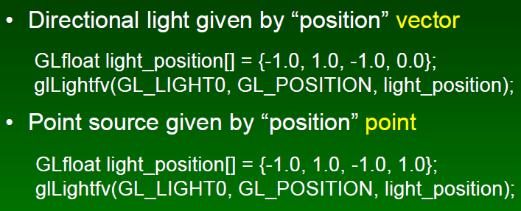
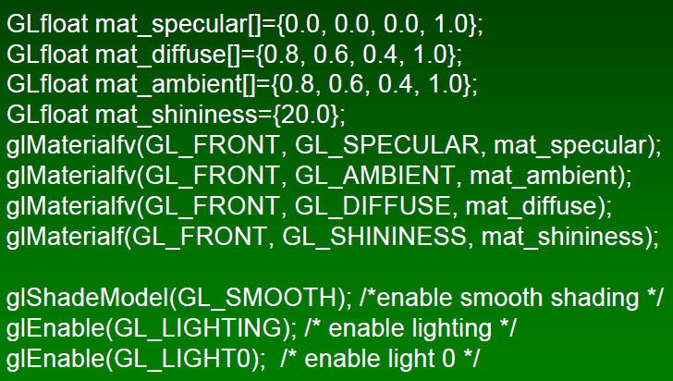
Review [4]:
OpenGL Shading (Overview)
Set Up Point Light Sources
Set Up Materials, Turn Lights On
Start Drawing (glBegin … glEnd)
Frank Pfenning
Professor of Computer Science
School of Computer Science
Carnegie Mellon University
http://www.cs.cmu.edu/~fp/
See also: OpenGL: A Primer, 3e (Angel)
http://bit.ly/hVcVWN
Adapted from slides © 2003 F. Pfenning, Carnegie Mellon University
http://bit.ly/g1J2nj

Slide 8
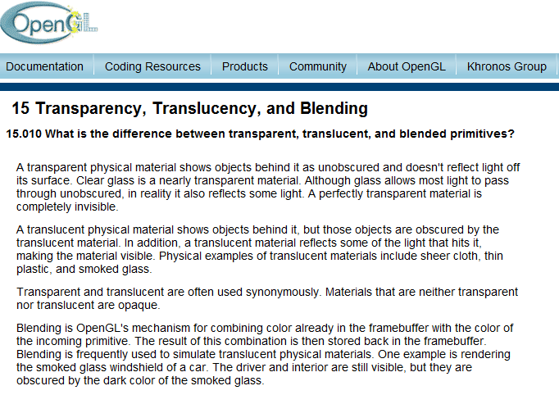
Transparency in OpenGL [1]:
Transparent vs. Translucent, Blended
© 1997 – 2011 Khronos Group
http://bit.ly/hRaQgk

Slide 9
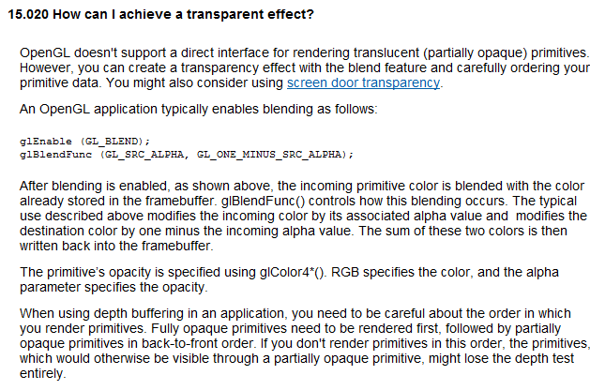
Transparency in OpenGL [2]:
Blending vs. Screen Door
© 1997 – 2011 Khronos Group
http://bit.ly/hRaQgk

Slide 10
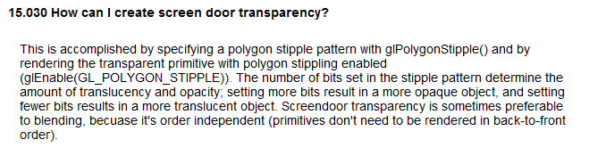
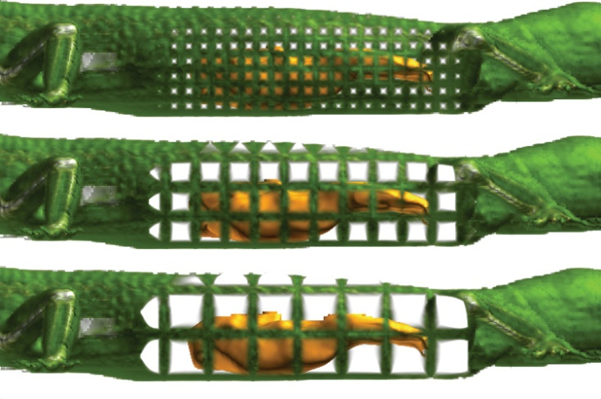
Transparency in OpenGL [3]:
Screen Door
Screen door: Viola et al. (2004), http://bit.ly/dVEa7l
Technical University of Vienna, IEEE Vis 2004
© 1997 – 2011 Khronos Group
http://bit.ly/hRaQgk

Slide 11
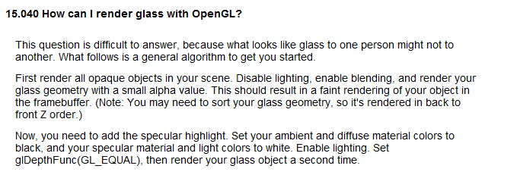
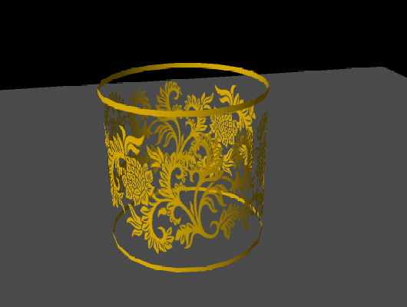
Transparency in OpenGL [4]:
Glass
Alpha blending: Lim (2010), http://bit.ly/6TsJrb
Goon Creative, Maya Transparency Tutorial
© 1997 – 2011 Khronos Group
http://bit.ly/hRaQgk

Slide 12
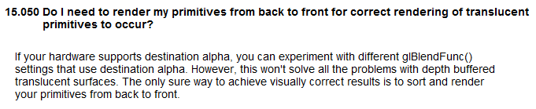

Transparency in OpenGL [5]:
Alpha & Painter’s Algorithm
© 2004 – 2009 Wikipedia, Painter’s Algorithm
http://bit.ly/eeebCN
© 1997 – 2011 Khronos Group
http://bit.ly/hRaQgk

Slide 13
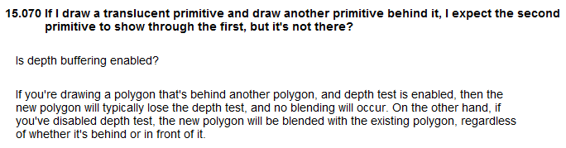
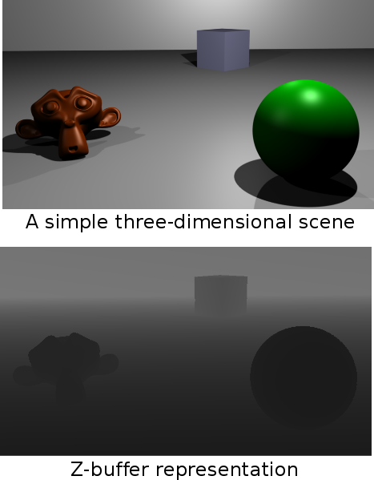
Transparency in OpenGL [6]:
Painter’s algorithm & Z-buffering
© 2009 Wikipedia, Z-buffering
http://bit.ly/gGRFMA
© 1997 – 2011 Khronos Group
http://bit.ly/hRaQgk

Slide 14
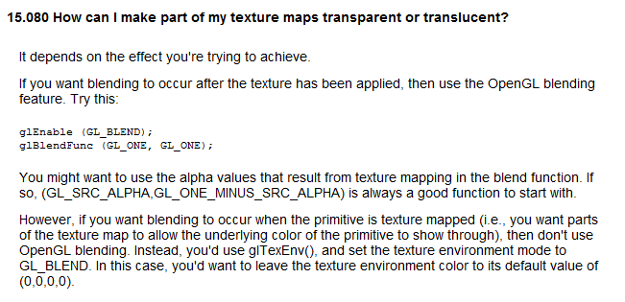
Transparency in OpenGL [6]:
Partial Transparency
© 1997 – 2011 Khronos Group
http://bit.ly/hRaQgk

Slide 15
Summary
Reading for Last Class: §4.1 – 4.3, Eberly 2e; CGA handout
Reading for Today: §2.6, 20.1, Eberly 2e; OpenGL primer material
Reading for Next Class: §5.1 – 5.2, Eberly 2e
Last Time: Scene Graphs
  Maintaining state
  Coming up: traversal
CGA Demos, Videos
  State of CGA: videos
  Issues: photorealism, hardware, traditional (non-CG) animation
  Techniques showcased: multipass texturing, alpha, portals
Shading and Transparency in OpenGL
  Alpha blending
  Painter’s algorithm – less efficient, can handle non-opaque objects
  Depth buffering (z-buffering) – in hardware, fast, opaque only

Slide 16
Terminology
Non-Photorealistic Rendering
  Cartoon shaders
  Pencil shaders
CGA and Realism
  Aliasing – reconstructed image differs from original
  Alias – artifact in reconstructed image (jaggies, Moiré pattern, etc.)
  Anti-aliasing – techniques (e.g., area sampling) for avoiding aliasing
  Temporal aliasing – aliasing over time (e.g., in animation)
  Temporal anti-aliasing – smoothing out aliasing over time
Shading and Transparency in OpenGL
  Alpha blending – using A channel of R, G, B, A to combine colors
  Painter’s algorithm aka priority fill – back-to-front rendering
  Depth buffering (z-buffering) – checking z values

