Slide 1
Lecture 17 of 41
Animation 1 of 3: Basics, Keyframing
Sample Exam Review
William H. Hsu
Department of Computing and Information Sciences, KSU
KSOL course pages: http://bit.ly/hGvXlH / http://bit.ly/eVizrE
Public mirror web site: http://www.kddresearch.org/Courses/CIS636
Instructor home page: http://www.cis.ksu.edu/~bhsu
Readings:
Today: §5.1 – 5.2, Eberly 2e – see http://bit.ly/ieUq45
Next class: no new reading – review Chapters 1 – 4, 20
Optional review session during next class period; evening exam time TBD
Lecture 18 reading (two class days from today): §4.4 – 4.7, Eberly 2e

Slide 2
Lecture Outline
Reading for Last Class: §2.6, 20.1, Eberly 2e; OpenGL primer material
Reading for Today: §5.1 – 5.2, Eberly 2e
Reading for Next Lecture (Two Classes from Now): §4.4 – 4.7, Eberly 2e
Last Time: Shading and Transparency in OpenGL
  Transparency revisited
  OpenGL how-to: http://bit.ly/hRaQgk
    Alpha blending (15.020, 15.040)
    Screen-door transparency (15.030)
  Painter’s algorithm & depth buffering (z-buffering)
Today: Introduction to Animation
  What is it and how does it work?
  Brief history
  Principles of traditional animation
  Keyframe animation
  Articulated figures: inbetweening

Slide 3
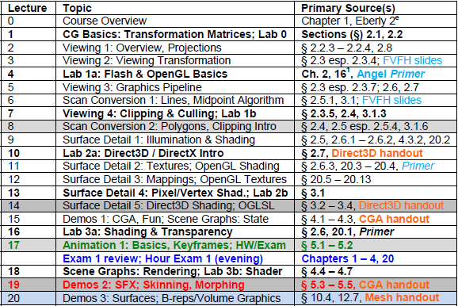

Where We Are

Slide 4

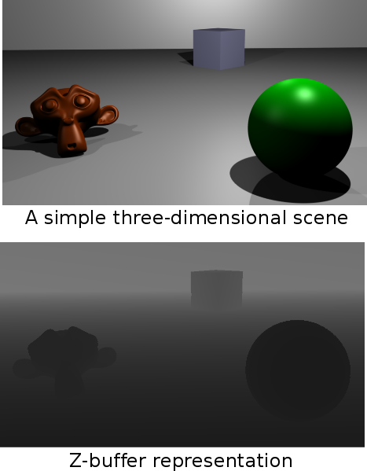
Review:
Painter’s Algorithm vs. z-Buffering
© 2004 – 2009 Wikipedia, Painter’s Algorithm
http://bit.ly/eeebCN
© 2009 Wikipedia, Z-buffering
http://bit.ly/gGRFMA

Slide 5
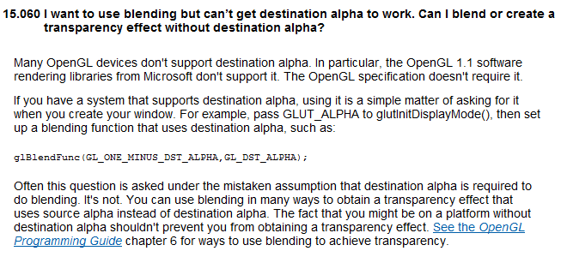
Transparency in OpenGL:
Final Note
© 1997 – 2011 Khronos Group
http://bit.ly/hRaQgk

Slide 6


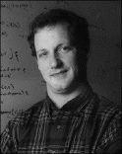

Acknowledgements:
Computer Animation Intro
Jason Lawrence
Assistant Professor
Department of Computer Science
University of Virginia
http://www.cs.virginia.edu/~jdl/
Acknowledgment: slides by Misha Kazhdan, Allison Klein, Tom Funkhouser, Adam Finkelstein and David Dobkin
http://bit.ly/eB1Oj4
Thomas A. Funkhouser
Professor
Department of Computer Science
Computer Graphics Group
Princeton University
http://www.cs.princeton.edu/~funk/

Slide 7
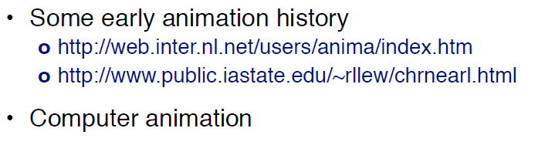
Overview
© 2010 J. Lawrence, University of Virginia
CS 4810: Introduction to Computer Graphics – http://bit.ly/hPIXdi

Slide 8
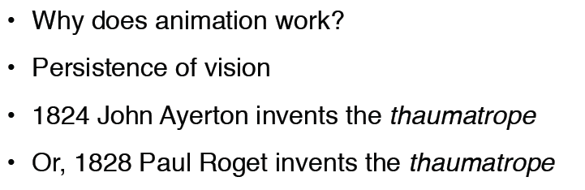


Thaumatrope
Thaumatrope of flowers & vase (1825)
© 2008 Wikipedia, Thaumatrope
http://bit.ly/fFl6xH
Adapted from slides © 2010 J. Lawrence, University of Virginia
CS 4810: Introduction to Computer Graphics – http://bit.ly/hPIXdi

Slide 9
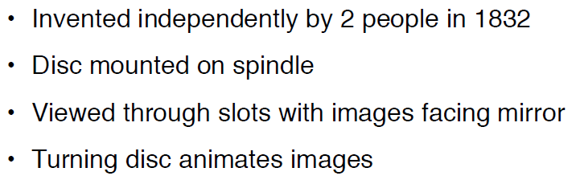
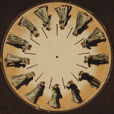
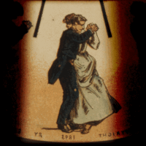
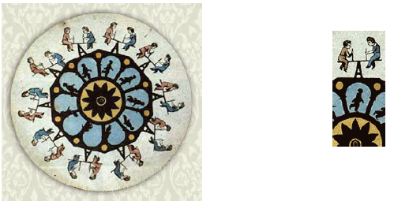
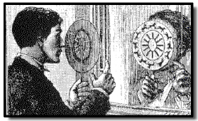
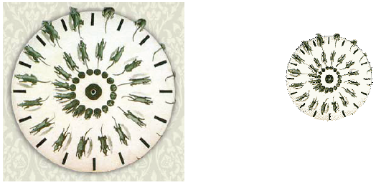
Phenakistoscope
Phenakistoscope of couple (1893)
© 2007 Wikipedia, Phenakistoscope
http://bit.ly/eAnURG
Adapted from slides © 2010 J. Lawrence, University of Virginia
CS 4810: Introduction to Computer Graphics – http://bit.ly/hPIXdi

Slide 10
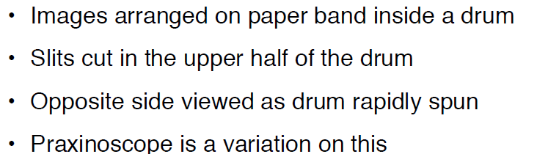
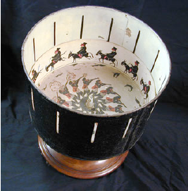
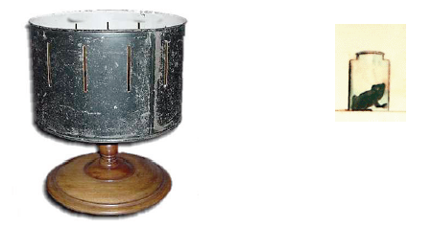
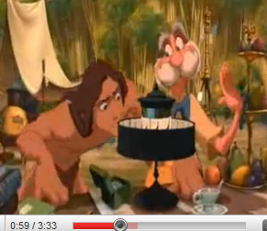
Zoetrope (1834)
Tarzan © 2000 Disney
http://youtu.be/zc3MnoSS5Hw
Adapted from slides © 2010 J. Lawrence, University of Virginia
CS 4810: Introduction to Computer Graphics – http://bit.ly/hPIXdi

Slide 11
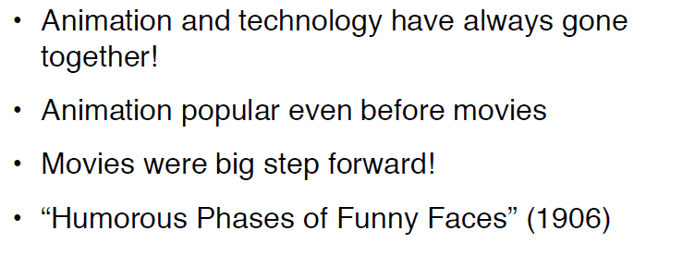
Animation History
© 2010 J. Lawrence, University of Virginia
CS 4810: Introduction to Computer Graphics – http://bit.ly/hPIXdi

Slide 12
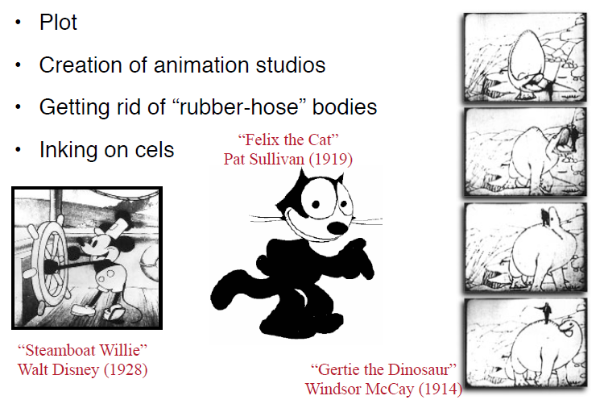
Key Developments [1]:
Storytelling & Cel Animation
© 2010 J. Lawrence, University of Virginia
CS 4810: Introduction to Computer Graphics – http://bit.ly/hPIXdi

Slide 13
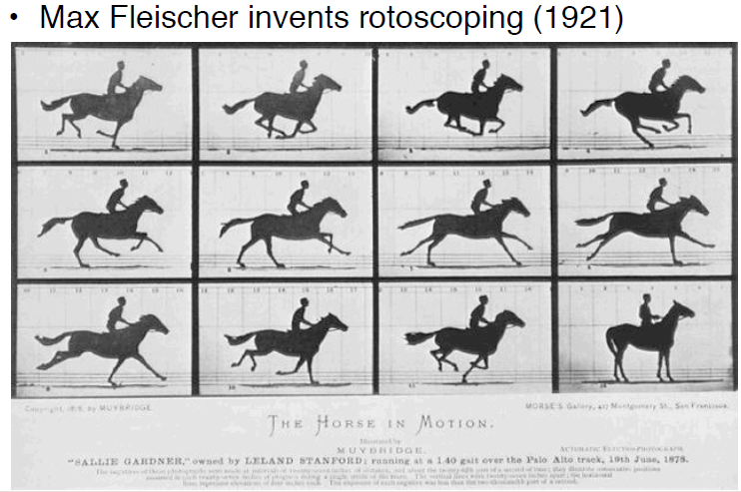
Key Developments [2]:
Rotoscoping (1921)
© 2010 J. Lawrence, University of Virginia
CS 4810: Introduction to Computer Graphics – http://bit.ly/hPIXdi

Slide 14
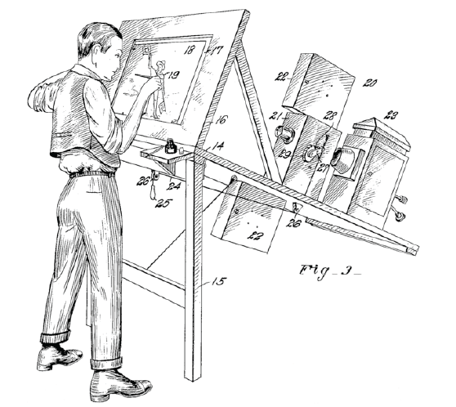
Key Developments [4]
Fleischer’s Rotoscope
© 2010 J. Lawrence, University of Virginia
CS 4810: Introduction to Computer Graphics – http://bit.ly/hPIXdi

Slide 15
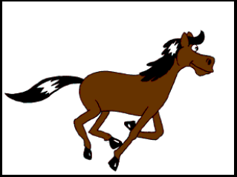
Key Developments [5]:
Using Rotoscoping
Adapted from slides © 2010 J. Lawrence, University of Virginia
CS 4810: Introduction to Computer Graphics – http://bit.ly/hPIXdi

Slide 16
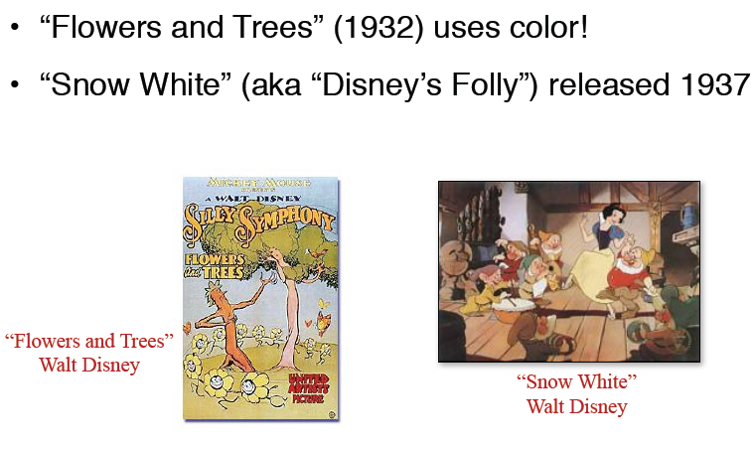
Key Developments [6]:
Color
© 2010 J. Lawrence, University of Virginia
CS 4810: Introduction to Computer Graphics – http://bit.ly/hPIXdi

Slide 17

Overview
© 2010 J. Lawrence, University of Virginia
CS 4810: Introduction to Computer Graphics – http://bit.ly/hPIXdi

Slide 18
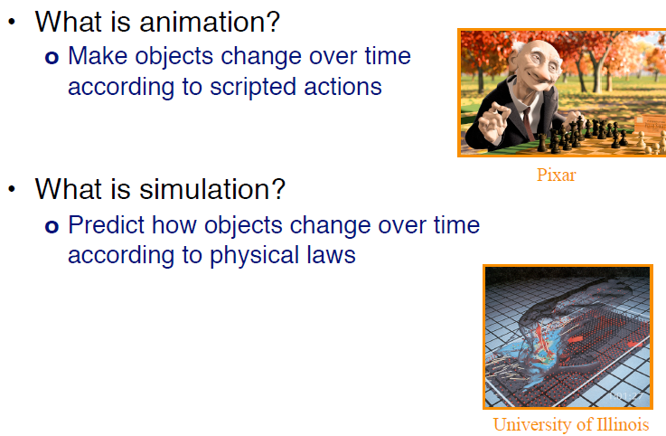
Animation, Simulation, &
Visualization
Wilhelmson et al. (2004)
http://youtu.be/EgumU0Ns1YI
http://avl.ncsa.illinois.edu
http://bit.ly/eA8PXN
Adapted from slides © 2010 J. Lawrence, University of Virginia
CS 4810: Introduction to Computer Graphics – http://bit.ly/hPIXdi

Slide 19

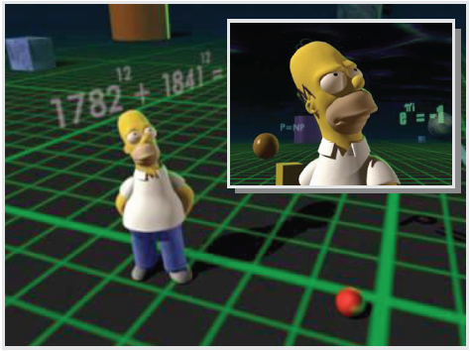
2-D & 3-D Animation
Homer 2-D
Homer 3-D
http://youtu.be/TKQ8Ilr6PgU (Making Of)
The Simpsons
© 1989 – 2011 Fox Broadcasting Company, Inc.
© 2010 J. Lawrence, University of Virginia
CS 4810: Introduction to Computer Graphics – http://bit.ly/hPIXdi

Slide 20
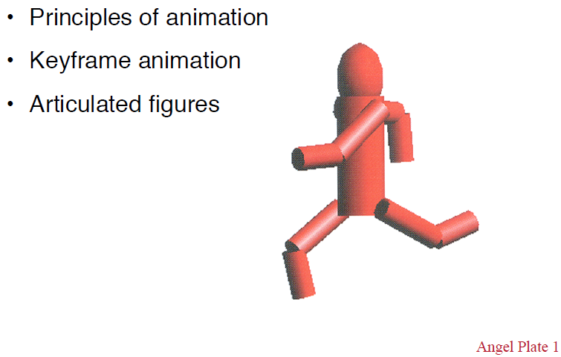
Outline
© 2010 J. Lawrence, University of Virginia
CS 4810: Introduction to Computer Graphics – http://bit.ly/hPIXdi

Slide 21
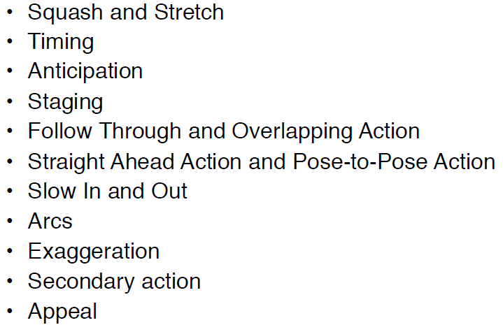
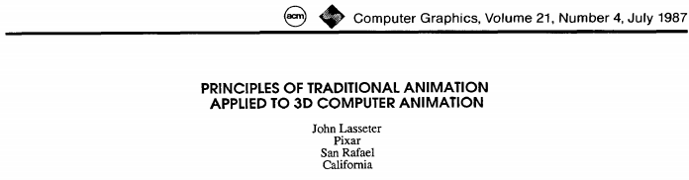
Traditional Animation [1]:
Lasseter’s List of Principles (1987)
Lasseter, J. (1987). Principles of traditional animation applied to
3D computer animation. Computer Graphics, 21(4), pp. 35-44.
SIGGRAPH: http://bit.ly/1DsO44
ACM Portal: http://bit.ly/eyx2PN
© 2010 J. Lawrence, University of Virginia
CS 4810: Introduction to Computer Graphics – http://bit.ly/hPIXdi

Slide 22
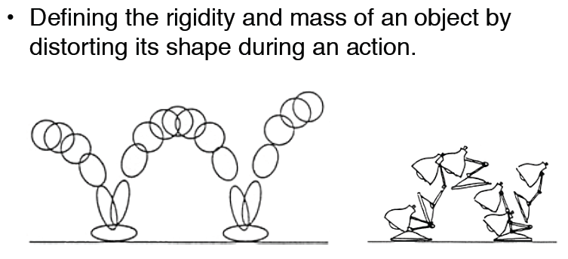
Traditional Animation [2]:
Squash & Stretch
© 2010 J. Lawrence, University of Virginia
CS 4810: Introduction to Computer Graphics – http://bit.ly/hPIXdi

Slide 23
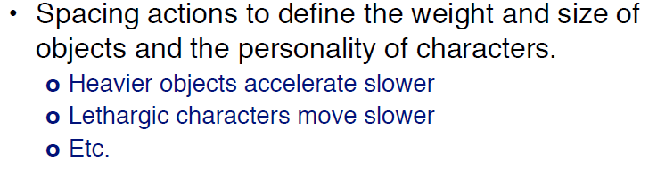
Traditional Animation [3]:
Timing
© 2010 J. Lawrence, University of Virginia
CS 4810: Introduction to Computer Graphics – http://bit.ly/hPIXdi

Slide 24
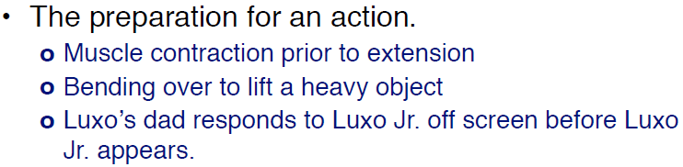
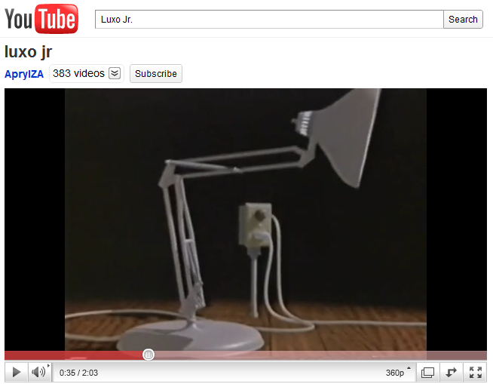
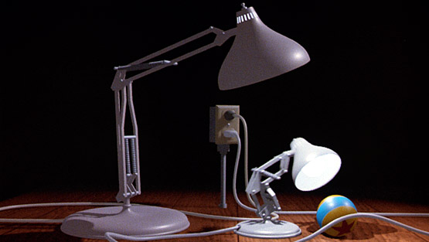

Traditional Animation [4]:
Anticipation
Luxo Jr. © 1986 Pixar
http://www.pixar.com/shorts/ljr/
http://youtu.be/qGxoui3IFS0
© 2010 J. Lawrence, University of Virginia
CS 4810: Introduction to Computer Graphics – http://bit.ly/hPIXdi

Slide 25
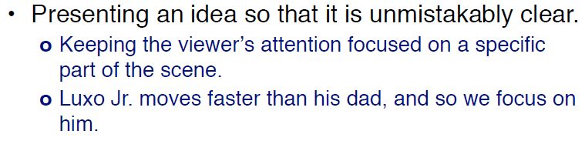
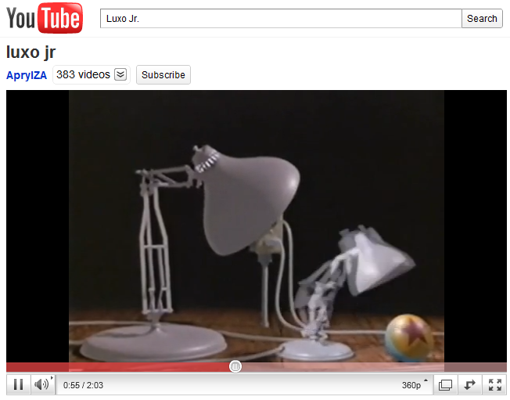
Traditional Animation [5]:
Staging
Luxo Jr. © 1986 Pixar
http://www.pixar.com/shorts/ljr/
http://youtu.be/qGxoui3IFS0
© 2010 J. Lawrence, University of Virginia
CS 4810: Introduction to Computer Graphics – http://bit.ly/hPIXdi

Slide 26
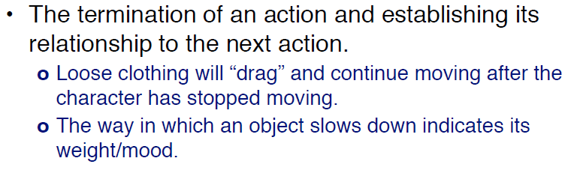
Traditional Animation [6]:
Follow Through & Overlapping Action
© 2010 J. Lawrence, University of Virginia
CS 4810: Introduction to Computer Graphics – http://bit.ly/hPIXdi

Slide 27
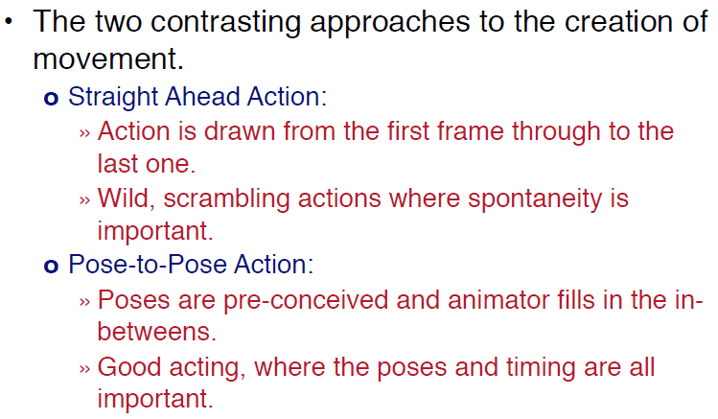
Traditional Animation [7]:
Straight-Ahead vs. Pose-to-Pose Action
© 2010 J. Lawrence, University of Virginia
CS 4810: Introduction to Computer Graphics – http://bit.ly/hPIXdi

Slide 28

Traditional Animation [8]:
Slow In-And-Out
© 2010 J. Lawrence, University of Virginia
CS 4810: Introduction to Computer Graphics – http://bit.ly/hPIXdi

Slide 29
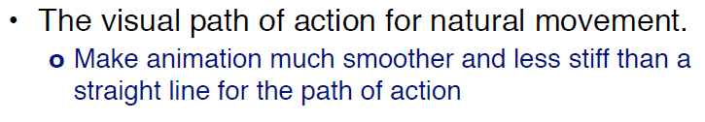
Traditional Animation [9]:
Arcs
© 2010 J. Lawrence, University of Virginia
CS 4810: Introduction to Computer Graphics – http://bit.ly/hPIXdi

Slide 30

Traditional Animation [10]:
Exaggeration
© 2010 J. Lawrence, University of Virginia
CS 4810: Introduction to Computer Graphics – http://bit.ly/hPIXdi

Slide 31
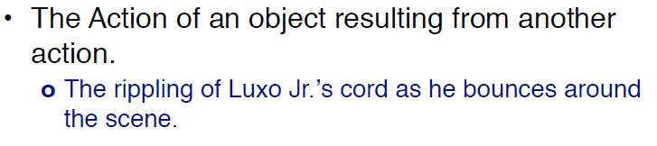
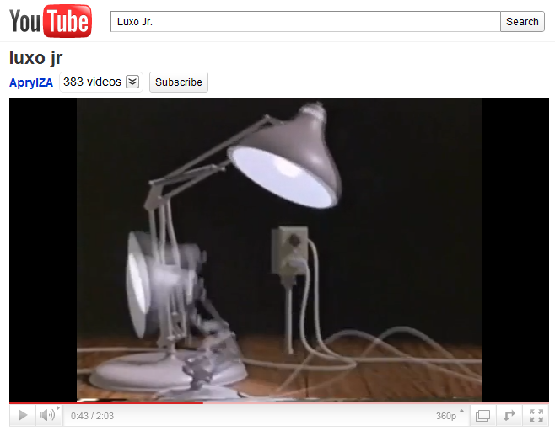
Traditional Animation [11]:
Secondary Action
Luxo Jr. © 1986 Pixar
http://www.pixar.com/shorts/ljr/
http://youtu.be/qGxoui3IFS0
© 2010 J. Lawrence, University of Virginia
CS 4810: Introduction to Computer Graphics – http://bit.ly/hPIXdi

Slide 32
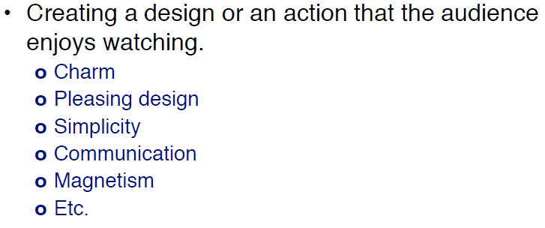
Traditional Animation [12]:
Appeal
© 2010 J. Lawrence, University of Virginia
CS 4810: Introduction to Computer Graphics – http://bit.ly/hPIXdi

Slide 33
Outline
© 2010 J. Lawrence, University of Virginia
CS 4810: Introduction to Computer Graphics – http://bit.ly/hPIXdi

Slide 34
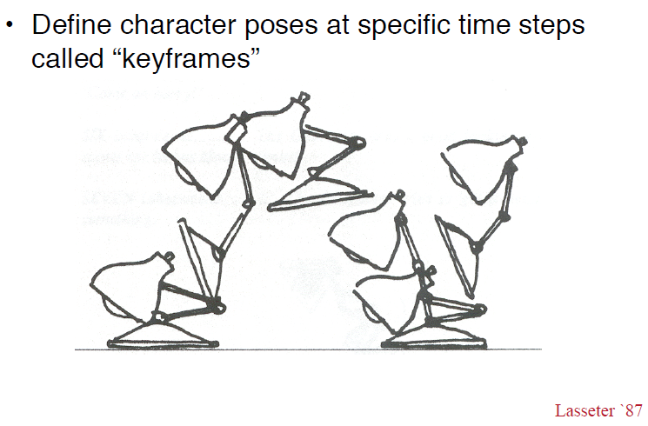
Keyframe Animation [1]:
Keyframes
© 2010 J. Lawrence, University of Virginia
CS 4810: Introduction to Computer Graphics – http://bit.ly/hPIXdi

Slide 35
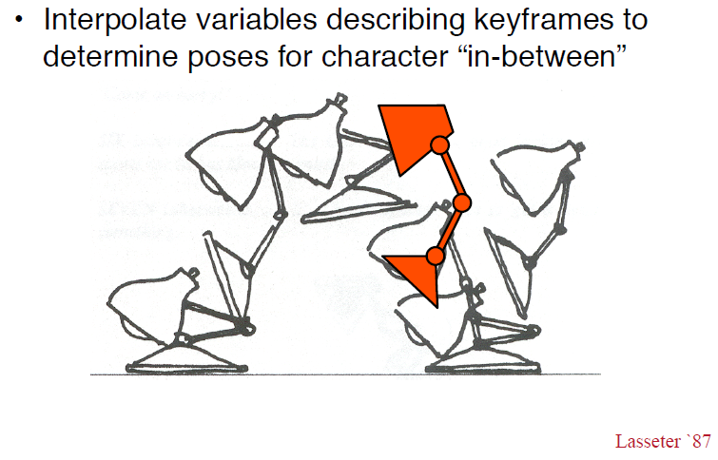
Keyframe Animation [2]:
Interpolation (aka Inbetweening)
© 2010 J. Lawrence, University of Virginia
CS 4810: Introduction to Computer Graphics – http://bit.ly/hPIXdi

Slide 36
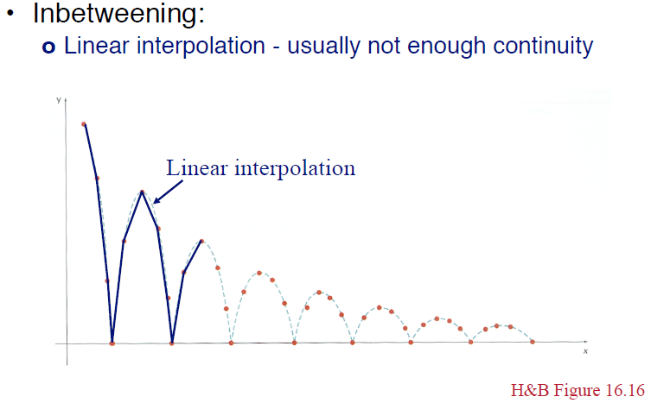
Keyframe Animation [3]:
Linear Interpolation aka Lerping
© 2010 J. Lawrence, University of Virginia
CS 4810: Introduction to Computer Graphics – http://bit.ly/hPIXdi

Slide 37
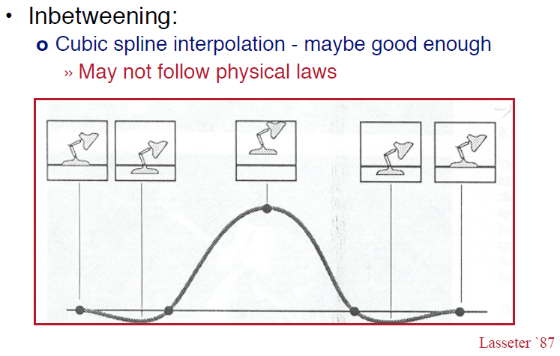
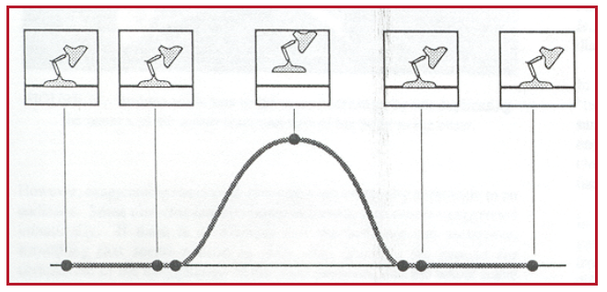
Keyframe Animation [4]:
Cubic Curve (Spline) Interpolation
© 2010 J. Lawrence, University of Virginia
CS 4810: Introduction to Computer Graphics – http://bit.ly/hPIXdi

Slide 38
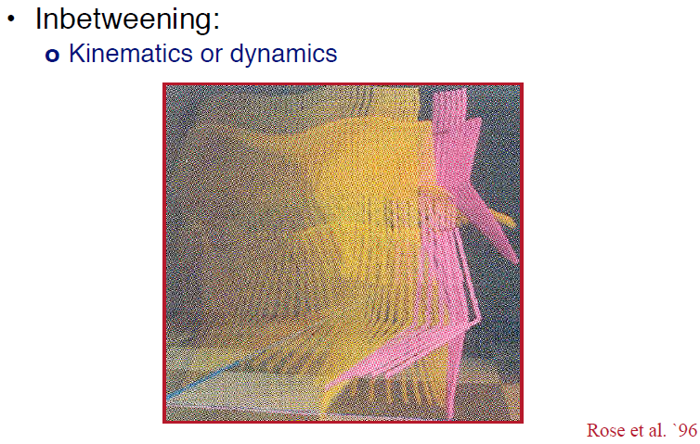
Keyframe Animation [5]:
Dynamics & Kinematics
© 2010 J. Lawrence, University of Virginia
CS 4810: Introduction to Computer Graphics – http://bit.ly/hPIXdi

Slide 39
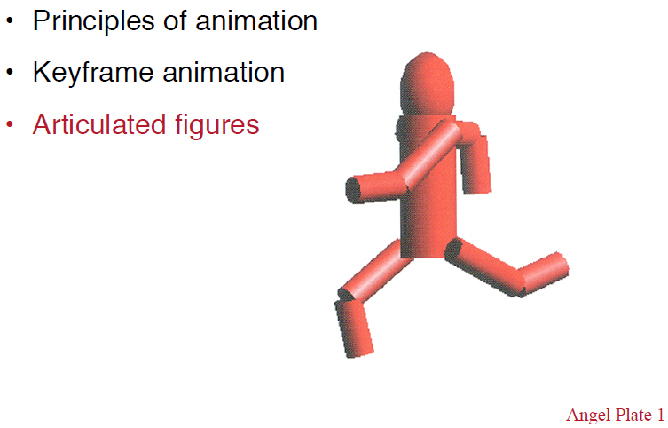
Outline
© 2010 J. Lawrence, University of Virginia
CS 4810: Introduction to Computer Graphics – http://bit.ly/hPIXdi

Slide 40
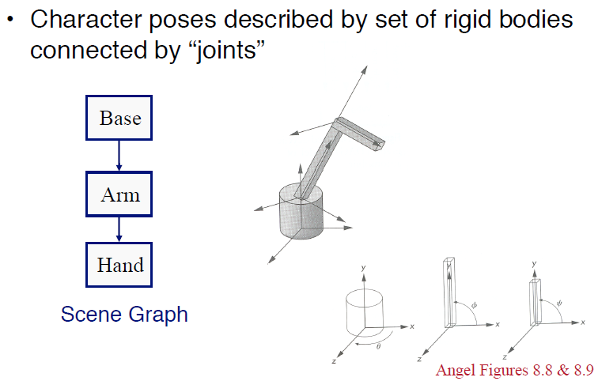
Articulated Figures [1]:
Definition
© 2010 J. Lawrence, University of Virginia
CS 4810: Introduction to Computer Graphics – http://bit.ly/hPIXdi

Slide 41
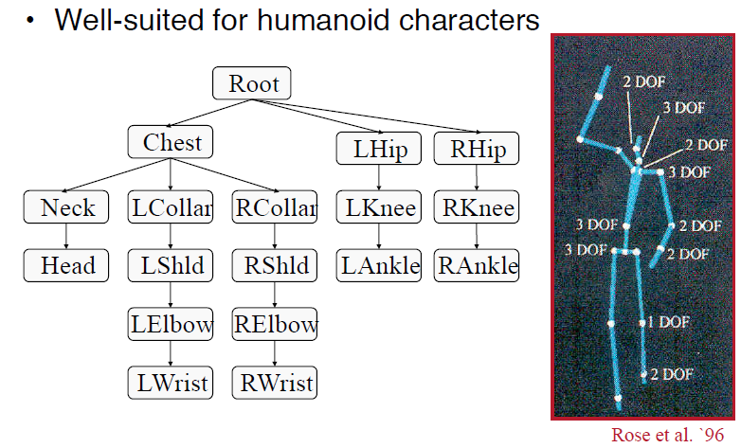
Articulated Figures [2]:
Character Modeling
© 2010 J. Lawrence, University of Virginia
CS 4810: Introduction to Computer Graphics – http://bit.ly/hPIXdi

Slide 42
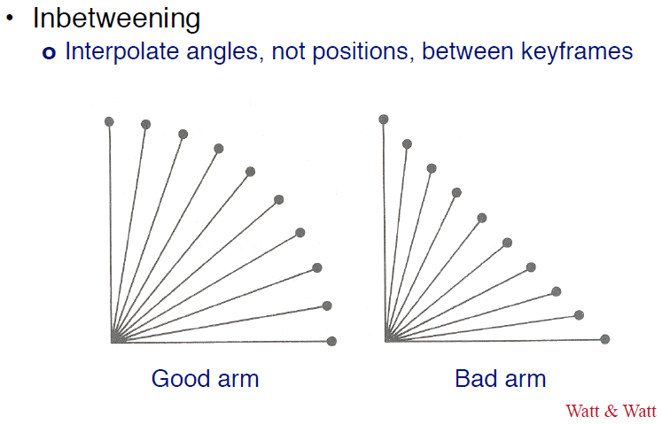
Articulated Figures [3]:
Angular Interpolation
© 2010 J. Lawrence, University of Virginia
CS 4810: Introduction to Computer Graphics – http://bit.ly/hPIXdi

Slide 43

Articulated Figures [4]:
Bones & Joints
© 2010 J. Lawrence, University of Virginia
CS 4810: Introduction to Computer Graphics – http://bit.ly/hPIXdi

Slide 44

Articulated Figures [5]:
Example – Walk Cycle 1
© 2010 J. Lawrence, University of Virginia
CS 4810: Introduction to Computer Graphics – http://bit.ly/hPIXdi

Slide 45

Articulated Figures [6]:
Example – Walk Cycle 2
© 2010 J. Lawrence, University of Virginia
CS 4810: Introduction to Computer Graphics – http://bit.ly/hPIXdi

Slide 46

Articulated Figures [7]:
Example – Walk Cycle 3
© 2010 J. Lawrence, University of Virginia
CS 4810: Introduction to Computer Graphics – http://bit.ly/hPIXdi

Slide 47

Articulated Figures [7]:
Example – Walk Cycle 4
© 2002 D. M. Murillo
http://bit.ly/eZ9MA8
© 2010 J. Lawrence, University of Virginia
CS 4810: Introduction to Computer Graphics – http://bit.ly/hPIXdi

Slide 48

Looking Ahead:
Scene Graph Traversal
© 2002 – 2005 Virtools
http://bit.ly/eM1gz8

Slide 49


Looking Ahead:
Scene Graph Rendering
Performer © 1997 D. Pape
http://www.evl.uic.edu/pape/talks/VSI97/pf/

Slide 50



Problem Set 3:
Hour Exam 1Review

Slide 51
Summary
Reading for Last Class: §2.6, 20.1, Eberly 2e; OpenGL primer material
Reading for Today: §5.1 – 5.2, Eberly 2e
Reading for Next Lecture (Two Classes from Now): §4.4 – 4.7, Eberly 2e
Last Time: Shading and Transparency in OpenGL
  Alpha blending
  Painter’s algorithm – less efficient, can handle non-opaque objects
  Depth buffering (z-buffering) – in hardware, fast, opaque only
Today: Introduction to Animation
  What is it and how does it work?
  Brief history
  Principles of traditional animation
  Keyframe animation
  Articulated figures: inbetweening

Slide 52
Terminology
Shading and Transparency in OpenGL: Alpha, Painter’s, z-buffering
Animation – Bringing Still Objects “to Life” (Change Over Time)
Early Animation
  Thaumatrope (c. 1824) – early Victorian toy prefiguring flipbooks
  Flipbook – simple paper-based animation technique
Action in Traditional Animation
  Before: squash & stretch, timing, anticipation, staging
  During: exaggeration, secondary
  After: follow-through & overlapping action
  Design: straight-ahead vs. pose-to-pose
Keyframe Animation
  Inbetweening – interpolation technique
    Lerping – linear interpolation
    Splines & other cubic curves
  Articulated figures: angular interpolation

