Slide 1
Lecture 18 of 41
Scene Graphs: Rendering
Lab 3b: Shader
William H. Hsu
Department of Computing and Information Sciences, KSU
KSOL course pages: http://bit.ly/hGvXlH / http://bit.ly/eVizrE
Public mirror web site: http://www.kddresearch.org/Courses/CIS636
Instructor home page: http://www.cis.ksu.edu/~bhsu
Readings:
Today: §4.4 – 4.7, Eberly 2e – see http://bit.ly/ieUq45
Next class: §5.3 – 5.5, Eberly 2e, CGA handout

Slide 2
Lecture Outline
Reading for Last Class: §5.1 – 5.2, Eberly 2e
Reading for Today: §4.4 – 4.7, Eberly 2e
Reading for Next Class: §5.3 – 5.5, Eberly 2e, CGA handout
Last Time: Introduction to Animation
  Definition, overview, brief history
  Principles of traditional animation
  Keyframe animation, inbetweening (interpolation)
  Articulated figures (preliminaries of character modeling)
  Dynamics vs. kinematics, forward vs. inverse
Today: Scene Graph Rendering
  State: transforms, bounding volumes, render state, animation state
  Managing renderer and animation state
  Rendering: object-oriented message passing overview
Next Class: Special Effects (SFX), Skinning, Morphing
Coming Up: More Videos (Lectures 19 & 20)

Slide 3
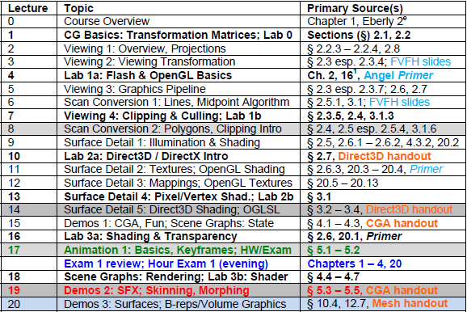

Where We Are

Slide 4




Acknowledgements:
Computer Animation Intro
Jason Lawrence
Assistant Professor
Department of Computer Science
University of Virginia
http://www.cs.virginia.edu/~jdl/
Acknowledgment: slides by Misha Kazhdan, Allison Klein, Tom Funkhouser, Adam Finkelstein and David Dobkin
http://bit.ly/eB1Oj4
Thomas A. Funkhouser
Professor
Department of Computer Science
Computer Graphics Group
Princeton University
http://www.cs.princeton.edu/~funk/

Slide 5



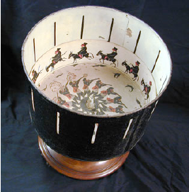
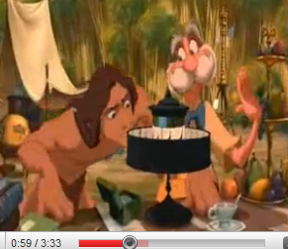
Review [1]:19th Century Animation
Before Motion Pictures
© 2007 Wikipedia, Phenakistoscope
http://bit.ly/eAnURG
© 2008 Wikipedia, Thaumatrope
http://bit.ly/fFl6xH
Zoetrope (Praxinoscope)
Tarzan © 2000 Disney
http://youtu.be/zc3MnoSS5Hw
Adapted from slides © 2010 J. Lawrence, University of Virginia
CS 4810: Introduction to Computer Graphics – http://bit.ly/hPIXdi

Slide 6
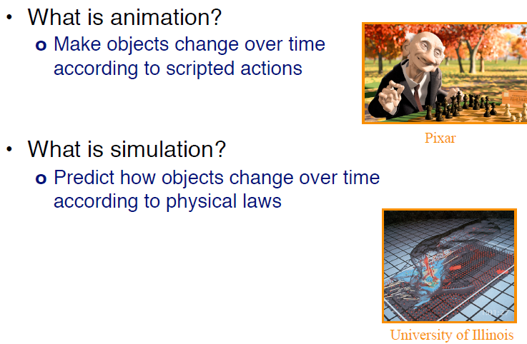
Review [2]: Animation,
Simulation & Visualization
Wilhelmson et al. (2004)
http://youtu.be/EgumU0Ns1YI
http://avl.ncsa.illinois.edu
http://bit.ly/eA8PXN
Adapted from slides © 2010 J. Lawrence, University of Virginia
CS 4810: Introduction to Computer Graphics – http://bit.ly/hPIXdi

Slide 7
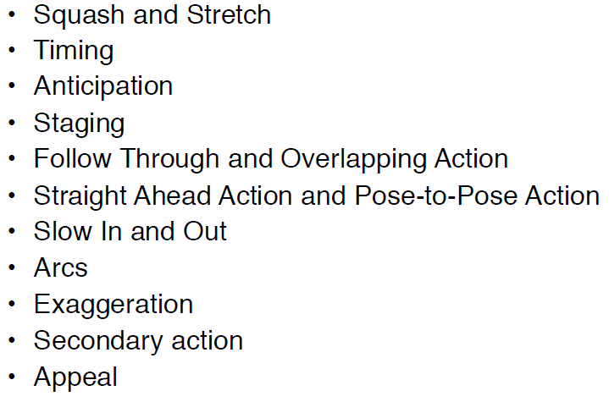
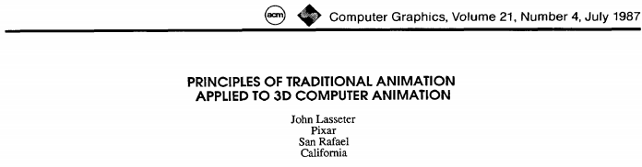
Review [3]:
Principles of Traditional Animation
Lasseter, J. (1987). Principles of traditional animation applied to
3D computer animation. Computer Graphics, 21(4), pp. 35-44.
SIGGRAPH: http://bit.ly/1DsO44
ACM Portal: http://bit.ly/eyx2PN
© 2010 J. Lawrence, University of Virginia
CS 4810: Introduction to Computer Graphics – http://bit.ly/hPIXdi

Slide 8
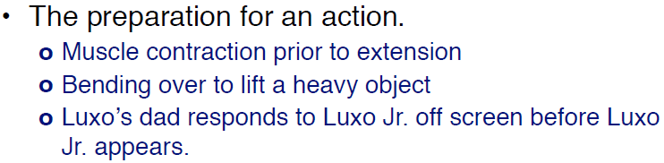
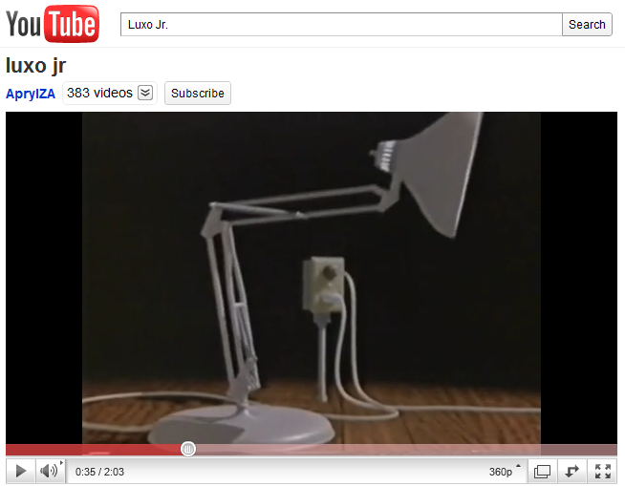


Review [4]:
Traditional Animation – Anticipation
Luxo Jr. © 1986 Pixar
http://www.pixar.com/shorts/ljr/
http://youtu.be/qGxoui3IFS0
© 2010 J. Lawrence, University of Virginia
CS 4810: Introduction to Computer Graphics – http://bit.ly/hPIXdi

Slide 9
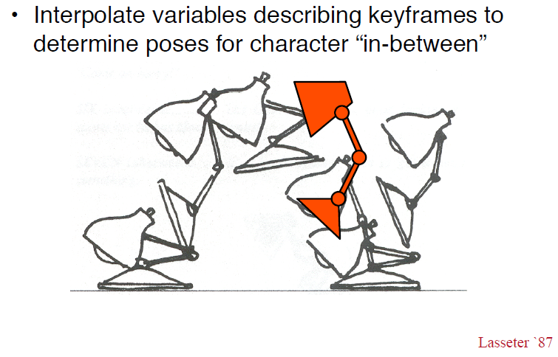
Review [5]:
Keyframe Animation & Inbetweening
© 2010 J. Lawrence, University of Virginia
CS 4810: Introduction to Computer Graphics – http://bit.ly/hPIXdi

Slide 10
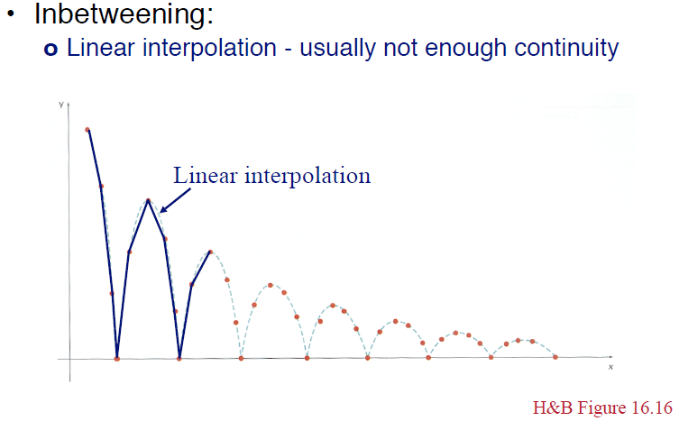
Review [6]:
Linear Interpolation aka Lerping
© 2010 J. Lawrence, University of Virginia
CS 4810: Introduction to Computer Graphics – http://bit.ly/hPIXdi

Slide 11
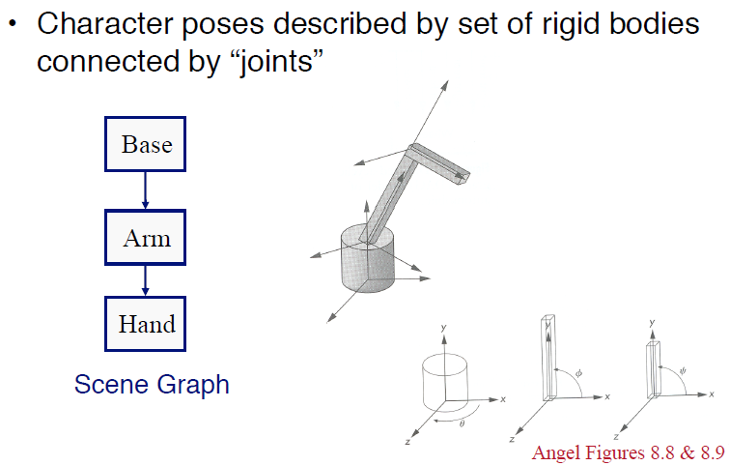
Review [7]:
Articulated Figures
© 2010 J. Lawrence, University of Virginia
CS 4810: Introduction to Computer Graphics – http://bit.ly/hPIXdi

Slide 12
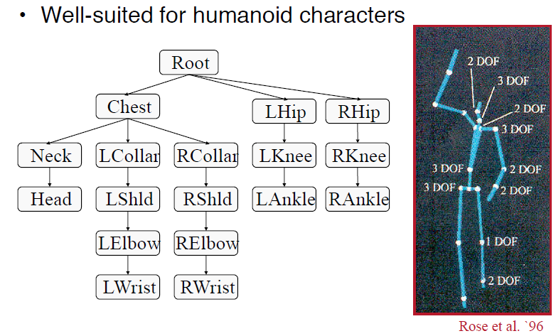
Review [8]:
Character Modeling
© 2010 J. Lawrence, University of Virginia
CS 4810: Introduction to Computer Graphics – http://bit.ly/hPIXdi

Slide 13
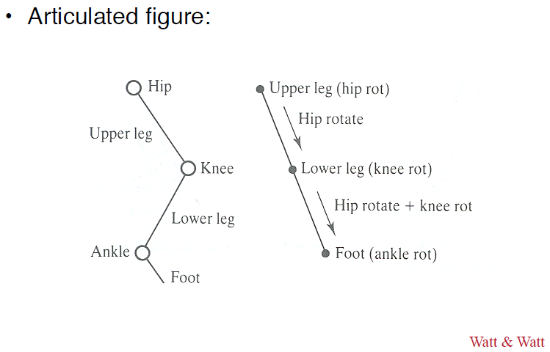
Review [9]:
Bones & Joints
© 2010 J. Lawrence, University of Virginia
CS 4810: Introduction to Computer Graphics – http://bit.ly/hPIXdi

Slide 14
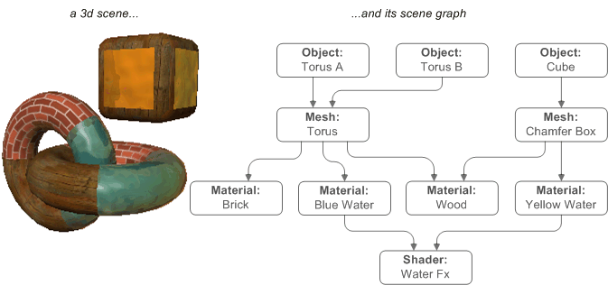
Scene Graph Traversal
© 2002 – 2005 Virtools
http://bit.ly/eM1gz8

Slide 15
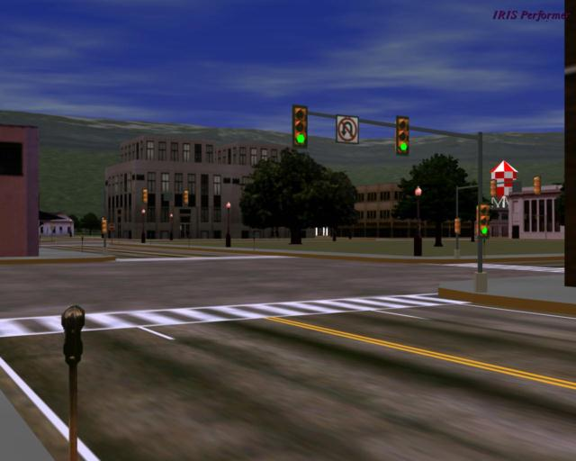
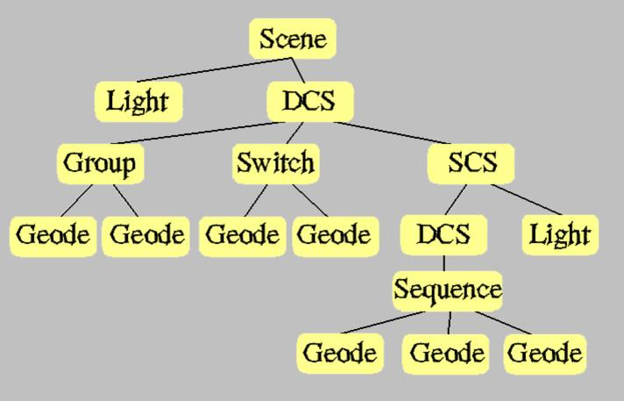
Scene Graph Rendering
Performer © 1997 D. Pape
http://www.evl.uic.edu/pape/talks/VSI97/pf/

Slide 16
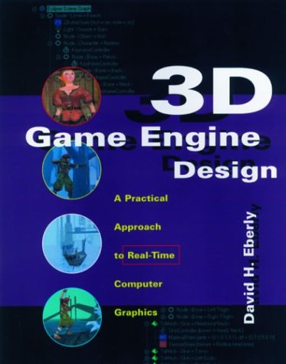
Acknowledgements:
Scene Graphs – Eberly 1e
David H. Eberly
Chief Technology Officer
Geometric Tools, LLC
http://www.geometrictools.com
http://bit.ly/enKbfs
3D Game Engine Design © 2000 D. H. Eberly
See http://bit.ly/ieUq45 for second edition

Slide 17
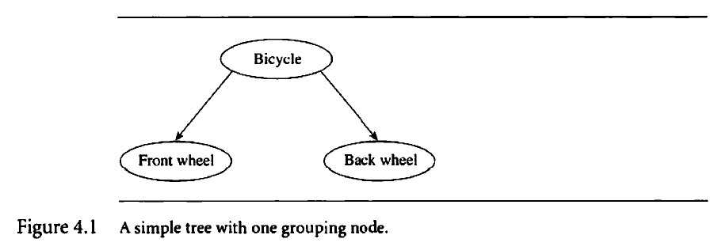
Review:
What Information is in Scene Graphs?
Transforms
Bounding Volumes
Render State
Animation State
3D Game Engine Design © 2000 D. H. Eberly
See http://bit.ly/ieUq45 for second edition

Slide 18
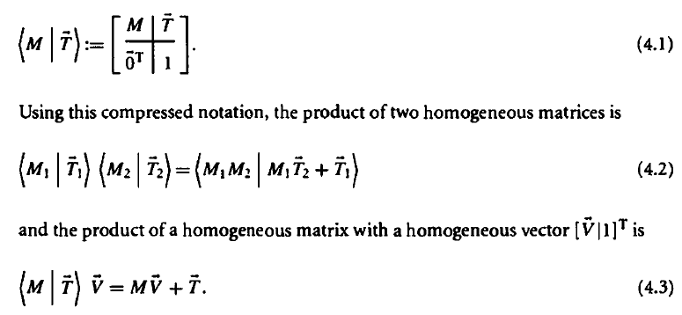
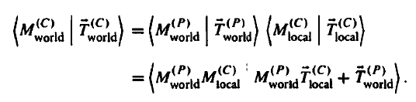
Review:
Kinds of Transforms
Local
  Translation, rotation, scaling, shearing
  All within parent’s coordinate system
World: Position Child C With Respect to Parent P (Depends on Local)
Both Together Part of Modelview Transformation
Adapted from 3D Game Engine Design © 2000 D. H. Eberly
See http://bit.ly/ieUq45 for second edition

Slide 19
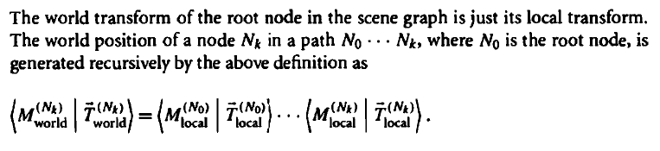
Traversing Scene Graph:
World Transform of Node
Adapted from 3D Game Engine Design © 2000 D. H. Eberly
See http://bit.ly/ieUq45 for second edition

Slide 20
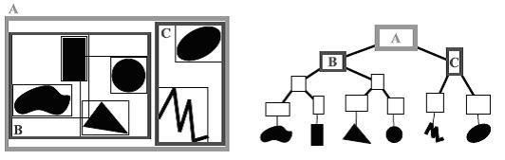
Bounding Volumes [1]:
Definition
Bounding Volume Hierarchies (BVHs)
  Root: entire scene
  Interior node: rectangle (volume in general) enclosing other nodes
  Leaves: primitive objects
  Often axis-aligned (e.g., axis-aligned bounding box aka AABB)
Used
  Visible surface determination (VSD) – especially occlusion culling
  Other intersection testing: collisions, ray tracing
Bounding Volume Hierarchy (BVH) © 2009 Wikipedia
http://en.wikipedia.org/wiki/Bounding_volume_hierarchy

Slide 21
Bounding Volumes [2]:
Types Covered in Eberly
Spheres
Oriented Boxes aka Oriented Bounding Boxes (OBBs)
Capsules
Lozenges
Cylinders
Ellipsoids
Adapted from 3D Game Engine Design © 2000 D. H. Eberly
See http://bit.ly/ieUq45 for second edition

Slide 22
Renderer State
Can Capture Render Information Hierarchically
Example
  Suppose subtree has all leaf nodes that want textures alpha blended
  Can tag root of subtree with “alpha blend all”
  Alternatively: tag every leaf
How Traversal Works: State Accumulation
  Root-to-leaf traversal accumulates state to draw geometry
  Renderer checks whether state change is needed before leaf drawn
Efficiency Considerations
  Minimize state changes
  Reason: memory copy (e.g., system to video memory) takes time
Adapted from 3D Game Engine Design © 2000 D. H. Eberly
See http://bit.ly/ieUq45 for second edition

Slide 23

Animation State
Can Capture Animation Information Hierarchically
Example
  Consider articulated figure from last lecture
  Let each node represent joint of character model
    Neck
    Shoulder
    Elbow
    Wrist
    Knee
Procedural Transformation
How It Works: Controllers
  Each node has controller function/method
  Manages quantity that changes over time (e.g., angle)
© 2002 D. M. Murillo
http://bit.ly/eZ9MA8
Adapted from 3D Game Engine Design © 2000 D. H. Eberly
See http://bit.ly/ieUq45 for second edition

Slide 24
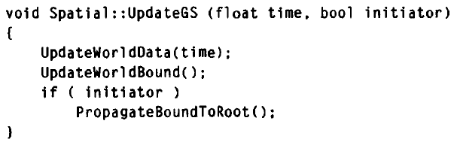
Updating Scene Graphs
Need to Merge Bounding Volumes (Boxes, Lozenges, Capsules)
Update Geometric State: UpdateGS
UpdateWorldData: Virtual Function, Controls Downward Pass
UpdateWorldBound: Also Virtual, Controls Upward Pass
PropagateBoundToRoot: Not Virtual, Simple Recursive Call
  parent.UpdateWorldBound()
  parent.PropagateBoundToRoot()
Adapted from 3D Game Engine Design © 2000 D. H. Eberly
See http://bit.ly/ieUq45 for second edition

Slide 25
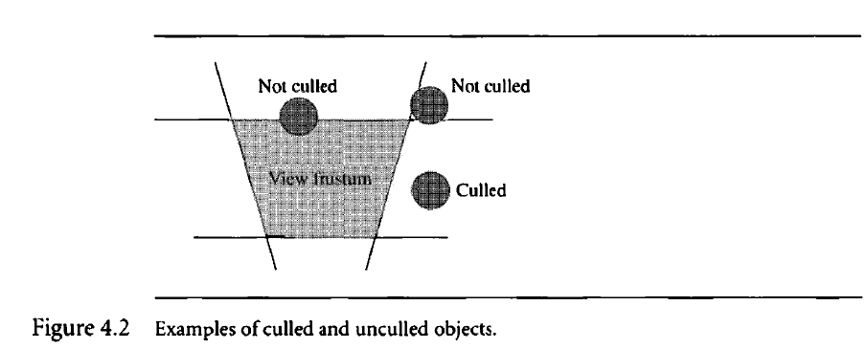
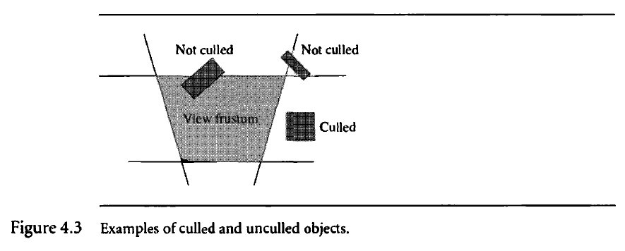
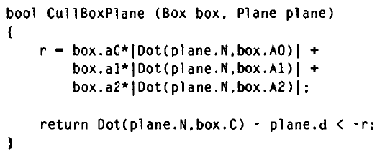
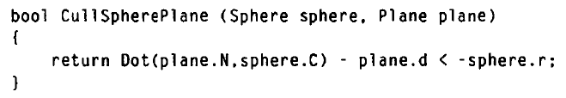
Rendering Scene Graphs [1]:
View Frustum Culling
By Spheres vs. By Oriented Boxes
Pseudocode
Can Also Cull by: Lozenges, Cylinders, Ellipsoids
Adapted from 3D Game Engine Design © 2000 D. H. Eberly
See http://bit.ly/ieUq45 for second edition

Slide 26
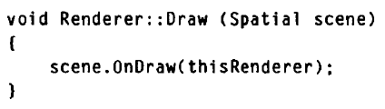
Rendering Scene Graphs [2]:
Message Passing
Main Draw Method
Spatial::OnDraw(Renderer renderer)
  Calls virtual function Draw(renderer)
  Passed down
Geometry::Draw(Renderer renderer)
Node::Draw(Renderer renderer)Calls child.onDraw(renderer)
Derived Classes of Geometry
  TriMesh::Draw(Renderer renderer)
  Similarly for other derived classes
Adapted from 3D Game Engine Design © 2000 D. H. Eberly
See http://bit.ly/ieUq45 for second edition

Slide 27
Summary
Reading for Last Class: §5.1 – 5.2, Eberly 2e
Reading for Today: §4.4 – 4.7, Eberly 2e
Reading for Next Class:
Last Time: Introduction to Animation
  Definition, overview, brief history, principles
  Keyframes, interpolation, articulated figures for character modeling
  Dynamics vs. kinematics, forward vs. inverse
Today: Scene Graph Rendering
  State: transforms, bounding volumes, render state, animation state
  Updating: merging bounding volumes
  View frustum culling
  Rendering: object-oriented message passing overview
Next Class: Special Effects (SFX), Skinning, Morphing; More Videos

Slide 28
Terminology
Shading and Transparency in OpenGL: Alpha, Painter’s, z-buffering
Animation – Modeling Change Over Time According to Known Actions
Keyframe Animation
  Keyframe
  Interpolation
  Character model
State in Scene Graphs
  Transforms – local & global TRS to orient parts of model
  Bounding volumes – spheres, boxes, capsules, lozenges, ellipsoids
  Renderer state – lighting, shading/textures/alpha
  Animation state – TRS transformations (especially R), controllers
Traversal: Moving through Data Structure, Calling Methods

