Slide 1
Lecture 19 of 41
Skinning & Morphing
Videos 2: Special Effects (SFX)
William H. Hsu
Department of Computing and Information Sciences, KSU
KSOL course pages: http://bit.ly/hGvXlH / http://bit.ly/eVizrE
Public mirror web site: http://www.kddresearch.org/Courses/CIS636
Instructor home page: http://www.cis.ksu.edu/~bhsu
Readings:
Today: §5.3 – 5.5, Eberly 2e – see http://bit.ly/ieUq45; CGA handout
Next class: §10.4, 12.7, Eberly 2e, Mesh handout
Videos: http://www.kddresearch.org/Courses/CIS636/Lectures/Videos/

Slide 2
Lecture Outline
Reading for Last Class: §4.4 – 4.7, Eberly 2e
Reading for Today: §5.3 – 5.5, Eberly 2e, CGA handout
Reading for Next Class: §10.4, 12.7, Eberly 2e, Mesh handout
Last Time: Scene Graph Rendering
  State: transforms, bounding volumes, render state, animation state
  Managing renderer and animation state
  Rendering: object-oriented message passing overview
Today: Skinning and Morphing
  Skins: surface meshes for faces, character models
  Morphing: animation techniques – gradual transition between skins
    Vertex tweening
    Using Direct3D n (Shader Model m, m ≤ n - 6)
  GPU-based interpolation: texture arrays, vertex texturing, hybrid
Videos: Special Effects (SFX)

Slide 3
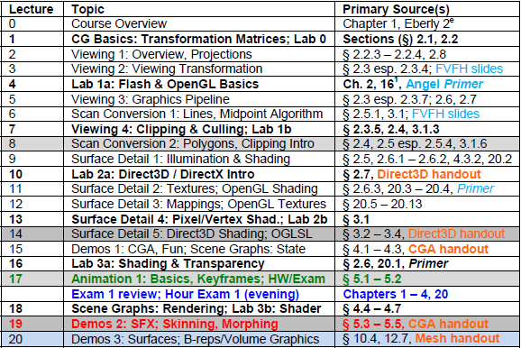

Where We Are

Slide 4




Acknowledgements:
Computer Animation Intro
Jason Lawrence
Assistant Professor
Department of Computer Science
University of Virginia
http://www.cs.virginia.edu/~jdl/
Acknowledgment: slides by Misha Kazhdan, Allison Klein, Tom Funkhouser, Adam Finkelstein and David Dobkin
http://bit.ly/eB1Oj4
Thomas A. Funkhouser
Professor
Department of Computer Science
Computer Graphics Group
Princeton University
http://www.cs.princeton.edu/~funk/

Slide 5
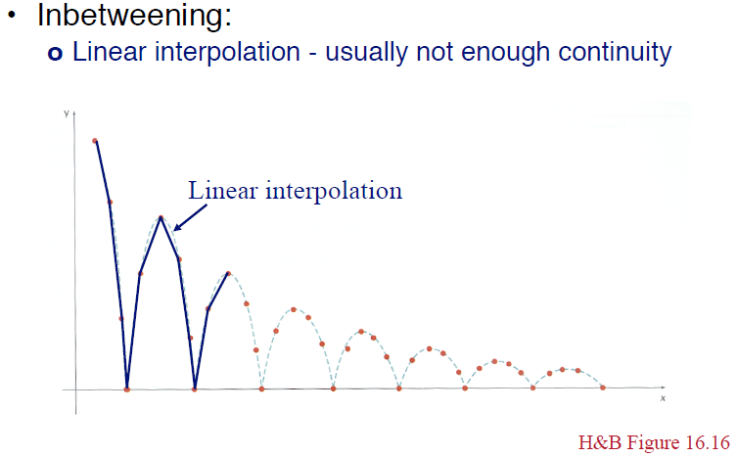
Review [1]:
Linear Interpolation aka Lerping
© 2010 J. Lawrence, University of Virginia
CS 4810: Introduction to Computer Graphics – http://bit.ly/hPIXdi

Slide 6
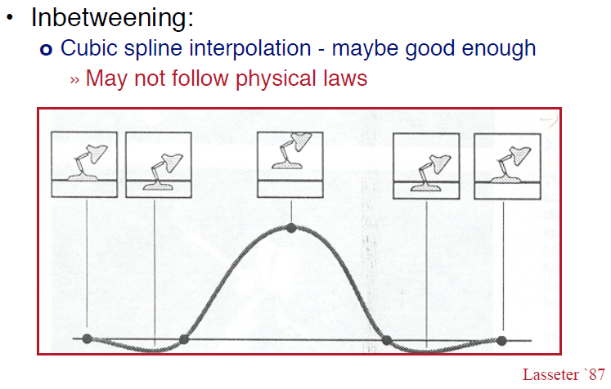
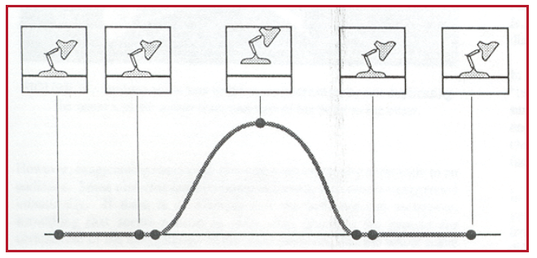
Review [2]:
Cubic Curve (Spline) Interpolation
© 2010 J. Lawrence, University of Virginia
CS 4810: Introduction to Computer Graphics – http://bit.ly/hPIXdi

Slide 7
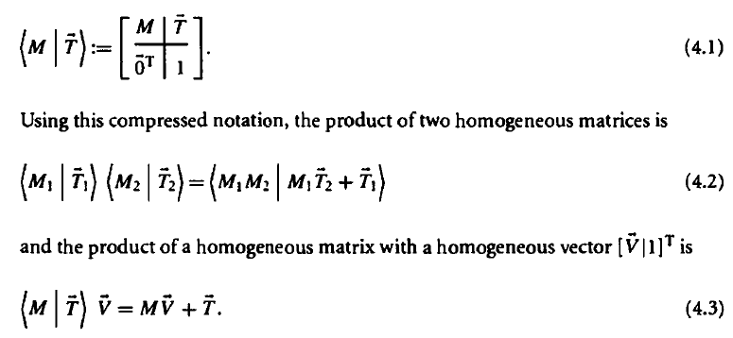
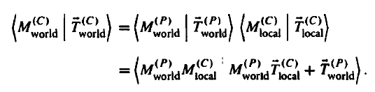
Review [3]:
Scene Graph State – Transforms
Local
  Translation, rotation, scaling, shearing
  All within parent’s coordinate system
World: Position Child C With Respect to Parent P (Depends on Local)
Both Together Part of Modelview Transformation
Adapted from 3D Game Engine Design © 2000 D. H. Eberly
See http://bit.ly/ieUq45 for second edition

Slide 8
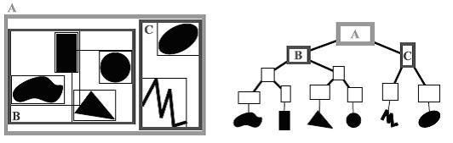
Review [4]:
Scene Graph State – BVHs
Bounding Volume Hierarchies (BVHs)
  Root: entire scene
  Interior node: rectangle (volume in general) enclosing other nodes
  Leaves: primitive objects
  Often axis-aligned (e.g., axis-aligned bounding box aka AABB)
Used
  Visible surface determination (VSD) – especially occlusion culling
  Other intersection testing: collisions, ray tracing
Bounding Volume Hierarchy (BVH) © 2009 Wikipedia
http://en.wikipedia.org/wiki/Bounding_volume_hierarchy

Slide 9
Review [5]:
Scene Graph State – Renderer State
Can Capture Render Information Hierarchically
Example
  Suppose subtree has all leaf nodes that want textures alpha blended
  Can tag root of subtree with “alpha blend all”
  Alternatively: tag every leaf
How Traversal Works: State Accumulation
  Root-to-leaf traversal accumulates state to draw geometry
  Renderer checks whether state change is needed before leaf drawn
Efficiency Considerations
  Minimize state changes
  Reason: memory copy (e.g., system to video memory) takes time
Adapted from 3D Game Engine Design © 2000 D. H. Eberly
See http://bit.ly/ieUq45 for second edition

Slide 10
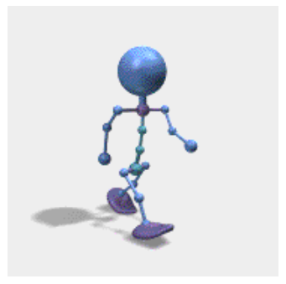
Review [6]:
Scene Graph State – Animation State
Can Capture Animation Information Hierarchically
Example
  Consider articulated figure from last lecture
  Let each node represent joint of character model
    Neck
    Shoulder
    Elbow
    Wrist
    Knee
Procedural Transformation
How It Works: Controllers
  Each node has controller function/method
  Manages quantity that changes over time (e.g., angle)
© 2002 D. M. Murillo
http://bit.ly/eZ9MA8
Adapted from 3D Game Engine Design © 2000 D. H. Eberly
See http://bit.ly/ieUq45 for second edition

Slide 11
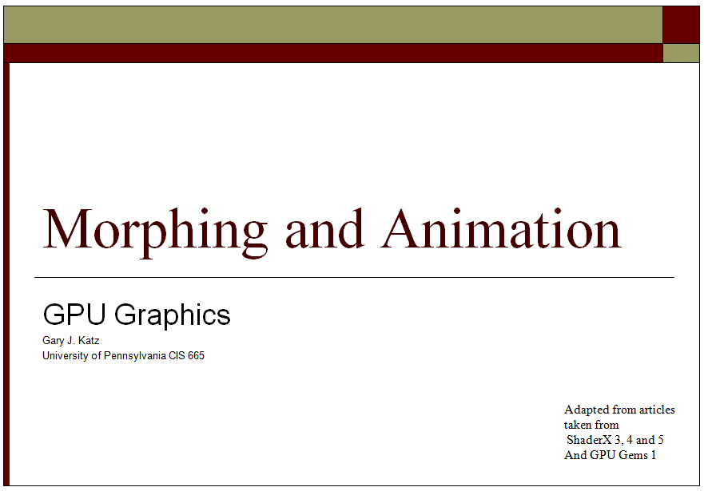
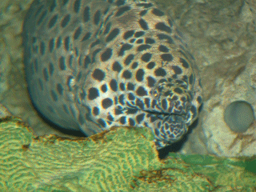

Acknowledgements:
Morphing & Animation
“Morphing How-To Guide”
© 2005 – 2011 B. Ropelato & J. C. Weaver
TopTenReviews.com
http://bit.ly/gbufRA
Adapted from “Morphing and Animation” © 2007 G. J. Katz, University of Pennsylvania
Lecture 12, CIS 565 (formerly 665): GPU Programming and Architecture, http://bit.ly/eFkXmk

Slide 12
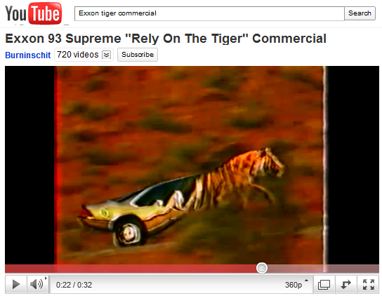
Morphing Techniques
Vertex Tweening
  Two key meshes are blended
  Varying by time
Morph Targets
  Represent by relative vectors
    From base mesh
    To target meshes
  Geometry: mesh represents model
  Samples: corresponding images
Applications
  Image morphing (see videos)
  Lip syncing (work of Elon Gasper)
© 1987 Exxon Mobil, Inc.
http://youtu.be/Vi5PlrZpG40
Adapted from “Morphing and Animation” © 2007 G. J. Katz, University of Pennsylvania
Lecture 12, CIS 565 (formerly 665): GPU Programming and Architecture, http://bit.ly/eFkXmk

Slide 13
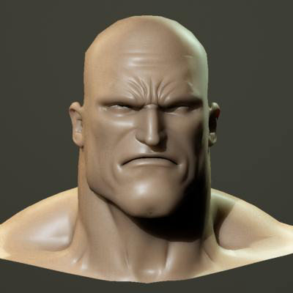

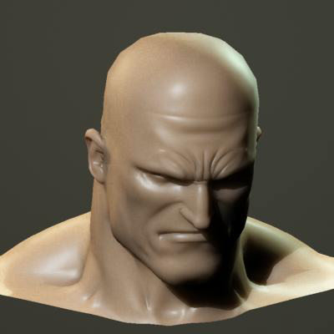
Morph Target Animation [1]:
Definition
Idea
  One base mesh
  Can morph into multiple targets at same time
Effects
  Facial animation, e.g., Alphabet Blocks (1992) – http://bit.ly/hSKCE3
  Muscle deformation
Adapted from “Morphing and Animation” © 2007 G. J. Katz, University of Pennsylvania
Lecture 12, CIS 565 (formerly 665): GPU Programming and Architecture, http://bit.ly/eFkXmk

Slide 14
Morph Target Animation [2]:
Interpolation
1
2
3
4
5
12
1
12
2
6
10
11
3
7
8
9
11
4
10
5
8
9
6
7
Linear Interpolation
Relative: Position_{Output} = Position_{Source} + (Position_{Destination} * Factor)
Absolute: Position_{Output} = Position_{Source} + (Position_{Destination} – Position_{Source})*Factor
Adapted from “Morphing and Animation” © 2007 G. J. Katz, University of Pennsylvania
Lecture 12, CIS 565 (formerly 665): GPU Programming and Architecture, http://bit.ly/eFkXmk

Slide 15
Relative vs. Absolute
Coordinates
3
< 7, 3, 9 >
4
< 4, 3, 5 >
Relative
Absolute
Adapted from “Morphing and Animation” © 2007 G. J. Katz, University of Pennsylvania
Lecture 12, CIS 565 (formerly 665): GPU Programming and Architecture, http://bit.ly/eFkXmk

Slide 16
Constraints
Constraints on Source, Target Mesh
  Number of vertices must be the same
  Faces and attributes must be the same
  Material must be equal
  Textures must be the same
  Shaders, etc. must be the same
Useful Only Where Skinning Fails!
Adapted from “Morphing and Animation” © 2007 G. J. Katz, University of Pennsylvania
Lecture 12, CIS 565 (formerly 665): GPU Programming and Architecture, http://bit.ly/eFkXmk

Slide 17
Data Structures for Morphing
DirectX allows for flexible vertex formats
So does OpenGL: http://bit.ly/fJ9U3Y
Position 1 holds the relative position for the morph target
D3DVERTEXELEMENT9 pStandardMeshDeclaration[] =
{
{ 0, 0, D3DDECLTYPE_FLOAT3, D3DDECLMETHOD_DEFAULT,
D3DDECLUSAGE_POSITION, 0 },
{ 0, 12, D3DDECLTYPE_FLOAT3, D3DDECLMETHOD_DEFAULT,
D3DDECLUSAGE_POSITION, 1 },
{ 0, 24, D3DDECLTYPE_FLOAT3, D3DDECLMETHOD_DEFAULT,
D3DDECLUSAGE_NORMAL, 0 },
{ 0, 32, D3DDECLTYPE_FLOAT3, D3DDECLMETHOD_DEFAULT,
D3DDECLUSAGE_TEXCOORD, 0 },
D3DDECL_END()
}
Adapted from “Morphing and Animation” © 2007 G. J. Katz, University of Pennsylvania
Lecture 12, CIS 565 (formerly 665): GPU Programming and Architecture, http://bit.ly/eFkXmk

Slide 18
Skeletal Animation
Hierarchical Animation
  Mesh vertex attached to exactly one bone
  Transform vertex using inverse of bone’s world matrix
Issues
  Buckling
  Occurs at regions where two bones connected
Adapted from “Morphing and Animation” © 2007 G. J. Katz, University of Pennsylvania
Lecture 12, CIS 565 (formerly 665): GPU Programming and Architecture, http://bit.ly/eFkXmk

Slide 19
Skeletal Subspace Deformation
Vertices Attached to Multiple Bones by Weighting
  Move every vertex into associated bone space by multiplying inverse of initial transformation
  Apply current world transformation
  Resulting vertices blended using morphing
Compare: Scene Graph for Transformations from Previous Lecture
Adapted from “Morphing and Animation” © 2007 G. J. Katz, University of Pennsylvania
Lecture 12, CIS 565 (formerly 665): GPU Programming and Architecture, http://bit.ly/eFkXmk

Slide 20
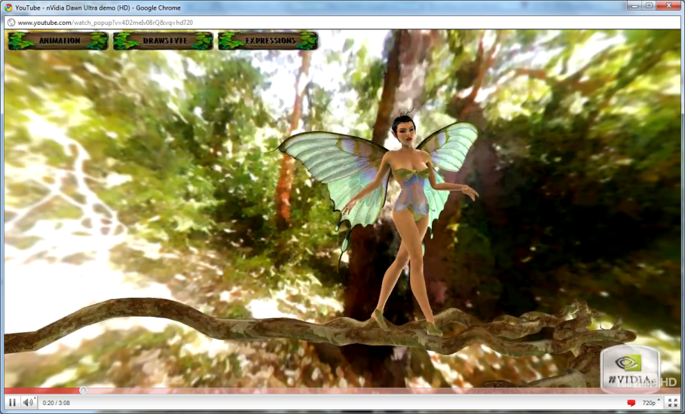
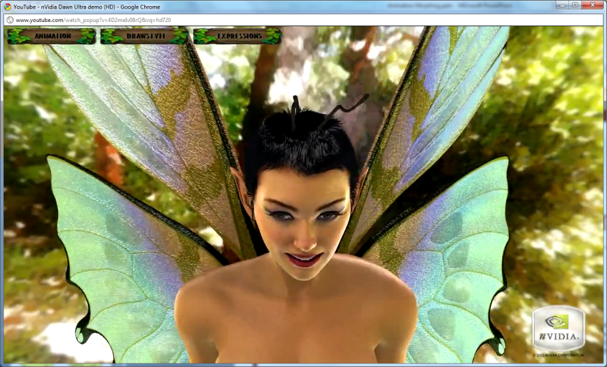
Demo: Dawn
(Nvidia, Direct3D v.9 / Shader 2.0)
Compare: Scene Graph for Transformations from Previous Lecture
Wikipedia: http://en.wikipedia.org/wiki/Dawn_(demo)
Dawn © 2004 Jim Henson’s Creature Shop & Nvidia
http://youtu.be/4D2meIv08rQ
http://hdps.wikia.com/wiki/Dawn
Adapted from “Morphing and Animation” © 2007 G. J. Katz, University of Pennsylvania
Lecture 12, CIS 565 (formerly 665): GPU Programming and Architecture, http://bit.ly/eFkXmk

Slide 21
GPU Animation [1]:
Speedups
Can Skip Processing of Unused Scene Elements
  Elements
    Bones
    Morph targets
  Need hardware support for dynamic branching
Can Separate Independent Processes
  Processes
    Modification
    Rendering
  Need hardware support for:
    Four component floating point texture formats
    Multiple render targets: normal map, position map, tangent map
Adapted from “Morphing and Animation” © 2007 G. J. Katz, University of Pennsylvania
Lecture 12, CIS 565 (formerly 665): GPU Programming and Architecture, http://bit.ly/eFkXmk

Slide 22
GPU Animation [2]:
Method 1
Hold Vertex Data in Texture Arrays
Manipulate Data in Pixel Shader / Fragment Shader
Re-output to Texture Arrays
Pass Output as Input to Vertex Shader (NB: Usually Other Way Around!)
Adapted from “Morphing and Animation” © 2007 G. J. Katz, University of Pennsylvania
Lecture 12, CIS 565 (formerly 665): GPU Programming and Architecture, http://bit.ly/eFkXmk

Slide 23
GPU Animation [3]:
Storage Procedures
If:
vertex array is one-dimensional
frame buffer is two-dimensional
index2D.x = index % textureWidth;
index2D.y = index / textureWidth;
index = index2D.y * textureWidth + index2D.x;
Adapted from “Morphing and Animation” © 2007 G. J. Katz, University of Pennsylvania
Lecture 12, CIS 565 (formerly 665): GPU Programming and Architecture, http://bit.ly/eFkXmk

Slide 24
GPU Animation [4]:
Vertex Program
Draw Rectangle of Coordinates
  (0, 0), (0, 1), (1, 1), (1, 0)
  (-1, -1), (-1, 1), (1, 1), (1, -1)
Remap Them using Vertex Program Below
float4 VS(float4 index2D: POSITION0,
out float4 outIndex2D : TEXCOORD0) : POSITION
{
outIndex2D = index2D;
return float4(2 * index2D.x – 1, -2 * index2D.y + 1, 0, 1);
}
Adapted from “Morphing and Animation” © 2007 G. J. Katz, University of Pennsylvania
Lecture 12, CIS 565 (formerly 665): GPU Programming and Architecture, http://bit.ly/eFkXmk

Slide 25
GPU Animation [5]:
Pixel Shader
float2 halfTexel = float2(.5/texWidth, .5/texHeight);
float4 PS(float4 index2D : TEXCOORD0,
out float4 position : COLOR0,
out float4 normal : COLOR1, ...)
{
index2D.xy += halfTexel;
float4 vertAttr0 = tex2Dlod(Sampler0, index2D);
float4 vertAttr1 = tex2Dlod(Sampler1, index2D);
...
...
// perform modifications and assign the final
// vertex attributes to the output registers
}
Adapted from “Morphing and Animation” © 2007 G. J. Katz, University of Pennsylvania
Lecture 12, CIS 565 (formerly 665): GPU Programming and Architecture, http://bit.ly/eFkXmk

Slide 26
GPU Animation [6]:
Analysis
Advantages
  Keeps vertex, geometry processing units’ workload at minimum (Why is this good?)
  Good for copy operations, vertex tweening
Disadvantages
  Per-vertex data has to be accessed through texture lookups
  Number of constant registers is less in pixel shader (224) than vertex shader (256)
  Can not divide modification process into several pieces because only single quad is drawn
  Therefore: constant registers must hold all bone matrices and morph target weights for entire object
Adapted from “Morphing and Animation” © 2007 G. J. Katz, University of Pennsylvania
Lecture 12, CIS 565 (formerly 665): GPU Programming and Architecture, http://bit.ly/eFkXmk

Slide 27
GPU Animation [7]:
Method 2
Apply Modifications in Vertex Shader, Do Nothing in Pixel Shader
  Destination pixel is specified explicitly as vertex shader input
  Still writing all vertices to texture
Advantage: Can Easily Segment Modification Groups
Disadvantage: Speed Issues Make This Method Impractical
Adapted from “Morphing and Animation” © 2007 G. J. Katz, University of Pennsylvania
Lecture 12, CIS 565 (formerly 665): GPU Programming and Architecture, http://bit.ly/eFkXmk

Slide 28
GPU Animation [8]:
Accessing Modified Data
Do Not Want to Send Data Back to CPU, Except in One Case
Solution 1: DirectRenderToVertexBuffer
  Problem: DirectRenderToVertexBuffer doesn’t exist yet!
  … but we can always dream
Solution 2: Transfer Result to Graphics Card
  From: render target
  To: Vertex Buffer Object (VBO) on graphics card
  Use OpenGL’s ARB_pixel_buffer_object
Solution 3: Vertex Textures (Use RenderTexture Capability)
  Access texture in vertex shader (VS)
  Store texture lookop in vertices’ texture coordinates
  Problem: slow; can’t look up in parallel with other instructions
Adapted from “Morphing and Animation” © 2007 G. J. Katz, University of Pennsylvania
Lecture 12, CIS 565 (formerly 665): GPU Programming and Architecture, http://bit.ly/eFkXmk

Slide 29
GPU Animation [9]:
Performance Issues
Prefer to Perform Modification, Rendering in Single Pass
Vertex Texturing: Slow
  Copy within video memory: fast
  Accessing vertex attributes using vertex texturing always slower
Application Overhead
  Accessing morph in vertex texture slows down app
  Must use constants
Adapted from “Morphing and Animation” © 2007 G. J. Katz, University of Pennsylvania
Lecture 12, CIS 565 (formerly 665): GPU Programming and Architecture, http://bit.ly/eFkXmk

Slide 30
GPU Animation [10]:
Hybrid CPU/GPU System
Use Hybrid CPU/GPU Approach to Get Real Speed Advantage
  Let CPU compute final vertex attributes used during rendering frames n, n + k
  Let GPU compute vertex tweening at frames greater than n, smaller than n + k
  Phase shift animations between characters so processors do not have peak loads
Advantages
  Vertex tweening supported on almost all hardware
  Modification algorithms performed on CPU, so no restrictions
Adapted from “Morphing and Animation” © 2007 G. J. Katz, University of Pennsylvania
Lecture 12, CIS 565 (formerly 665): GPU Programming and Architecture, http://bit.ly/eFkXmk

Slide 31
Massive Character Animation [1]:
Agent State
Can Perform Simple Artificial Intelligence (AI) Effects
  Reactive planning: finite state machine (FSM) for behavior
  e.g., obstacle/pursuer avoidance
  Also: flocking & herding (later: Reynolds’ boid model)
Each Pixel of Output Texture Holds One Character’s State
Pixel Shader Computes Next State
State Used to Determine Which Animation to Use
More Advanced AI Techniques (See: CIS 530 / 730)
  Follow-the-leader
  Target acquisition & fire control (ballistics)
  Pursuer-evader
  Attack planning (may use inverse kinematics)
Adapted from “Morphing and Animation” © 2007 G. J. Katz, University of Pennsylvania
Lecture 12, CIS 565 (formerly 665): GPU Programming and Architecture, http://bit.ly/eFkXmk

Slide 32
Massive Character Animation [2]:
Simulating Character Behavior
Implement Finite State Machine (FSM) in Pixel Shader
Pixel Values Represent States
Can Also Capture Transitions using Pixels!
Turn
If no Obstacle
If Obstacle
If Obstacle
Walk
If Chased
Run
If Chased
Adapted from “Morphing and Animation” © 2007 G. J. Katz, University of Pennsylvania
Lecture 12, CIS 565 (formerly 665): GPU Programming and Architecture, http://bit.ly/eFkXmk

Slide 33
Massive Character Animation [3]:
Implementing FSMs on GPUs
Use Dependent Texture Lookups
Agent-Space Maps: Contain Information About State of Characters
  Position
  State
  Frame
World-Space Image Maps: Contain Information About Environment
  Influences behavior of character
  e.g., preprocessed obstacles
FSM Maps: Contain State, Transition Info
  Behavior for each state
  Transition functions between states
    Rows: group transitions within same state
    Columns: conditions to trigger transitions
Adapted from “Morphing and Animation” © 2007 G. J. Katz, University of Pennsylvania
Lecture 12, CIS 565 (formerly 665): GPU Programming and Architecture, http://bit.ly/eFkXmk

Slide 34
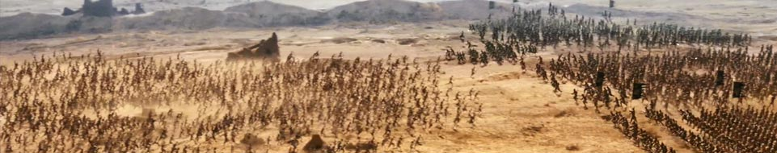
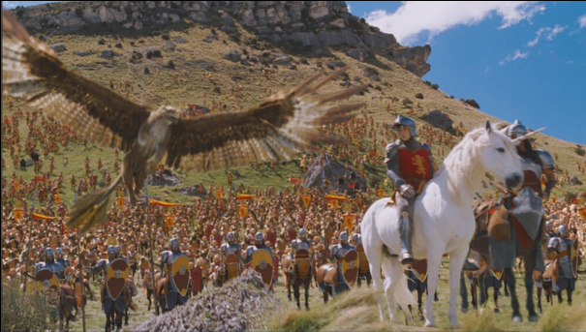


Preview:
Software Simulations
Massive Software: Grew Out of WETA Digital’s Work
  The Lord of the Rings movie trilogy
  Since then: advertising, Narnia, King Kong, Avatar, many more
Multi-Agent Simulation in Virtual Environments
See: http://www.massivesoftware.com
Narnia © 2005 20th Century Fox
http://youtu.be/pYcGFLgJ8Uo
King Kong © 2005 Universal Pictures
http://youtu.be/stMN1hwCJg0
Avatar © 2009 20th Century Fox
http://youtu.be/d1_JBMrrYw8

Slide 35
Summary
Reading for Last Class: §5.1 – 5.2, Eberly 2e
Reading for Today: §4.4 – 4.7, Eberly 2e
Reading for Next Class: §10.4, 12.7, Eberly 2e, Mesh handout
Last Time: Scene Graph Rendering
  State: transforms, bounding volumes, render state, animation state
  Updating and culling
  Rendering: object-oriented message passing overview
Today: Skinning and Morphing
  Morphing defined
  GPU-based interpolation: methods
    Texture arrays – need to use constant registers
    Vertex texturing – too slow
    Hybrid – works best
  Getting agents cheap using GPU-based finite state machines
More Videos: Special Effects (SFX)

Slide 36
Terminology
Shading and Transparency in OpenGL: Alpha, Painter’s, z-buffering
Animation – Modeling Change Over Time According to Known Actions
Keyframe Animation – Interpolating Between Set Keyframes
State in Scene Graphs
  Transforms – local & global TRS to orient parts of model
  Bounding volumes – spheres, boxes, capsules, lozenges, ellipsoids
  Renderer state – lighting, shading/textures/alpha
  Animation state – TRS transformations (especially R), controllers
Skins – Surface Meshes for Faces, Character Models
Morphing
  Animation techniques – gradual transition between skins
  Vertex tweening – texture arrays, vertex texturing, or hybrid method
  GPU computing – offload some tasks to GPU
  Finite state machine – simple agent model

