Slide 1
Lecture 20 of 41
Boundary Representations & Volume Graphics
Videos 3: Surfaces, Solid Modeling
William H. Hsu
Department of Computing and Information Sciences, KSU
KSOL course pages: http://bit.ly/hGvXlH / http://bit.ly/eVizrE
Public mirror web site: http://www.kddresearch.org/Courses/CIS636
Instructor home page: http://www.cis.ksu.edu/~bhsu
Readings:
Today: §10.4, 12.7, Eberly 2e – see http://bit.ly/ieUq45, Mesh handout
Next class: Flash animation handout
Reference on curves (required for CIS 736): §11.1 – 11.6, Eberly 2e
Videos: http://www.kddresearch.org/Courses/CIS636/Lectures/Videos/

Slide 2
Lecture Outline
Reading for Last Class: §5.3 – 5.5, Eberly 2e, CGA handout
Reading for Today: §10.4, 12.7, Eberly 2e, Mesh handout
Reading for Next Class: §11.1 – 11.6 (736), Flash animation handout
Last Time: Skinning and Morphing
  Skins: surface meshes for faces, character models
  Morphing: gradual transition between skins
  GPU-based vertex tweening: texture arrays, vertex texturing, hybrid
Today: Curves & Surfaces
  Piecewise linear, quadratic, cubic curves and their properties
  Interpolation: subdivision (DeCasteljau’s algorithm)
  Bicubic surfaces & bilinear interpolation
Outside Viewing: CG Basics 10, Advanced CG 4 & 5
Previous Videos: Morphing & Other Special Effects (SFX)
Today’s Videos: Bicubic Surfaces (NURBS), Solid Modeling

Slide 3
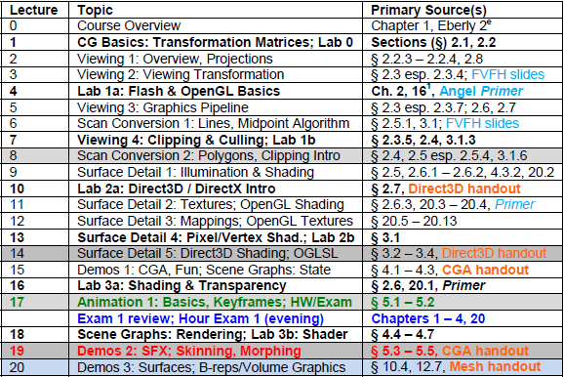

Where We Are

Slide 4
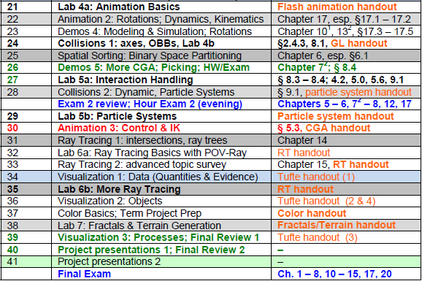

Where We’re Going

Slide 5
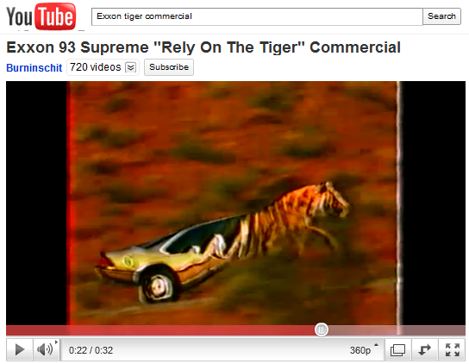

Review [1]:
Morphing Targets
Vertex Tweening
  Two key meshes are blended
  Varying by time
Morph Targets
  Represent by relative vectors
    From base mesh
    To target meshes
  Geometry: mesh represents model
  Samples: corresponding images
Applications
  Image morphing (see videos)
  Lip syncing (work of Elon Gasper)
© 1987 Exxon Mobil, Inc.
http://youtu.be/Vi5PlrZpG40
Adapted from “Morphing and Animation” © 2007 G. J. Katz, University of Pennsylvania
Lecture 12, CIS 565 (formerly 665): GPU Programming and Architecture, http://bit.ly/eFkXmk

Slide 6
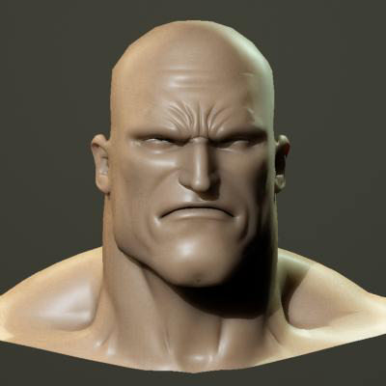
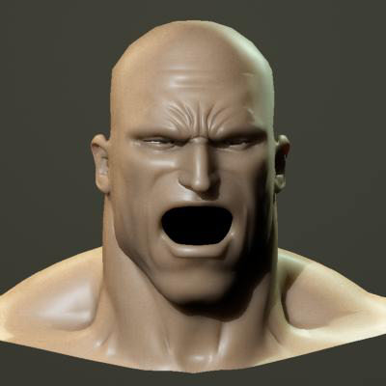
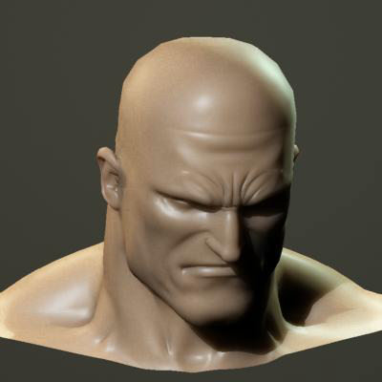
Review [2]:
Morph Target Animation & Lip Sync
From Base Mesh to Multiple Targets
Effects: Facial Animation with Muscle Deformation
Lip Sync
  Problem: matching mouth movements to speech waveform
  Early work: Elon Gasper & Bright Star – http://bit.ly/g4sKBL
  Used in Sierra’s Alphabet Blocks (1992) – http://bit.ly/hSKCE3
Adapted from “Morphing and Animation” © 2007 G. J. Katz, University of Pennsylvania
Lecture 12, CIS 565 (formerly 665): GPU Programming and Architecture, http://bit.ly/eFkXmk

Slide 7
Review [3]:
GPU Animation Method 1
Hold Vertex Data in Texture Arrays
Manipulate Data in Pixel Shader / Fragment Shader
Re-output to Texture Arrays
Pass Output as Input to Vertex Shader (NB: Usually Other Way Around!)
Adapted from “Morphing and Animation” © 2007 G. J. Katz, University of Pennsylvania
Lecture 12, CIS 565 (formerly 665): GPU Programming and Architecture, http://bit.ly/eFkXmk

Slide 8
Review [4]:
Pros & Cons of GPU Method 1
Advantages
  Keeps vertex, geometry processing units’ workload at minimum (Why is this good?)
  Good for copy operations, vertex tweening
Disadvantages
  Per-vertex data has to be accessed through texture lookups
  Number of constant registers is less in pixel shader (224) than vertex shader (256)
  Can not divide modification process into several pieces because only single quad is drawn
  Therefore: constant registers must hold all bone matrices and morph target weights for entire object
Adapted from “Morphing and Animation” © 2007 G. J. Katz, University of Pennsylvania
Lecture 12, CIS 565 (formerly 665): GPU Programming and Architecture, http://bit.ly/eFkXmk

Slide 9
Review [5]:
GPU Animation Method 2
Apply Modifications in Vertex Shader, Do Nothing in Pixel Shader
  Destination pixel is specified explicitly as vertex shader input
  Still writing all vertices to texture
Advantage: Can Easily Segment Modification Groups
Disadvantage: Speed Issues Make This Method Impractical
Adapted from “Morphing and Animation” © 2007 G. J. Katz, University of Pennsylvania
Lecture 12, CIS 565 (formerly 665): GPU Programming and Architecture, http://bit.ly/eFkXmk

Slide 10
Review [6]:
Hybrid CPU/GPU System
Use Hybrid CPU/GPU Approach to Get Real Speed Advantage
  Let CPU compute final vertex attributes used during rendering frames n, n + k
  Let GPU compute vertex tweening at frames greater than n, smaller than n + k
  Phase shift animations between characters so processors do not have peak loads
Advantages
  Vertex tweening supported on almost all hardware
  Modification algorithms performed on CPU, so no restrictions
Adapted from “Morphing and Animation” © 2007 G. J. Katz, University of Pennsylvania
Lecture 12, CIS 565 (formerly 665): GPU Programming and Architecture, http://bit.ly/eFkXmk

Slide 11





Acknowledgements:
Curves & Surfaces
Steve Rotenberg
Visiting Lecturer
Graphics Lab
University of California – San Diego
CEO/Chief Scientist, PixelActive
http://graphics.ucsd.edu
Barry McCaul
Lecturer
School of Computing
Dublin City University
http://www.computing.dcu.ie/~bmccaul/
Ken Hawick
Professor
Institute of Information and Mathematical Sciences (IIMS)
Massey University – Albany
http://www.massey.ac.nz/~kahawick/

Slide 12


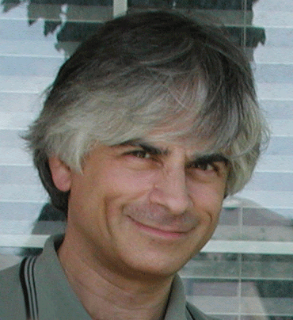

Acknowledgements:
Splines
Jim Foley
Professor, College of Computing & Stephen Fleming Chair in Telecommunications
Georgia Institute of Technology
James D. Foley
Georgia Tech
http://bit.ly/ajYf2Q
Andries van Dam
Brown University
http://www.cs.brown.edu/~avd/
Steven K. Feiner
Columbia University
http://www.cs.columbia.edu/~feiner/
John F. Hughes
Brown University
http://www.cs.brown.edu/~jfh/
Andy van Dam
T. J. Watson University Professor of Technology and Education & Professor of Computer Science
Brown University
Steve Feiner
Professor of Computer Science & Director, Computer Graphics and User Interfaces Laboratory
Columbia University
John F. Hughes
Associate Professor of Computer Science
Brown University

Slide 13
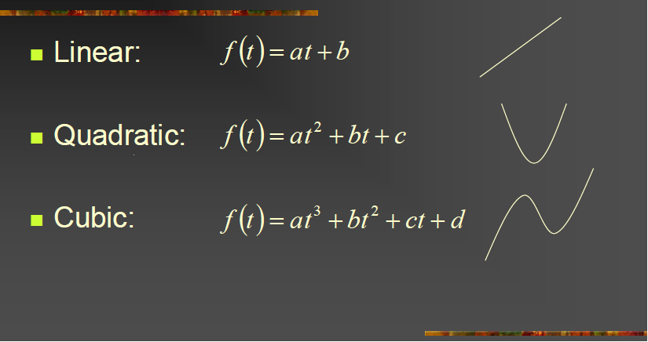
Polynomial Functions
Adapted from slides © 2003 – 2006 S. Rotenberg, UCSD
CSE167: Computer Graphics, Fall 2006, http://bit.ly/hXxAlP

Slide 14
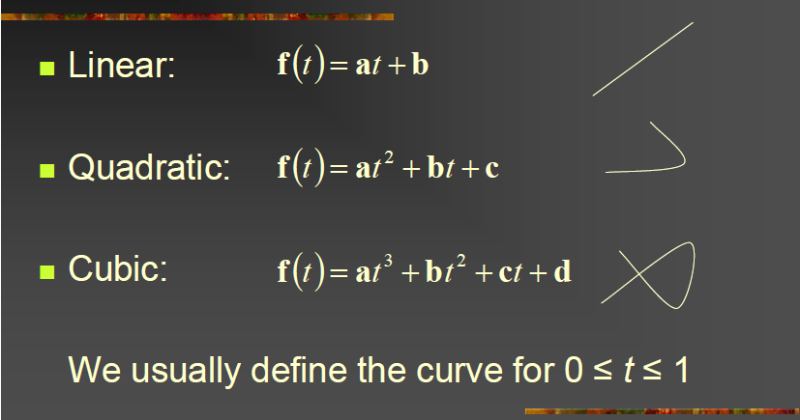
Vector Polynomials (Curves)
Adapted from slides © 2003 – 2006 S. Rotenberg, UCSD
CSE167: Computer Graphics, Fall 2006, http://bit.ly/hXxAlP

Slide 15
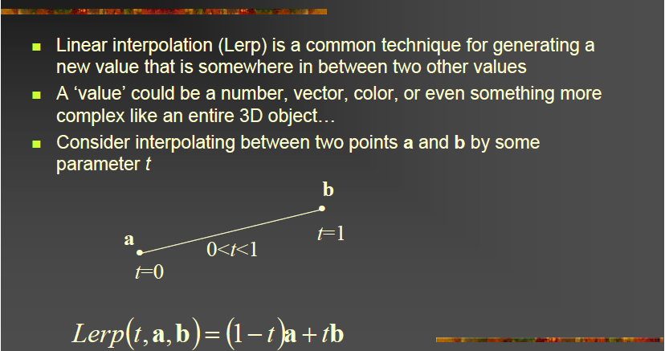
Linear Interpolation
Adapted from slides © 2003 – 2006 S. Rotenberg, UCSD
CSE167: Computer Graphics, Fall 2006, http://bit.ly/hXxAlP

Slide 16
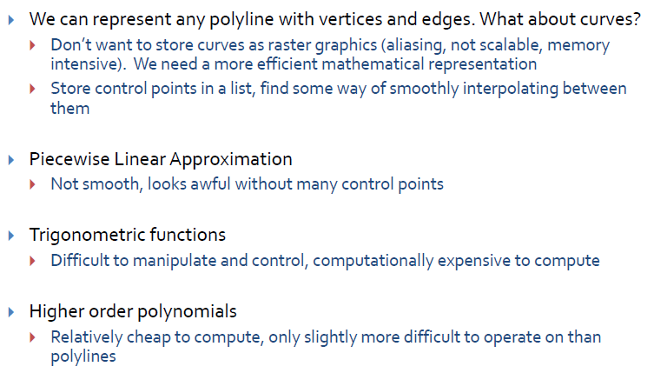

Splines [1]:
Representing General Curves
Adapted from slides © 2010 van Dam et al., Brown University
http://bit.ly/hiSt0f Reused with permission.

Slide 17
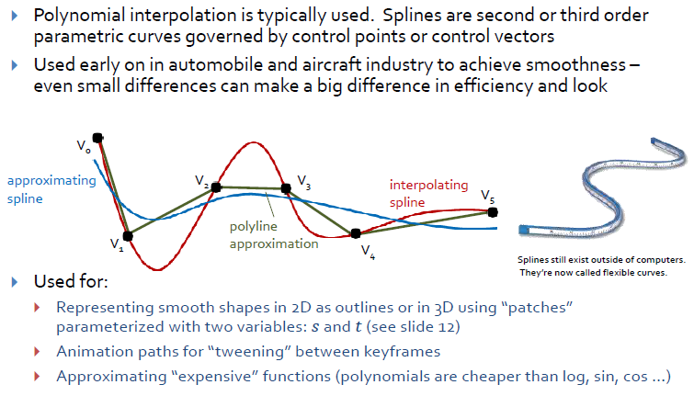
Splines [2]:
Spline Types & Uses
Adapted from slides © 2010 van Dam et al., Brown University
http://bit.ly/hiSt0f Reused with permission.

Slide 18
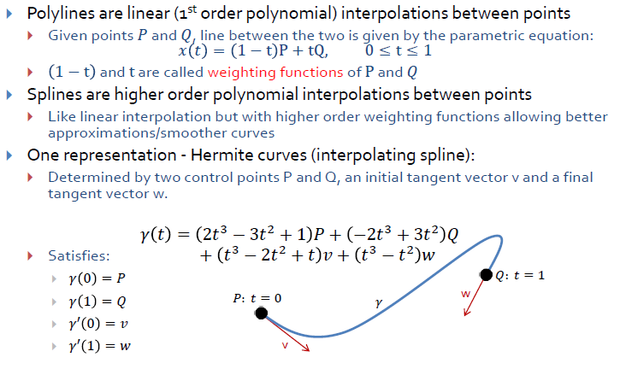
Splines [3]:
Hermite Curves
Adapted from slides © 2010 van Dam et al., Brown University
http://bit.ly/hiSt0f Reused with permission.

Slide 19
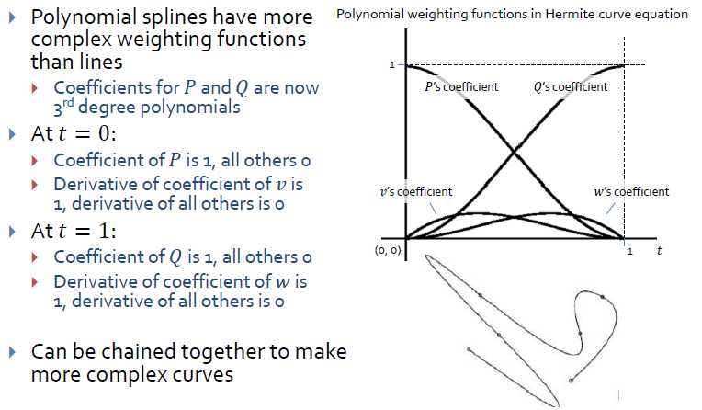
Splines [4]:
Hermite Weighting Explained
Adapted from slides © 2010 van Dam et al., Brown University
http://bit.ly/hiSt0f Reused with permission.

Slide 20
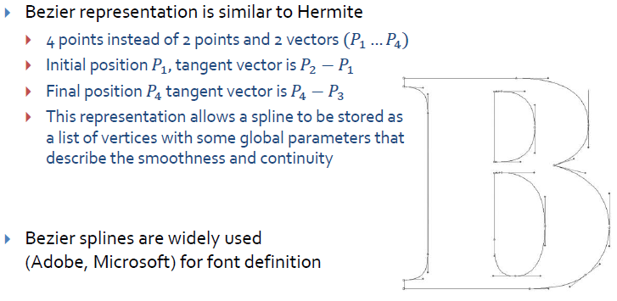
Splines [5]:
Bézier Curves
Brown Exploratory (Spalter & Bielawa): http://bit.ly/fva1il
Adapted from slides © 2010 van Dam et al., Brown University
http://bit.ly/hiSt0f Reused with permission.

Slide 21
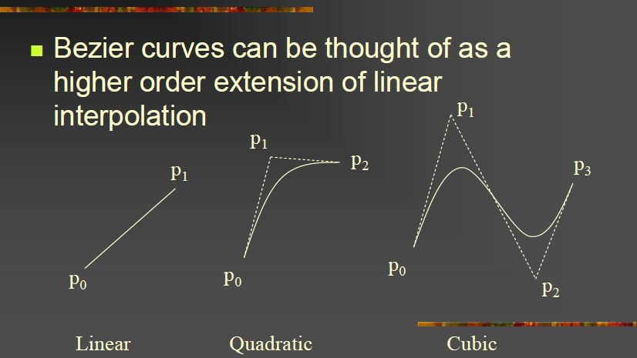
Bézier Curves [1]:
Piecewise Cubic Curves
Adapted from slides © 2003 – 2006 S. Rotenberg, UCSD
CSE167: Computer Graphics, Fall 2006, http://bit.ly/hXxAlP

Slide 22
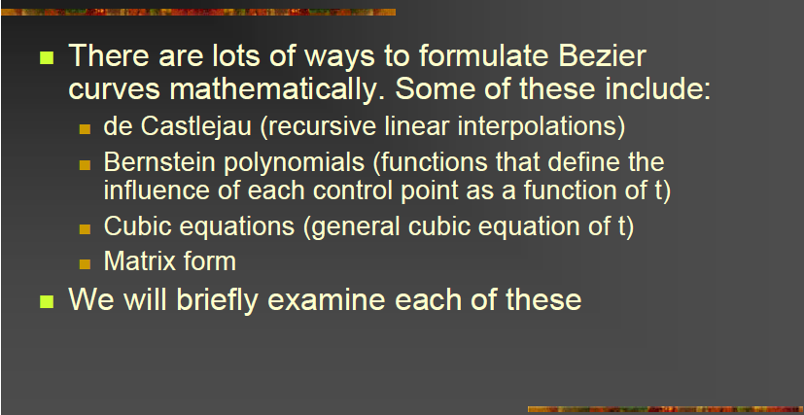
Bézier Curves [2]:
Formulation
Adapted from slides © 2003 – 2006 S. Rotenberg, UCSD
CSE167: Computer Graphics, Fall 2006, http://bit.ly/hXxAlP

Slide 23
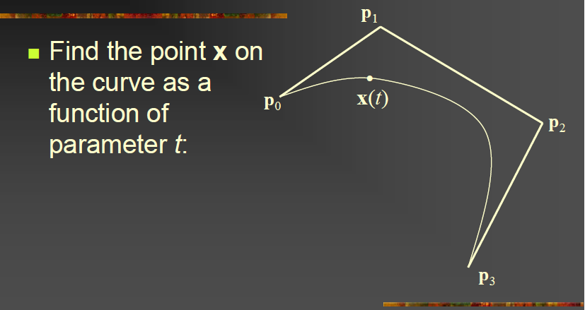
Bézier Curves [3]:
Interpolation Problem Defined
Adapted from slides © 2003 – 2006 S. Rotenberg, UCSD
CSE167: Computer Graphics, Fall 2006, http://bit.ly/hXxAlP

Slide 24
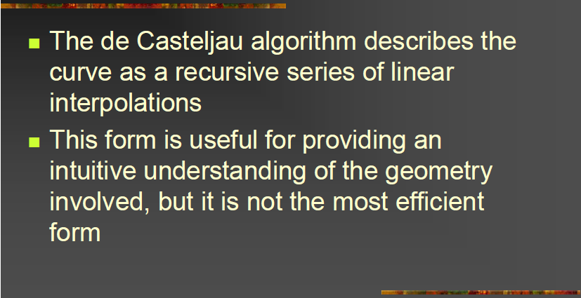
De Casteljau’s Algorithm [1]:
Idea
Adapted from slides © 2003 – 2006 S. Rotenberg, UCSD
CSE167: Computer Graphics, Fall 2006, http://bit.ly/hXxAlP

Slide 25
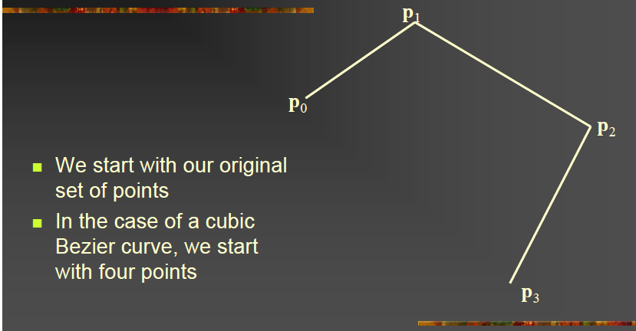
De Casteljau’s Algorithm [2]:
Initialization
Adapted from slides © 2003 – 2006 S. Rotenberg, UCSD
CSE167: Computer Graphics, Fall 2006, http://bit.ly/hXxAlP

Slide 26
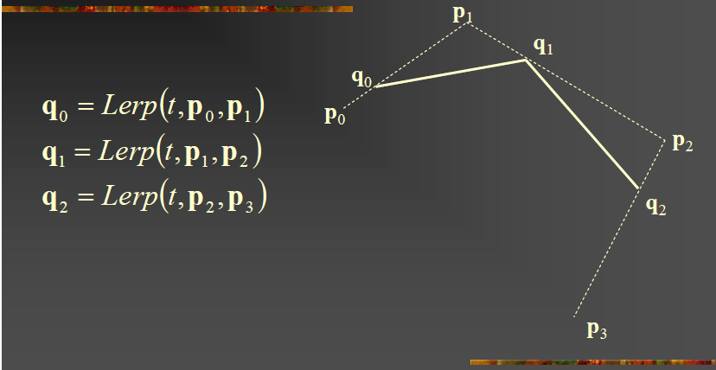
De Casteljau’s Algorithm [3]:
Lerp Step 1
Adapted from slides © 2003 – 2006 S. Rotenberg, UCSD
CSE167: Computer Graphics, Fall 2006, http://bit.ly/hXxAlP

Slide 27
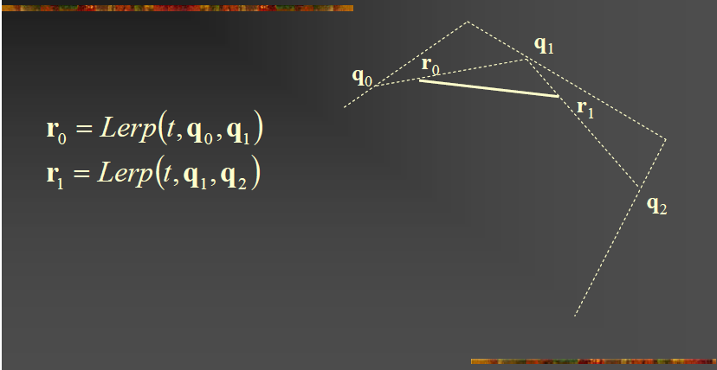
De Casteljau’s Algorithm [4]:
Lerp Step 2
Adapted from slides © 2003 – 2006 S. Rotenberg, UCSD
CSE167: Computer Graphics, Fall 2006, http://bit.ly/hXxAlP

Slide 28
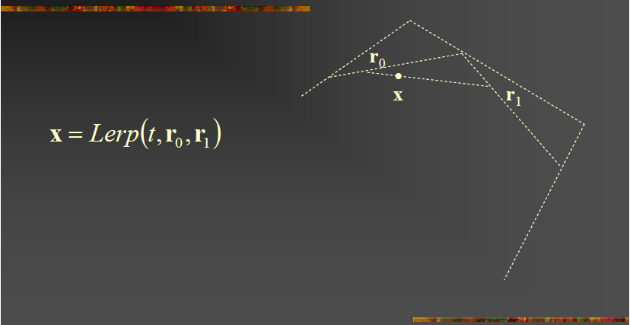
De Casteljau’s Algorithm [5]:
Lerp Step 3
Adapted from slides © 2003 – 2006 S. Rotenberg, UCSD
CSE167: Computer Graphics, Fall 2006, http://bit.ly/hXxAlP

Slide 29
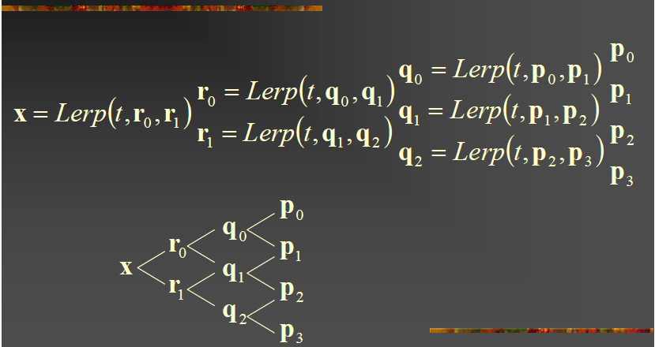
De Casteljau’s Algorithm [6]:
Recursive Linear Interpolation
Adapted from slides © 2003 – 2006 S. Rotenberg, UCSD
CSE167: Computer Graphics, Fall 2006, http://bit.ly/hXxAlP

Slide 30
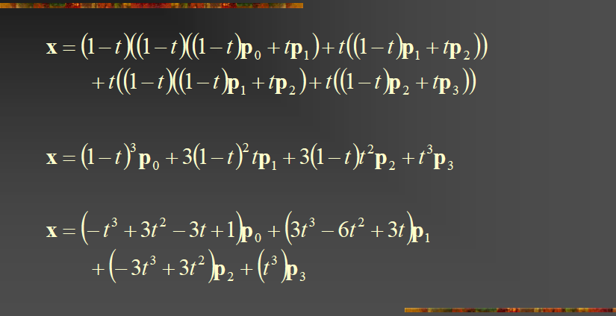
Bernstein Polynomials [1]:
Coefficients of Control Points
Adapted from slides © 2003 – 2006 S. Rotenberg, UCSD
CSE167: Computer Graphics, Fall 2006, http://bit.ly/hXxAlP

Slide 31
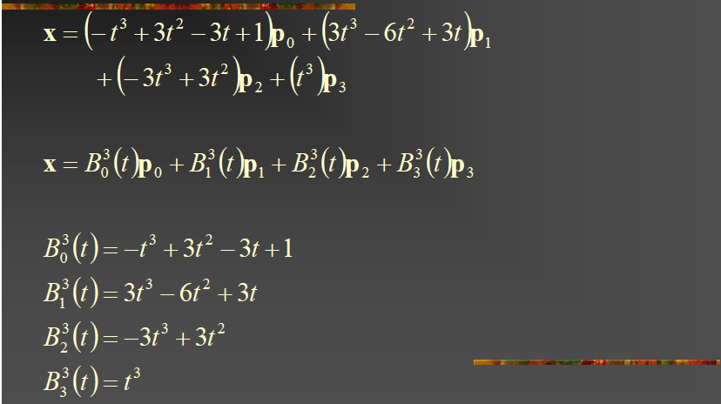
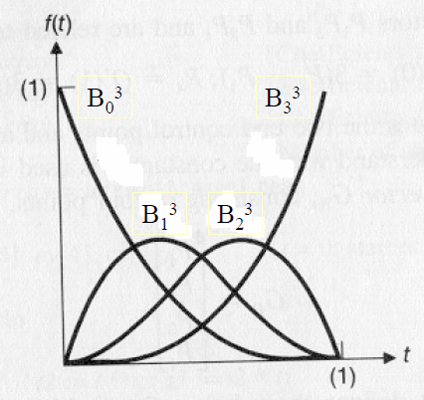
Bernstein Polynomials [2]:
Piecewise Cubic Basis
Adapted from slides © 2003 – 2006 S. Rotenberg, UCSD
CSE167: Computer Graphics, Fall 2006, http://bit.ly/hXxAlP

Slide 32
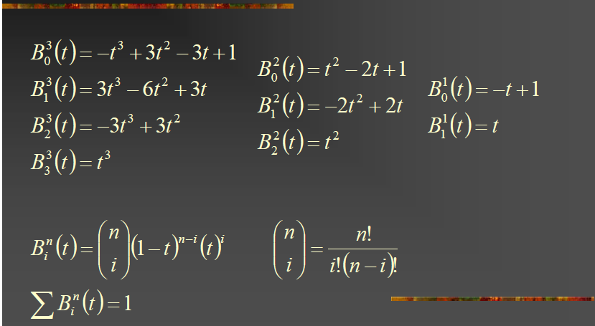
Bernstein Polynomials [3]:
Binomial Form of Basis Functions
Adapted from slides © 2003 – 2006 S. Rotenberg, UCSD
CSE167: Computer Graphics, Fall 2006, http://bit.ly/hXxAlP

Slide 33
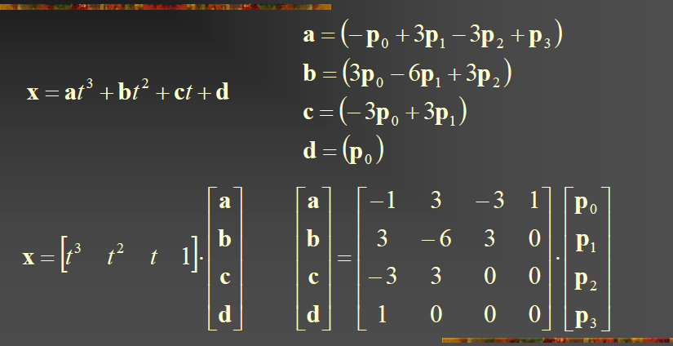
Bernstein Polynomials [4]:
Cubic Matrix Form
Adapted from slides © 2003 – 2006 S. Rotenberg, UCSD
CSE167: Computer Graphics, Fall 2006, http://bit.ly/hXxAlP

Slide 34
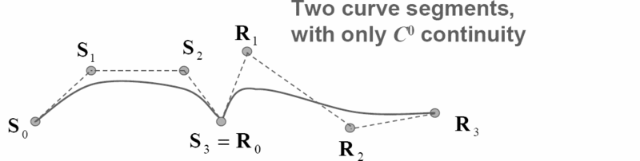
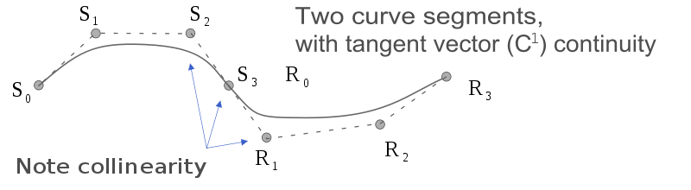
Geometric (G^{i})vs. Mathematical (C^{i} ) Continuity
Geometric Continuity: G^{i}
  Guarantees that direction of i^{th} derivative equal
  G⁰: curves touch at join point
  G¹: curves also share common tangent direction at join point
  G²: curves also share common center of curvature at join point
Mathematical Continuity: C^{i}
  Guarantees that direction, magnitude of i^{th} derivative equal
  C⁰ ≡ G⁰: curves touch at join point
  C¹: curves share common tangent direction / magnitude at join point
  C²: curves share common second derivative at join point
© 2008 – 2009 Wikipedia, Smooth Function
http://bit.ly/hQwnY2

Slide 35
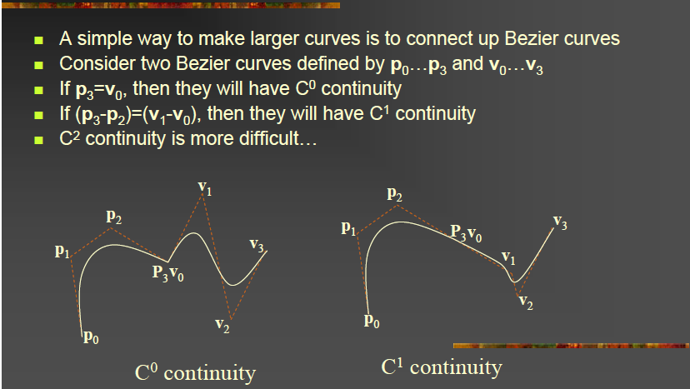
Connecting Bézier Curves:
C^{i} Continuity
Adapted from slides © 2003 – 2006 S. Rotenberg, UCSD
CSE167: Computer Graphics, Fall 2006, http://bit.ly/hXxAlP

Slide 36
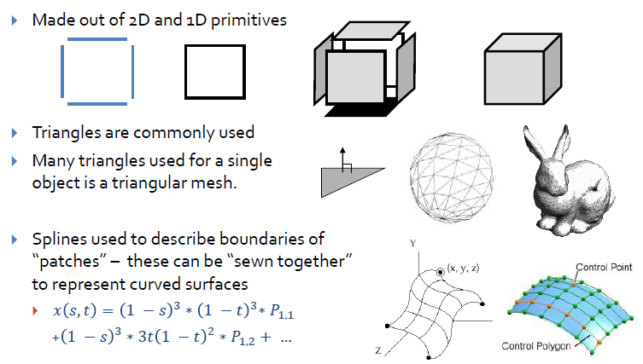
Building 3-D Primitives
Image credit (Stanford Bunny): http://bit.ly/fDSxn9
Adapted from slides © 2010 van Dam et al., Brown University
http://bit.ly/hiSt0f Reused with permission.

Slide 37
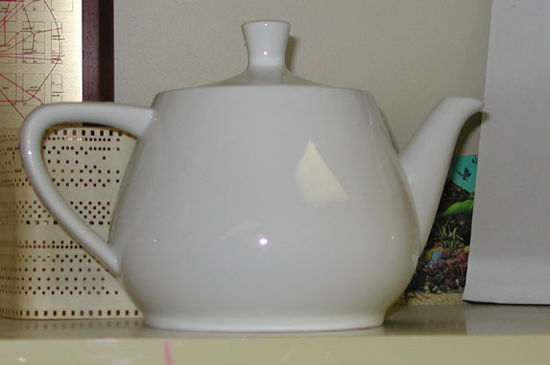
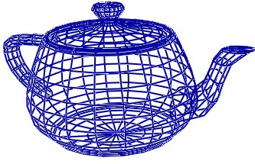
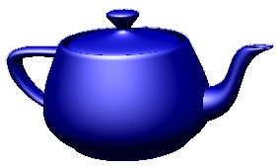
Surface Modeling:
Utah Teapot
Many real-world objects: inherently smooth
  Therefore need infinitely many points to model them
  Not feasible for a computer with finite storage
More often we merely approximate objects with
  Pieces of planes
  Spheres
  Other shapes that are easy to describe mathematically
Two most common representations for 3-D surfaces
  Polygon mesh surfaces
  Parametric surfaces
Will also discuss parametric curves
  2-D, embedded in 3-D
  Think of parametric surfaces as generalization of curves
Adapted from slides © 2006 B. McCaul, Dublin City University
CA433 Computer Graphics I, http://bit.ly/ghw08y

Slide 38
Polygon Meshes [1]:
Vertex, Edge, Polygon Tables
V₁
E₃
E₆
E₁
P₁
P₂
E₂
V₃
E₄
E₅
V₅
V₂
V₄
VERTEX TABLE
V₁: x₁, y₁, z₁
V₂: x₂, y₂, z₂
V₃: x₃, y₃, z₃
V₄: x₄, y₄, z₄
V₅: x₅, y₅, z₅
EDGE TABLE
E₁: V₁, V₂
E₂: V₂, V₃
E₃: V₃, V₁
E₄: V₃, V₄
E₅: V₄, V₅
E₆: V₅, V₁
POLYGON TABLE
P₁: V₁, V₂ , V₃
P₂: V₁ , V₃ , V₄ , V₅
OR
POLYGON TABLE
P₁: E₁, E₂ , E₃
P₂: E₃ , E₄ , E₅ , E₆
Adapted from slides © 2006 B. McCaul, Dublin City University
CA433 Computer Graphics I, http://bit.ly/ghw08y

Slide 39
Polygon Meshes [2]:
“Eliminating” Edge Table
The geometry can be stored as three tables: a vertex table, an edge table, and a polygon table. Each entry in the vertex table is a list of coordinates defining that point. Each entry in the edge table consists of a pointer to each endpoint of that edge. And the entries in the polygon table define a polygon by providing pointers to the edges that make up the polygon.
We can eliminate the edge table by letting the polygon table reference the vertices directly, but we can run into problems, such as drawing some edges twice, because we don't realise that we have visited the same set of points before, in a different polygon. We could go even further and eliminate the vertex table by listing all the coordinates explicitly in the polygon table, but this wastes space because the same points appear in the polygon table several times.
Adapted from slides © 2006 B. McCaul, Dublin City University
CA433 Computer Graphics I, http://bit.ly/ghw08y

Slide 40
Polygon Meshes [3]:
Representation
Explicit way: just list 3D vertices of each polygon in a certain order. Problems are, firstly it represents same vertex many times and secondly, no explicit representation of shared edges and vertices
Pointer to a vertex list: store all vertices once into a numbered list, and represent each polygon by its vertices. It saves space (vertex only listed once) but still has no explicit representation of shared edges and vertices
Explicit edges: list all edges that belong to a polygon, and for each edge list the vertices that define it along with the polygons of which it is a member.
Adapted from slides © 2006 B. McCaul, Dublin City University
CA433 Computer Graphics I, http://bit.ly/ghw08y

Slide 41
Types of Curves [1]:
Explicit & Implicit
Explicit
  In Cartesian plane, explicit equation of planar curve given by
  y = f(x)
  Difficulties with this approach
  impossible to get multiple values of y for single x, so curves such as circles and ellipses must be represented by multiple curve segments
  describing curves with vertical tangents: difficult, numerically unstable
Implicit
  f(x, y) = 0
  Ax + By + C =0
Difficulties: determining tangent continuity of two given curves – crucial in many applications
(Circle can be defined as: x² + y² = 1, but what about half circle?)
Adapted from slides © 2006 B. McCaul, Dublin City University
CA433 Computer Graphics I, http://bit.ly/ghw08y

Slide 42
Types of Curves [2]:
Parametric
Parametric Curves
Cubic polynomials that define curve segment Q(t)= [x(t) y(t)]^{T} are of form:
Written in matrix form, system becomes
Q(t)= [x(t) y(t)] = T⋅ C
where
Adapted from slides © 2006 B. McCaul, Dublin City University
CA433 Computer Graphics I, http://bit.ly/ghw08y

Slide 43
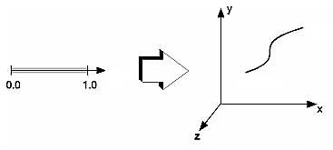
Parametric Bicubic Surfaces [1]
Equations that describe parametric curve depend on variable t not explicitly part of geometry
By sweeping through t, in our case 0 ≤ t ≤ 1, we can evaluate equations and determine x, y values for points on curve
t = 1.0
t
t = 0.0
Parameter space
Object space
Adapted from slides © 2006 B. McCaul, Dublin City University
CA433 Computer Graphics I, http://bit.ly/ghw08y

Slide 44
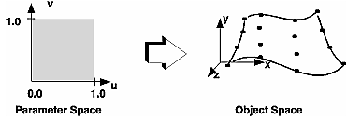
Review [8]:
Parametric Bicubic Surfaces
Parametric Bicubic Surface: Generalization of Parametric Cubic Curve
From Curves to Surfaces
  Let one parameter (say v) be held at constant value
  Above will represent a curve
  Surface generated by sweeping all points on boundary curve, e.g., P(u, 0), through cubic trajectories, defined using v, to boundary curve P(u,1)
u = 1
u = 0
v = 0
v = 1
Adapted from slides © 2006 B. McCaul, Dublin City University
CA433 Computer Graphics I, http://bit.ly/ghw08y

Slide 45
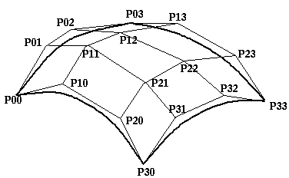
Bézier Surface Patch
The representation of the bicubic surface patch can be illustrated by considering the Bézier Surface Patch. The edge P(0, v) of a Bezier patch is defined by giving four control points P₀₀, P₀₁, P₀₂ and P₀₃. Similarly the opposite edge P(1, v) can be represented by a Bezier curve with four control points. The surface patch is generated by sweeping the curve P(0, v) through a cubic trajectory in the parameter u to P(1, v). To define this trajectory we need four control points, hence the Bezier surface patch requires a mesh of 4×4 control points as illustrated below.
Adapted from slides © 2006 B. McCaul, Dublin City University
CA433 Computer Graphics I, http://bit.ly/ghw08y

Slide 46
Surfaces – Simple Extension
Easy to generalize from cubic curves to bicubic surfaces
Surfaces defined by parametric equations of two variables, s and t
i.e., surface is approximated by series of crossing parametric cubic curves
Result is polygon mesh
Decreasing step size in s and t will give
  mesh of small near-planar quadrilateral patches
  more accuracy
Adapted from slide © 2007 - 2008 K. Hawick, Massey University
159-235 Graphics and Graphical Programming, http://bit.ly/gmY8R8

Slide 47
Control of Surface Shape
Control is now 2-D array of control points
Two parameter surface function, forming tensor product with blending functions, is:
Use appropriate blending functions for Bézier and B-Spline surface functions
Convex Hull property preserved since bicubic is still weighted sum (1)
Adapted from slide © 2007 - 2008 K. Hawick, Massey University
159-235 Graphics and Graphical Programming, http://bit.ly/gmY8R8

Slide 48
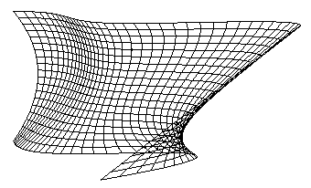
Example :
Bézier Surface
Matrix formulation as follows
Substitute suitable values for s, t (20 in above example)
Adapted from slide © 2007 - 2008 K. Hawick, Massey University
159-235 Graphics and Graphical Programming, http://bit.ly/gmY8R8

Slide 49
B-Spline Surfaces
Break surface into 4-sided patches choosing suitable values for s and t
Points on any external edges must be multiple knots of multiplicity k
Lot more work than Bézier
There are other types of spline systems and NURBS modelling packages are available to make the work much easier
Use polygon packages for display, hidden-surface removal and rendering (Bézier too)
Adapted from slide © 2007 - 2008 K. Hawick, Massey University
159-235 Graphics and Graphical Programming, http://bit.ly/gmY8R8

Slide 50
Continuity of Bicubic Patches
Hermite and Bézier patches
  C⁰ continuity by sharing 4 control points between patches
  C¹ continuity when both sets of control points either side of the edge are collinear with the edge
B-Spline patch
  C² continuity between patches
Adapted from slide © 2007 - 2008 K. Hawick, Massey University
159-235 Graphics and Graphical Programming, http://bit.ly/gmY8R8

Slide 51
Display (Rendering) of Bicubic Patches
Can calculate surface normals to bicubic surfaces by vector cross product of their 2 tangent vectors
Normal is expensive to compute
  Formulation of normal is a biquintic (two-variable, fifth-degree) polynomial
Display
  Can use brute-force method – very expensive!
  Forward differencing method very attractive
Adapted from slide © 2007 - 2008 K. Hawick, Massey University
159-235 Graphics and Graphical Programming, http://bit.ly/gmY8R8

Slide 52
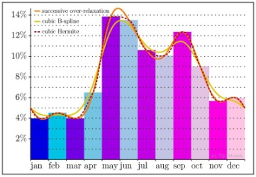
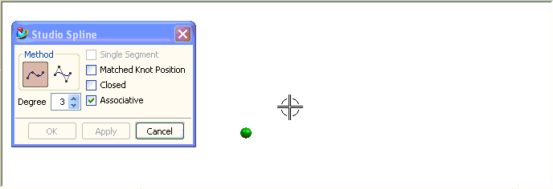
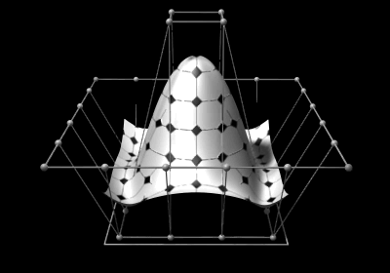
Non-Uniform Rational B-Splines &
NURBS Surfaces
B-Splines
NURBS
NURBS Surface
© 2009 Wikipedia, B-spline
http://bit.ly/gNzrCK
© 2007 Wikipedia, Non-uniform rational B-spline
http://bit.ly/eNmDA4
© 2010 Wikipedia, Non-uniform rational B-spline
http://bit.ly/eNmDA4

Slide 53
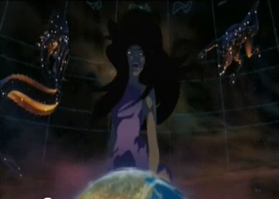
Curves & Surfaces: Summary
Curves
  Bézier: easier to scan convert (DeCasteljau)
  Hermite: easier to control via GUI (tangent)
Bicubic patches
  Bilinear interpolation
  Control patch aka Coons patch
Acknowledgments - thanks to Eric McKenzie, Edinburgh, from whose Graphics Course some of these slides were adapted.
Sinbad: Legend of the Seven Seas
© 2003 Dreamworks SKG
Trailer: http://youtu.be/1KCX0pFPRwk
Eris scene: http://youtu.be/w1r8_vByXW4
2003 Wired article: http://bit.ly/gm85UU
Adapted from slide © 2007 - 2008 K. Hawick, Massey University
159-235 Graphics and Graphical Programming, http://bit.ly/gmY8R8

Slide 54
Further Reading
Foley et al.: Computer Graphics: Principles and Practice
  2nd edition in C (1991), http://amzn.to/hFNqNC
  Chapter 11: Representing Curves and Surfaces
Approaches: Classical (OpenGL v1 & 2) vs. New (OpenGL v3 & 4)
  Classical: evalCoord (http://bit.ly/e8olZj), evalMesh (http://bit.ly/gGkt8Z)
  New: Map{1|2}{f|d}; Chapter 5, compatibility profile (http://bit.ly/gkbVyE)
OpenGL 1.1 Specification
  All versions: http://www.opengl.org/documentation/specs/
  Chapter 5: Evaluators, http://bit.ly/gMVzAO
Red Book (OpenGL Programming Guide)
  v1.1: http://glprogramming.com/red/ (current edition: 7th)
  Chapter 12: Evaluators and NURBS, http://bit.ly/hZ1tpb
Blue Book (OpenGL Reference Manual)
  1992 edition: http://glprogramming.com/blue/
  See evalCoord (http://bit.ly/eADQLM), evalMesh (http://bit.ly/f7Juog)
Adapted from slides © 2006 B. McCaul, Dublin City University
CA433 Computer Graphics I, http://bit.ly/ghw08y

Slide 55
Summary
Reading for Last Class: §5.3 – 5.5, Eberly 2e, CGA handout
Reading for Today: §10.4, 12.7, Eberly 2e, Mesh handout
Reading for Next Class: §11.1 – 11.6 (736), Flash animation handout
Last Time: Brief Survey of Skinning and Morphing
  GPU-based vertex tweening: texture arrays, vertex texturing, hybrid
  Agent simulation using GPU-based finite state machines
Today: Curves & Surfaces
  Piecewise linear, quadratic, cubic curves and their properties
  Interpolation: subdivision (DeCasteljau’s algorithm)
  Bicubic surfaces & bilinear interpolation
Outside Viewing
  CIS 536 & 636 students: watch Basic CG lecture 10 on VSD
  CIS 736 students: watch Advanced CG lectures 4 & 5 on CGA, IK
Previous Videos: Morphing & Other Special Effects (SFX)
Today’s Videos: Bicubic Surfaces (NURBS), Solid Modeling

Slide 56
Terminology
Skins – Surface Meshes for Faces, Character Models
Morphing – gradual transition between images or meshes
  Vertex tweening – texture arrays, vertex texturing, or hybrid method
  GPU computing – offload some tasks to GPU
Piecewise Polynomial Curves aka Splines
  Piecewise linear, piecewise quadratic, piecewise cubic
  Types of splines: Bézier, Hermite, B-splines, NURBS
  DeCasteljau’s algorithm: recursive linear interpolation (subdivision)
  Control points: vertices of control polygon, determine spline shape
  Bernstein polynomials: weight of each control point as function of t
Continuity: Geometric (G^{i}), Mathematical (C^{i})
Bicubic Surfaces
  Controlled by control patch (Coons patch), defining 3-D surface
  Bilinear interpolation – sweep spline along another spline path
  NURBS surface – bicubic surface based on NURBS curves

