Slide 1
Lecture 21 of 41
Animation Basics
Lab 4: Modeling & Rigging in Maya
William H. Hsu
Department of Computing and Information Sciences, KSU
KSOL course pages: http://bit.ly/hGvXlH / http://bit.ly/eVizrE
Public mirror web site: http://www.kddresearch.org/Courses/CIS636
Instructor home page: http://www.cis.ksu.edu/~bhsu
Readings:
Today: Flash animation handout
Next class: Chapter 17, esp. §17.1 – 17.2, Eberly 2e – see http://bit.ly/ieUq45
Reference: http://www.learning-maya.com

Slide 2
Lecture Outline
Reading for Last Class: §10.4, 12.7, Eberly 2e, Mesh handout
Reading for Today: §11.1 – 11.6 Eberly 2e (736), Flash handout
Reading for Next Class: §17.1 – 17.2, Eberly 2e
Last Time: Curves & Surfaces
  Piecewise polynomial curves (aka splines) and their properties
  Hermite vs. Bézier curves: manipulation vs. display (rendering)
  DeCasteljau’s algorithm: recursive linear interpolation
  Other representations: Bernstein basis functions, matrix form
  Bicubic surfaces
  Bilinear interpolation
Today: Maya & Animation Preliminaries – Ross Tutorials
  Maya interface: navigation, menus, tools, primitives
  Ross tutorials (http://bit.ly/dFpTwq)
  Preview of character models: PolyFacecom (http://bit.ly/h6tzrd)
Next Class: Animations 2 – Rotations, Dynamics & Kinematics

Slide 3
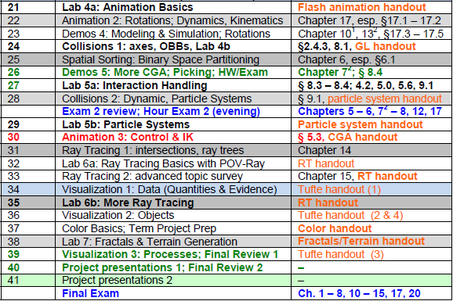

Where We Are

Slide 4





Acknowledgements:
Curves & Surfaces
Steve Rotenberg
Visiting Lecturer
Graphics Lab
University of California – San Diego
CEO/Chief Scientist, PixelActive
http://graphics.ucsd.edu
Barry McCaul
Lecturer
School of Computing
Dublin City University
http://www.computing.dcu.ie/~bmccaul/
Ken Hawick
Professor
Institute of Information and Mathematical Sciences (IIMS)
Massey University – Albany
http://www.massey.ac.nz/~kahawick/

Slide 5


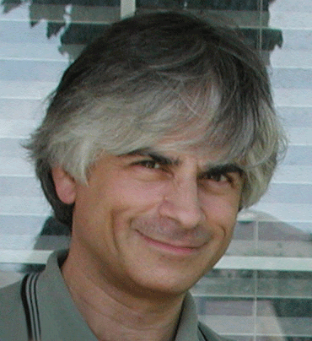

Acknowledgements:
Splines
Jim Foley
Professor, College of Computing & Stephen Fleming Chair in Telecommunications
Georgia Institute of Technology
James D. Foley
Georgia Tech
http://bit.ly/ajYf2Q
Andries van Dam
Brown University
http://www.cs.brown.edu/~avd/
Steven K. Feiner
Columbia University
http://www.cs.columbia.edu/~feiner/
John F. Hughes
Brown University
http://www.cs.brown.edu/~jfh/
Andy van Dam
T. J. Watson University Professor of Technology and Education & Professor of Computer Science
Brown University
Steve Feiner
Professor of Computer Science & Director, Computer Graphics and User Interfaces Laboratory
Columbia University
John F. Hughes
Associate Professor of Computer Science
Brown University

Slide 6
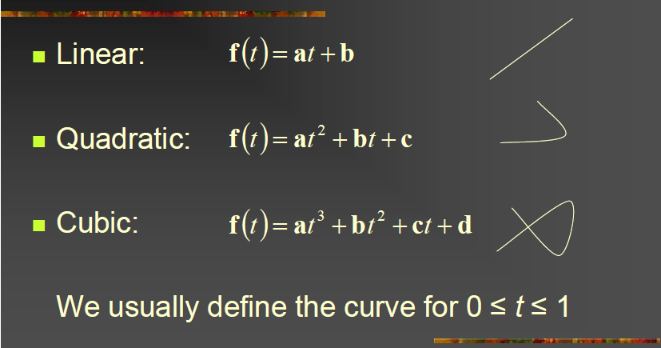
Review [1]:
Vector Polynomials (Curves)
Adapted from slides © 2003 – 2006 S. Rotenberg, UCSD
CSE167: Computer Graphics, Fall 2006, http://bit.ly/hXxAlP

Slide 7
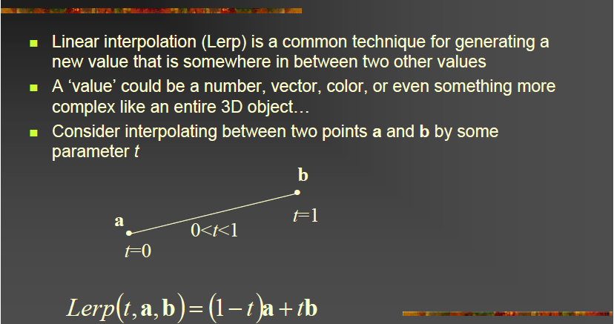
Review [2]:
Linear Interpolation
Adapted from slides © 2003 – 2006 S. Rotenberg, UCSD
CSE167: Computer Graphics, Fall 2006, http://bit.ly/hXxAlP

Slide 8
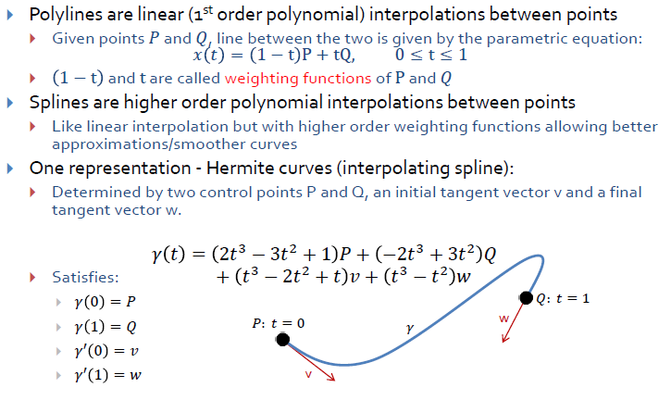

Review [3]:
Hermite Curves
Adapted from slides © 2010 van Dam et al., Brown University
http://bit.ly/hiSt0f Reused with permission.

Slide 9
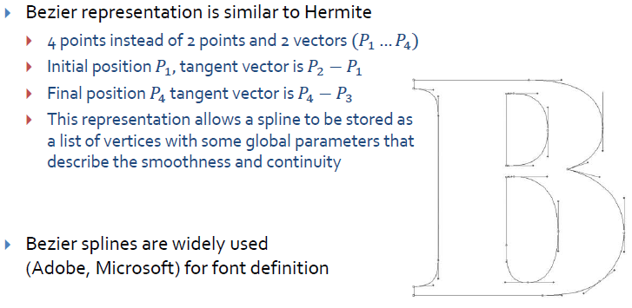
Review [4]:
Bézier Curves
Brown Exploratory (Spalter & Bielawa): http://bit.ly/fva1il
Adapted from slides © 2010 van Dam et al., Brown University
http://bit.ly/hiSt0f Reused with permission.

Slide 10
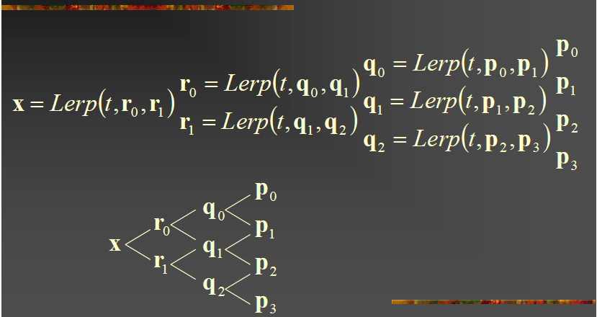
Review [5]:
De Casteljau’s Algorithm
Adapted from slides © 2003 – 2006 S. Rotenberg, UCSD
CSE167: Computer Graphics, Fall 2006, http://bit.ly/hXxAlP

Slide 11
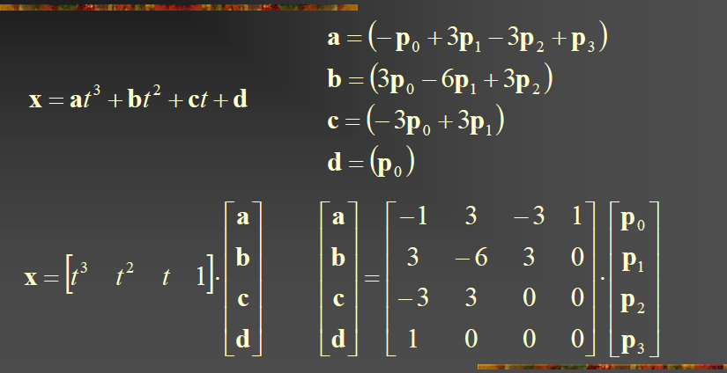
Review [6]:
Bernstein Polynomials – Matrix Form
Adapted from slides © 2003 – 2006 S. Rotenberg, UCSD
CSE167: Computer Graphics, Fall 2006, http://bit.ly/hXxAlP

Slide 12
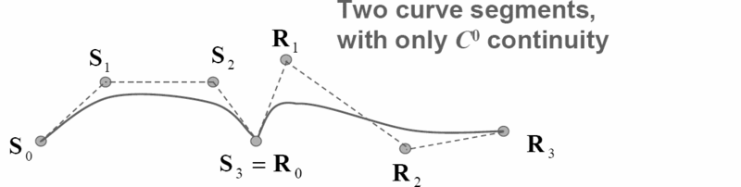
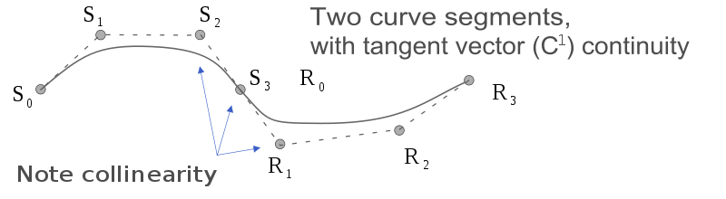
Review [7]:
G^{i}vs. C^{i} Continuity
Geometric Continuity: G^{i}
  Guarantees that direction of i^{th} derivative equal
  G⁰: curves touch at join point
  G¹: curves also share common tangent direction at join point
  G²: curves also share common center of curvature at join point
Mathematical Continuity: C^{i}
  Guarantees that direction, magnitude of i^{th} derivative equal
  C⁰ ≡ G⁰: curves touch at join point
  C¹: curves share common tangent direction / magnitude at join point
  C²: curves share common second derivative at join point
© 2008 – 2009 Wikipedia, Smooth Function
http://bit.ly/hQwnY2

Slide 13
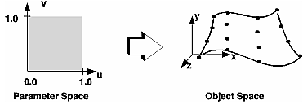
Review [8]:
Parametric Bicubic Surfaces
Parametric Bicubic Surface: Generalization of Parametric Cubic Curve
From Curves to Surfaces
  Let one parameter (say v) be held at constant value
  Above will represent a curve
  Surface generated by sweeping all points on boundary curve, e.g., P(u, 0), through cubic trajectories, defined using v, to boundary curve P(u,1)
u = 1
u = 0
v = 0
v = 1
Adapted from slides © 2006 B. McCaul, Dublin City University
CA433 Computer Graphics I, http://bit.ly/ghw08y

Slide 14
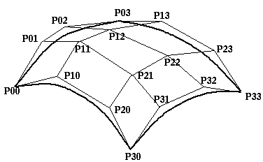
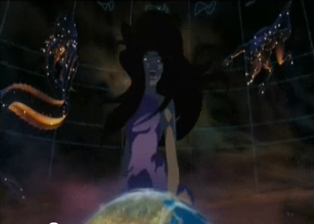
Review [9]:
Curves & Surfaces
Curves
  Bézier: easier to scan convert (DeCasteljau)
  Hermite: easier to control via GUI (tangent)
Bicubic patches
  Bilinear interpolation
  Control patch aka Coons patch
Acknowledgments - thanks to Eric McKenzie, Edinburgh, from whose Graphics Course some of these slides were adapted.
Sinbad: Legend of the Seven Seas
© 2003 Dreamworks SKG
Trailer: http://youtu.be/1KCX0pFPRwk
Eris scene: http://youtu.be/w1r8_vByXW4
2003 Wired article: http://bit.ly/gm85UU
Adapted from slide © 2007 - 2008 K. Hawick, Massey University
159-235 Graphics and Graphical Programming, http://bit.ly/gmY8R8

Slide 15



Acknowledgements:
Maya Character Rigging
Aaron Ross
Founder, Digital Arts Guild
http://dr-yo.com
http://bit.ly/fzxN74
http://www.youtube.com/user/DigitalArtsGuild
Jim Lammers
President
Trinity Animation
http://www.trinity3d.com
http://bit.ly/i6yfyV
Larry Neuberger
Associate Professor, Alfred State SUNY College of Technology
Online Instructor, Art Institute of Pittsburgh
http://poorhousefx.com

Slide 16


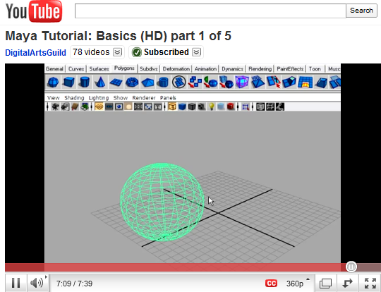
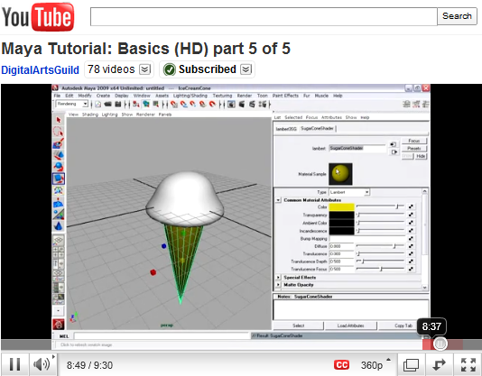
Resources [1]:
Basic Maya Tutorials - Ross
Maya Tutorial: Basics © 2011 A. F. Ross
Playlist: http://bit.ly/dFpTwq

Slide 17
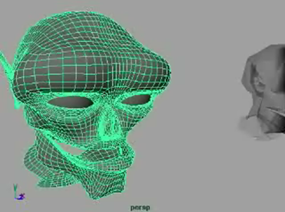
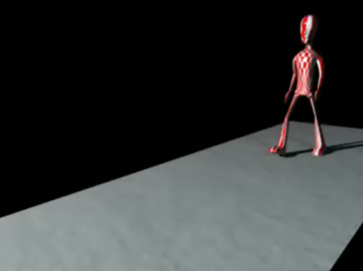
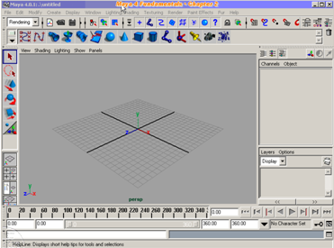
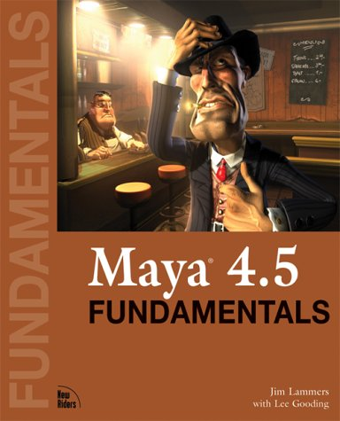
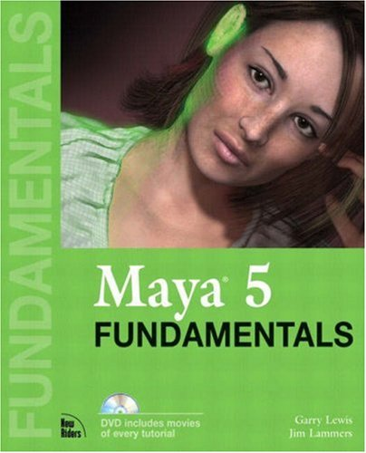
Resources [2]:
Animation Tutorials - Lammers
Maya 4 Fundamentals © 2001 J. Lammers & L. Gooding, http://amzn.to/eWvrkn Maya 4.5 Fundamentals © 2003 J. Lammers & L. Gooding, http://bit.ly/hxTpl1
Maya 5 Fundamentals © 2006 G. Lewis & J. Lammers, http://amzn.to/g021Ct

Slide 18


Resources [3]:
Examples Online
“Maya Animation” at Animation Arena © 2004 – 2011 G. Nakpil, Toronto, CANADA
http://bit.ly/gXXQTG
© 2001 J. Wilson, http://bit.ly/hxTpl1
Student art gallery for Maya 4 Fundamentals (http://amzn.to/eOld3Q)

Slide 19
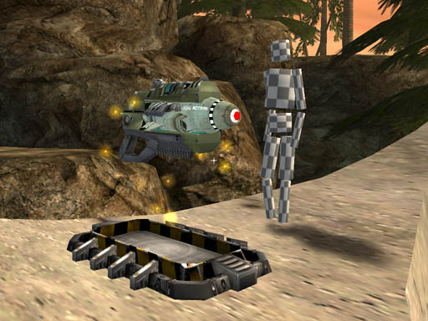
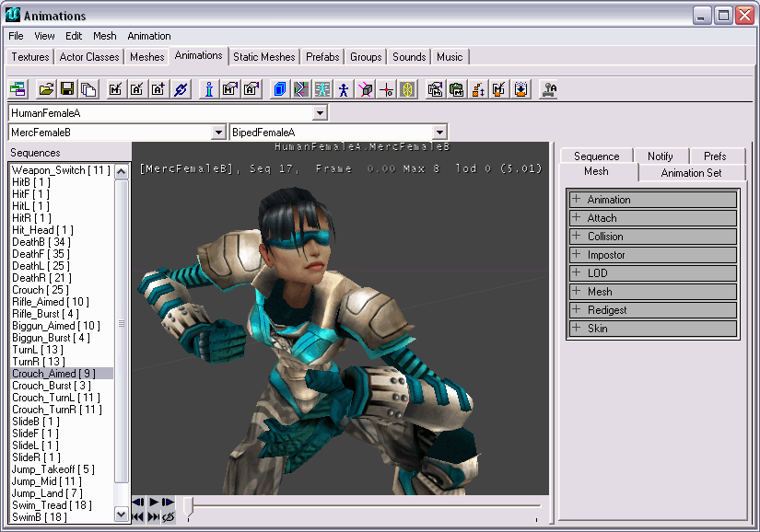
Lab 4 [1]:
Rigging “Tin Can Man”, Unreal Wiki
© 2003 – 2008 Unreal Wiki
http://bit.ly/dLRkXN

Slide 20
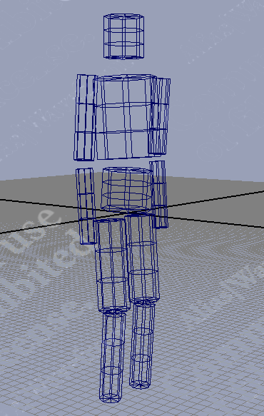
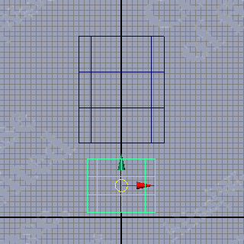
Lab 4 [2]:
Part A – Modeling
Maya Tutorial Part 1: Modeling, © 2003 – 2008 Unreal Wiki
http://bit.ly/h9lRmT

Slide 21
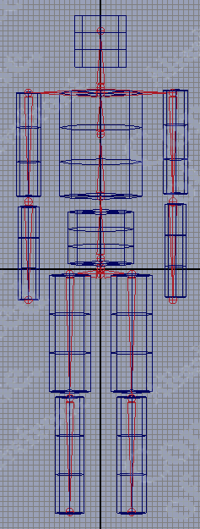
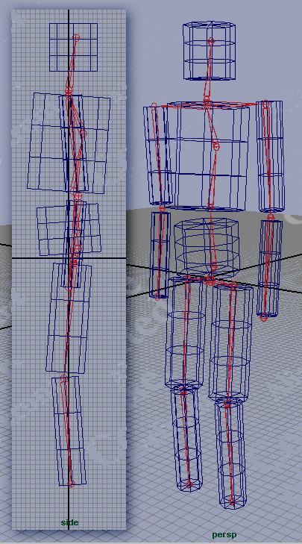
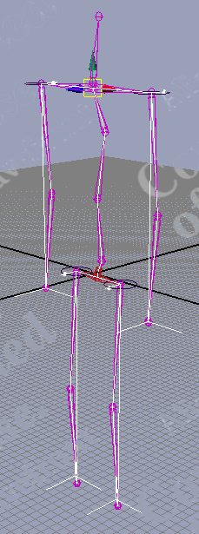
Lab 4 [3] :
Part B – Rigging
Maya Tutorial Part 2: Rigging, © 2003 – 2008 Unreal Wiki
http://bit.ly/gcZIJW

Slide 22
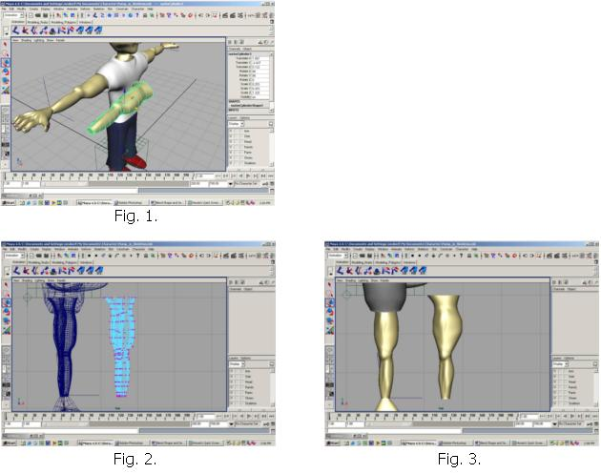

Character Modeling in Maya [1]:
Muscle Models & Deformations
Adapted from material © 2003 L. Neuberger, http://bit.ly/gqBZ0d
Alfred State College, State University of New York

Slide 23
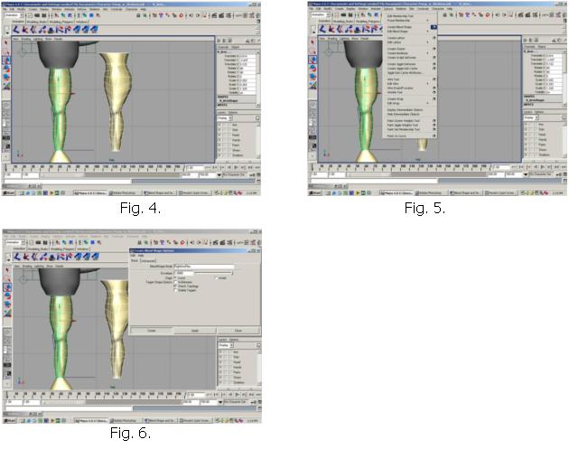
Character Modeling in Maya [2]:
Deform → Blend Shape
Adapted from material © 2003 L. Neuberger, http://bit.ly/gqBZ0d
Alfred State College, State University of New York

Slide 24
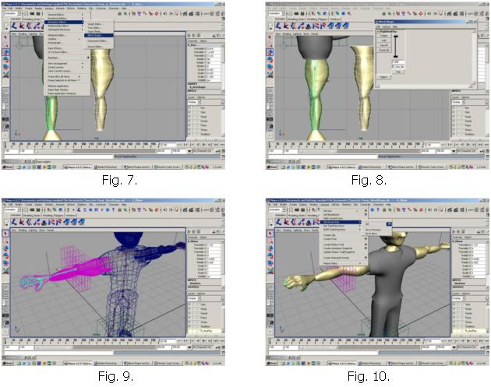
Character Modeling in Maya [3]:
Animate → Set Driven Key → Set
Adapted from material © 2003 L. Neuberger, http://bit.ly/gqBZ0d
Alfred State College, State University of New York

Slide 25
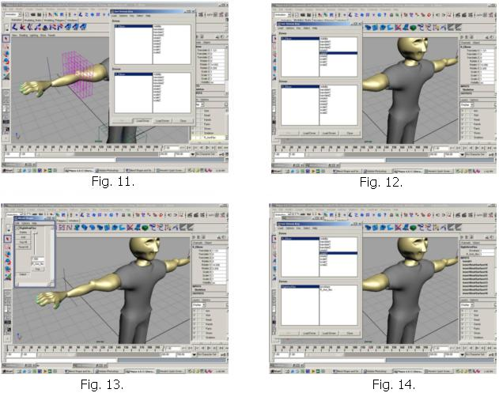
Character Modeling in Maya [4]:
Driver
Adapted from material © 2003 L. Neuberger, http://bit.ly/gqBZ0d
Alfred State College, State University of New York

Slide 26
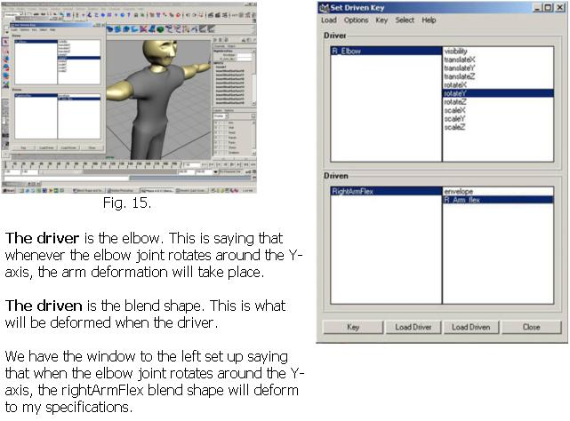
Character Modeling in Maya [5]:
Blend Shape Deformation Setup
Adapted from material © 2003 L. Neuberger, http://bit.ly/gqBZ0d
Alfred State College, State University of New York

Slide 27
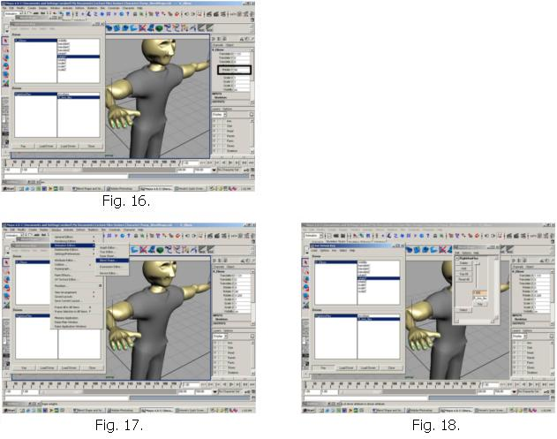
Character Modeling in Maya [6]:
Inverse Kinematics (IK)
Adapted from material © 2003 L. Neuberger, http://bit.ly/gqBZ0d
Alfred State College, State University of New York

Slide 28
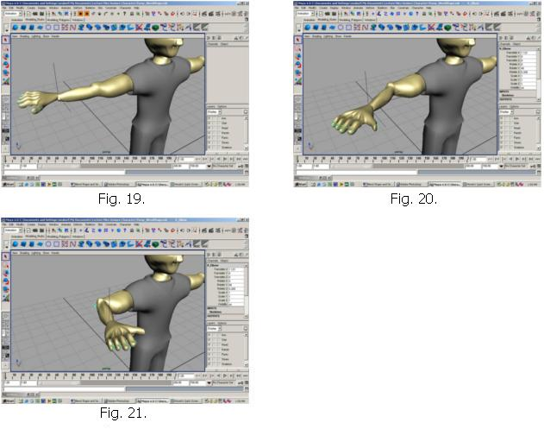
Character Modeling in Maya [7]:
Controlling Deformation & Rotation
Adapted from material © 2003 L. Neuberger, http://bit.ly/gqBZ0d
Alfred State College, State University of New York

Slide 29
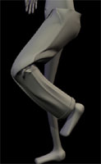
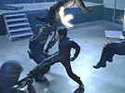

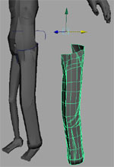
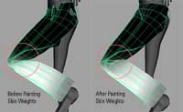
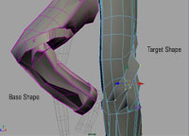
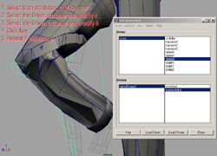
Cloth Modeling in Maya [1]:
More Driven Keys & Blend Shape
© 2002 - 2003 PlanetSack Tutorials
http://bit.ly/hocnu1

Slide 30
Cloth Modeling in Maya [2]:
Output
© 2002 - 2003 PlanetSack Tutorials
http://bit.ly/hocnu1

Slide 31
Summary
Reading for Next Class: §17.1 – 17.2, Eberly 2e
Last Time: Curves & Surfaces
  Piecewise linear, quadratic, cubic curves and their properties
  Interpolation: subdivision (DeCasteljau’s algorithm)
  Bicubic surfaces & bilinear interpolation
Today: Maya & CGA Preliminaries – Ross Tutorials (http://bit.ly/dFpTwq)
  Maya interface: navigation, menus, tools, primitives
  GUI & objects (Ross 1); viewports, transforms, & hotkeys (Ross 2)
  Nodes & attributes (Ross 3); UI, channel box & deformers (Ross 4)
  Modeling, scene creation, materials (Ross 5)
  Character models: PolyFacecom (http://bit.ly/h6tzrd)
Previous Videos (#3): Morphing & Other Special Effects (SFX)
Next Set of Videos (#4): Modeling & Simulation
Next Class: Animations 2 – Rotations, Dynamics & Kinematics
Lab 4: Unreal Wiki Tutorial, Modeling/Rigging (http://bit.ly/dLRkXN)

Slide 32
Terminology
Piecewise Polynomial Curves aka Splines
Continuity: Geometric (G^{i}), Mathematical (C^{i})
Bicubic Surfaces including NURBS Surfaces
Maya Software for 3-D Modeling & Animation
  Shelves – groups of tools & action icons; compare palettes, toolbars
  Hotkeys – key combos for common functions; compare macros
  Viewports – scene views for editing: orthographic, persspective
  Channel box – GUI for accessing position, rotation, scale, history
  Deformers – tools for controlling complex vertex meshes
Rigging Character Models: Defining Components of Articulated Figure
  Joints – axis of rotation, angular degree(s) of freedom (DOFs)
  Bones – attached to joints, rotate about joint axis

