Slide 1
Lecture 22 of 41
Animation 2 of 3: Rotations, Quaternions
Dynamics & Kinematics
William H. Hsu
Department of Computing and Information Sciences, KSU
KSOL course pages: http://bit.ly/hGvXlH / http://bit.ly/eVizrE
Public mirror web site: http://www.kddresearch.org/Courses/CIS636
Instructor home page: http://www.cis.ksu.edu/~bhsu
Readings:
Today: Chapter 17, esp. §17.1 – 17.2, Eberly 2e – see http://bit.ly/ieUq45
Next class: Chapter 10, 13, §17.3 – 17.5, Eberly 2e
Ross’s Maya tutorials: http://bit.ly/dFpTwq
PolyFacecom’s Maya character modeling tutorials: http://bit.ly/h6tzrd
Wikipedia, Flight Dynamics: http://bit.ly/gVaQCX

Slide 2
Lecture Outline
Reading for Last Class: §11.1 – 11.6 Eberly 2e (736), Flash handout
Reading for Today: §17.1 – 17.2, Eberly 2e
Reading for Next Class: Chapter 10, 13, §17.3 – 17.5, Eberly 2e
Previously: Evaluators, Piecewise Polynomial Curves, Bicubic Surfaces
Last Time: Maya & Animation Preliminaries – Ross Tutorials
  Maya interface: navigation, menus, tools, primitives
  Ross tutorials (http://bit.ly/dFpTwq)
  Preview of character models: PolyFacecom (http://bit.ly/h6tzrd)
Today: Rotations in Animation
  Flight dynamics: roll, pitch, yaw
  Matrix, angles (fixed, Euler, axis), quaternions, exponential maps
  Dynamics: forward (trajectories, simulation), inverse (e.g., ballistics)
  Kinematics: forward, inverse
Next Time: Videos Part 4 – Modeling & Simulation

Slide 3
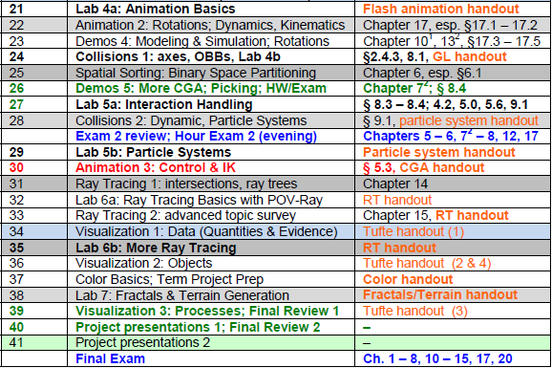

Where We Are

Slide 4



References:
Maya Character Rigging
Aaron Ross
Founder, Digital Arts Guild
http://dr-yo.com
http://bit.ly/fzxN74
http://www.youtube.com/user/DigitalArtsGuild
Jim Lammers
President
Trinity Animation
http://www.trinity3d.com
http://bit.ly/i6yfyV
Larry Neuberger
Associate Professor, Alfred State SUNY College of Technology
Online Instructor, Art Institute of Pittsburgh
http://poorhousefx.com

Slide 5





Acknowledgements:
CGA Rotations, Dynamics & Kinematics
Rick Parent
Professor
Department of Computer Science and Engineering
Ohio State University
http://www.cse.ohio-state.edu/~parent/
David C. Brogan
Visiting Assistant Professor, Computer Science Department, University of Virginia
http://www.cs.virginia.edu/~dbrogan/
Susquehanna International Group (SIG)
http://www.sig.com
Steve Rotenberg
Visiting Lecturer
Graphics Lab
University of California – San Diego
CEO/Chief Scientist, PixelActive
http://graphics.ucsd.edu

Slide 6
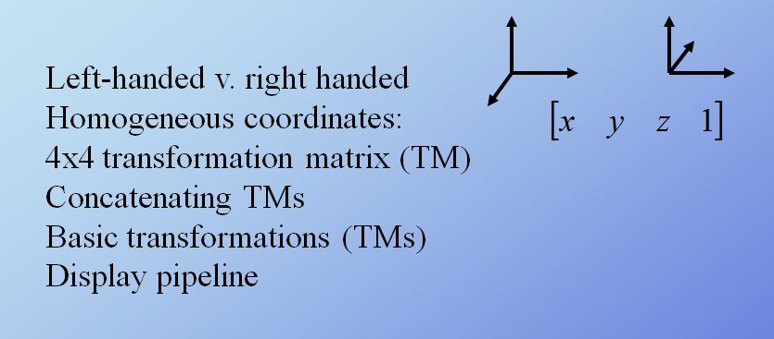
Spaces & Transformations
Adapted from slides © 2007 – 2011 R. Parent, Ohio State University
CSE 682 (Computer Animation), http://bit.ly/feUESy
CSE 683/684A (Computer Animation Algorithms & Techniques), http://bit.ly/f8Myky

Slide 7
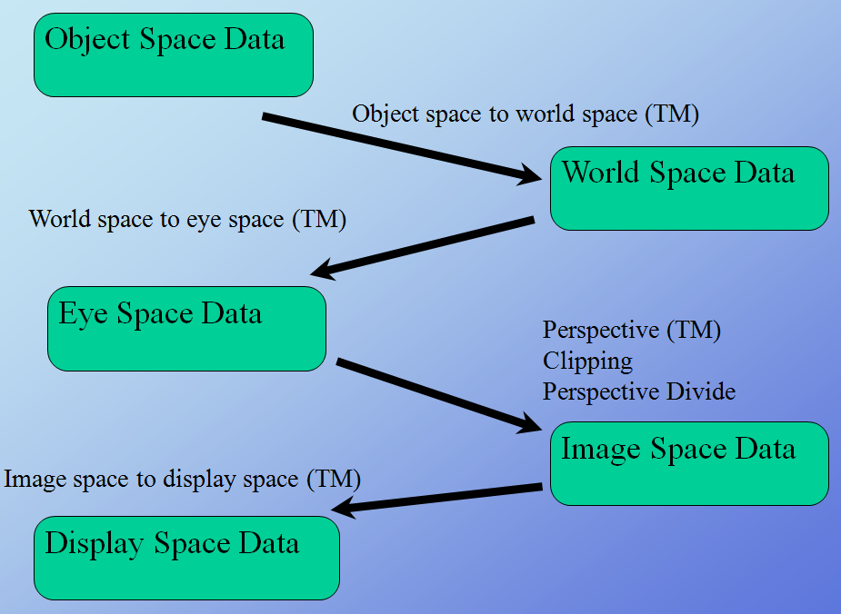
Display Pipeline
Adapted from slides © 2007 – 2011 R. Parent, Ohio State University
CSE 682 (Computer Animation), http://bit.ly/feUESy
CSE 683/684A (Computer Animation Algorithms & Techniques), http://bit.ly/f8Myky

Slide 8
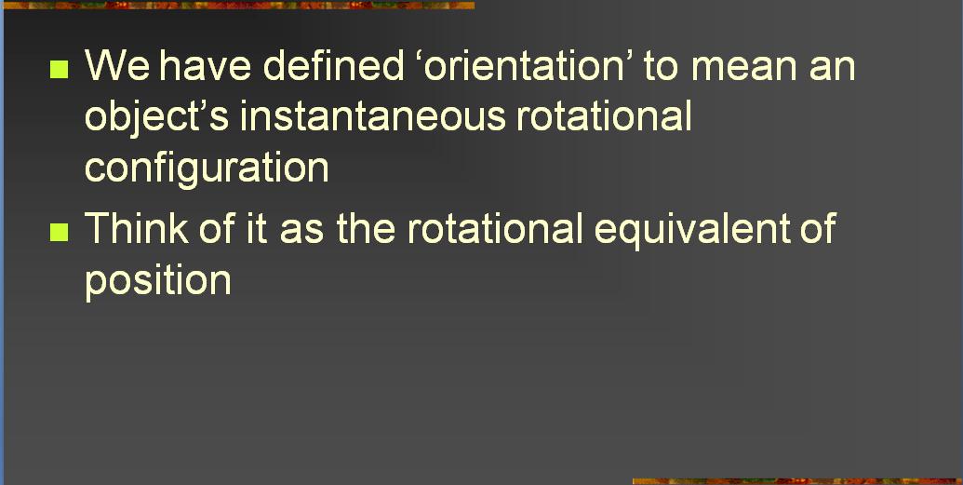
Rotations [1]:
Orientation
Adapted from slides © 2004 – 2005 S. Rotenberg, UCSD
CSE169: Computer Animation, Winter 2005, http://bit.ly/f0ViAN

Slide 9
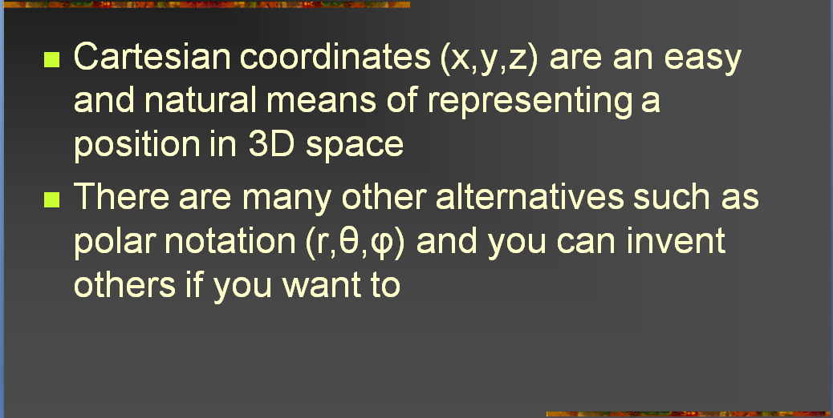
Rotations [2]:
Representing Position
Adapted from slides © 2004 – 2005 S. Rotenberg, UCSD
CSE169: Computer Animation, Winter 2005, http://bit.ly/f0ViAN

Slide 10
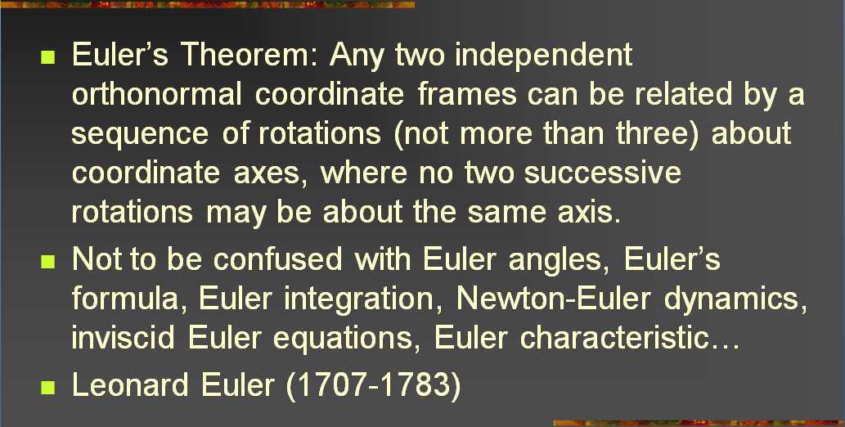
Rotations [3]:
Euler’s Theorem
Adapted from slides © 2004 – 2005 S. Rotenberg, UCSD
CSE169: Computer Animation, Winter 2005, http://bit.ly/f0ViAN

Slide 11
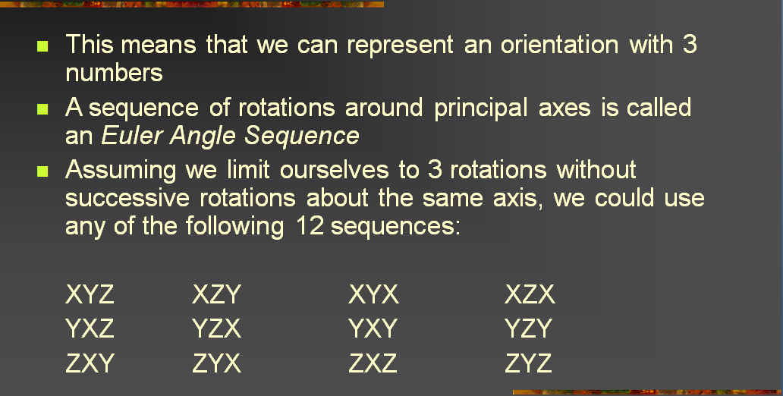
Rotations [4]:
Euler Angles
Adapted from slides © 2004 – 2005 S. Rotenberg, UCSD
CSE169: Computer Animation, Winter 2005, http://bit.ly/f0ViAN

Slide 12
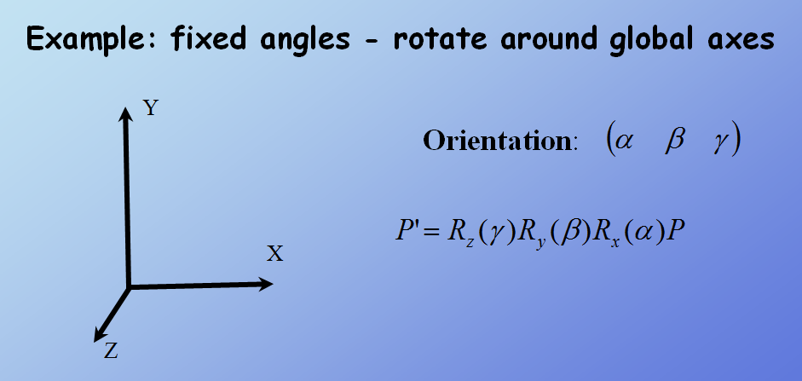
Representing Orientations
Adapted from slides © 2007 – 2011 R. Parent, Ohio State University
CSE 682 (Computer Animation), http://bit.ly/feUESy
CSE 683/684A (Computer Animation Algorithms & Techniques), http://bit.ly/f8Myky

Slide 13
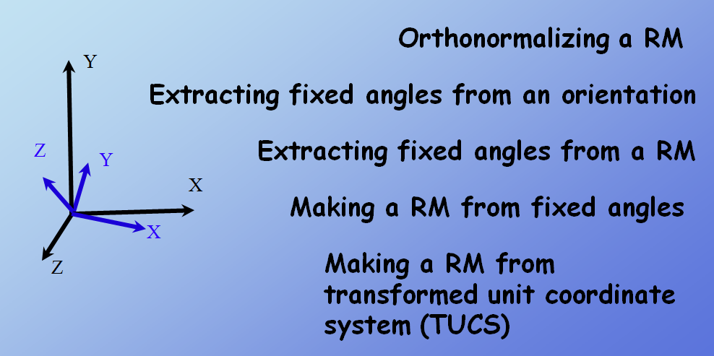
Working with Fixed Angles &
Rotation Matrices (RMs)
Adapted from slides © 2007 – 2011 R. Parent, Ohio State University
CSE 682 (Computer Animation), http://bit.ly/feUESy
CSE 683/684A (Computer Animation Algorithms & Techniques), http://bit.ly/f8Myky

Slide 14
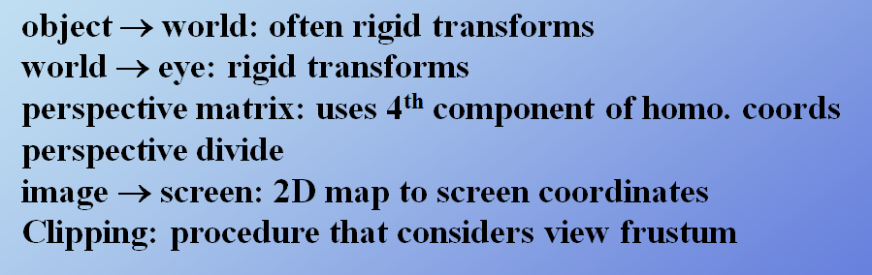
Transformations in Pipeline
Adapted from slides © 2007 – 2011 R. Parent, Ohio State University
CSE 682 (Computer Animation), http://bit.ly/feUESy
CSE 683/684A (Computer Animation Algorithms & Techniques), http://bit.ly/f8Myky

Slide 15
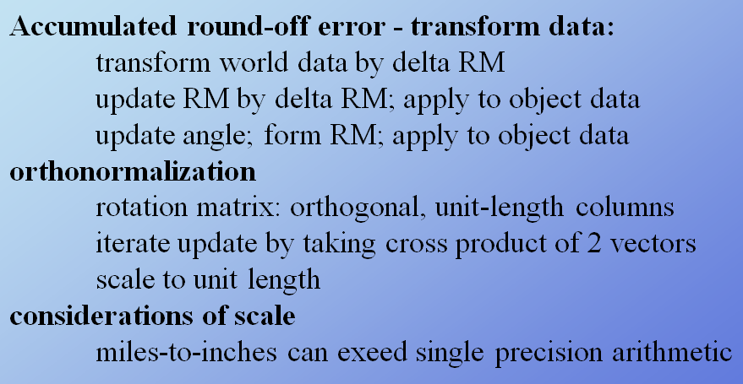
Error Considerations
Adapted from slides © 2007 – 2011 R. Parent, Ohio State University
CSE 682 (Computer Animation), http://bit.ly/feUESy
CSE 683/684A (Computer Animation Algorithms & Techniques), http://bit.ly/f8Myky

Slide 16
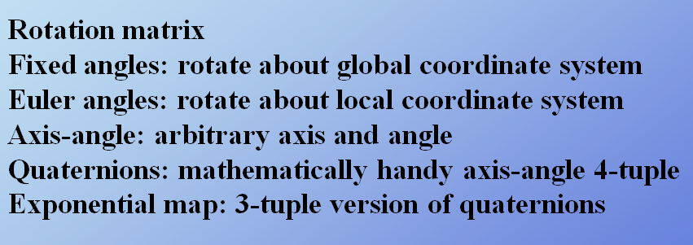
Six Ways to Represent Orientations
Adapted from slides © 2007 – 2011 R. Parent, Ohio State University
CSE 682 (Computer Animation), http://bit.ly/feUESy
CSE 683/684A (Computer Animation Algorithms & Techniques), http://bit.ly/f8Myky

Slide 17
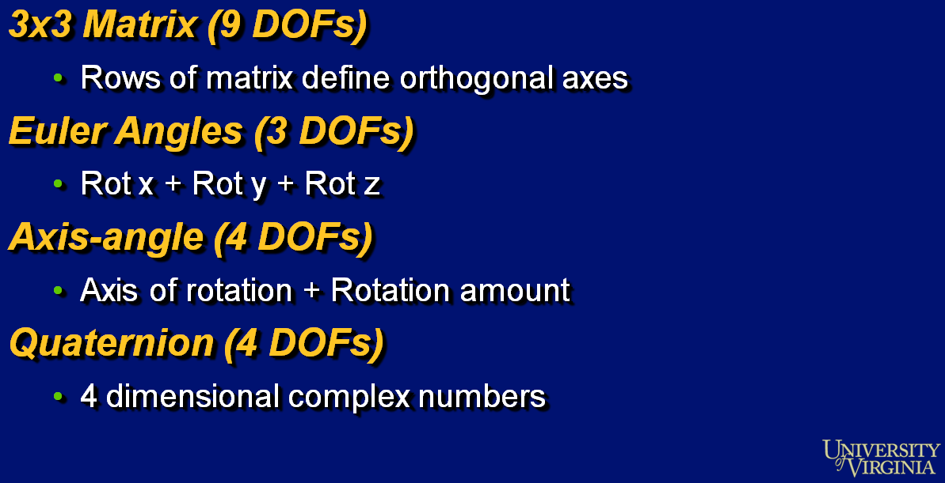
Representing 3 Rotational
Degrees of Freedom (DOFs)
Adapted from slides © 2000 – 2004 D. Brogan, University of Virginia
CS 445/645, Introduction to Computer Graphics, http://bit.ly/h9AHRg

Slide 18
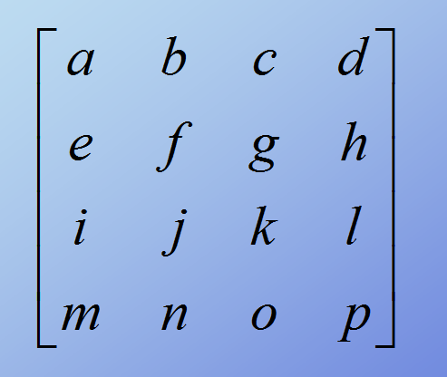
Method 1 – Transformation Matrix [1]
4 × 4 Homogeneous TMs
Adapted from slides © 2007 – 2011 R. Parent, Ohio State University
CSE 682 (Computer Animation), http://bit.ly/feUESy
CSE 683/684A (Computer Animation Algorithms & Techniques), http://bit.ly/f8Myky

Slide 19
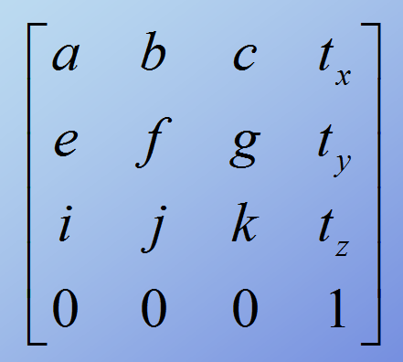
Method 1 – Transformation Matrix [2]:
Translation
Adapted from slides © 2007 – 2011 R. Parent, Ohio State University
CSE 682 (Computer Animation), http://bit.ly/feUESy
CSE 683/684A (Computer Animation Algorithms & Techniques), http://bit.ly/f8Myky

Slide 20
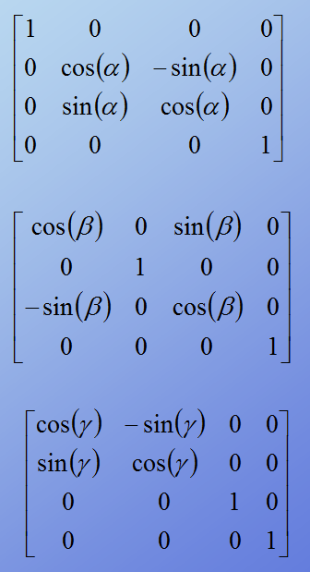
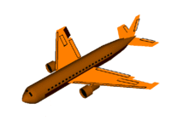
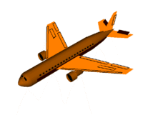
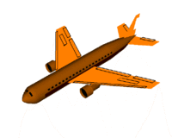
Method 1 – Transformation Matrix [3]:
Rotation about x, y, z
Rotation about x axis
(Roll)
x
© 2006 Wikipedia,
Flight Dynamics
http://bit.ly/gVaQCX
Rotation about y axis
(Pitch)
y
z
Rotation about z axis
(Yaw)
Adapted from slides © 2007 – 2011 R. Parent, Ohio State University
CSE 682 (Computer Animation), http://bit.ly/feUESy
CSE 683/684A (Computer Animation Algorithms & Techniques), http://bit.ly/f8Myky

Slide 21
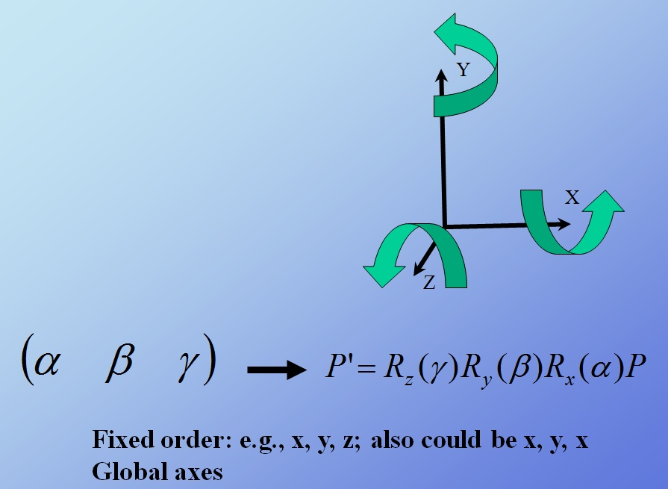
Method 2 – Fixed Angles [1]
Adapted from slides © 2007 – 2011 R. Parent, Ohio State University
CSE 682 (Computer Animation), http://bit.ly/feUESy
CSE 683/684A (Computer Animation Algorithms & Techniques), http://bit.ly/f8Myky

Slide 22
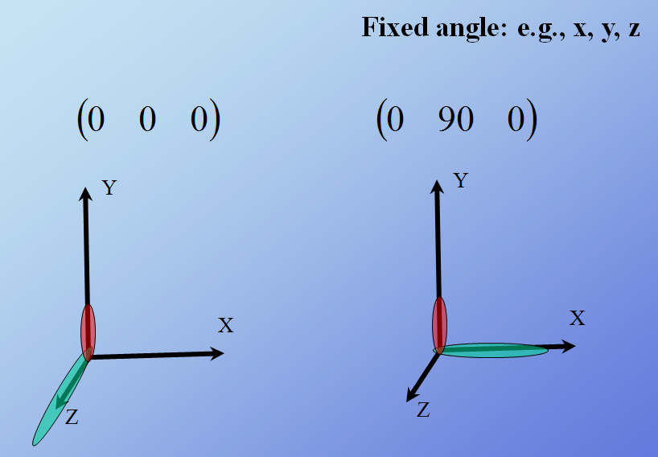
Method 2 – Fixed Angles [2]:
Gimbal Lock
Adapted from slides © 2007 – 2011 R. Parent, Ohio State University
CSE 682 (Computer Animation), http://bit.ly/feUESy
CSE 683/684A (Computer Animation Algorithms & Techniques), http://bit.ly/f8Myky

Slide 23
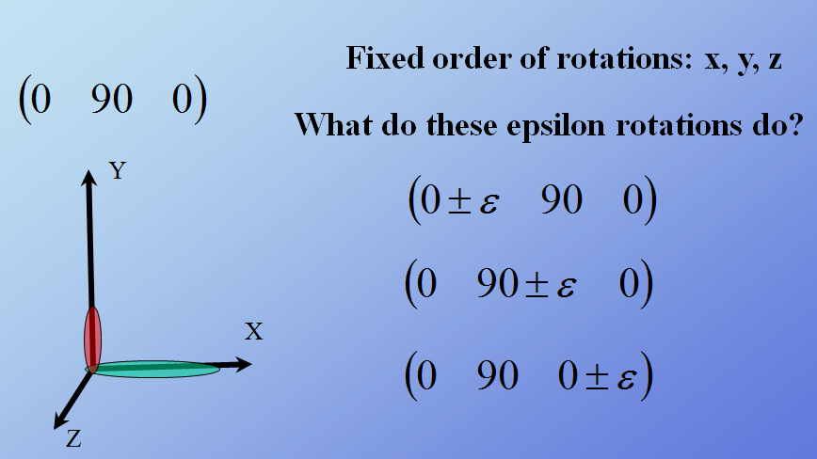
Method 2 – Fixed Angles [3]:
Order of Rotations
Adapted from slides © 2007 – 2011 R. Parent, Ohio State University
CSE 682 (Computer Animation), http://bit.ly/feUESy
CSE 683/684A (Computer Animation Algorithms & Techniques), http://bit.ly/f8Myky

Slide 24
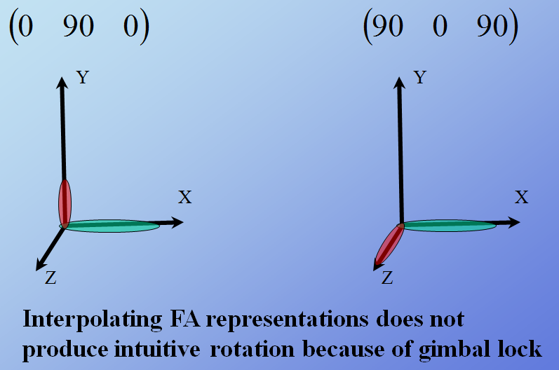
Method 2 – Fixed Angles [4]:
Interpolating Fixed Angles
Adapted from slides © 2007 – 2011 R. Parent, Ohio State University
CSE 682 (Computer Animation), http://bit.ly/feUESy
CSE 683/684A (Computer Animation Algorithms & Techniques), http://bit.ly/f8Myky

Slide 25
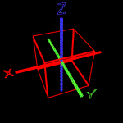
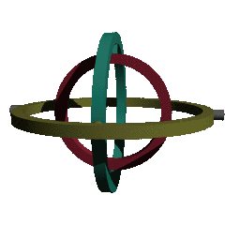
Method 2 – Fixed Angles [5]:
Gimbal Lock Illustrated
Gimbal Lock: Term Derived from Mechanical Problem in Gimbal
Gimbal: Mechanism That Supports Compass, Gyroscope
Anticz.com © 2001 M. Brown
http://bit.ly/6NIXVr
Gimbal Lock © 2006 Wikipedia
(Rendered using POV-Ray)
http://bit.ly/hR88V2
Adapted from slides © 2000 – 2005 D. Brogan, University of Virginia
CS 551, Computer Animation, http://bit.ly/ggbjuv

Slide 26
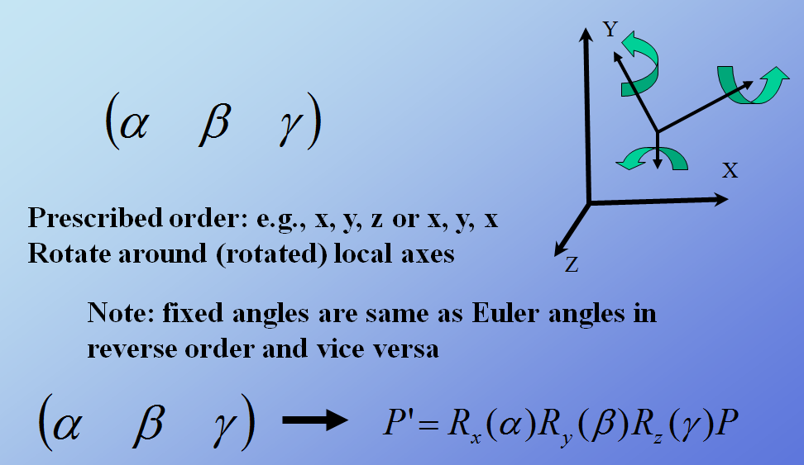
Method 3 – Euler Angles [1]
Adapted from slides © 2007 – 2011 R. Parent, Ohio State University
CSE 682 (Computer Animation), http://bit.ly/feUESy
CSE 683/684A (Computer Animation Algorithms & Techniques), http://bit.ly/f8Myky

Slide 27
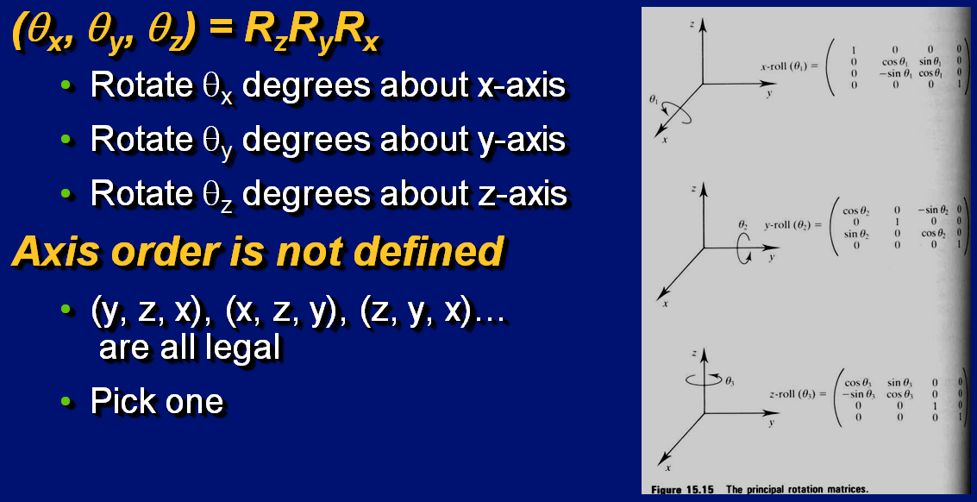
Method 3 – Euler Angles [2]
Adapted from slides © 2000 – 2004 D. Brogan, University of Virginia
CS 445/645, Introduction to Computer Graphics, http://bit.ly/h9AHRg

Slide 28
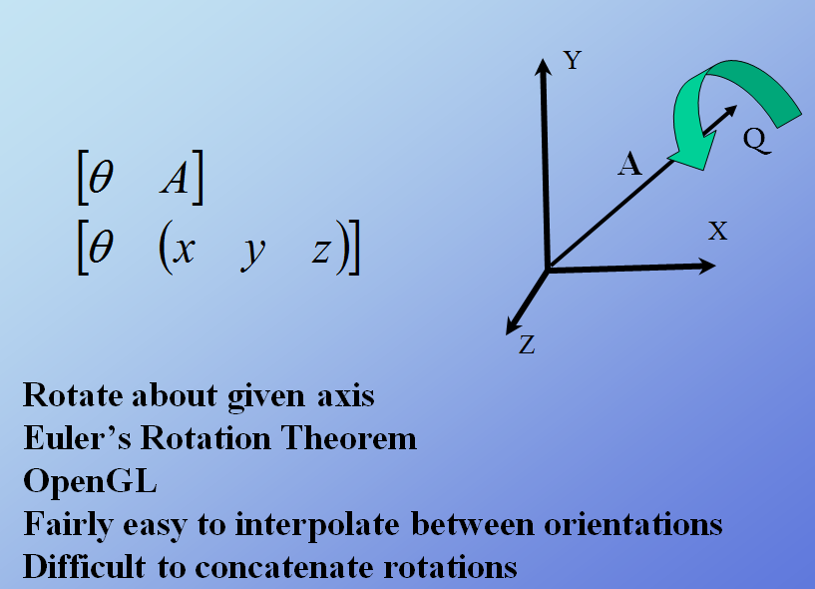
Method 4 – Axis-Angle [1]
Adapted from slides © 2007 – 2011 R. Parent, Ohio State University
CSE 682 (Computer Animation), http://bit.ly/feUESy
CSE 683/684A (Computer Animation Algorithms & Techniques), http://bit.ly/f8Myky

Slide 29
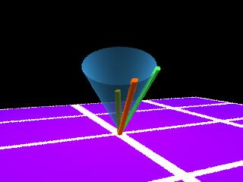
Method 4 – Axis-Angle [2]
Given
r – vector in space to rotate
n – unit-length axis in space about which to rotate
θ –amount about n to rotate
Solve
r’ – rotated vector
r’
r
n
Adapted from slides © 2000 – 2004 D. Brogan, University of Virginia
CS 445/645, Introduction to Computer Graphics, http://bit.ly/h9AHRg

Slide 30
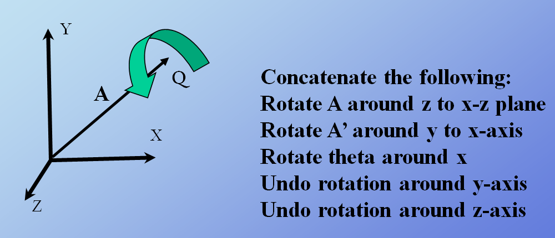
Method 4 – Axis-Angle [3]:
Axis-Angle to Series of Rotations
Adapted from slides © 2007 – 2011 R. Parent, Ohio State University
CSE 682 (Computer Animation), http://bit.ly/feUESy
CSE 683/684A (Computer Animation Algorithms & Techniques), http://bit.ly/f8Myky

Slide 31
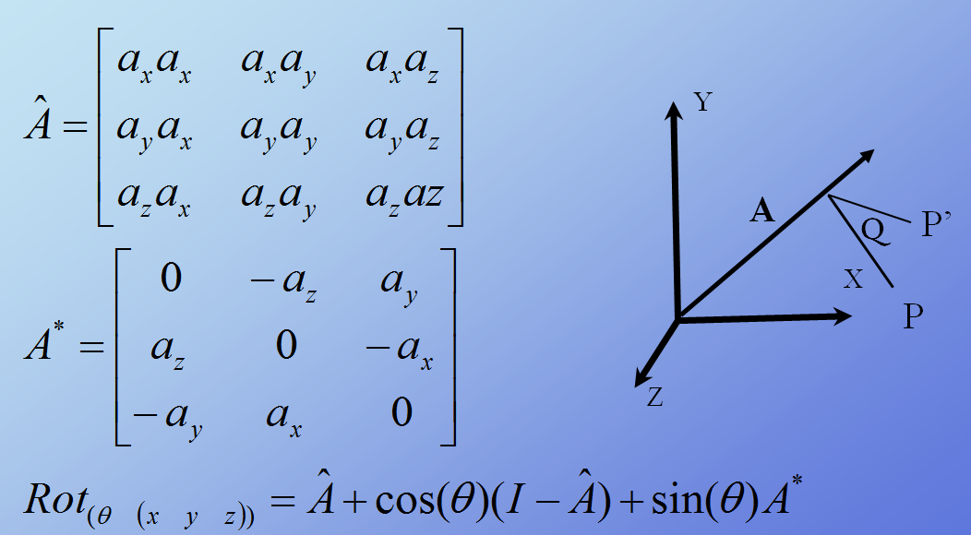
Method 4 – Axis-Angle [4]:
Axis-Angle to Rotation Matrix
Adapted from slides © 2007 – 2011 R. Parent, Ohio State University
CSE 682 (Computer Animation), http://bit.ly/feUESy
CSE 683/684A (Computer Animation Algorithms & Techniques), http://bit.ly/f8Myky

Slide 32
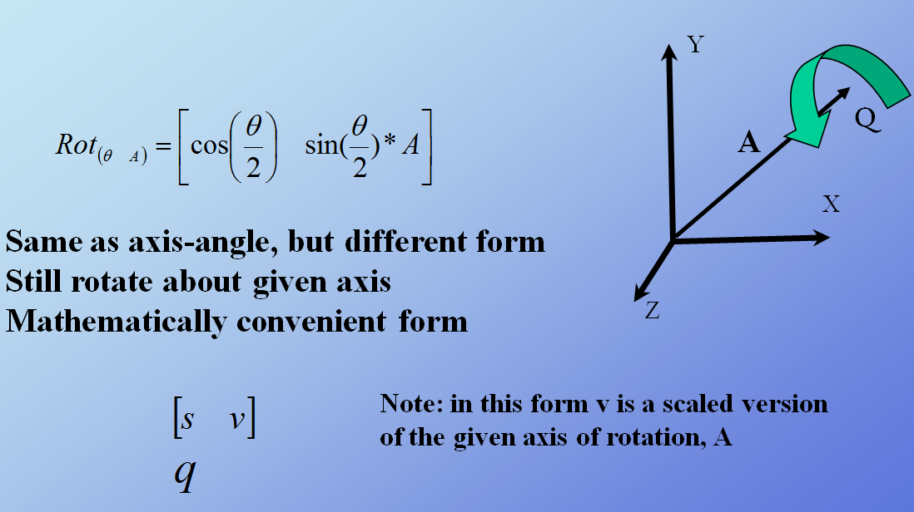
Method 5 – Quaternions [1]
Adapted from slides © 2007 – 2011 R. Parent, Ohio State University
CSE 682 (Computer Animation), http://bit.ly/feUESy
CSE 683/684A (Computer Animation Algorithms & Techniques), http://bit.ly/f8Myky

Slide 33
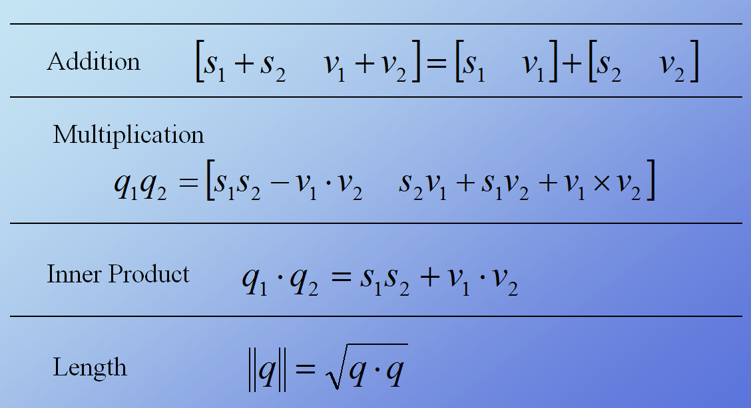
Method 5 – Quaternions [2]:
Arithmetic
Adapted from slides © 2007 – 2011 R. Parent, Ohio State University
CSE 682 (Computer Animation), http://bit.ly/feUESy
CSE 683/684A (Computer Animation Algorithms & Techniques), http://bit.ly/f8Myky

Slide 34
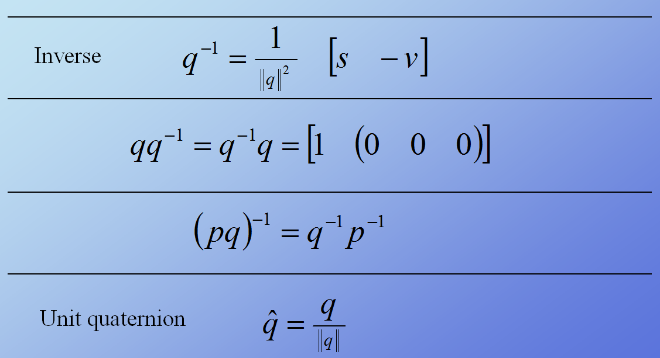
Method 5 – Quaternions [3]:
Inverse & Normalization
Adapted from slides © 2007 – 2011 R. Parent, Ohio State University
CSE 682 (Computer Animation), http://bit.ly/feUESy
CSE 683/684A (Computer Animation Algorithms & Techniques), http://bit.ly/f8Myky

Slide 35
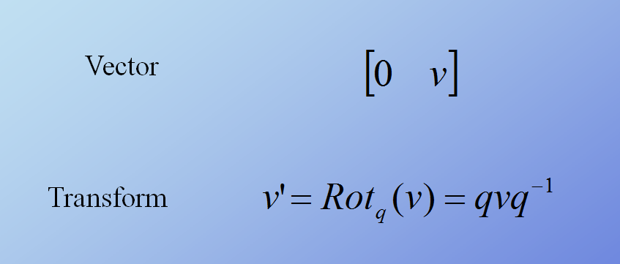
Method 5 – Quaternions [4]:
Representation
Adapted from slides © 2007 – 2011 R. Parent, Ohio State University
CSE 682 (Computer Animation), http://bit.ly/feUESy
CSE 683/684A (Computer Animation Algorithms & Techniques), http://bit.ly/f8Myky

Slide 36
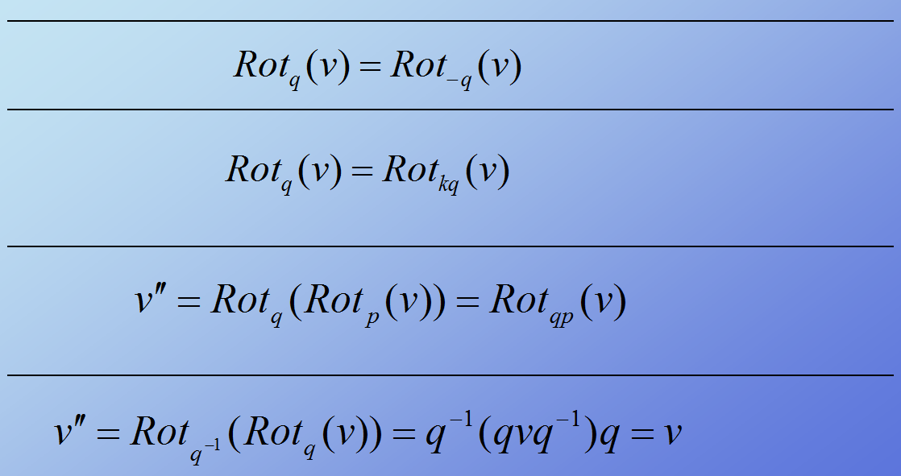
Method 5 – Quaternions [5]:
Geometric Operations
Adapted from slides © 2007 – 2011 R. Parent, Ohio State University
CSE 682 (Computer Animation), http://bit.ly/feUESy
CSE 683/684A (Computer Animation Algorithms & Techniques), http://bit.ly/f8Myky

Slide 37
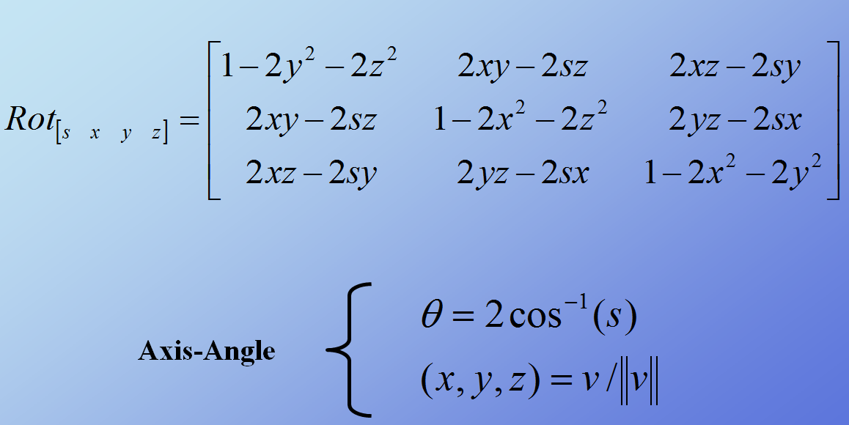
Method 5 – Quaternions [6]:
Unit Quaternion Conversions
Adapted from slides © 2007 – 2011 R. Parent, Ohio State University
CSE 682 (Computer Animation), http://bit.ly/feUESy
CSE 683/684A (Computer Animation Algorithms & Techniques), http://bit.ly/f8Myky

Slide 38
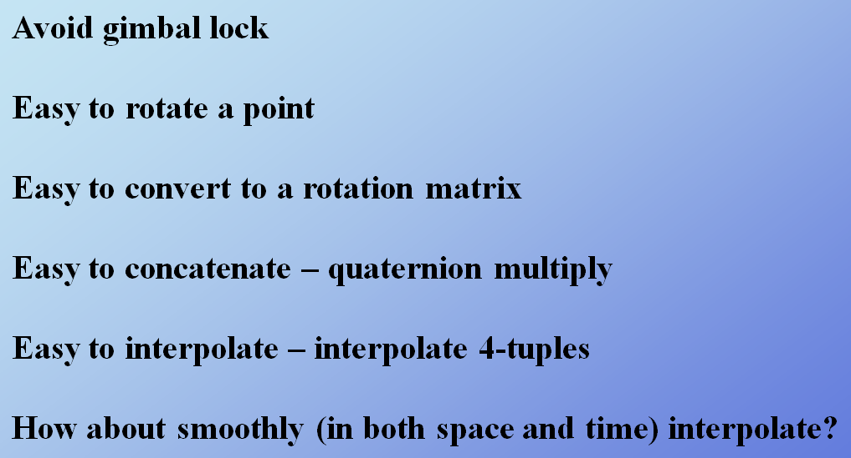
Method 5 – Quaternions [7]:
Properties
Adapted from slides © 2007 – 2011 R. Parent, Ohio State University
CSE 682 (Computer Animation), http://bit.ly/feUESy
CSE 683/684A (Computer Animation Algorithms & Techniques), http://bit.ly/f8Myky

Slide 39
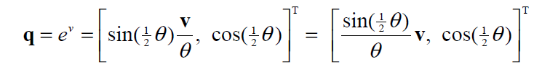
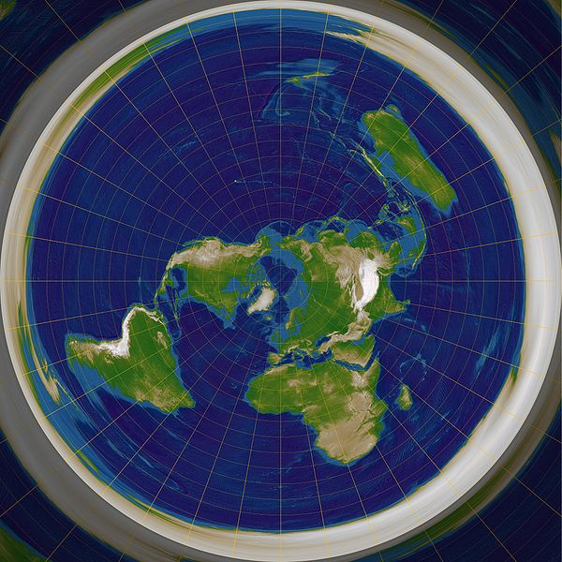
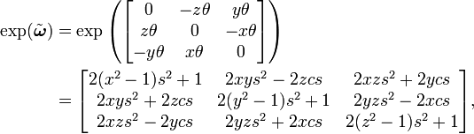
Method 6 – Exponential Maps
Original paper, Journal of Graphics Tools: Grassia (1998), http://bit.ly/gwHQnt
Wikipedia: Exponential Map,
http://bit.ly/fgSqLT
Wikipedia: Rotation Matrix, http://bit.ly/edluTR

Slide 40
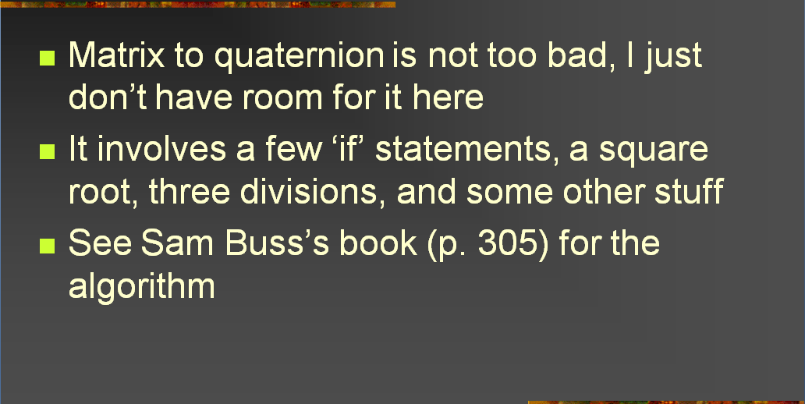
Quaternions [1]:
Matrix to Quaternion
Adapted from slides © 2004 – 2005 S. Rotenberg, UCSD
CSE169: Computer Animation, Winter 2005, http://bit.ly/f0ViAN

Slide 41
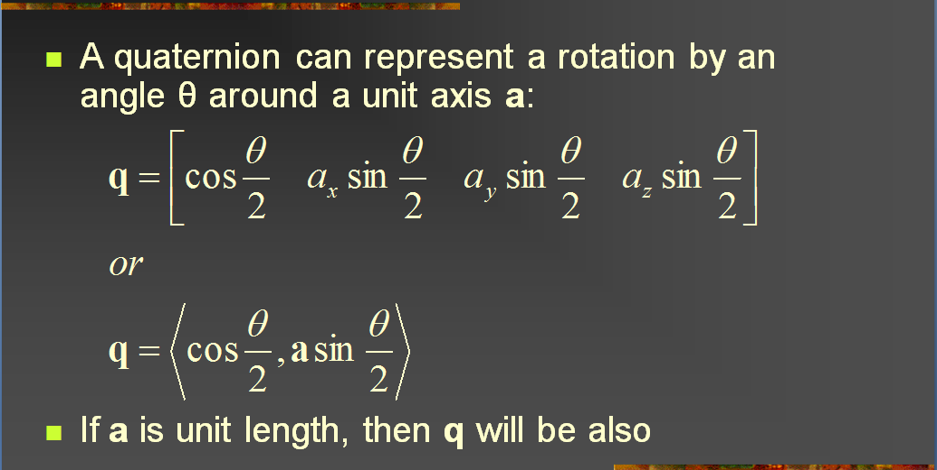
Quaternions [2]:
Axis-Angle to Quaternion
Adapted from slides © 2004 – 2005 S. Rotenberg, UCSD
CSE169: Computer Animation, Winter 2005, http://bit.ly/f0ViAN

Slide 42
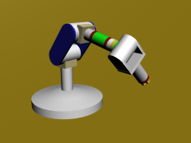
Dynamics & Kinematics
Dynamics: Study of Motion & Changes in Motion
  Forward: model forces over time to find state, e.g.,
    Given: initial position p₀ , velocity v₀, gravitational constants
    Calculate: position p_{t} at time t
  Inverse: given state and constraints, calculate forces, e.g.,
    Given: desired position p_{t} at time t, gravitational constants
    Calculate: position p₀ , velocity v₀ needed
  Wikipedia: http://bit.ly/hH43dX (see also: “Analytical dynamics”)
  For non-particle objects: rigid-body dynamics (http://bit.ly/dLvejg)
Kinematics: Study of Motion without Regard to Causative Forces
  Modeling systems – e.g., articulated figure
  Forward: from angles to position (http://bit.ly/eh2d1c)
  Inverse: finding angles given desired position (http://bit.ly/hsyTb0)
  Wikipedia: http://bit.ly/hr8r2u
Forward Kinematics
© 2009 Wikipedia

Slide 43
Summary
Reading for Next Class: §Chapter 10, 13, §17.3 – 17.5, Eberly 2e
Last Time: Maya & CGA, Ross Tutorials (http://bit.ly/dFpTwq)
  Maya interface: navigation, menus, tools, primitives
  GUI, viewports, transforms, nodes, attributes, deformers, scenes
  Object modeling and rigging; driven keys, blend shape
Today: Rotations in Animation
  Flight dynamics: roll, pitch, yaw
  Matrix, angles (fixed, Euler, axis), quaternions, exponential maps
  Dynamics: forward (trajectories, simulation), inverse (e.g., ballistics)
  Kinematics: forward, inverse
Previous Videos (#3): Morphing & Other Special Effects (SFX)
Next Set of Videos (#4): Modeling & Simulation
Next Class: Animation for Simulation, Visualization
Lab 4: Unreal Wiki Tutorial, Modeling/Rigging (http://bit.ly/dLRkXN)

Slide 44
Terminology
Maya Software for 3-D Modeling & Animation
  Shelves and hotkeys, viewports
  Channel box, deformers – controlling complex vertex meshes
Rigging Character Models: Defining Components of Articulated Figure
  Joints – axis of rotation, angular degree(s) of freedom (DOFs)
  Bones – attached to joints, rotate about joint axis
Dynamics (Motion under Forces) vs. Kinematics (Articulated Motion)
Roll (Rotation about x), Pitch (Rotation about y), Yaw (Rotation about z)
Today: Six Degrees of Rotation
  Matrix – what we studied before: 4 × 4 Homogeneous TMs
  Fixed angles – global basis
  Euler angles – rotate around local axes (themselves rotated)
  Axis-angle – rotate around arbitrary axis
  Quaternions – different representation of arbitrary rotation
  Exponential maps – 3-D representation related to quaternions

