Slide 1
Lecture 23 of 41
More Rotations; Visualization, Simulation
Videos 4: Virtual & Augmented Reality, Viz-Sim
William H. Hsu
Department of Computing and Information Sciences, KSU
KSOL course pages: http://bit.ly/hGvXlH / http://bit.ly/eVizrE
Public mirror web site: http://www.kddresearch.org/Courses/CIS636
Instructor home page: http://www.cis.ksu.edu/~bhsu
Readings:
Today: Chapter 10, 13, §17.3 – 17.5, Eberly 2e – see http://bit.ly/ieUq45
Next class: §2.4.3, 8.1, Eberly 2e, GL handout
Wikipedia, Visualization: http://bit.ly/gVxRFp
Wikipedia on quaternions: http://bit.ly/f1GvTS, http://bit.ly/eBnCY4
Reference: Ogre Wiki quaternion primer – http://bit.ly/hv6zv0

Slide 2
Lecture Outline
Reading for Last Class: §17.1 – 17.2, Eberly 2e
Reading for Today: Chapter 10, 13, §17.3 – 17.5, Eberly 2e
Reading for Next Class: §2.4.3, 8.1, Eberly 2e, GL handout
Last Time: Rotations in Animation
Flight dynamics: roll, pitch, yaw
Matrix, angles (fixed, Euler, axis), quaternions, exponential maps
Quaternions Concluded
How quaternions work – properties (review)
Equivalent rotation matrix (RM)
Quaternion arithmetic
Composition of rotations by quaternion multiplication
Advantage: easy incremental rotation; camera, character animation
Today: Intro to Visualization, Modeling & Simulation
Virtual reality (VR), virtual environments (VE)
Augmented reality (AR)

Slide 3
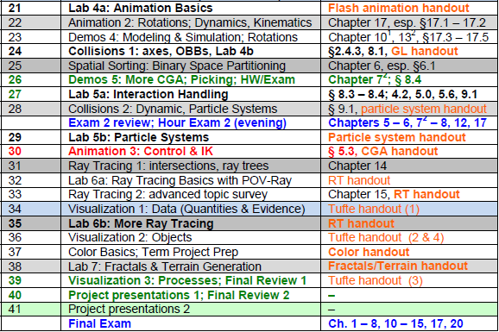
Where We Are

Slide 4
Acknowledgements:
CGA Rotations, Dynamics & Kinematics
Rick Parent
Professor
Department of Computer Science and Engineering
Ohio State University
http://www.cse.ohio-state.edu/~parent/
David C. Brogan
Visiting Assistant Professor, Computer Science Department, University of Virginia
http://www.cs.virginia.edu/~dbrogan/
Susquehanna International Group (SIG)
http://www.sig.com
Steve Rotenberg
Visiting Lecturer
Graphics Lab
University of California – San Diego
CEO/Chief Scientist, PixelActive
http://graphics.ucsd.edu

Slide 5
Review [1]:
Representing 3 Rotational DOFs
Adapted from slides © 2000 – 2004 D. Brogan, University of Virginia
CS 445/645, Introduction to Computer Graphics, http://bit.ly/h9AHRg

Slide 6
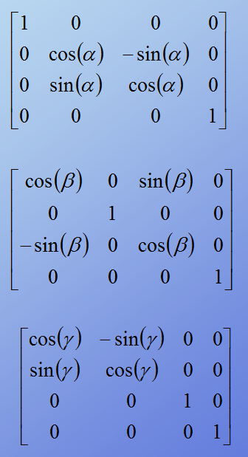
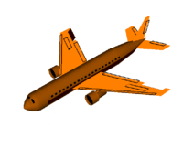
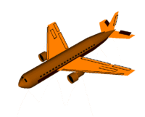
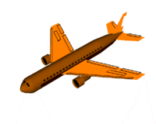
Review [2]: Method 1
Rotation Matrices – Roll, Pitch, & Yaw
Rotation about x axis
(Roll)
x
© 2006 Wikipedia,
Flight Dynamics
http://bit.ly/gVaQCX
Rotation about y axis
(Pitch)
y
z
Rotation about z axis
(Yaw)
Adapted from slides © 2007 – 2011 R. Parent, Ohio State University
CSE 682 (Computer Animation), http://bit.ly/feUESy
CSE 683/684A (Computer Animation Algorithms & Techniques), http://bit.ly/f8Myky

Slide 7
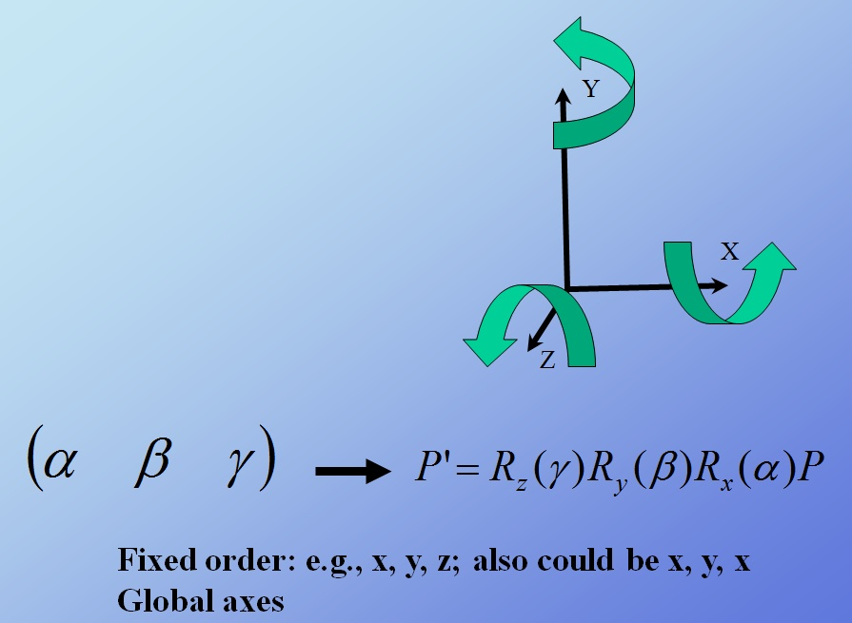
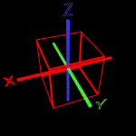
Review [3]: Method 2
Fixed Angles & Gimbal Lock
Anticz.com © 2001 M. Brown
http://bit.ly/6NIXVr
Adapted from slides © 2007 – 2011 R. Parent, Ohio State University
CSE 682 (Computer Animation), http://bit.ly/feUESy
CSE 683/684A (Computer Animation Algorithms & Techniques), http://bit.ly/f8Myky

Slide 8
Gimbal Lock Illustrated [1]
Gimbal Lock: Loss of DOF when 2 of 3 Gimbals Driven until Parallel
Animated Examples
e.g., x & z (left), y & z (right)
Caution: Seefeld (right) refers to these as “x” (red) & z (blue)
y (Pitch) = “x”, x (Roll) = “y”, z (Yaw) = “z” (“zed”)
Anticz.com © 2001 M. Brown
http://bit.ly/6NIXVr
© 2007 S. Seefeld
http://bit.ly/e1nuo9

Slide 9
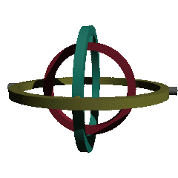
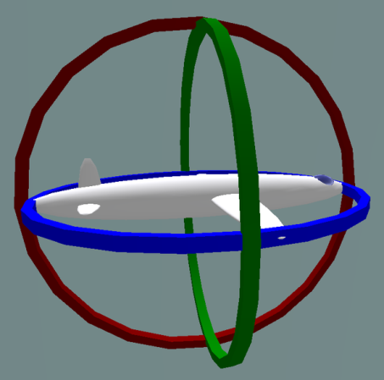
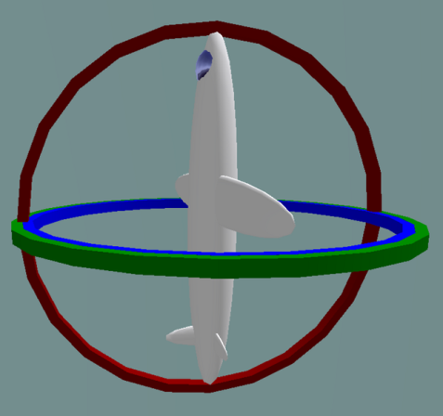
Gimbal Lock Illustrated [2]
Gimbals: 2 of 3 Driven into Parallel Configuration
Happens With Euler Angles Too: http://bit.ly/g32DQ5 (Wikipedia)
Solution Approaches
Extra gimbal
Quaternions:
Gimbal Lock figure © 2006 Wikipedia
(Rendered using POV-Ray)
http://bit.ly/hR88V2
Left: not locked
Right: x & z rotations locked (roll & pitch, no yaw)
Gimbal Lock figures © 2009 Wikipedia
http://bit.ly/he0LN9

Slide 10
Review [4]: Method 3
Euler Angles & Order Independence
Adapted from slides © 2000 – 2004 D. Brogan, University of Virginia
CS 445/645, Introduction to Computer Graphics, http://bit.ly/h9AHRg

Slide 11
Review [5]:
Euler Angle Sequences
Adapted from slides © 2004 – 2005 S. Rotenberg, UCSD
CSE169: Computer Animation, Winter 2005, http://bit.ly/f0ViAN

Slide 12
Using Euler Angles [1]:
Representing Orientations
Adapted from slides © 2004 – 2005 S. Rotenberg, UCSD
CSE169: Computer Animation, Winter 2005, http://bit.ly/f0ViAN

Slide 13
Using Euler Angles [2]:
Conversion: Euler Angle to RM
Adapted from slides © 2004 – 2005 S. Rotenberg, UCSD
CSE169: Computer Animation, Winter 2005, http://bit.ly/f0ViAN

Slide 14
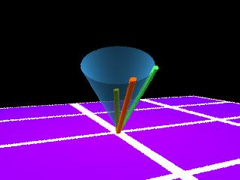
Review [6]: Method 4
Axis-Angle: Specification
Given
r – vector in space to rotate
n – unit-length axis in space about which to rotate
θ –amount about n to rotate
Solve
r’ – rotated vector
r’
r
n
Adapted from slides © 2000 – 2004 D. Brogan, University of Virginia
CS 445/645, Introduction to Computer Graphics, http://bit.ly/h9AHRg

Slide 15
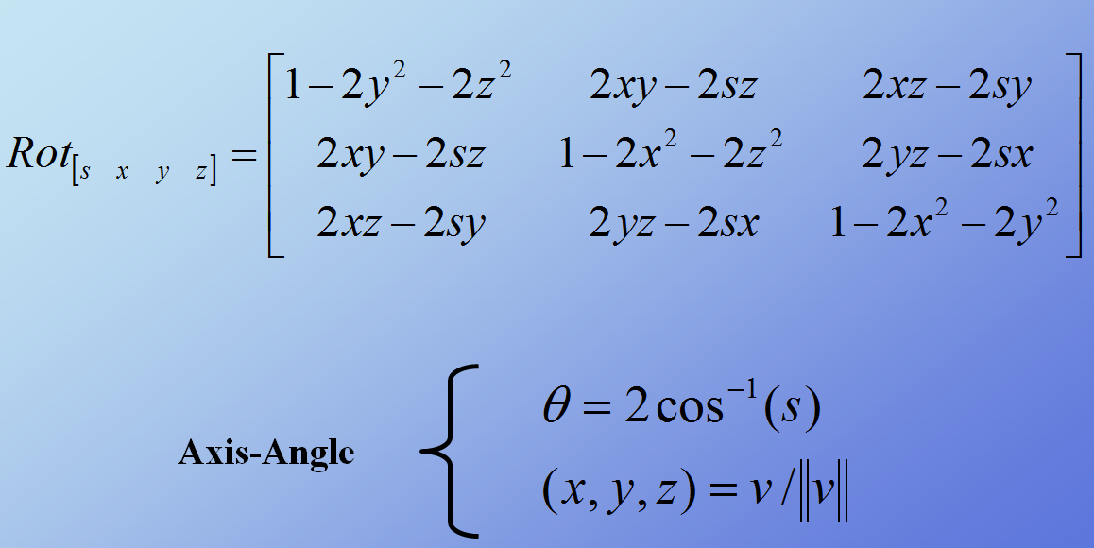
Review [7]: Method 5
Quaternions to RM, Axis-Angle
Adapted from slides © 2007 – 2011 R. Parent, Ohio State University
CSE 682 (Computer Animation), http://bit.ly/feUESy
CSE 683/684A (Computer Animation Algorithms & Techniques), http://bit.ly/f8Myky

Slide 16
Quaternions [1]:
Basic Idea
Adapted from slides © 2000 – 2004 D. Brogan, University of Virginia
CS 445/645, Introduction to Computer Graphics, http://bit.ly/h9AHRg

Slide 17
Quaternions [2]:
Definition
Adapted from slides © 2000 – 2004 D. Brogan, University of Virginia
CS 445/645, Introduction to Computer Graphics, http://bit.ly/h9AHRg

Slide 18
Quaternions [3]:
Equivalent RM & Composition
Adapted from slides © 2000 – 2004 D. Brogan, University of Virginia
CS 445/645, Introduction to Computer Graphics, http://bit.ly/h9AHRg

Slide 19
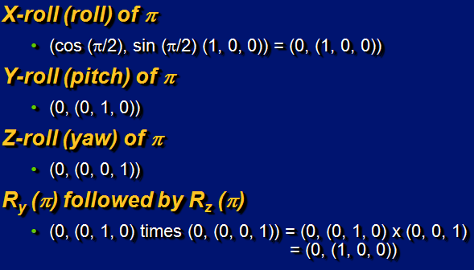
Quaternions [4]:
Examples
Adapted from slides © 2000 – 2004 D. Brogan, University of Virginia
CS 445/645, Introduction to Computer Graphics, http://bit.ly/h9AHRg

Slide 20
Quaternions [5]:
Interpolation
Hint: see http://youtu.be/-jBKKV2V8eU
Adapted from slides © 2000 – 2004 D. Brogan, University of Virginia
CS 445/645, Introduction to Computer Graphics, http://bit.ly/h9AHRg

Slide 21
Quaternions [6]:
Spherical Linear Interpolation (SLERP)
Adapted from slides © 2000 – 2004 D. Brogan, University of Virginia
CS 445/645, Introduction to Computer Graphics, http://bit.ly/h9AHRg

Slide 22
Quaternions [7]:
Comparison with Euler Interpolation
Adapted from slides © 2000 – 2004 D. Brogan, University of Virginia
CS 445/645, Introduction to Computer Graphics, http://bit.ly/h9AHRg

Slide 23
Quaternions [8]:
Code
Gamasutra (1998): http://bit.ly/dQy8Cp
Nate Robins’s Implementation: http://bit.ly/fcGufq
File gltb.c
gltbMatrix
gltbMotion
Adapted from slides © 2000 – 2004 D. Brogan, University of Virginia
CS 445/645, Introduction to Computer Graphics, http://bit.ly/h9AHRg

Slide 24
Spherical Interpolation [1]:
Spheres
Adapted from slides © 2004 – 2005 S. Rotenberg, UCSD
CSE169: Computer Animation, Winter 2005, http://bit.ly/f0ViAN

Slide 25
Spherical Interpolation [2]:
Hyperspheres
Adapted from slides © 2004 – 2005 S. Rotenberg, UCSD
CSE169: Computer Animation, Winter 2005, http://bit.ly/f0ViAN

Slide 26
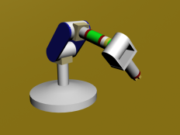
Review [8]:
Dynamics & Kinematics
Dynamics: Study of Motion & Changes in Motion
Forward: model forces over time to find state, e.g.,
Given: initial position p₀ , velocity v₀, gravitational constants
Calculate: position p_{t} at time t
Inverse: given state and constraints, calculate forces, e.g.,
Given: desired position p_{t} at time t, gravitational constants
Calculate: position p₀ , velocity v₀ needed
Wikipedia: http://bit.ly/hH43dX (see also: “Analytical dynamics”)
For non-particle objects: rigid-body dynamics (http://bit.ly/dLvejg)
Kinematics: Study of Motion without Regard to Causative Forces
Modeling systems – e.g., articulated figure
Forward: from angles to position (http://bit.ly/eh2d1c)
Inverse: finding angles given desired position (http://bit.ly/hsyTb0)
Wikipedia: http://bit.ly/hr8r2u
Forward Kinematics
© 2009 Wikipedia

Slide 27
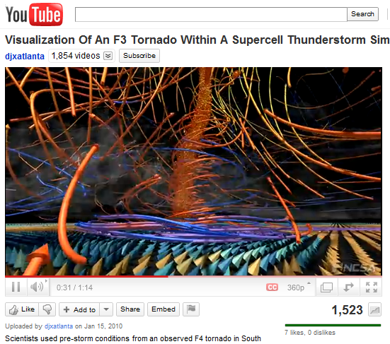
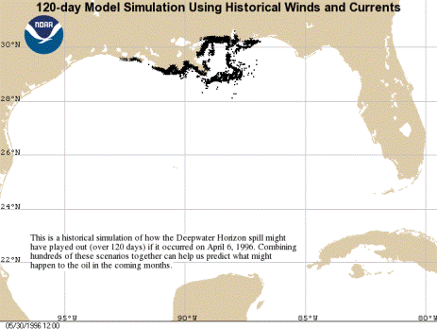
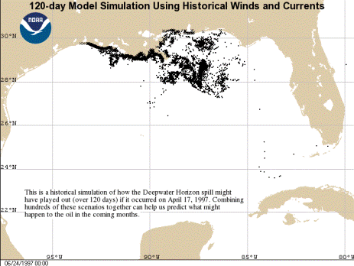
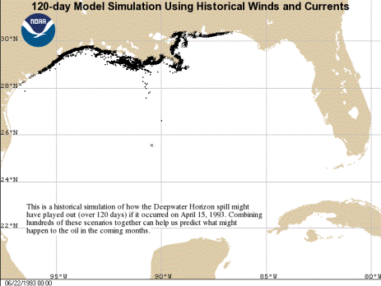
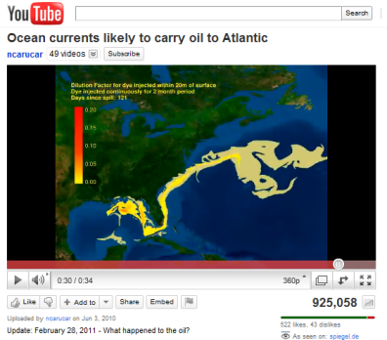
Visualization [1]:
Animating Simulations
Deepwater Horizon Oil Spill (20 Apr 2010)
http://bit.ly/9QHax4
120-day images © 2010 NOAA, http://1.usa.gov/c02xuQ
120-day simulation using
06 Apr 1996 weather conditions
120-day simulation using
17 Apr 1997 weather conditions
Wilhelmson et al. (2004)
http://youtu.be/EgumU0Ns1YI
http://avl.ncsa.illinois.edu
http://bit.ly/eA8PXN
120-day simulation using
15 Apr 1993 weather conditions
132-day simulation using 2010 conditions
© 2010 National Center for Supercomputing Applications (NCSA)
http://youtu.be/pE-1G_476nA

Slide 28
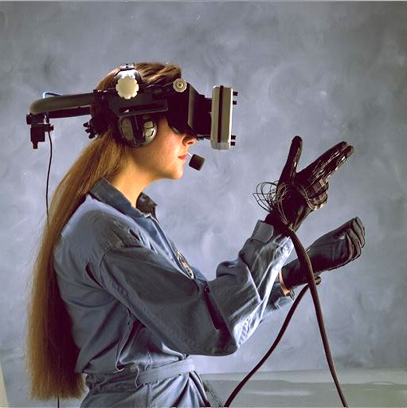
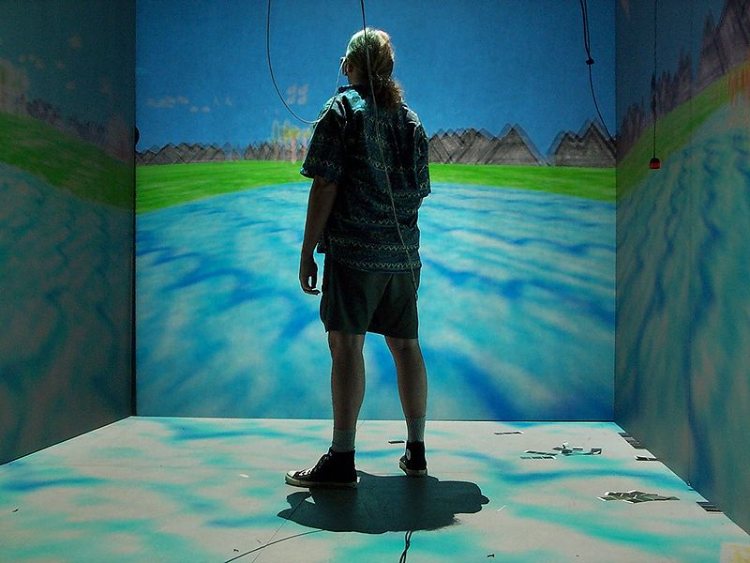
Visualization [2]:
Virtual Reality (VR)
Virtual Reality: Computer-Simulated Environments
Physical Presence: Real & Imaginary
Hardware: User Interface
Head-mounted display (HMD), gloves – see PopOptics goggles (left)
VR glasses, wand, etc. – see NCSA CAVE (right)
Virtual Reality, Wikipedia: http://bit.ly/fAvNeP
Image © 2007 National Air & Space Museum
CAVE (Cave Automatic Virtual Environment)
Image © 2009 D. Pape
HowStuffWorks article: http://bit.ly/feQxNK © 2009 J. Strickland
Wikipedia: http://bit.ly/dKNEnU

Slide 29
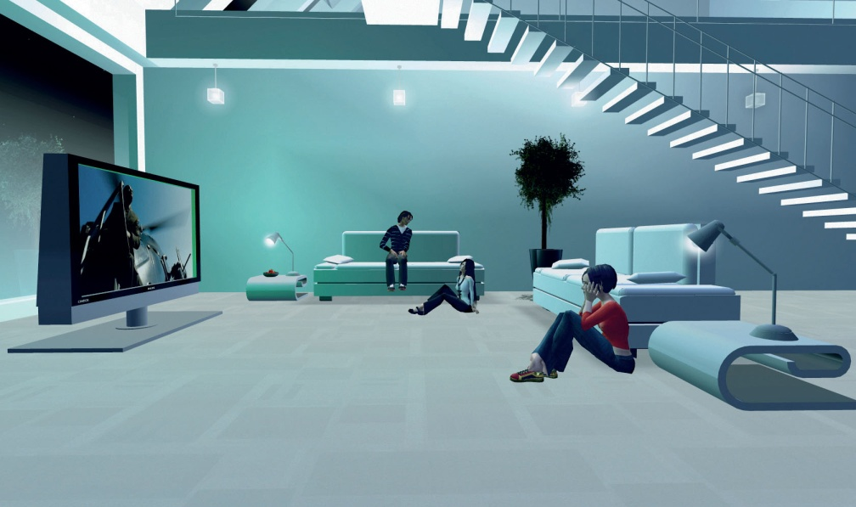
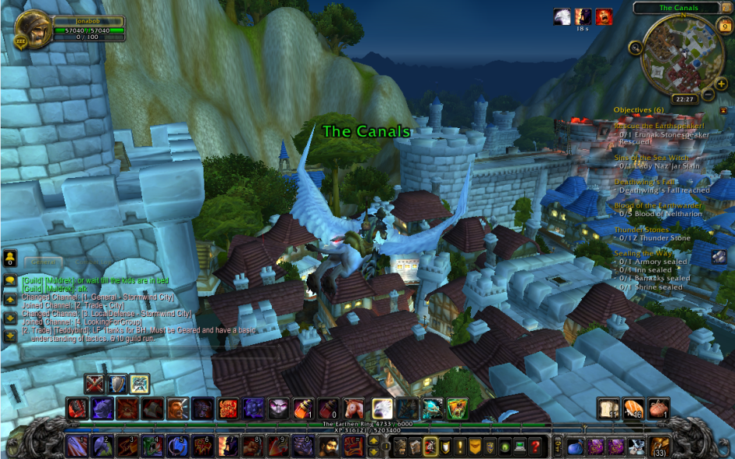
Visualization [3]:
Virtual Environments (VE)
Virtual Environment: Part of Virtual Reality Experience
Other Parts
Virtual artifacts (VA): simulated objects – http://bit.ly/hskSyX
Intelligent agents, artificial & real – http://bit.ly/y2gQk
Experientia © 2006 M. Vanderbeeken et al., http://bit.ly/hzfAQx
Second Life © 2003 – 2011 Linden Labs, Inc., http://bit.ly/wbvoL
Image © 2006 Philips Design
We Are Arcade © 2011 D. Grossett et al., http://bit.ly/ftALjU
World of Warcraft: Cataclysm review © 2011 J. Greer, http://bit.ly/eENHXt
World of Warcraft © 2001 – 2011 Blizzard Entertainment, Inc.,
http://bit.ly/2qvPYF

Slide 30
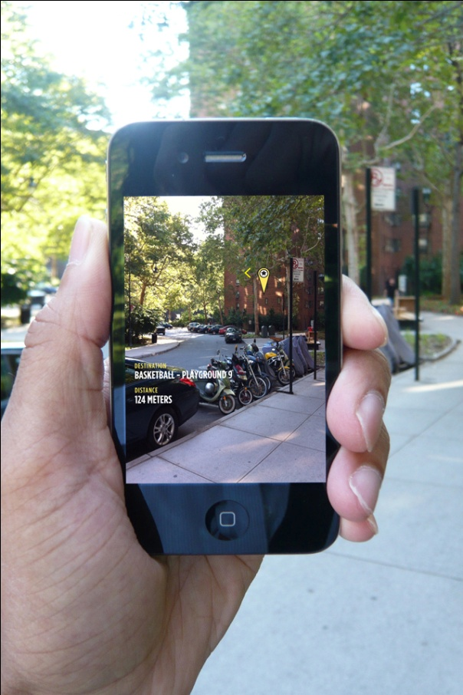
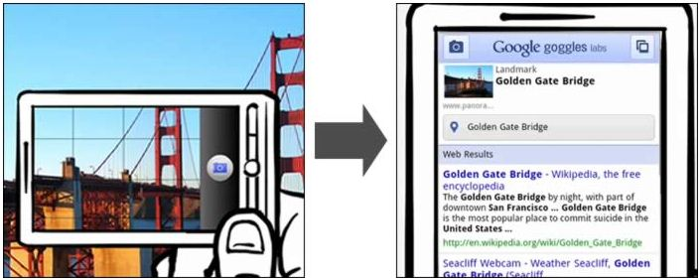
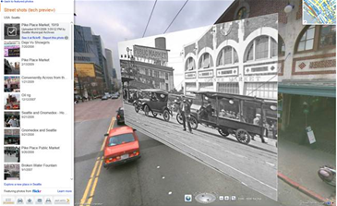
Visualization [4]:
Augmented Reality (AR)
Augmented Reality: Computer-Generated (CG) Sensory Overlay
Added to Physical, Real-World Environment
Wikipedia, Google Goggles:
http://bit.ly/gRRMLS
Bing Maps © 2010 – 2011 Microsoft Corporation
http://bit.ly/a9UviT
© 2010 TED Talks
“40 Best Augmented Reality iPhone Applications”, © 2010 iPhoneNess.com, http://bit.ly/2qT35y
MyNav © 2010 Winfield & Co. http://bit.ly/dLTir7

Slide 31
Summary
Reading for Last Class: §17.1 – 17.2, Eberly 2e
Reading for Today: Chapter 10, 13, §17.3 – 17.5, Eberly 2e
Reading for Next Class: §2.4.3, 8.1, Eberly 2e, GL handout
Last Time: Rotations in Animation
Matrix, fixed angles, Euler angles, axis
Quaternions & how they work – properties, arithmetic operations
Gimbal lock defined & illustrated
Quaternions Concluded
Incremental rotation: spherical linear interpolation (slerping)
Advantages of slerping vs. cubic interpolation between Euler angles
Uses: character animation, camera control (rotating Look vector)
Dynamics & Kinematics (Preview of Lectures 28 – 30)
Today: Modeling & Simulation
Virtual / augmented reality (VR/AR) & virtual environments (VE)
Visualization & simulation (Viz-Sim) preview

Slide 32
Terminology
Last Time: Rotation using Matrices, Fixed Angles, Euler Angles
Gimbal Lock
Loss of DOF
Reference (© 2007 S. Seefield): http://bit.ly/e1nuo9
Axis-Angle – Rotate Reference Vector r about Arbitrary Axis (Vector) A/n
Quaternions
Quaternions – different representation of arbitrary rotation
Exponential maps – 3-D representation related to quaternions
Visualization – Communicating with Images, Diagrams, Animations
Simulation – Artificial Model of Real Process for Answering Questions
VR, VE, VA, AR
Virtual Reality: computer-simulated environments, objects
Virtual Environment: part of VR dealing with surroundings
Virtual Artifacts: part of VR dealing with simulated objects
Augmented Reality: CG sensory overlay on real-world images

