Slide 1
Lecture 24 of 41
Collision Handling Part 1 of 2:
Separating Axes, Oriented Bounding Boxes
William H. Hsu
Department of Computing and Information Sciences, KSU
KSOL course pages: http://bit.ly/hGvXlH / http://bit.ly/eVizrE
Public mirror web site: http://www.kddresearch.org/Courses/CIS636
Instructor home page: http://www.cis.ksu.edu/~bhsu
Readings:
Today: §2.4.3, 8.1, Eberly 2e – see http://bit.ly/ieUq45; GL handout
Next class: Chapter 6, esp. §6.1, Eberly 2e
Wikipedia, Collision Detection: http://bit.ly/14rFzG

Slide 2
Lecture Outline
Reading for Last Class: Chapter 10, 13, §17.3 – 17.5, Eberly 2e
Reading for Today: §2.4.3, 8.1, Eberly 2e, GL handout
Reading for Next Class: Chapter 6, Esp. §6.1, Eberly 2e
Last Time: Quaternions Concluded
How quaternions work – properties, matrix equivalence, arithmetic
Composing rotations by quaternion multiplication
Incremental rotation and error issues
Videos 4: Modeling & Simulation, Visualization; VR/VE/VA/AR
Virtual reality, environments, artifacts (VR/VE/VA); augmented reality
Relationship among visualization, simulation, & animation
Today: Collision Detection Part 1 of 2
Test-intersection queries vs. find-intersection queries
Static: stationary objects (both not moving)
Dynamic: moving objects (one or both)
Distance vs. intersection methods

Slide 3
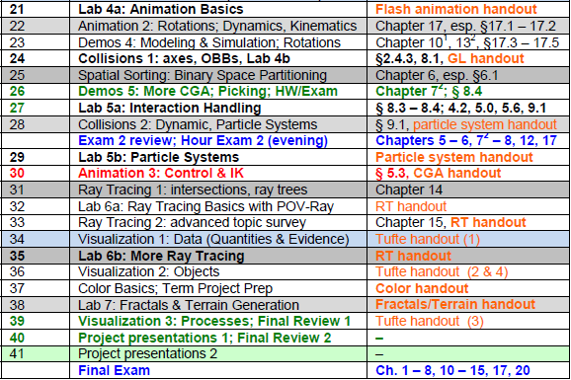
Where We Are

Slide 4
Acknowledgements:
Quaternions, Collision Handling
Rick Parent
Professor
Department of Computer Science and Engineering
Ohio State University
http://www.cse.ohio-state.edu/~parent/
David C. Brogan
Visiting Assistant Professor, Computer Science Department, University of Virginia
http://www.cs.virginia.edu/~dbrogan/
Susquehanna International Group (SIG)
http://www.sig.com
Steve Rotenberg
Visiting Lecturer
Graphics Lab
University of California – San Diego
CEO/Chief Scientist, PixelActive
http://graphics.ucsd.edu

Slide 5
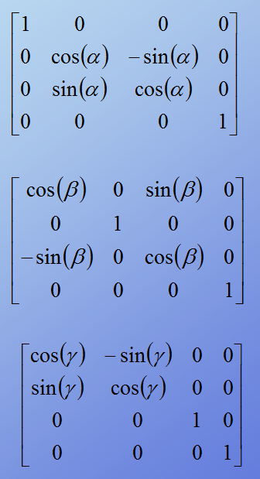
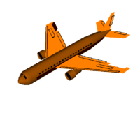
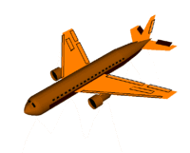
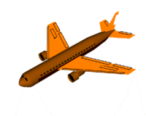
Review [1]:
Fixed Angles & Euler Angles
Rotation about x axis
(Roll)
x
© 2006 Wikipedia,
Flight Dynamics
http://bit.ly/gVaQCX
Rotation about y axis
(Pitch)
y
z
Rotation about z axis
(Yaw)
Adapted from slides © 2007 – 2011 R. Parent, Ohio State University
CSE 682 (Computer Animation), http://bit.ly/feUESy
CSE 683/684A (Computer Animation Algorithms & Techniques), http://bit.ly/f8Myky

Slide 6
Review [2]:
Axis-Angle to Quaternion Conversion
Adapted from slides © 2000 – 2004 D. Brogan, University of Virginia
CS 445/645, Introduction to Computer Graphics, http://bit.ly/h9AHRg

Slide 7
Review [3]:
Quaternion to RM Conversion
Adapted from slides © 2000 – 2004 D. Brogan, University of Virginia
CS 445/645, Introduction to Computer Graphics, http://bit.ly/h9AHRg

Slide 8
Review [4]:
Advantage – Interpolation
Hint: see http://youtu.be/-jBKKV2V8eU
Adapted from slides © 2000 – 2004 D. Brogan, University of Virginia
CS 445/645, Introduction to Computer Graphics, http://bit.ly/h9AHRg

Slide 9
Interpolating Quaternions [1]:
Lerp
Adapted from slides © 2004 – 2005 S. Rotenberg, UCSD
CSE169: Computer Animation, Winter 2005, http://bit.ly/f0ViAN

Slide 10
Interpolating Quaternions [2]:
Slerp
Adapted from slides © 2004 – 2005 S. Rotenberg, UCSD
CSE169: Computer Animation, Winter 2005, http://bit.ly/f0ViAN

Slide 11
Interpolating Quaternions [3]:
Slerp Optimization
Adapted from slides © 2004 – 2005 S. Rotenberg, UCSD
CSE169: Computer Animation, Winter 2005, http://bit.ly/f0ViAN

Slide 12
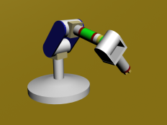
Review [5]:
Dynamics & Kinematics
Dynamics: Study of Motion & Changes in Motion
Forward: model forces over time to find state, e.g.,
Given: initial position p₀ , velocity v₀, gravitational constants
Calculate: position p_{t} at time t
Inverse: given state and constraints, calculate forces, e.g.,
Given: desired position p_{t} at time t, gravitational constants
Calculate: position p₀ , velocity v₀ needed
Wikipedia: http://bit.ly/hH43dX (see also: “Analytical dynamics”)
For non-particle objects: rigid-body dynamics (http://bit.ly/dLvejg)
Kinematics: Study of Motion without Regard to Causative Forces
Modeling systems – e.g., articulated figure
Forward: from angles to position (http://bit.ly/eh2d1c)
Inverse: finding angles given desired position (http://bit.ly/hsyTb0)
Wikipedia: http://bit.ly/hr8r2u
Forward Kinematics
© 2009 Wikipedia

Slide 13
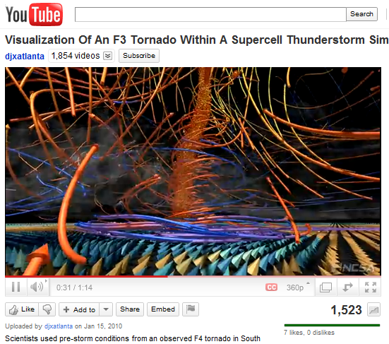
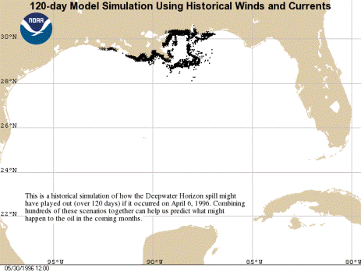
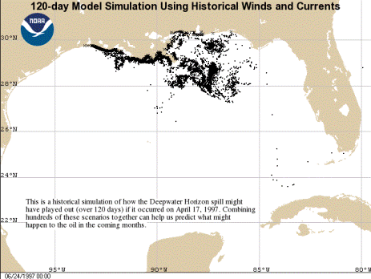
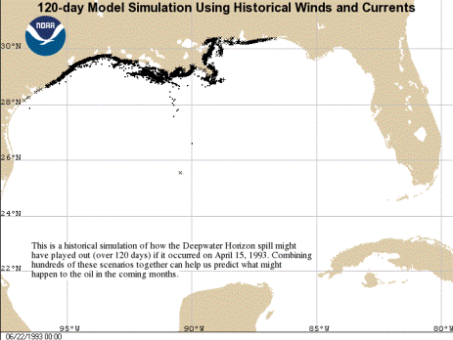
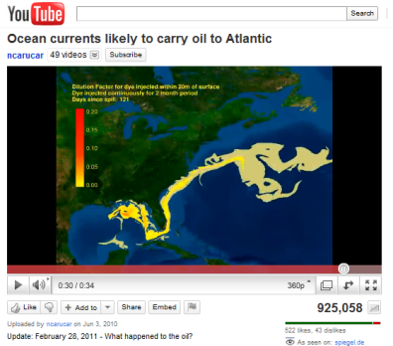
Review [6]:
Visualization & Simulation
Deepwater Horizon Oil Spill (20 Apr 2010)
http://bit.ly/9QHax4
120-day images © 2010 NOAA, http://1.usa.gov/c02xuQ
120-day simulation using
06 Apr 1996 weather conditions
120-day simulation using
17 Apr 1997 weather conditions
Wilhelmson et al. (2004)
http://youtu.be/EgumU0Ns1YI
http://avl.ncsa.illinois.edu
http://bit.ly/eA8PXN
120-day simulation using
15 Apr 1993 weather conditions
132-day simulation using 2010 conditions
© 2010 National Center for Supercomputing Applications (NCSA)
http://youtu.be/pE-1G_476nA

Slide 14
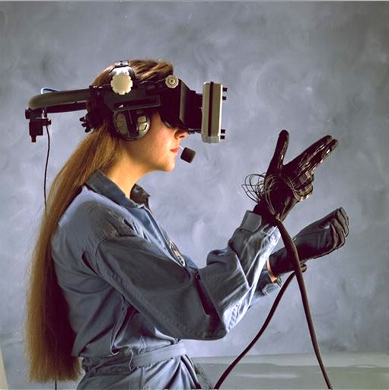
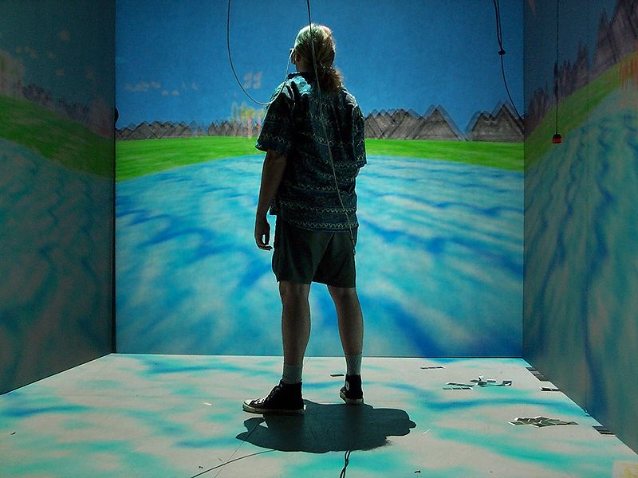
Review [7]:
Virtual Reality (VR)
Virtual Reality: Computer-Simulated Environments
Physical Presence: Real & Imaginary
Hardware: User Interface
Head-mounted display (HMD), gloves – see PopOptics goggles (left)
VR glasses, wand, etc. – see NCSA CAVE (right)
Virtual Reality, Wikipedia: http://bit.ly/fAvNeP
Image © 2007 National Air & Space Museum
CAVE (Cave Automatic Virtual Environment)
Image © 2009 D. Pape
HowStuffWorks article: http://bit.ly/feQxNK © 2009 J. Strickland
Wikipedia: http://bit.ly/dKNEnU

Slide 15
Review [8]:
Virtual Environments (VE)
Virtual Environment: Part of Virtual Reality Experience
Other Parts
Virtual artifacts (VA): simulated objects – http://bit.ly/hskSyX
Intelligent agents, artificial & real – http://bit.ly/y2gQk
Experientia © 2006 M. Vanderbeeken et al., http://bit.ly/hzfAQx
Second Life © 2003 – 2011 Linden Labs, Inc., http://bit.ly/wbvoL
Image © 2006 Philips Design
We Are Arcade © 2011 D. Grossett et al., http://bit.ly/ftALjU
World of Warcraft: Cataclysm review © 2011 J. Greer, http://bit.ly/eENHXt
World of Warcraft © 2001 – 2011 Blizzard Entertainment, Inc.,
http://bit.ly/2qvPYF

Slide 16
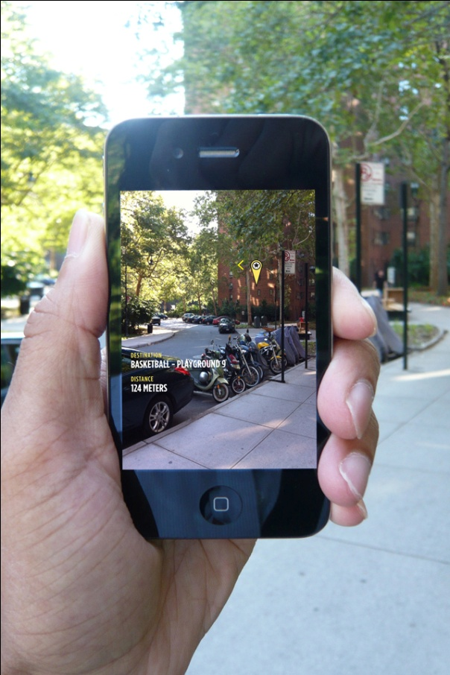
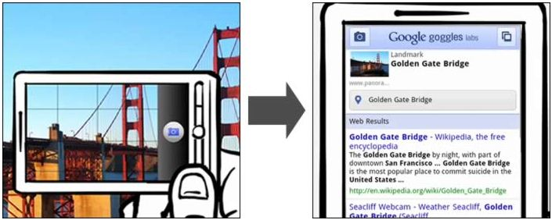
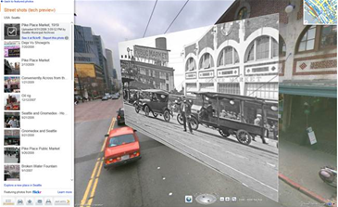
Review [9]:
Augmented Reality (AR)
Augmented Reality: Computer-Generated (CG) Sensory Overlay
Added to Physical, Real-World Environment
Wikipedia, Google Goggles:
http://bit.ly/gRRMLS
Bing Maps © 2010 – 2011 Microsoft Corporation
http://bit.ly/a9UviT
© 2010 TED Talks
“40 Best Augmented Reality iPhone Applications”, © 2010 iPhoneNess.com, http://bit.ly/2qT35y
MyNav © 2010 Winfield & Co. http://bit.ly/dLTir7

Slide 17
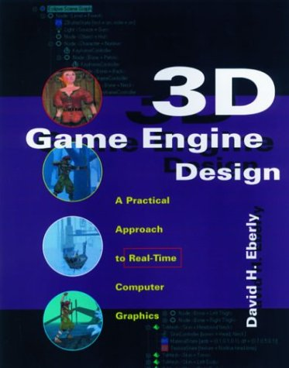
Acknowledgements:
Intersections, Containment – Eberly 1e
David H. Eberly
Chief Technology Officer
Geometric Tools, LLC
http://www.geometrictools.com
http://bit.ly/enKbfs
Today’s material:
View Frustum clipping
§2.4.3, p. 70 – 77, 2e
§3.4.3, p. 93 – 99, & §3.7.2, p. 133 – 136, 1e
Collision detection: separating axes
§8.1, p. 393 – 443, 2e
§6.4. p. 203 – 214, 1e
Later:
Distance methods
Chapter 14, p. 639 – 679, 2e
§2.6, p. 38 – 77, 1e
Intersection methods
Chapter 15, p. 681 – 717, 2e
§6.2 – 6.5, p. 188 – 243, 1e
3D Game Engine Design © 2000 D. H. Eberly
See http://bit.ly/ieUq45 for second edition table of contents (TOC)

Slide 18
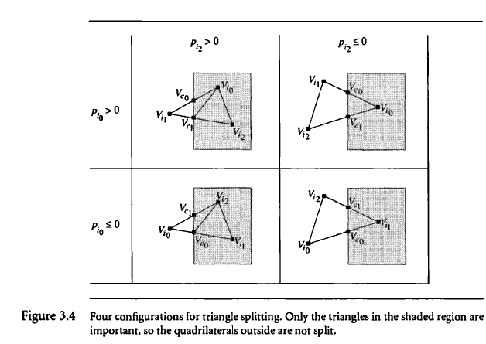
View Frustum Clipping:
Triangle Splitting
3D Game Engine Design © 2000 D. H. Eberly
See http://bit.ly/ieUq45 for second edition table of contents (TOC)

Slide 19
Collision Handling:
Detection vs. Response
Adapted from slides © 2004 – 2005 S. Rotenberg, UCSD
CSE169: Computer Animation, Winter 2005, http://bit.ly/f0ViAN

Slide 20
Collision Detection [1]:
Technical Problem Defined
Adapted from slides © 2004 – 2005 S. Rotenberg, UCSD
CSE169: Computer Animation, Winter 2005, http://bit.ly/f0ViAN

Slide 21
Collision Detection [2]:
Intersections – Testing vs. Finding
Adapted from slides © 2004 – 2005 S. Rotenberg, UCSD
CSE169: Computer Animation, Winter 2005, http://bit.ly/f0ViAN

Slide 22
Collision Detection [3]:
Queries – Test- vs. Find-Intersection
Test-Intersection: Determine If Objects Intersect
Static: test whether they do at given instant
Dynamic: test whether they intersect at any point along trajectories
Find-Intersection: Determine Intersection (or Contact) Set of Objects
Static: intersection set (compare: A ∩ B)
Dynamic: contact time (interval of overlap), sets (depends on time)
Adapted from 3D Game Engine Design © 2000 D. H. Eberly
See http://bit.ly/ieUq45 for second edition table of contents (TOC)

Slide 23
Collision Detection [3]:
Queries – Distance vs. Intersection
Distance-Based
Parametric representation of object boundaries/interiors
Want: closest points on two objects (to see whether they intersect)
Use: constrained minimization to solve for closest points
Intersection-Based
Also uses parametric representation
Want: overlapping subset of interior of two objects
General approach: equate objects, solve for parameters
Use one of two kinds of solution methods
Analytical (when feasible to solve exactly – e.g., OBBs)
Numerical (approximate region of overlap)
Solving for parameters in equation
Harder to compute than distance-based; use only when needed
Adapted from 3D Game Engine Design © 2000 D. H. Eberly
See http://bit.ly/ieUq45 for second edition table of contents (TOC)

Slide 24
Collision Detection [4]:
Primitives
Adapted from slides © 2004 – 2005 S. Rotenberg, UCSD
CSE169: Computer Animation, Winter 2005, http://bit.ly/f0ViAN

Slide 25
Collision Detection [5]:
Particle Collisions
Adapted from slides © 2004 – 2005 S. Rotenberg, UCSD
CSE169: Computer Animation, Winter 2005, http://bit.ly/f0ViAN

Slide 26
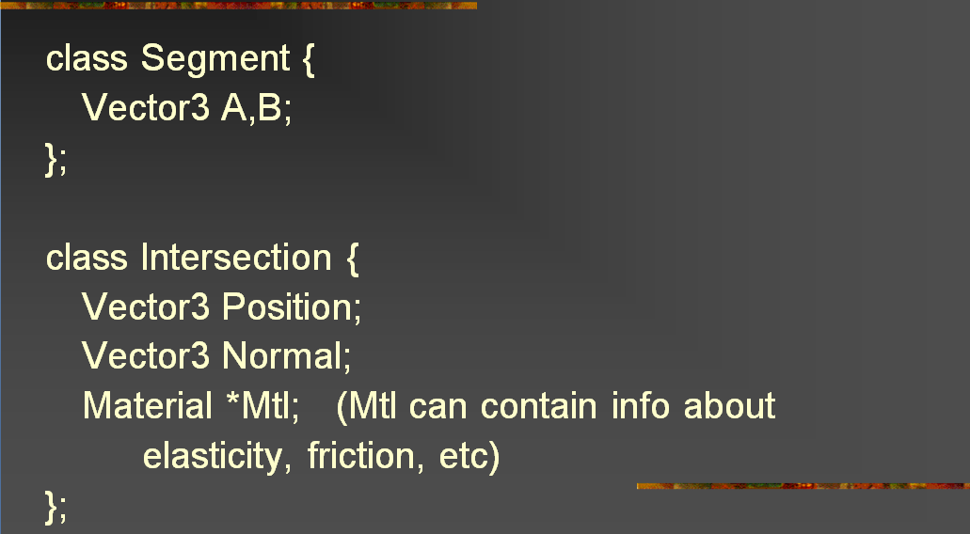
Collision Detection [6]:
Code – Basic Components
Adapted from slides © 2004 – 2005 S. Rotenberg, UCSD
CSE169: Computer Animation, Winter 2005, http://bit.ly/f0ViAN

Slide 27
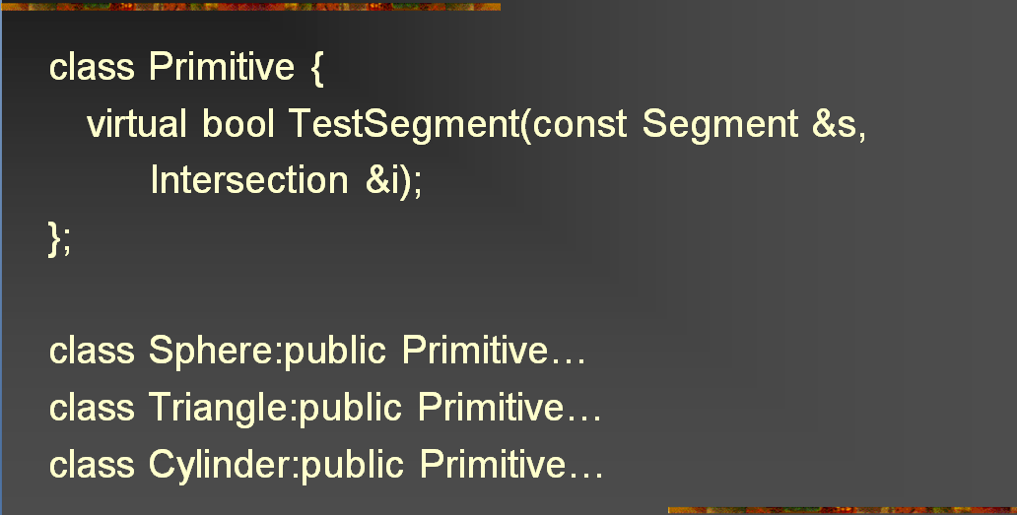
Collision Detection [7]:
Code – Primitives
Adapted from slides © 2004 – 2005 S. Rotenberg, UCSD
CSE169: Computer Animation, Winter 2005, http://bit.ly/f0ViAN

Slide 28
Collision Detection [8]:
Segment vs. Triangle – Query
Adapted from slides © 2004 – 2005 S. Rotenberg, UCSD
CSE169: Computer Animation, Winter 2005, http://bit.ly/f0ViAN

Slide 29
Collision Detection [9]:
Segment vs. Triangle – Solution
Adapted from slides © 2004 – 2005 S. Rotenberg, UCSD
CSE169: Computer Animation, Winter 2005, http://bit.ly/f0ViAN

Slide 30
Collision Detection [10]:
Segment vs. Triangle – Point Test
Adapted from slides © 2004 – 2005 S. Rotenberg, UCSD
CSE169: Computer Animation, Winter 2005, http://bit.ly/f0ViAN

Slide 31
Collision Detection [11]:
Faster Triangle – Point Containment
Adapted from slides © 2004 – 2005 S. Rotenberg, UCSD
CSE169: Computer Animation, Winter 2005, http://bit.ly/f0ViAN

Slide 32
Collision Detection [12]:
Segmentvs. Mesh
Adapted from slides © 2004 – 2005 S. Rotenberg, UCSD
CSE169: Computer Animation, Winter 2005, http://bit.ly/f0ViAN

Slide 33
Collision Detection [13]:
Segment vs. Moving Mesh
Adapted from slides © 2004 – 2005 S. Rotenberg, UCSD
CSE169: Computer Animation, Winter 2005, http://bit.ly/f0ViAN

Slide 34
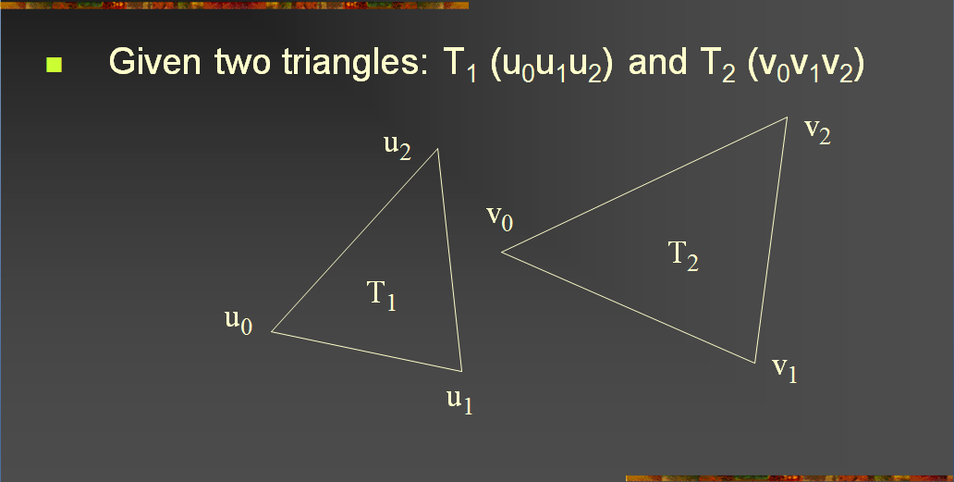
Collision Detection [14]:
Trianglevs. Triangle – Query
Adapted from slides © 2004 – 2005 S. Rotenberg, UCSD
CSE169: Computer Animation, Winter 2005, http://bit.ly/f0ViAN

Slide 35
Collision Detection [15]:
Trianglevs. Triangle – Plane Equations
Adapted from slides © 2004 – 2005 S. Rotenberg, UCSD
CSE169: Computer Animation, Winter 2005, http://bit.ly/f0ViAN

Slide 36
Collision Detection [16]:
Trianglevs. Triangle – Distances
Adapted from slides © 2004 – 2005 S. Rotenberg, UCSD
CSE169: Computer Animation, Winter 2005, http://bit.ly/f0ViAN

Slide 37
Collision Detection [17]:
Trianglevs. Triangle – Intersection
Adapted from slides © 2004 – 2005 S. Rotenberg, UCSD
CSE169: Computer Animation, Winter 2005, http://bit.ly/f0ViAN

Slide 38
Collision Detection [18]:
Meshvs. Mesh – Kinds of Collisions
Adapted from slides © 2004 – 2005 S. Rotenberg, UCSD
CSE169: Computer Animation, Winter 2005, http://bit.ly/f0ViAN

Slide 39
Collision Detection [19]:
Moving Mesh vs. Moving Mesh
Adapted from slides © 2004 – 2005 S. Rotenberg, UCSD
CSE169: Computer Animation, Winter 2005, http://bit.ly/f0ViAN

Slide 40
Collision Detection [20]:
Moving Meshes: Extrusion
Adapted from slides © 2004 – 2005 S. Rotenberg, UCSD
CSE169: Computer Animation, Winter 2005, http://bit.ly/f0ViAN

Slide 41
Collision Detection [21]:
Intersection Issues
Adapted from slides © 2004 – 2005 S. Rotenberg, UCSD
CSE169: Computer Animation, Winter 2005, http://bit.ly/f0ViAN

Slide 42
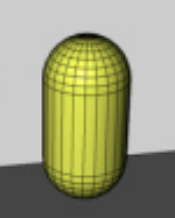
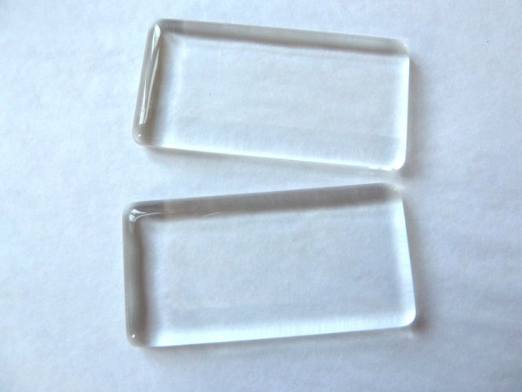
Static Intersection [1]:
Sphere-Swept Volumes
Sphere
Locus of points in 3-D equidistant from center point
Rotational sweep of circle (hollow sphere) or disc (solid ball)
“Null” sweep of sphere (invariant under rotation, translation by 0)
Capsule: Translational Sweep of Sphere Along Line Segment
Lozenge: Sweep of Sphere Across Rectangle
Wikipedia: Sphere
http://bit.ly/9OWjQi
Image © 2008 ClipArtOf.com
http://bit.ly/eKhE2f
Capsule
Image © 2007 Remotion Wiki
http://bit.ly/huEzNW
Lozenge
Image © 2011 Jasmin Studio Crafts
http://bit.ly/euEopw
Adapted from 3D Game Engine Design © 2000 D. H. Eberly
See http://bit.ly/ieUq45 for second edition table of contents (TOC)

Slide 43
Static Intersection [2]:
Distance Calculators
3D Game Engine Design © 2000 D. H. Eberly
See http://bit.ly/ieUq45 for second edition table of contents (TOC)

Slide 44
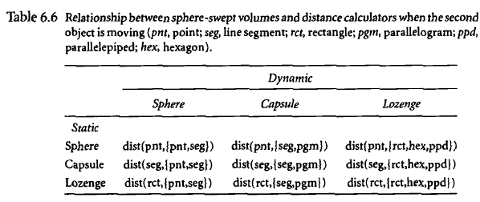
Dynamic Intersection [1]:
One Moving Object
3D Game Engine Design © 2000 D. H. Eberly
See http://bit.ly/ieUq45 for second edition table of contents (TOC)

Slide 45
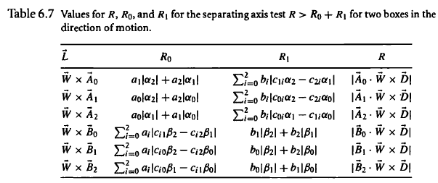
Dynamic Intersection [2]:
Two Moving Objects – Separating Axes
3D Game Engine Design © 2000 D. H. Eberly
See http://bit.ly/ieUq45 for second edition table of contents (TOC)

Slide 46
Preview:
Collision Response & Optimization
What Happens After Collision Is Detected?
Contact & application of force vs. impact & impulse
Compression: deformation of solid
Restitution: springing back of solid
Friction?
Secondary collisions due to changes in trajectories
Bouncing?
Optimization
Spatial partitioning: bounding volume hierarchies (BVHs) revisited
Binary space partitioning (BSP) trees
k-d trees
Quadtrees & octrees
Volume graphics: uniform grids and data parallelism
Adapted from slides © 2004 – 2005 S. Rotenberg, UCSD
CSE169: Computer Animation, Winter 2005, http://bit.ly/f0ViAN

Slide 47
Summary
Reading for Last Class: Chapter 10, 13, §17.3 – 17.5, Eberly 2e
Reading for Today: §2.4.3, 8.1, Eberly 2e, GL handout
Reading for Next Class: Chapter 6, Esp. §6.1, Eberly 2e
Last Time: Quaternions Concluded
How quaternions work – properties, matrix equivalence, arithmetic
Composing rotations by quaternion multiplication
Incremental rotation and error issues
Review: Virtual Reality & Virtual Environments; Augmented Reality
Today: Collision Detection Part 1 of 2
Static: stationary objects (both not moving)
Dynamic: moving objects (one or both)
Test-intersection queries vs. find-intersection queries
Distance vs. intersection methods

Slide 48
Terminology
Visualization – Communicating with Images, Diagrams, Animations
VR, VE, VA, AR
Virtual Reality: computer-simulated environments, objects
Virtual Environment: part of VR dealing with surroundings
Virtual Artifacts: part of VR dealing with simulated objects
Augmented Reality: CG sensory overlay on real-world images
Collision Detection
Static: stationary objects (both not moving)
Dynamic: moving objects (one or both)
Queries
Test-intersection: determine whether objects do/will intersect
Find-intersection: calculate intersection set or contact set, time
Parametric methods: use parameters to describe objects
Distance-based: constrained minimization (closest points)
Intersection-based: solving for parameters in equation

