Slide 1
Lecture 25 of 41
Spatial Sorting: Binary Space Partitioning
Quadtrees & Octrees
William H. Hsu
Department of Computing and Information Sciences, KSU
KSOL course pages: http://bit.ly/hGvXlH / http://bit.ly/eVizrE
Public mirror web site: http://www.kddresearch.org/Courses/CIS636
Instructor home page: http://www.cis.ksu.edu/~bhsu
Readings:
Today: Chapter 6, esp. §6.1, Eberly 2e – see http://bit.ly/ieUq45
Next class: Chapter 7, §8.4, Eberly 2e
Wikipedia, Binary Space Partitioning: http://bit.ly/eE10lc
Wikipedia, Quadtree (http://bit.ly/ky0Xy) & Octree (http://bit.ly/dVrthx)

Slide 2
Lecture Outline
Reading for Last Class: §2.4.3, 8.1, Eberly 2e, GL handout
Reading for Today: Chapter 6, Esp. §6.1, Eberly 2e
Reading for Next Class: Chapter 7, §8.4, Eberly 2e
Last Time: Collision Handling, Part 1 of 2
  Static vs. dynamic objects, testing vs. finding intersections
  Distance vs. intersection methods
  Triangle point containment test
  Method of separating axes
Today: Adaptive Spatial Partitioning
  Visible Surface Determination (VSD) revisited
  Constructive Solid Geometry (CSG) trees
  Binary Space Partitioning (BSP) trees
  Quadtrees: adaptive 2-D (planar) subdivision
  Octrees: adaptive 3-D (spatial) subdivision
Coming Soon: Volume Graphics & Voxels

Slide 3
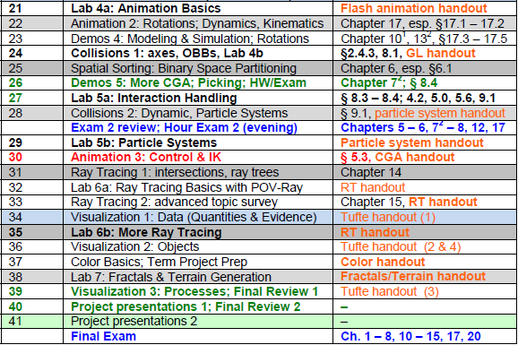

Where We Are

Slide 4
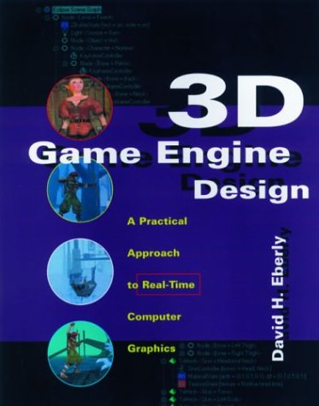
Acknowledgements:
Intersections, Containment – Eberly 1e
David H. Eberly
Chief Technology Officer
Geometric Tools, LLC
http://www.geometrictools.com
http://bit.ly/enKbfs
Last lecture’s material:
View Frustum clipping
  §2.4.3, p. 70 – 77, 2e
  §3.4.3, p. 93 – 99, & §3.7.2, p. 133 – 136, 1e
Collision detection: separating axes
  §8.1, p. 393 – 443, 2e
  §6.4. p. 203 – 214, 1e
Later:
Distance methods
  Chapter 14, p. 639 – 679, 2e
  §2.6, p. 38 – 77, 1e
Intersection methods
  Chapter 15, p. 681 – 717, 2e
  §6.2 – 6.5, p. 188 – 243, 1e
3D Game Engine Design © 2000 D. H. Eberly
See http://bit.ly/ieUq45 for second edition table of contents (TOC)

Slide 5
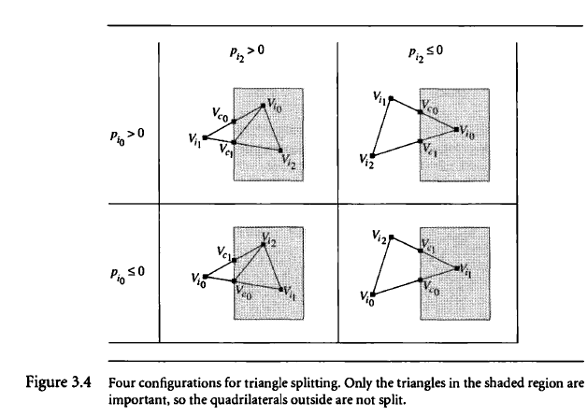
Review [1]:
View Frustum Clipping
3D Game Engine Design © 2000 D. H. Eberly
See http://bit.ly/ieUq45 for second edition table of contents (TOC)

Slide 6
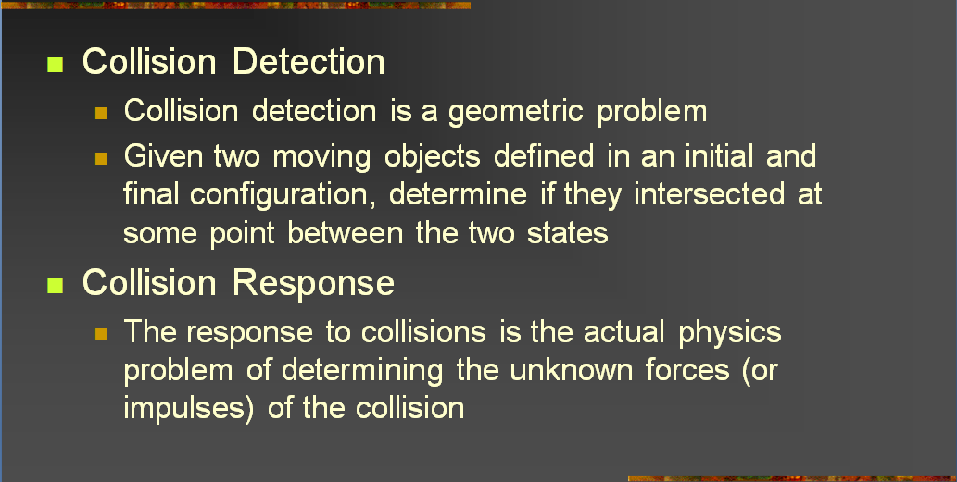
Review [2]:
Collision Detection vs. Response
Adapted from slides © 2004 – 2005 S. Rotenberg, UCSD
CSE169: Computer Animation, Winter 2005, http://bit.ly/f0ViAN

Slide 7
Review [3]:
Queries – Test- vs. Find-Intersection
Test-Intersection: Determine If Objects Intersect
  Static: test whether they do at given instant
  Dynamic: test whether they intersect at any point along trajectories
Find-Intersection: Determine Intersection (or Contact) Set of Objects
  Static: intersection set (compare: A ∩ B)
  Dynamic: contact time (interval of overlap), sets (depends on time)
Adapted from 3D Game Engine Design © 2000 D. H. Eberly
See http://bit.ly/ieUq45 for second edition table of contents (TOC)

Slide 8
Review [4]:
Queries – Distance vs. Intersection
Distance-Based
  Parametric representation of object boundaries/interiors
  Want: closest points on two objects (to see whether they intersect)
  Use: constrained minimization to solve for closest points
Intersection-Based
  Also uses parametric representation
  Want: overlapping subset of interior of two objects
  General approach: equate objects, solve for parameters
  Use one of two kinds of solution methods
    Analytical (when feasible to solve exactly – e.g., OBBs)
    Numerical (approximate region of overlap)
  Solving for parameters in equation
  Harder to compute than distance-based; use only when needed
Adapted from 3D Game Engine Design © 2000 D. H. Eberly
See http://bit.ly/ieUq45 for second edition table of contents (TOC)

Slide 9
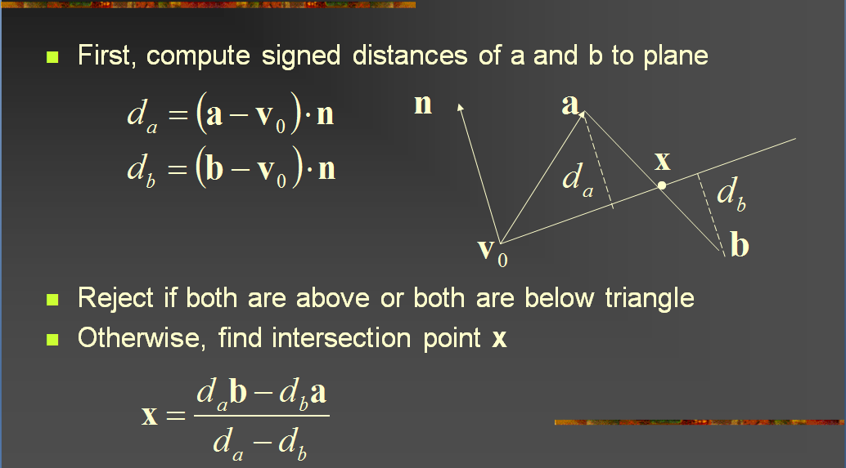
Review [5]:
Segment vs. Triangle – Solution
Adapted from slides © 2004 – 2005 S. Rotenberg, UCSD
CSE169: Computer Animation, Winter 2005, http://bit.ly/f0ViAN

Slide 10
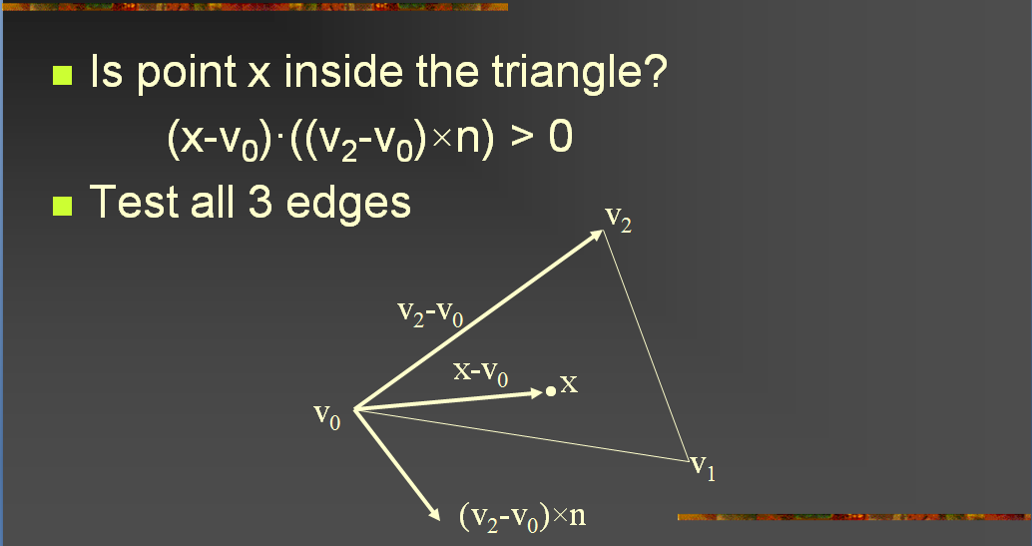
Review [6]:
Segment vs. Triangle – Point Test
Adapted from slides © 2004 – 2005 S. Rotenberg, UCSD
CSE169: Computer Animation, Winter 2005, http://bit.ly/f0ViAN

Slide 11
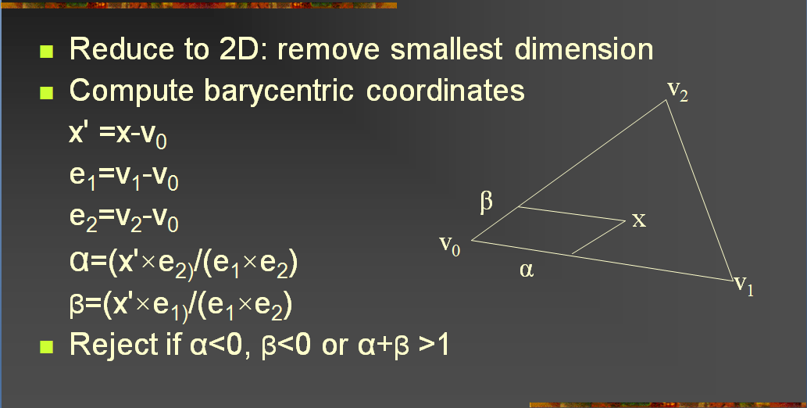
Review [7]:
Faster Triangle – Point Containment
Adapted from slides © 2004 – 2005 S. Rotenberg, UCSD
CSE169: Computer Animation, Winter 2005, http://bit.ly/f0ViAN

Slide 12
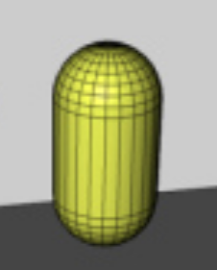
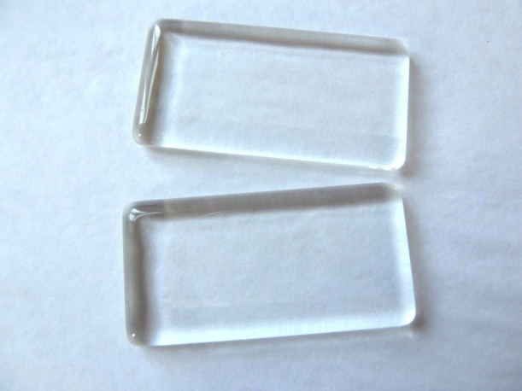

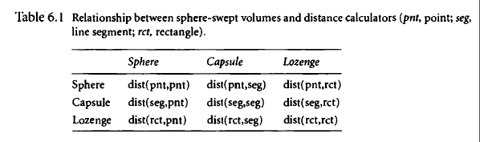
Review [8]:
Sphere-Swept Volumes & Distances
Wikipedia: Sphere
http://bit.ly/9OWjQi
Image © 2008 ClipArtOf.com
http://bit.ly/eKhE2f
Capsule
Image © 2007 Remotion Wiki
http://bit.ly/huEzNW
Lozenge
Image © 2011 Jasmin Studio Crafts
http://bit.ly/euEopw
Adapted from 3D Game Engine Design © 2000 D. H. Eberly
See http://bit.ly/ieUq45 for second edition table of contents (TOC)

Slide 13
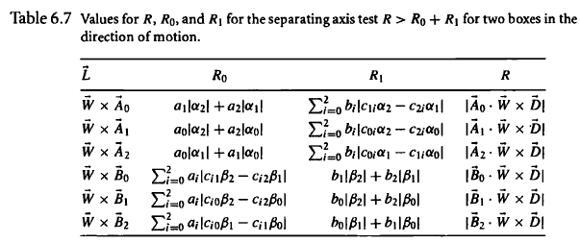
Review [9]:
Method of Separating Axes
3D Game Engine Design © 2000 D. H. Eberly
See http://bit.ly/ieUq45 for second edition table of contents (TOC)

Slide 14



Acknowledgements:
Collisions, BSP/Quadtrees/Octrees
Steve Rotenberg
Visiting Lecturer
Graphics Lab
University of California – San Diego
CEO/Chief Scientist, PixelActive
http://graphics.ucsd.edu
Glenn G. Chappell
Associate Professor
Department of Computer Science
University of Alaska Fairbanks
http://www.cs.uaf.edu/~chappell/

Slide 15
Data Structures for Scenes [1]:
Four Tree Representations
Scene Graphs
  Organized by how scene is constructed
  Nodes hold objects
Constructive Solid Geometry (CSG) Trees
  Organized by how scene is constructed
  Leaves hold 3-D primitives
  Internal nodes hold set operations
Binary Space Partitioning (BSP) Trees
  Organized by spatial relationships in scene
  Nodes hold facets (in 3-D, polygons)
Quadtrees & Octrees
  Organized spatially
  Nodes represent regions in space
  Leaves hold objects
Adapted from slides © 2004 G. G. Chappell, UAF
CS 481/681: Advanced Computer Graphics, Spring 2004, http://bit.ly/eivvVc

Slide 16
Data Structures for Scenes [2]:
Implementing Scene Graphs
We think of scene graphs as looking like the tree on the left.
However, it is often convenient to implement them as shown on the right.
  Implementation is a B-tree.
  Child pointers are first-logical-child and next-logical-sibling.
  Then traversing the logical tree is a simple pre-order traversal of the physical tree. This is how we draw.
Logical Tree
Physical Tree
Adapted from slides © 2004 G. G. Chappell, UAF
CS 481/681: Advanced Computer Graphics, Spring 2004, http://bit.ly/eivvVc

Slide 17
Data Structures for Scenes [3]:
Constructive Solid Geometry Trees
In Constructive Solid Geometry (CSG), we construct a scene out of primitives representing solid 3-D shapes. Existing objects are combined using set operations (union, intersection, set difference).
We represent a scene as a binary tree.
  Leaves hold primitives.
  Internal nodes, which always have two
  children, hold set operations.
  Order of children matters!
CSG trees are useful for things other than rendering.
  Intersection tests (collision detection, etc.) are not too hard. (Thus: ray tracing.)
CSG does not integrate well with pipeline-based rendering, so we are not covering it in depth right now.
  How about a project on CSG?
U
U
U
∩
–
sphere
sphere
cube
cone
sphere
cube
Adapted from slides © 2004 G. G. Chappell, UAF
CS 481/681: Advanced Computer Graphics, Spring 2004, http://bit.ly/eivvVc

Slide 18
Binary Space Partitioning Trees [1]:
Idea
BSP tree: very different way to represent a scene
  Nodes hold facets
  Structure of tree encodes spatial information about the scene
Applications
  Visible Surface Determination (VSD) aka Hidden Surface Removal
  Wikipedia: Visible Surface Determination, http://bit.ly/et2yNQ
  Related applications: portal rendering (http://bit.ly/fYO5T6), etc.
Adapted from slides © 2004 G. G. Chappell, UAF
CS 481/681: Advanced Computer Graphics, Spring 2004, http://bit.ly/eivvVc

Slide 19
Binary Space Partitioning Trees [2]:
Definition
BSP tree: type of binary tree
  Nodes can have 0, 1, or two children
  Order of child nodes matters, and if a node has just 1 child, it matters whether this is its left or right child
Each node holds a facet
  This may be only part of a facet from original scene
  When constructing a BSP tree, we may need to split facets
Organization
  Each facet lies in a unique plane
    In 2-D, a unique line
  For each facet, we choose one side of its plane to be “outside” Other direction: “inside”
    This can be the side the normal vector points toward
  Rule: For each node
    Its left descendant subtree holds only facets “inside” it
    Its right descendant subtree holds only facets “outside” it
Adapted from slides © 2004 G. G. Chappell, UAF
CS 481/681: Advanced Computer Graphics, Spring 2004, http://bit.ly/eivvVc

Slide 20
Binary Space Partitioning Trees [3]:
Construction
To construct a BSP tree, we need
  List of facets (with vertices)
  “Outside” direction for each
Procedure
  Begin with empty tree
  Iterate through facets, adding new node to tree for each new facet
  First facet goes in root node.
  For each subsequent facet, descend through tree, going left or right depending on whether facet lies inside or outside the facet stored in relevant node
    If facet lies partially inside & partially outside, split it along plane [line] of facet
    Facet becomes two “partial” facets
    Each inherits its “outside” direction from original facet
    Continue descending through tree with each partial facet separately
  Finally, (partial) facet is added to current tree as leaf
Adapted from slides © 2004 G. G. Chappell, UAF
CS 481/681: Advanced Computer Graphics, Spring 2004, http://bit.ly/eivvVc

Slide 21
Binary Space Partitioning Trees [4]:
Simple Example
Suppose we are given the following (2-D) facets and
“outside” directions:
We iterate through the facets in numerical order
  Facet 1 becomes the root
  Facet 2 is inside of 1
  Thus, after facet 2, we have the following BSP tree:
Facet 3 is partially inside facet 1 and partially outside.
  We split facet 3 along the line containing facet 1
  The resulting facets are 3a and 3b
  They inherit their “outside” directions from facet 3
We place facets 3a and 3b separately
  Facet 3a is inside facet 1 and outside facet 2
  Facet 3b is outside facet 1
The final BSP tree looks like this:
2
1
3
1
2
2
3a
1
3b
1
2
3b
3a
Adapted from slides © 2004 G. G. Chappell, UAF
CS 481/681: Advanced Computer Graphics, Spring 2004, http://bit.ly/eivvVc

Slide 22
BSP Tree Traversal [1]
Important use of BSP trees: provide back-to-front (or front-to-back) ordering of facets in scene, from point of view of observer
  When we say “back-to-front” ordering, we mean that no facet comes before something that appears directly behind it
  This still allows nearby facets to precede those farther away
  Key idea: All descendants on one side of facet can come before facet, which can come before all descendants on other side
Procedure
  For each facet, determine on which side of it observer lies
  Back-to-front ordering: in-order traversal of tree where subtree opposite from observer comes before subtree on same side
2
3a
1
3b
Adapted from slides © 2004 G. G. Chappell, UAF
CS 481/681: Advanced Computer Graphics, Spring 2004, http://bit.ly/eivvVc

Slide 23
BSP Tree Traversal [2]
Procedure:
  For each facet, determine on which side of it the observer lies.
  Back-to-front ordering: Do an in-order traversal of the tree in which the subtree opposite from the observer comes before the subtree on the same side as the observer.
Our observer is inside 1, outside 2, inside 3a, outside 3b.
Resulting back-to-front ordering: 3b, 1, 2, 3a.
Is this really back-to-front?
1
2
2
3b
3a
1
3b
3a
Adapted from slides © 2004 G. G. Chappell, UAF
CS 481/681: Advanced Computer Graphics, Spring 2004, http://bit.ly/eivvVc

Slide 24
BSP Trees:
What Are They Good For?
BSP trees are primarily useful when a back-to-front or front-to-back ordering is desired:
  For HSR
  For translucency via blending
Since it can take some time to construct a BSP tree, they are useful primarily for:
  Static scenes
  Some dynamic objects are acceptable
BSP-tree techniques are generally a waste of effort for small scenes. We use them on:
  Large, complex scenes
Adapted from slides © 2004 G. G. Chappell, UAF
CS 481/681: Advanced Computer Graphics, Spring 2004, http://bit.ly/eivvVc

Slide 25
BSP Tree Optimization
Order in which we iterate through the facets can matter a great deal
  Consider our simple example again
  If we change the ordering, we can obtain a simpler BSP tree
If a scene is not going to change, and the BSP tree will be used many times, then it may be worth a large amount of preprocessing time to find the best possible BSP tree
1
2
2
3a
2
3b
1
3
1
3b
3a
numbers
reversed
1
1
2
3
2
3
Adapted from slides © 2004 G. G. Chappell, UAF
CS 481/681: Advanced Computer Graphics, Spring 2004, http://bit.ly/eivvVc

Slide 26
BSP Trees:
Finding Inside/Outside [1]
When dealing with BSP trees, we need to determine inside or outside many times. What exactly does this mean?
  A facet lies entirely on one side of a plane if all of its vertices lie on that side.
  Vertices are points. The position of the observer is also a point.
  Thus, given a facet and a point, we need to be able to determine on which side of the facet’s plane the point lies.
We assume we know the normal vector of the facet (and that it points toward the “outside”).
  If not, compute the normal using a cross product.
  If you are using vecpos.h, and three non-colinear vertices of the facet are stored in pos variables p1, p2, p3, then you can find the normal as follows.
vec n = cross(p2-p1, p3-p1).normalized();
Adapted from slides © 2004 G. G. Chappell, UAF
CS 481/681: Advanced Computer Graphics, Spring 2004, http://bit.ly/eivvVc

Slide 27
BSP Trees:
Finding Inside/Outside [2]
To determine on which side of a facet’s plane a point lies:
  Let N be the normal vector of the facet
  Let p be a point in the facet’s plane
    Maybe p is a vertex of the facet?
  Let z be the point we want to check
  Compute (z – p) · N
    If this is positive, then z is on the outside
    Negative: inside
    Zero: on the plane
Using vecpos.h, and continuing from previous slide:
  pos z = …; // point to check
  if (dot(z-p1, n) >= 0.)
  // Outside or on plane
  else
  // Inside
Adapted from slides © 2004 G. G. Chappell, UAF
CS 481/681: Advanced Computer Graphics, Spring 2004, http://bit.ly/eivvVc

Slide 28
BSP Trees:
Splitting Polygons [1]
May need to split facet when constructing BSP tree
Example
  Suppose we have the facet shown below.
  If all vertices are (say) outside, then no split required
  But if A, E, and F are outside (+), and B, C, and D are inside (–), then we must split into two facets
E
+
–
D
+
–
F
C
A
+
–
B
Adapted from slides © 2004 G. G. Chappell, UAF
CS 481/681: Advanced Computer Graphics, Spring 2004, http://bit.ly/eivvVc

Slide 29
BSP Trees:
Splitting Polygons [2]
Where do we split?
  Since the expression (z – p) · N is positive at E and negative at D, it must be zero somewhere on the line segment joining D and E. Call this point S. This is one place where the facet splits.
  Let k₁ be the value of (z – p) · N at D, and let k₂ be the value at E.
  Then S = (1/(k₂ – k₁)) (k₂D – k₁E).
  Point T (shown in the diagram) is computed similarly.
Using vecpos.h (continuing from earlier slides):
double k1 = dot(D-p1, n);
double k2 = dot(E-p1, n);
pos S = affinecomb(k2, D, -k1, E);
// Explanation of above line?
E
+
–
D
S
–
+
C
F
T
A
+
–
B
Adapted from slides © 2004 G. G. Chappell, UAF
CS 481/681: Advanced Computer Graphics, Spring 2004, http://bit.ly/eivvVc

Slide 30
BSP Trees:
Splitting Polygons [3]
We were given vertices A, B, C, D, E, F in order
We computed S and T
  S lies between D and E
  T lies between A and B
We have A, (split at T), B, C, D, (split at S), E, F
We form two polygons as follows:
  Start through vertex list
  When we get to split, use that vertex, and skip to other split
  Result: A, T, S, E, F
  Do the same with the part we skipped
  Result: B, C, D, S, T
E
D
S
F
C
T
A
B
Adapted from slides © 2004 G. G. Chappell, UAF
CS 481/681: Advanced Computer Graphics, Spring 2004, http://bit.ly/eivvVc

Slide 31
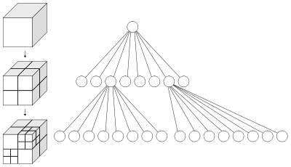
Quadtrees & Octrees [1]:
Background
Idea of binary space partition: good general applicability
Variations used in several different structures
  BSP trees (of course)
    Split along planes containing facets
  Quadtrees & octrees (next)
    Split along pre-defined planes.
  K-d trees (Lecture 28)
    Split along planes parallel to coordinate axes, so as to split up the objects nicely.
    How about a project on K-d trees?
Quadtrees used to partition 2-D space; octrees are for 3-D
  Two concepts are nearly identical
  Unfortunate that they are given different names
Wikipedia, Octree
http://bit.ly/dVrthx
Adapted from slides © 2004 G. G. Chappell, UAF
CS 481/681: Advanced Computer Graphics, Spring 2004, http://bit.ly/eivvVc

Slide 32
Quadtrees & Octrees [2]:
Definition
In general
  Quadtree: tree in which each node has at most 4 children
  Octree: tree in which each node has at most 8 children
  Binary tree: tree in which each node has at most 2 children
In practice, however, we use “quadtree” and “octree” to mean something more specific
  Each node of the tree corresponds to a square (quadtree) or cubical (octree) region
  If a node has children, think of its region being chopped into 4 (quadtree) or 8 (octree) equal subregions
  Child nodes correspond to these smaller subregions of parent’s region
  Subdivide as little or as much as is necessary
  Each internal node has exactly 4 (quadtree) or 8 (octree) children
Adapted from slides © 2004 G. G. Chappell, UAF
CS 481/681: Advanced Computer Graphics, Spring 2004, http://bit.ly/eivvVc

Slide 33
Quadtrees & Octrees [3]:
Example
Root node of quadtree corresponds to square region in space
  Generally, this encompasses entire “region of interest”
If desired, subdivide along lines parallel to the coordinate axes, forming four smaller identically sized square regions
  Child nodes correspond to these
Some or all of these children may be subdivided further
Octrees work in a similar fashion, but in 3-D, with cubical regions subdivided into 8 parts
A
A
A
B
C
B
C
D
E
D
E
A
A
B
C
B
C
D
E
D
E
F
G
F
G
H
I
H
I
Adapted from slides © 2004 G. G. Chappell, UAF
CS 481/681: Advanced Computer Graphics, Spring 2004, http://bit.ly/eivvVc

Slide 34
Quadtrees & Octrees [4]:
What Are They Good For?
Handling Observer-Object Interactions
  Subdivide the quadtree/octree until each leaf’s region intersects only a small number of objects
  Each leaf holds a list of pointers to objects that intersect its region
  Find out which leaf the observer is in. We only need to test for interactions with the objects pointed to by that leaf
Inside/Outside Tests for Odd Shapes
  The root node represent a square containing the shape
  If node’s region lies entirely inside or entirely outside shape, do not subdivide it
  Otherwise, do subdivide (unless a predefined depth limit has been exceeded)
  Then the quadtree or octree contains information allowing us to check quickly whether a given point is inside the shape
Sparse Arrays of Spatially-Organized Data
  Store array data in the quadtree or octree
  Only subdivide if that region of space contains interesting data
  This is how an octree is used in the BLUIsculpt program
Adapted from slides © 2004 G. G. Chappell, UAF
CS 481/681: Advanced Computer Graphics, Spring 2004, http://bit.ly/eivvVc

Slide 35
Summary
Reading for Last Class: §2.4.3, 8.1, Eberly 2e, GL handout
Reading for Today: Chapter 6, Esp. §6.1, Eberly 2e
Reading for Next Class: Chapter 7, §8.4, Eberly 2e
Last Time: Collision Detection Part 1 of 2
  Static vs. dynamic, testing vs. finding, distance vs. intersection
  Triangle point containment test
  Lots of intersections: spheres, capsules, lozenges
  Method of separating axes
Today: Adaptive Spatial Partitioning
  Visible Surface Determination (VSD) revisited
  Constructive Solid Geometry (CSG) trees
  Binary Space Partitioning (BSP) trees
  Quadtrees: adaptive 2-D (planar) subdivision
  Octrees: adaptive 3-D (spatial) subdivision
Coming Soon: Volume Graphics & Voxels

Slide 36
Terminology
Collision Detection
  Static vs. dynamic objects
  Queries: test-intersection vs. find-intersection
  Parametric methods: distance-based, intersection-based
Bounding Objects
  Axis-aligned bounding box
  Oriented bounding box: can point in arbitrary direction
  Sphere
  Capsule
  Lozenge
Constructive Solid Geometry Tree: Regularized Boolean Set Operators
Adaptive Spatial Partitioning: Calculating Intersection, Visibility
  Binary Space Partitioning tree – 2-way decision tree/surface
  Quadtree – 4-way for 2-D
  Octree – 8-way for 3-D

