Slide 1
Lecture 26 of 41
Picking
Videos 5: More CGA
William H. Hsu
Department of Computing and Information Sciences, KSU
KSOL course pages: http://bit.ly/hGvXlH / http://bit.ly/eVizrE
Public mirror web site: http://www.kddresearch.org/Courses/CIS636
Instructor home page: http://www.cis.ksu.edu/~bhsu
Readings:
Today: Chapter 7, §8.4, Eberly 2e – see http://bit.ly/ieUq45
Next class: §8.3 – 8.4, 4.2, 5.0, 5.6, 9.1, Eberly 2e
Lighthouse 3-D picking tutorial by A. R. Fernandes: http://bit.ly/dZud4j

Slide 2
Lecture Outline
Reading for Last Class: Chapter 6, Esp. §6.1, Eberly 2e
Reading for Today: Chapter 7, §8.4, Eberly 2e
Reading for Next Class: §8.3 – 8.4, 4.2, 5.0, 5.6, 9.1, Eberly 2e
Last Time: Adaptive Spatial Partitioning
  Visible Surface Determination (VSD) revisited
  Constructive Solid Geometry (CSG), Binary Space Partitioning (BSP)
  Quadtrees (2-D) & octrees (3-D)
Today: Picking
  OpenGL modes: rendering (default), feedback, selection
  Name stack
  Hit records
  Rendering in selection mode
  Using selection buffer
  Color coding to keep track of what has been picked, what to do
Next Class: Interaction Handling

Slide 3
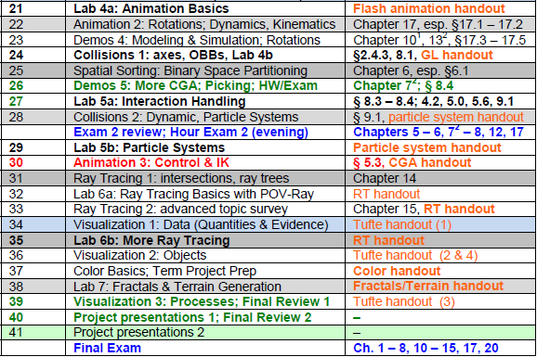

Where We Are

Slide 4





Acknowledgements:
Collisions, Data Structures, Picking
Steve Rotenberg
Visiting Lecturer
Graphics Lab
University of California – San Diego
CEO/Chief Scientist, PixelActive
http://graphics.ucsd.edu
Glenn G. Chappell
Associate Professor
Department of Computer Science
University of Alaska Fairbanks
http://www.cs.uaf.edu/~chappell/
Edward Angel
Professor Emeritus of Computer Science
Founding Director, ARTS Lab
University of New Mexico
http://www.cs.unm.edu/~angel/

Slide 5
Review [1]:
Tree Representations for Scenes
Scene Graphs
  Organized by how scene is constructed
  Nodes hold objects
Constructive Solid Geometry (CSG) Trees
  Organized by how scene is constructed
  Leaves hold 3-D primitives
  Internal nodes hold set operations
Binary Space Partitioning (BSP) Trees
  Organized by spatial relationships in scene
  Nodes hold facets (in 3-D, polygons)
Quadtrees & Octrees
  Organized spatially
  Nodes represent regions in space
  Leaves hold objects
Adapted from slides © 2004 G. G. Chappell, UAF
CS 481/681: Advanced Computer Graphics, Spring 2004, http://bit.ly/eivvVc

Slide 6
Review [2]:
Scene Graphs as B-Trees
We think of scene graphs as looking like the tree on the left.
However, it is often convenient to implement them as shown on the right.
  Implementation is a B-tree.
  Child pointers are first-logical-child and next-logical-sibling.
  Then traversing the logical tree is a simple pre-order traversal of the physical tree. This is how we draw.
Logical Tree
Physical Tree
Adapted from slides © 2004 G. G. Chappell, UAF
CS 481/681: Advanced Computer Graphics, Spring 2004, http://bit.ly/eivvVc

Slide 7
Review [3]:
Binary Space Partitioning (BSP) Tree
BSP tree: type of binary tree
  Nodes can have 0, 1, or two children
  Order of child nodes matters, and if a node has just 1 child, it matters whether this is its left or right child
Each node holds a facet
  This may be only part of a facet from original scene
  When constructing a BSP tree, we may need to split facets
Organization
  Each facet lies in a unique plane
    In 2-D, a unique line
  For each facet, we choose one side of its plane to be “outside” Other direction: “inside”
    This can be the side the normal vector points toward
  Rule: For each node
    Its left descendant subtree holds only facets “inside” it
    Its right descendant subtree holds only facets “outside” it
Adapted from slides © 2004 G. G. Chappell, UAF
CS 481/681: Advanced Computer Graphics, Spring 2004, http://bit.ly/eivvVc

Slide 8
Review [4]:
BSP Tree Construction Example
Suppose we are given the following (2-D) facets and
“outside” directions:
We iterate through the facets in numerical order
  Facet 1 becomes the root
  Facet 2 is inside of 1
  Thus, after facet 2, we have the following BSP tree:
Facet 3 is partially inside facet 1 and partially outside.
  We split facet 3 along the line containing facet 1
  The resulting facets are 3a and 3b
  They inherit their “outside” directions from facet 3
We place facets 3a and 3b separately
  Facet 3a is inside facet 1 and outside facet 2
  Facet 3b is outside facet 1
The final BSP tree looks like this:
2
1
3
1
2
2
3a
1
3b
1
2
3b
3a
Adapted from slides © 2004 G. G. Chappell, UAF
CS 481/681: Advanced Computer Graphics, Spring 2004, http://bit.ly/eivvVc

Slide 9
Review [5]:
BSP Tree Traversal Example
Procedure:
  For each facet, determine on which side of it the observer lies.
  Back-to-front ordering: Do an in-order traversal of the tree in which the subtree opposite from the observer comes before the subtree on the same side as the observer.
Our observer is inside 1, outside 2, inside 3a, inside 3b.
Resulting back-to-front ordering: 3b, 1, 2, 3a.
Is this really back-to-front?
1
2
2
3b
3a
1
3b
3a
Adapted from slides © 2004 G. G. Chappell, UAF
CS 481/681: Advanced Computer Graphics, Spring 2004, http://bit.ly/eivvVc

Slide 10
Review [6]:
BSP Tree Optimization Example
Order in which we iterate through the facets can matter a great deal
  Consider our simple example again
  If we change the ordering, we can obtain a simpler BSP tree
If a scene is not going to change, and the BSP tree will be used many times, then it may be worth a large amount of preprocessing time to find the best possible BSP tree
1
2
2
3a
2
3b
1
3
1
3b
3a
numbers
reversed
1
1
2
3
2
3
Adapted from slides © 2004 G. G. Chappell, UAF
CS 481/681: Advanced Computer Graphics, Spring 2004, http://bit.ly/eivvVc

Slide 11
Review [7]:
Quadtrees & Octrees – Definition
In general
  Quadtree: tree in which each node has at most 4 children
  Octree: tree in which each node has at most 8 children
  Binary tree: tree in which each node has at most 2 children
In practice, however, we use “quadtree” and “octree” to mean something more specific
  Each node of the tree corresponds to a square (quadtree) or cubical (octree) region
  If a node has children, think of its region being chopped into 4 (quadtree) or 8 (octree) equal subregions
  Child nodes correspond to these smaller subregions of parent’s region
  Subdivide as little or as much as is necessary
  Each internal node has exactly 4 (quadtree) or 8 (octree) children
Adapted from slides © 2004 G. G. Chappell, UAF
CS 481/681: Advanced Computer Graphics, Spring 2004, http://bit.ly/eivvVc

Slide 12
Review [8]:
Quadtree Construction Example
Root node of quadtree corresponds to square region in space
  Generally, this encompasses entire “region of interest”
If desired, subdivide along lines parallel to the coordinate axes, forming four smaller identically sized square regions
  Child nodes correspond to these
Some or all of these children may be subdivided further
Octrees work in a similar fashion, but in 3-D, with cubical regions subdivided into 8 parts
A
A
A
B
C
B
C
D
E
D
E
A
A
B
C
B
C
D
E
D
E
F
G
F
G
H
I
H
I
Adapted from slides © 2004 G. G. Chappell, UAF
CS 481/681: Advanced Computer Graphics, Spring 2004, http://bit.ly/eivvVc

Slide 13
Interactive CG Programming:
Objectives
More Sophisticated Interactive Programs
  Modes of interaction
  Tools for building
Techniques
  Picking: select objects from display (three methods covered)
  Rubberbanding: interactive drawing of lines, rectangles
  Display lists: retained mode graphics
Adapted from slides © 2005-2008 E. Angel, University of New Mexico
Interactive Computer Graphics, 4th & 5th edition slides, http://bit.ly/gvxfPV

Slide 14
Picking [1]:
Definition & Challenges
Identify User-Defined Object on Display
In Principle, Should Be Simple
  Mouse gives position
  We should be able to determine object-position correspondence
Practical Difficulties
  Pipeline architecture: feed forward
  Hard to map screen back to world
  Complicated by screen being 2-D, world 3-D
  How close do we have to come to object to say we selected it?
Adapted from slides © 2005-2008 E. Angel, University of New Mexico
Interactive Computer Graphics, 4th & 5th edition slides, http://bit.ly/gvxfPV

Slide 15
Picking [2]:
Three Approaches
1. Hit List
  Most general approach
  Difficult to implement
2. Buffered Object IDs
  Write to back buffer or some other buffer
  Store object IDs as objects rendered
3. Rectangular Maps
  Easy to implement for many applications
  e.g., simple paint programs
Adapted from slides © 2005-2008 E. Angel, University of New Mexico
Interactive Computer Graphics, 4th & 5th edition slides, http://bit.ly/gvxfPV

Slide 16
Rendering Modes
OpenGL: Can Render in One of Three Modes
  GL_RENDER
    Normal rendering to frame buffer
    Default
  GL_FEEDBACK
    Provides list of primitives rendered
    No output to frame buffer
  GL_SELECTION
    Each primitive in view volume generates hit record
    Record placed in name stack
    Stack can be examined later
Mode Selected by glRenderMode(mode)
Adapted from slides © 2005-2008 E. Angel, University of New Mexico
Interactive Computer Graphics, 4th & 5th edition slides, http://bit.ly/gvxfPV

Slide 17
Selection Mode Functions
glSelectBuffer(): Specifies Name Buffer aka Name Stack
glInitNames(): Initializes Name Buffer
glPushName(id): Push ID on Name Buffer
glPopName(): Pop Top of Name Buffer
glLoadName(id): Replace Top Name on Buffer
id set by application program to identify objects
Adapted from slides © 2005-2008 E. Angel, University of New Mexico
Interactive Computer Graphics, 4th & 5th edition slides, http://bit.ly/gvxfPV

Slide 18

OpenGL Functions for Manipulating
Name Stack
void glInitNames(void);
  Creates empty name stack
  Must call to initialize stack prior to pushing names
void glPushName(GLuint name);
  Adds name to top of stack
  Maximum dimension: implementation-dependent
  Must contain at least 64 names
  Can query state variable GL_NAME_STACK_DEPTH
  Pushing too many values causes GL_STACK_OVERFLOW
void glPopName();
  Removes name from top of stack
  Popping value from empty stack causes GL_STACK_UNDERFLOW
void glLoadName(GLunit name);
  Replaces top of stack with name
  Same as calling glPopName(); glPushName(name);
Adapted from tutorial © 2001-2009 A. R. Fernandes
Lighthouse 3D, http://www.lighthouse3d.com

Slide 19
Rendering in Selection Mode:
Example
#define BODY 1
#define HEAD 2
…
void renderInSelectionMode()
{
glInitNames(); // 1. create empty name stack (NS)
glPushName(BODY); // 2. push first name
        // 3. hit record (HR) for each primitive intersecting view volume
        drawBody();
        // 4. empty stack & save HRs to selection buffer (SB)
        glPopName();
        glPushName(HEAD); // 5. new name; no HR, same SB
        drawHead(); // 6. new HR for each primitive in VV
        drawEyes(); // 7. update HR with new max/min depths
        glPopName(); // 8. empty NS; write HRs to SB
        drawGround(); // 9. new HRs; empty NS, depth update only
        }
Same as
glLoadName(HEAD);
Adapted from tutorial © 2001-2009 A. R. Fernandes
Lighthouse 3D, http://www.lighthouse3d.com

Slide 20
Using Selection Mode
Initialize Name Buffer aka Name Stack
Enter Selection Mode (using Mouse)
Render Scene with User-Defined Identifiers
  Accumulates hits
  Create new hit record iff needed (otherwise update depth)
Reenter Normal Render Mode
  Returns number of hits
  Objects rendered on small area of screen around cursor
Examine contents of name buffer
  Hit records written to selection buffer
  Include information about each hit
    ID
    Depth
Adapted from slides © 2005-2008 E. Angel, University of New Mexico
Interactive Computer Graphics, 4th & 5th edition slides, http://bit.ly/gvxfPV

Slide 21
Selection Mode:
Redefining View Volume
Caveat
  As just described, selection mode won’t work for picking – why?
  Because every primitive in view volume will generate a hit
  Need to change viewing parameters
    Only those primitives near cursor are in altered view volume
    Use gluPickMatrix (see Angel 5e or 6e for details)
New Procedure (cf. Fernandes Tutorial)
  1. Get the window coordinates of the mouse
  2. Enter selection mode
  3. Redefine viewing volume so that only small area of window around cursor is rendered
  4. Render scene, either using all primitives or only those relevant to picking operation
  5. Exit selection mode and identify objects which were rendered on that small part of screen
Adapted from slides © 2005-2008 E. Angel, University of New Mexico
Interactive Computer Graphics, 4th & 5th edition slides, http://bit.ly/gvxfPV

Slide 22
Graphical User Interface Design:
Using Regions of Screen
Rectangular Arrangement
  Used by many applications
  e.g., paint & computer-aided design (CAD) programs
Advantages
  Compared to: selection mode picking
  Easier to look at cursor position, determine part of window it is in
Common Graphical User Interface (GUI) Design
  Xerox Palo Alto Research Center (PARC) – http://bit.ly/dSAr1O
  Human Interface Guidelines – Wikipedia: http://bit.ly/dO6I5F
Tools
Menus
Drawing Area
Adapted from slides © 2005-2008 E. Angel, University of New Mexico
Interactive Computer Graphics, 4th & 5th edition slides, http://bit.ly/gvxfPV

Slide 23
Picking:
Using Second Buffer & Color-Coding
Color Coding
  For small number of objects
  Can assign a unique color to each object
  Often assigned in color index mode
Using Color Coding for Picking
  Render scene to color buffer other than front buffer
  Results of rendering not visible
  Get mouse position
  Use glReadPixels() to read color in buffer written at position of cursor
  Returned color gives ID of object
Adapted from slides © 2005-2008 E. Angel, University of New Mexico
Interactive Computer Graphics, 4th & 5th edition slides, http://bit.ly/gvxfPV

Slide 24
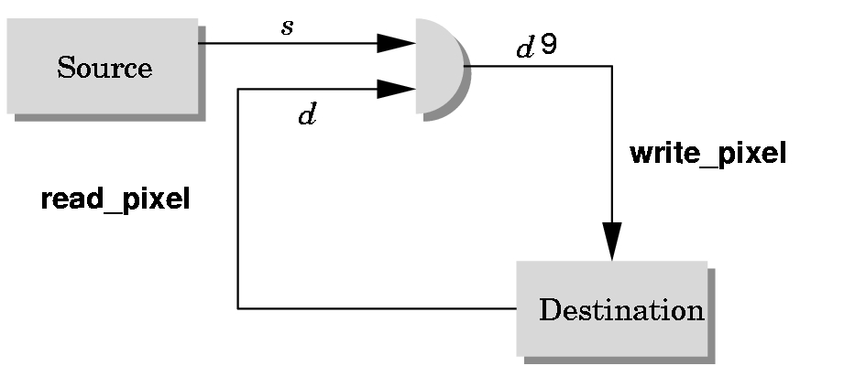
Writing Modes
application
bitwise logical operation
‘
frame buffer
Adapted from slides © 2005-2008 E. Angel, University of New Mexico
Interactive Computer Graphics, 4th & 5th edition slides, http://bit.ly/gvxfPV

Slide 25
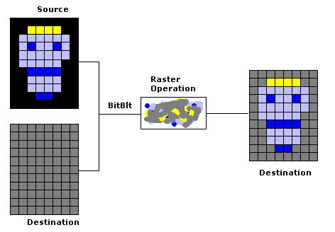
Exclusive OR (XOR) Write
Usual (Default) Mode
  Source replaces destination: d’ = s
  Cannot write temporary lines this way – why?
    Cannot recover what was “under” line in fast, simple way
    Consequence: cannot deselect (toggle select) easily
Solution: Exclusive OR Mode (XOR)
  d’ = d ⊕ s
  Suppose we use XOR mode to scan convert line
  Can draw it again to erase it!
Visual Basic Explorer © 2002 S. Christensen & B. Abreu
http://bit.ly/gXstAM
Adapted from slides © 2005-2008 E. Angel, University of New Mexico
Interactive Computer Graphics, 4th & 5th edition slides, http://bit.ly/gvxfPV

Slide 26
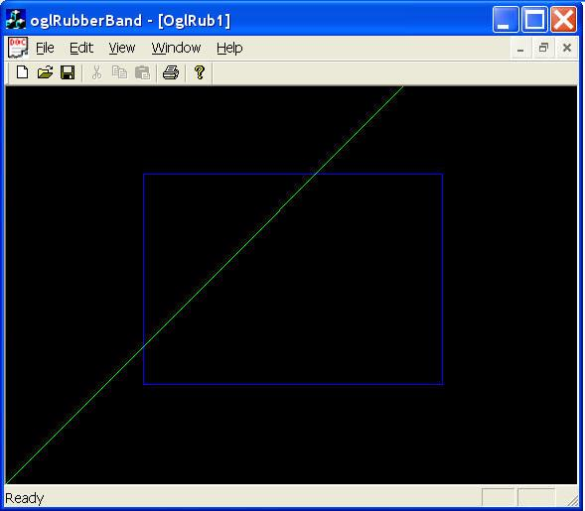
Rubberbanding
Switch to XOR Write Mode
Draw Object
  Line
    Can use first mouse click to fix one endpoint
    Then use motion callback to continuously update second endpoint
    Each time mouse is moved, redraw line which erases it
    Then draw line from fixed first position to new second position
    At end, switch back to normal drawing mode and draw line
  Works for other objects
    Rectangles
    Circles
“Rubber-Banding with OpenGL”
© 2009 J. Xu
The Code Project
http://bit.ly/hGvFkB
Adapted from slides © 2005-2008 E. Angel, University of New Mexico
Interactive Computer Graphics, 4th & 5th edition slides, http://bit.ly/gvxfPV

Slide 27
Rubberband Lines:
Example
second point
first point
Draw line with mouse
in XOR mode
Initial display
Mouse moved to
new position
Original line redrawn
with XOR
New line drawn
with XOR
Adapted from slides © 2005-2008 E. Angel, University of New Mexico
Interactive Computer Graphics, 4th & 5th edition slides, http://bit.ly/gvxfPV

Slide 28
XOR in OpenGL
Logical Operations between Two Bits X, Y
  2 bits ⇒ 2² = 4 values
  4 values ⇒ 2⁴ = 16 pairwise functions
    X, Y, ¬X ≡ , X ∧ Y ≡ XY, X ∨ Y ≡ X + Y, X ⊕ Y ≡
    etc.
    In general: functions for b bits
All 16 Operations Supported by OpenGL
  Must enable logical operations: glEnable(GL_COLOR_LOGIC_OP)
  Choose logical operation
    glLogicOp(GL_XOR)
    glLogicOp(GL_COPY) – default
Adapted from slides © 2005-2008 E. Angel, University of New Mexico
Interactive Computer Graphics, 4th & 5th edition slides, http://bit.ly/gvxfPV

Slide 29
Immediate versus Retained Modes
OpenGL Standard: Immediate Mode Graphics
  OpenGL programs use immediate mode by default
  Once object is rendered, there is no memory of it
  In order to redisplay it, must re-execute its rendering code
  Can be especially slow if objects
    are complex
    must be sent over network
Alternative: Retained Mode Graphics
  Accomplished in OpenGL via display lists, vertex buffer objects
  Define objects
  Keep them in some form that is easy to redisplay
Adapted from slides © 2005-2008 E. Angel, University of New Mexico
Interactive Computer Graphics, 4th & 5th edition slides, http://bit.ly/gvxfPV

Slide 30
Display Lists in OpenGL
Conceptually Similar to Graphics Files
  Compare: Flexible Vertex Format (FVF) definitions in Direct3D
  Also compare: mesh formats for OpenGL itself, other CG libraries
Requirements
  Define each display list (DL)
    Name
    Create
  Populate: add contents by
    reading in file
    generating mesh automatically
  Close
Client-Server Environment
  DL placed on server
  Can redisplay without sending primitives over network each time
Adapted from slides © 2005-2008 E. Angel, University of New Mexico
Interactive Computer Graphics, 4th & 5th edition slides, http://bit.ly/gvxfPV

Slide 31
Display List Functions
Creating Display List
  GLuint id;
  void init()
  {
  id = glGenLists( 1 );
  glNewList( id, GL_COMPILE );
  /* other OpenGL routines */
  glEndList();
  }
Calling Created List
  void display()
  {
  glCallList(id);
  }
  Documentation: http://bit.ly/gJYana
  Tutorial © 2005 S. H. Ahn: http://bit.ly/eN3R8c
Adapted from slides © 2005-2008 E. Angel, University of New Mexico
Interactive Computer Graphics, 4th & 5th edition slides, http://bit.ly/gvxfPV

Slide 32
Display Lists & State
Using Display Lists as Macros (http://bit.ly/hPPBVo)
  DLs are syntactic sugar (text abbreviations) for
    Rendering commands (especially mesh traversal)
    Parameters
  Now deprecated! Use vertex buffer objects (VBOs) instead
Side Effects: State Changes within DLs
  Most OpenGL functions can be put in display lists
  State changes made inside DL persist after DL is executed
Avoiding Unexpected Results
  Use glPushAttrib and glPushMatrix upon entering DL
  Use glPopAttrib and glPopMatrix before exiting
Adapted from slides © 2005-2008 E. Angel, University of New Mexico
Interactive Computer Graphics, 4th & 5th edition slides, http://bit.ly/gvxfPV

Slide 33
Hierarchy & Display Lists
Consider: Model of Car
  Similar hierarchy to that for general scene graphs
  Describes relative modelview transformation (MVT)
    translation
    rotation (relative Euler angle or quaternion)
Need to Create Display Lists
  Chassis
  Wheel
  glCallList( CHASSIS );
  glTranslatef( … );
  glCallList( WHEEL );
  glTranslatef( … );
  glCallList( WHEEL );
  …
  glEndList();NewList( CAR, GL_COMPILE );
Adapted from slides © 2005-2008 E. Angel, University of New Mexico
Interactive Computer Graphics, 4th & 5th edition slides, http://bit.ly/gvxfPV

Slide 34
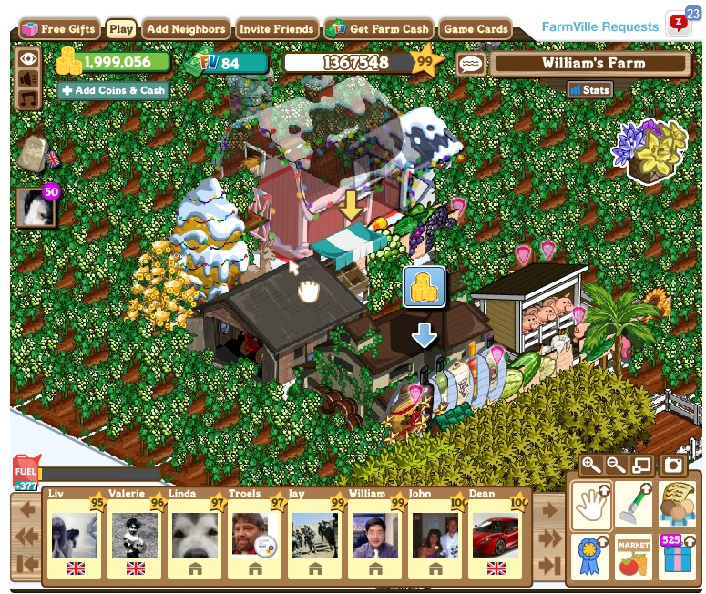
Picking in Action
FarmVille © 2009 – 2011 Zynga, Inc.
http://bit.ly/f1Ct3C

Slide 35
Summary
Reading for Last Class: §2.4.3, 8.1, Eberly 2e, GL handout
Reading for Today: Chapter 6, Esp. §6.1, Eberly 2e
Reading for Next Class: Chapter 7, §8.4, Eberly 2e
Last Time: Adaptive Spatial Partitioning
  Trees: VSD, CSG, BSP
  Spatial partitioning (SP)
    Examples: BSP trees, quad/octrees (adaptive); voxels (uniform)
    Scenes: spatial partitioning vs. boundary representation (B-rep)
Today: Picking
  OpenGL modes: rendering (default), feedback, selection
  Name stack
  Hit records
  Rendering in selection mode using selection buffer
  Color coding of pickable objects
Next Class: Interaction Handling

Slide 36
Terminology
Spatial Partitioning (SP): Calculating Intersection, Visibility
  Binary Space Partitioning tree – 2-way decision tree/surface
  Quadtree – 4-way for 2-D
  Octree – 8-way for 3-D
Volume Graphics aka Volumetric Representation: Uniform SP (Voxels)
Boundary Representation: Describing Enclosing Surface
  Meshes
  Implicit surfaces
  Sweeps (e.g., sphere-swept volumes: sphere, capsule, lozenge)
Picking: Allowing User to Select Objects in Scene
  Selection mode: mode when cursor (“mouse”) is active
  Name stack: last in, first out data structure holding object names
  Hit records: ID, depth info for intersections with view volume
  Selection buffer: holds hits, depth (compare: frame/z-buffer)
  Color coding: using color to represent pickable object ID

