Slide 1
Lecture 27 of 41
Interaction Handling
Lab 5: Using Particle Systems
William H. Hsu
Department of Computing and Information Sciences, KSU
KSOL course pages: http://bit.ly/hGvXlH / http://bit.ly/eVizrE
Public mirror web site: http://www.kddresearch.org/Courses/CIS636
Instructor home page: http://www.cis.ksu.edu/~bhsu
Readings:
Today: §8.3 – 8.4, 4.2, 5.0, 5.6, 9.1, Eberly 2e – see http://bit.ly/ieUq45
Next class: §9.1, Particle System Handout
Wikipedia, Human-Computer Interaction: http://bit.ly/bqrQTg
Wikipedia, User Interface: http://bit.ly/eaTY7u
Wikipedia, Particle System: http://bit.ly/hzZofI

Slide 2
Lecture Outline
Reading for Last Class: Chapter 7, §8.4, Eberly 2e
Reading for Today: §8.3 – 8.4, 4.2, 5.0, 5.6, 9.1, Eberly 2e
Reading for Next Class: §9.1, Particle System Handout
Last Time: Picking
  OpenGL modes: rendering (default), feedback, selection
  Name stack, hit records, rendering in selection mode
  Selection buffer and other buffers with color coding
Today: Interaction Handling
  Human-Computer Interaction (HCI)
  Perceptual Principles: Legibility, Consistency, Redundancy
  Mental Models: Realism, User Expectations
  Attention: Access Cost/Benefit, Multiple Sources, Sensory Modes
  Memory: Self-Explanatory GUIs, Predictive Aids, Reusable Skills
Next Class: Particle Systems

Slide 3
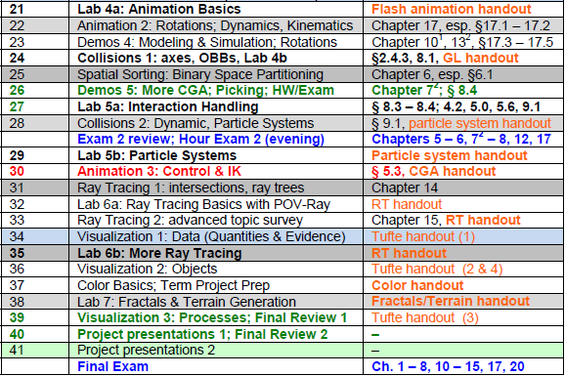

Where We Are

Slide 4






Acknowledgements:
Picking, Interaction, Particles
Edward Angel
Professor Emeritus of Computer Science
Founding Director, ARTS Lab
University of New Mexico
http://www.cs.unm.edu/~angel/
François Guimbretière
Associate Professor
Department of Computer Science
Cornell University
http://www.cs.cornell.edu/~francois/
Hubert Pak Ho Shum
Postdoctoral Researcher
Advanced Science Institute
RIKEN (理研)
http://hubertshum.com/info/

Slide 5
Review [1]:
Interactive Computer Graphics
More Sophisticated Interactive Programs
  Modes of interaction
  Tools for building
Techniques
  Picking: select objects from display (three methods covered)
  Rubberbanding: interactive drawing of lines, rectangles
  Display lists: retained mode graphics
Adapted from slides © 2005-2008 E. Angel, University of New Mexico
Interactive Computer Graphics, 4th & 5th edition slides, http://bit.ly/gvxfPV

Slide 6
Review [2]:
Picking – Three Approaches
1. Hit List
  Most general approach
  Difficult to implement
2. Buffered Object IDs
  Write to back buffer or some other buffer
  Store object IDs as objects rendered
3. Rectangular Maps
  Easy to implement for many applications
  e.g., simple paint programs
Adapted from slides © 2005-2008 E. Angel, University of New Mexico
Interactive Computer Graphics, 4th & 5th edition slides, http://bit.ly/gvxfPV

Slide 7
Review [3]:
OpenGL Rendering Modes
OpenGL: Can Render in One of Three Modes
  GL_RENDER
    Normal rendering to frame buffer
    Default
  GL_FEEDBACK
    Provides list of primitives rendered
    No output to frame buffer
  GL_SELECTION
    Each primitive in view volume generates hit record
    Record placed in name stack
    Stack can be examined later
Mode Selected by glRenderMode(mode)
Adapted from slides © 2005-2008 E. Angel, University of New Mexico
Interactive Computer Graphics, 4th & 5th edition slides, http://bit.ly/gvxfPV

Slide 8

Review [4]:
OpenGL Name Stack Functions
void glInitNames(void);
  Creates empty name stack
  Must call to initialize stack prior to pushing names
void glPushName(GLuint name);
  Adds name to top of stack
  Maximum dimension: implementation-dependent
  Must contain at least 64 names
  Can query state variable GL_NAME_STACK_DEPTH
  Pushing too many values causes GL_STACK_OVERFLOW
void glPopName();
  Removes name from top of stack
  Popping value from empty stack causes GL_STACK_UNDERFLOW
void glLoadName(GLunit name);
  Replaces top of stack with name
  Same as calling glPopName(); glPushName(name);
Adapted from tutorial © 2001-2009 A. R. Fernandes
Lighthouse 3D, http://www.lighthouse3d.com

Slide 9
Review [5]:
Example – OpenGL Selection Mode
#define BODY 1
#define HEAD 2
…
void renderInSelectionMode()
{
glInitNames(); // 1. create empty name stack (NS)
glPushName(BODY); // 2. push first name
        // 3. hit record (HR) for each primitive intersecting view volume
        drawBody();
        // 4. empty stack & save HRs to selection buffer (SB)
        glPopName();
        glPushName(HEAD); // 5. new name; no HR, same SB
        drawHead(); // 6. new HR for each primitive in VV
        drawEyes(); // 7. update HR with new max/min depths
        glPopName(); // 8. empty NS; write HRs to SB
        drawGround(); // 9. new HRs; empty NS, depth update only
        }
Same as
glLoadName(HEAD);
Adapted from tutorial © 2001-2009 A. R. Fernandes
Lighthouse 3D, http://www.lighthouse3d.com

Slide 10
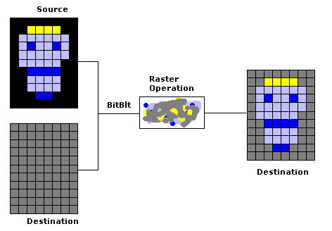
Review [6]:
BitBlitting, Sprites, & XOR Write
Usual (Default) Mode
  Source replaces destination: d’ = s
  Cannot write temporary lines this way – why?
    Cannot recover what was “under” line in fast, simple way
    Consequence: cannot deselect (toggle select) easily
Solution: Exclusive OR Mode (XOR)
  d’ = d ⊕ s
  Suppose we use XOR mode to scan convert line
  Can draw it again to erase it!
Visual Basic Explorer © 2002 S. Christensen & B. Abreu
http://bit.ly/gXstAM
Adapted from slides © 2005-2008 E. Angel, University of New Mexico
Interactive Computer Graphics, 4th & 5th edition slides, http://bit.ly/gvxfPV

Slide 11
Review [7]:
Example – Rubberband Lines
second point
first point
Draw line with mouse
in XOR mode
Initial display
Mouse moved to
new position
Original line redrawn
with XOR
New line drawn
with XOR
Adapted from slides © 2005-2008 E. Angel, University of New Mexico
Interactive Computer Graphics, 4th & 5th edition slides, http://bit.ly/gvxfPV

Slide 12
Review [8]:
OpenGL Display List Functions
Creating Display List
  GLuint id;
  void init()
  {
  id = glGenLists( 1 );
  glNewList( id, GL_COMPILE );
  /* other OpenGL routines */
  glEndList();
  }
Calling Created List
  void display()
  {
  glCallList(id);
  }
  Documentation: http://bit.ly/gJYana
  Tutorial © 2005 S. H. Ahn: http://bit.ly/eN3R8c
Adapted from slides © 2005-2008 E. Angel, University of New Mexico
Interactive Computer Graphics, 4th & 5th edition slides, http://bit.ly/gvxfPV

Slide 13
Human-Computer Interaction (HCI)
Study, Planning, & Design of Interaction between People, Computers
  Study: intersection of computer science, behavioral science, design
  Planning: information management tasks, media
  Design: graphical user interfaces, displays, algorithms, systems
Related Areas
  Cognitive Science & Cognitive Modeling
  Ergonomics & Human Factors
    HCI: more emphasis on computers (vs. other artifacts)
    Some overlap within information technology
  Computational Information & Knowledge Management (CIKM)
  Software Engineering: Operating Systems
  Computer Graphics
  Wearable Computers & Ubiquitous Communication/Computing
Adapted from Wikipedia, Human-Computer Interaction
http://bit.ly/bqrQTg

Slide 14
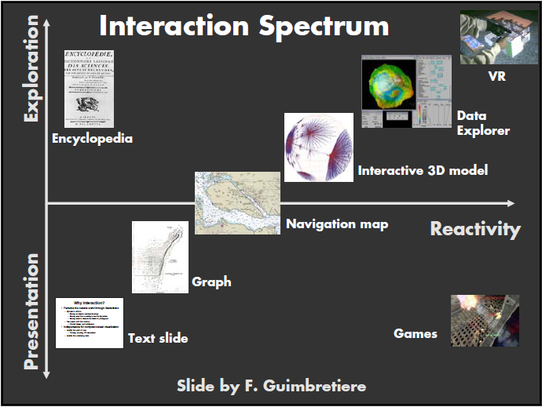
Interaction Spectrum
for HCI & Print Media
Adapted from slide © 2004 F. Guimbretière, Cornell University
Stanford CS448B: Visualization, Fall 2004, http://bit.ly/h0hRzU

Slide 15
HCI Design [1]:
Perceptual Principles
1. Make Displays Perceivable (Legible, Audible, etc.)
  User must discern characters, objects, processes to interact
  Usual sense of perceivability: legibility (readability)
2. Avoid Absolute Judgment Limits
  Don’t ask user to sense level of variable based on one channel
  Examples: color, size, (audio) volume
3. Use Top-Down Processing: Be Consistent with Past Experience
4. Exploit Redundancy
  Present signal in alternative forms: color & shape, voice & print, etc.
  Example: traffic light (color & position, sometimes sound)
5. Use Discriminable Elements to Minimize Confusion
  Allow visual elements to overlap only when necessary
  Example: A423B9 more similar to A423B8 than 92 to 93
Adapted from material © 2008 Wikimedia Foundation (from Wickens et al., 2004)
Human-Computer Interaction, http://bit.ly/bqrQTg

Slide 16
HCI Design [2]:
Mental Models Principles
6. Maintain Pictorial Realism
  UI elements should match real-world elements
  Organization & layout should match those of real-world
7. Follow User’s Expectations Regarding Moving Parts
  Motion paths should follow behavior of processes they model
  Example: mark on altimeter should move up as altitude increases
Adapted from material © 2008 Wikimedia Foundation (from Wickens et al., 2004)
Human-Computer Interaction, http://bit.ly/bqrQTg

Slide 17
HCI Design [3]:
Principles Based on Attention
8. Minimize Information Access Cost
  Reduce cognitive load, especially time/effort overhead
  Make convenience/accessibility proportional to frequency of access
9. Place Multiple Information Sources Close Together & Integrate Them
  Ensure design compatibility (layout, style, symbols, controls, etc.)
  Tradeoff: usability aspects – understandability vs. efficiency
  Use convenient shortcuts in proportion to frequency of need
  User education needs
10. Multiple Information Channels
  Multisensory channels and integration (e.g., audio-visual)
  Take advantage of brain’s ability to merge senses
Adapted from material © 2008 Wikimedia Foundation (from Wickens et al., 2004)
Human-Computer Interaction, http://bit.ly/bqrQTg

Slide 18
HCI Design [4]:
Memory Principles
11. Replace Memory with Visual Information: Knowledge in The World
  Don’t rely on user to remember menus, shortcuts & macros
  Present GUI elements in self-explanatory way to user
  Balance usability for new users and experienced users
12. Develop Methods for Predictive Aiding
  Proactive (as opposed to reactive) user feedback
  Example: road signs depicting km to destination, progress bars
13. Ensure Consistency
  Fulfill user’s expectations of similarity towards lookalike GUIs
  Maximize skill transfer
Adapted from material © 2008 Wikimedia Foundation (from Wickens et al., 2004)
Human-Computer Interaction, http://bit.ly/bqrQTg

Slide 19
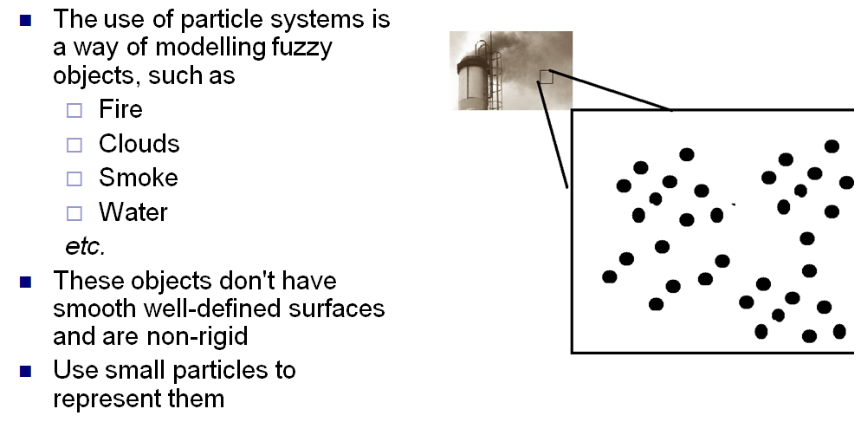
Particle Systems [1]:
Natural Effects
Adapted from slide © 2008 H. P. H. Shum, RIKEN (理研)
Computer Animation, http://bit.ly/ig6KTK

Slide 20
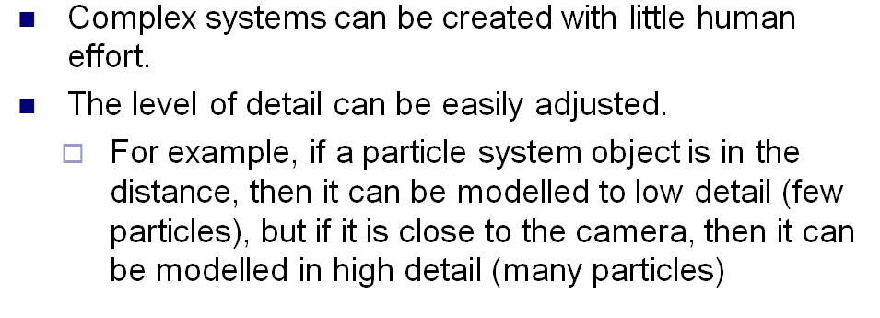
Particle Systems [2]:
Advantages
Adapted from slide © 2008 H. P. H. Shum, RIKEN (理研)
Computer Animation, http://bit.ly/ig6KTK

Slide 21
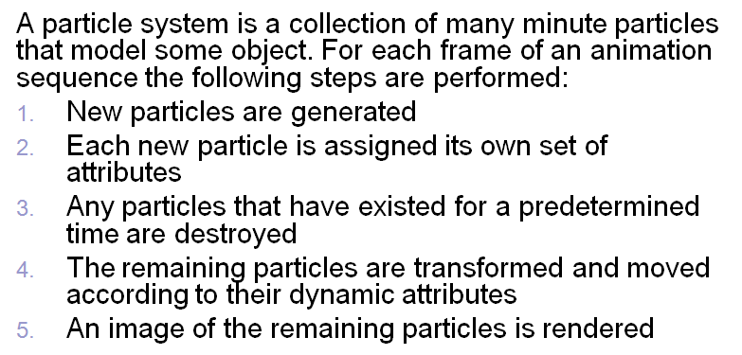
Particle Systems [3]:
Basic Model
Adapted from slide © 2008 H. P. H. Shum, RIKEN (理研)
Computer Animation, http://bit.ly/ig6KTK

Slide 22
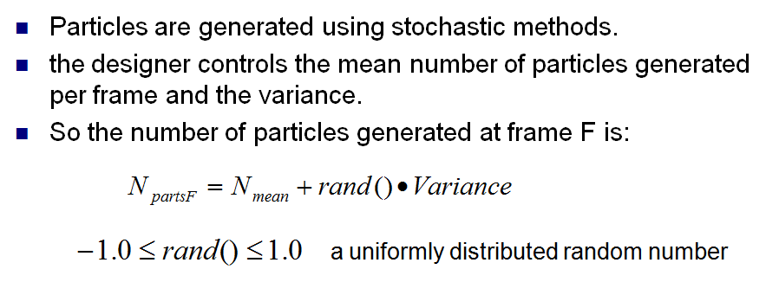
Particle Generation
Adapted from slide © 2008 H. P. H. Shum, RIKEN (理研)
Computer Animation, http://bit.ly/ig6KTK

Slide 23
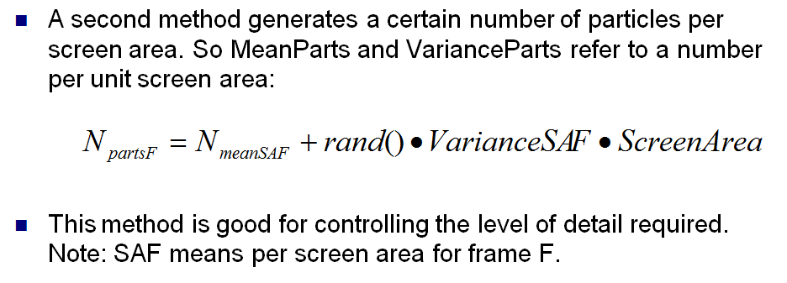
Particles per Area
Adapted from slide © 2008 H. P. H. Shum, RIKEN (理研)
Computer Animation, http://bit.ly/ig6KTK

Slide 24
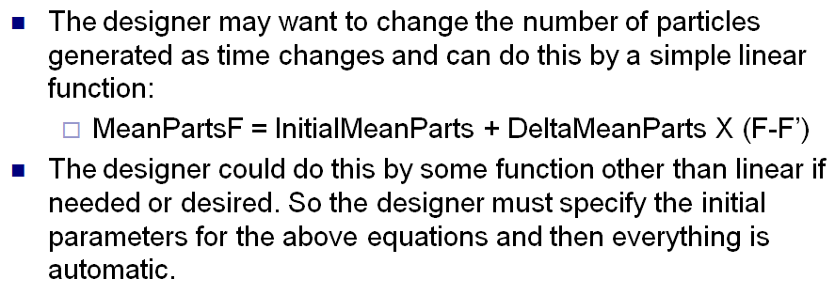
Particle Emission Rate
as a Function of Time
Adapted from slide © 2008 H. P. H. Shum, RIKEN (理研)
Computer Animation, http://bit.ly/ig6KTK

Slide 25
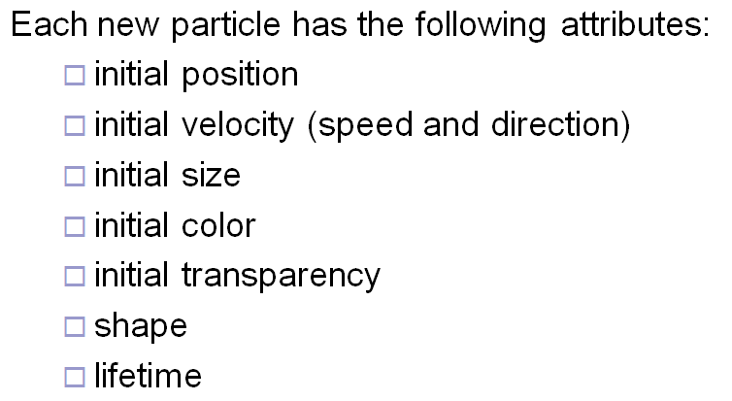
Particle Attributes
Adapted from slide © 2008 H. P. H. Shum, RIKEN (理研)
Computer Animation, http://bit.ly/ig6KTK

Slide 26
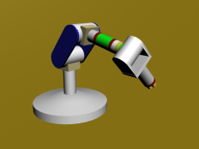
Review:
Dynamics & Kinematics
Dynamics: Study of Motion & Changes in Motion
  Forward: model forces over time to find state, e.g.,
    Given: initial position p₀ , velocity v₀, gravitational constants
    Calculate: position p_{t} at time t
  Inverse: given state and constraints, calculate forces, e.g.,
    Given: desired position p_{t} at time t, gravitational constants
    Calculate: position p₀ , velocity v₀ needed
  Wikipedia: http://bit.ly/hH43dX (see also: “Analytical dynamics”)
  For non-particle objects: rigid-body dynamics (http://bit.ly/dLvejg)
Kinematics: Study of Motion without Regard to Causative Forces
  Modeling systems – e.g., articulated figure
  Forward: from angles to position (http://bit.ly/eh2d1c)
  Inverse: finding angles given desired position (http://bit.ly/hsyTb0)
  Wikipedia: http://bit.ly/hr8r2u
Forward Kinematics
© 2009 Wikipedia

Slide 27
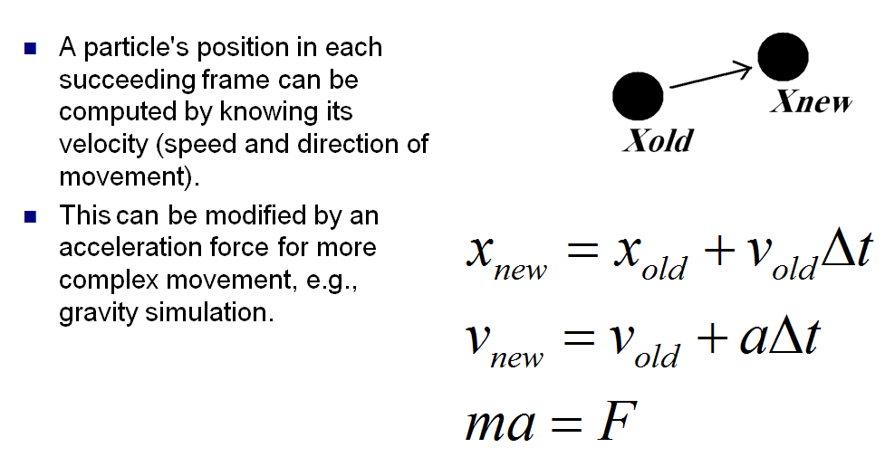
Particle Dynamics
Adapted from slide © 2008 H. P. H. Shum, RIKEN (理研)
Computer Animation, http://bit.ly/ig6KTK

Slide 28
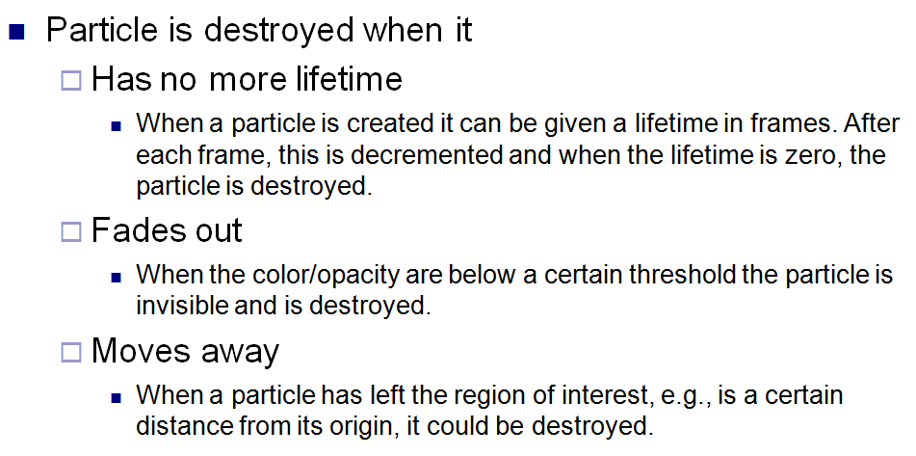
Particle Extinction
Adapted from slide © 2008 H. P. H. Shum, RIKEN (理研)
Computer Animation, http://bit.ly/ig6KTK

Slide 29
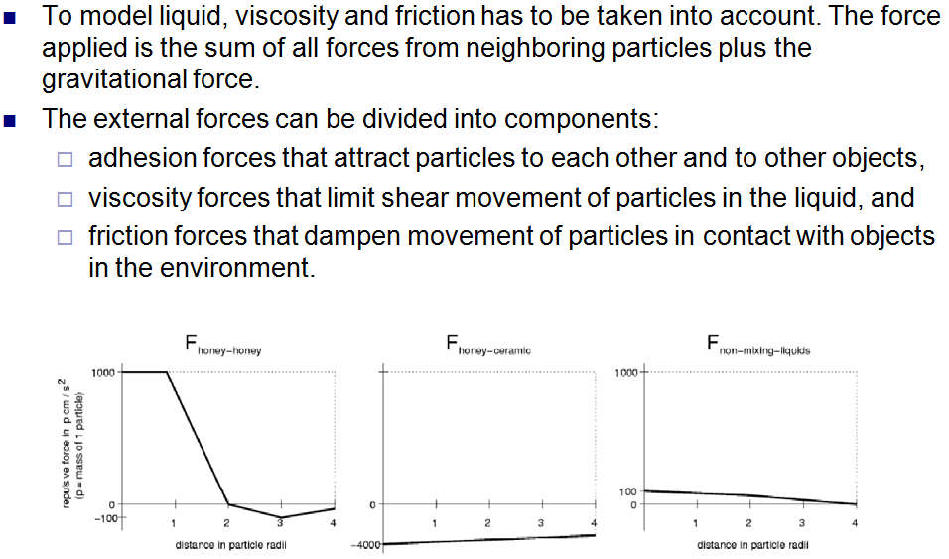
Modeling Water
Adapted from slide © 2008 H. P. H. Shum, RIKEN (理研)
Computer Animation, http://bit.ly/ig6KTK

Slide 30
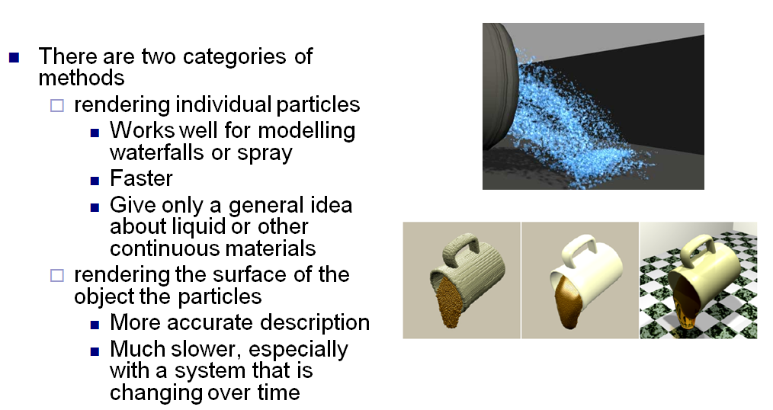
Particle Systems [2]:
Adapted from slide © 2008 H. P. H. Shum, RIKEN (理研)
Computer Animation, http://bit.ly/ig6KTK

Slide 31
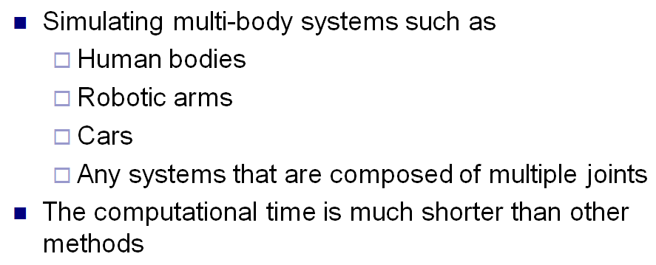
Particle Systems for
Multi-Body Systems
Adapted from slide © 2008 H. P. H. Shum, RIKEN (理研)
Computer Animation, http://bit.ly/ig6KTK

Slide 32
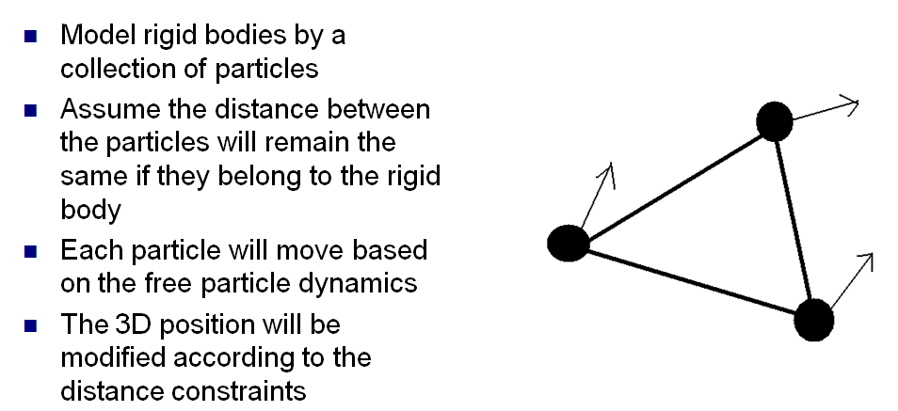
Rigid Body Dynamics:
How to Do It?
Adapted from slide © 2008 H. P. H. Shum, RIKEN (理研)
Computer Animation, http://bit.ly/ig6KTK

Slide 33
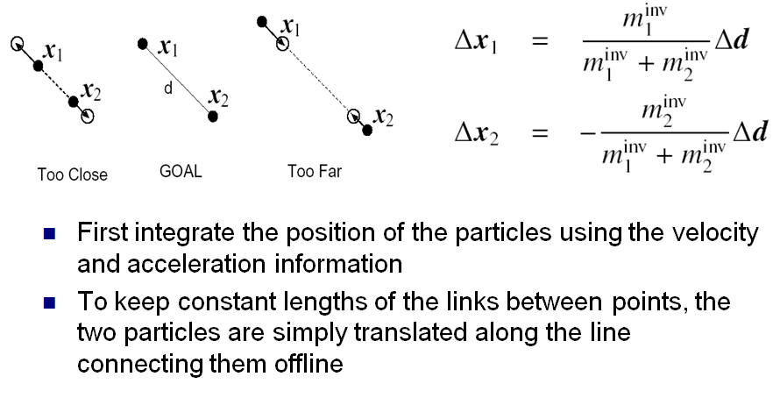
Distance between Particles:
Keep Constant
Adapted from slide © 2008 H. P. H. Shum, RIKEN (理研)
Computer Animation, http://bit.ly/ig6KTK

Slide 34
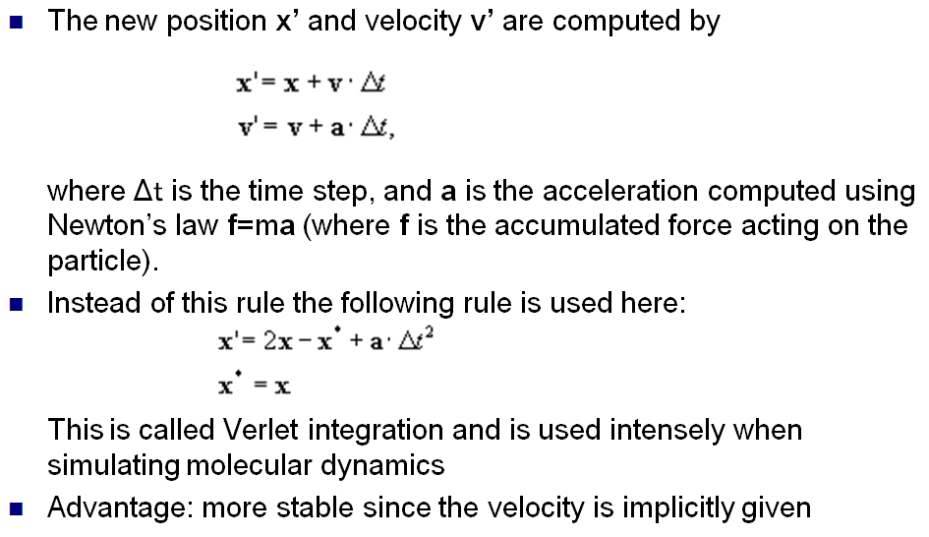
Verlet Integration
Adapted from slide © 2008 H. P. H. Shum, RIKEN (理研)
Computer Animation, http://bit.ly/ig6KTK

Slide 35
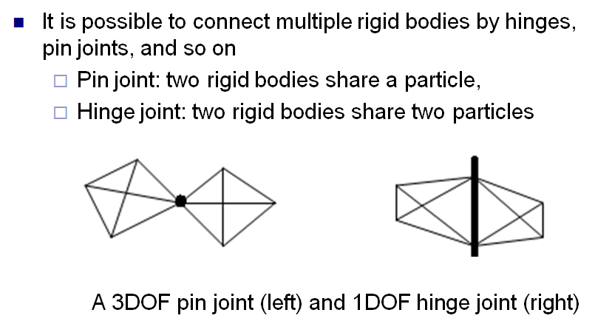
Modeling Joints
Adapted from slide © 2008 H. P. H. Shum, RIKEN (理研)
Computer Animation, http://bit.ly/ig6KTK

Slide 36
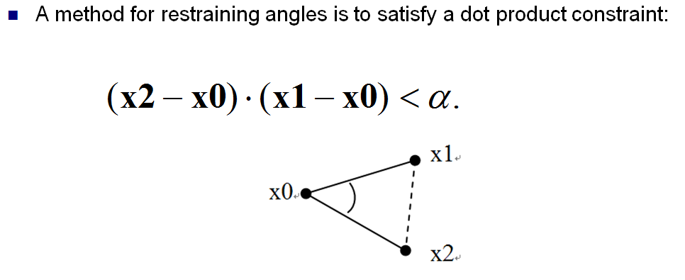
Setting Joint Limits
Adapted from slide © 2008 H. P. H. Shum, RIKEN (理研)
Computer Animation, http://bit.ly/ig6KTK

Slide 37
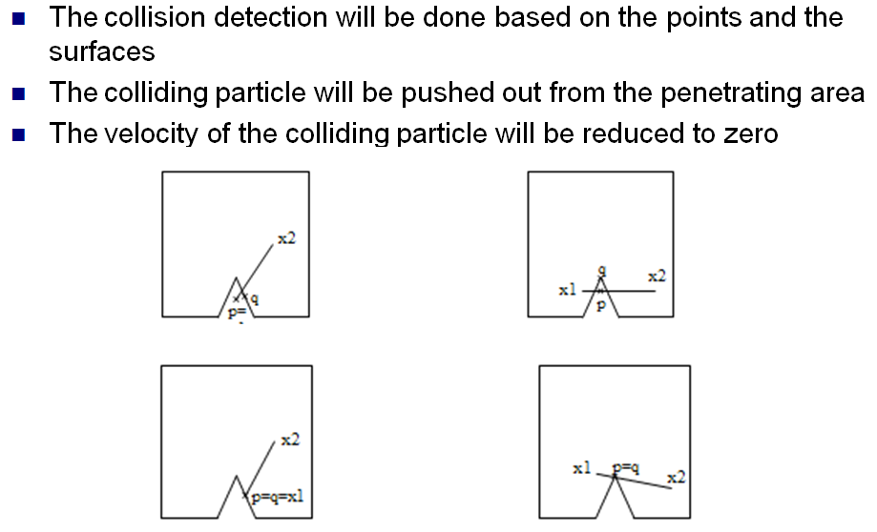
Collision Detection Redux
Adapted from slide © 2008 H. P. H. Shum, RIKEN (理研)
Computer Animation, http://bit.ly/ig6KTK

Slide 38
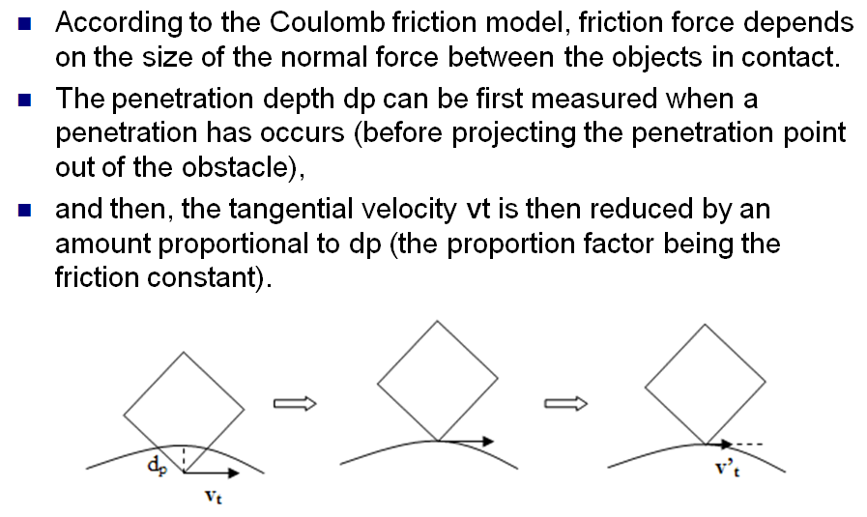
Friction Force
Adapted from slide © 2008 H. P. H. Shum, RIKEN (理研)
Computer Animation, http://bit.ly/ig6KTK

Slide 39
Summary
Reading for Last Class: Chapter 7, §8.4, Eberly 2e
Reading for Today: §8.3 – 8.4, 4.2, 5.0, 5.6, 9.1, Eberly 2e
Reading for Next Class: §9.1, Particle System Handout
Last Time: Picking
  OpenGL modes: rendering (default), feedback, selection
  Name stack
  Hit records
  Rendering in selection mode using selection buffer
  Color coding of pickable objects
Today: Interaction Handling & Human Computer Interaction (HCI)
  Spectrum of interaction
  Kinds of interaction
    User input: selection, control
    Stimuli: much more when we cover visualization, color
Next: Particle Systems, Collision Response

Slide 40
Terminology
Picking: Allowing User to Select Objects in Scene
  Selection mode: mode when cursor (“mouse”) is active
  Name stack: last in, first out data structure holding object names
  Hit records: ID, depth info for intersections with view volume
  Selection buffer: holds hits, depth (compare: frame/z-buffer)
  Color coding: using color to represent pickable object ID
Human-Computer Interaction (HCI)
  aka Man-Machine Interaction (archaic), Computer-Human Interaction
  Study, planning, design of interaction between humans & computers
  User interface
    Operation and control of machine
    Feedback to human
Particle Systems – Simulation of Processes, Simple Physical Bodies
  Events: birth (emission), collision, death
  Properties: mass, initial velocity, lifetime

