Slide 1
Lecture 28 of 41
Collision Handling Part 2 of 2:
Dynamic Collision Response, Particle Systems
William H. Hsu
Department of Computing and Information Sciences, KSU
KSOL course pages: http://bit.ly/hGvXlH / http://bit.ly/eVizrE
Public mirror web site: http://www.kddresearch.org/Courses/CIS636
Instructor home page: http://www.cis.ksu.edu/~bhsu
Readings:
Last class: §8.3 – 8.4, 4.2, 5.0, 5.6, 9.1, Eberly 2e – see http://bit.ly/ieUq45
Today: §9.1, Eberly 2e; Particle System Handout
Next class: Particle System Handout
Wikipedia, Particle System: http://bit.ly/hzZofI

Slide 2
Lecture Outline
Reading for Last Class: §8.3 – 8.4, 4.2, 5.0, 5.6, 9.1, Eberly 2e
Reading for Today: §9.1, Eberly 2e; Particle System Handout
Reading for Next Class: Particle System Handout
Last Time: Interaction Handling
  Human-Computer Interaction (HCI)
  Perceptual Principles: Legibility, Consistency, Redundancy
  Mental Models: Realism, User Expectations
  Attention: Access Cost/Benefit, Multiple Sources, Sensory Modes
  Memory: Self-Explanatory GUIs, Predictive Aids, Reusable Skills
Today: Collision Response
Today & Next Class: Particle Systems
  Simulation of Processes, Simple Physical Bodies
  Events: birth (emission), collision, death
  Properties: mass, initial velocity, lifetime
Next: Lab on Particle Systems; Dissection of Working Program

Slide 3
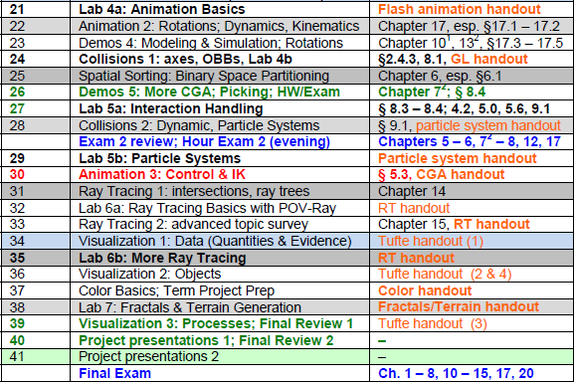

Where We Are

Slide 4
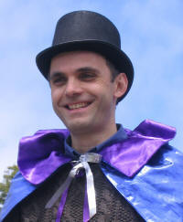

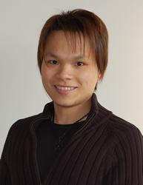


Acknowledgements:
Picking, Interaction, Particles
François Guimbretière
Associate Professor
Department of Computer Science
Cornell University
http://www.cs.cornell.edu/~francois/
Hubert Pak Ho Shum
Postdoctoral Researcher
Advanced Science Institute
RIKEN (理研)
http://hubertshum.com/info/
Steve Rotenberg
Visiting Lecturer
Graphics Lab
University of California – San Diego
CEO/Chief Scientist, PixelActive
http://graphics.ucsd.edu

Slide 5
Review [1]:
Human-Computer Interaction (HCI)
Study, Planning, & Design of Interaction between People, Computers
  Study: intersection of computer science, behavioral science, design
  Planning: information management tasks, media
  Design: graphical user interfaces, displays, algorithms, systems
Related Areas
  Cognitive Science & Cognitive Modeling
  Ergonomics & Human Factors
    HCI: more emphasis on computers (vs. other artifacts)
    Some overlap within information technology
  Computational Information & Knowledge Management (CIKM)
  Software Engineering: Operating Systems
  Computer Graphics
  Wearable Computers & Ubiquitous Communication/Computing
Adapted from Wikipedia, Human-Computer Interaction
http://bit.ly/bqrQTg

Slide 6
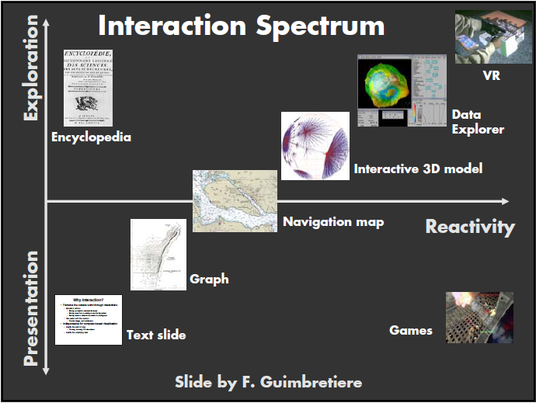
Review [2]:
Interaction Spectrum for HCI & Print
Adapted from slide © 2004 F. Guimbretière, Cornell University
Stanford CS448B: Visualization, Fall 2004, http://bit.ly/h0hRzU

Slide 7
Review [3]:
Perception & Mental Models in HCI
Perceptual Principles
  1. Make Displays Perceivable (Legible, Audible, etc.)
  2. Avoid Absolute Judgment Limits
  3. Use Top-Down Processing: Be Consistent with Past Experience
  4. Exploit Redundancy
  5. Use Discriminable Elements to Minimize Confusion
Principles Based upon Mental Models
  6. Maintain Pictorial Realism
  7. Follow User’s Expectations Regarding Moving Parts
Adapted from material © 2008 Wikimedia Foundation (from Wickens et al., 2004)
Human-Computer Interaction, http://bit.ly/bqrQTg

Slide 8
Review [4]:
Attention & Memory in HCI
Attention-Based Principles
  8. Minimize Information Access Cost
  9. Put Multiple Information Sources Close Together, Integrate Them
  10. Make Use of Multiple Information Channels
Memory-Based Principles
  11. Replace Memory with Visual Information
  12. Develop Methods for Predictive Aiding
  13. Ensure Consistency
Adapted from material © 2008 Wikimedia Foundation (from Wickens et al., 2004)
Human-Computer Interaction, http://bit.ly/bqrQTg

Slide 9
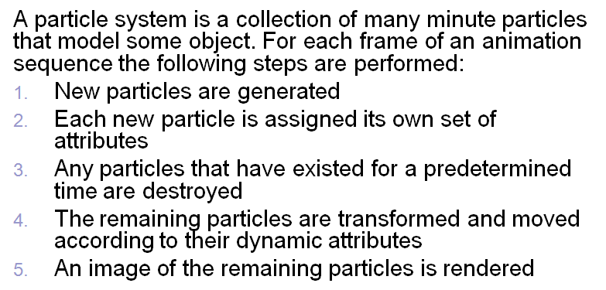
Review [5]:
Particle Systems – Basic Model
Adapted from slide © 2008 H. P. H. Shum, RIKEN (理研)
Computer Animation, http://bit.ly/ig6KTK

Slide 10
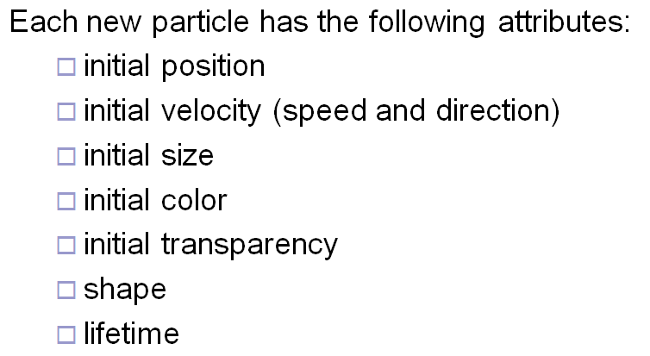
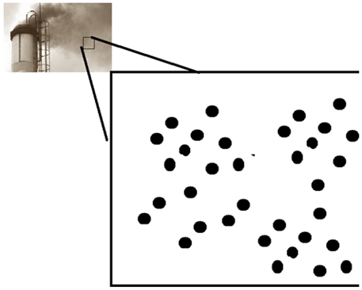
Review [6]:
Particle Emitters & Attributes
Adapted from slide © 2008 H. P. H. Shum, RIKEN (理研)
Computer Animation, http://bit.ly/ig6KTK

Slide 11
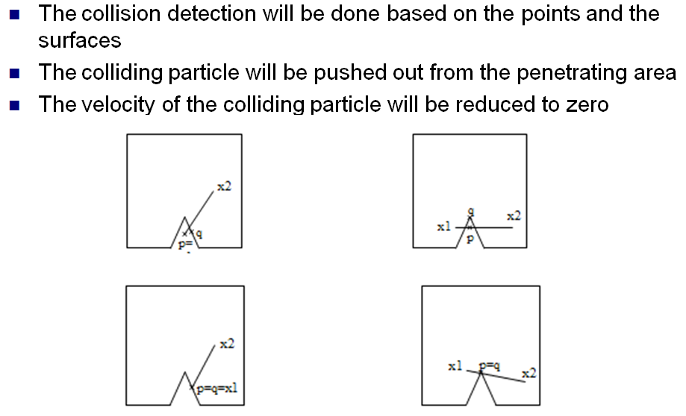
Review [7]:
Collision Detection Redux
Adapted from slide © 2008 H. P. H. Shum, RIKEN (理研)
Computer Animation, http://bit.ly/ig6KTK

Slide 12
Review [9]:
Collision Detection Redux

Slide 13
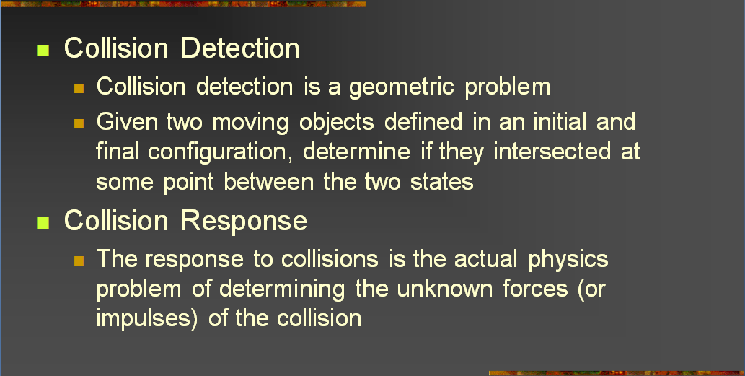
Review [8]:
Collisions – Detection vs. Response
Adapted from slides © 2004 – 2005 S. Rotenberg, UCSD
CSE169: Computer Animation, Winter 2005, http://bit.ly/f0ViAN

Slide 14
Review [9]:
Collision Detection
Goals
  Given: two objects with current & previous orientations specified
  Determine: if, where, when they intersect
Alternative (Static)
  Given: two objects with current orientations specified
  Determine: if they intersect
Variants
  Static: stationary objects (both not moving)
  Dynamic: moving objects (one or both)
  Queries
    Test-intersection: determine whether objects do/will intersect
    Find-intersection: calculate intersection set or contact set, time
  Parametric methods: use parameters to describe objects
    Distance-based: constrained minimization (closest points)
    Intersection-based: solving for parameters in equation

Slide 15
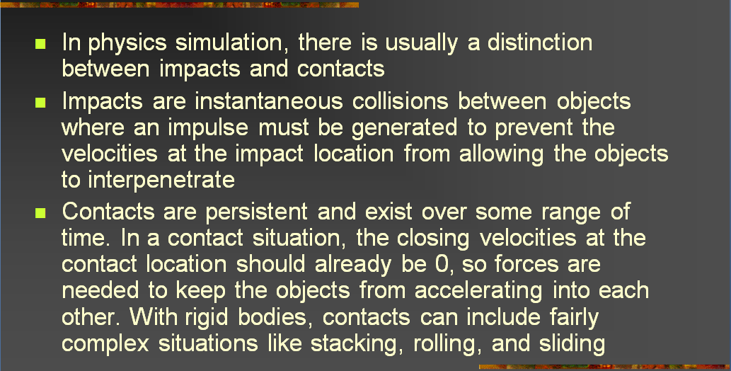
Impact vs. Contact [1]:
Distinction
Adapted from slides © 2004 – 2005 S. Rotenberg, UCSD
CSE169: Computer Animation, Winter 2005, http://bit.ly/f0ViAN

Slide 16
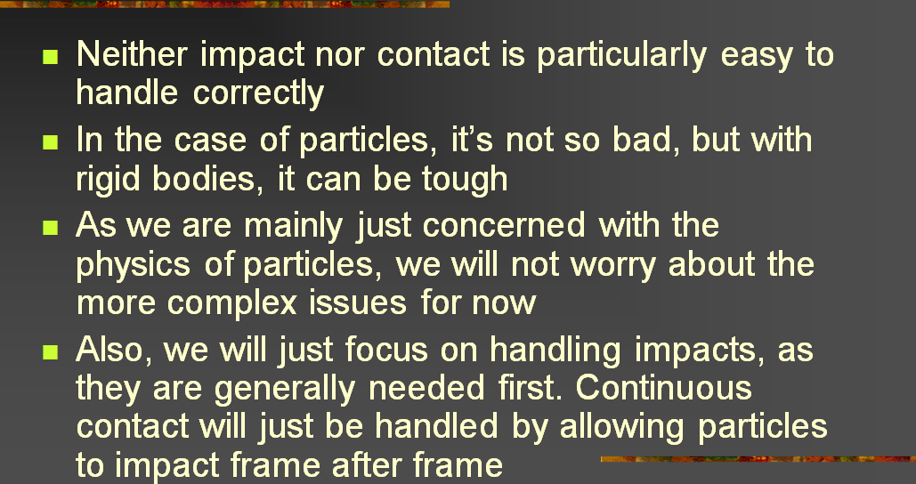
Impact vs. Contact [2]:
Handling
Adapted from slides © 2004 – 2005 S. Rotenberg, UCSD
CSE169: Computer Animation, Winter 2005, http://bit.ly/f0ViAN

Slide 17
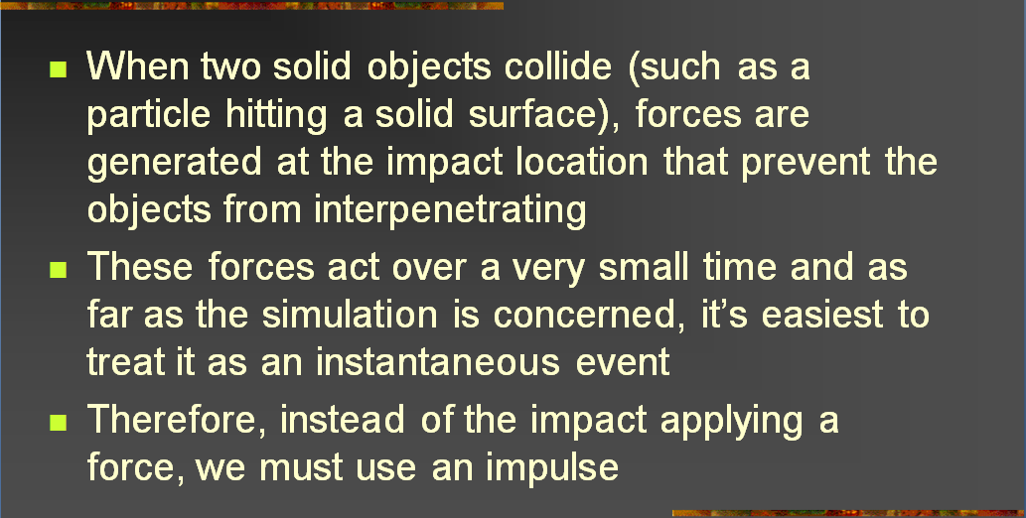
Impacts
Adapted from slides © 2004 – 2005 S. Rotenberg, UCSD
CSE169: Computer Animation, Winter 2005, http://bit.ly/f0ViAN

Slide 18
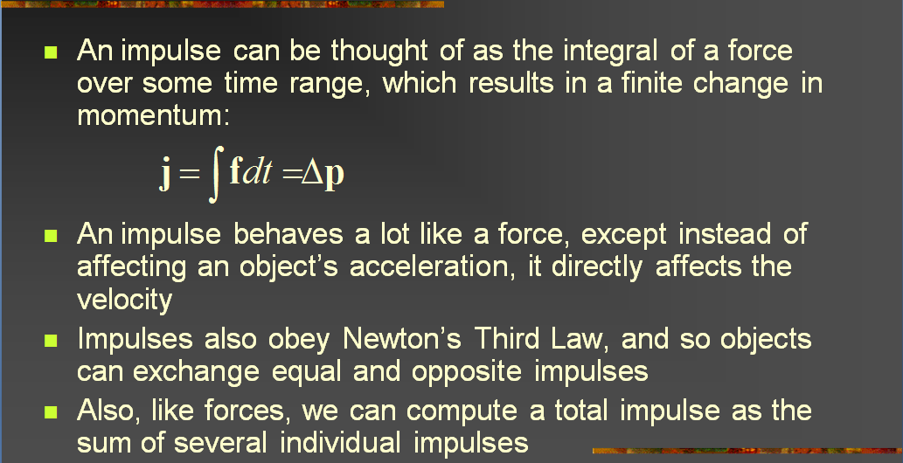
Impulse
Adapted from slides © 2004 – 2005 S. Rotenberg, UCSD
CSE169: Computer Animation, Winter 2005, http://bit.ly/f0ViAN

Slide 19
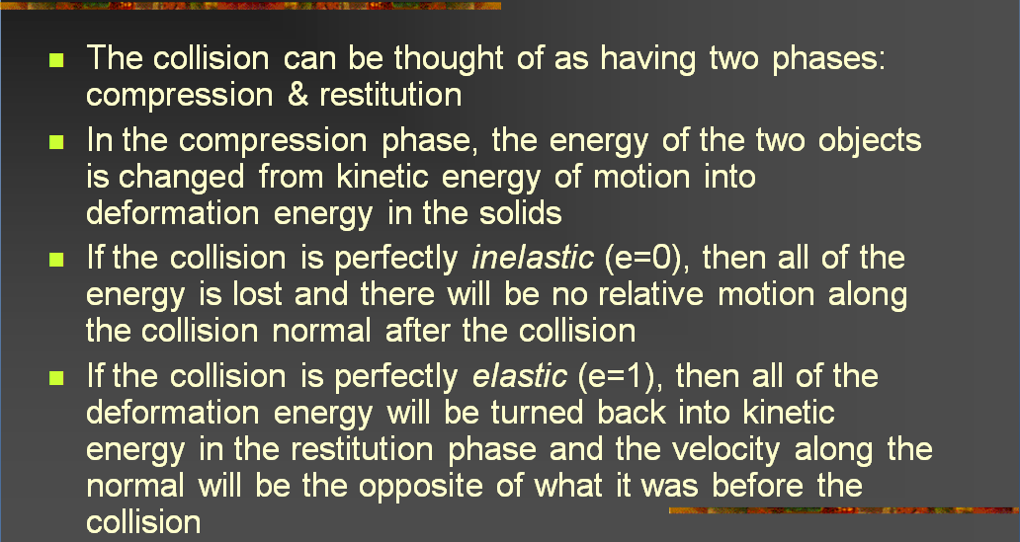
Compression & Restitution [1]:
Definition, Elasticity of Collision
Adapted from slides © 2004 – 2005 S. Rotenberg, UCSD
CSE169: Computer Animation, Winter 2005, http://bit.ly/f0ViAN

Slide 20
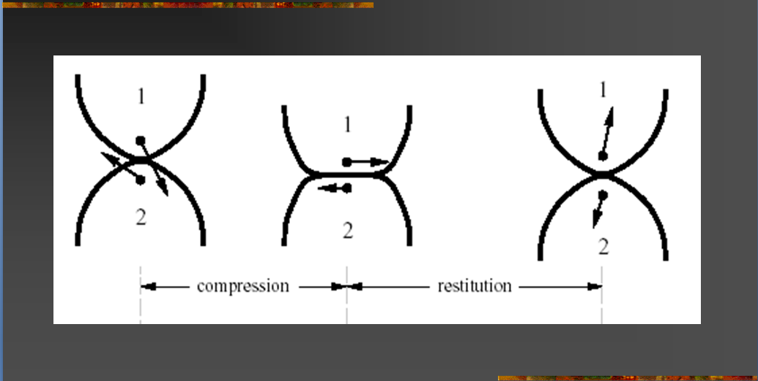
Compression & Restitution [2]:
Illustration
Adapted from slides © 2004 – 2005 S. Rotenberg, UCSD
CSE169: Computer Animation, Winter 2005, http://bit.ly/f0ViAN

Slide 21
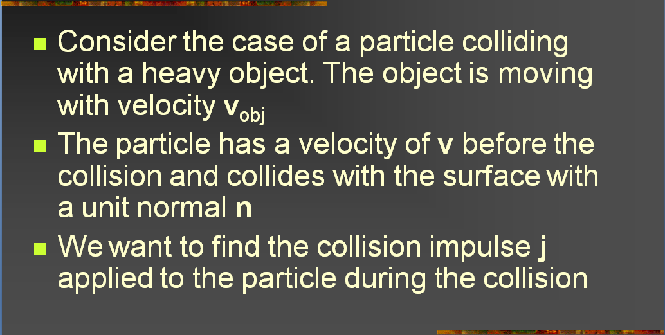
Calculations [1]:
Impulse for Particle-Object Case
Adapted from slides © 2004 – 2005 S. Rotenberg, UCSD
CSE169: Computer Animation, Winter 2005, http://bit.ly/f0ViAN

Slide 22
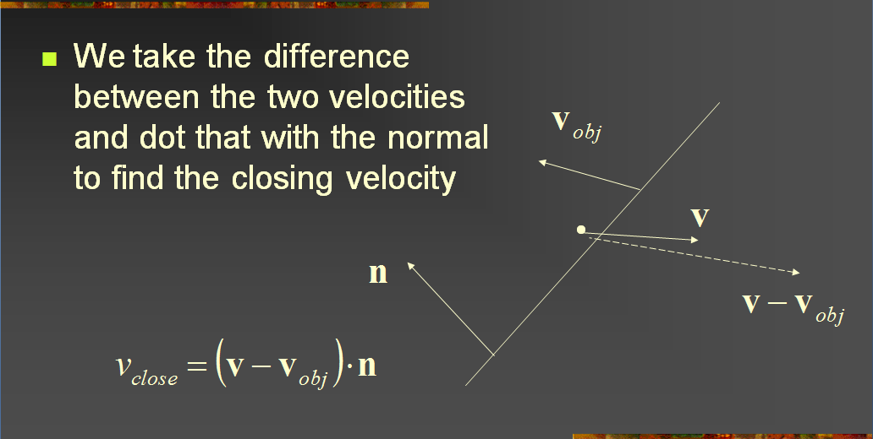
Calculations [2]:
Final Velocity
Adapted from slides © 2004 – 2005 S. Rotenberg, UCSD
CSE169: Computer Animation, Winter 2005, http://bit.ly/f0ViAN

Slide 23
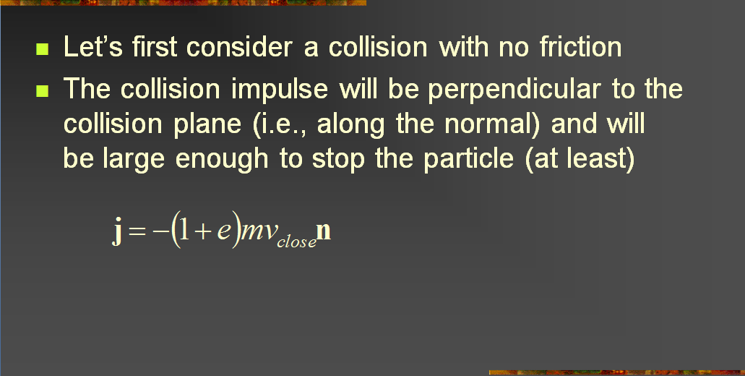
Calculations [3]:
Impulse given Velocity (Frictionless)
Adapted from slides © 2004 – 2005 S. Rotenberg, UCSD
CSE169: Computer Animation, Winter 2005, http://bit.ly/f0ViAN

Slide 24
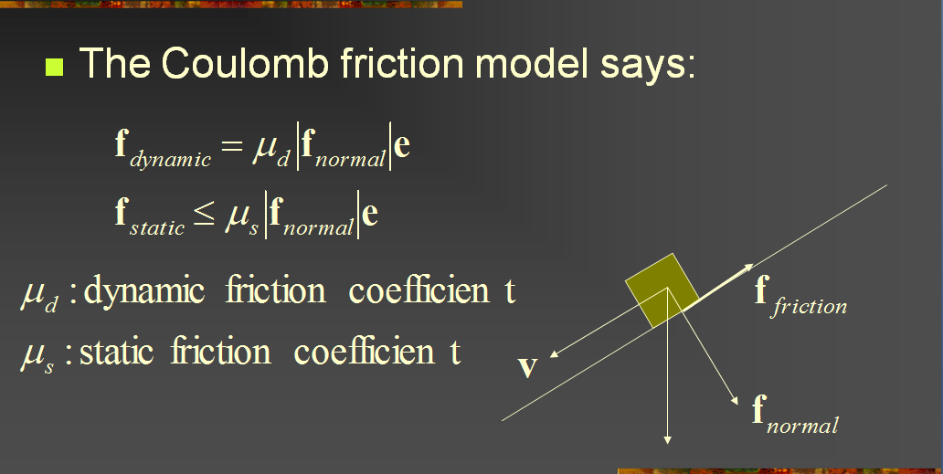
Friction [1]:
Coulomb Friction Model
Adapted from slides © 2004 – 2005 S. Rotenberg, UCSD
CSE169: Computer Animation, Winter 2005, http://bit.ly/f0ViAN

Slide 25
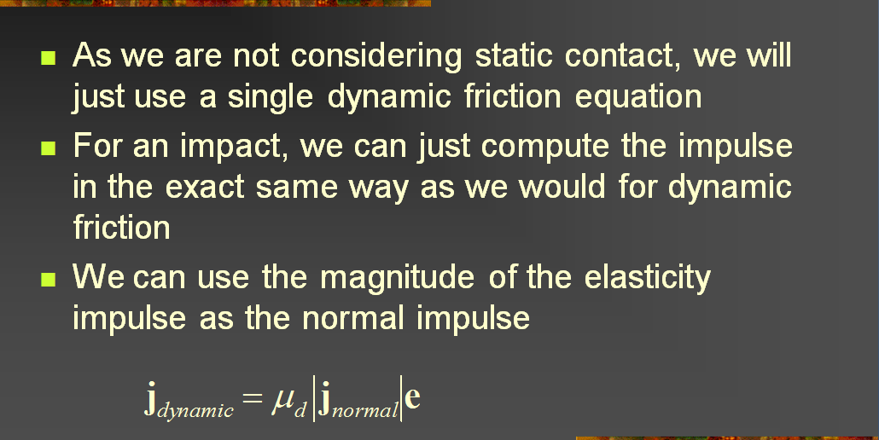
Friction [2]:
Dynamic Friction Equation
Adapted from slides © 2004 – 2005 S. Rotenberg, UCSD
CSE169: Computer Animation, Winter 2005, http://bit.ly/f0ViAN

Slide 26
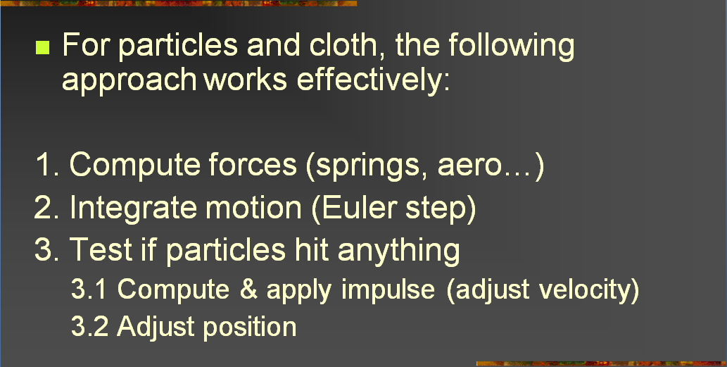
Collision Handling
Adapted from slides © 2004 – 2005 S. Rotenberg, UCSD
CSE169: Computer Animation, Winter 2005, http://bit.ly/f0ViAN

Slide 27
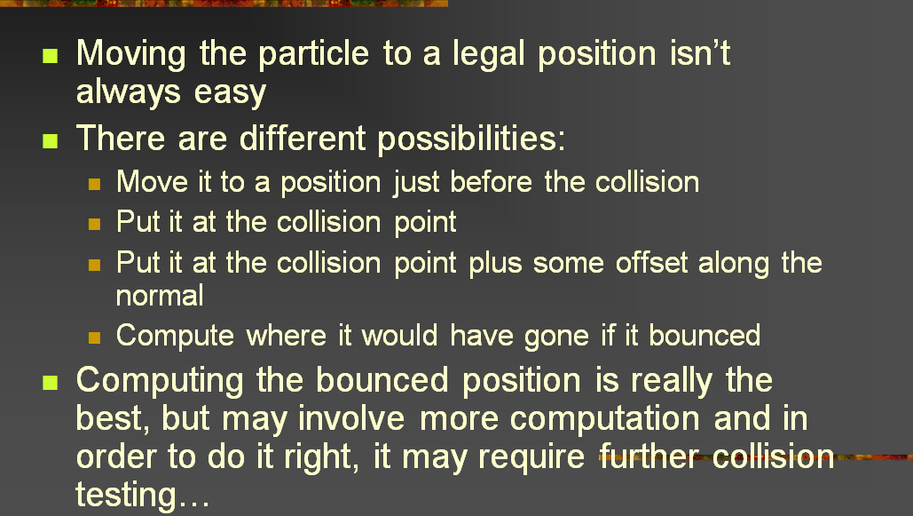
Position Adjustment [1]:
Options Defined
Adapted from slides © 2004 – 2005 S. Rotenberg, UCSD
CSE169: Computer Animation, Winter 2005, http://bit.ly/f0ViAN

Slide 28
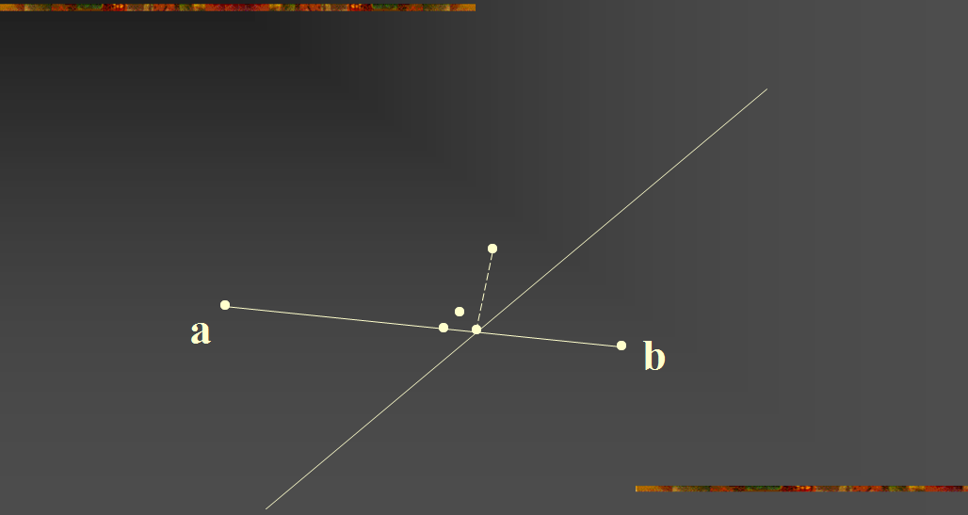
Position Adjustment [2]:
Options Illustrated
Adapted from slides © 2004 – 2005 S. Rotenberg, UCSD
CSE169: Computer Animation, Winter 2005, http://bit.ly/f0ViAN

Slide 29
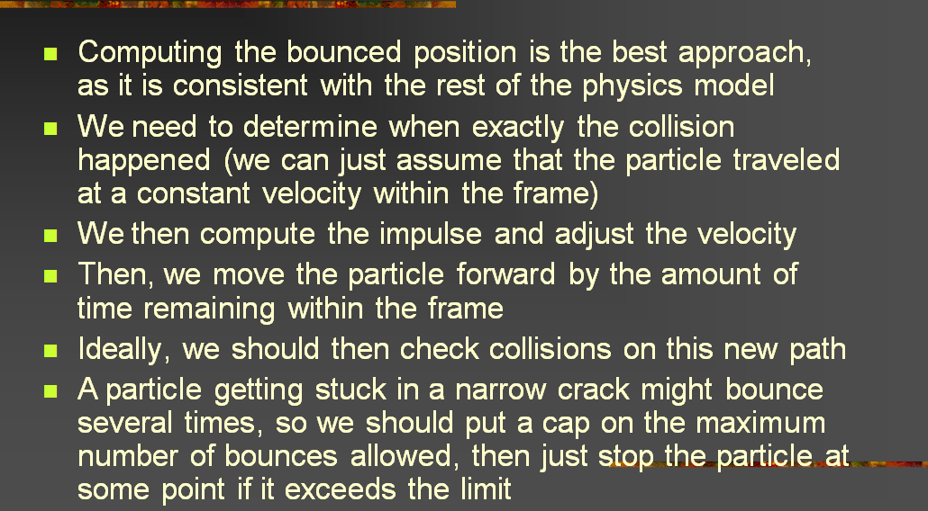
Bouncing
Adapted from slides © 2004 – 2005 S. Rotenberg, UCSD
CSE169: Computer Animation, Winter 2005, http://bit.ly/f0ViAN

Slide 30
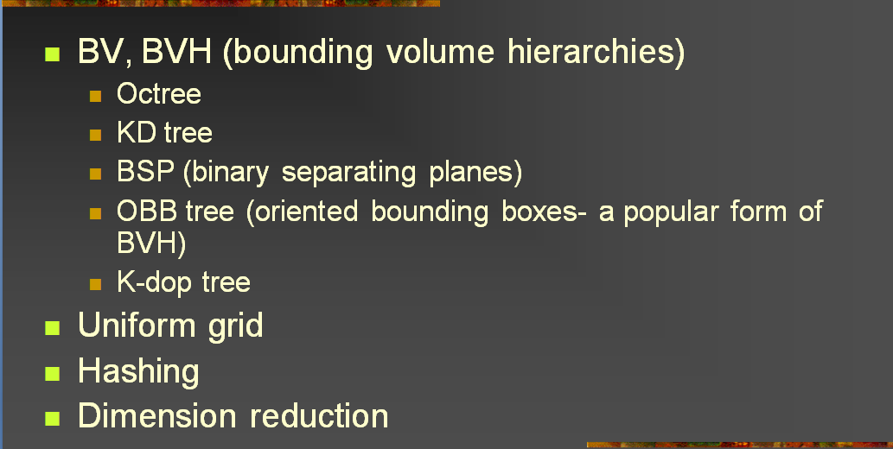
Collision Optimization [1]:
Overview of Data Structures
Adapted from slides © 2004 – 2005 S. Rotenberg, UCSD
CSE169: Computer Animation, Winter 2005, http://bit.ly/f0ViAN

Slide 31
Bounding Volume Hierarchies Redux
Adapted from slides © 2004 – 2005 S. Rotenberg, UCSD
CSE169: Computer Animation, Winter 2005, http://bit.ly/f0ViAN

Slide 32
Adaptive Spatial Partitioning [1]:
(Quadtrees & Octrees) Redux
Adapted from slides © 2004 – 2005 S. Rotenberg, UCSD
CSE169: Computer Animation, Winter 2005, http://bit.ly/f0ViAN

Slide 33
Adaptive Spatial Partitioning [2]:
k-D Trees
Adapted from slides © 2004 – 2005 S. Rotenberg, UCSD
CSE169: Computer Animation, Winter 2005, http://bit.ly/f0ViAN

Slide 34
Adaptive Spatial Partitioning [3]:
BSP Trees Redux
Adapted from slides © 2004 – 2005 S. Rotenberg, UCSD
CSE169: Computer Animation, Winter 2005, http://bit.ly/f0ViAN

Slide 35
Adaptive Spatial Partitioning [4]:
Oriented Bounding Box Trees
Adapted from slides © 2004 – 2005 S. Rotenberg, UCSD
CSE169: Computer Animation, Winter 2005, http://bit.ly/f0ViAN

Slide 36
Adaptive Spatial Partitioning [5]:
K-Discrete Orientation Polytopes
Adapted from slides © 2004 – 2005 S. Rotenberg, UCSD
CSE169: Computer Animation, Winter 2005, http://bit.ly/f0ViAN

Slide 37
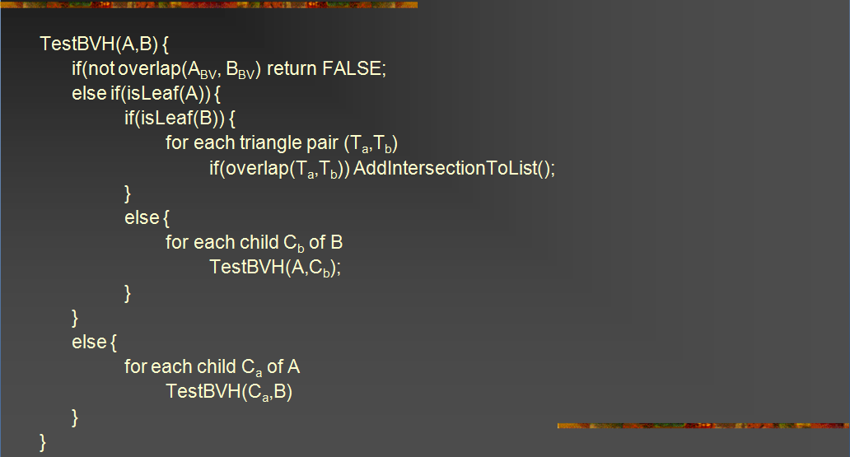
Testing BVHs
Adapted from slides © 2004 – 2005 S. Rotenberg, UCSD
CSE169: Computer Animation, Winter 2005, http://bit.ly/f0ViAN

Slide 38
Uniform Grids
Adapted from slides © 2004 – 2005 S. Rotenberg, UCSD
CSE169: Computer Animation, Winter 2005, http://bit.ly/f0ViAN

Slide 39
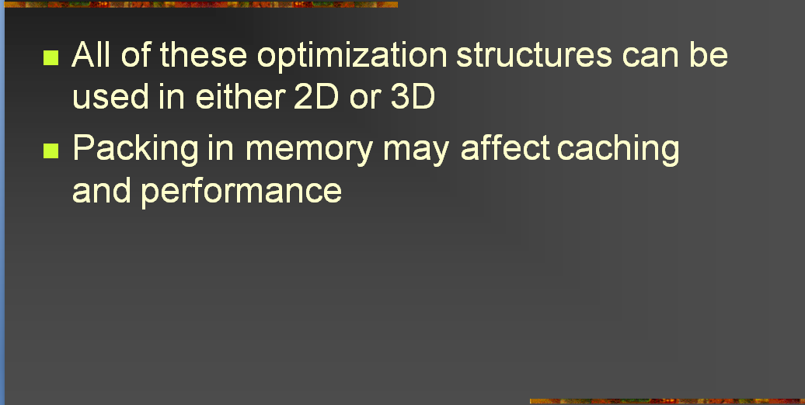
Collision Optimization [2]:
2-D vs. 3-D Optimization Structures
Adapted from slides © 2004 – 2005 S. Rotenberg, UCSD
CSE169: Computer Animation, Winter 2005, http://bit.ly/f0ViAN

Slide 40
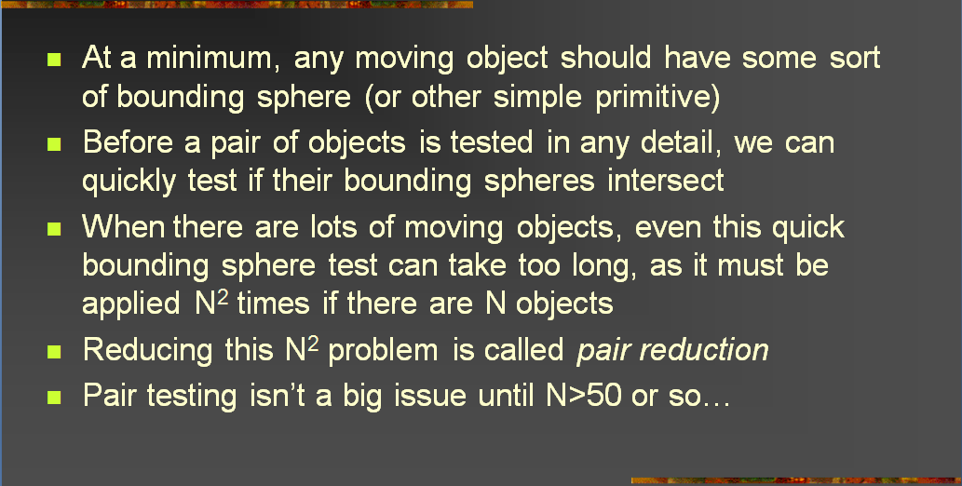
Collision Optimization [3]:
Pair Reduction
Adapted from slides © 2004 – 2005 S. Rotenberg, UCSD
CSE169: Computer Animation, Winter 2005, http://bit.ly/f0ViAN

Slide 41
Summary
Reading for Last Class: §8.3 – 8.4, 4.2, 5.0, 5.6, 9.1, Eberly 2e
Reading for Today: §9.1, Eberly 2e; Particle System Handout
Reading for Next Class: Particle System Handout
Last Time: Interaction Handling & Human Computer Interaction (HCI)
  Spectrum of interaction
  Kinds of interaction
    User input: selection, control
    Stimuli: much more when we cover visualization, color
Today: Collision Response
Today & Next Class: Particle Systems
  Collision response
  Simulation of Processes, Simple Physical Bodies
  Events: birth (emission), collision, death
  Properties: mass, initial velocity, lifetime
Next: Lab on Particle Systems; Dissection of Working Program

Slide 42
Terminology
Human-Computer Interaction (HCI)
  aka Man-Machine Interaction (archaic), Computer-Human Interaction
  Study, planning, design of interaction between humans & computers
  User interface: operation & control of machine, feedback to human
Particle Systems – Simulation of Processes, Simple Physical Bodies
  Events
    Birth – particle generated based on shape, position of emitter
    Collision – particle with object (including other particles)
    Death – end of particle life, due to collision or expiration
  Properties
    Mass
    Initial velocity
    Lifetime
    etc.
Data Structures: k-D Trees, K-Discrete Oriented Polytopes

