Slide 1
Lecture 29 of 41
Lab 5b: Particle Systems
William H. Hsu
Department of Computing and Information Sciences, KSU
KSOL course pages: http://bit.ly/hGvXlH / http://bit.ly/eVizrE
Public mirror web site: http://www.kddresearch.org/Courses/CIS636
Instructor home page: http://www.cis.ksu.edu/~bhsu
Readings:
Today: Particle System Handout
Next class: §5.3, Eberly 2e – see http://bit.ly/ieUq45; CGA Handout
Wikipedia, Particle System: http://bit.ly/hzZofI

Slide 2
Lecture Outline
Reading for Last Class: §9.1, Eberly 2e; Particle System Handout
Reading for Today: Particle System Handout
Reading for Next Class: §5.3, Eberly 2e; CGA Handout
Last Time: Collision Response, Particle Systems
Collision handling, concluded: response
Impulse vs. force
Compression & restitution
Bounce
Friction
Simulation of Processes, Simple Physical Bodies
Events: birth (emission), collision, death
Properties: mass, initial velocity, lifetime
Today: Lab on Particle Systems; Dissection of Working Program
Next Class: Animation Part 3 of 3 – Inverse Kinematics

Slide 3
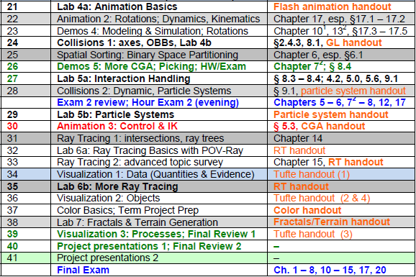
Where We Are

Slide 4
Acknowledgements:
3-D Particle Systems
Hubert Pak Ho Shum
Postdoctoral Researcher
Advanced Science Institute
RIKEN (理研)
http://hubertshum.com/info/
Steve Rotenberg
Visiting Lecturer
Graphics Lab
University of California – San Diego
CEO/Chief Scientist, PixelActive
http://graphics.ucsd.edu
Xiaoyu Zhang
Assistant Professor, Computer Science
California State University – San Marcos
http://public.csusm.edu/xiaoyu/
Rahul Malhotra
Senior Software Engineer, Overstock.com

Slide 5
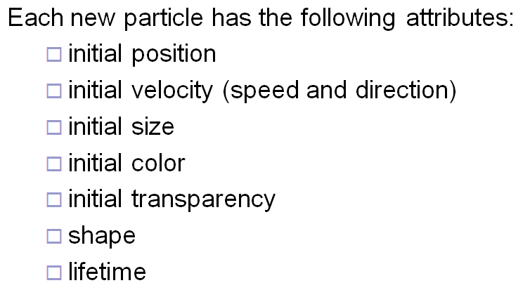
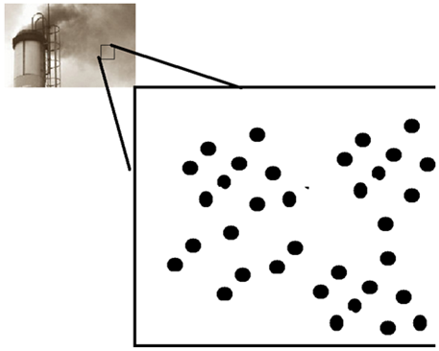
Review [1]:
Particle Emitters & Attributes
Adapted from slide © 2008 H. P. H. Shum, RIKEN (理研)
Computer Animation, http://bit.ly/ig6KTK

Slide 6
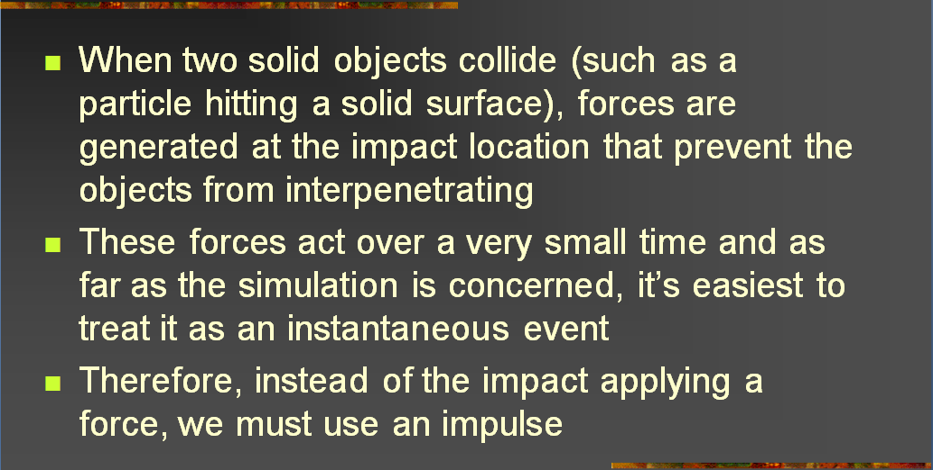
Review [2]:
Impacts
Adapted from slides © 2004 – 2005 S. Rotenberg, UCSD
CSE169: Computer Animation, Winter 2005, http://bit.ly/f0ViAN

Slide 7
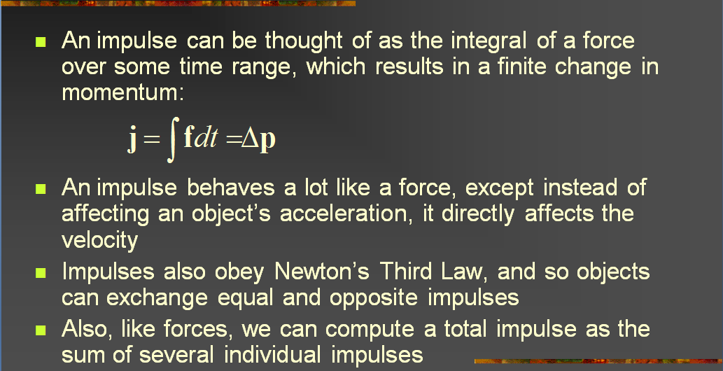
Review [3]:
Impulse
Adapted from slides © 2004 – 2005 S. Rotenberg, UCSD
CSE169: Computer Animation, Winter 2005, http://bit.ly/f0ViAN

Slide 8
Review [4]:
Final Velocity & Collision Impulse J
Adapted from slides © 2004 – 2005 S. Rotenberg, UCSD
CSE169: Computer Animation, Winter 2005, http://bit.ly/f0ViAN

Slide 9
Review [5]:
Impulse given Velocity (Frictionless)
Adapted from slides © 2004 – 2005 S. Rotenberg, UCSD
CSE169: Computer Animation, Winter 2005, http://bit.ly/f0ViAN

Slide 10
Review [6]:
Dynamic Friction Equation (Coulomb)
Adapted from slides © 2004 – 2005 S. Rotenberg, UCSD
CSE169: Computer Animation, Winter 2005, http://bit.ly/f0ViAN

Slide 11
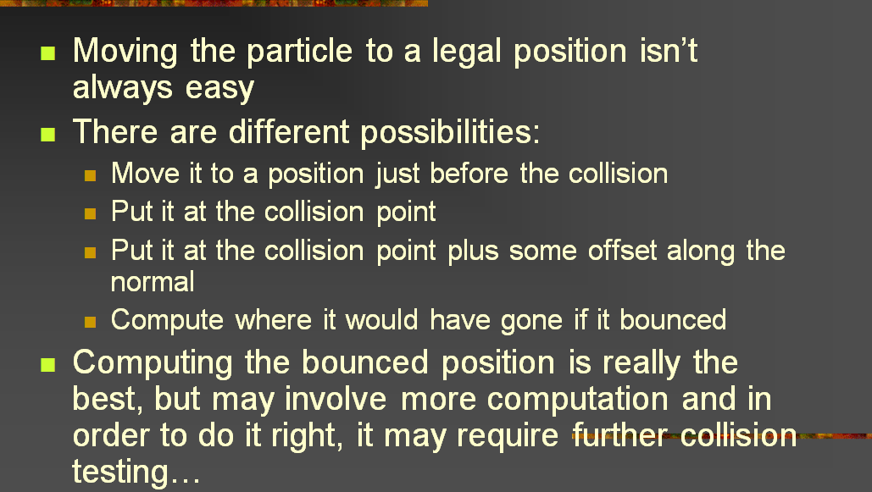
Review [8]:
Position Adjustment Options
Adapted from slides © 2004 – 2005 S. Rotenberg, UCSD
CSE169: Computer Animation, Winter 2005, http://bit.ly/f0ViAN

Slide 12
Review [9]:
Data Structures for Collisions
Adapted from slides © 2004 – 2005 S. Rotenberg, UCSD
CSE169: Computer Animation, Winter 2005, http://bit.ly/f0ViAN

Slide 13
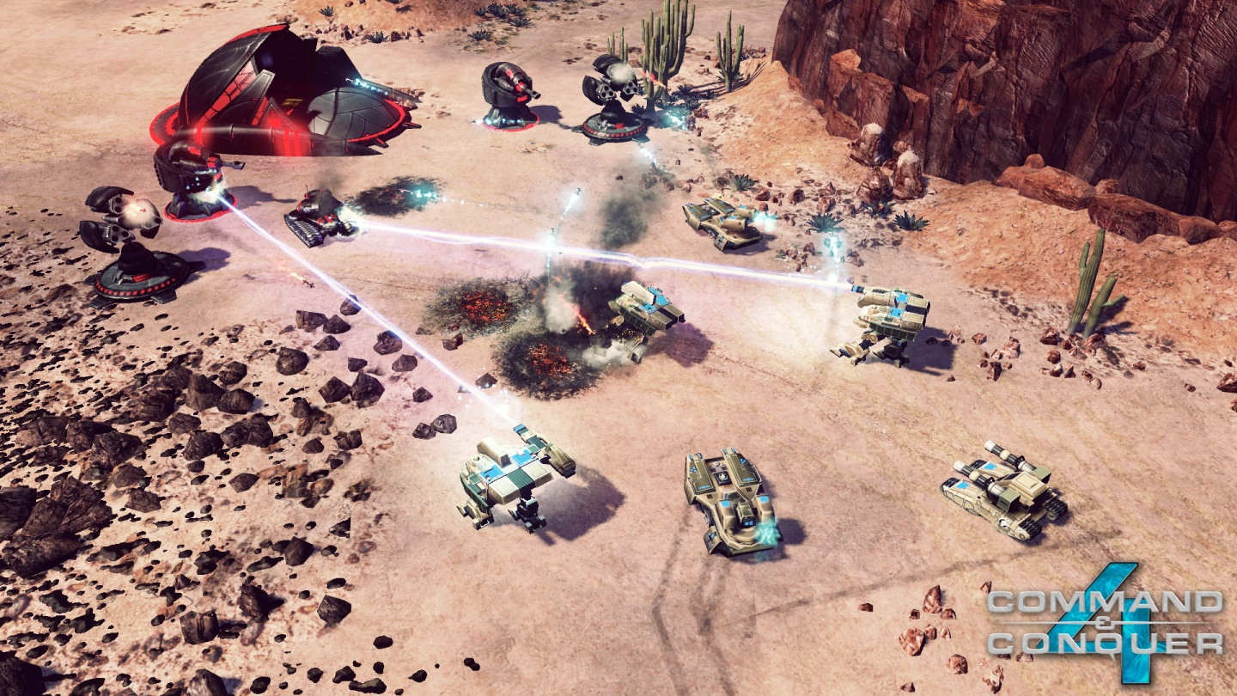
How Are Particle Systems Used?
Explosions
Large
Fireworks
Fire
Vapor
Clouds
Dust
Fog
Smoke
Contrails
Water
Waterfalls
Streams
Plants
Command & Conquer 4: Tiberian Twilight
© 2010 Electronic Arts, Inc.
Wikipedia: http://bit.ly/gFGMjO
Adapted from slides © 2008 R. Malhotra, CSU San Marcos
CS 536, Intro to 3-D Game Graphics, Spring 2008 – http://bit.ly/hNhUuE

Slide 14
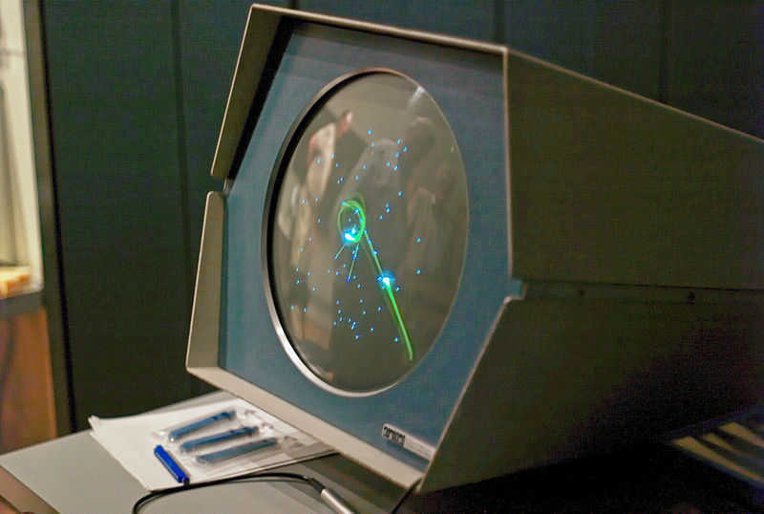
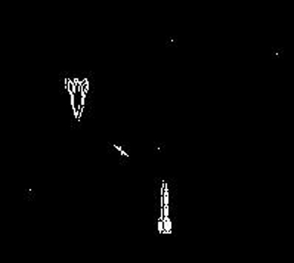
History of Particle Systems [1]:
Spacewar!
Developed in 1962 on Digital Equipment Corporation PDP-1
Steve “Slug” Russell, Martin “Shag” Graetz, Wayne Witaenem
Trig functions by DEC
Other features, Dan Edwards & Peter Samson
Used Pixel Clouds as Explosions
Spacewar! © 1962 S. Russell et al.
Wikipedia: http://bit.ly/eaiWUW
Adapted from slides © 2008 R. Malhotra, CSU San Marcos
CS 536, Intro to 3-D Game Graphics, Spring 2008 – http://bit.ly/hNhUuE

Slide 15
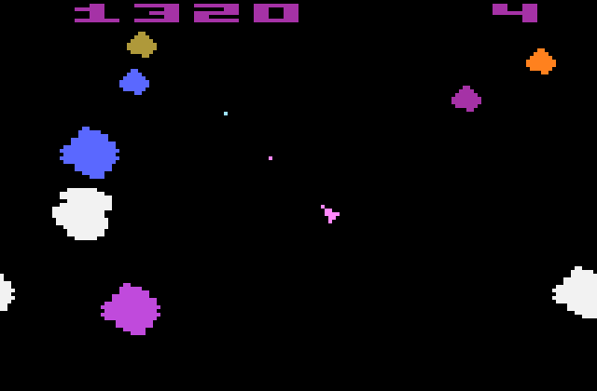
History of Particle Systems [2]:
Asteroids
Short Moving Vectors for Explosions
Probably First “Physical” Particle System (Collision Model) in Games
Hey, Hey, 16K © 2000 M. J. Hibbett, Video © 2004 R. Manuel http://youtu.be/Ts96J7HhO28
Asteroids © 1979 L. Rains & E. Logg
Wikipedia: http://bit.ly/hwfEQk
Adapted from slides © 2008 R. Malhotra, CSU San Marcos
CS 536, Intro to 3-D Game Graphics, Spring 2008 – http://bit.ly/hNhUuE

Slide 16
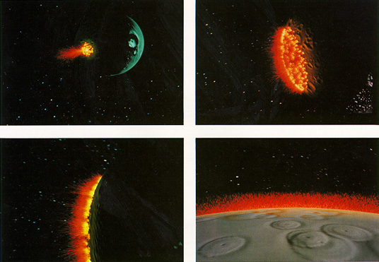
History of Particle Systems [3]:
Genesis Device inStar Trek II
Particle System for Genesis Bomb: http://youtu.be/Qe9qSLYK5q4
Part of Planetary Fly-By “Visualization”
One of Earliest Cinematic Uses
“Wall of Fire” effect from Star Trek II: The Wrath of Khan © 1983 Evans & Sutherland
Wikipedia: http://bit.ly/eXwrhb
Adapted from slides © 2008 R. Malhotra, CSU San Marcos
CS 536, Intro to 3-D Game Graphics, Spring 2008 – http://bit.ly/hNhUuE

Slide 17
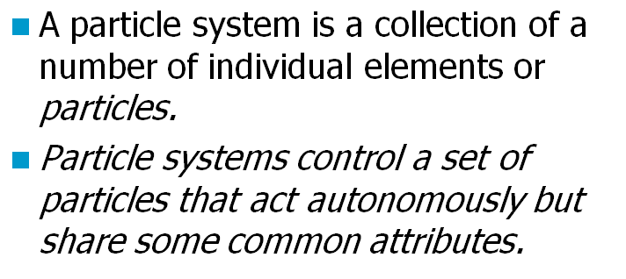
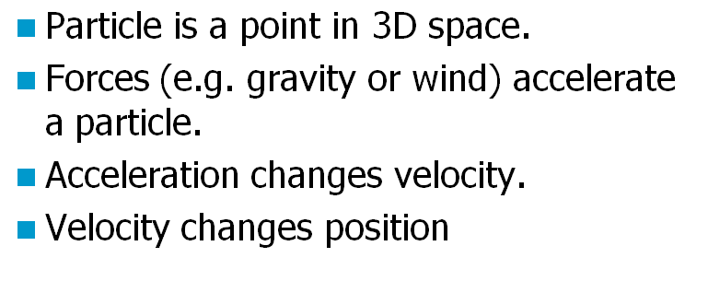
Definition &
Basic Particle System Physics
Adapted from slides © 2008 R. Malhotra, CSU San Marcos
CS 536, Intro to 3-D Game Graphics, Spring 2008 – http://bit.ly/hNhUuE

Slide 18
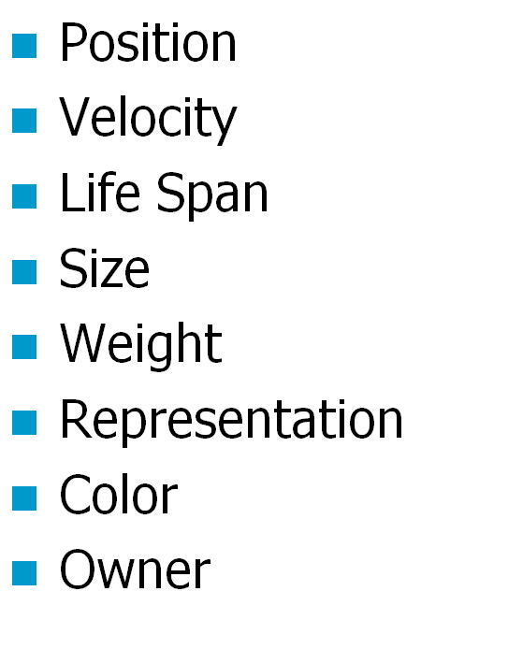
More Attributes of Particles
Adapted from slides © 2008 R. Malhotra, CSU San Marcos
CS 536, Intro to 3-D Game Graphics, Spring 2008 – http://bit.ly/hNhUuE

Slide 19
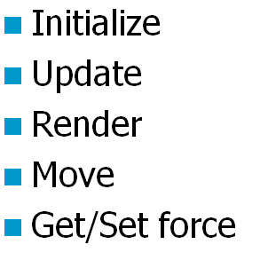
Methods of Particle Systems
Adapted from slides © 2008 R. Malhotra, CSU San Marcos
CS 536, Intro to 3-D Game Graphics, Spring 2008 – http://bit.ly/hNhUuE

Slide 20
Implementation [1]:
Particle Struct
struct Particle
{
Vector3 m_pos; // current position
Vector3 m_prevPos; // last position
Vector3 m_velocity; // direction and speed
Vector3 m_acceleration; // acceleration
float m_energy; // how long particle is alive
float m_size; // size of particle
float m_sizeDelta; // change in size per time unit
float m_weight; // how gravity affects particle
float m_weightDelta; // change over time
float m_color[4]; // current color
float m_colorDelta[4]; // change over time
};
Adapted from slides © 2008 R. Malhotra, CSU San Marcos
CS 536, Intro to 3-D Game Graphics, Spring 2008 – http://bit.ly/hNhUuE

Slide 21
Implementation [2]:
Particle System Class
class ParticleSystem
{
public:
ParticleSystem (int maxParticles, Vector3 origin);
// abstract functions
virtual void Update(float elapsedTime) = 0;
virtual void Render() = 0;
virtual int Emit(int numParticles);
virtual void InitializeSystem();
virtual void KillSystem();
protected:
virtual void InitializeParticle(int index) = 0;
Particle *m_particleList; // particles for this emitter
int m_maxParticles; // maximum total number of particles
int m_numParticles; // indices of all free particles
Vector3 m_origin; // center of the particle system
float m_accumulatedTime; // track when last particle emitted
Vector3 m_force; // forces (gravity, wind, etc.) on PS
};
Adapted from slides © 2008 R. Malhotra, CSU San Marcos
CS 536, Intro to 3-D Game Graphics, Spring 2008 – http://bit.ly/hNhUuE

Slide 22
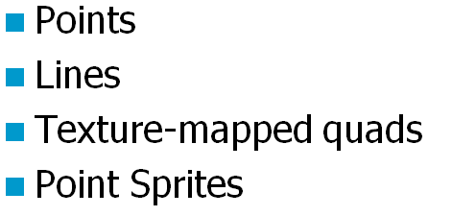
How to Represent Particles?
Adapted from slides © 2008 R. Malhotra, CSU San Marcos
CS 536, Intro to 3-D Game Graphics, Spring 2008 – http://bit.ly/hNhUuE

Slide 23
Rendering Particles [1]:
Points
glBegin( GL_POINTS );
glVertex3f
(m_position.x,
m_position.y,
m_position.z);
glEnd();
Adapted from slides © 2008 R. Malhotra, CSU San Marcos
CS 536, Intro to 3-D Game Graphics, Spring 2008 – http://bit.ly/hNhUuE

Slide 24
Rendering Particles [2]:
Lines
glBegin(GL_LINES);
glColor4f( r, g, b, 0.1f );
glVertex3f
(m_position.x,
m_position.y,
m_position.z);
glColor4f( r, g, b, a );
glVertex3f
(m_position.x + m_direction.x,
m_position.y + m_direction.y,
m_position.z + m_direction.z);
glEnd();
Adapted from slides © 2008 R. Malhotra, CSU San Marcos
CS 536, Intro to 3-D Game Graphics, Spring 2008 – http://bit.ly/hNhUuE

Slide 25
Rendering Particles [3]:
Quads
glBegin(GL_TRIANGLE_FAN);
if (textured)
glTexCoord2f(0.0f, 0.0f);
glVertex3f(pts[0].x, pts[0].y, pts[0].z);
if (textured)
glTexCoord2f(1.0f, 0.0f);
glVertex3f(pts[1].x, pts[1].y, pts[1].z);
if (textured)
glTexCoord2f(1.0f, 1.0f);
glVertex3f(pts[2].x, pts[2].y, pts[2].z);
if (textured)
glTexCoord2f(0.0f, 1.0f);
glVertex3f(pts[3].x, pts[3].y, pts[3].z);
glEnd();
Adapted from slides © 2008 R. Malhotra, CSU San Marcos
CS 536, Intro to 3-D Game Graphics, Spring 2008 – http://bit.ly/hNhUuE

Slide 26
Rendering Particles [4]:
Point Sprites
glTexEnvf (GL_POINT_SPRITE,
GL_COORD_REPLACE,
GL_TRUE);
glEnable(GL_POINT_SPRITE);
glBegin( GL_POINTS );
glVertex3f
(m_position.x,
m_position.y,
m_position.z);
glEnd();
glDisable(GL_POINT_SPRITE);
See also Saar & Rotzler tutorial (2008): http://bit.ly/fkjBPY
Adapted from slides © 2008 R. Malhotra, CSU San Marcos
CS 536, Intro to 3-D Game Graphics, Spring 2008 – http://bit.ly/hNhUuE

Slide 27
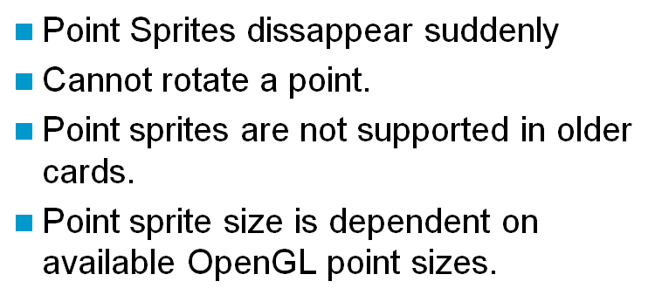
Point Sprites vs.
Textured Quads
Adapted from slides © 2008 R. Malhotra, CSU San Marcos
CS 536, Intro to 3-D Game Graphics, Spring 2008 – http://bit.ly/hNhUuE

Slide 28
Particle Systems API v2
Wayback Machine archive (2007):
http://bit.ly/g5GqQc
Adapted from slides © 2008 R. Malhotra, CSU San Marcos
CS 536, Intro to 3-D Game Graphics, Spring 2008 – http://bit.ly/hNhUuE

Slide 29
Advanced Topics
Adapted from slides © 2008 R. Malhotra, CSU San Marcos
CS 536, Intro to 3-D Game Graphics, Spring 2008 – http://bit.ly/hNhUuE

Slide 30
References
More OpenGL Game Programming – © 2006 D. Astle, http://bit.ly/eWM5kY
Particle Systems API © 2006 – 2007 D. K. McAllister: http://bit.ly/g5GqQc
“Everything about Particle System Effects”, L. Latta (Electronic Arts) http://bit.ly/dOQrwN
Tutorial on particle systems, A. Johnson (University of Illinois Chicago): http://bit.ly/ekuC20
Spacewar!
In Java: http://spacewar.oversigma.com
More history: http://www.wheels.org/spacewar/
“Simulate fuzzy phenomena with particle systems”, J. Friesen, JavaWorld, http://bit.ly/ghgTqF
Adapted from slides © 2008 R. Malhotra, CSU San Marcos
CS 536, Intro to 3-D Game Graphics, Spring 2008 – http://bit.ly/hNhUuE

Slide 31
Summary
Reading for Last Class: §9.1, Eberly 2e; Particle System Handout
Reading for Today: Particle System Handout
Reading for Next Class: §5.3, Eberly 2e; CGA Handout
Last Class: Particle Systems
Collision response
Simulation, events: birth (emission), collision, death
Properties: mass, initial velocity, lifetime
Changing properties: color, position (trajectory)
Today: Lab on Particle Systems; Dissection of Working Program
Next Class: Computer-Generated Animation Concluded
Autonomous movement in agents vs. hand-animated characters
Inverse kinematics
Rag doll physics
Minimization models
More CGA resources

Slide 32
Terminology
Particle Systems – Simulation of Processes, Simple Physical Bodies
Events
Birth – particle generated based on shape, position of emitter
Collision – particle with object (including other particles)
Death – end of particle life, due to collision or expiration
Initial properties: mass, position, velocity, size, lifetime, color, owner
Change in properties: delta mass, position, etc.
Emitter – Point, Line, Plane or Region from which Particles Originate
Particle Fountain – Particle System with Directional Emitter
Sprite (Wikipedia: http://bit.ly/gyInPg)
Definition: 2-D image or animation made part of larger scene
Point sprite
Screen-aligned element of variable size
Defined by single point
(Saar & Rotzler, 2008): http://bit.ly/fkjBPY

