Slide 1
Lecture 30 of 41
Animation 3 of 3: Inverse Kinematics
Control & Ragdoll Physics
William H. Hsu
Department of Computing and Information Sciences, KSU
KSOL course pages: http://bit.ly/hGvXlH / http://bit.ly/eVizrE
Public mirror web site: http://www.kddresearch.org/Courses/CIS636
Instructor home page: http://www.cis.ksu.edu/~bhsu
Readings:
Last class: Particle System Handout
Today: §5.3, Eberly 2e – see http://bit.ly/ieUq45; CGA Handout
Next class: Chapter 14, Eberly 2e
Reference: Wikipedia, Inverse Kinematics, http://bit.ly/hr8r2u
Reference: Wikipedia, Ragdoll Physics, http://bit.ly/3oggUZ

Slide 2
Lecture Outline
Reading for Last Class: Particle System Handout
Reading for Today: §5.3, Eberly 2e; CGA Handout
Reading for Next Class: Chapter 14, Eberly 2e
Last Time: Lab on Particle Systems; Dissection of Working Program
Today: Animation Part 3 of 3 – Inverse Kinematics
  Autonomous agents (robots, swarms) vs. hand-animated movement
  Forward kinematics and control
  Inverse kinematics for autonomous movement in robotics
  Jacobians and iterative minimization models
  Rag doll physics
End of Material on: Particle Systems, Collisions, CGA
Also Conclusion of Physically-Based Modeling (PBM)
Next Class: Ray Tracing, Part 1 of 2
  Vectors: light/shadow (L), reflected (R), transmitted/refracted (T)
  Basic recursive ray tracing: ray trees

Slide 3
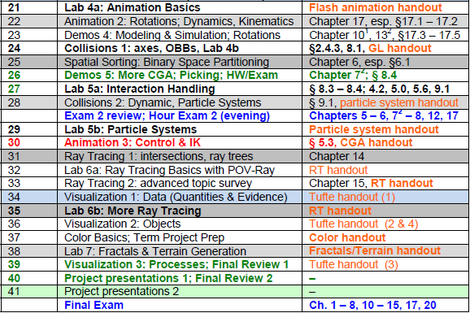

Where We Are

Slide 4





Acknowledgements:
Inverse Kinematics
David C. Brogan
Visiting Assistant Professor, Computer Science Department, University of Virginia
http://www.cs.virginia.edu/~dbrogan/
Susquehanna International Group (SIG)
http://www.sig.com
Steve Rotenberg
Visiting Lecturer
Graphics Lab
University of California – San Diego
CEO/Chief Scientist, PixelActive
http://graphics.ucsd.edu
Renata Melamud
Ph.D. Candidate
Mechanical Engineering Department
Stanford University
http://micromachine.stanford.edu/~rmelamud/

Slide 5
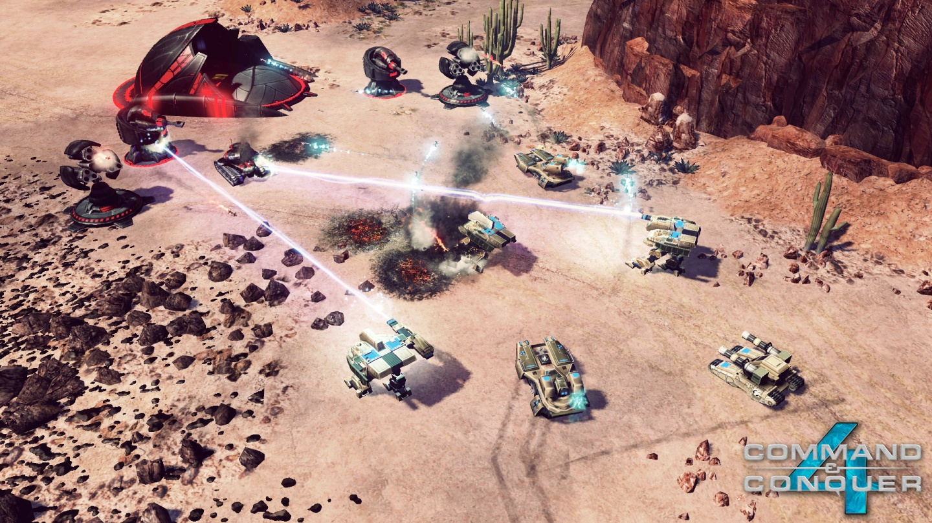

Review [1]:
Uses of Particle Systems
Explosions
  Large
  Fireworks
Fire
Vapor
  Clouds
  Dust
  Fog
  Smoke
  Contrails
Water
  Waterfalls
  Streams
Plants
Command & Conquer 4: Tiberian Twilight
© 2010 Electronic Arts, Inc.
Wikipedia: http://bit.ly/gFGMjO
Adapted from slides © 2008 R. Malhotra, CSU San Marcos
CS 536 Intro to 3-D Game Graphics, Spring 2008 – http://bit.ly/hNhUuE

Slide 6
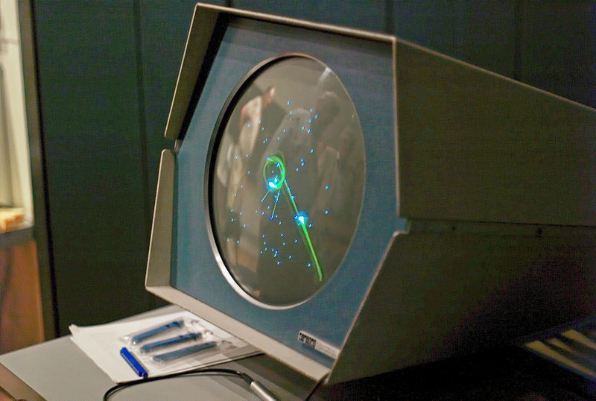
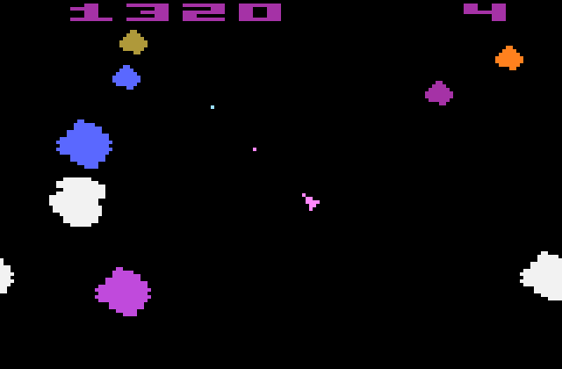
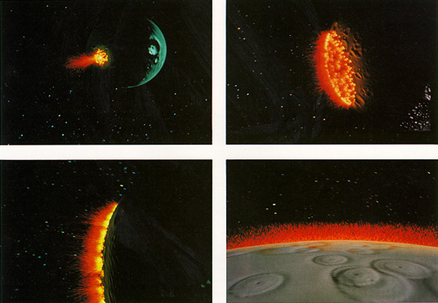
Review [2]:
History of Particle Systems
Spacewar! (1962) Used Pixel Clouds as Explosions
Asteroids (1979) First “Physically-Based” PS/Collision Model in Games
Star Trek II (1983) Particle Fountain: http://youtu.be/Qe9qSLYK5q4
Hey, Hey, 16K © 2000 M. J. Hibbett, Video © 2004 R. Manuel http://youtu.be/Ts96J7HhO28
Spacewar! © 1962 S. Russell et al.
Wikipedia: http://bit.ly/eaiWUW
Asteroids © 1979 L. Rains & E. Logg
Wikipedia: http://bit.ly/hwfEQk
Star Trek II © 1983 Paramount
Wikipedia: http://bit.ly/eXwrhb
Adapted from slides © 2008 R. Malhotra, CSU San Marcos
CS 536 Intro to 3-D Game Graphics, Spring 2008 – http://bit.ly/hNhUuE

Slide 7
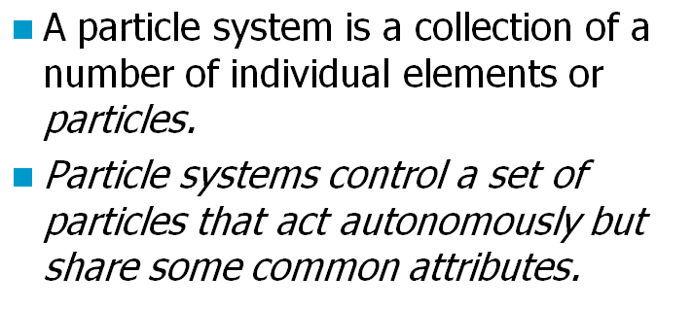
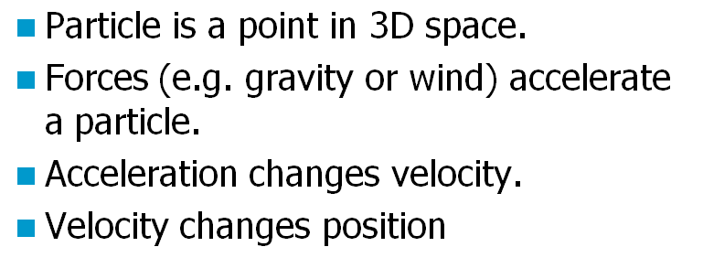
Review [3]:
Definition & Physically-Based Model
Adapted from slides © 2008 R. Malhotra, CSU San Marcos
CS 536 Intro to 3-D Game Graphics, Spring 2008 – http://bit.ly/hNhUuE

Slide 8
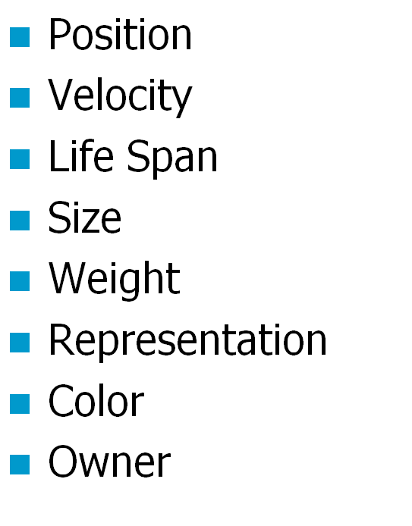
Review [4]:
More Attributes of Particles
Adapted from slides © 2008 R. Malhotra, CSU San Marcos
CS 536 Intro to 3-D Game Graphics, Spring 2008 – http://bit.ly/hNhUuE

Slide 9
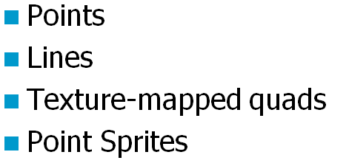
Review [5]:
Four Ways to Represent Particles
Adapted from slides © 2008 R. Malhotra, CSU San Marcos
CS 536 Intro to 3-D Game Graphics, Spring 2008 – http://bit.ly/hNhUuE

Slide 10
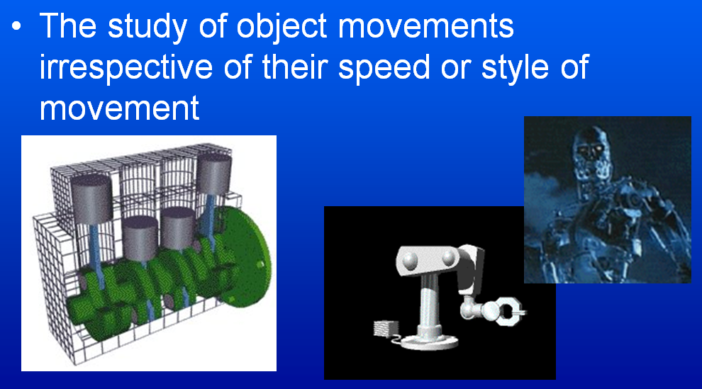
Kinematics
Adapted from slides © 2000 – 2005 D. Brogan, University of Virginia
CS 551, Advanced CG & Animation – http://bit.ly/hUXrqd

Slide 11
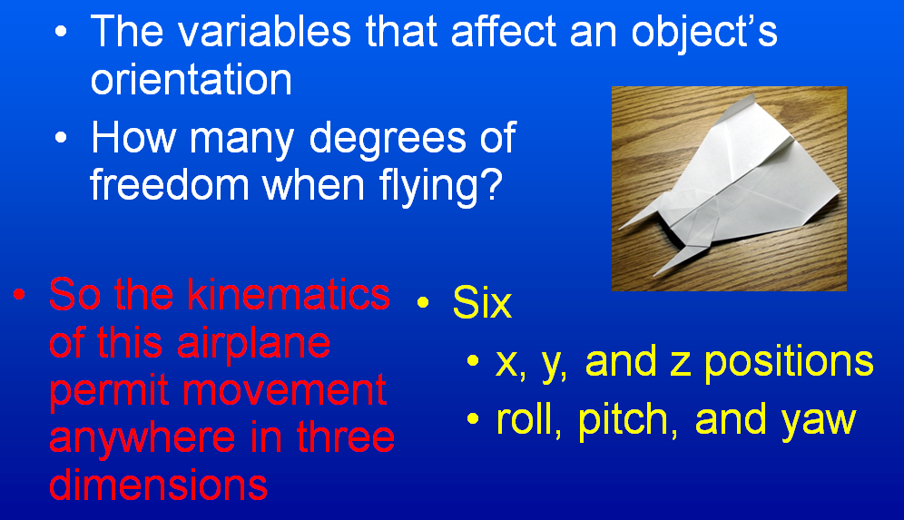
Degrees of Freedom (DOFs) [1]:
Translational & Rotational
Adapted from slides © 2000 – 2005 D. Brogan, University of Virginia
CS 551, Advanced CG & Animation – http://bit.ly/hUXrqd

Slide 12
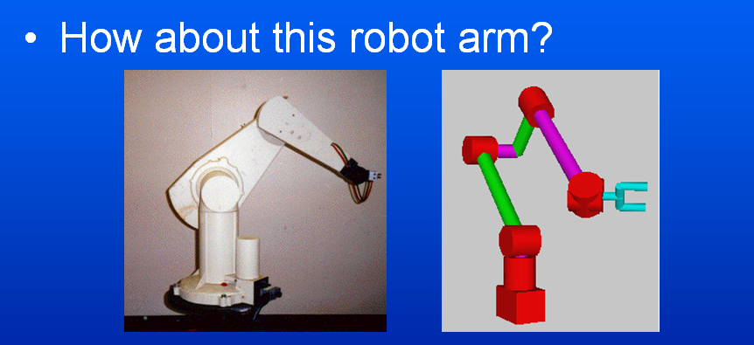

Degrees of Freedom (DOFs) [2]:
Robot Arm
Adapted from slides © 2000 – 2005 D. Brogan, University of Virginia
CS 551, Advanced CG & Animation – http://bit.ly/hUXrqd

Slide 13
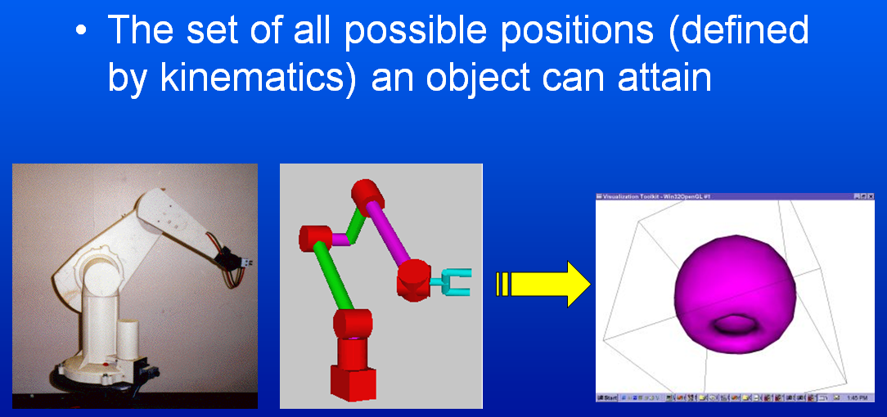
Configuration Space
Adapted from slides © 2000 – 2005 D. Brogan, University of Virginia
CS 551, Advanced CG & Animation – http://bit.ly/hUXrqd

Slide 14
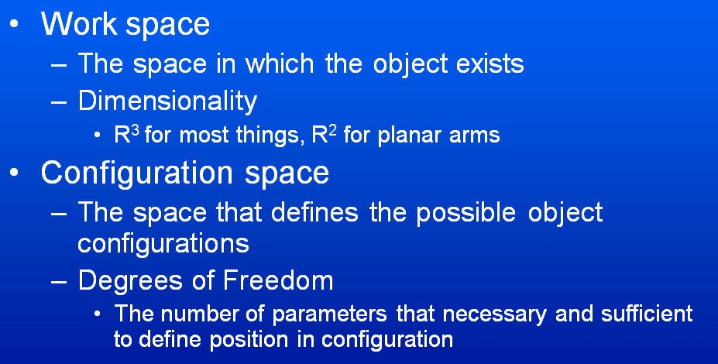
Work Space
vs. Configuration Space
Adapted from slides © 2000 – 2005 D. Brogan, University of Virginia
CS 551, Advanced CG & Animation – http://bit.ly/hUXrqd

Slide 15
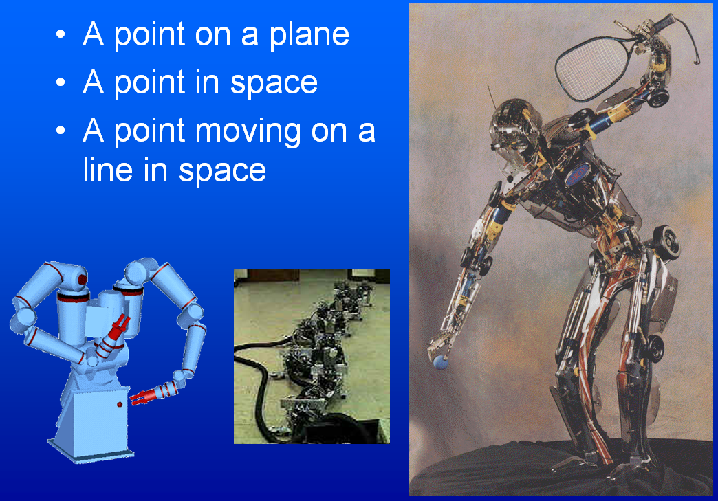
More Examples
Adapted from slides © 2000 – 2005 D. Brogan, University of Virginia
CS 551, Advanced CG & Animation – http://bit.ly/hUXrqd

Slide 16
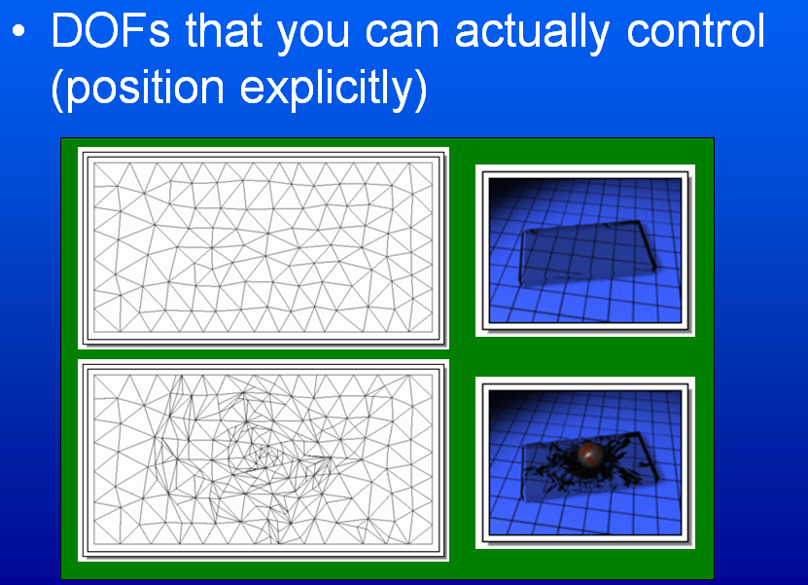
Controlled DOFs
Adapted from slides © 2000 – 2005 D. Brogan, University of Virginia
CS 551, Advanced CG & Animation – http://bit.ly/hUXrqd

Slide 17
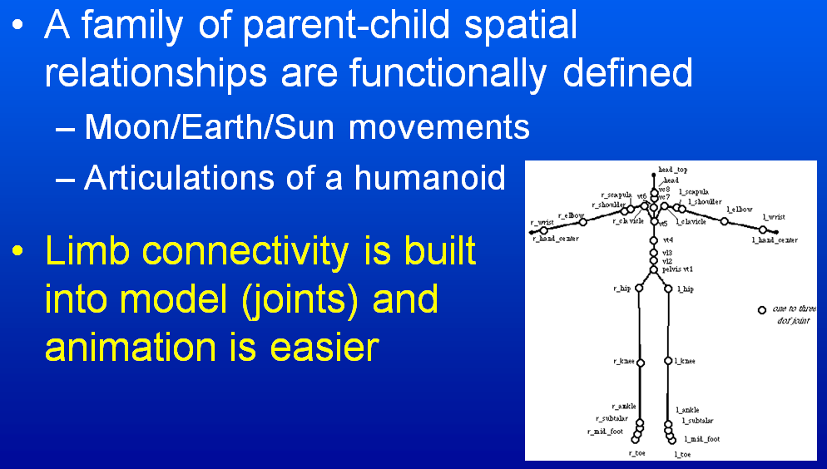
Hierarchical Kinetic Modeling
Adapted from slides © 2000 – 2005 D. Brogan, University of Virginia
CS 551, Advanced CG & Animation – http://bit.ly/hUXrqd

Slide 18
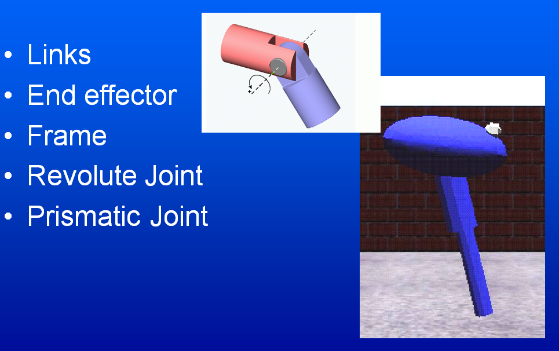
Robot Parts & Terms
Adapted from slides © 2000 – 2005 D. Brogan, University of Virginia
CS 551, Advanced CG & Animation – http://bit.ly/hUXrqd

Slide 19
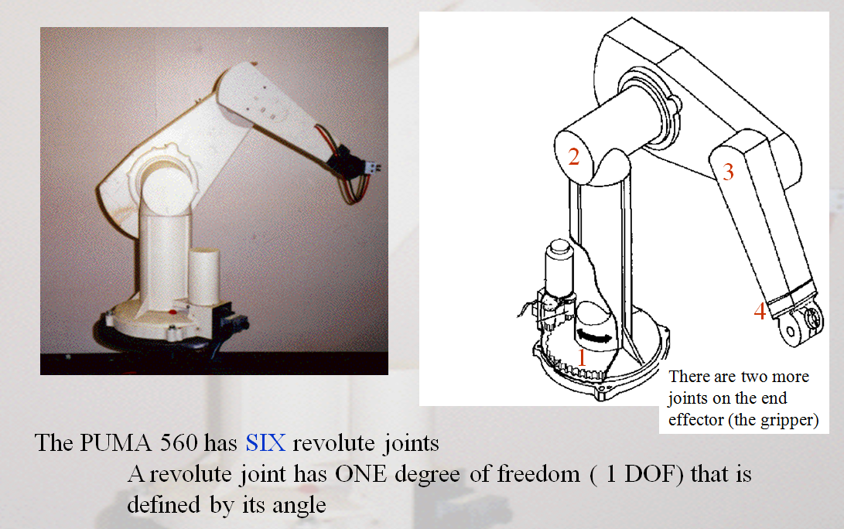
Example:
Puma 560 Robot
Wikipedia, Programmable Universal Machine for Assembly (PUMA): http://bit.ly/fBMRaM
Adapted from slides © 2002 R. Melamud, Stanford University
Mirrored at CMU 16-311 Introduction to Robotics, http://generalrobotics.org

Slide 20
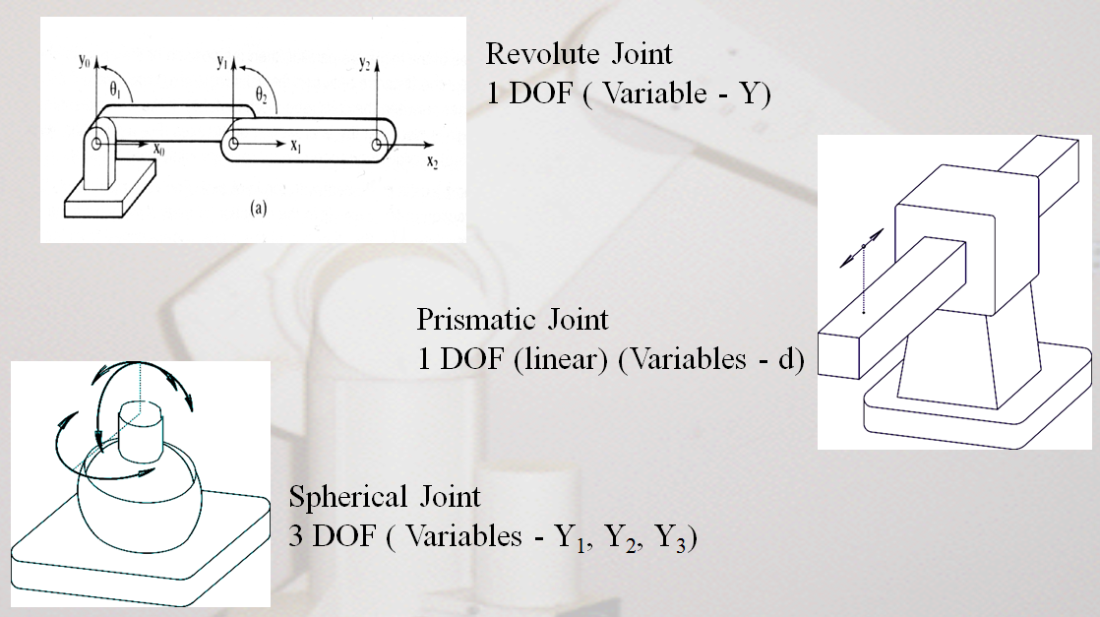
Joint Types:
Revolute, Prismatic, Spherical
Adapted from slides © 2002 R. Melamud, Stanford University
Mirrored at CMU 16-311 Introduction to Robotics, http://generalrobotics.org

Slide 21
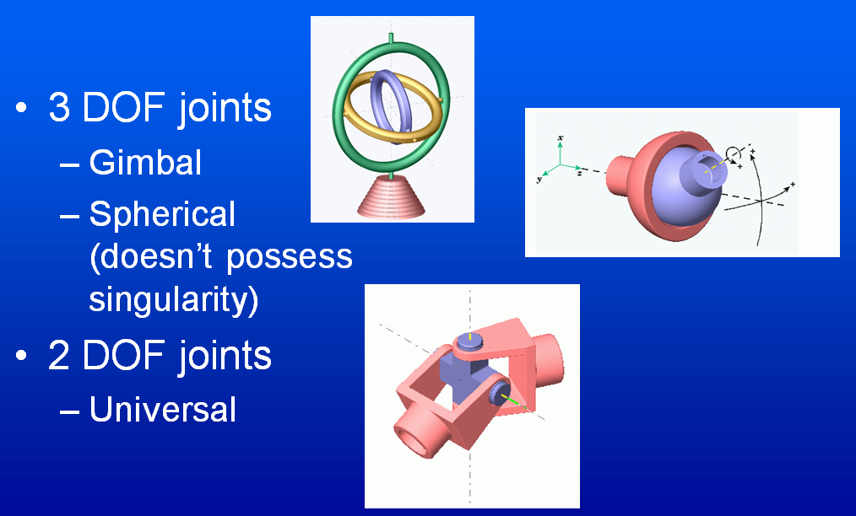
More Complex Joints
Adapted from slides © 2000 – 2005 D. Brogan, University of Virginia
CS 551, Advanced CG & Animation – http://bit.ly/hUXrqd

Slide 22
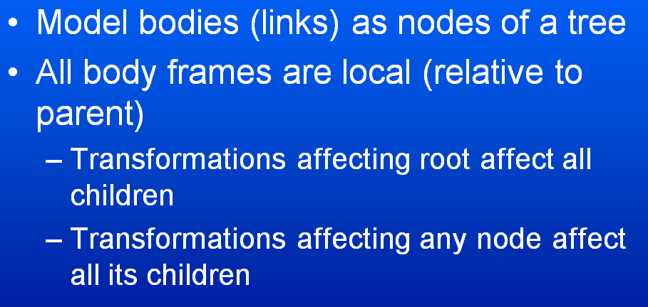
Hierarchical Representation
Adapted from slides © 2000 – 2005 D. Brogan, University of Virginia
CS 551, Advanced CG & Animation – http://bit.ly/hUXrqd

Slide 23
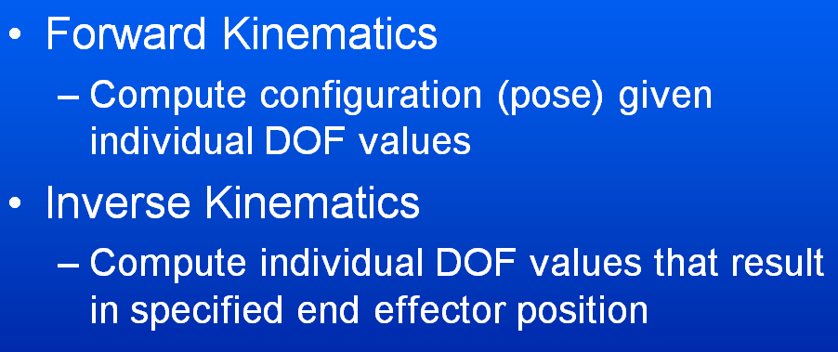
Forward vs. Inverse Kinematics
Adapted from slides © 2000 – 2005 D. Brogan, University of Virginia
CS 551, Advanced CG & Animation – http://bit.ly/hUXrqd

Slide 24
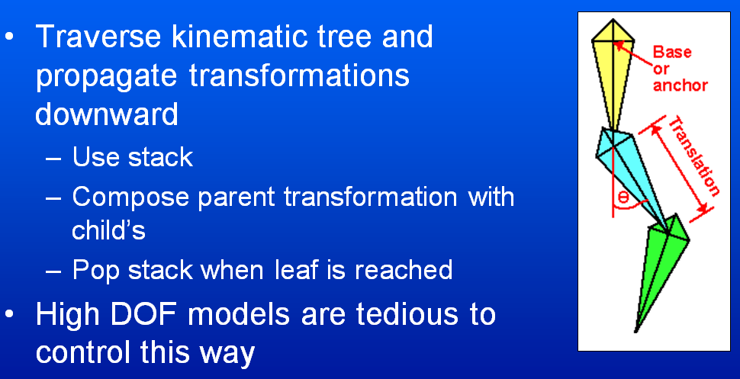
Forward Kinematics [1]:
Definition & General Approach
Adapted from slides © 2000 – 2005 D. Brogan, University of Virginia
CS 551, Advanced CG & Animation – http://bit.ly/hUXrqd

Slide 25

Forward Kinematics [2]:
Illustration
?
End Effector
Base
Choi
Rotenberg
Adapted from slides © 2002 K. J. Choi, Seoul National University
Graphics and Media Lab (http://graphics.snu.ac.kr) – mirrored at: http://bit.ly/hnzSAN

Slide 26
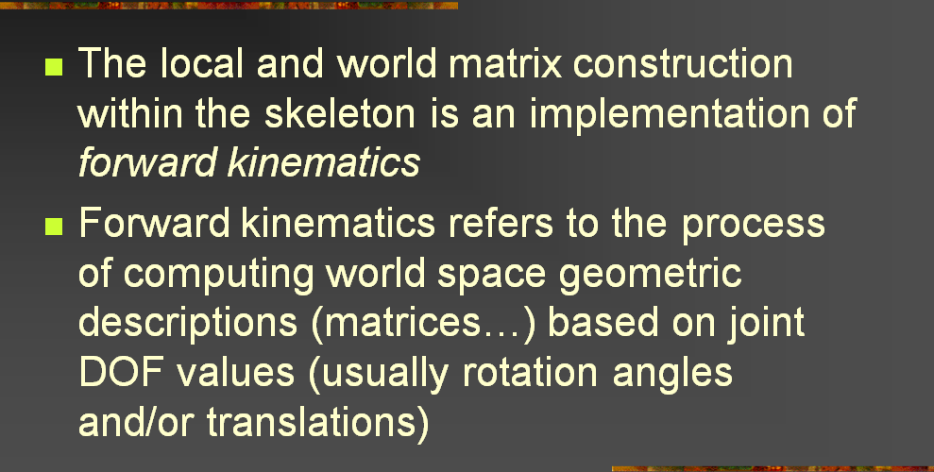
Forward Kinematics [3]:
Joint Angles to Bone Coordinates
Adapted from slides © 2004 – 2005 S. Rotenberg, UCSD
CSE169: Computer Animation, Winter 2005 – http://bit.ly/f0ViAN

Slide 27
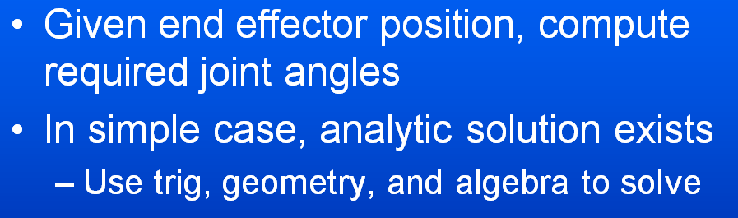
Inverse Kinematics [1]:
Definition & General Approach
Adapted from slides © 2000 – 2005 D. Brogan, University of Virginia
CS 551, Advanced CG & Animation – http://bit.ly/hUXrqd

Slide 28
Inverse Kinematics [2]:
Illustration
For more on characters & IK, see:
Advanced Topics in CG Lecture 05
?
?
End Effector
Base
Choi
Rotenberg
Adapted from slides © 2002 K. J. Choi, Seoul National University
Graphics and Media Lab (http://graphics.snu.ac.kr) – mirrored at: http://bit.ly/hnzSAN

Slide 29
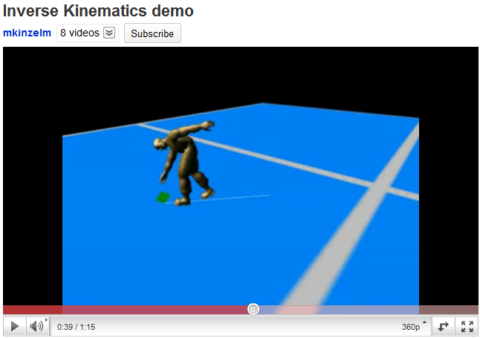
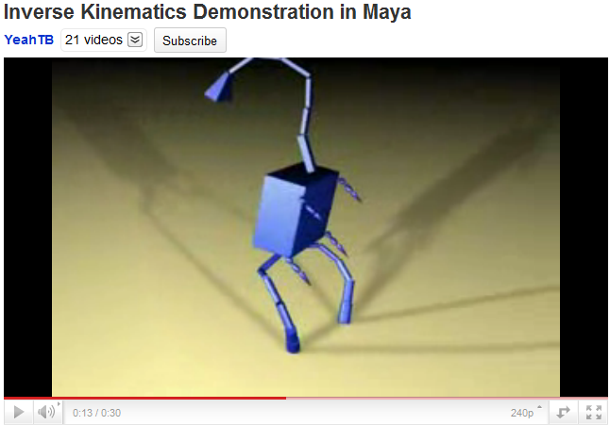
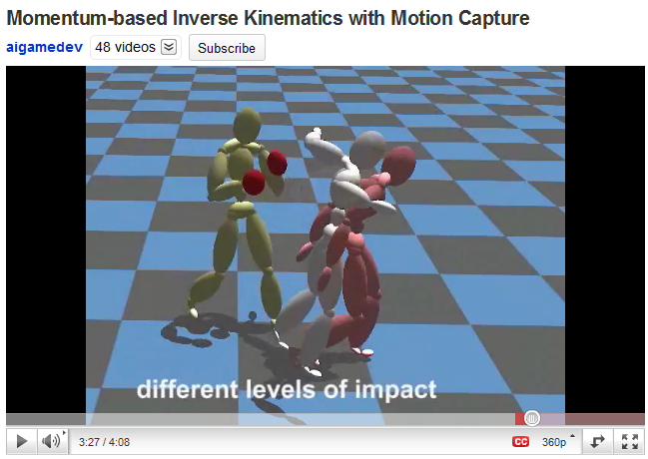
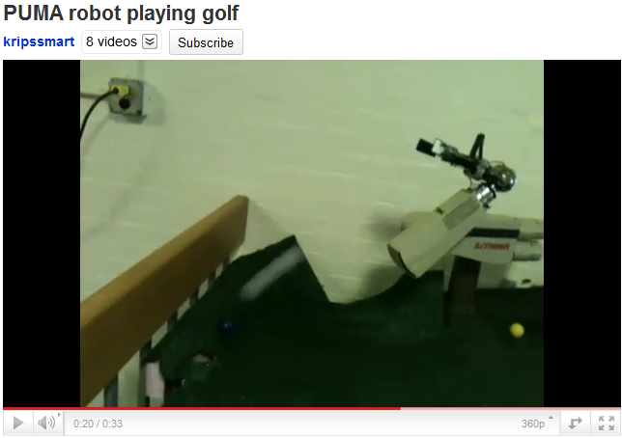
Inverse Kinematics [3]:
Demos
© 2008 M. Kinzelman
http://youtu.be/l52yZ491kPo
© 2007 A. Brown
http://youtu.be/6JdLOLazJJ0
© 2008 T. Komura, H. S. Lim, & R. W. H. Lau
http://youtu.be/FJTBMnP6oCM
© 2011 K. Iyer
http://youtu.be/YvRBWIRAPsE

Slide 30
Inverse Kinematics [4]:
Analytic Solution for 2-Link Case
x₂
y₂
(x,y)
O₂
θ₂
y₀
y₁
a₂
θ₂
x₁
ψ
a₁
O₁
φ
θ₁
x₀
Two solutions: elbow up & elbow down
O₀
Adapted from slides © 2000 – 2005 D. Brogan, University of Virginia
CS 551, Advanced CG & Animation – http://bit.ly/hUXrqd

Slide 31
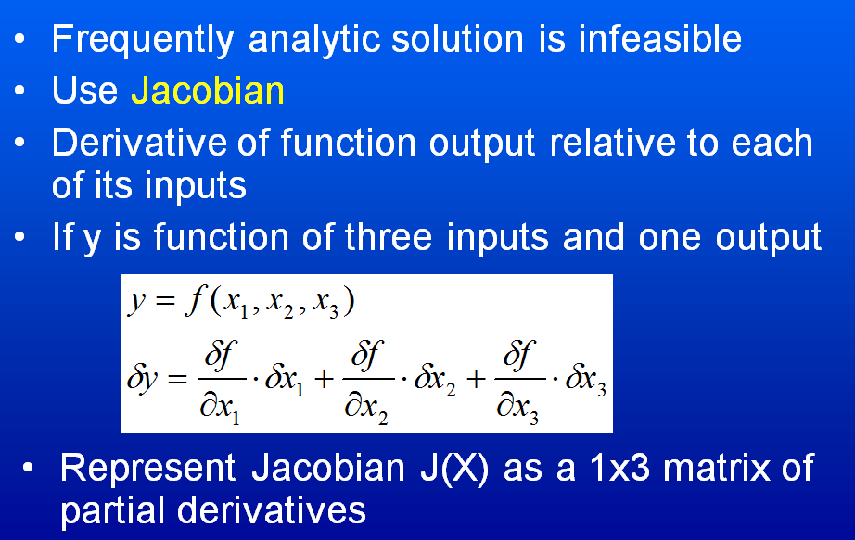
Inverse Kinematics [5]:
Iterative IK Solutions
Adapted from slides © 2000 – 2005 D. Brogan, University of Virginia
CS 551, Advanced CG & Animation – http://bit.ly/hUXrqd

Slide 32
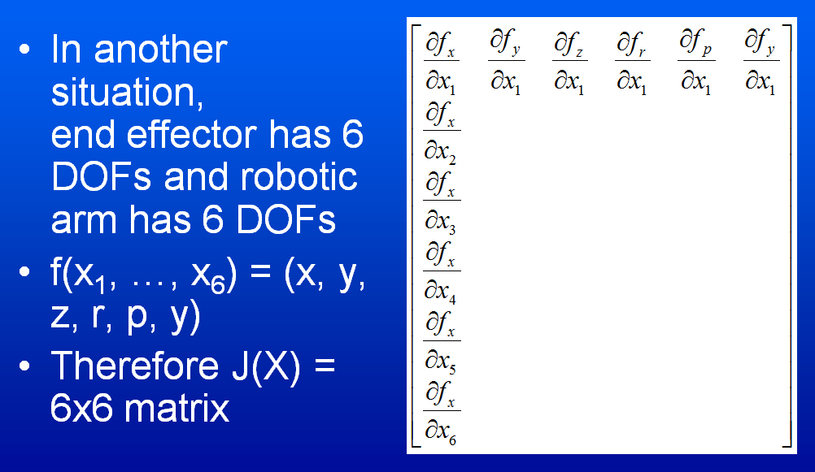
Jacobian [1]:
6x6 DOF Case
Adapted from slides © 2000 – 2005 D. Brogan, University of Virginia
CS 551, Advanced CG & Animation – http://bit.ly/hUXrqd

Slide 33
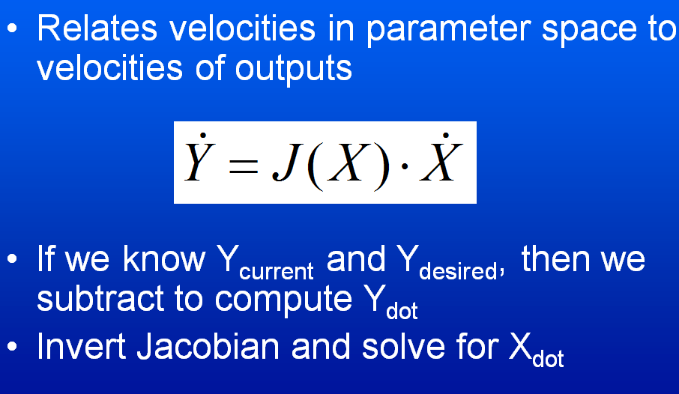
Jacobian [2]:
Solution
Adapted from slides © 2000 – 2005 D. Brogan, University of Virginia
CS 551, Advanced CG & Animation – http://bit.ly/hUXrqd

Slide 34
Another IK Problem:
Revolute & Prismatic Joints Combined
Finding :
(x , y)
More Specifically:
arctan2() specifies that it’s in the first quadrant
Y
S
₁
Finding S:
X
Adapted from slides © 2002 R. Melamud, Stanford University
Mirrored at CMU 16-311 Introduction to Robotics, http://generalrobotics.org

Slide 35
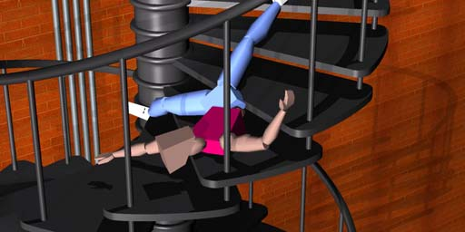
Ragdoll Physics [1]:
Definition
Type of Procedural Animation
  Automatically generates CGA directives (rotations)
  Based on simulation
  Rigid-body dynamics
Articulated Figure
  Gravity
  No autonomous movement
  Used for inert body
    Usually: character death (car impact, falling body, etc.)
    Less often: unconscious, paralyzed character
Collisions with Multiple Bodies
  Inter-character
  Character-object
Falling Bodies © 1997 – 2001 Animats
http://www.animats.com

Slide 36
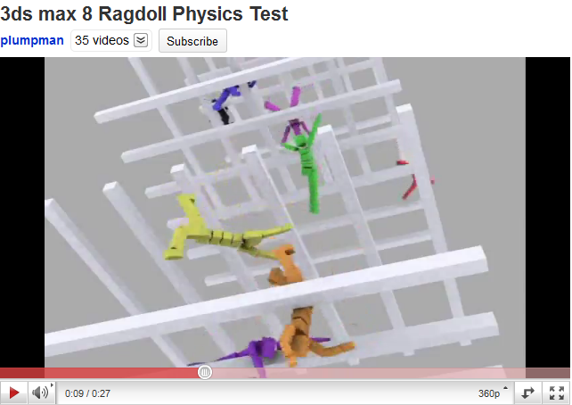
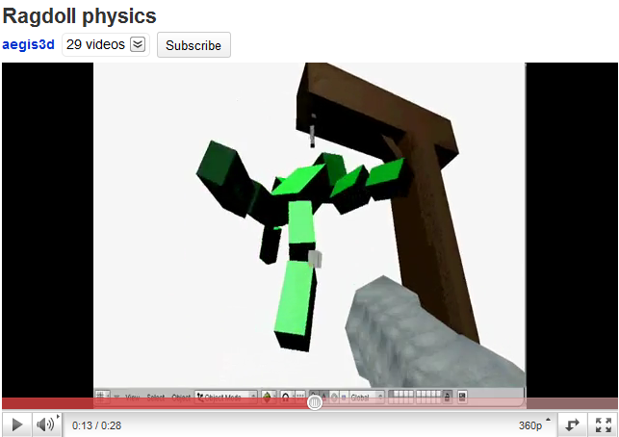
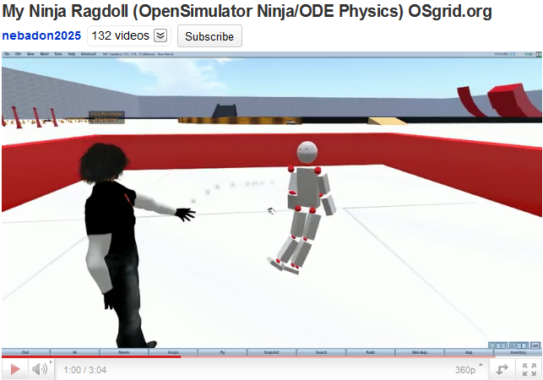
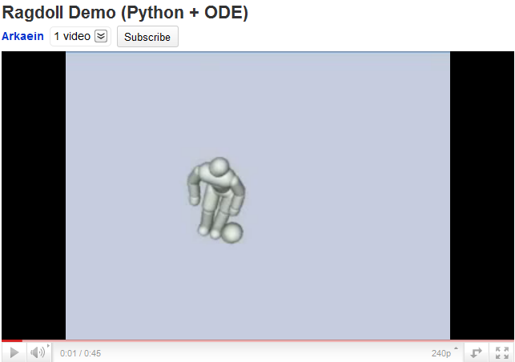
Ragdoll Physics [2]:
Demos
© 2007 N. Picouet
http://youtu.be/ohNqCb--aSs
© 2006 P. Pelt
http://youtu.be/6JdLOLazJJ0
See also: http://youtu.be/5_QIsI0fyaU
© 2009 M. E. Cerquoni
http://youtu.be/uW_DK2qvKv8
© 2010 M. Heinzen (Arkaein)
http://bit.ly/gUj9Su / http://youtu.be/FJTBMnP6oCM

Slide 37
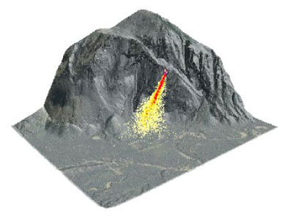
Physically-Based Modeling (PBM) [1]:
Looking Back
Particle Dynamics
  Emitters
    0-D (points), 1-D (lines), 2-D (planes, discs, cross-sections)
    e.g., fireworks (0-D); fountains (0/1/2-D); smokestacks, jets (2-D)
  Simulation: birth-death process, functions of particle age/trajectory
Rigid-Body Dynamics
  Constrained systems of connected parts
  Examples: falling rocks, colliding vehicles, rag dolls
Articulated Figures
More References
  ACM, Intro to Physically-Based Modeling: http://bit.ly/hhQvXd
  Wikipedia, Physics Engine: http://bit.ly/h4PIRt
  Wikipedia, N-Body Problem: http://bit.ly/1ayWwe
Rocks fall
Everyone dies

Slide 38
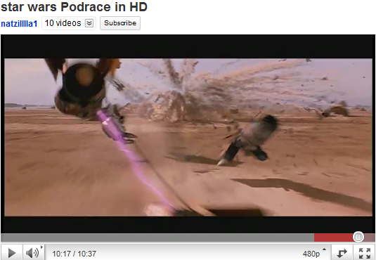
Physically-Based Modeling (PBM) [2]:
Applications in Movies & Games
Star Wars Episode I: The Phantom Menace © 1999 Lucasfilm, Inc. http://youtu.be/d4PSMXUCi-0

Slide 39
Summary
Reading for Today: §5.3, Eberly 2e; CGA Handout
Reading for Next Class: Chapter 14, Eberly 2e
Last Class: Lab on Particle Systems; Dissection of Working Program
Today: Computer-Generated Animation Concluded
  CGA of autonomous agents (robots, swarms) vs. animation by hand
  Degrees of freedom (DOFs) and kinds of joints
  Forward kinematics (FK)
    Forward problem illustrated
    Control problem
  Inverse kinematics (IK)
    IK (finding angles) vs. mechanical problem of finding forces
    Analytical models
    Iterative models (Jacobian-based)
  Ragdoll physics
Next Class: Ray Tracing, Part 1 of 2

Slide 40
Terminology
Emitter – Point, Line, Plane or Region from which Particles Originate
Particle Fountain – Particle System with Directional Emitter
Sprite (Wikipedia: http://bit.ly/gyInPg)
  Definition: 2-D image or animation made part of larger scene
  Point sprite (Saar & Rotzler, 2008): http://bit.ly/fkjBPY
Joints: Parts of Robot / Articulated Figure That Turn, Slide
  Revolute: able to turn (rotate), forming angle between bones
  Prismatic (aka slider): “bone” slides through – http://bit.ly/hScjoe
  Spherical (aka ball joint): “bone” rotates around socket
  Cylindrical (aka hinge): flaps wrap around joint, joined to surfaces
Effectors: Parts of Robot / Articulated Figure That Act (e.g., Hand, Foot)
Bones: Effectors, Other Parts That Rotate about, Slide through Joints
Procedural Animation: Automatic Generation of Motion via Simulation
  Ragdoll physics: procedural animation for inert characters
  Other types: particle systems, N-body dynamics

