Slide 1
Lecture 31of 41
Ray Tracing, Part 1 of 2:
Intersections, Ray Trees & Recursion
William H. Hsu
Department of Computing and Information Sciences, KSU
KSOL course pages: http://bit.ly/hGvXlH / http://bit.ly/eVizrE
Public mirror web site: http://www.kddresearch.org/Courses/CIS636
Instructor home page: http://www.cis.ksu.edu/~bhsu
Readings:
Last class: §5.3, Eberly 2e – see http://bit.ly/ieUq45; CGA Handout
Today: Chapter 14, Eberly 2e
Next class: Ray Tracing Handout
Reference – Wikipedia, Ray Tracing: http://bit.ly/dV7lNm
Reference – ACM Ray Tracing News: http://bit.ly/fqyZNQ

Slide 2
Lecture Outline
Reading for Last Class: §5.3, Eberly 2e; CGA Handout
Reading for Today: Chapter 14, Eberly 2e
Reading for Next Class: Ray Tracing Handout
Last Time: Animation Part 3 of 3 – Inverse Kinematics
  FK vs. IK
  IK
    Autonomous agents vs. hand-animated movement
    Analytical vs. iterative solutions
  Rag doll physics, rigid-body dynamics, physically-based models
End of Material on: Particle Systems, Collisions, CGA, PBM
Today: Ray Tracing, Part 1 of 2
  Vectors: Light/shadow (L), Reflected (R), Transmitted/refracted (T)
  Basic recursive ray tracing: ray trees
Next Class: Ray Tracing Lab

Slide 3
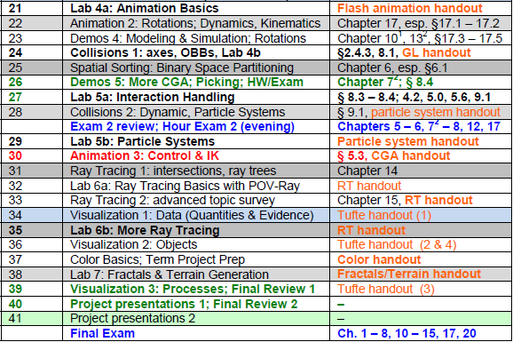

Where We Are

Slide 4
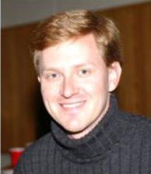

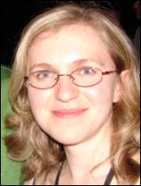


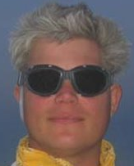


Acknowledgements:
Inverse Kinematics, Ray Tracing
David C. Brogan
Visiting Assistant Professor, Computer Science Department, University of Virginia
http://www.cs.virginia.edu/~dbrogan/
Susquehanna International Group (SIG)
http://www.sig.com
Renata Melamud
Ph.D. Candidate
Mechanical Engineering Department
Stanford University
http://micromachine.stanford.edu/~rmelamud/
Dave Shreiner & Brad Grantham
Adjunct Professor & Adjunct Lecturer, Santa Clara University
ARM Holdings, plc
http://www.plunk.org/~shreiner/
http://www.plunk.org/~grantham/

Slide 5
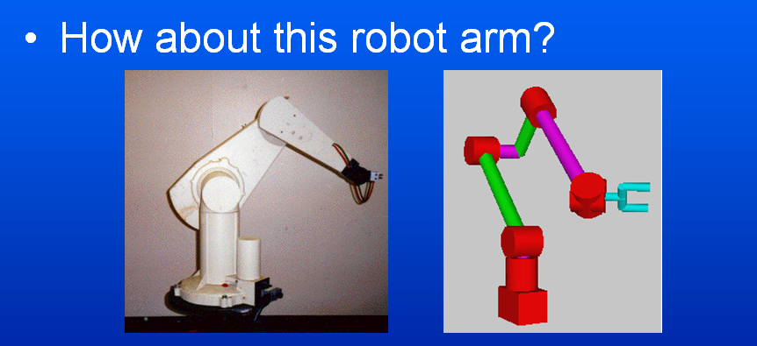
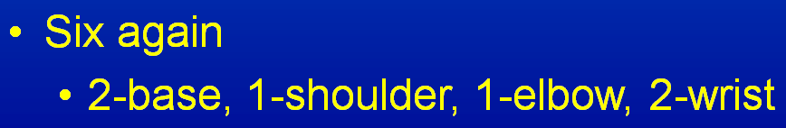
Review [1]:
Kinematics & Degrees of Freedom
Adapted from slides © 2000 – 2005 D. Brogan, University of Virginia
CS 551, Advanced CG & Animation – http://bit.ly/hUXrqd

Slide 6
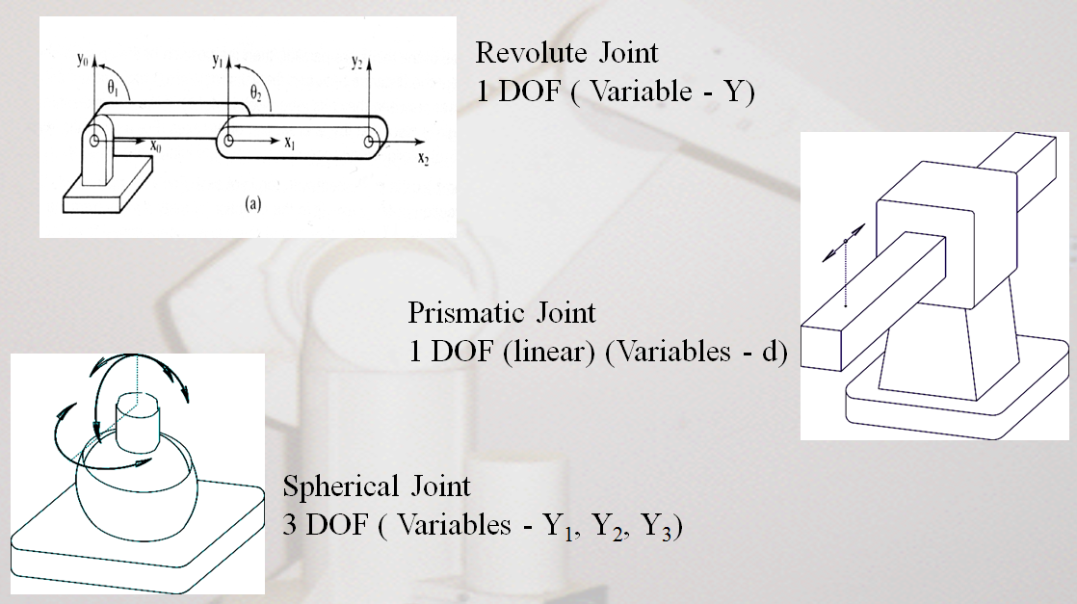
Review [2]:
Joint Types
Adapted from slides © 2002 R. Melamud, Stanford University
Mirrored at CMU 16-311 Introduction to Robotics, http://generalrobotics.org

Slide 7
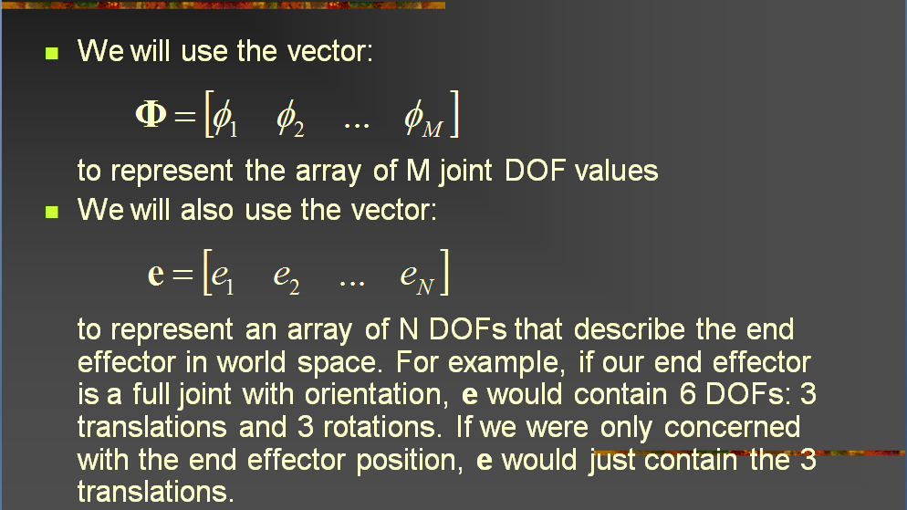
Forward Kinematics:
Joint Angles to Bone Coordinates
Adapted from slides © 2004 – 2005 S. Rotenberg, UCSD
CSE169: Computer Animation, Winter 2005 – http://bit.ly/f0ViAN

Slide 8

Review [3]:
Forward Kinematics
?
End Effector
Base
Choi
Rotenberg
Adapted from slides © 2002 K. J. Choi, Seoul National University
Graphics and Media Lab (http://graphics.snu.ac.kr) – mirrored at: http://bit.ly/hnzSAN

Slide 9
Review [4]:
Inverse Kinematics
For more on characters & IK, see:
Advanced Topics in CG Lecture 05
?
?
End Effector
Base
Choi
Rotenberg
Adapted from slides © 2002 K. J. Choi, Seoul National University
Graphics and Media Lab (http://graphics.snu.ac.kr) – mirrored at: http://bit.ly/hnzSAN

Slide 10
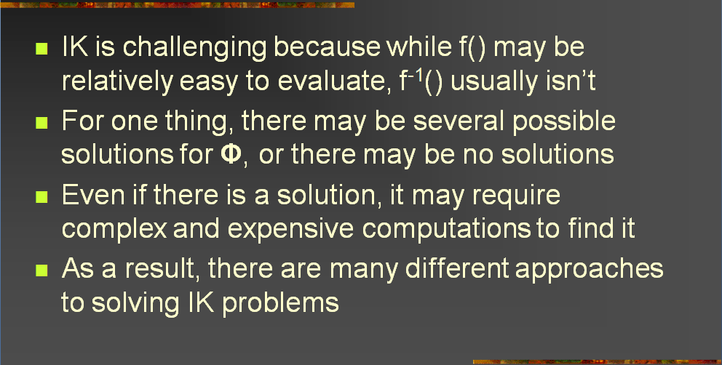
Inverse Kinematics:
Issues
Adapted from slides © 2004 – 2005 S. Rotenberg, UCSD
CSE169: Computer Animation, Winter 2005 – http://bit.ly/f0ViAN

Slide 11
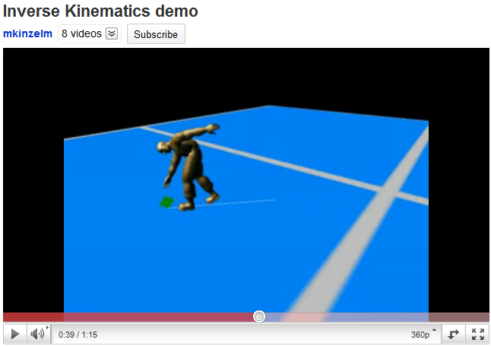
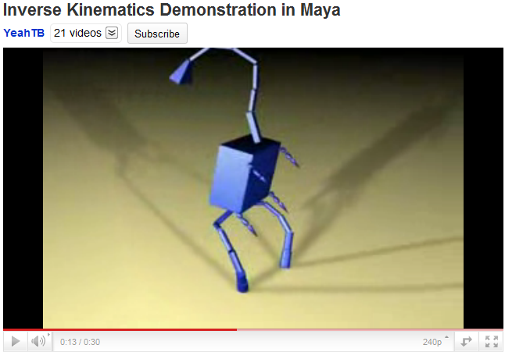
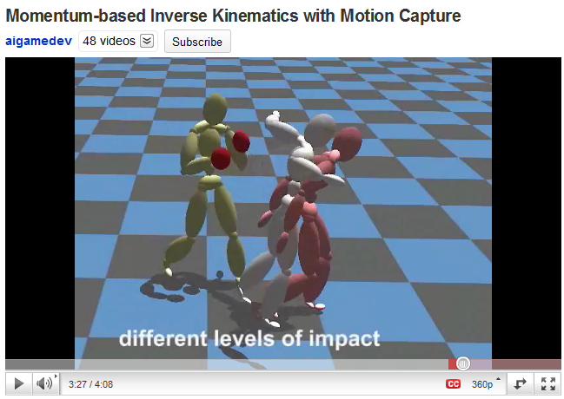
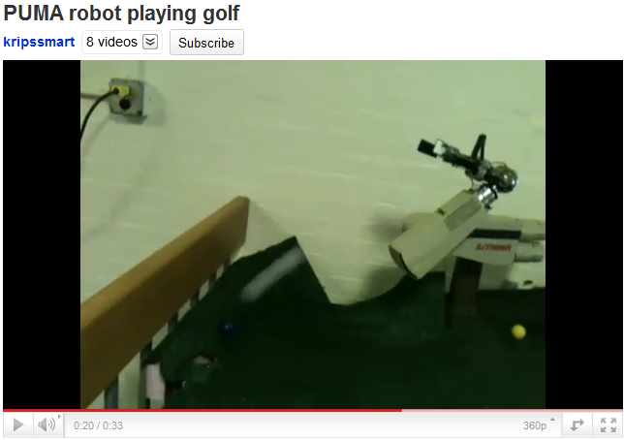
Review [5]:
Inverse Kinematics Demos
© 2008 M. Kinzelman
http://youtu.be/l52yZ491kPo
© 2007 A. Brown
http://youtu.be/6JdLOLazJJ0
© 2008 T. Komura, H. S. Lim, & R. W. H. Lau
http://youtu.be/FJTBMnP6oCM
© 2011 K. Iyer
http://youtu.be/YvRBWIRAPsE

Slide 12
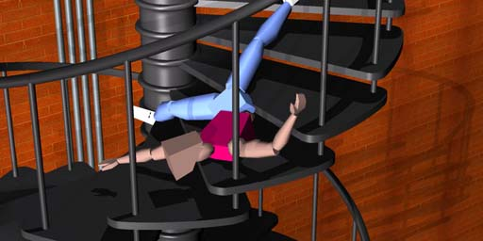
Review [6]:
Ragdoll Physics
Type of Procedural Animation
  Automatically generates CGA directives (rotations)
  Based on simulation
  Rigid-body dynamics
Articulated Figure
  Gravity
  No autonomous movement
  Used for inert body
    Usually: character death (car impact, falling body, etc.)
    Less often: unconscious, paralyzed character
Collisions with Multiple Bodies
  Inter-character
  Character-object
Falling Bodies © 1997 – 2001 Animats
http://www.animats.com

Slide 13
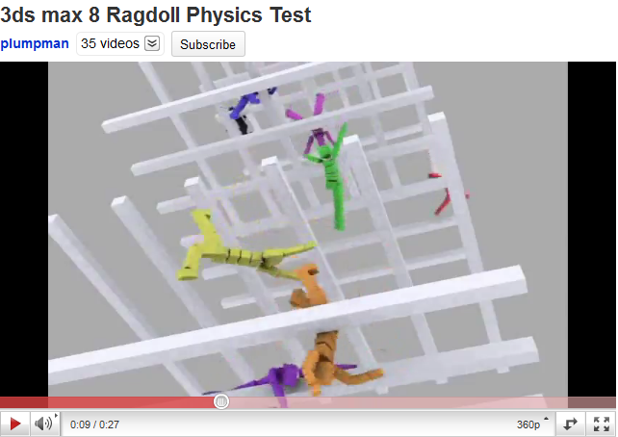
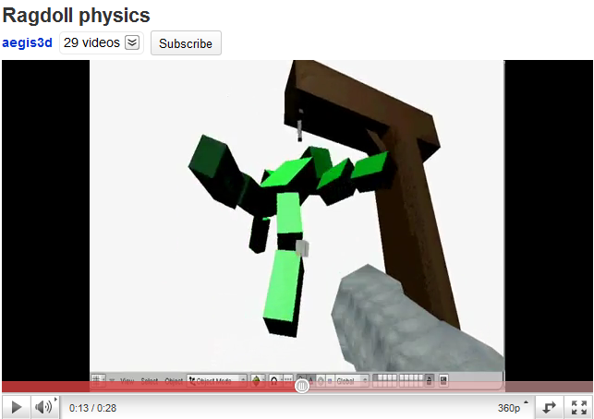
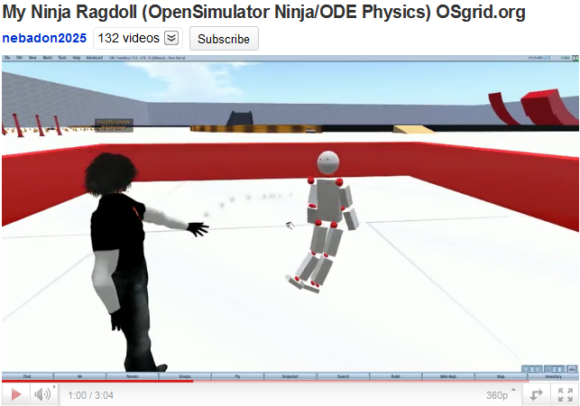
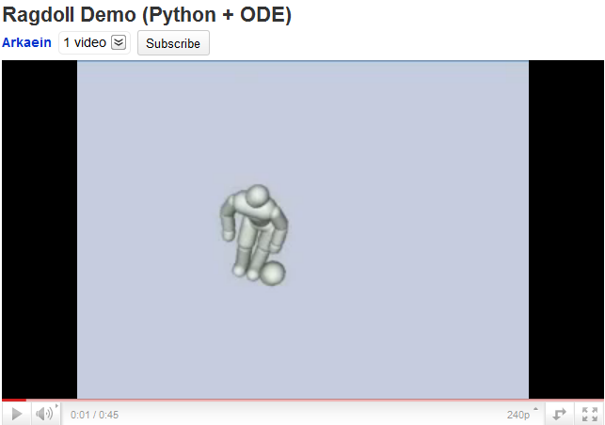
Review [7]:
Ragdoll Physics Demos
© 2007 N. Picouet
http://youtu.be/ohNqCb--aSs
© 2006 P. Pelt
http://youtu.be/6JdLOLazJJ0
See also: http://youtu.be/5_QIsI0fyaU
© 2009 M. E. Cerquoni
http://youtu.be/uW_DK2qvKv8
© 2010 M. Heinzen (Arkaein)
http://bit.ly/gUj9Su / http://youtu.be/FJTBMnP6oCM

Slide 14
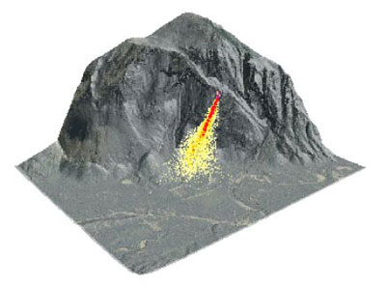
Review [8}:
Physically-Based Modeling (PBM)
Particle Dynamics
  Emitters
    0-D (points), 1-D (lines), 2-D (planes, discs, cross-sections)
    e.g., fireworks (0-D); fountains (0/1/2-D); smokestacks, jets (2-D)
  Simulation: birth-death process, functions of particle age/trajectory
Rigid-Body Dynamics
  Constrained systems of connected parts
  Examples: falling rocks, colliding vehicles, rag dolls
Articulated Figures: Primarily IK
More References
  ACM, Intro to Physically-Based Modeling: http://bit.ly/hhQvXd
  Wikipedia, Physics Engine: http://bit.ly/h4PIRt
  Wikipedia, N-Body Problem: http://bit.ly/1ayWwe
PBM System: nVidia (Ageia) PhysX: http://bit.ly/cp7bnA
Rocks fall
Everyone dies

Slide 15
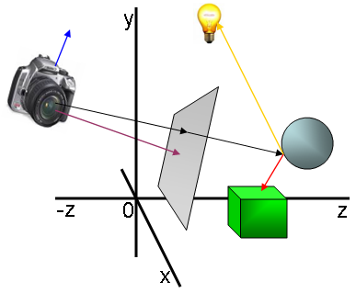
Ray Tracing [1]:
Overview
What is it?
Why use it?
Basics
Advanced topics
References
© 2006 – 2007 H. Kuijpers,
Capgemini Netherlands
http://bit.ly/erkKrC
Adapted from slides © 2001 D. Shreiner & B. Grantham, SCU
COEN 290: Computer Graphics I, Winter 2001 – http://bit.ly/hz1kfU

Slide 16
Ray Tracing [2]:
Why Use It?
Simulate rays of light
Produces natural lighting effects
Hard to simulate effects with rasterization techniques (OpenGL)
Rasterizers require many passes
Ray-tracing easier to implement
Adapted from slides © 2001 D. Shreiner & B. Grantham, SCU
COEN 290: Computer Graphics I, Winter 2001 – http://bit.ly/hz1kfU

Slide 17
Ray Tracing [3]:
Who Uses It?
Entertainment (Movies, Commercials)
Games pre-production
Simulation
Adapted from slides © 2001 D. Shreiner & B. Grantham, SCU
COEN 290: Computer Graphics I, Winter 2001 – http://bit.ly/hz1kfU

Slide 18
Ray Tracing [4]:
Brief History
Decartes, 1637 A.D. - analysis of rainbow
Arthur Appel, 1968 - used for lighting 3D models
Turner Whitted, 1980 - “An Improved Illumination Model for Shaded Display” really kicked everyone off.
1980-now - Lots of research
Adapted from slides © 2001 D. Shreiner & B. Grantham, SCU
COEN 290: Computer Graphics I, Winter 2001 – http://bit.ly/hz1kfU

Slide 19
Ray Tracing [5]:
Basic Operations
Generating Rays
Intersecting Rays with Scene
Lighting
Shadowing
Reflections
Adapted from slides © 2001 D. Shreiner & B. Grantham, SCU
COEN 290: Computer Graphics I, Winter 2001 – http://bit.ly/hz1kfU

Slide 20
Ray Tracing [6]:
Basic Idea
Simulate light rays from light source to eye
Eye
Light
Reflected ray
Incident ray
Surface
Adapted from slides © 2001 D. Shreiner & B. Grantham, SCU
COEN 290: Computer Graphics I, Winter 2001 – http://bit.ly/hz1kfU

Slide 21
“Forward” Ray Tracing
Trace rays from light
Lots of work for little return
Light
Image
Plane
Light Rays
Eye
Object
Adapted from slides © 2001 D. Shreiner & B. Grantham, SCU
COEN 290: Computer Graphics I, Winter 2001 – http://bit.ly/hz1kfU

Slide 22
“Backward” Ray Tracing
Trace rays from eye instead
Do work where it matters
Light
Image
Plane
Eye
Object
This is what most people mean by “ray tracing”.
Adapted from slides © 2001 D. Shreiner & B. Grantham, SCU
COEN 290: Computer Graphics I, Winter 2001 – http://bit.ly/hz1kfU

Slide 23
Ray: Parametric Form
Ray expressed as function of a single parameter (“t”)
<x, y, z> = <x_{o}, y_{o}, z_{o}> + t * <x_{d}, y_{d}, z_{d}>
<x, y, z> = r_{o} + tr_{d}
t = 2.5
r_{d} = <x_{d}, y_{d}, z_{d}>
t = 2.0
r_{o} = <x_{o}, y_{o}, z_{o}>
t = 1.0
t = 0.0
Adapted from slides © 2001 D. Shreiner & B. Grantham, SCU
COEN 290: Computer Graphics I, Winter 2001 – http://bit.ly/hz1kfU

Slide 24
Generating Rays [1]
Trace one ray for each pixel (u, v) in image plane
tan(fov_{x}) * 2
Image
Plane
fov_{x}
Eye
Eye
(Looking down from the top)
Adapted from slides © 2001 D. Shreiner & B. Grantham, SCU
COEN 290: Computer Graphics I, Winter 2001 – http://bit.ly/hz1kfU

Slide 25
Generating Rays [2]
Trace one ray for each pixel (u, v) in image plane
(Looking from the side)
m
(tan(fov_{x})* 2) / m
(tan(fov_{y})* 2) / n
Eye
n
Image
Plane
Adapted from slides © 2001 D. Shreiner & B. Grantham, SCU
COEN 290: Computer Graphics I, Winter 2001 – http://bit.ly/hz1kfU

Slide 26
Generating Rays [3]
Trace one ray for each pixel (u, v) in image plane
renderImage(){
for each pixel i, j in the image
ray.setStart(0, 0, 0); // r_{o}
ray.setDir ((.5 + i) * tan(fov_{x})* 2 / m,
(.5 + j) * tan(fov_{y})* 2 / n,
1.0); // r_{d}
ray.normalize();
image[i][j] = rayTrace(ray);
}
Adapted from slides © 2001 D. Shreiner & B. Grantham, SCU
COEN 290: Computer Graphics I, Winter 2001 – http://bit.ly/hz1kfU

Slide 27
Ray/Triangle Intersection [1]:
Intersection Test Revisited
Want to know: at what point p does ray intersect triangle?
Compute lighting, reflected rays, shadowing from that point
p = t_{min}
r_{d}
r_{o}
<?, ?, ?>
(t = ???)
Adapted from slides © 2001 D. Shreiner & B. Grantham, SCU
COEN 290: Computer Graphics I, Winter 2001 – http://bit.ly/hz1kfU

Slide 28
Ray/Triangle Intersection [2]:
Ray/Plane Intersection Point p
Step 1 : Intersect with plane
  ( Ax + By + Cz + D = 0 )
Plane normal
n = <A, B, C>
p
r_{d}
r_{o}
t_{min} = p = -(n • r_{o} + D) / (n • r_{d} )
Adapted from slides © 2001 D. Shreiner & B. Grantham, SCU
COEN 290: Computer Graphics I, Winter 2001 – http://bit.ly/hz1kfU

Slide 29
Ray/Triangle Intersection [3]:
Triangle Containment
Step 2 : Check against triangle edges
n
V₁
V₀V₁
E₀
p
E_{i} = V_{i}V_{i+1} ^{x} n (plane A, B, C)
d_{i} = -A.N (plane D)
V₀
V₂
Plug p into (p • E_{i} + d_{i} ) for each edge
if signs are all positive or negative,
point is inside triangle!
Adapted from slides © 2001 D. Shreiner & B. Grantham, SCU
COEN 290: Computer Graphics I, Winter 2001 – http://bit.ly/hz1kfU

Slide 30
Triangle Normals
for Shading
Could use plane normals (flat shading)
Better to interpolate from vertices
n_{V1}
V₁
Find areas
n
n_{V0}
p
c
a
b
V₀
n_{V2}
V₂
n = an_{V0} + bn_{V1} + cn_{V2}
Adapted from slides © 2001 D. Shreiner & B. Grantham, SCU
COEN 290: Computer Graphics I, Winter 2001 – http://bit.ly/hz1kfU

Slide 31
Finding Intersections
Check all triangles, keep closest intersection t_{min}
hitObject(ray) {
for each triangle in scene
does ray intersect triangle?
if(intersected and was closer)
save that intersection
if(intersected)
return intersection point and normal
}
Adapted from slides © 2001 D. Shreiner & B. Grantham, SCU
COEN 290: Computer Graphics I, Winter 2001 – http://bit.ly/hz1kfU

Slide 32
Lighting [1]:
General Notation Review
We’ll use triangles for lights
Can build complex shapes from triangles
Some lighting terms
Light
Eye
N
I
R
V
Adapted from slides © 2001 D. Shreiner & B. Grantham, SCU
COEN 290: Computer Graphics I, Winter 2001 – http://bit.ly/hz1kfU

Slide 33
Lighting [2]:
Modified Phong Illumination
Use modified Phong lighting
  similar to OpenGL
  simulates rough and shiny surfaces
for each light
I_{n} = I_{ambient}K_{ambient} +
I_{diffuse}K_{diffuse} (L.N) +
I_{specular}K_{specular} (R.V)^{n}
Adapted from slides © 2001 D. Shreiner & B. Grantham, SCU
COEN 290: Computer Graphics I, Winter 2001 – http://bit.ly/hz1kfU

Slide 34
Ambient Light
I_{ambient} – simulates indirect lighting in a scene
May not need for RT!
Eye
Light
Adapted from slides © 2001 D. Shreiner & B. Grantham, SCU
COEN 290: Computer Graphics I, Winter 2001 – http://bit.ly/hz1kfU

Slide 35
Diffuse Light
I_{diffuse} – simulates direct lighting on rough surface
Viewer-independent
Paper, rough wood, brick, etc...
Eye
Light
Adapted from slides © 2001 D. Shreiner & B. Grantham, SCU
COEN 290: Computer Graphics I, Winter 2001 – http://bit.ly/hz1kfU

Slide 36
Specular Light
I_{specular} simulates direct lighting on a smooth surface
Viewer dependent
Plastic, metal, polished wood, etc...
Eye
Light
Adapted from slides © 2001 D. Shreiner & B. Grantham, SCU
COEN 290: Computer Graphics I, Winter 2001 – http://bit.ly/hz1kfU

Slide 37
Shadow Test
Check against other objects to see if point is shadowed
Eye
Shadowing
object
Light
Adapted from slides © 2001 D. Shreiner & B. Grantham, SCU
COEN 290: Computer Graphics I, Winter 2001 – http://bit.ly/hz1kfU

Slide 38
Reflection
Angle of incidence = angle of reflection (θ_{I} = θ_{R} )
I, R, N lie in the same plane
R = I - 2 (N • I) N
N
I
θ_{I}
θ_{R}
R
Adapted from slides © 2001 D. Shreiner & B. Grantham, SCU
COEN 290: Computer Graphics I, Winter 2001 – http://bit.ly/hz1kfU

Slide 39
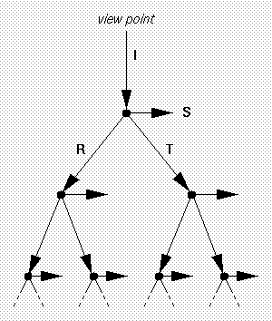
Putting It All Together [1]:
Recursive Calculation & Ray Tree
Recursive ray evaluation
Generates ray tree shown at right
rayTrace(ray) {
hitObject(ray, p, n, triangle);
color = object color;
if(object is light)
return(color);
else
return(lighting(p, n, color));
}
Ray tree
© 2000 N. Patrikalakis, MIT
http://bit.ly/fjcGGk
I = Incident ray
S = light Source vector (aka L)
R = reflected ray
T = transmitted ray
Adapted from slides © 2001 D. Shreiner & B. Grantham, SCU
COEN 290: Computer Graphics I, Winter 2001 – http://bit.ly/hz1kfU

Slide 40
Putting It All Together [2]:
Applying Lighting
Calculating surface color
lighting(point) {
color = ambient color;
for each light
if(hitObject(shadow ray))
color += lightcolor *
dot(shadow ray, n);
color += rayTrace(reflection) *
pow(dot(reflection, ray), shininess);
return(color);
}
Adapted from slides © 2001 D. Shreiner & B. Grantham, SCU
COEN 290: Computer Graphics I, Winter 2001 – http://bit.ly/hz1kfU

Slide 41
Putting It All Together [3]:
Main Program
main() {
triangles = readTriangles();
image = renderImage(triangles);
writeImage(image);
}
Adapted from slides © 2001 D. Shreiner & B. Grantham, SCU
COEN 290: Computer Graphics I, Winter 2001 – http://bit.ly/hz1kfU

Slide 42
Good Start:
What next?
Lighting, Shadows, Reflection are enough to make some compelling images
Want better lighting and objects
Need more speed
Adapted from slides © 2001 D. Shreiner & B. Grantham, SCU
COEN 290: Computer Graphics I, Winter 2001 – http://bit.ly/hz1kfU

Slide 43
More Quality, More Speed
Better Lighting + Forward Tracing
Texture Mapping
Modeling Techniques
Distributed Ray Tracing: Techniques
  Motion Blur
  Depth of Field
  Blurry Reflection/Refraction
  Wikipedia, Distributed Ray Tracing: http://bit.ly/ihyVUs
Improving Image Quality
Acceleration Techniques
Adapted from slides © 2001 D. Shreiner & B. Grantham, SCU
COEN 290: Computer Graphics I, Winter 2001 – http://bit.ly/hz1kfU

Slide 44
Refraction [1]:
Snell’s Law
Keep track of medium (air, glass, etc)
Need index of refraction (η )
Need solid objects
N
θ_{I}
Medium 1
(e.g., air)
sin(θ_{I}) η₁
sin(θ_{T}) η₂
I
=
Medium 2
(e.g., water)
T
θ_{T}
Adapted from slides © 2001 D. Shreiner & B. Grantham, SCU
COEN 290: Computer Graphics I, Winter 2001 – http://bit.ly/hz1kfU

Slide 45
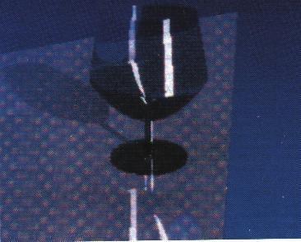
Refraction [2]:
Example
Adapted from slides © 2001 D. Shreiner & B. Grantham, SCU
COEN 290: Computer Graphics I, Winter 2001 – http://bit.ly/hz1kfU

Slide 46
Improved Light Model:
Cook-Torrance
Cook-Torrance model
  Based on a microfacet model
  Wikipedia: http://bit.ly/hX3U30
Metals have different color at angle
Oblique reflections leak around corners
Adapted from slides © 2001 D. Shreiner & B. Grantham, SCU
COEN 290: Computer Graphics I, Winter 2001 – http://bit.ly/hz1kfU

Slide 47
Using “Forward” Ray Tracing [1]:
Lensed Caustics for Indirect Lighting
Backward tracing doesn’t handle indirect lighting too well
To get caustics, trace forward, store results in texture map
Adapted from slides © 2001 D. Shreiner & B. Grantham, SCU
COEN 290: Computer Graphics I, Winter 2001 – http://bit.ly/hz1kfU

Slide 48
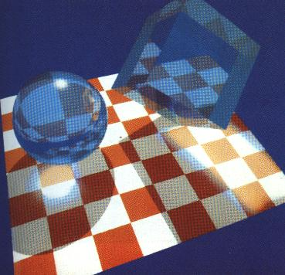
Using “Forward” Ray Tracing [2]:
Example
Adapted from slides © 2001 D. Shreiner & B. Grantham, SCU
COEN 290: Computer Graphics I, Winter 2001 – http://bit.ly/hz1kfU

Slide 49
Texture Mapping & Ray Tracing [1]:
Applying Surface Detail
Using texture maps
  Add surface detail
  Think of it like texturing in OpenGL
Diffuse, specular colors
Shininess value
Bump map
Transparency value
Adapted from slides © 2001 D. Shreiner & B. Grantham, SCU
COEN 290: Computer Graphics I, Winter 2001 – http://bit.ly/hz1kfU

Slide 50
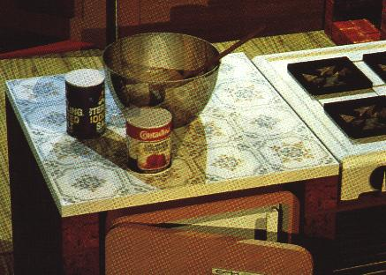
Texture Mapping & Ray Tracing [2]:
Example
Adapted from slides © 2001 D. Shreiner & B. Grantham, SCU
COEN 290: Computer Graphics I, Winter 2001 – http://bit.ly/hz1kfU

Slide 51
Parametric Surfaces
More expressive than triangle
Intersection is probably slower
u and v on surface can be used as texture s, t
Adapted from slides © 2001 D. Shreiner & B. Grantham, SCU
COEN 290: Computer Graphics I, Winter 2001 – http://bit.ly/hz1kfU

Slide 52
Constructive Solid Geometry
Union, Subtraction, Intersection of solid objects
Have to keep track of intersections
Adapted from slides © 2001 D. Shreiner & B. Grantham, SCU
COEN 290: Computer Graphics I, Winter 2001 – http://bit.ly/hz1kfU

Slide 53
Hierarchical Transformation
Scene made of parts
Each part made of smaller parts
Each smaller part has transformation linking it to larger part
Transformation can change over time: animation (CGA)
Adapted from slides © 2001 D. Shreiner & B. Grantham, SCU
COEN 290: Computer Graphics I, Winter 2001 – http://bit.ly/hz1kfU

Slide 54
Distributed Ray Tracing [1]:
Basic Idea
Average multiple rays instead of just one ray
Use for both shadows, reflections, transmission (refraction)
Use for motion blur
Use for depth of field
Adapted from slides © 2001 D. Shreiner & B. Grantham, SCU
COEN 290: Computer Graphics I, Winter 2001 – http://bit.ly/hz1kfU

Slide 55
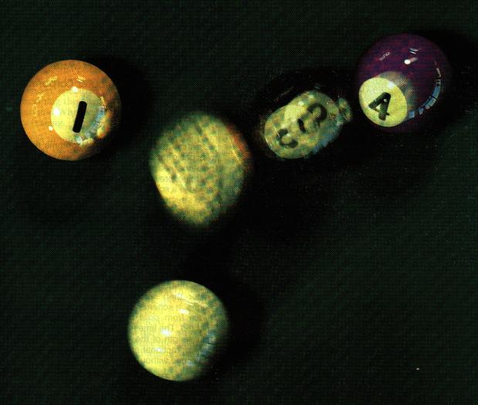
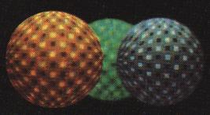
Distributed Ray Tracing [2]:
Example
Adapted from slides © 2001 D. Shreiner & B. Grantham, SCU
COEN 290: Computer Graphics I, Winter 2001 – http://bit.ly/hz1kfU

Slide 56
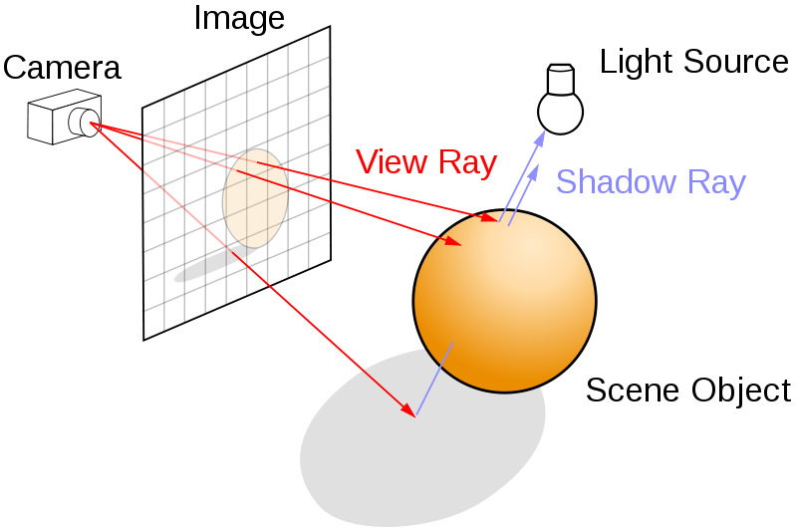
Distributed Ray Tracing [3]:
Supersampling
One ray is not enough (jaggies)
Can use multiple rays per pixel - supersampling
Can use a few samples, continue if they’re very different - adaptive supersampling
Texture interpolation & filtering
Ray Tracing © 2008 Wikipedia
http://bit.ly/dV7lNm
Adapted from slides © 2001 D. Shreiner & B. Grantham, SCU
COEN 290: Computer Graphics I, Winter 2001 – http://bit.ly/hz1kfU

Slide 57
Acceleration!
1280x1024 image with 10 rays/pixel
1000 objects (triangle, CSG, NURBS)
3 levels recursion
39321600000 intersection tests
100000 tests/second -> 109 days!
Must use an acceleration method!
Adapted from slides © 2001 D. Shreiner & B. Grantham, SCU
COEN 290: Computer Graphics I, Winter 2001 – http://bit.ly/hz1kfU

Slide 58
Bounding Volumes
Use simple shape for quick test, keep BV hierarchy
Adapted from slides © 2001 D. Shreiner & B. Grantham, SCU
COEN 290: Computer Graphics I, Winter 2001 – http://bit.ly/hz1kfU

Slide 59
Spatial Partitioning:
Subdivision
Break your space into pieces
Search the structure linearly
Adapted from slides © 2001 D. Shreiner & B. Grantham, SCU
COEN 290: Computer Graphics I, Winter 2001 – http://bit.ly/hz1kfU

Slide 60
Parallelism
Can always throw more processors at it
Parallel computing model
  Multiple processes or threads
  Data parallel: separate pixel for each
Adapted from slides © 2001 D. Shreiner & B. Grantham, SCU
COEN 290: Computer Graphics I, Winter 2001 – http://bit.ly/hz1kfU

Slide 61
Really Advanced Stuff
Error analysis
Hybrid radiosity/ray-tracing
Metropolis Light Transport
Memory-Coherent Ray-tracing
Adapted from slides © 2001 D. Shreiner & B. Grantham, SCU
COEN 290: Computer Graphics I, Winter 2001 – http://bit.ly/hz1kfU

Slide 62
References
Introduction to Ray-Tracing, Glassner et al., 1989, 0-12-286160-4
Advanced Animation and Rendering Techniques, Watt & Watt, 1992, 0-201-54412-1
Computer Graphics: Image Synthesis, Joy et al., 1988, 0-8186-8854-4
SIGGRAPH Proceedings (All)
Adapted from slides © 2001 D. Shreiner & B. Grantham, SCU
COEN 290: Computer Graphics I, Winter 2001 – http://bit.ly/hz1kfU

Slide 63
Summary
Reading for Last Class: §5.3, Eberly 2e; CGA Handout
Reading for Today: Chapter 14, Eberly 2e
Reading for Next Class: Ray Tracing Handout
Last Class: Particle Systems, Collisions, IK/CGA Concluded
  Dynamics vs. kinematics, forward vs. inverse revisited
  IK: autonomous vs. hand-animated; solution approaches
  Rag doll physics, rigid-body dynamics, physically-based models
Today: Ray Tracing, Part 1 of 2
  Vectors
    Light (L): to point light sources (or shadows)
    Reflected (R): from object surface
    Transmitted or Transparency (T): through transparent object
  t_{min}: distance to intersection between ray and bounding volume
  Ways to find t_{min}
  Basic recursive ray tracing: ray trees

Slide 64
Terminology
Joints: Parts of Robot / Articulated Figure That Turn, Slide
Effectors: Parts of Robot / Articulated Figure That Act (e.g., Hand, Foot)
Bones: Effectors, Other Parts That Rotate about, Slide through Joints
Procedural Animation: Automatic Generation of Motion via Simulation
Ray Tracing aka Ray Casting
  Given: screen with pixels (u, v)
  Find intersection t_{min}(u, v) of rays through each (u, v) with scene
  Calculate vectors emanating from world-space coordinate of t_{min}
    Light (L): to point light sources (or shadows)
    Reflected (R): from object surface
    Transmitted or Transparency (T): through transparent object
  Recursive RT: call raytracer for each intersection found
    Builds ray tree rooted at intersection point
    Base cases: unobstructed vector to light; depth limit
  Parallel RT: use multiple threads/processes for each (u, v) or t

