Slide 1
Lecture 32 of 41
Lab 6: Ray Tracing
with ACM SIGGRAPH Demo & POV-Ray
William H. Hsu
Department of Computing and Information Sciences, KSU
KSOL course pages: http://bit.ly/hGvXlH / http://bit.ly/eVizrE
Public mirror web site: http://www.kddresearch.org/Courses/CIS636
Instructor home page: http://www.cis.ksu.edu/~bhsu
Readings:
Last class: Chapter 14, Eberly 2e – see http://bit.ly/ieUq45
Today: Ray Tracing Handout
Next class: Chapter 15, Ray Tracing Handout

Slide 2
Lecture Outline
Reading for Last Class: Chapter 14, Eberly 2e
Reading for Today: Ray Tracing Handout
Reading for Next Class: Chapter 15, Eberly 2e; Ray Tracing Handout
Last Time: Ray Tracing (RT), Part 1 of 2
  Vectors: Light (L) & shadow, Reflected (R), Transmitted & refraction
  Basic recursive ray tracing & ray trees
  Phong illumination model, texture mapping revisited
  Distributed RT: survey, supersampling illustrated
  Things you get “for free”: clipping, VSD (backface/occlusion culling)
Today: Ray Tracing Lab
  ACM SIGGRAPH demo: http://bit.ly/cIlgx2
  POV-Ray: http://www.povray.org
Next Class: Ray Tracing 2 of 2
  Hybridizing RT with radiosity (photon maps)
  Progressive refinement

Slide 3
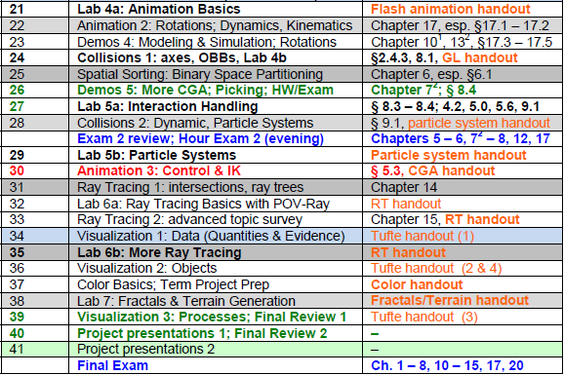

Where We Are

Slide 4

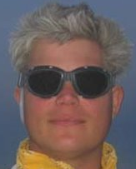







Acknowledgements:
Ray Tracing
Dave Shreiner & Brad Grantham
Adjunct Professor & Adjunct Lecturer, Santa Clara University
ARM Holdings, plc
http://www.plunk.org/~shreiner/
http://www.plunk.org/~grantham/
David K. Buck, Aaron Collins, et al.
Developers
Persistence of Vision Raytracer (POV-Ray)
http://www.povray.org
G. Scott Owen & Yan Liu
Professor Emeritus / ACM SIGGRAPH President & Graduate Research Assistant
Hypermedia and Visualization Laboratory
Department of Computer Science
Georgia State University / ACM
http://www.cs.gsu.edu/gsowen/

Slide 5
Review [1]:
Reasons for Using Ray Tracing
Simulate rays of light
Produces natural lighting effects
Hard to simulate effects with rasterization techniques (OpenGL)
Rasterizers require many passes
Ray-tracing easier to implement
Adapted from slides © 2001 D. Shreiner & B. Grantham, SCU
COEN 290: Computer Graphics I, Winter 2001 – http://bit.ly/hz1kfU

Slide 6
Review [2]:
How Ray Tracing Works
Trace rays from eye instead
Do work where it matters
Light
Image
Plane
Eye
Object
This is what most people mean by “ray tracing”.
Adapted from slides © 2001 D. Shreiner & B. Grantham, SCU
COEN 290: Computer Graphics I, Winter 2001 – http://bit.ly/hz1kfU

Slide 7
Review [3]:
Ray/Triangle Intersection
Want to know: at what point p does ray intersect triangle?
Compute lighting, reflected rays, shadowing from that point
p = t_{min}
r_{d}
r_{o}
<?, ?, ?>
(t = ???)
Adapted from slides © 2001 D. Shreiner & B. Grantham, SCU
COEN 290: Computer Graphics I, Winter 2001 – http://bit.ly/hz1kfU

Slide 8
Review [4]:
General Notation Review
We’ll use triangles for lights
Can build complex shapes from triangles
Some lighting terms
Light
Eye
N
I
R
V
Adapted from slides © 2001 D. Shreiner & B. Grantham, SCU
COEN 290: Computer Graphics I, Winter 2001 – http://bit.ly/hz1kfU

Slide 9
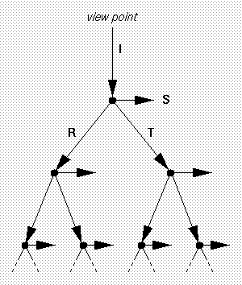
Review [5]:
Recursive Calculation & Ray Tree
Recursive ray evaluation
Generates ray tree shown at right
rayTrace(ray) {
hitObject(ray, p, n, triangle);
color = object color;
if(object is light)
return(color);
else
return(lighting(p, n, color));
}
Ray tree
© 2000 N. Patrikalakis, MIT
http://bit.ly/fjcGGk
I = Incident ray
S = light Source vector (aka L)
R = reflected ray
T = transmitted ray
Adapted from slides © 2001 D. Shreiner & B. Grantham, SCU
COEN 290: Computer Graphics I, Winter 2001 – http://bit.ly/hz1kfU

Slide 10
Review [6]:
Putting It All Together
Calculating surface color
lighting(point) {
color = ambient color;
for each light
if(hitObject(shadow ray))
color += lightcolor *
dot(shadow ray, n);
color += rayTrace(reflection) *
pow(dot(reflection, ray), shininess);
return(color);
}
Adapted from slides © 2001 D. Shreiner & B. Grantham, SCU
COEN 290: Computer Graphics I, Winter 2001 – http://bit.ly/hz1kfU

Slide 11
Review [7]:
More Quality, More Speed
Better Lighting + Forward Tracing
Texture Mapping
Modeling Techniques
Distributed Ray Tracing: Techniques
  Motion Blur
  Depth of Field
  Blurry Reflection/Refraction
  Wikipedia, Distributed Ray Tracing: http://bit.ly/ihyVUs
Improving Image Quality
Acceleration Techniques
Adapted from slides © 2001 D. Shreiner & B. Grantham, SCU
COEN 290: Computer Graphics I, Winter 2001 – http://bit.ly/hz1kfU

Slide 12
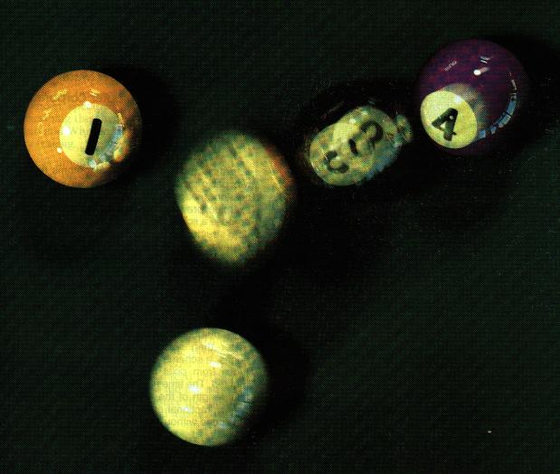
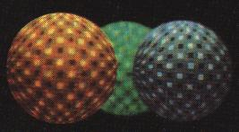
Review [8]:
Distributed Ray Tracing
Adapted from slides © 2001 D. Shreiner & B. Grantham, SCU
COEN 290: Computer Graphics I, Winter 2001 – http://bit.ly/hz1kfU

Slide 13
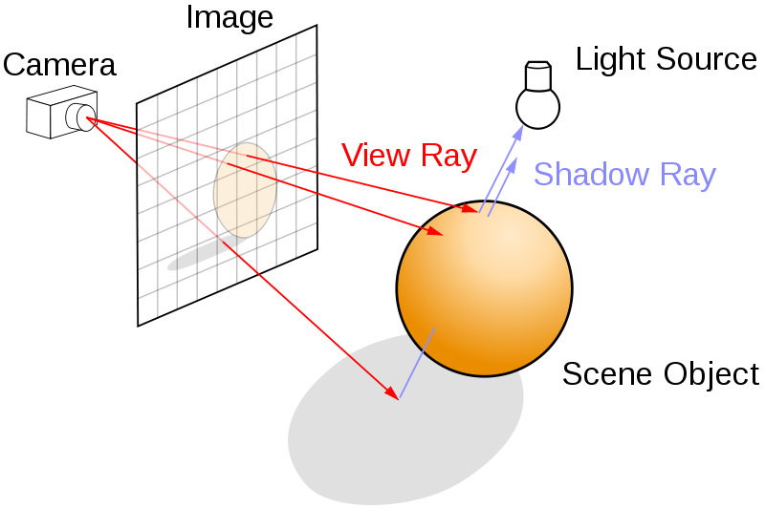
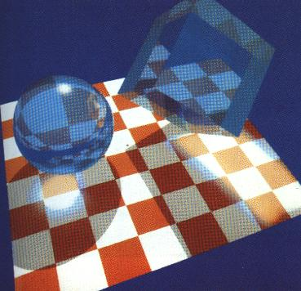
Review [9]:
Supersampling, “Forward” RT
One ray is not enough (jaggies)
Can use multiple rays per pixel - supersampling
Can use a few samples, continue if they’re very different - adaptive supersampling
Texture interpolation & filtering
Ray Tracing © 2008 Wikipedia
http://bit.ly/dV7lNm
“Forward” RT for Caustics
Adapted from slides © 2001 D. Shreiner & B. Grantham, SCU
COEN 290: Computer Graphics I, Winter 2001 – http://bit.ly/hz1kfU

Slide 14
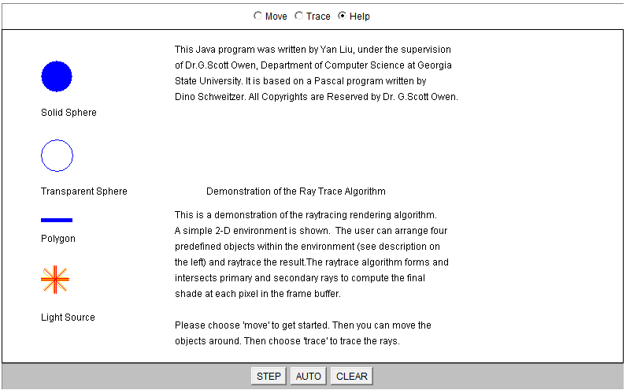
Lab 6a [1]:
ACM SIGGRAPH 2-D RT Program Help
Screenshots from Java program © 2001 G. S. Owen & Y. Liu, GSU
ACM SIGGRAPH Ray Trace Java Demo – http://bit.ly/cIlgx2

Slide 15
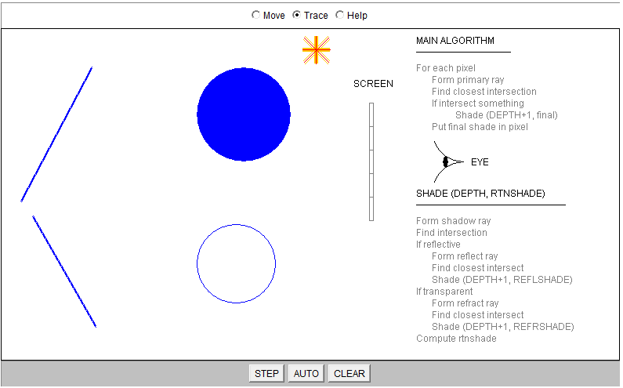
Lab 6a [2]:
Trace Screen
Screenshots from Java program © 2001 G. S. Owen & Y. Liu, GSU
ACM SIGGRAPH Ray Trace Java Demo – http://bit.ly/cIlgx2

Slide 16
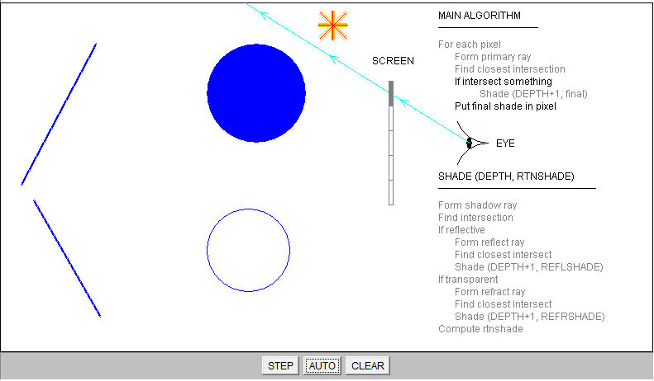
Lab 6a [3]:
First Ray (Click “Clear” & “Auto”)
Screenshots from Java program © 2001 G. S. Owen & Y. Liu, GSU
ACM SIGGRAPH Ray Trace Java Demo – http://bit.ly/cIlgx2

Slide 17
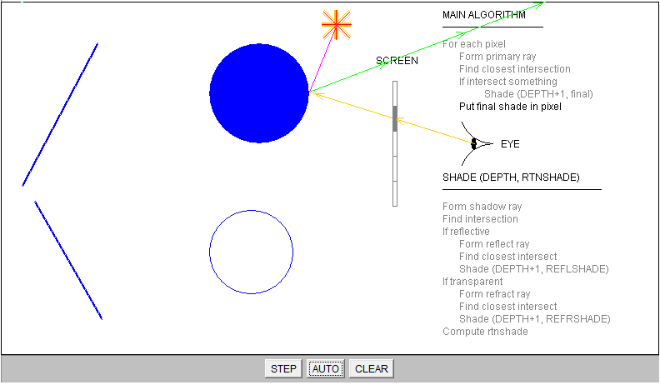
Lab 6a [4]:
Second Ray (Click “Auto” to Advance)
Screenshots from Java program © 2001 G. S. Owen & Y. Liu, GSU
ACM SIGGRAPH Ray Trace Java Demo – http://bit.ly/cIlgx2

Slide 18
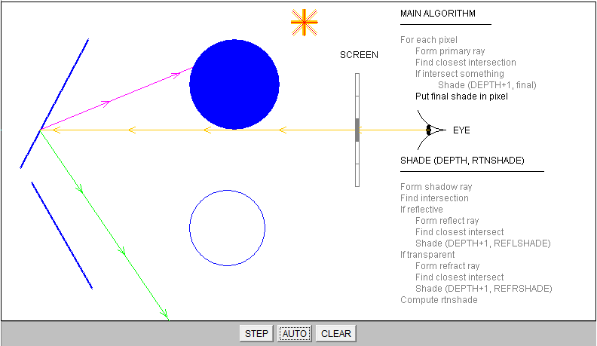
Lab 6a [5]:
Third Ray
Screenshots from Java program © 2001 G. S. Owen & Y. Liu, GSU
ACM SIGGRAPH Ray Trace Java Demo – http://bit.ly/cIlgx2

Slide 19
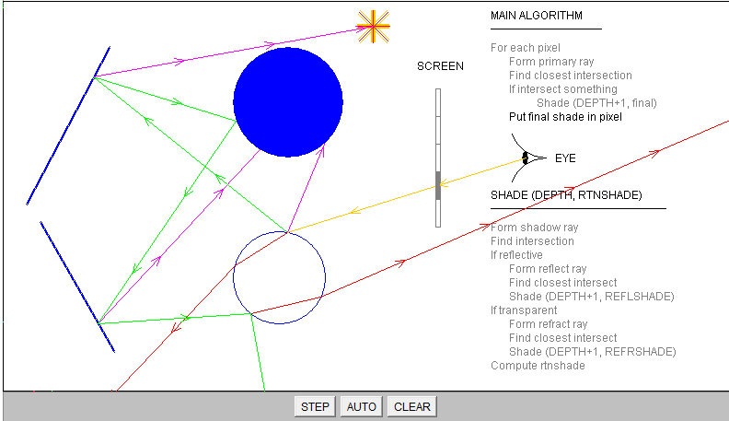
Lab 6a [6]:
Fourth Ray
Screenshots from Java program © 2001 G. S. Owen & Y. Liu, GSU
ACM SIGGRAPH Ray Trace Java Demo – http://bit.ly/cIlgx2

Slide 20

Lab 6a [7]:
Fifth Ray
Screenshots from Java program © 2001 G. S. Owen & Y. Liu, GSU
ACM SIGGRAPH Ray Trace Java Demo – http://bit.ly/cIlgx2

Slide 21
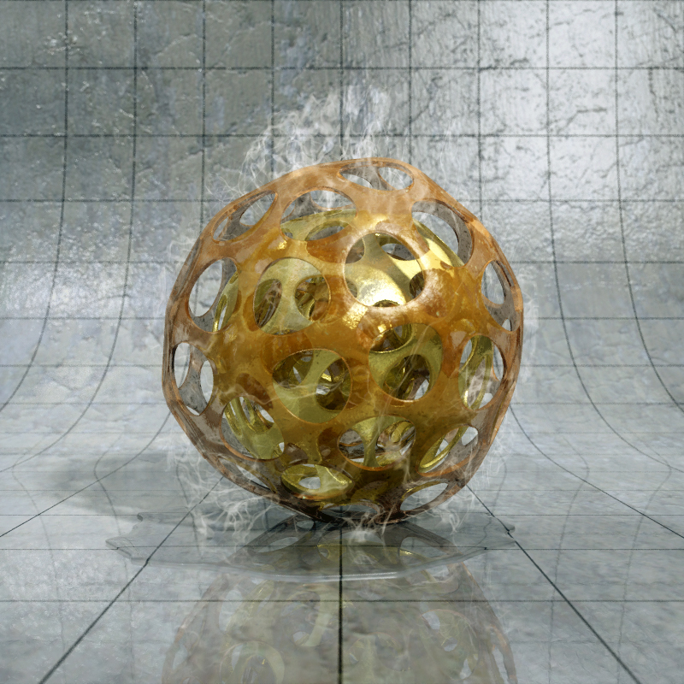
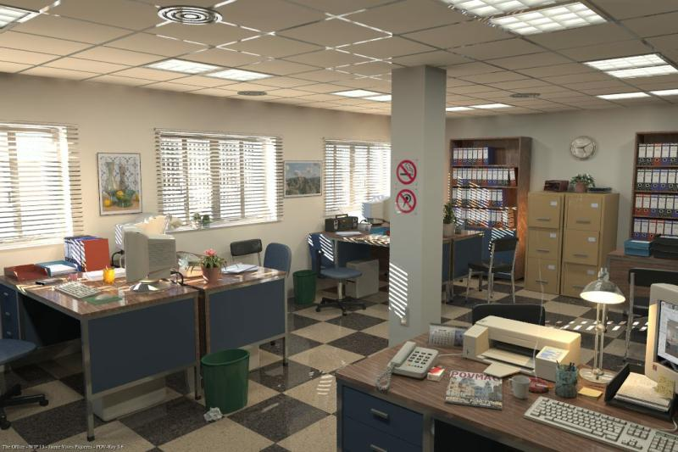
Lab 6b [1]:
POV-Ray
“Office“ © 2004 Jaime Vives Piqueres
http://bit.ly/g9dnGH
“My First CGSphere“ © 2008 Robert McGregor
http://bit.ly/fGb6Pj
Images © respective authors, generated using POV-Ray
© 1991 – 2011 D. K. Buck et al. – http://www.povray.org

Slide 22
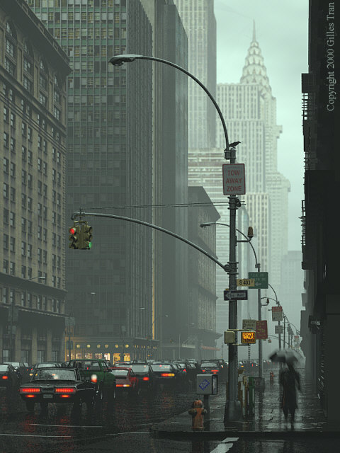
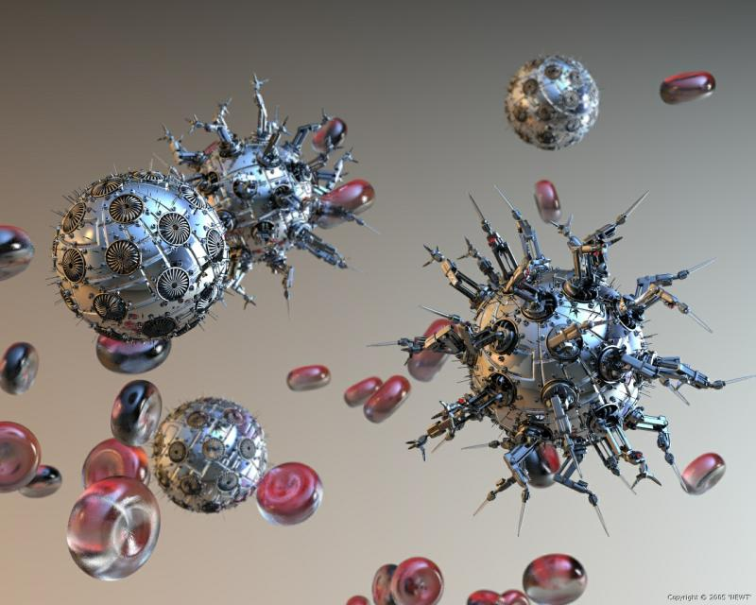
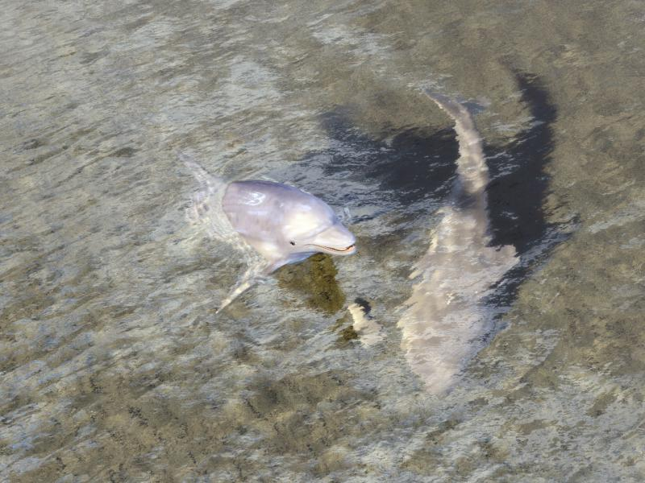
Lab 6b [2]:
POV-Ray
“Dissolution“ © 2005 Newt
http://bit.ly/fVqj5d
“The Wet Bird“ © 2001 Gilles Tran
http://bit.ly/gMBuGt
"Thanks for all the fish“ © 2008 Robert McGregor
http://bit.ly/fE04gm
Images © respective authors, generated using POV-Ray
© 1991 – 2011 D. K. Buck et al. – http://www.povray.org

Slide 23
Summary
Reading for Last Class: Chapter 14, Eberly 2e
Reading for Today: Ray Tracing Handout
Reading for Next Class: Chapter 15, Eberly 2e; Ray Tracing Handout
Last Time: Ray Tracing (RT), Part 1 of 2
  Vectors: I (incident ray), L, R, T
  Basic recursive ray tracing & ray trees
  Distributed RT: survey, supersampling illustrated
Today: Ray Tracing Lab
  ACM SIGGRAPH demo: http://bit.ly/cIlgx2
    2-D “screen”
    Moveable objects: transparent, opaque (both reflective)
  POV-Ray (http://www.povray.org) Example Renderings
Next Class: Ray Tracing 2 of 2
  Progressive refinement radiosity (photon maps) introduced
  Using RT/radiosity together and with shading

Slide 24
Terminology
Ray Tracing aka Ray Casting
  Given: screen with pixels (u, v)
  Find intersection t_{min}(u, v) of rays through each (u, v) with scene
  Vectors emanating from world-space coordinate of t_{min}
    Light (L) aka Source (S): to point light sources (or shadows)
    Reflected (R): from object surface
    Transmitted or Transparency (T): through transparent object
  Recursive RT: call raytracer for each intersection, get ray tree
  Incident vector (I): incoming from eye
Caustic: Envelope of Light Rays Reflected/Refracted by Curved Object
  Wikipedia: http://bit.ly/etIXId
  Example: Slide 13 (today’s lecture)
“Backward” RT: Eye-to-Scene, Scene-to-Light (Typical Order)
“Forward” RT: Light-to-Scene, Scene-to-Eye (Only for Caustics)
Screen: Parallel to View “Plane”, Rays Shot Through It

