Slide 1
Lecture 33 of 41
Ray Tracing, Part 2 of 2:
Distributed RT & Radiosity/RT Hybrid Systems
William H. Hsu
Department of Computing and Information Sciences, KSU
KSOL course pages: http://bit.ly/hGvXlH / http://bit.ly/eVizrE
Public mirror web site: http://www.kddresearch.org/Courses/CIS636
Instructor home page: http://www.cis.ksu.edu/~bhsu
Readings:
Last class: Ray Tracing Handout
Today: Chapter 15, Eberly 2e – see http://bit.ly/ieUq45; Ray Tracing Handout
Next class: Tufte Handout 1

Slide 2
Lecture Outline
Reading for Last Class: Ray Tracing Handout
Reading for Today: Chapter 15, Eberly 2e; Ray Tracing Handout
Reading for Next Class: Tufte Handout 1
Last Time: Ray Tracing Lab
  ACM SIGGRAPH demo: http://bit.ly/cIlgx2
  POV-Ray: http://www.povray.org
Today: Ray Tracing, Part 2 of 2
  Hybrid global illumination: RT with radiosity
    Calculating specular exponents
    Pre-rendering backgrounds
    Progressive refinement
  Other optimizations
Next Class: Visualization, Part 1 of 3 – Data
  Source: The Visual Display of Quantitative Information, 2e
  Applications: scientific visualization, information visualization

Slide 3
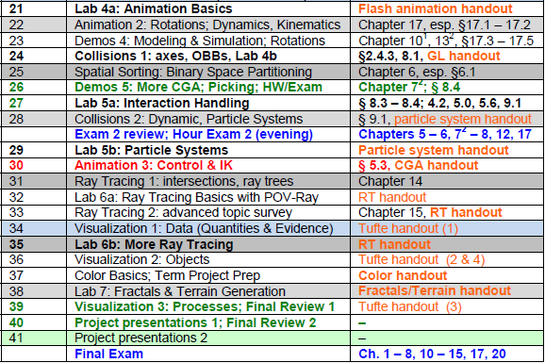

Where We Are

Slide 4








Acknowledgements:
Advanced Ray Tracing & Radiosity
David K. Buck, Aaron Collins, et al.
Developers
Persistence of Vision Raytracer (POV-Ray)
http://www.povray.org
C. Khambamettu & Mani V. Thomas
Professor, Department of Computing and Information Sciences, University of Delaware &
Ph.D. graduate (University of Delaware) / Research Scientist, Canfield Scientific
http://www.cis.udel.edu/~chandra/ http://vims.cis.udel.edu/~mani/
Mario Costa Sousa
Associate Professor
Department of Computer Science
University of Calgary
http://pages.cpsc.ucalgary.ca/~mario/

Slide 5
Review [1]:
Recursive Ray Tracing Algorithm
Compute 3D ray into scene for each 2D image pixel
Compute 3D intersection point of ray with nearest object in scene
  Test each primitive in the scene for intersection
  Find nearest intersection
Recursively spawn rays from point of intersection
  Shadow Rays
  Reflected rays
  Transmitted rays
Accumulate color from each spawned ray at point of intersection
Adapted from slides © 2005 M. Thomas & C. Khambamettu, U. Del.
CISC 440/640: Computer Graphics, Spring 2005 – http://bit.ly/hz1kfU

Slide 6
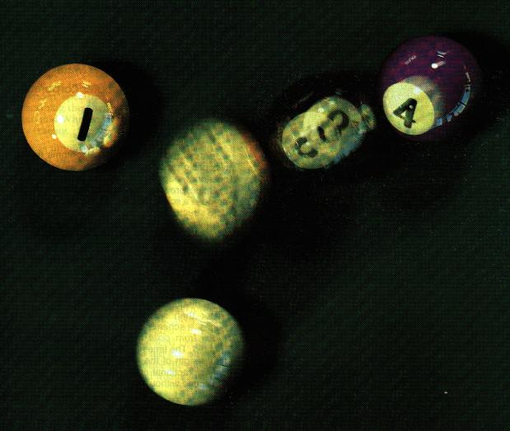
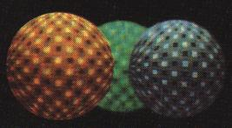

Review [2]:
Distributed Ray Tracing
Adapted from slides © 2001 D. Shreiner & B. Grantham, SCU
COEN 290: Computer Graphics I, Winter 2001 – http://bit.ly/hz1kfU

Slide 7
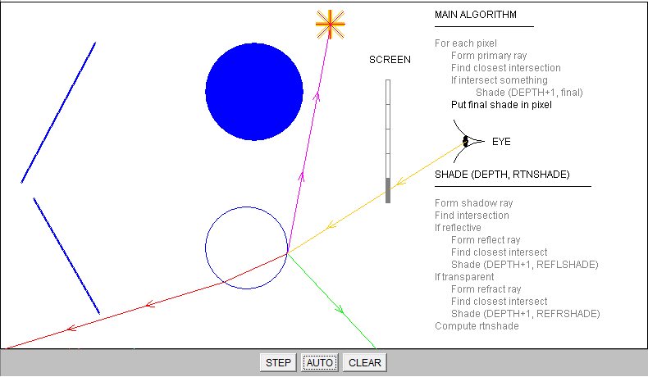
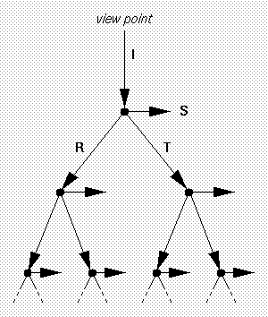

Review [3]:
Java-Based 2-D RT Demo, SIGGRAPH
Point
Light
Source
S / L
I
T
R
T
Screenshots from Java program © 2001 G. S. Owen & Y. Liu, GSU
ACM SIGGRAPH Ray Trace Java Demo – http://bit.ly/cIlgx2

Slide 8
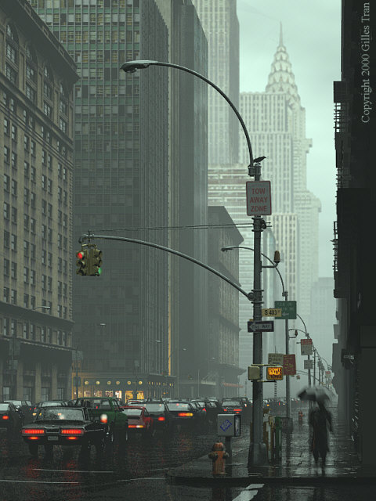
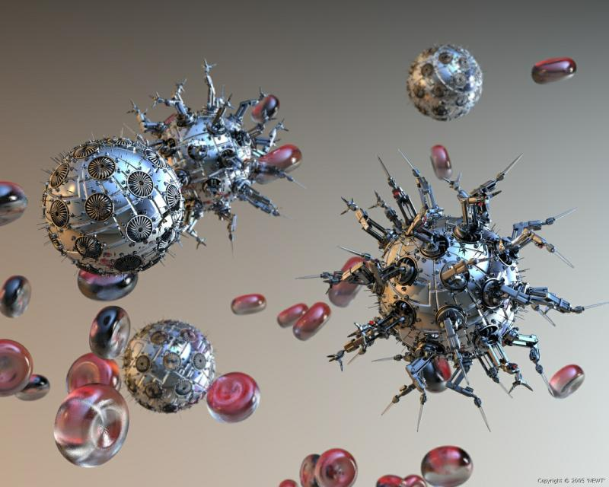
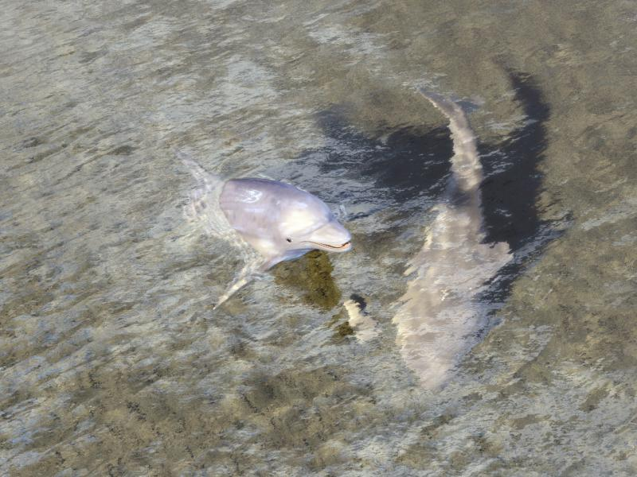
Review [4]:
POV-Ray
“Dissolution“ © 2005 Newt
http://bit.ly/fVqj5d
“The Wet Bird“ © 2001 Gilles Tran
http://bit.ly/gMBuGt
"Thanks for all the fish“ © 2008 Robert McGregor
http://bit.ly/fE04gm
Images © respective authors, generated using POV-Ray
© 1991 – 2011 D. K. Buck et al. – http://www.povray.org

Slide 9
Formulas:
Ray-Object Intersection
Intersection with plane
  Implicit form
  Intersection
Intersection with sphere
  Implicit form
  Intersection
Adapted from slides © 2005 M. Thomas & C. Khambamettu, U. Del.
CISC 440/640: Computer Graphics, Spring 2005 – http://bit.ly/hz1kfU

Slide 10
Formulas:
Light Vectors aka Shadow Rays
“Shadow feelers”
  Spawn ray from P to each light source
  If there is intersection of shadow ray with any object then P is in shadow
Reflection
  Angle of incidence = angle of reflection
Adapted from slides © 2005 M. Thomas & C. Khambamettu, U. Del.
CISC 440/640: Computer Graphics, Spring 2005 – http://bit.ly/hz1kfU

Slide 11
Formulas:
Refraction of Transmitted Ray
Ray passing through two media
  Different refractive indices
  Ray bends towards/away from normal
Snell’s Law
  n_{i} and n_{r} are refractive indices of two media
Transmitted ray
Adapted from slides © 2005 M. Thomas & C. Khambamettu, U. Del.
CISC 440/640: Computer Graphics, Spring 2005 – http://bit.ly/hz1kfU

Slide 12
Speeding Up RT Using Extents/BVs [1]:
Motivation
Ray tracing slow, performs same functions repeatedly
Most time spent in computing intersections
  Each ray should be intersected with every object in scene
  Each ray spawns out reflected/transmitted rays which have to be interested with objects in scene
Adapted from slides © 2005 M. Thomas & C. Khambamettu, U. Del.
CISC 440/640: Computer Graphics, Spring 2005 – http://bit.ly/hz1kfU

Slide 13
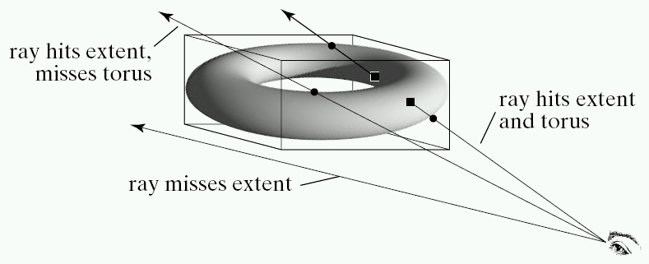
Speeding Up RT Using Extents/BVs [2]:
Definition & Basic Idea
Extent (aka bounding volume) of object: shape that encloses it
Compute complicated intersections if and only if ray hits extent
Two shapes most commonly used as extents
  Sphere – specified by center and radius (C, r)
  Box – specified by sides aligned to coordinate axis
    Axis-aligned bounding box (AABB) – more typical for RT
    Oriented bounding box (OBB)
Adapted from slides © 2005 M. Thomas & C. Khambamettu, U. Del.
CISC 440/640: Computer Graphics, Spring 2005 – http://bit.ly/hz1kfU

Slide 14
Super-Sampling
Instead of shooting one ray per pixel, shoot four rays through corners of pixel
Adaptive super-sampling (Whitted’s approach)
  Shoot more rays through corners with higher intensity variation
  Compute final color as weighted average rather than regular average
Adapted from slides © 2005 M. Thomas & C. Khambamettu, U. Del.
CISC 440/640: Computer Graphics, Spring 2005 – http://bit.ly/hz1kfU

Slide 15
Advanced Topics in RT:
Road Map
Monte Carlo Methods: Distributed RT
Bidirectional Ray Tracing: Caustics
POV-Ray
Hybrid Global Illumination
  RT: good for
    Specular highlights (highlights)
    Point-to-point interobject reflectance, shadows
  Radiosity: good for
    Diffuse reflectance (matte effects)
    Patch-to-patch interobject reflectance
  Best of both worlds
    RT for exponents
    Radiosity for backgrounds
Adapted from slides © 2005 M. Thomas & C. Khambamettu, U. Del.
CISC 440/640: Computer Graphics, Spring 2005 – http://bit.ly/hz1kfU

Slide 16

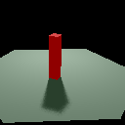
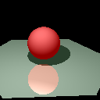

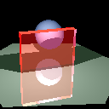
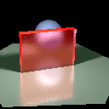
Distributed Ray Tracing [1]:
What Is It?
Distributed ray tracing: not RT on distributed systems!
Ray tracing method
  based on randomly distributed oversampling
  to reduce aliasing artifacts
  in rendered images
Reference
  Allen Martin, Worcester Polytechnic Institute (WPI)
  Examples for shadows, reflection, transparency
Regular RT
Distributed RT
Regular RT
Distributed RT
Regular RT
Distributed RT
  “Distributed Ray Tracing” © 1995 A. Martin – http://bit.ly/ex5ZUm
Adapted from slides © 2005 M. Thomas & C. Khambamettu, U. Del.
CISC 440/640: Computer Graphics, Spring 2005 – http://bit.ly/hz1kfU

Slide 17
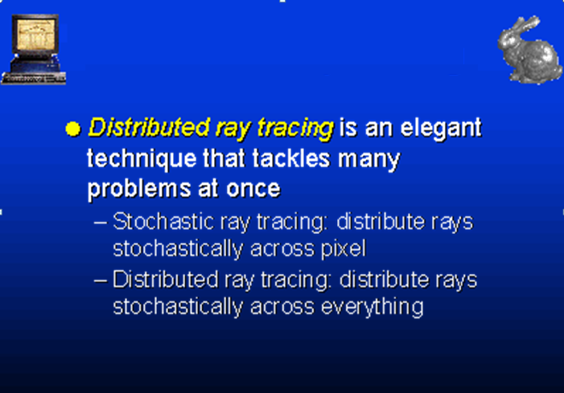

Distributed Ray Tracing [2]:
From Stochastic RT to Distributed RT
Adapted from slide © 2005 D. Luebke, University of Virginia
CS 551-0003/651-0001: Advanced CG, Spring 2005 – http://bit.ly/eTWYAo

Slide 18
Distributed Ray Tracing [3]:
Stochastic Oversampling (Cook, 1984)
Developed by Cook et al. (“Distributed Ray Tracing”, Computer Graphics, vol. 18, no. 3, pp 137-145, 1984)
Stochastic Oversampling: http://bit.ly/eTWYAo
  Pixel for antialiasing
  Light source for soft shadows
  Reflection function for soft (glossy) reflections
  Time for motion blur
  Lens for depth of field
Adapted from slides © 2005 M. Thomas & C. Khambamettu, U. Del.
CISC 440/640: Computer Graphics, Spring 2005 – http://bit.ly/hz1kfU

Slide 19
Distributed Ray Tracing [4]:
Gloss
Partially reflecting surfaces
Traditional ray tracing
  reflections look identical to scene they are reflecting
  reflections are always sharp
Randomly distributing rays reflected by surface
Send out packet of rays around reflecting direction
Actual value of reflectance is statistical mean of the values returned by each of these rays
Adapted from slides © 2005 M. Thomas & C. Khambamettu, U. Del.
CISC 440/640: Computer Graphics, Spring 2005 – http://bit.ly/hz1kfU

Slide 20
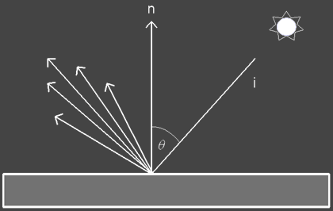
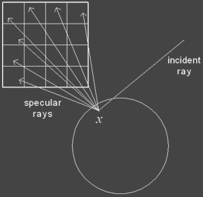
Distributed Ray Tracing [5]:
Perturbing Specular Reflection Ray
Distributing set of reflection rays by randomly perturbing ideal specular reflection ray
Spread of distribution determines glossiness where wider distribution spread models rougher surface
“Realistic Raytracing” © 2003 Z. Waters & E. Agu, WPI
http://bit.ly/gUNeGr
Adapted from slides © 2005 M. Thomas & C. Khambamettu, U. Del.
CISC 440/640: Computer Graphics, Spring 2005 – http://bit.ly/hz1kfU

Slide 21
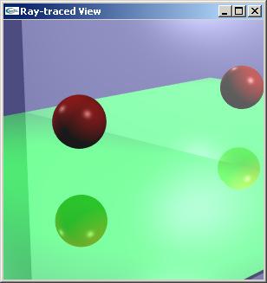
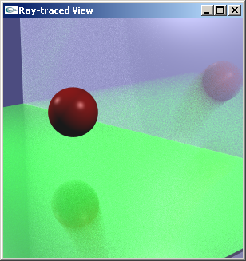
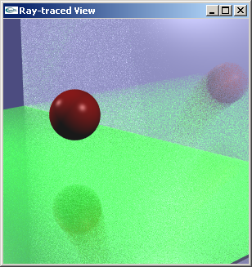
Distributed Ray Tracing [6]:
Multiple Reflected Rays
First image is from traditional ray tracer
Second one uses 16 rays in place of single reflected ray
Third image uses 64 rays
“Monte Carlo Ray Tracing”
© 2005 D. Strock, University of Wisconsin Milwaukee
http://bit.ly/fSIYsL
Adapted from slides © 2005 M. Thomas & C. Khambamettu, U. Del.
CISC 440/640: Computer Graphics, Spring 2005 – http://bit.ly/hz1kfU

Slide 22
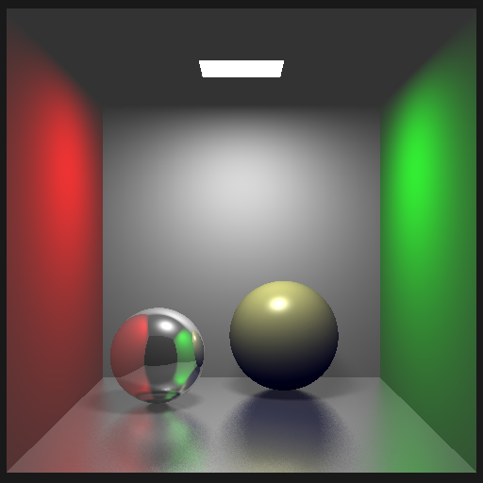
Distributed Ray Tracing [7]:
Soft Shadows & Reflection
“Realistic Raytracing” © 2003 Z. Waters & E. Agu, WPI
http://bit.ly/gUNeGr
Adapted from slides © 2005 M. Thomas & C. Khambamettu, U. Del.
CISC 440/640: Computer Graphics, Spring 2005 – http://bit.ly/hz1kfU

Slide 23
Distributed Ray Tracing [8]:
Fuzzy Translucency
Same as glossy reflections, but jitter refracted ray
Analytical function similar to shading
  Transmission function is used instead of reflectance function
  Light is gathered from other side of surface.
Cast randomly distributed rays in general direction of transmitted ray from traditional ray tracing
Average value computed from each of these rays: true translucent component
Adapted from slides © 2005 M. Thomas & C. Khambamettu, U. Del.
CISC 440/640: Computer Graphics, Spring 2005 – http://bit.ly/hz1kfU

Slide 24
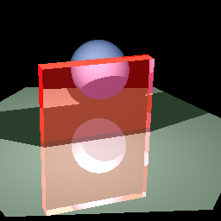
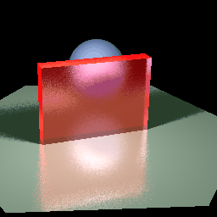

Distributed Ray Tracing [9]:
Soft Reflection & Transparency
First image is obtained from traditional ray tracer
Second image uses 10 rays for transmitted ray
Third image uses 20 rays
  “Distributed Ray Tracing” © 1995 A. Martin – http://bit.ly/ex5ZUm
Adapted from slides © 2005 M. Thomas & C. Khambamettu, U. Del.
CISC 440/640: Computer Graphics, Spring 2005 – http://bit.ly/hz1kfU

Slide 25
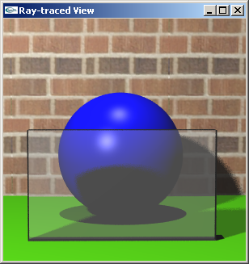
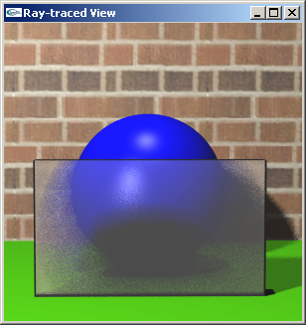

Distributed Ray Tracing [10]:
Shadows, Reflection, Transparency
First image is from traditional ray tracer
Second one uses 16 rays in place of single reflected ray
Third image uses 64 rays
“Monte Carlo Ray Tracing”
© 2005 D. Strock, University of Wisconsin Milwaukee
http://bit.ly/fSIYsL
Adapted from slides © 2005 M. Thomas & C. Khambamettu, U. Del.
CISC 440/640: Computer Graphics, Spring 2005 – http://bit.ly/hz1kfU

Slide 26
Distributed Ray Tracing [11]:
Penumbras (Soft Shadows)
Traditional ray tracing shadows: discrete
  Shadow feelers used to check if point is in shadow with respect to point light source
Incorrect for large light sources and/or light sources that are close to object
Transition from fully shadowed to partially shadowed is gradual
  Due to finite area of real light sources
  Also due to scattering of light of other surfaces
Adapted from slides © 2005 M. Thomas & C. Khambamettu, U. Del.
CISC 440/640: Computer Graphics, Spring 2005 – http://bit.ly/hz1kfU

Slide 27
Distributed Ray Tracing [12]:
Tracing Penumbras (Soft Shadows)
Set of rays cast about projected area of light source
  Projected area helps tackle large area light source
Amount of light transmitted by: ratio of number of rays that hit source to number of rays cast
Adapted from slides © 2005 M. Thomas & C. Khambamettu, U. Del.
CISC 440/640: Computer Graphics, Spring 2005 – http://bit.ly/hz1kfU

Slide 28
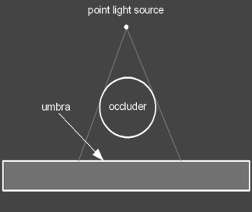
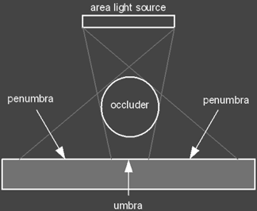
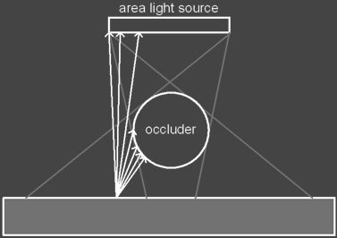
Distributed Ray Tracing [13]:
Shadow Feelers & Penumbras
“Realistic Raytracing” © 2003 Z. Waters & E. Agu, WPI
http://bit.ly/gUNeGr
In case of point source, occluder would create sharp shadow boundary
In area light source or if light source is closer to object
  Creation of penumbra region
Sending out shadow feelers to capture penumbra region
Adapted from slides © 2005 M. Thomas & C. Khambamettu, U. Del.
CISC 440/640: Computer Graphics, Spring 2005 – http://bit.ly/hz1kfU

Slide 29
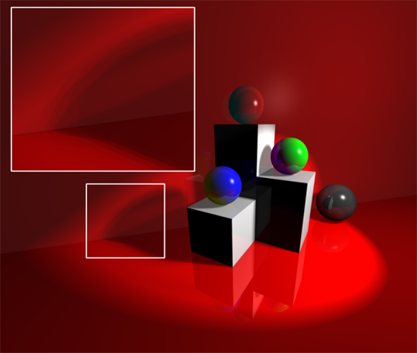
Distributed Ray Tracing [14]:
Example – Transitions inside Penumbra
“Realistic Raytracing” © 2003 Z. Waters & E. Agu, WPI
http://bit.ly/gUNeGr
Adapted from slides © 2005 M. Thomas & C. Khambamettu, U. Del.
CISC 440/640: Computer Graphics, Spring 2005 – http://bit.ly/hz1kfU

Slide 30
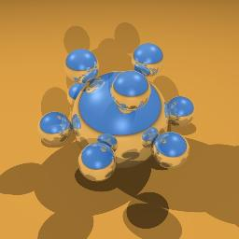
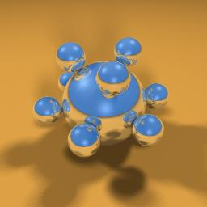
Distributed Ray Tracing [15]:
Example – Soft Shadows
Regular RT
Distributed RT
© 2000 A. G. Zaferakis, UNC Chapel Hill
COMP 238, Advanced Image Generation – http://bit.ly/fGYzgw / http://bit.ly/dNQHtH
Adapted from slides © 2005 M. Thomas & C. Khambamettu, U. Del.
CISC 440/640: Computer Graphics, Spring 2005 – http://bit.ly/hz1kfU

Slide 31
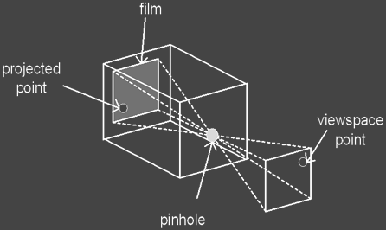
Distributed Ray Tracing [16]:
Depth of Field
Distance at which objects appear in focus
Objects too far away or too close appear unfocused, blurry
Pinhole camera model does not truly mimic real world
  Pinhole assumed to be infinitely small
  Changing focal length changes field of view but does not change focus
“Realistic Raytracing” © 2003 Z. Waters & E. Agu, WPI
http://bit.ly/gUNeGr
Adapted from slides © 2005 M. Thomas & C. Khambamettu, U. Del.
CISC 440/640: Computer Graphics, Spring 2005 – http://bit.ly/hz1kfU

Slide 32
Distributed Ray Tracing [17]:
Creating Depth of Field
Distributed RT: places artificial lens in front of view plane
Randomly distributed rays: used once again to simulate blurring of depth of field
  First ray cast not modified by lens
  Focal point of lens is at fixed distance along this ray
  Rest of rays sent out for same pixel scattered about surface of lens
  Points in scene close to focal point of lens: in sharp focus
  Points closer or further away: blurred
Adapted from slides © 2005 M. Thomas & C. Khambamettu, U. Del.
CISC 440/640: Computer Graphics, Spring 2005 – http://bit.ly/hz1kfU

Slide 33
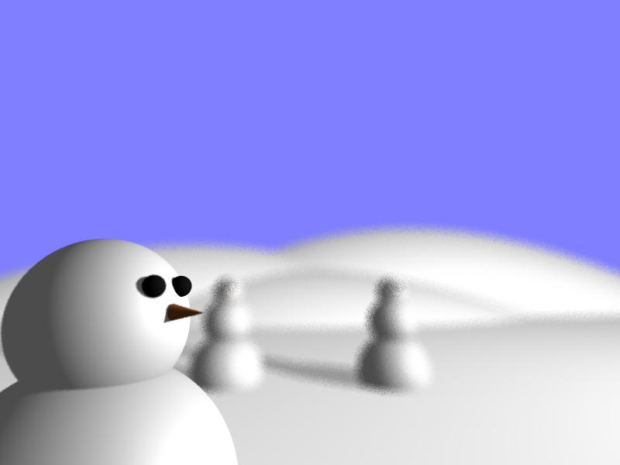

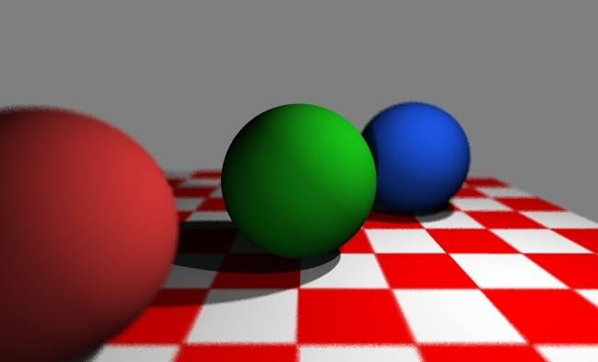

Distributed Ray Tracing [18]:
Example – Depth of Field
Low Focal Distance, © 2004 S. C. Mikula (http://bit.ly/fK6ckX)
High Focal Distance, © 2004 S. C. Mikula (http://bit.ly/fKA3b3)
Intermediate Focal Distance, © 2003 A. Bair (http://bit.ly/faXUFh)
© 2001-2006 respective authors, University of Illinois at Urbana-Champaign
CS 419, Advanced Computer Graphics – http://bit.ly/e0UfsN
Adapted from slides © 2005 M. Thomas & C. Khambamettu, U. Del.
CISC 440/640: Computer Graphics, Spring 2005 – http://bit.ly/hz1kfU

Slide 34
Distributed Ray Tracing [19]:
Motion Blur
Temporal sampling rather than spatial sampling
Frame represents average of scene during time that camera shutter is open
Before each ray is cast, objects are translated or rotated to their correct position for that frame
Rays are averaged to give actual value
Objects with most motion will have most blurring in rendered image
Adapted from slides © 2005 M. Thomas & C. Khambamettu, U. Del.
CISC 440/640: Computer Graphics, Spring 2005 – http://bit.ly/hz1kfU

Slide 35
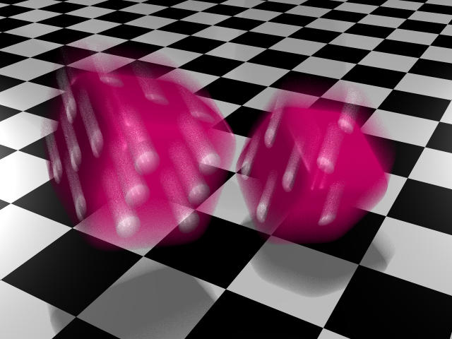
Distributed Ray Tracing [20]:
Example – Motion Blur
© 2005 C. M. Cameron, University of Illinois at Urbana-Champaign
CS 419, Advanced Computer Graphics – http://bit.ly/hmZU3x
Adapted from slides © 2005 M. Thomas & C. Khambamettu, U. Del.
CISC 440/640: Computer Graphics, Spring 2005 – http://bit.ly/hz1kfU

Slide 36
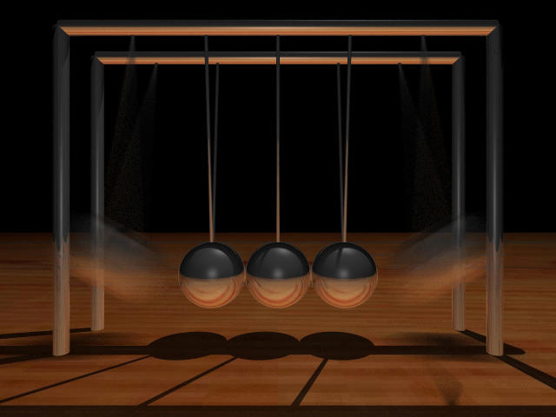
Distributed Ray Tracing [21]:
Example – Soft Shadows
© 2005 M. A. Townsend, University of Illinois at Urbana-Champaign
CS 419, Advanced Computer Graphics – http://bit.ly/dL8GrH
Adapted from slides © 2005 M. Thomas & C. Khambamettu, U. Del.
CISC 440/640: Computer Graphics, Spring 2005 – http://bit.ly/hz1kfU

Slide 37
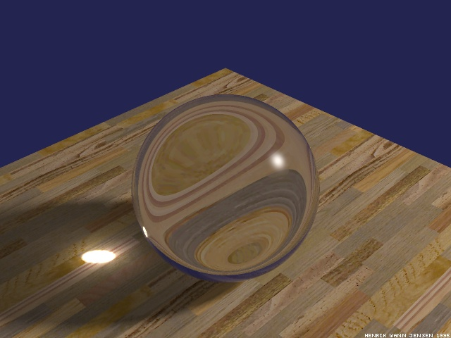
Bidirectional Ray Tracing [1]:
Example – Caustic
caustic
© 1996 H. W. Jensen, University of California, San Diego
http://graphics.ucsd.edu/~henrik/
Adapted from slides © 2005 M. Thomas & C. Khambamettu, U. Del.
CISC 440/640: Computer Graphics, Spring 2005 – http://bit.ly/hz1kfU

Slide 38
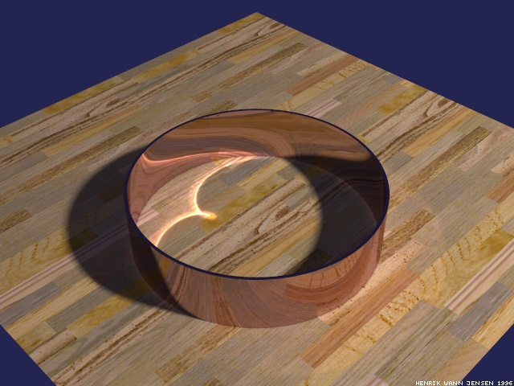
Bidirectional Ray Tracing [2]:
Example – Caustic
Caustic – (concentrated) specular reflection/refraction onto diffuse surface
Standard ray tracing cannot handle caustics
caustic
© 1996 H. W. Jensen, University of California, San Diego
http://graphics.ucsd.edu/~henrik/
Adapted from slides © 2005 M. Thomas & C. Khambamettu, U. Del.
CISC 440/640: Computer Graphics, Spring 2005 – http://bit.ly/hz1kfU

Slide 39
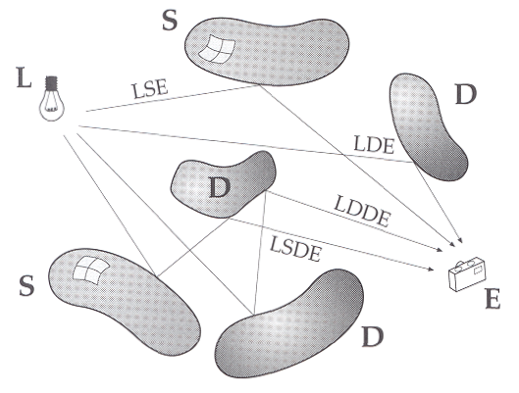
Light Paths:
Abbreviated Notation
Shown: interactions of light ray
Can be expressed using regular expressions
  L: light source
  E: eye/camera
  D: diffuse surface
  S: specular surface
Sillion, F. X. & Puech, C. (1994). Radiosity and Global Illumination. San Francisco, CA: Morgan-Kaufmann.
Amazon: http://amzn.to/evNBJH
Adapted from slides © 2005 M. Thomas & C. Khambamettu, U. Del.
CISC 440/640: Computer Graphics, Spring 2005 – http://bit.ly/hz1kfU

Slide 40
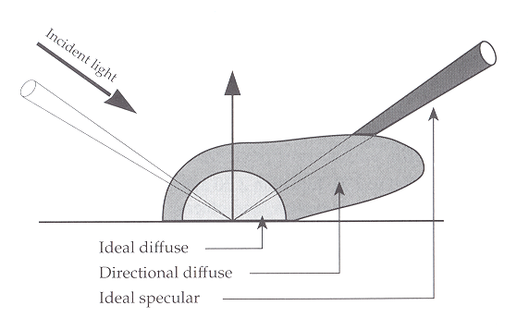
BRDF Revisited: Diffuse Surfaces [1]
Uncertainty in direction photon will take for diffuse surfaces
Specular surfaces: Bidirectional Reflectance Distribution Function (probability that incoming photon will leave in particular direction) has thin profile
  Can predict direction of outgoing photon
For ideal diffuse surfaces, BRDF would be spherical
  Photon can travel along any direction with equal probability
Sillion, F. X. & Puech, C. (1994). Radiosity and Global Illumination. San Francisco, CA: Morgan-Kaufmann.
Amazon: http://amzn.to/evNBJH
Adapted from slides © 2005 M. Thomas & C. Khambamettu, U. Del.
CISC 440/640: Computer Graphics, Spring 2005 – http://bit.ly/hz1kfU

Slide 41
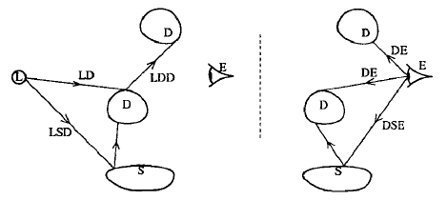
BRDF Revisited: Diffuse Surfaces [2]
Idea: Trace forward light rays into scene as well as backward eye rays
  At diffuse surfaces, light rays additively “deposit” photons in radiosity textures, or “rexes”, where they are picked up by eye rays
Rays of forward and backward pass "meet in middle" to exchange information
Heckbert, P. S. (1990). “Adaptive radiosity textures for bidirectional ray tracing”, Proceedings of the 17th Annual Conference on Computer Graphics and Interactive Techniques (Scott 1990).
Adapted from slides © 2005 M. Thomas & C. Khambamettu, U. Del.
CISC 440/640: Computer Graphics, Spring 2005 – http://bit.ly/hz1kfU

Slide 42
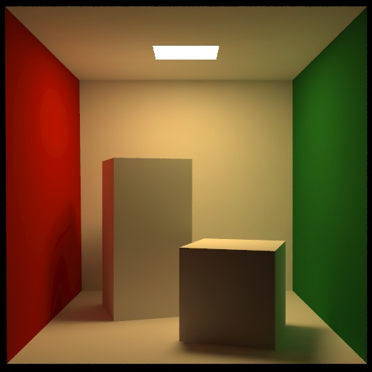
Radiosity
Handling cases such as LD*E
“Color Bleeding”
Adapted from slides © 2005 M. Thomas & C. Khambamettu, U. Del.
CISC 440/640: Computer Graphics, Spring 2005 – http://bit.ly/hz1kfU

Slide 43
Software Packages
Two excellent, full-featured rendering & modeling packages
POV-Ray (http://www.povray.org/)
  Persistence of Vision Ray Tracer
  Free rendering tool (not modeling tool)
  Uses text-based scene description language (SDL)
  Available on Windows, Linux, Mac OS
Blender (http://www.blender3d.org)
  Modeling, animation, rendering tool
  Especially useful in 3-D game creation
  Available for Windows, Linux, Irix, Sun Solaris, FreeBSD or Mac OS X under GPL
Adapted from slides © 2005 M. Thomas & C. Khambamettu, U. Del.
CISC 440/640: Computer Graphics, Spring 2005 – http://bit.ly/hz1kfU

Slide 44
Radiosity [1]:
Basic Idea
“Radiosity" method: basis is field of thermal heat transfer
Heat transfer theory describes radiation as transfer of energy from surface when that surface has been thermally excited
Adapted from slides © 2001 - 2005 M. C. Sousa, University of Calgary
CPSC 591/691: Rendering, Spring 2001 through Spring 2011 – http://bit.ly/ftMP0G

Slide 45
Radiosity [2]:
Derivation of Radiosity Equation
Radiosity equation describes amount of energy which can be emitted from surface, as sum of
  energy inherent in surface (e.g., light source)
  energy which strikes surface, being emitted from some other surface
Energy which leaves surface j and strikes another surface i is attenuated by two factors
  “form factor” between surfaces i and j, which accounts for physical relationship between two surfaces
  the reflectivity of surface i, which will absorb some percentage of light energy striking surface
Adapted from slides © 2001 - 2005 M. C. Sousa, University of Calgary
CPSC 591/691: Rendering, Spring 2001 through Spring 2011 – http://bit.ly/ftMP0G

Slide 46
Radiosity [3]:
Radiosity Equation
Form Factor of surface j relative to surface i
Radiosity of surface i
Radiosity of surface j
Emissivity of surface i
Reflectivity of surface i
accounts for physical relationship between two surfaces
Surface j
will absorb certain percentage of light energy which strikes surface
Surface i
Adapted from slides © 2001 - 2005 M. C. Sousa, University of Calgary
CPSC 591/691: Rendering, Spring 2001 through Spring 2011 – http://bit.ly/ftMP0G

Slide 47
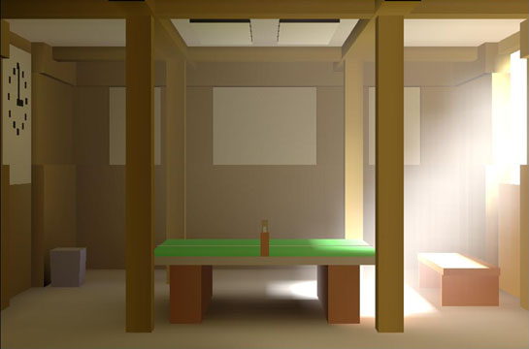
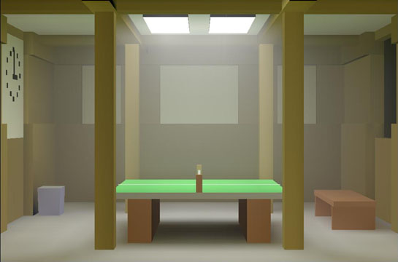
Radiosity [4]:
Implementation, Pros & Cons
Classic radiosity = finite element method
Assumptions
  Diffuse reflectance
  Usually polygonal surfaces
Advantages
  Soft shadows and indirect lighting
  View independent solution
  Precompute for set of light sources
  Useful for walkthroughs
Adapted from slides © 2001 - 2005 M. C. Sousa, University of Calgary
CPSC 591/691: Rendering, Spring 2001 through Spring 2011 – http://bit.ly/ftMP0G

Slide 48
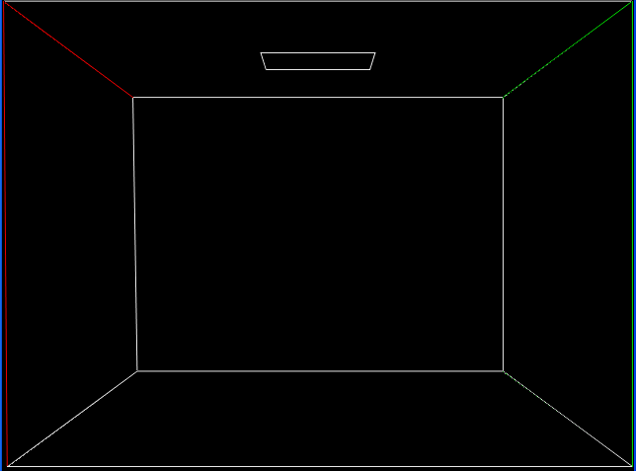
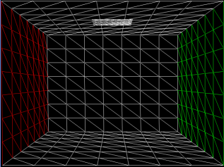
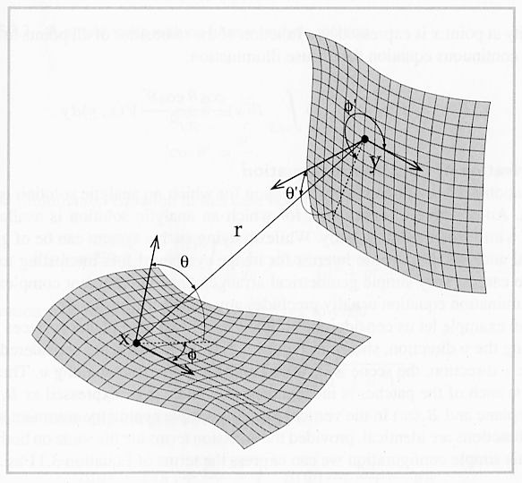
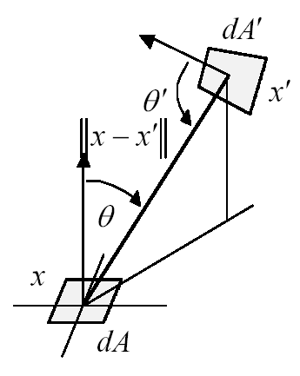
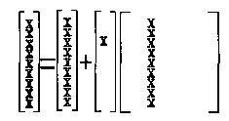

Radiosity [5]:
Classic Radiosity Algorithm
Mesh Surfaces into Elements
Compute Form Factors
Between Elements
Solve Linear System
for Radiosities
Reconstruct and Display Solution
Adapted from slides © 2001 - 2005 M. C. Sousa, University of Calgary
CPSC 591/691: Rendering, Spring 2001 through Spring 2011 – http://bit.ly/ftMP0G

Slide 49
Radiosity [6]:
Form Factors Illustrated
Purely geometric relationship, independent of viewpoint or surface attributes
Surface j
Surface i
Adapted from slides © 2001 - 2005 M. C. Sousa, University of Calgary
CPSC 591/691: Rendering, Spring 2001 through Spring 2011 – http://bit.ly/ftMP0G

Slide 50
Radiosity [7]:
Formula – Form Factor
differential area of surface I, j
angle between Normal_{i} and r
angle between Normal_{j} and r
Surface j
vector from dA_{i} to dA_{j}
Surface i
Adapted from slides © 2001 - 2005 M. C. Sousa, University of Calgary
CPSC 591/691: Rendering, Spring 2001 through Spring 2011 – http://bit.ly/ftMP0G

Slide 51
Radiosity [8]:
Formula – Overall Form Factor
Overall form factor between i and j is found by integrating
Surface j
Surface i
Adapted from slides © 2001 - 2005 M. C. Sousa, University of Calgary
CPSC 591/691: Rendering, Spring 2001 through Spring 2011 – http://bit.ly/ftMP0G

Slide 52
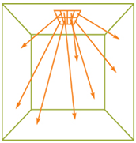
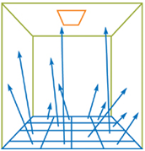

Radiosity [9]:
Progressive Refinement
Each element in scene maintains two energy values
  Accumulated
  Residual (“unshot”)
Choose one element as shooter
Test visibility of every other element from this shooter
  If visible, calculate shooter-to-receiver energy transfer
  Based on shooter’s residual, receiver’s reflectance
Progressive refinement: reset residual, repeat with new shooter
Terminate when shooter residuals below threshold
Adapted from GPU Gems 2, Chapter 39, “Global Illumination Using Progressive Refinement Radiosity”, © 2005 G. Coombe & M. Harris, nVidia Corporation – http://bit.ly/hXQ8Zd

Slide 53


Radiosity [10]:
Example – Progressive Refinement
Myszkowski, K. (2001). Efficient and Predictive Realistic Image Synthesis.
Habilitation thesis, Warsaw University of Technology – http://bit.ly/gij9k6
Politechnika
Warszawska

Slide 54

Radiosity [11]:
Example – Cornell Box
This simulation of the Cornell box was done by Michael F. Cohen and Donald P. Greenberg for the 1985 paper The Hemi-Cube, A Radiosity Solution for Complex Environments, Vol. 19, No. 3, July 1985, pp. 31-40.
The hemi-cube allowed form factors to be calculated using scan conversion algorithms (which were available in hardware), and made it possible to calculate shadows from occluding objects.
Adapted from slides © 2001 - 2005 M. C. Sousa, University of Calgary
CPSC 591/691: Rendering, Spring 2001 through Spring 2011 – http://bit.ly/ftMP0G

Slide 55

Radiosity [12]:
Example – Discontinuity Meshing
Dani Lischinski, Filippo Tampieri and Donald P. Greenberg created this image for the 1992 paper Discontinuity Meshing for Accurate Radiosity.
It depicts a scene that represents a pathological case for traditional radiosity images, many small shadow casting details.
Notice, in particular, the shadows cast by the windows, and the slats in the chair.
Adapted from slides © 2001 - 2005 M. C. Sousa, University of Calgary
CPSC 591/691: Rendering, Spring 2001 through Spring 2011 – http://bit.ly/ftMP0G

Slide 56

Radiosity [13]:
Example – Focused Opera Lighting
This scene from La Bohème demonstrates the use of focused lighting and angular projection of predistorted images for the background.
It was rendered by Julie O'B. Dorsey, Francois X. Sillion, and Donald P. Greenberg for the 1991 paper Design and Simulation of Opera Lighting and Projection Effects.
Adapted from slides © 2001 - 2005 M. C. Sousa, University of Calgary
CPSC 591/691: Rendering, Spring 2001 through Spring 2011 – http://bit.ly/ftMP0G

Slide 57

Radiosity [14]:
Formula – Overall Form Factor
These two images were rendered by Michael F. Cohen, Shenchang Eric Chen, John R. Wallace and Donald P. Greenberg for the 1988 paper A Progressive Refinement Approach to Fast Radiosity Image Generation.
The factory model contains 30,000 patches, and was the most complex radiosity solution computed at that time.
The radiosity solution took approximately 5 hours for 2,000 shots, and the image generation required 190 hours; each on a VAX8700.
Adapted from slides © 2001 - 2005 M. C. Sousa, University of Calgary
CPSC 591/691: Rendering, Spring 2001 through Spring 2011 – http://bit.ly/ftMP0G

Slide 58


Radiosity [15]:
Example – Cornell Virtual Museum
Most of the illumination that comes into this simulated museum arrives via the baffles on the ceiling.
As the progressive radiosity solution executed, users could witness each of the baffles being illuminated from above, and then reflecting some of this light to the bottom of an adjacent baffle.
A portion of this reflected light was eventually bounced down into the room.
The image appeared on the proceedings cover of SIGGRAPH 1988.
© 1988-1989 E. Chen & M. Cohen,
Cornell University – http://bit.ly/e7Y1tj
Adapted from slides © 2001 - 2005 M. C. Sousa, University of Calgary
CPSC 591/691: Rendering, Spring 2001 through Spring 2011 – http://bit.ly/ftMP0G

Slide 59
Summary
Reading for Last Class: Ray Tracing Handout
Reading for Today: Chapter 15, Eberly 2e; Ray Tracing Handout
Reading for Next Class: Tufte Handout 1
Last Time: Ray Tracing Lab
  ACM SIGGRAPH demo: http://bit.ly/cIlgx2
    2-D “screen”
    Moveable objects: transparent, opaque (both reflective)
  POV-Ray (http://www.povray.org) Example Renderings
Next Class: Visualization Part 1 of 3

Slide 60
Terminology
Caustic: Envelope of Light Rays Reflected/Refracted by Curved Object
RT Direction
  “Forward” RT: Light-to-Scene, Scene-to-Eye (Only for Caustics)
  “Backward” RT: Eye-to-Scene, Scene-to-Light (Typical Order)
  Bidirectional RT: both directions (meet in middle)
Stochastic Jitter: Local Random Perturbations of Traced Rays
Distributed RT: Nonlocal Randomization
Penumbra: Region Where Only Part of Light Source Blocked
Blurring
  Soft shadows: blurred penumbras (achieved using shadow feelers)
  Gloss: property of smooth surface material (multiple reflected rays)
  Reflections: soften (also distributed RT)
  Transparency: lensed caustic effect (also distributed RT)
Form Factor: Fraction of Energy Leaving Surface i That Reaches j
Radiosity: Heat Transfer-Based Global Illumination Method

