Slide 1
Lecture 34 of 41
Visualization, Part 1 of 3:
Data (Quantities & Evidence)
William H. Hsu
Department of Computing and Information Sciences, KSU
KSOL course pages: http://bit.ly/hGvXlH / http://bit.ly/eVizrE
Public mirror web site: http://www.kddresearch.org/Courses/CIS636
Instructor home page: http://www.cis.ksu.edu/~bhsu
Readings:
Last class: Chapter 15, Eberly 2e – see http://bit.ly/ieUq45; Ray Tracing Handout
Today: Tufte Handout 1
Next class: Ray Tracing Handout
Wikipedia, Visualization: http://bit.ly/gVxRFp
Wikipedia, Data Visualization: http://bit.ly/9icAZk

Slide 2
Lecture Outline
Reading for Last Class: Chapter 15, Eberly 2e; Ray Tracing Handout
Reading for Today: Tufte Handout
Reading for Next Class: Ray Tracing Handout
Last Time: Ray Tracing 2 of 2
Stochastic & distributed RT
Stochastic (local) vs. distributed (nonlocal) randomization
“Softening” shadows, reflection, transparency
Hybrid global illumination: RT with progressive refinement radiosity
Today: Visualization Part 1 of 3 – Scientific, Data, Information Vis
What is visualization?
Tufte 1: The Visual Display of Quantitative Information, 2e
Basic statistical & scientific visualization techniques
Graphical integrity vs. lie factor (“How to lie with statisticsvis”)
Graphical excellence vs. chartjunk
Data-ink, data-ink ratio (& “data-pixels”)

Slide 3
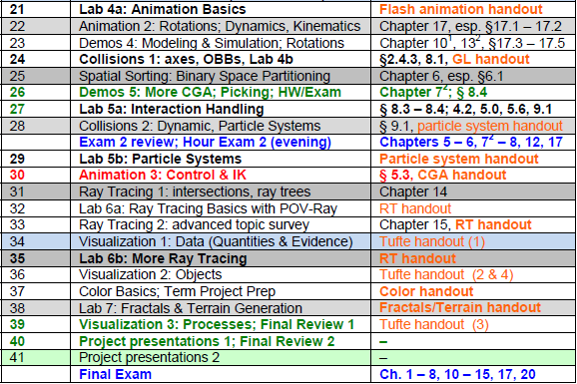
Where We Are

Slide 4
Acknowledgements:
Statistical & Data Visualization
Edward R. Tufte
Professor Emeritus of Political Science, Statistics, & Computer Science
Yale University
http://bit.ly/gKhM0G
http://www.edwardtufte.com
Leland Wilkinson
Executive Vice President, SYSTAT Software
Adjunct Professor of Computer Science, University of Illinois at Chicago
Adjunct Professor of Statistics, Northwestern University http://www.cs.uic.edu/~wilkinson/
UIC

Slide 5
Oops!
© 2009 M. A. Goetz
Mark Goetz: A blog of technology, usability, and sensemaking – http://bit.ly/cBMKR3

Slide 6
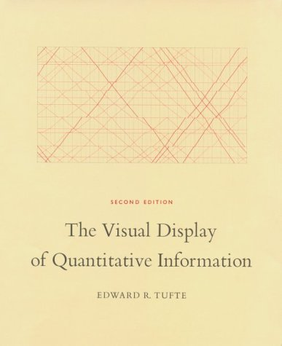
Tufte 1: The Visual Display of
Quantitative Information, 2e
Tufte, E. R. (2001). The Visual Display of Quantitative Information. Cheshire, CT, USA: Graphics Press.
http://www.edwardtufte.com/tufte/books_vdqi

Slide 7
Apologia Pro PowerPoint Sua
Tufte’s Criticisms of Microsoft PowerPoint (Summarized in Wikipedia)
Used to guide, reassure presenters, rather than enlighten audience
Unhelpfully simplistic tables, charts (due in part to low-res displays)
Outliners may arrange ideas in necessarily deep hierarchy
Not visually retained: must be repeated on each slide
Artifact of “outline”, “overview” format
Enforcement of linear progression
Poor design: typography, chart layout, use of templates, defaults
Simplistic thinking due to ideas being squashed into bulleted lists
Discontinuity of stories: beginning, middle, end → points
Cognitive load on reader: illusion of objectivity, neutrality
Some (Though Not All) Problems with PowerPoint Avoidable by Design
Garbage In, Garbage Out (Wikipedia: http://bit.ly/ff3EZ)
Tufte, The Cognitive Style of PowerPoint: http://bit.ly/TYch
Wikipedia Synopsis of Tufte’s Critique: http://bit.ly/8XQFZm

Slide 8
Definition: Visualization
Wikipedia: “Using Images, Diagrams, Animations to Communicate”
Images: illustrations; photographs, especially modified photos
Diagrams: structural diagrams, blueprints, plots & charts
Animations: based on simulation or other specifications
Includes, But Not Limited to, Statistical Graphics
Kinds of Visualization (Often Abbreviated “Vis” cf. IEEE InfoVis)
Scientific: transformation, representation of data for exploration
Data: schematic form
e.g., relational database form (tuples of attribute values)
“Data vis” often synonymous with “statistical vis”
Information: spectrum from “raw data” to “info”, “knowledge”
Premise: info more structured, organized, abstract than data
Emphasis on computational tools
Working with (especially analyzing) large data sets
Adapted from book material © 2001 E. R. Tufte, Yale University
The Visual Display of Quantitative Information, Graphics Press: http://bit.ly/16Se1

Slide 9
Definition: Graphical Excellence
Complex Ideas
Communicated with
Clarity
Precision
Efficiency
Adapted from book material © 2001 E. R. Tufte, Yale University
The Visual Display of Quantitative Information, Graphics Press: http://bit.ly/16Se1

Slide 10
Graphical Excellence:
Graphical Displays Should… (“DO’s”)
1. Show the data
2. Induce the reader to think about the substance rather than about
Methodology
Graphic design
Technology of graphic production
Something else
3. Avoid distorting what the data have to say
4. Present many numbers in a small space
5. Make large data sets coherent
6. Encourage the eye to compare different pieces of data
7. Reveal the data at different levels of detail, broad to fine
8. Serve a clear purpose: description, evaluation, tabulation, decoration
9. Be closely integrated with statistical and verbal descriptions of data
Rules were made to be broken (“What’s different on this slide?”)
Adapted from book material © 2001 E. R. Tufte, Yale University
The Visual Display of Quantitative Information, Graphics Press: http://bit.ly/16Se1

Slide 11
Graphics Reveal Data [1]:
Limitations of Descriptive Statistics
© 2001 E. R. Tufte, Yale University
The Visual Display of Quantitative Information, Graphics Press: http://bit.ly/16Se1

Slide 12
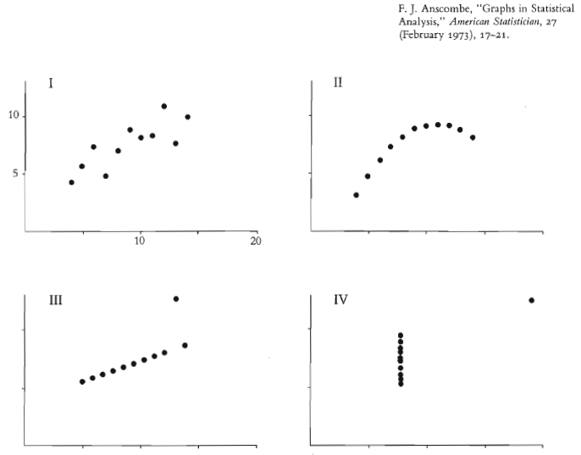
Graphics Reveal Data [2]:
Differences in Data Shown by Vis
© 2001 E. R. Tufte, Yale University
The Visual Display of Quantitative Information, Graphics Press: http://bit.ly/16Se1

Slide 13
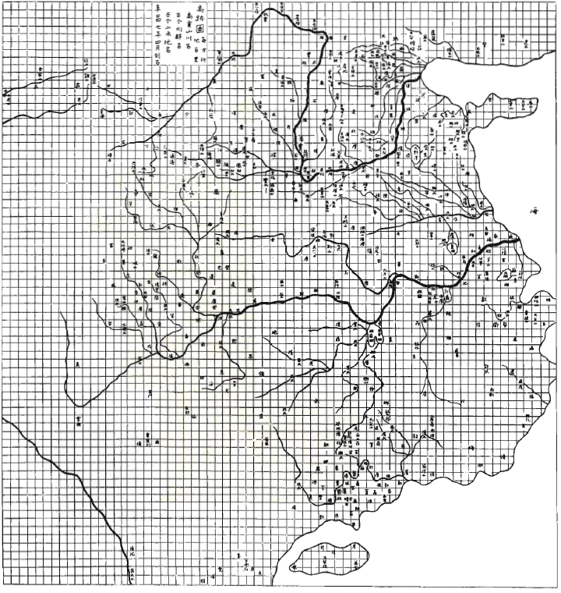
Earliest Grid Map:
Song Dynasty, 960 – 1279 CE)
This grid map, compiled c. 1100 CE (carved in stone c. 1137 CE) uses a grid of ~100 里 (li) to the square, ~42km in Han dynasty standard units (415.8m per li)
Shown:
Major rivers and tributaries
Adapted from book material © 2001 E. R. Tufte, Yale University
The Visual Display of Quantitative Information, Graphics Press: http://bit.ly/16Se1

Slide 14
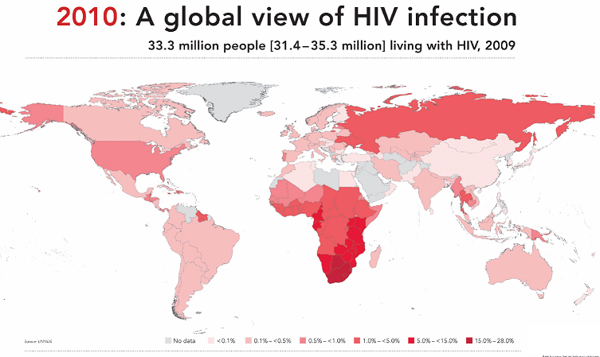
Thematic Maps & Other Data Maps
Data Maps: Visual Presentation of Variables over Region (e.g., Spatial)
Thematic Map: Shows Topic (Theme) Referenced by Geographic Area
Wikipedia: http://en.wikipedia.org/wiki/Thematic_map
Example: 2010 UNAIDS Report on Global HIV Infection Rates
© 2010, UNAids
http://bit.ly/ftHhd4
Inspired by book material © 2001 E. R. Tufte, Yale University
The Visual Display of Quantitative Information, Graphics Press: http://bit.ly/16Se1

Slide 15
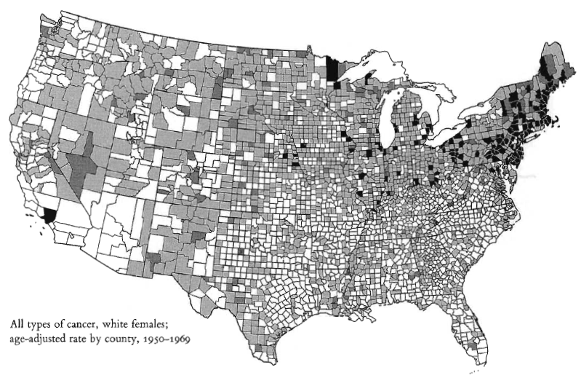
Example – Cancer Rates by County [1]:
White Females, All Types of Cancer
© 2001 E. R. Tufte, Yale University
The Visual Display of Quantitative Information, Graphics Press: http://bit.ly/16Se1

Slide 16
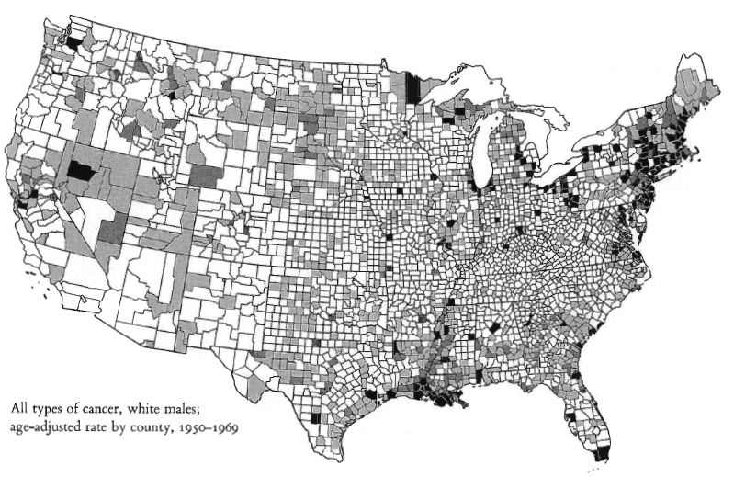
Example – Cancer Rates by County [2]:
White Males, All Types of Cancer
What’s different?
Compared to what?
Why?
Adapted from book material © 2001 E. R. Tufte, Yale University
The Visual Display of Quantitative Information, Graphics Press: http://bit.ly/16Se1

Slide 17
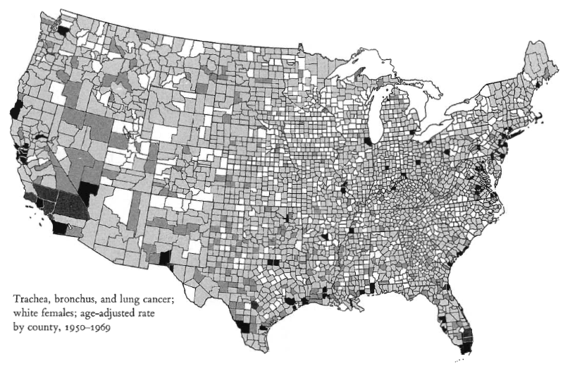
Example – Cancer Rates by County [3]:
White Females, Respiratory Cancers
Adapted from book material © 2001 E. R. Tufte, Yale University
The Visual Display of Quantitative Information, Graphics Press: http://bit.ly/16Se1

Slide 18
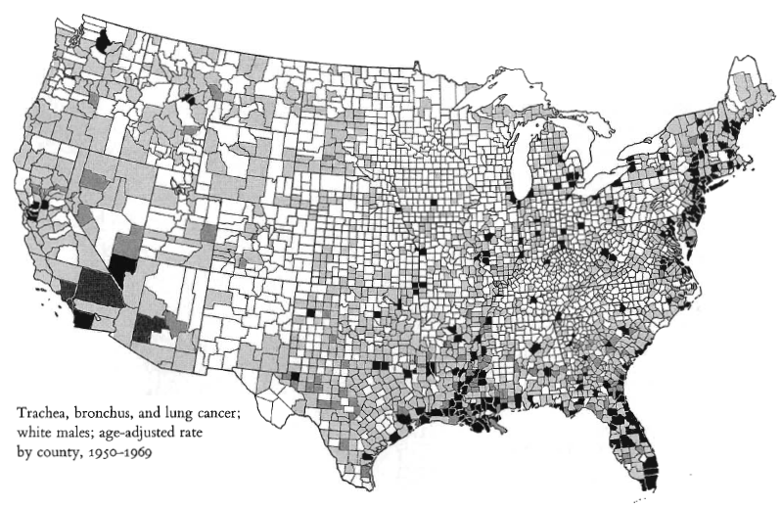
Example – Cancer Rates by County [4]:
White Males, Respiratory Cancers
Adapted from book material © 2001 E. R. Tufte, Yale University
The Visual Display of Quantitative Information, Graphics Press: http://bit.ly/16Se1

Slide 19
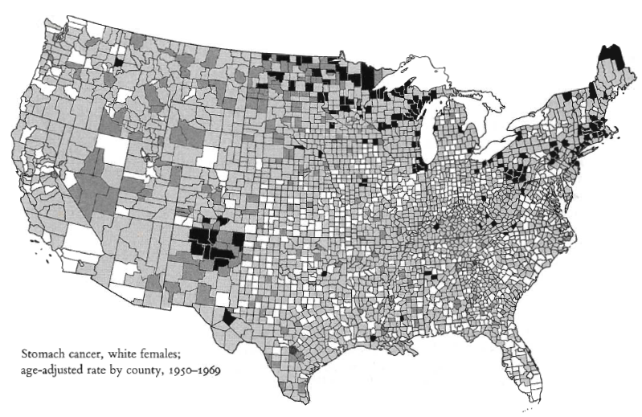
Example – Cancer Rates by County [5]:
White Females, GI Cancers
Adapted from book material © 2001 E. R. Tufte, Yale University
The Visual Display of Quantitative Information, Graphics Press: http://bit.ly/16Se1

Slide 20
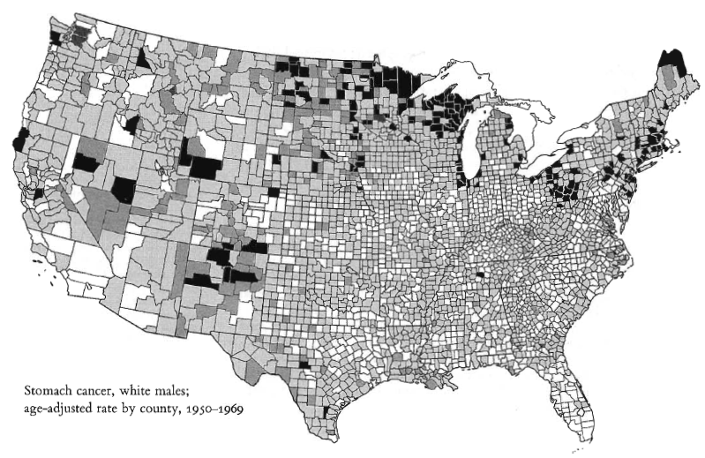
Example – Cancer Rates by County [6]:
White Males, GI Cancers
Adapted from book material © 2001 E. R. Tufte, Yale University
The Visual Display of Quantitative Information, Graphics Press: http://bit.ly/16Se1

Slide 21
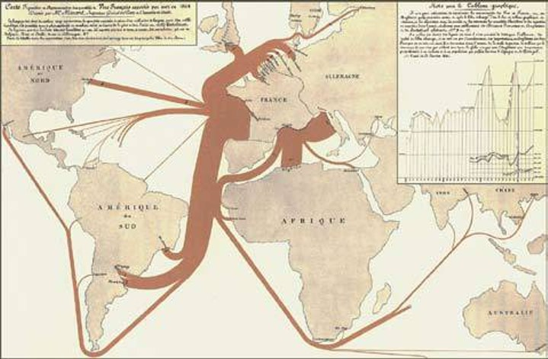
Flow Maps [1]:
Minard, 1865 – French Wine Exports
Minard, C. J. (1865). Carte figurative et approximative des quantités de vin français exportés par mer en 1864. Lithograph (835 x 547). Retrieved from: http://bit.ly/hTz4ST
Wikipedia:
Flow Map – http://bit.ly/dJgJCY
Thematic Map – http://bit.ly/enon7w
Reprinted by National Visualization and Analysis Center (NVAC), Pacific Northwest National Lab (PNL): http://bit.ly/egbQUJ
Inspired by book material © 2001 E. R. Tufte, Yale University
The Visual Display of Quantitative Information, Graphics Press: http://bit.ly/16Se1

Slide 22
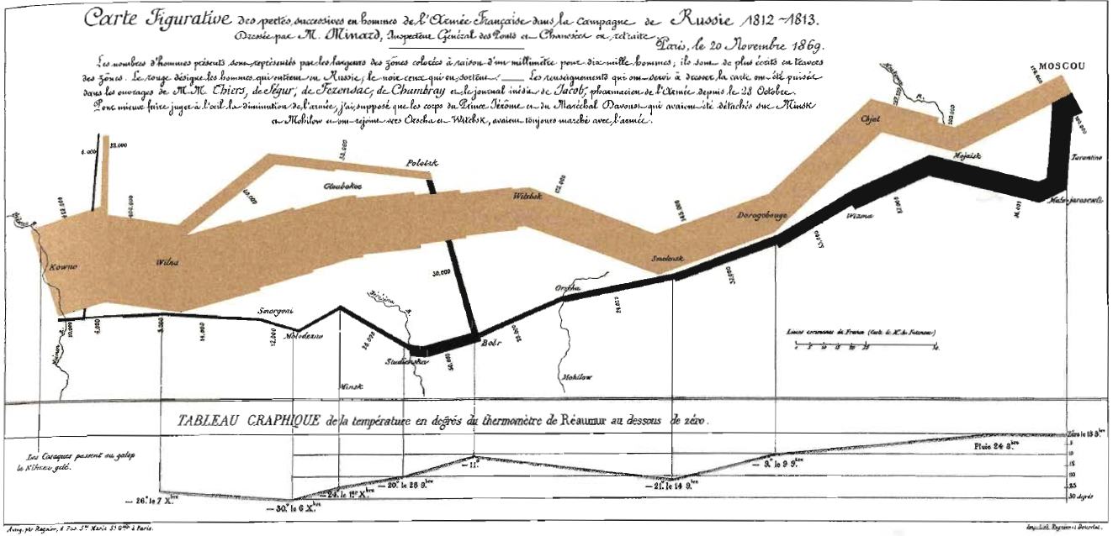
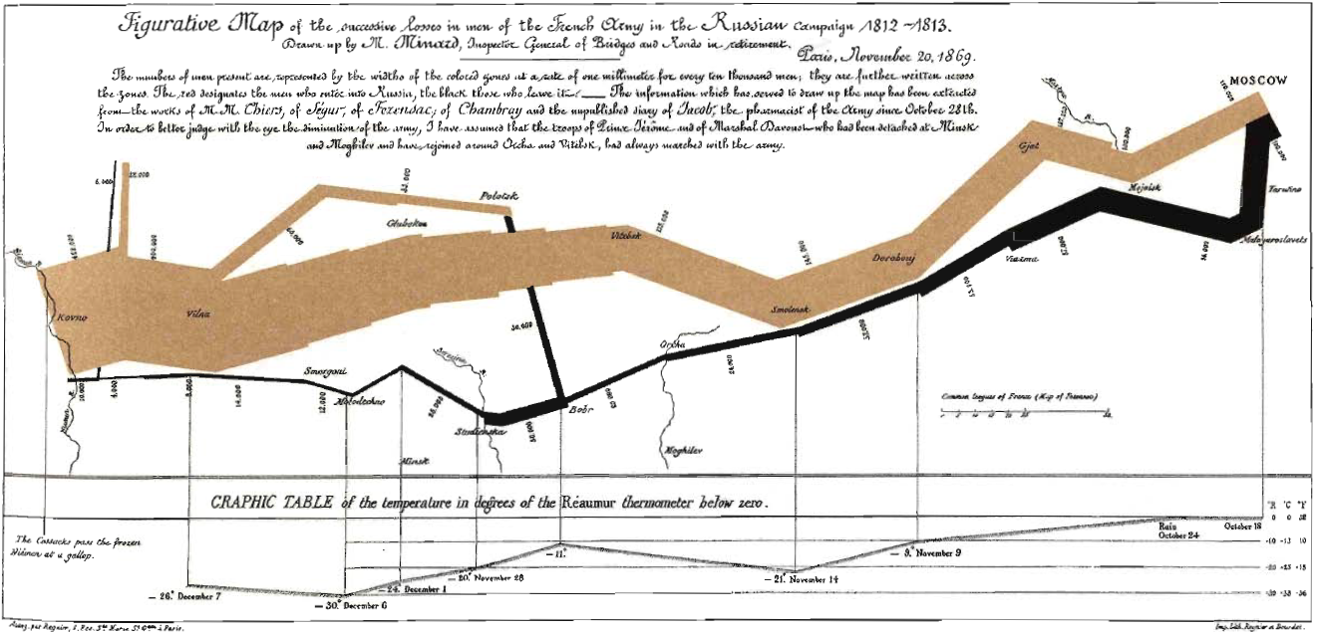
Flow Maps [2]:
Minard, 1869 – Napoleon in Russia
Minard, C. J. (1869). Carte figurative des pertes successives en hommes de l'Armée Française dans la campagne de Russie 1812-1813. Lithograph, 62 x 30 cm.
Translation by E. R. Tufte. French version mirrored at: http://bit.ly/6MHa87
Wikipedia: Charles Joseph Minard – http://bit.ly/4zZ8nQ
Adapted from book material © 2001 E. R. Tufte, Yale University
The Visual Display of Quantitative Information, Graphics Press: http://bit.ly/16Se1

Slide 23
Flow Maps [3]:
Minard’s Map of Napoleon’s March
2-D Map
6 Scalar Dimensions
Size of army
Location on 2-D surface by date (compare: latitude & longitude)
Direction of movement
Date
Temperature (referenced by position & date)
How to Represent 6 Dimensions in 2
Size – width of line and written besides army (main camp) position
Location – (x, y) coordinate on map; align with timeline on bottom
Direction – color, arrow
Date – timeline on bottom
Temperature – next to date on timeline (today: brush-over tooltip)
Adapted from book material © 2001 E. R. Tufte, Yale University
The Visual Display of Quantitative Information, Graphics Press: http://bit.ly/16Se1

Slide 24
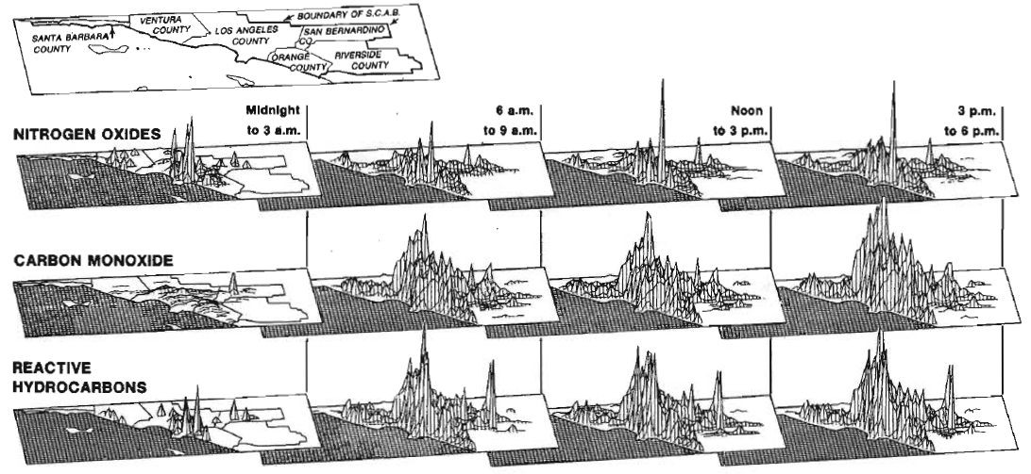
Preview:
Small Multiple – Air Pollution Map
p. 42 (Tufte 1 aka VDQI, 1e & 2^{e)}
© 2001 E. R. Tufte, Yale University
The Visual Display of Quantitative Information, Graphics Press: http://bit.ly/16Se1

Slide 25
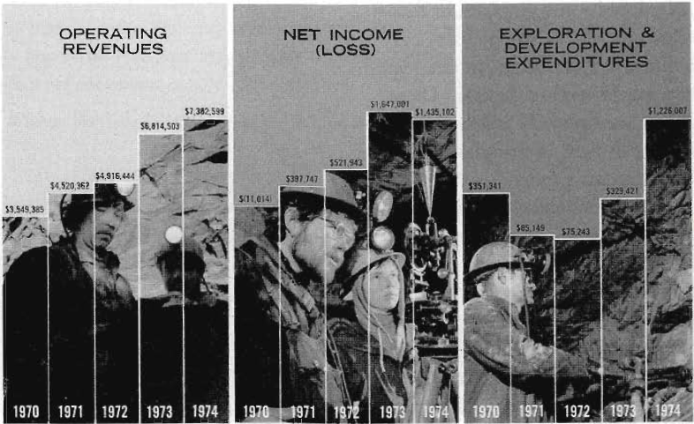
Graphical Integrity [1]:
Consistency in Labeling, Baselines
$0
© 2001 E. R. Tufte, Yale University
The Visual Display of Quantitative Information, Graphics Press: http://bit.ly/16Se1

Slide 26
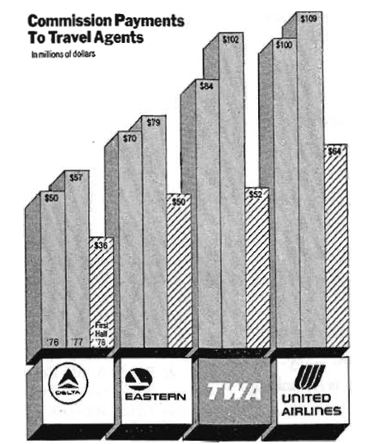
Graphical Integrity [2]:
Consistency in Time (Independent Axis)
Time frame: half year
Time frame: one year
© 2001 E. R. Tufte, Yale University
The Visual Display of Quantitative Information, Graphics Press: http://bit.ly/16Se1

Slide 27
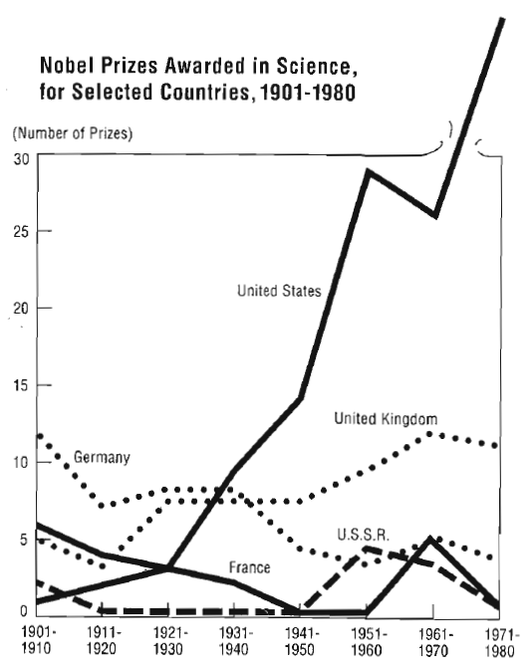
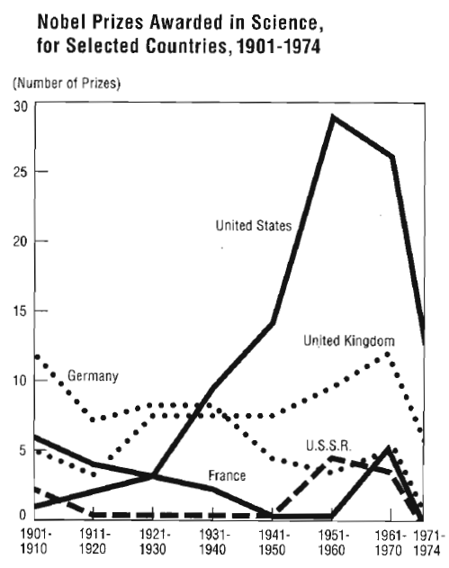
Graphical Integrity [3]:
Dangers of Partial Annual Data
© 2001 E. R. Tufte, Yale University
The Visual Display of Quantitative Information, Graphics Press: http://bit.ly/16Se1

Slide 28
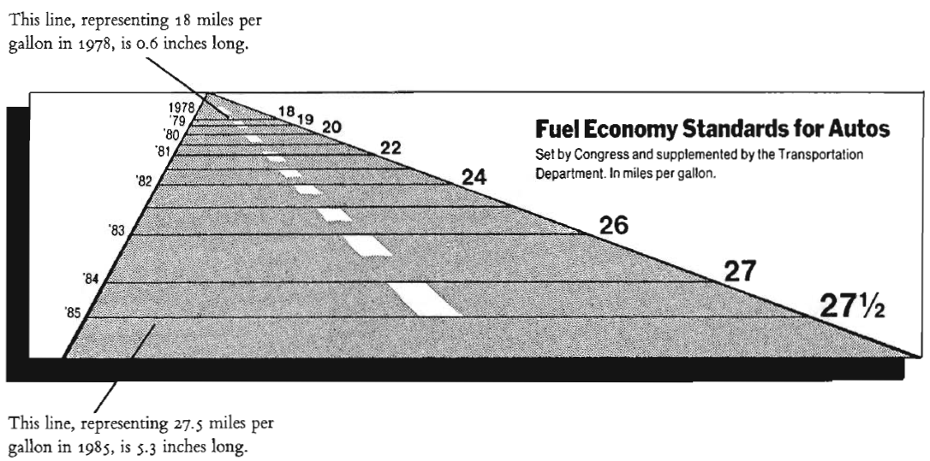
Lie Factor [1]:
Definition & Example
Definition
Goal: Keep Close to 1 (e.g., in interval [0.95, 1.05])
© 2001 E. R. Tufte, Yale University
The Visual Display of Quantitative Information, Graphics Press: http://bit.ly/16Se1

Slide 29
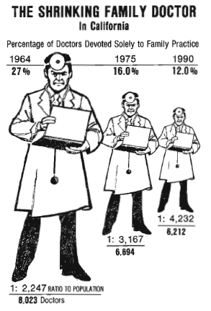
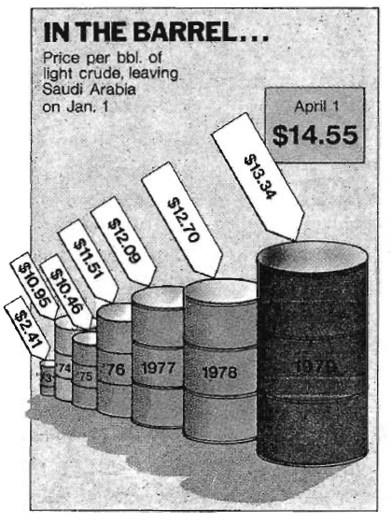
Lie Factor [2]:
Examples – Excess Dimensions (2- & 3-D)
Lie Factor: ~1 based on height, 2.8 based on area
Lie Factor: 9.4 based on area, 59.4 based on volume!
© 2001 E. R. Tufte, Yale University
The Visual Display of Quantitative Information, Graphics Press: http://bit.ly/16Se1

Slide 30
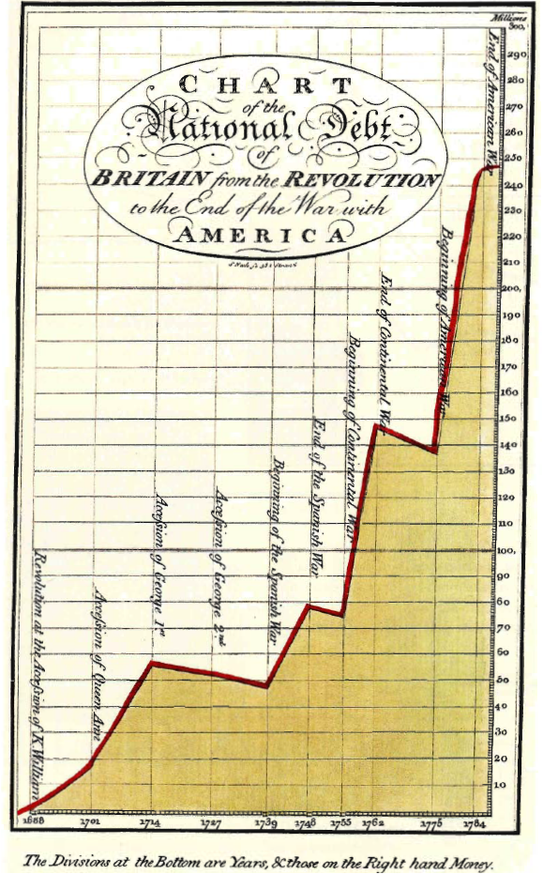
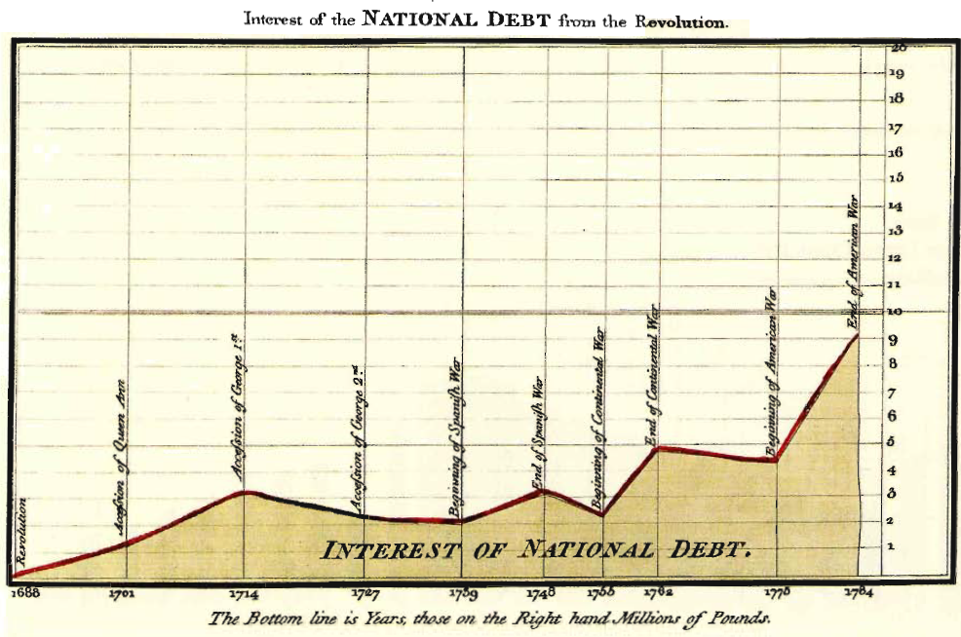
Graphical Integrity [4]:
Need for Data Normalization
Playfair (1786): Nominal Money
Playfair (1786): Real (Standardized, i.e., Inflation-Adjusted aka Deflated) Money
© 2001 E. R. Tufte, Yale University
The Visual Display of Quantitative Information, Graphics Press: http://bit.ly/16Se1

Slide 31
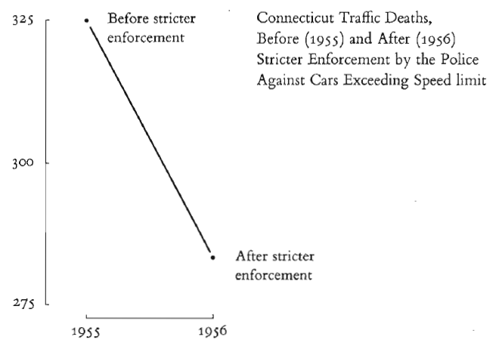
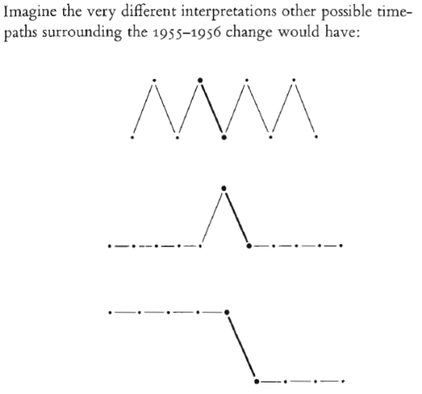
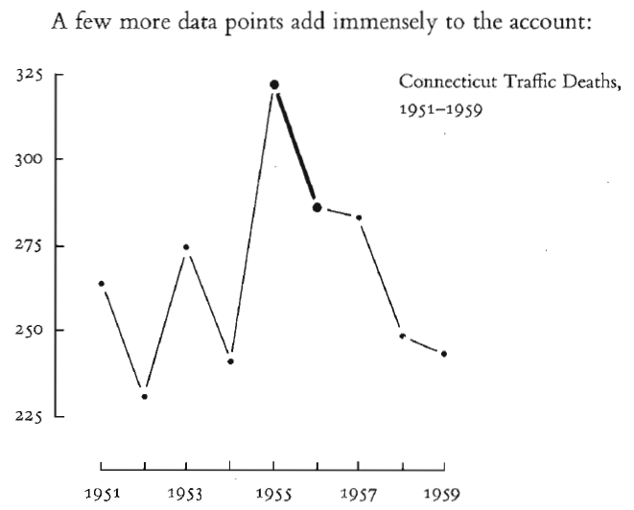
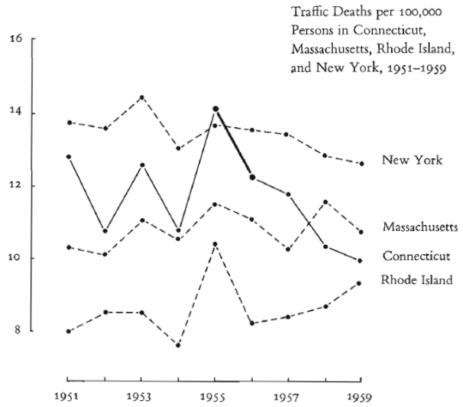
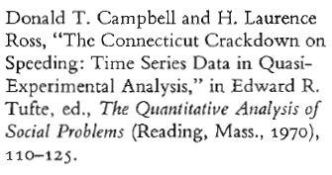
Graphical Integrity [5]:
Context – “Compared to What?”
What
If…?
© 2001 E. R. Tufte, Yale University
The Visual Display of Quantitative Information, Graphics Press: http://bit.ly/16Se1

Slide 32
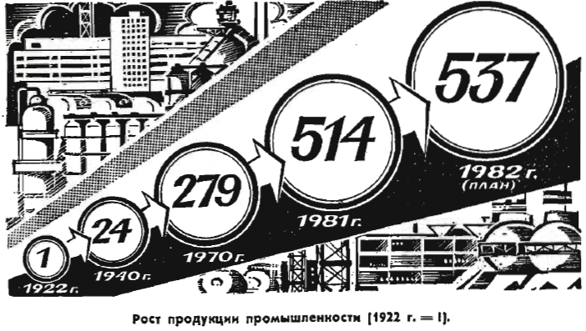
Graphical Integrity [6]:
Pravda School of Ordinal Graphics
© 2001 E. R. Tufte, Yale University
The Visual Display of Quantitative Information, Graphics Press: http://bit.ly/16Se1

Slide 33
Graphical Integrity:
Tufte’s Six Principles (“DO’s”)
See also How to Lie With Statistics (Huff, 1984): http://bit.ly/3wAgS0
1. Make Representation of Numbers Proportional to Quantities
Ratio of size to numerical value should be close to 1
As physically measured on surface of graphic
2. Use Clear, Detailed, Thorough Labeling
Don’t introduce or propagate graphical distortion, ambiguity
Write out explanations of the data on the graphic itself
Label important events in the data
3. Show Data Variation, Not Design Variation
4. Use Standardized (e.g., Inflation-Adjusted) Units, Not Nominal
5. Depict N Data Dimensions with ≤ N Variable Dimensions
Don’t use more than N information-carrying dimensions for N-D data
When graphing data in N-D, use N-D ratio (see #1 above)
6. Quote Data in Full Context (Don’t Quote Out of Context)
Adapted from book material © 2001 E. R. Tufte, Yale University
The Visual Display of Quantitative Information, Graphics Press: http://bit.ly/16Se1

Slide 34
Data-Ink
Above all else show the data.
- Edward Tufte
Data-Ink: Non-Erasable Core of A Graphic
Non-redundant ink
Arranged in response to variation in numbers represented
Data Density
Amount of usable information per unit (space, ink, time, etc.)
Want: higher data density as function of resource
Example: data-ink ratio
Non-Data-Ink Can Be Erased to Improve Data Density
© 2001 E. R. Tufte, Yale University
The Visual Display of Quantitative Information, Graphics Press: http://bit.ly/16Se1

Slide 35
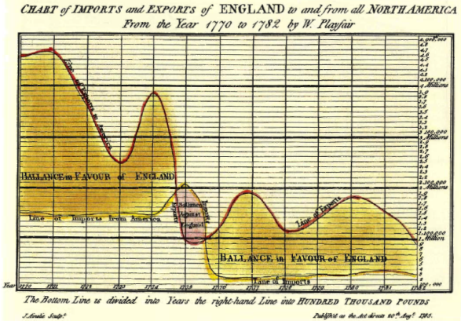
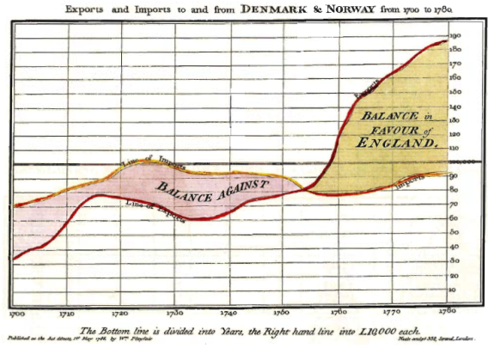
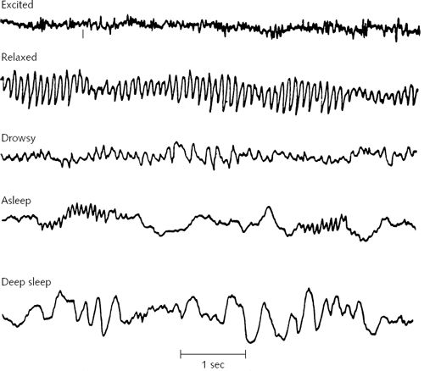
Data-Ink Ratio
Low Data-Ink Ratio (Playfair, 1785):
Charts with Many Grid Lines & Detailed Labels
Intermediate Data-Ink Ratio (Playfair, 1786):
Conventional Charts – Grid Thinned
High Data-Ink Ratio:
Electroencephalogram (EEG) Signals
© 2001 E. R. Tufte, Yale University
The Visual Display of Quantitative Information, Graphics Press: http://bit.ly/16Se1

Slide 36
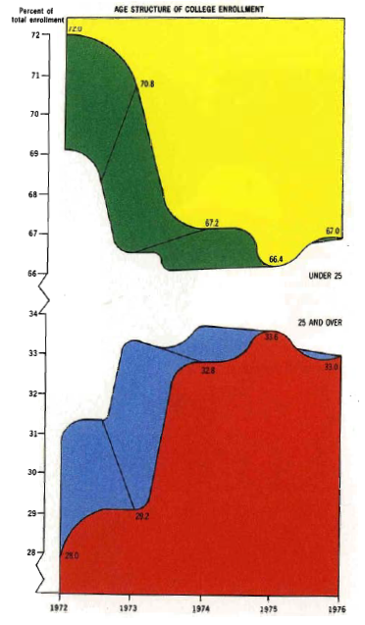
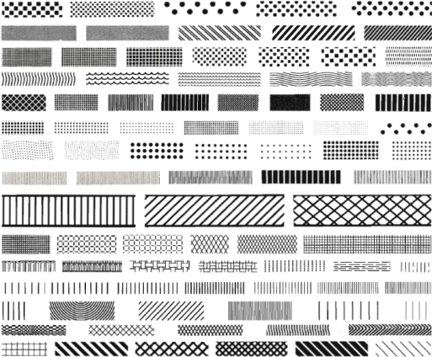
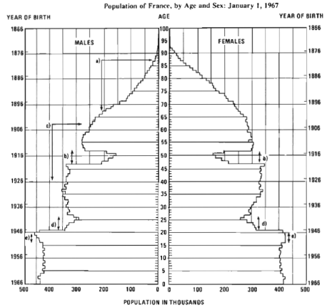
Chartjunk
}
Wikipedia, Moiré pattern: http://bit.ly/fssTem
© 1973 H. S. Shyrock & J. S. Siegel
}
“Duck” here refers to self-promoting decorative graphics.
This chart uses five colors, three dimensions, and two parts to show only five data points!
Redundancy in
Symmetry
Superfluous use of perspective and color
Big Duck © 2000 E. R. Tufte
Forgo chartjunk, including moiré vibration, the grid, and the duck. - Edward Tufte
© 2001 E. R. Tufte, Yale University
The Visual Display of Quantitative Information, Graphics Press: http://bit.ly/16Se1

Slide 37
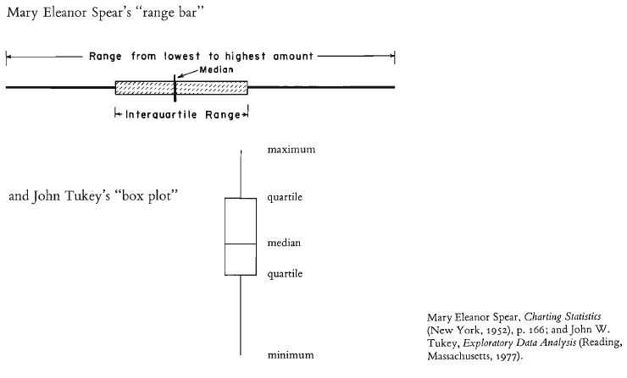
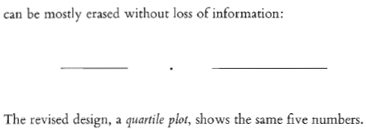
Statistical Graphics [1]:
Box plots (Spear, 1958; Tukey, 1977)
Wikipedia, Box Plot:
http://bit.ly/AxVBN
© 2001 E. R. Tufte, Yale University
The Visual Display of Quantitative Information, Graphics Press: http://bit.ly/16Se1

Slide 38
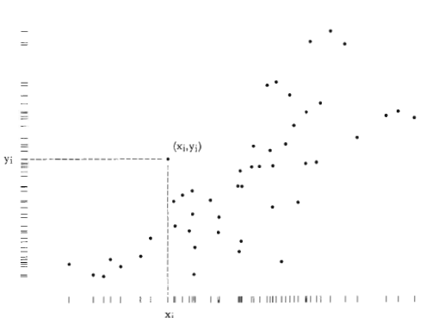
Statistical Graphics [2]:
Dot-Dash Scatter Plots (Tufte, 1983)
Wikipedia, Scatter Plot:
http://bit.ly/hkGYri
}
In a dot-dash plot, sometimes called a Tufte scatterplot, the axes are replaced with marginal distributions (the projection of the bivariate scatter down to one variable)
See: http://bit.ly/f6yDru
© 2008 University of Michigan
© 2001 E. R. Tufte, Yale University
The Visual Display of Quantitative Information, Graphics Press: http://bit.ly/16Se1

Slide 39
Statistical Graphics [3]:
Stemplots (Bowley, c. 1900)
Also Known As Stem-and-Leaf Plots (Wikipedia: http://bit.ly/adrgEM)
Construct Distribution of Variable Using Numbers Themselves
Construction Algorithm
Sort data in ascending order – example:
44 46 47 49 63 64 66 68 68 72 72 75 76 81 84 88 106
Designate meaning of stems, leaves
Leaves: suffixes, to right of vertical line – usually last digit
Stems: prefixes, to left of vertical line – usually all other digits
Group data by common stem (prefix) – example:
4 | 4 6 7 9
5 |
6 | 3 4 6 8 8
7 | 2 2 5 6
8 | 1 4 8
9 |
10 |
6 key: 6|3=63, leaf unit: 1.0, stem unit: 10.0
© 2001 E. R. Tufte, Yale University
The Visual Display of Quantitative Information, Graphics Press: http://bit.ly/16Se1

Slide 40
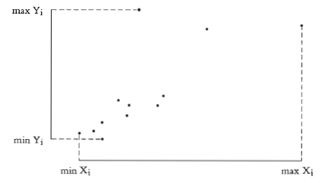
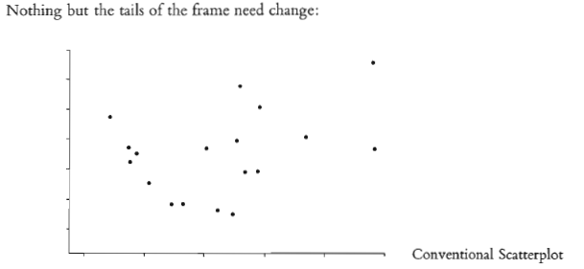
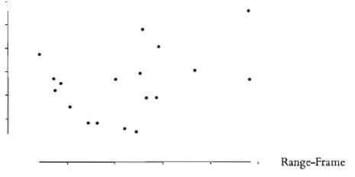
Statistical Graphics [4]:
Range-Frame Plot
}
The min and max values for each variable are made implicit by erasing the axes below the min and above the max value.
This is an example of how erasing non-data ink can lead to greater data density and data-ink ratio.
© 2001 E. R. Tufte, Yale University
The Visual Display of Quantitative Information, Graphics Press: http://bit.ly/16Se1

Slide 41
Graphical Excellence – Synopsis [1]
Well-Designed Presentation of Interesting Data
Substance – accurate, precise data, labels, other original content
Statistics – analytical content, summative & descriptive
Design – non-redundant, concise presentation of multiple variables
Complex Ideas Communicated with
Clarity – ease of interpretation and understanding
Precision – ability to reconstruct original data, process
Efficiency – rendering time vs. reading & comprehension time
Gives to Viewer
Greatest number of ideas – data
In shortest time – “ink ratio” really rate per time (cognitive effort)
With least ink – filled space, pixels, primitives, rendered objects
In smallest space – total size of graphic, page, viewport, window
Adapted from book material © 2001 E. R. Tufte, Yale University
The Visual Display of Quantitative Information, Graphics Press: http://bit.ly/16Se1

Slide 42
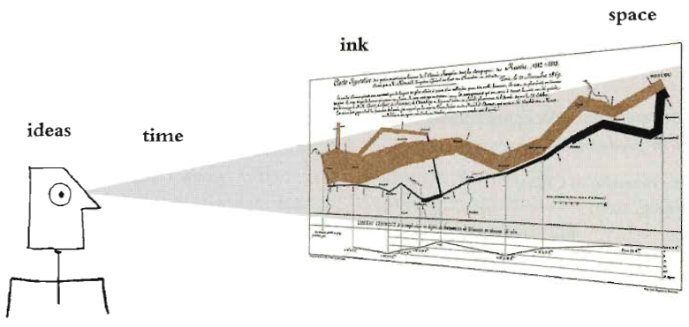
Graphical Excellence – Synopsis [2]
Nearly Always Multivariate
Requires Telling Truth about The Data (Graphical Integrity)
p. 51 (Tufte 1 aka VDQI, 1e & 2^{e)}
Adapted from book material © 2001 E. R. Tufte, Yale University
The Visual Display of Quantitative Information, Graphics Press: http://bit.ly/16Se1

Slide 43
Summary
Reading for Last Class: Chapter 15, Eberly 2e; Ray Tracing Handout
Reading for Today: Tufte Handout
Reading for Next Class: Ray Tracing Handout
Last Time: Ray Tracing 2 of 2
Stochastic & distributed RT
Hybrid RT (for specular reflectance) & radiosity (for diffuse)
Today: Visualization Part 1 of 3 – Statistical, Scientific, Data/Info Vis
Tufte 1: The Visual Display of Quantitative Information, 2e
Graphical integrity
Lack: lie factor (“How to lie with statisticsvisualization”)
Desiderata: transparency; labeled axes, clear comparisons
“Show variation in data, not presentation”
Graphical excellence
Lack: chartjunk
Desiderata: data-ink, data-ink ratio (& “data-pixels”)

Slide 44
Terminology
Visualization: Using Images, Diagrams, Animations to Communicate
Scientific: transformation, representation of data for exploration
Statistical / data: info in schematic form (attributes, variables)
Information: computational tools; analyzing large, abstract data sets
Statistical Visualization Techniques
Boxplot aka range bar, box-and-whisker diagram: mean, quartiles
Dot-dash plot aka Tufte scatterplot aka scatter plot with Tufte axes
Stemplots aka stem-and-leaf display: prefix (stem), suffix (leaf)
Range-frame plot: erase axes outside range (min/max x, y)
Tufte 1: The Visual Display of Quantitative Information, 2e
Graphical integrity: accurate, truthful visual communication
Example of lapse in graphical integrity: lie factor (distortion ratio)
Data-ink ratio: quantity of usable/accessible info per unit of “ink”
Graphical excellence: high data-ink ratio, no wasted axes
Antithesis of graphical excellence: chartjunk (visual clutter)

