Slide 1
Applications of Mining Heterogeneous Information Networks
Yizhou Sun
College of Computer and Information Science
Northeastern University
yzsun@ccs.neu.edu
June 10, 2015

Slide 2
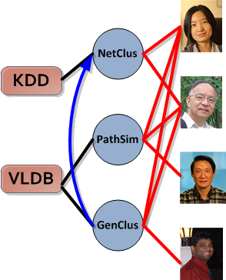
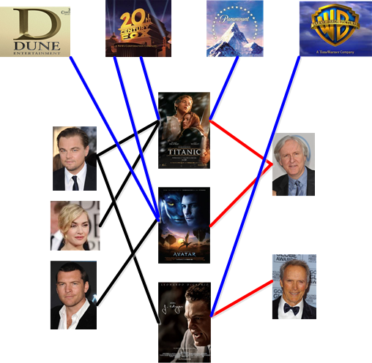
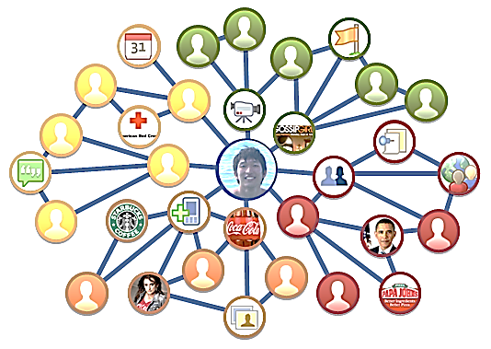
Heterogeneous Information Networks
Multiple object types and/or multiple link types
Movie
Studio
Venue
Paper
Author
Actor
Director
Movie
DBLP Bibliographic Network
The IMDB Movie Network
The Facebook Network
Homogeneous networks are Information loss projection of heterogeneous networks!
New problems are emerging in heterogeneous networks!
Directly Mining information richer heterogeneous networks

Slide 3
Outline
Why Heterogeneous Information Networks?
Entity Recommendation
Information Diffusion
Ideology Detection
Summary

Slide 4



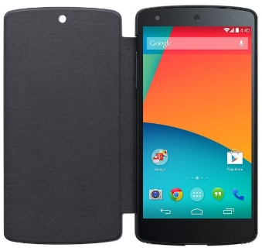

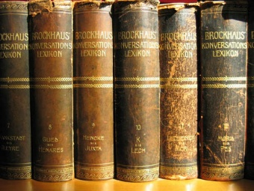
Recommendation Paradigm
feedback
user
community user-item feedback
recommender system
recommendation
product features
Collaborative Filtering
E.g., K-Nearest Neighbor (Sarwar WWW’01), Matrix Factorization (Hu ICDM’08, Koren IEEE-CS’09), Probabilistic Model (Hofmann SIGIR’03)
Content-Based Methods
E.g., (Balabanovic Comm. ACM’ 97, Zhang SIGIR’02)
Hybrid Methods
E.g., Content-Based CF (Antonopoulus, IS’06), External Knowledge CF (Ma WSDM’11)
external knowledge

Slide 5
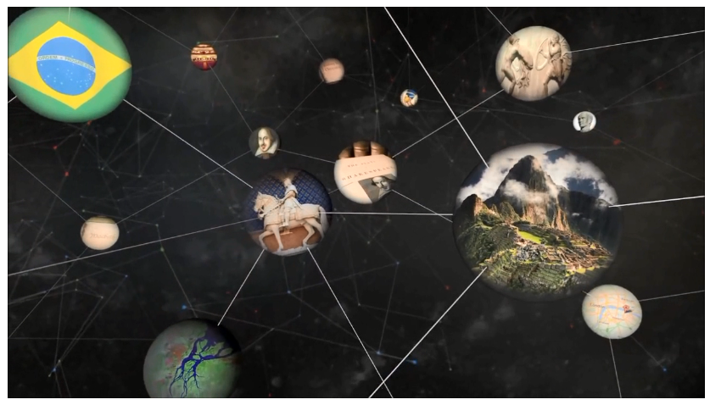
Problem Definition
feedback
user
implicit user feedback
recommender system
recommendation
hybrid collaborative filtering with information networks
information network

Slide 6

Hybrid Collaborative Filtering with Networks
Utilizing network relationship information can enhance the recommendation quality
However, most of the previous studies only use single type of relationship between users or items (e.g., social network Ma,WSDM’11, trust relationship Ester, KDD’10, service membership Yuan, RecSys’11)

Slide 7





The Heterogeneous Information Network View of Recommender System
Avatar
Aliens
Titanic
Revolution-ary Road
James Cameron
Romance
Zoe Saldana
Adventure
Leonardo Dicaprio
Kate Winslet

Slide 8
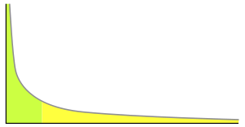
Relationship Heterogeneity Alleviates Data Sparsity
Collaborative filtering methods suffer from data sparsity issue
A small number of users and items have a large number of ratings
Most users and items have a small number of ratings
# of ratings
# of users or items
Heterogeneous relationships complement each other
Users and items with limited feedback can be connected to the network by different types of paths
  Connect new users or items (cold start) in the information network

Slide 9

Relationship Heterogeneity Based Personalized Recommendation Models
Different users may have different behaviors or preferences
Two levels of personalization
Data level
Most recommendation methods use one model for all users and rely on personal feedback to achieve personalization
Model level
With different entity relationships, we can learn personalized models for different users to further distinguish their differences
James Cameron fan
Aliens
80s Sci-fi fan
Sigourney Weaver fan
Different users may be interested in the same movie for different reasons

Slide 10








Preference Propagation-Based Latent Features
genre: drama
King Kong
Bob
Naomi Watts
Charlie
tag: Oscar Nomination
Ralph Fiennes
Alice
Titanic
skyfall
Kate Winslet
revolutionary road
Sam Mendes
Generate L different meta-path (path types) connecting users and items
Propagate user implicit feedback along each meta-path
Calculate latent-features for users and items for each meta-path with NMF related method

Slide 11


Recommendation Models
Observation 1: Different meta-paths may have different importance
Global Recommendation Model
ranking score
features for user i and item j
(1)
the q-th meta-path
Observation 2: Different users may require different models
Personalized Recommendation Model
user-cluster similarity
L
(2)
c total soft user clusters

Slide 12



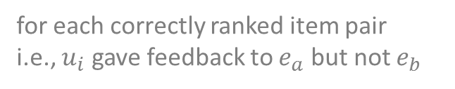
Parameter Estimation
Bayesian personalized ranking (Rendle UAI’09)
Objective function
sigmoid function
$$\min_{Θ}{ }$$
(3)
for each correctly ranked item pair
i.e., $u_{i}$ gave feedback to $e_{a}$ but not $e_{b}$
Soft cluster users with NMF + k-means
For each user cluster, learn one model with Eq. (3)
Generate personalized model for each user on the fly with Eq. (2)
Learning Personalized Recommendation Model

Slide 13

Experiment Setup
Datasets
Comparison methods:
  Popularity: recommend the most popular items to users
  Co-click: conditional probabilities between items
  NMF: non-negative matrix factorization on user feedback
  Hybrid-SVM: use Rank-SVM with plain features (utilize both user feedback and information network)

Slide 14
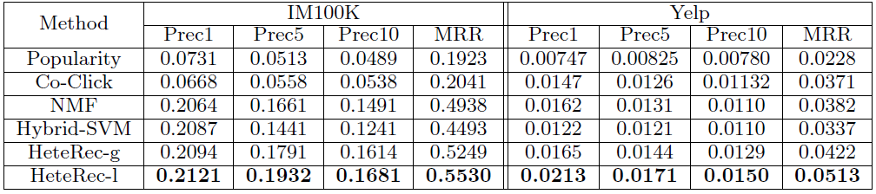
Performance Comparison
HeteRec personalized recommendation (HeteRec-p) provides the best recommendation results

Slide 15
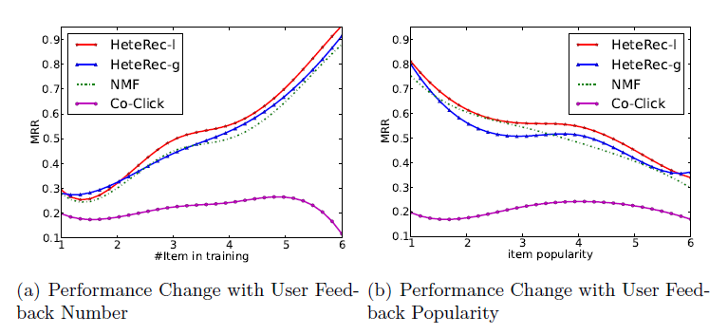
Performance under Different Scenarios
p
p
user
HeteRec–p consistently outperform other methods in different scenarios
  better recommendation results if users provide more feedback
  better recommendation for users who like less popular items

Slide 16
Contributions
Entity Recommendation in Information Networks with Implicit User Feedback
(RecSys’13, WSDM’14a)
Propose latent representations for users and items by propagating user preferences along different meta-paths
Employ Bayesian ranking optimization technique to correctly evaluate recommendation models
Further improve recommendation quality by considering user differences at model level and define personalized recommendation models
  Two levels of personalization

Slide 17
Outline
Why Heterogeneous Information Networks?
Entity Recommendation
Information Diffusion
Ideology Detection
Summary

Slide 18
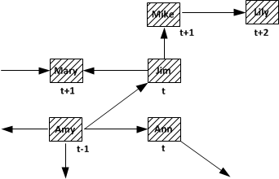
Information Diffusion in Networks
Action of a node is triggered by the actions of their neighbors

Slide 19

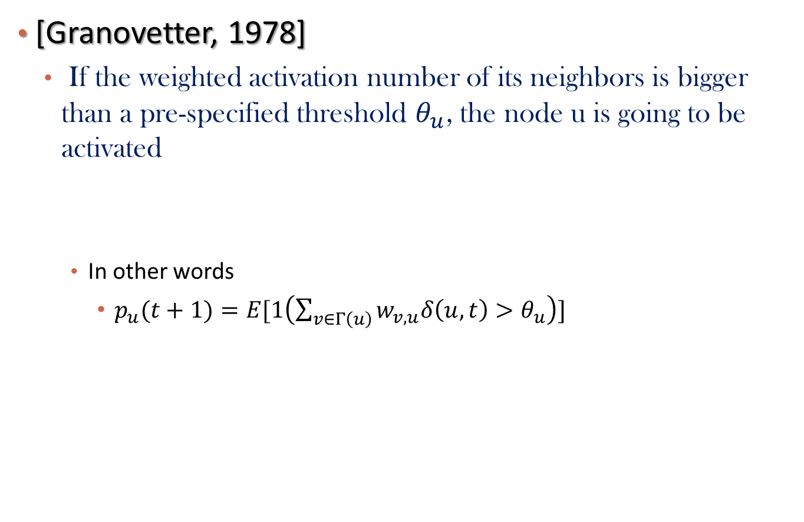
Linear Threshold Model
[Granovetter, 1978]
  If the weighted activation number of its neighbors is bigger than a pre-specified threshold $θ_{u}$, the node u is going to be activated
    In other words
      $p_{u}(t+1)=E[1\left(\sum_{v∈Γ\left(u\right)}{w_{v,u}δ\left(u,t\right)>θ_{u}}\right)]$

Slide 20
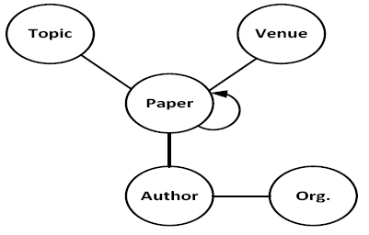
Heterogeneous Bibliographic Network
Multiple types of objects
Multiple types of links

Slide 21
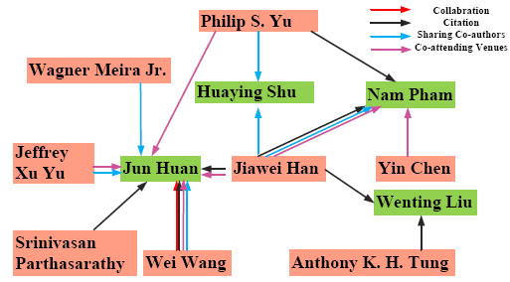
Derived Multi-Relational Bibliographic Network
Collaboration: Author-Paper-Author
Citation: Author-Paper->Paper-Author
Sharing Co-authors: Author-Paper-Author-Paper-Author
Co-attending venues: Author-Paper-Venue-Paper-Author
How to generate these meta-paths ?
PathSim: Sun et.al, VLDB’11

Slide 22
How Topics Are Propagated among Authors?
To Apply Existing approaches
  Select one relation between authors (say, A-P-A)
  Use all the relations, but ignore the relation types
Do different relation types play different roles?
  Need new models!
Information loss!

Slide 23
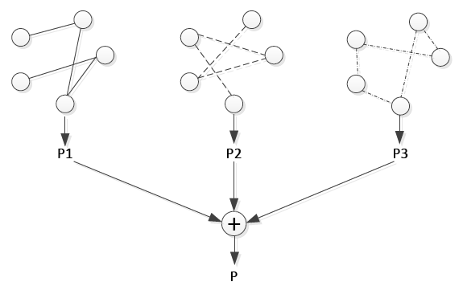
Two Assumptions for Topic Diffusion in Multi-Relational Networks
Assumption 1: Relation independent diffusion
Model-level aggregation

Slide 24
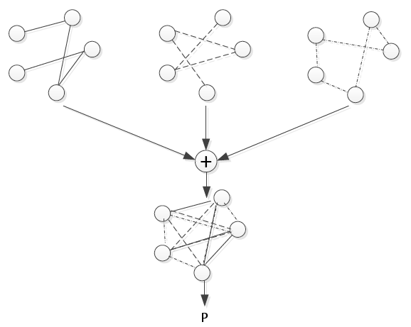
Assumption 2: Relation interdependent diffusion
Relation-level aggregation

Slide 25
Two Models under the Two Assumptions
Two multi-relational linear threshold models
  Model 1: MLTM-M
    Model-level aggregation
  Model 2: MLTM-R
    Relation-level aggregation

Slide 26


MLTM-M
For each relation type k
  The activation probability for object i at time t+1:
The collective model
  The final activation probability for object i is an aggregation over all relation types

Slide 27
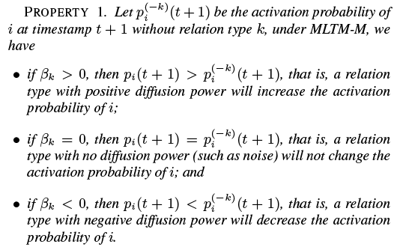
Properties of MLTM-M

Slide 28

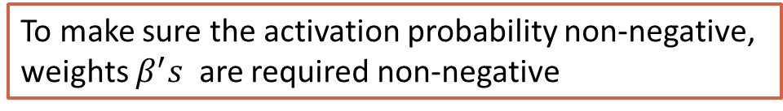
MLTM-R
Aggregate multi-relational network with different weights
  Treat the activation as in a single-relational network
To make sure the activation probability non-negative,
weights $β^{′}s$ are required non-negative

Slide 29
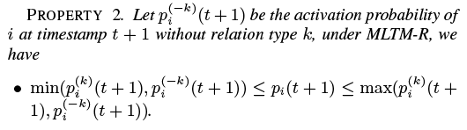

Properties of MLTM-R

Slide 30
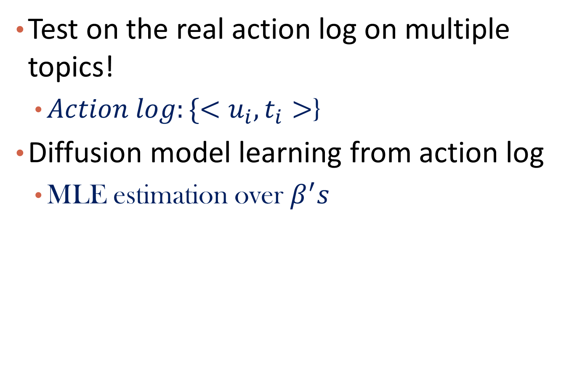
How to Evaluate the Two Models?
Test on the real action log on multiple topics!
  $Action log:\{<u_{i}, t_{i}>$}
Diffusion model learning from action log
  MLE estimation over $β^{′}s$

Slide 31
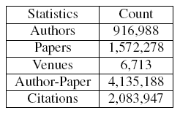
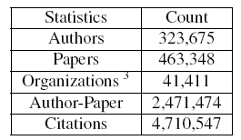
Two Real Datasets
DBLP
  Computer Science
  Relation types
    APA, AP->PA, APAPA, APVPA
APS
  Physics
  Relation types
    APA, AP->PA, APAPA, APOPA

Slide 32
Topics Selected
Select topics with increasing trends

Slide 33
Evaluation Methods
Global Prediction
  How many authors are activated at t+1
  Error rate = ½(predicted#/true# + true#/predicted#)-1
Local Prediction
  Which author is likely to be activated at t+1
  AUPR (Area under Precision-Recall Curve)

Slide 34
Global Prediction

Slide 35
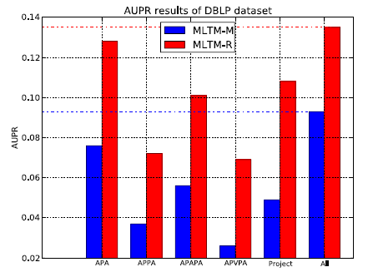
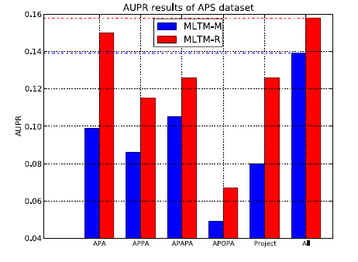
Local Prediction - AUPR
1: Different Relation Play Different Roles in Diffusion Process
2: Relation-Level Aggregation is better than Model-Level Aggregation

Slide 36
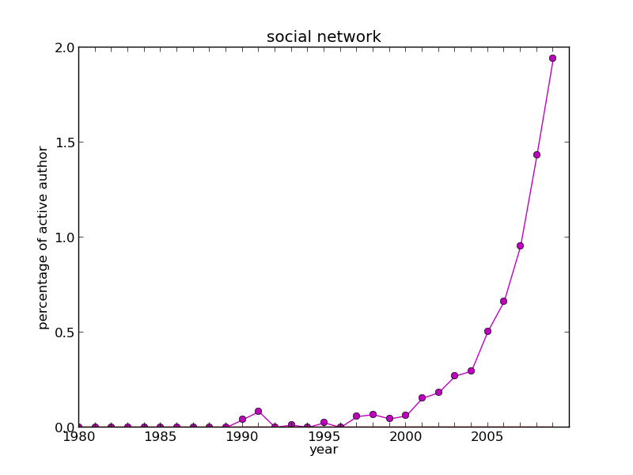
Case Study

Slide 37
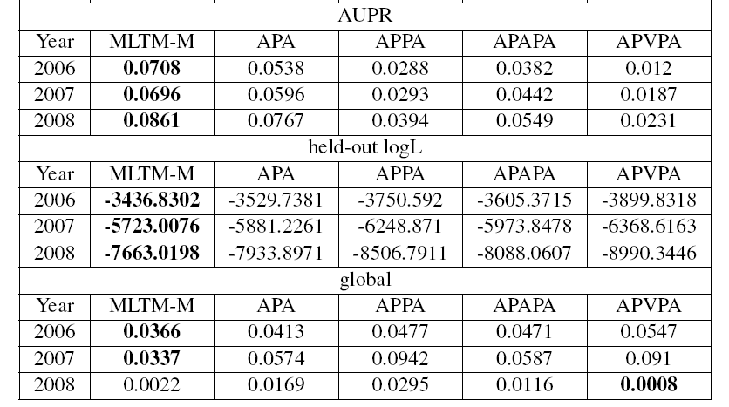
Prediction Results on “social network” Diffusion

Slide 38
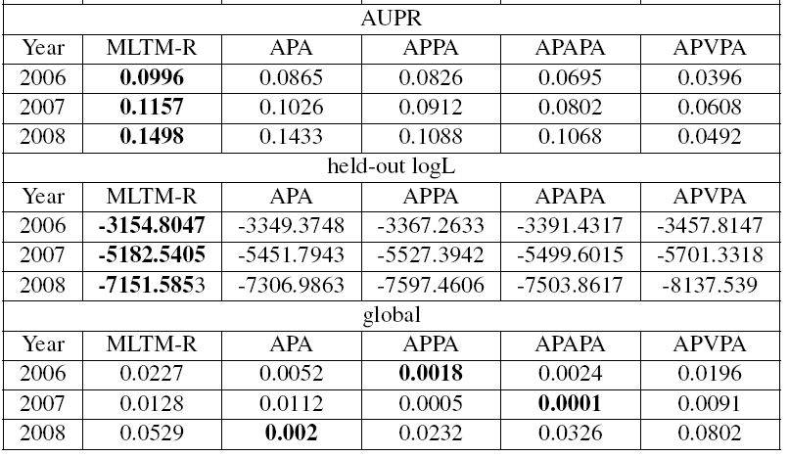

Slide 39
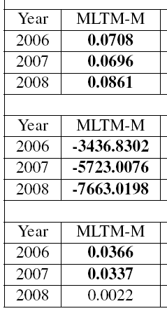
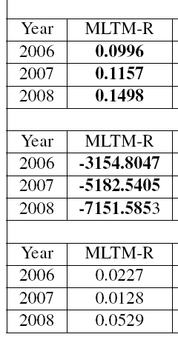
WIN!

Slide 40
Outline
Why Heterogeneous Information Networks?
Entity Recommendation
Information Diffusion
Ideology Detection
Summary

Slide 41
Topic-Factorized Ideal Point Estimation Model for Legislative Voting Network (KDD’14, Gu, Sun et al.)

Slide 42





Background
Federal Legislation
(bill)
The House
Senate
Law
Bill 1
Bill 2
……
United Stated Congress
Ronald Paul
Barack Obama
The House
Senate
Politician
Republican
Democrat
Ronald Paul
Barack Obama
liberal
conservative
Notes:
US Congress: is the bicameral legislature of the federal government of the United States consisting of two houses

Slide 43
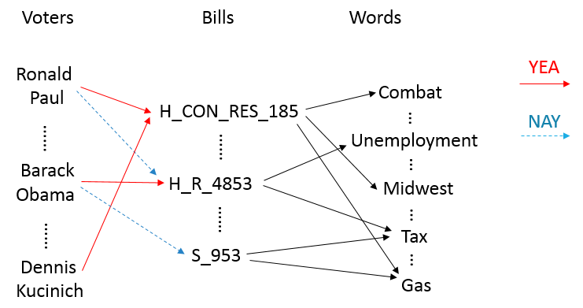
Legislative Voting Network
Notes:
Solid lines (support) & dashed lines (oppo’sition)
Point out this is a heterogeneous network

Slide 44
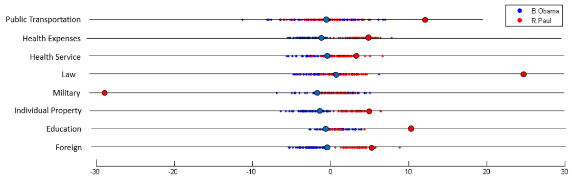

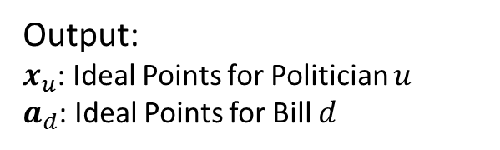
Problem Definition
Output:
$x_{u}$: Ideal Points for Politician $u$
$a_{d}$: Ideal Points for Bill $d$
Input:
Legislative Network
$x_{u}$’s on different topics
Notes:
Our goal: predict R/D, how liberal she is
It’s extremely helpful to predict the party affiliation for a politician, to know her attitude towards different topics, and her placement among all politicians

Slide 45
Existing Work
1-dimensional ideal point model (Poole and Rosenthal, 1985; Gerrish and Blei, 2011)
High-dimensional ideal point model (Poole and Rosenthal, 1997)
Issue-adjusted ideal point model (Gerrish and Blei, 2012)
Notes:
(3) First train a global ideal point like 1. When talked about different topics, they make adjustments based on the global ideal point. They train topic distribution on the text part, and use it as a guidance of the adjustment for each topic.

Slide 46







Motivations
Voters have different positions on different topics.
Topic 1
Topic 2
Topic 3
Topic 4
Traditional matrix factorization method cannot give the meanings for each dimension.
$$M$$
$$U$$
$$V^{T}$$
$$≈$$
$$⋅$$
$k^{th}$ latent factor
Topics of bills can influence politician’s voting, and the voting behavior can better interpret the topics of bills as well.
Topic Model:
Health
Public Transport
…
Voting-guided Topic Model:
Health Service
Health Expenses
Public Transport
…
Notes:
1, we need to find ideal points on multiple topics
2, how can we achieve this? → combine two parts
3, … that is, which topics do they concern when they vote → formulation of our model

Slide 47
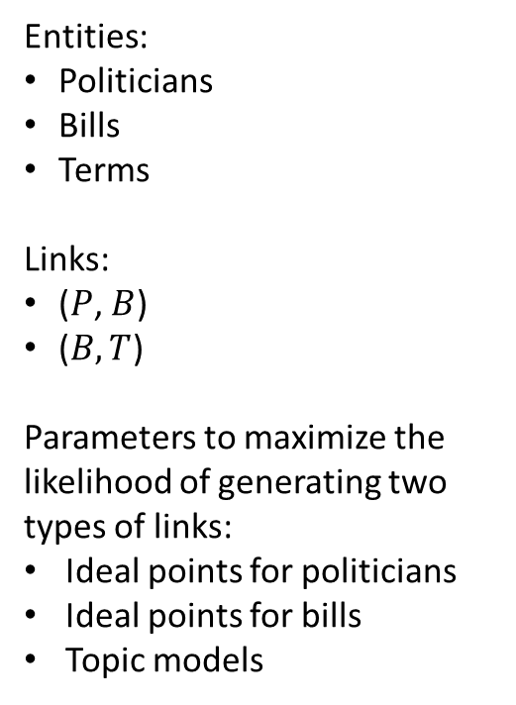





Topic-Factorized IPM
Entities:
Politicians
Bills
Terms
Links:
($P$, $B$)
($B, T$)
Parameters to maximize the likelihood of generating two types of links:
Ideal points for politicians
Ideal points for bills
Topic models
$$n(d,w)$$
$$w$$
$$v_{ud}$$
$$u$$
$$d$$
Politicians
Bills
Terms
Heterogeneous Voting Network
Notes:
Study the two different types of links

Slide 48
Text Part
Politicians
Bills
Terms

Slide 49






Text Part
We model the probability of each word in each document as a mixture of categorical distributions, as in PLSA (Hofmann, 1999) and LDA (Blei et al., 2003)
$$w_{d}=\left(n\left(d,1\right),n\left(d,2\right),…,n\left(d,N_{w}\right)\right)$$
$$p\left(w_{d} | θ,β\right)∝{\prod_{w}{(\sum_{k}{θ_{dk}β_{kw})}}}^{n(d,w)}$$
$$p\left(W | θ,β\right)∝\prod_{d}{\prod_{w}{({\sum_{k}{θ_{dk}β_{kw})}}^{n(d,w)}}}$$
$$θ_{dk}=p(k|d)$$
$$β_{kw}=p(w|k)$$
$$w$$
$$d$$
$$k$$
Bill
Topic
Word
Notes:
\theta: the probability of bill d belonging to topic k
\beta: the probability that topic k generates word w

Slide 50
Voting Part
Intuitions:
The more similar of the ideal points of u and d, the higher probability of “YEA” link
The higher portion a bill belongs to topic k, the higher weight of ideal points on topic k
Politicians
Bills
Terms

Slide 51












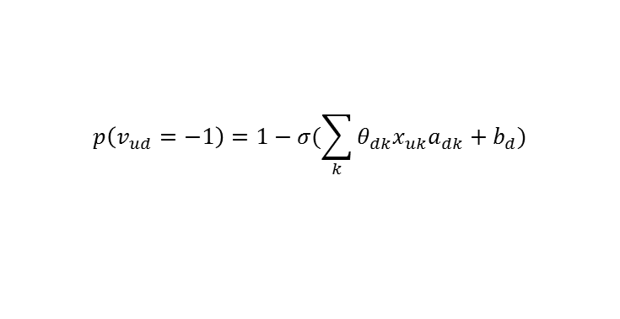











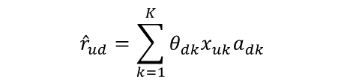

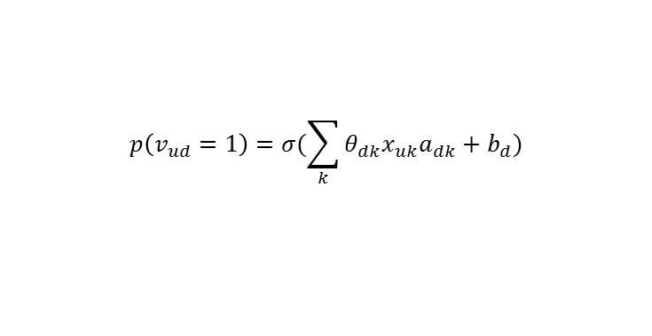






Voting Part
Topic
1
Topic
2
……
Topic
$$k$$
……
Topic
$$K$$
Voter $u$
$$x_{u}$$
$$x_{u1}$$ | $$x_{u2}$$ |  |  | $$x_{uk}$$ |  | $$x_{uK}$$
$$x_{uk}∈R$$
Bill $d$
$$a_{d}$$
$$a_{d1}$$ | $$a_{d2}$$ |  |  | $$a_{dk}$$ |  | $$a_{dK}$$
$$a_{dk}∈R$$
$$d_{1}$$
$$d_{2}$$
……
$$d_{N_{D}}$$
$$u_{1}$$
0 | 1 | -1 | 1 | 1 | 1 | 1 | 1
0 | 0 | -1 | 1 | 1 | 1 | -1 | 1
1 | 1 | 1 | 1 | -1 | 1 | 0 | 0
$$θ_{d1}$$
$$x_{u1}$$
$$a_{d1}$$
$${\hat{r}}_{ud}=\sum_{k=1}^{K}{x_{uk}a_{dk}}$$
$$u_{2}$$
……
$$θ_{dk}$$
$$x_{uk}$$
$$a_{dk}$$
……
……
$${\hat{r}}_{ud}=\sum_{k=1}^{K}{θ_{dk}x_{uk}a_{dk}}$$
$$θ_{dK}$$
$$x_{uK}$$
$$a_{dK}$$
$$u_{N_{U}}$$
$$p\left(v_{ud}=1\right)=σ(\sum_{k}{θ_{dk}x_{uk}a_{dk}}+b_{d})$$
YEA
User-Bill voting matrix $V$
$$p\left(v_{ud}=−1\right)=1−σ(\sum_{k}{θ_{dk}x_{uk}a_{dk}}+b_{d})$$
NAY
$$I_{\{v_{ud}=1\}}$$
$$I_{\{v_{ud}=−1\}}$$
$$p\left(V | θ,X,A,b\right)=\prod_{\left(u,d\right):v_{ud}≠0}{(p{\left(v_{ud}=1\right)}^{\frac{1+v_{ud}}{2}}p{\left(v_{ud}=−1\right)}^{\frac{1−v_{ud}}{2}}})$$
Notes:
In the settings of MF, low-dimension vectors x and a are learned for each user and bill respectively, to approximate the original voting matrix.
$b_{d}$: offset/bias (it is reasonable because some bills really have more supports than others)
$θ$: (“how can we utilize topic information?”)

Slide 52
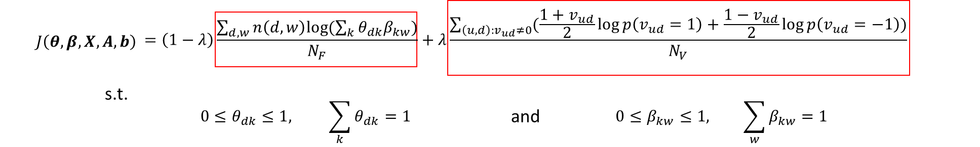
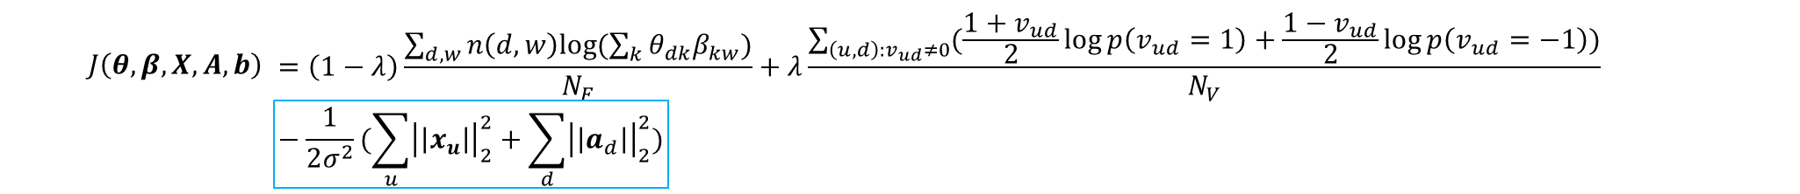

Combining Two Parts Together
The final objective function is a linear combination of the two average log-likelihood functions over the word links and voting links.
We also add an $l_{2}$ regularization term to $A$ and $X$ to reduce over-fitting.

Slide 53
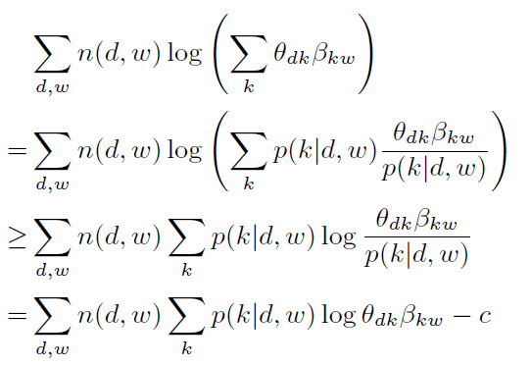
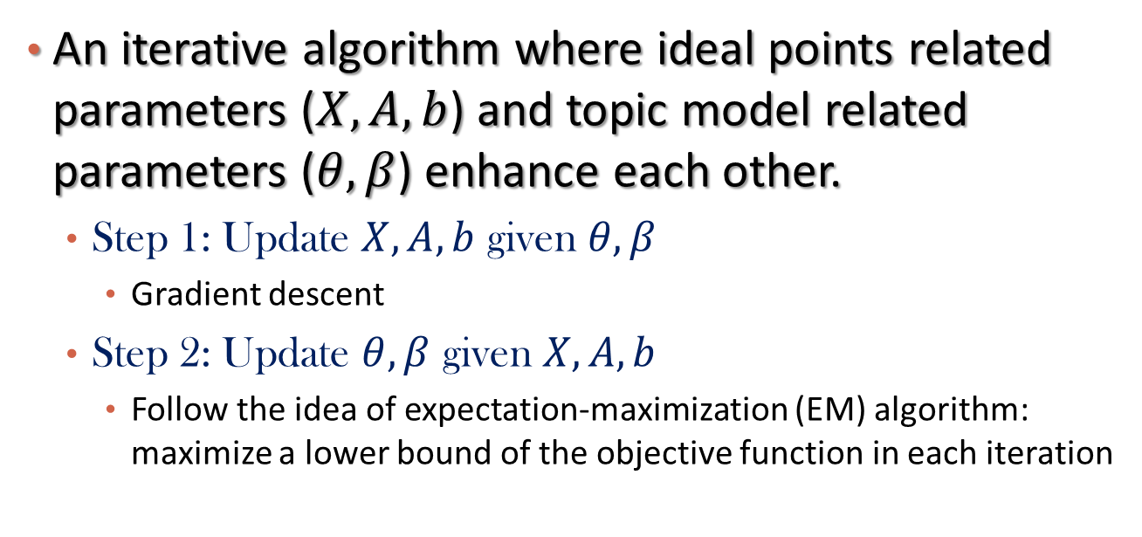
Learning Algorithm
An iterative algorithm where ideal points related parameters ($X,A,b$) and topic model related parameters ($θ,β$) enhance each other.
  Step 1: Update $X,A,b$ given $θ,β$
    Gradient descent
  Step 2: Update $θ,β$ given $X,A,b$
    Follow the idea of expectation-maximization (EM) algorithm: maximize a lower bound of the objective function in each iteration
Notes:
Step 1 (GD): because objective function is a concave function of X,A,b given \theta, \beta

Slide 54
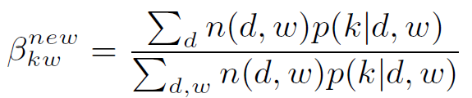
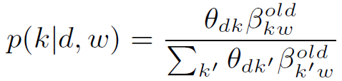

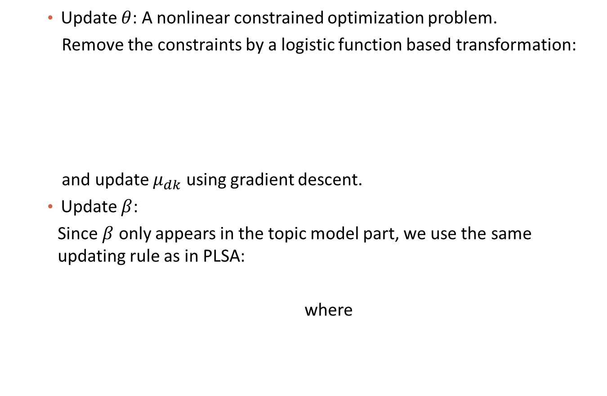


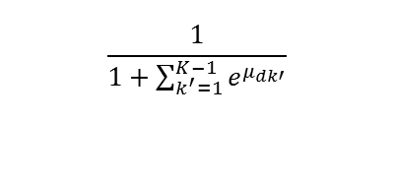
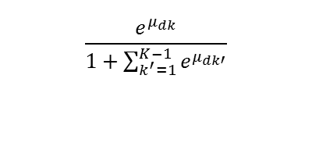
Learning Algorithm
    Update $θ$: A nonlinear constrained optimization problem.
    Remove the constraints by a logistic function based transformation:
    and update $μ_{dk}$ using gradient descent.
    Update $β$:
    Since $β$ only appears in the topic model part, we use the same updating rule as in PLSA:
    where
$$\frac{e^{μ_{dk}}}{1+\sum_{k^{′}=1}^{K−1}{e^{μ_{dk′}}}}$$
if $1≤k≤K−1$
$$θ_{dk}=$$
$$\frac{1}{1+\sum_{k^{′}=1}^{K−1}{e^{μ_{dk′}}}}$$
if $k=K$

Slide 55
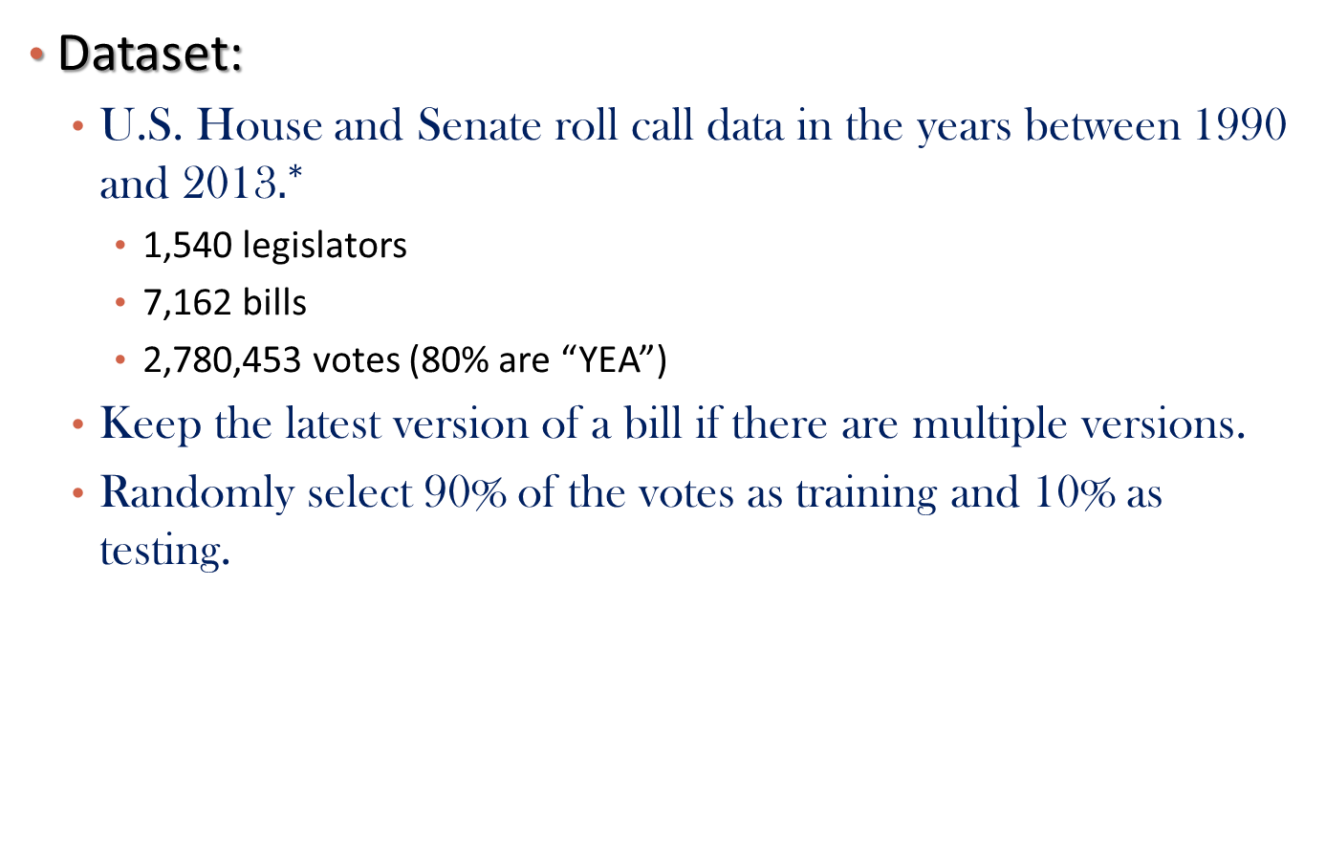
Data Description
Dataset:
  U.S. House and Senate roll call data in the years between 1990 and 2013$.^{∗}$
    1,540 legislators
    7,162 bills
    2,780,453 votes (80% are “YEA”)
  Keep the latest version of a bill if there are multiple versions.
  Randomly select 90% of the votes as training and 10% as testing.
${}^{∗}$ Downloaded from http://thomas.loc.gov/home/rollcallvotes.html

Slide 56

Evaluation Measures
Root mean square error (RMSE) between the predicted vote score and the ground truth
  RMSE = $\sqrt{\frac{\sum_{\left(u,d\right):v_{ud}≠0}{{\left(\frac{1+v_{ud}}{2}−p\left(v_{ud}=1\right)\right)}^{2}}}{N_{V}}}$
Accuracy of correctly predicted votes (using 0.5 as a threshold for the predicted accuracy)
  Accuracy = $\frac{\sum_{u,d}{(I_{\left\{p\left(v_{ud}=1\right)>0.5 \&\& v_{ud}=1\right\}}+I_{\left\{p\left(v_{ud}=1\right)<0.5 \&\& v_{ud}=−1\right\}})}}{N_{V}}$
Average log-likelihood of the voting link
  AvelogL = $\frac{\sum_{\left(u,d\right):v_{ud}≠0}{{\left(\frac{1+v_{ud}}{2}\log{p}\left(v_{ud}=1\right)+\frac{1−v_{ud}}{2}\log{p(v_{ud}=−1)}\right)}^{}}}{N_{V}}$

Slide 57


Experimental Results
Training Data set
Testing Data set
Notes:
Show our advantages over (1)1-ipm; (2)H-IPM; (3)IA-IPM

Slide 58




Parameter Study
$$J\left(θ,β,X,A,b\right)=\left(1−λ\right)⋅avelogL\left(text\right)+λ⋅avelogL(voting)−\frac{1}{2σ^{2}}(\sum_{u}{{\left|\left|x_{u}\right|\right|}_{2}^{2}+\sum_{d}{{\left|\left|a_{d}\right|\right|}_{2}^{2})}}$$
Parameter study on $λ$
Parameter study on $σ$ (regularization coefficient)
Notes:
\sigma: the performance becomes less sensitive when $σ$ becomes larger

Slide 59



Case Studies
  Ideal points for three famous politicians: (Republican, Democrat)
  Ronald Paul (R), Barack Obama (D), Joe Lieberman (D)
Public Transportation
Funds
Health Expenses
Health Service
Law
Military
Financial Institution
Individual Property
Education
Foreign
Ronald Paul
Barack Obama
Joe Lieberman
Notes:
Republican: conservative Democrat: liberal
Liberal at war = anti-war

Slide 60



Case Studies
Scatter plots over selected dimensions: (Republican, Democrat)
Notes:
We can also detect outliers from such visualization (e.g. R.Paul is an outlier in the first fig)

Slide 61








Case Studies
Bill: H_RES_578 — 109th Congress (2005-2006)
It is about supporting the government of Romania to improve the standard health care and well-being of children in Romania.
$$x_{uk}$$
YEA
R. Paul H_RES_578
For Unseen Bill $d$:
Topic Model
$$θ_{d}$$
TF-IPM
$$x_{u}$$
$$p\left(v_{ud}=1\right)$$
$$p\left(v_{ud}=1\right)=σ(\sum_{k}{θ_{dk}x_{uk}a_{dk}}+b_{d})$$
Experts/Algorithm
$$a_{d}$$
Notes:
Unseen bills: if $a_{dk}$ is provided by some experts

Slide 62
Outline
Why Heterogeneous Information Networks?
Entity Recommendation
Information Diffusion
Ideology Detection
Summary

Slide 63
Summary
Heterogeneous Information Networks are networks with multiple types of objects and links
Principles in mining heterogeneous information networks
  Meta-path-based mining
    Systematically form new types of relations
  Relation strength-aware mining
    Different types of relations have different strengths
  Relation semantic-aware mining
    Different types of relations need different modeling

Slide 64
Q & A
Thank you!

