Slide 1

3rd IJCAI Workshop on
HINA
Link-Augmented Dynamic Topic Modeling
Saturday, 25 July 2015
William H. Hsu
Laboratory for Knowledge Discovery in Databases, Kansas State University
http://www.kddresearch.org
Acknowledgements
Northeastern University: Yizhou Sun
Stony Brook University: Leman Akoglu
Illinois: Jiawei Han
Kansas State: Wesam Elshamy. Surya Teja Kallumadi

Slide 2
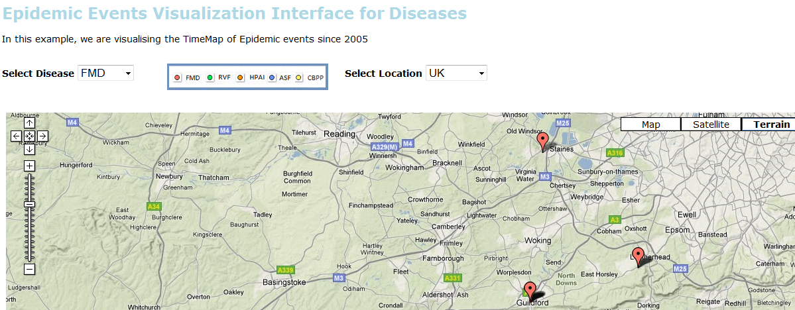
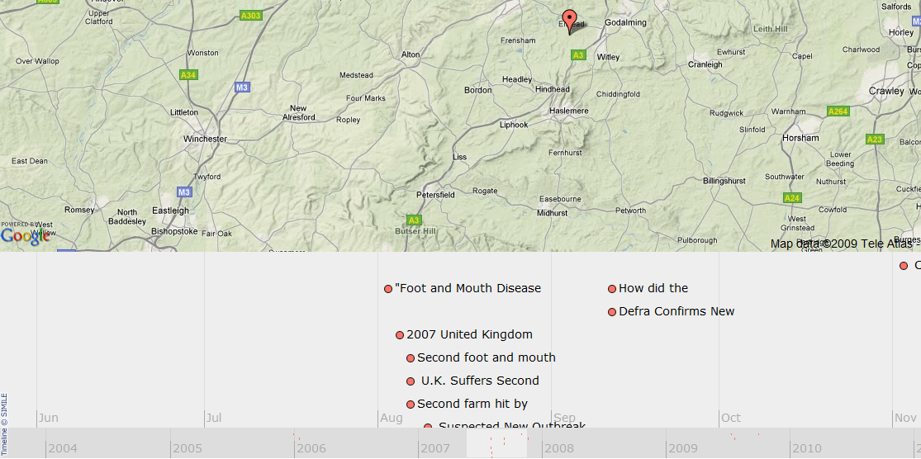
Previous Work [1]:
From Text to Spatiotemporal Events
http://fingolfin.user.cis.ksu.edu/timemap2gs
Based on
NLP Group NER Toolkit © 2005-2010 Stanford University
Simile © 2003-2010 Massachusetts Institute of Technology
Google Maps © 2007-2010 Tele Atlas, Inc. and Google, Inc.

Slide 3
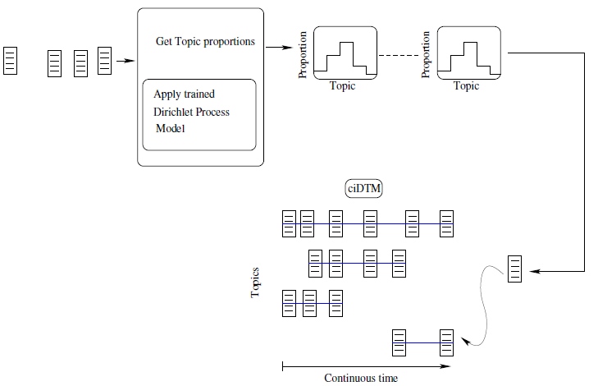
Previous Work [2]:
Timeline Formation
Elshamy (2012)

Slide 4
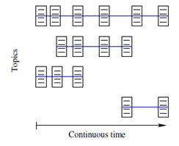
Previous Work [3]: Simultaneous Topic Enumeration & Tracking (STET)
Time t: 3 extant topics
Time t + k: 2 extant topics
Adapted from Elshamy (2012)

Slide 5
Outline
Topic Modeling: Static (STM) vs. Dynamic (DTM)
  Generative Model Concepts
  Using Time in DTM
Heterogeneous Information Network Analysis (HINA)
From Link Analysis to Link-Augmented DTM
  Community Detection: Gibson et al., Lu & Getoor
  From RankClus to NetClus: Sun et al.
  LIMTopic (Duan et al.) & Other Approaches

Slide 6
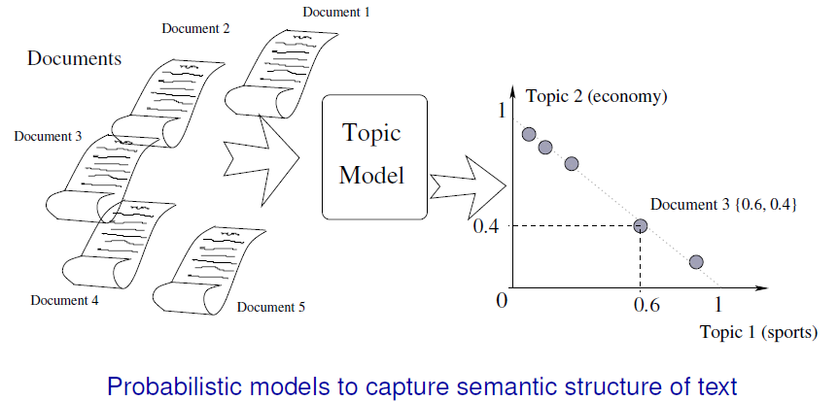
Topic Modeling [1]:
Basic Task (Static/Atemporal)
Elshamy (2012)

Slide 7
Outline
Topic Modeling: Static (STM) vs. Dynamic (DTM)
  Generative Model Concepts
  Using Time in DTM
Heterogeneous Information Network Analysis (HINA)
From Link Analysis to Link-Augmented DTM
  Community Detection: Gibson et al., Lu & Getoor
  From RankClus to NetClus: Sun et al.
  LIMTopic (Duan et al.) & Other Approaches

Slide 8
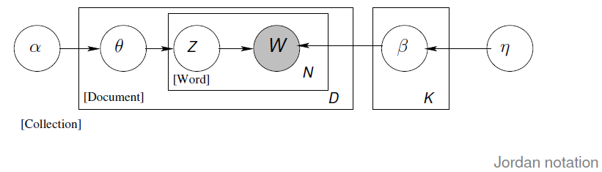
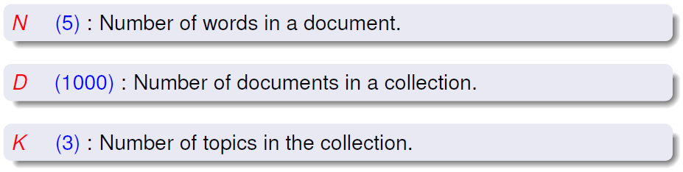
Topic Modeling [2]:
Understanding Plate Notation
Adapted from Elshamy (2012)

Slide 9
Outline
Topic Modeling: Static (STM) vs. Dynamic (DTM)
  Generative Model Concepts
  Using Time in DTM
Heterogeneous Information Network Analysis (HINA)
From Link Analysis to Link-Augmented DTM
  Community Detection: Gibson et al., Lu & Getoor
  From RankClus to NetClus: Sun et al.
  LIMTopic (Duan et al.) & Other Approaches

Slide 10
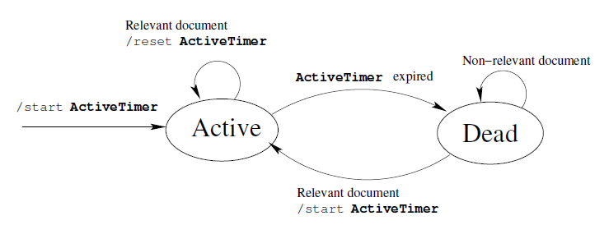
Dynamic Topic Modeling: HMM for Topic Detection & Tracking (TDT)
Observable Transition: Topic Arrival (Detected by Topic Model)
Hidden State: Topic Activity Level
Problem: Topic Drift (Similar to Concept Drift)
Hidden Markov Model (HMM)
Adapted from Elshamy (2012)

Slide 11
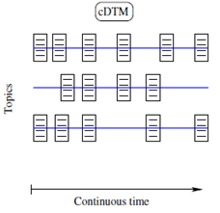
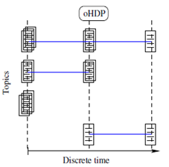
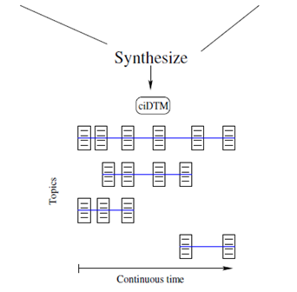
Continuous Time vs.
Variable Number of Topics
cDTM
Continuous Time,
Fixed Number of Topics
oHDP
Discrete Time,
Variable Number of Topics
State of the Field
Goal: Hybrid Model
Continuous Time,
Variable Number of Topics
Elshamy (2012)

Slide 12
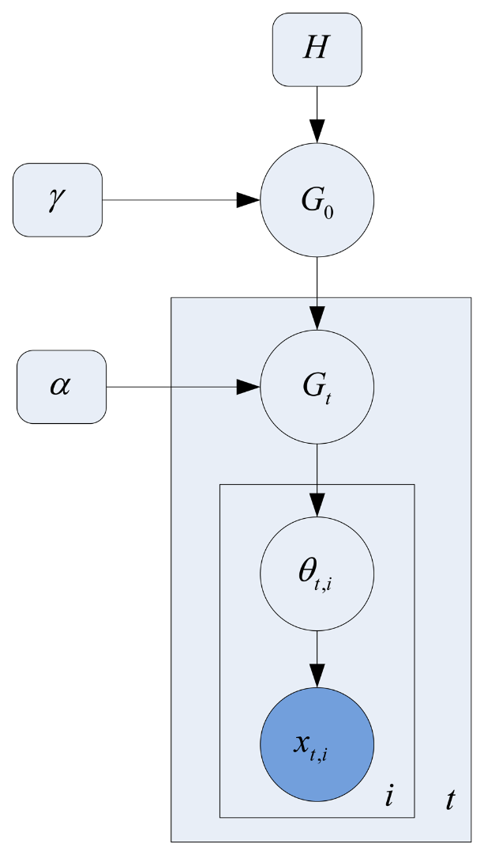
Hierarchical Dirichlet Process
(HDP) Model
Global prior $G_{0}$
Prior $G_{t}$ for words in document $t$
Index $i$ of words in document $t$
Concentration parameter $γ$ for $G_{0}$
Concentration parameter $α$ for $G_{t}$
Topics $θ_{t, i}$
Words${ x}_{t, i}$
Fan et al. (2013)

Slide 13
Retrieving Documents
Corpus representation from topic model
Word-Topic Inverted Index
Document-Topic Inverted Index
Query Document
Search
Interface
Ranked Results
Short Text Query
Author Query

Slide 14
Information Retrieval Task [1]:
Overview
Representation
  Document $d\text{: }\text{bag} \text{of} \text{words}$
  Author $a$: mixture of all (co-)authored documents
  Query $q$: (usually smaller) bag of words
Process: given input query $q$
  Intake: perform data processing on incoming $q$
  Infer topic mixture for $q$ using trained topic model
  Use to retrieve documents, authors for this $q$

Slide 15
Information Retrieval Task [2]:
Static Setting
Given: document $d$, query $q$
Estimate using query likelihood model, $P\left(q | d\right)$
Maintain two inverted indices
  $P\left(w | k\right)$ – word $w$ given topic $k$
  $P\left(k | d\right)$ – topic $k$ given document $d$
Use these indices for fast retrieval
Tested on small corpus: 100 documents

Slide 16
Information Retrieval Task [3]:
Dynamic Setting
Similar to static setting
Inputs: query, time duration (search window)
Query likelihood model: $P\left(q | d\right)$
For each time stamp in search window:
  Maintain two inverted indices as in static setting
  Perform query-based retrieval at each time stamp
  Aggregate results
Currently under development

Slide 17
Outline
Topic Modeling: Static (STM) vs. Dynamic (DTM)
  Generative Model Concepts
  Using Time in DTM
Heterogeneous Information Network Analysis (HINA)
From Link Analysis to Link-Augmented DTM
  Community Detection: Gibson et al., Lu & Getoor
  From RankClus to NetClus: Sun et al.
  LIMTopic (Duan et al.) & Other Approaches

Slide 18
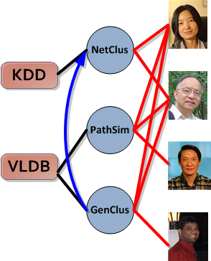
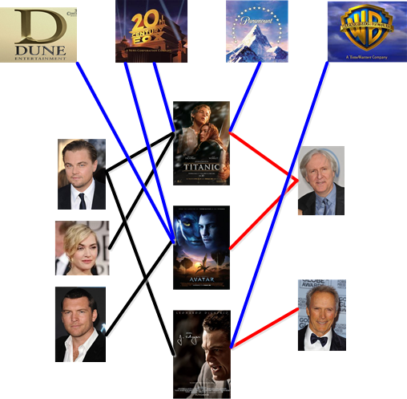
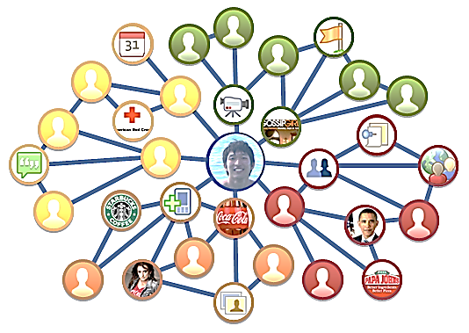
Heterogeneous Information Network Analysis (HINA)
Real-world data: Multiple object types and/or multiple link types
Movie
Studio
Venue
Paper
Author
Actor
Director
DBLP Bibliographic Network
Movie
The IMDB Movie Network
The Facebook Network
Han, Wang, & El-Kishky (KDD 2014)

Slide 19
Outline
Topic Modeling: Static (STM) vs. Dynamic (DTM)
  Generative Model Concepts
  Using Time in DTM
Heterogeneous Information Network Analysis (HINA)
From Link Analysis to Link-Augmented DTM
  Community Detection: Gibson et al., Lu & Getoor
  From RankClus to NetClus: Sun et al.
  LIMTopic (Duan et al.) & Other Approaches

Slide 20
Link Analysis [1]:
Instance-based Dependencies
P₃
P₃
I₁
A₁
Papers that cite P₃ are likely to be
Getoor, Bhattacharya, Lu, & Sen (MRDM 2004)

Slide 21
Link Analysis [2]:
Class-based Dependencies
?
I₁
?
A₁
Papers that cite are likely to be
Getoor, Bhattacharya, Lu, & Sen (MRDM 2004)

Slide 22
Outline
Topic Modeling: Static (STM) vs. Dynamic (DTM)
  Generative Model Concepts
  Using Time in DTM
Heterogeneous Information Network Analysis (HINA)
From Link Analysis to Link-Augmented DTM
  Community Detection: Gibson et al., Lu & Getoor
  From RankClus to NetClus: Sun et al.
  LIMTopic (Duan et al.) & Other Approaches

Slide 23
Link Descriptions
Categories
In-Links(X)
Out-Links(X)
mode:
binary: (1,1,1)
mode:
count: (3,1,1)
binary: (1,1,0)
count: (1,2,0)
X
CO(X)
CI(X)
mode:
mode:
binary: (1,1,0)
binary: (1,0,0)
count: (2,1,0)
count: (2,0,0)
Getoor, Bhattacharya, Lu, & Sen (MRDM 2004)

Slide 24
Predictive Model for Classification
A structured logistic regression
  Compute P(c | OA(X)) and P(c | LD(X)) separately using separate logistic regression models
  where OA(X) are the object attributes and LD_{f}(X) are the link features
Getoor, Bhattacharya, Lu, & Sen (MRDM 2004)

Slide 25
Prediction
category set { }
P₁
P₁
P₂
P₂
P₅
P₅
P₃
P₃
P₄
P₄
Step 1: Bootstrap using object attributes only
Getoor, Bhattacharya, Lu, & Sen (MRDM 2004)

Slide 26
Outline
Topic Modeling: Static (STM) vs. Dynamic (DTM)
  Generative Model Concepts
  Using Time in DTM
Heterogeneous Information Network Analysis (HINA)
From Link Analysis to Link-Augmented DTM
  Community Detection: Gibson et al., Lu & Getoor
  From RankClus to NetClus: Sun et al.
  LIMTopic (Duan et al.) & Other Approaches

Slide 27
NetClus [1]
Algorithm to perform clustering over heterogeneous network
Performs iterative ranking of clustering of objects.
Probabilistic generative model is used to model probability of generating different objects from each cluster
Maximum likelihood technique used to evaluate posterior probability of presence of object in cluster
Gupta, Aggarwal, Han, Sun (ASONAM 2011)

Slide 28
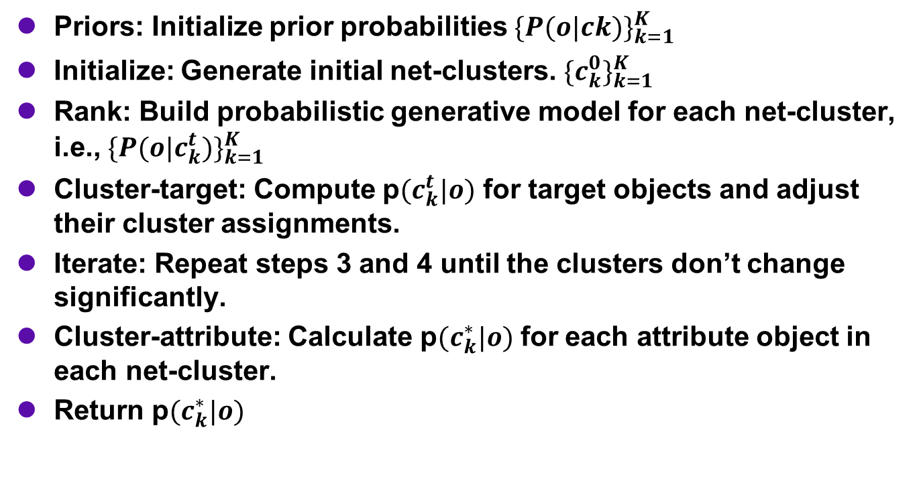
NetClus [2]
Priors: Initialize prior probabilities ${\{P(o|ck)\}}_{k=1}^{K}$
Initialize: Generate initial net-clusters. ${\{c_{k}^{0}\}}_{k=1}^{K}$
Rank: Build probabilistic generative model for each net-cluster, i.e., ${\{P(o|c_{k}^{t})\}}_{k=1}^{K}$
Cluster-target: Compute p$(c_{k}^{t}|o)$ for target objects and adjust their cluster assignments.
Iterate: Repeat steps 3 and 4 until the clusters don’t change significantly.
Cluster-attribute: Calculate p$(c_{k}^{∗}|o)$ for each attribute object in each net-cluster.
Return p$(c_{k}^{∗}|o)$
Gupta, Aggarwal, Han, Sun (ASONAM 2011)

Slide 29
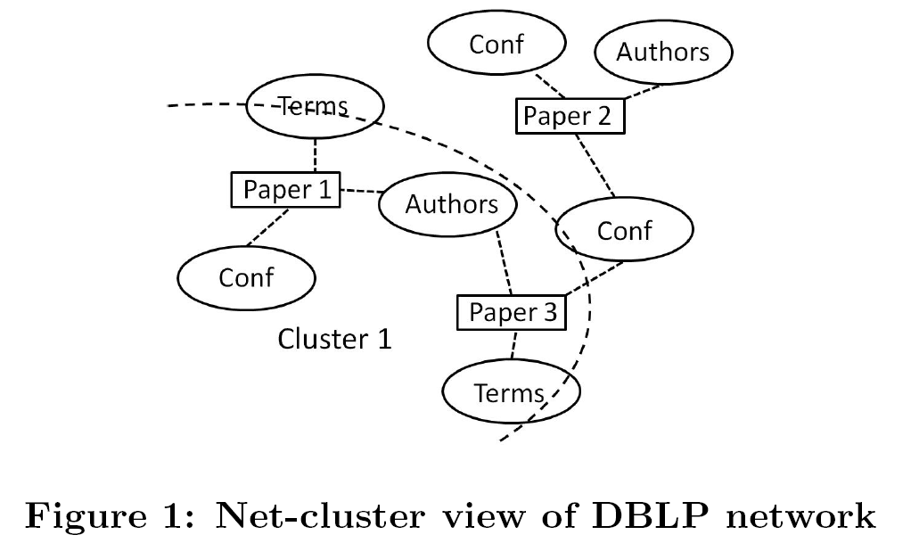
Using NetClus
Gupta, Aggarwal, Han, Sun (ASONAM 2011)

Slide 30
NetClus Results:
Net Cluster Tree
nc
Level 1
K=3
nc
nc
nc
Level 2
nc
nc
nc
nc
nc
nc
nc
nc
nc
Level 3
Gupta, Aggarwal, Han, Sun (ASONAM 2011)

Slide 31
Outline
Topic Modeling: Static (STM) vs. Dynamic (DTM)
  Generative Model Concepts
  Using Time in DTM
Heterogeneous Information Network Analysis (HINA)
From Link Analysis to Link-Augmented DTM
  Community Detection: Gibson et al., Lu & Getoor
  From RankClus to NetClus: Sun et al.
  LIMTopic (Duan et al.) & Other Approaches

Slide 32
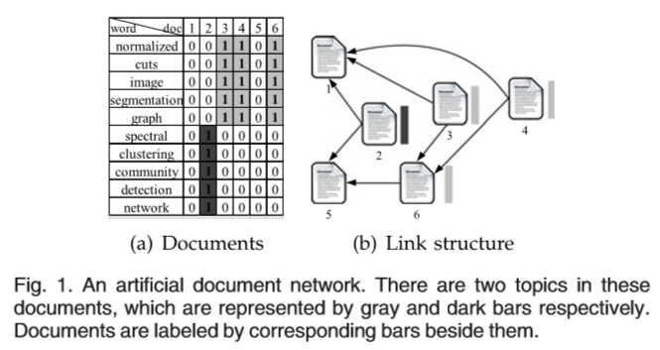
LIMTopic [1]:
Document Networks
Duan, Li, Li, Zhang, Gu, & Wen (IEEE TKDE 2011)

Slide 33
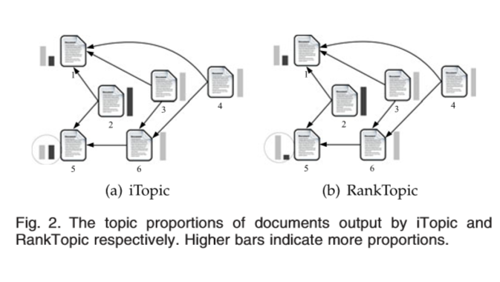
LIMTopic [2]:
PageRank-Like Ranking Algorithms
Duan, Li, Li, Zhang, Gu, & Wen (IEEE TKDE 2011)

Slide 34
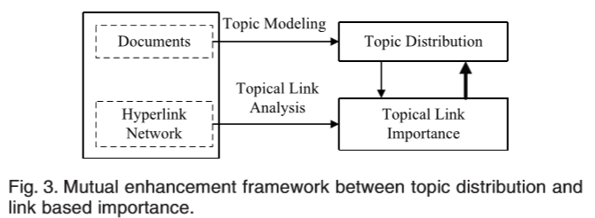
LIMTopic [3]:
Link-Augmented STM
Duan, Li, Li, Zhang, Gu, & Wen (IEEE TKDE 2011)

Slide 35
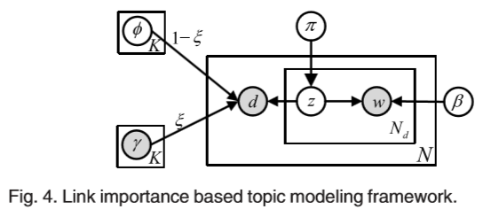
LIMTopic [4]:
Using Link Importance
Link importance
Duan, Li, Li, Zhang, Gu, & Wen (IEEE TKDE 2011)

Slide 36
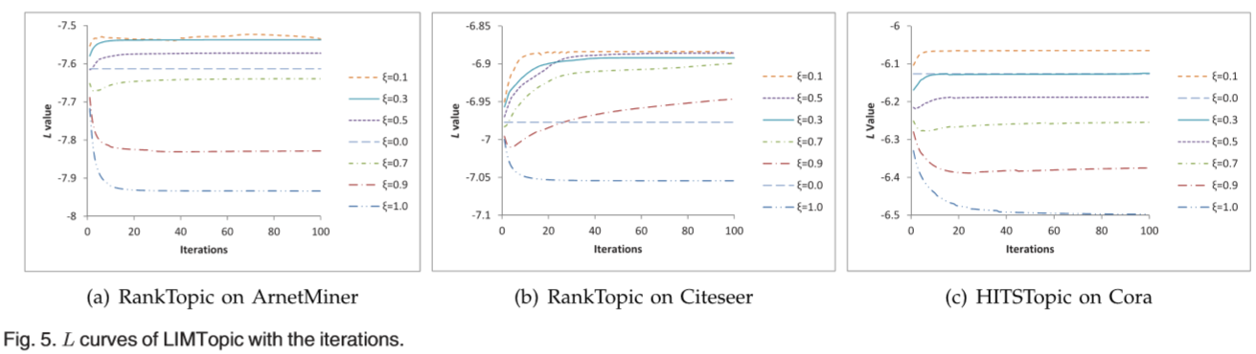
LIMTopic [5]:
Evaluating Topic Models for Ranking
Duan, Li, Li, Zhang, Gu, & Wen (IEEE TKDE 2011)

