Slide 1

Recommendation using
Extended Paths in Complex Networks
Robin Burke
Fatemeh Vahedian
Center for Web Intelligence
School of Computing
DePaul University
Chicago, Illinois USA

Slide 2
Other contributors
Bamshad Mobasher
Jonathan Gemmell
Thomas Schimoler
Yong Zheng
Ad for our group’s other presentations:
“Incorporating Context Correlation into Context-aware Matrix Factorization” IP workshop, Monday
“Adapting Recommendations to Contextual Changes Using Hierarchical Hidden Markov Models”
Main conference, session SIST3, Friday

Slide 3
Outline
Historical background
  Social tagging systems
Multi-component hybrid using metapaths
Multi-relational matrix factorization

Slide 4
Heterogeneous networks
No explanation needed for this audience
A variety of data sets in this work
  social tagging systems
    users, resources, tags
  social media sites
    users, businesses, locations, categories (Yelp)
  informal education
    students, schools, organizations, programs, offerings
  scientific publications
    authors, publications, venues, series
  commercial
    users, employers, job ads, applications, schools, etc.

Slide 5
Social Tagging Research
(Gemmell, et al. 2009, 2011)
Users apply tags to resources
Examples
  delicious.com
  Amazon.com
  Last.fm

Slide 6
As a network
R1
U1
A1
T1
R2
A2
T2
U2
A3
T4
T3

Slide 7
Recommendation Options
Input | Output
User | Similar users Recommended resources Recommended tags
User, Tag | Recommended resources
User, Resource | Recommended tags

Slide 8
Resource Recommendation
Given a user
  what resources to recommend
    most analogous to “normal” recommendation
    but little studied at the time

Slide 9


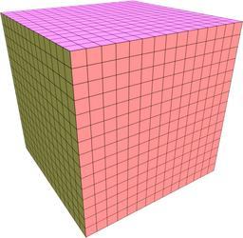
Two-Dimensional Projections
RT
UR
UT

Slide 10
Approach
Build weighted hybrids
  Incorporate all reduced dimension views
Individual predictions P_{i}
  scaled to 0..1 scale
  weighted by α_{i}
  α values sum to 1
  combined to overall prediction P*
Learn α values through optimization

Slide 11
Typical results

Slide 12
Learned weights
Dataset | Pop | TagSim | kNN_{ur} | kNN_{ut} | kNN_{ru} | kNN_{rt}
Amazon | 0.053 | 0.254 | 0.419 | 0.001 | 0.131 | 0.147
Bibsonomy | 0.01 | 0.023 | 0.431 | 0.020 | 0.209 | 0.307
Delicious | 0.004 | 0.263 | 0.512 | 0.069 | 0.119 | 0.033
LastFM | 0.006 | 0.153 | 0.410 | 0.005 | 0.425 | 0.001
kNNur weights similar across datasets
kNNrt is inconsistent

Slide 13
Key findings
Hybrid always does better than any single component
kNN_{ur} also does well
  makes sense since we are using users to predict resources
kNN_{ru} and kNN_{rt} inconsistent
  compare Bibsonomy and LastFM
  tags in LastFM are not good descriptors for resources
Not shown
  Hybrid performs better than the well-known PITF algorithm
    for tag recommendation

Slide 14
Extending to heterogeneous networks
(Burke and Vahedian, 2013; Burke, et al. 2014)
More types of nodes
More types of edges
Possible edges between nodes of the same type
Increased complexity but application-defined structure

Slide 15
Examples
user
location
user
position
author
biz
resume
paper
category
check-in
venue
company
keyword
keywords
Yelp
Career Builder
DBLP

Slide 16
Meta-paths
In a heterogeneous network
  many choices for how to represent a user’s profile
    in terms of items preferred
    in terms of tags given to items
    in terms of tags supplied by all users for their preferred
    etc.
Represent all such options as meta-paths
  classes of paths through the network
  each link follows a characteristic typed edge from one node type to another

Slide 17


Meta-path example (UBLB)
Brunch
Barrio Cafe
Alice
UB
Mexican
Salty Sow
UBL
Bob
UBLB
Phoenix
American
Gallo Blanco
Carl
Bar
Tempe
Chelsea’s Kitchen
Tom
Burger
Bar Louie
John

Slide 18
Meta-path example (BCBU)
Brunch
Barrio Cafe
Alice
Mexican
Salty Sow
Bob
Phoenix
American
Gallo Blanco
Carl
BCB
Bar
Tempe
BCBU
Chelsea’s Kitchen
Tom
Burger
Bar Louie
BC
John

Slide 19
WHyLDR
Weighted Hybrid of Low-Dimensional Recommenders
  Take the weighted hybrid approach from tag recommendation
  Build two-dimensional components using meta-paths,
    can be multiple steps through the network
    instead of the one-step relations used in tagging work

Slide 20
Problem: Unbounded
Component generation is an unbounded process
  Expensive
  Not efficient
Some components make only a minor contribution
Weight optimization process is slowed by adding components
Solution: estimate component utility using information gain

Slide 21
Computing Information Gain 1
Start with probability
  p(a) = probability of encountering node a (among the other nodes in class A)
  = probability of a random walk encountering a
  = (as length of walk -> ∞) degree of a
    relative to other nodes in A

Slide 22
Computing information gain 2
Entropy of dimension A
Entropy of dimension A given B

Slide 23
Information gain
G(A,B) = H(A) – H(A|B)
If the gain is small
  H(A) and H(A|B) are close
This means that knowing B
  does not decrease the entropy of A
Example
  knowing that a song is tagged “rock”
  doesn’t decrease its entropy across user profiles in Last.fm
    because the tag is used so loosely for almost everything

Slide 24

Example: Yelp
A = users
B = restaurants
A
B
User profile
 | Salty Sow | Barrio Cafe | Bar Louie
Bob | 1 | 2 | 0
Alice | 2 | 0 | 1
p(Bob)=1/2
p(Salty Sow|Bob)=1/3

Slide 25
Meta-paths in Yelp
Type | Meta-path
User-based | User-biz User-biz-category User-biz-category-biz User-biz-location User-biz-location-biz
Item-based | Biz-category Biz-user Biz-user-biz-category
user
location
biz
category
check-in

Slide 26
Hybrids
HM-1: User-based and item-based, paths of length 1 plus popularity
HM-2: HM-1 plus user-based and item-based, paths of lengths 2
HM-3: HM-2 plus cosine, paths of length 2
HM-4: HM-3 plus user-based, paths of length 3
HM-5: HM-4 plus item-based, paths of length 3

Slide 27
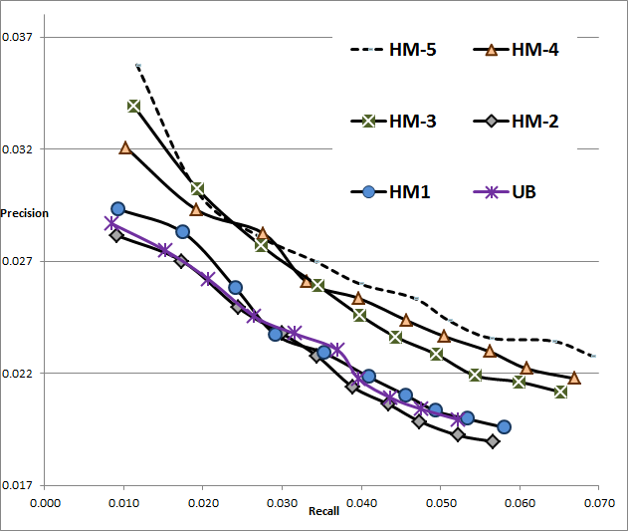
Results

Slide 28
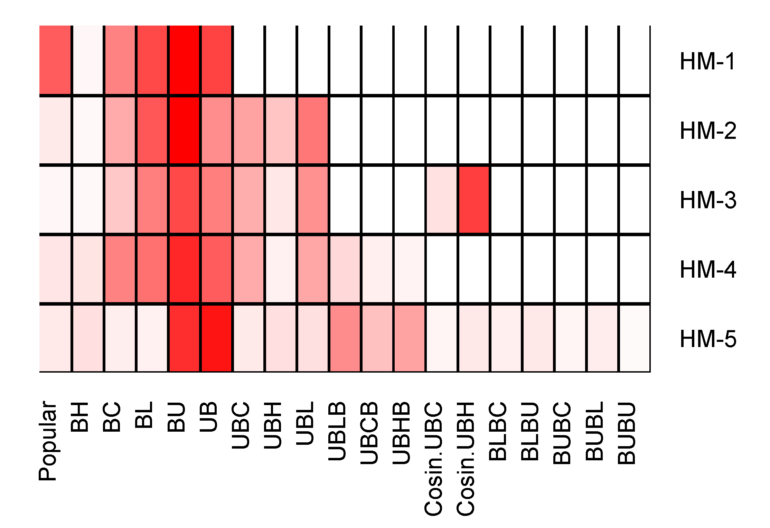
Component contribution

Slide 29
Correlation
Information gain vs learned weights
Other work
  demonstrated that IG could be used to prune the set of components
  improved learning time
  without loss of accuracy
Model | HM-1 | HM-2 | HM-3 | HM-4 | HM-5
Correlation | 0.788 | 0.523 | 0.587 | 0.90 | 0.627

Slide 30
Alternative recommendation model
Multi-Relational Matrix Factorization (Drummond, 2014)
  assume target relation (i.e. user – business)
  and auxiliary relations (i.e. business – category)
Learn the factorization model parameters
  by optimizing the sum over the loss functions on each relation
  auxiliary relations act as regularization terms

Slide 31
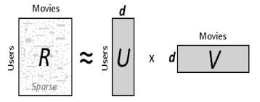

Single relation
(from Krohn-Grimberghe, et al. 2012)

Slide 32
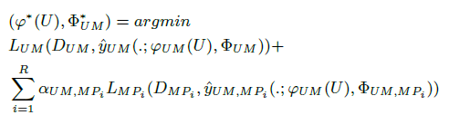
Multiple relations
Note that relations need not be direct associations
Can be generated by meta-paths
  as in our weighted hybrid work

Slide 33
DMF / CATSMF
(Drummond, et al. 2014)
DMF (Decoupled Target Specific Features Multi-Target Factorization)
  different latent feature models are defined for each relation
  factorization process in such a way that they are optimized for the best performance on each relation individually
CATSMF (Coupled Auxiliary and Target Specific Features Multi-Target Factorization)
  proposed to improve the efficiency of the DMF model when applied to multiple targets
  better accuracy than DMF in some domains

Slide 34
Methodology
Use 80% of the data as training set and the rest as test set
  All meta-paths are generated based on training data
  2 step and 3 step versions
Optimize the factorization model using BPR as loss function
Generate the list of 10 recommendations
Measure the recall and precision for top 10 recommendations

Slide 35
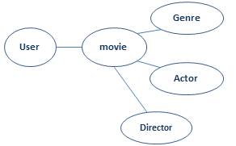
MovieLens Dataset Experiments
Target relation is UM
The user profile paths: UM, UMA, UMG, UMD, UMGM, UMDM, UMAM
The item profile paths: MG, MD, MA

Slide 36
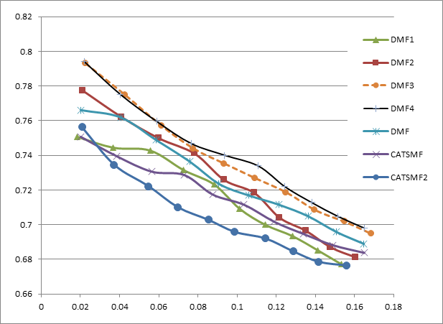
Movie Recommendation Results
 | um | ma | md | mg | uma | umd | umg | umam | umdm | umgm
DMF
DMF1
DMF2
DMF3
DMF4
CATSMF
CATSMF2
precision
Recall

Slide 37
DBLP dataset Experiment
citation
Paper
Venue Recommendation to Author
  APV is the target relation
  Direct links: paper-author, paper-citation, paper-venue
  Meta-paths: Author-paper-Author, Author-paper-citation
Citation Recommendation
  Paper-citation is target relation
  Direct links: paper-author, paper-citation, paper-venue
  Meta-paths: paper-citation-venue
Author
Venue

Slide 38
Venue Recommendation Results
precision
 | APV | PA | PV | PC | APC | APA | VPA | VPC | APCA | APCV | APAP | APVP | VPAP | VPCP
DMF-1
DMF-2
DMF-3

Slide 39
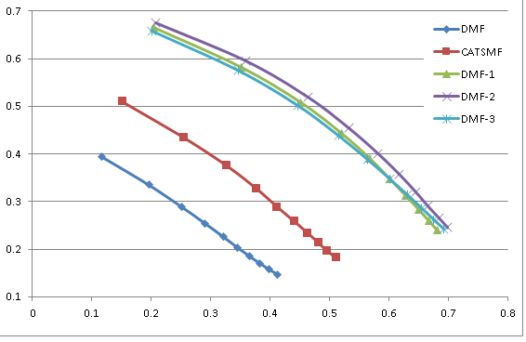
Citation-Recommendation Results
precision
Recall
 | pc | pv | pa | cpc | cpv | cpa | pap | pcp | pca | pcv | papa | papc | papv | pcpv | pcpa
DMF
DMF-1
DMF-2
DMF-3

Slide 40
Conclusions
A heterogeneous network approach is valuable for recommendation
  distant relations through the network can add accuracy
  (and sometimes diversity)
Examples
  weighted hybrid
  multi-relational factorization
Information gain
  correlates with component / relation utility
  but is probably too simple
    not sensitive to recommendation task
  is also computationally intensive

Slide 41
Future work
Studying information gain-based pruning in multi-relational models
Better relation / component utility metric
MRF vs weighted hybrid
  factorization is not always better
  when / why

Slide 42
Conclusion and Future work
Recommendation using multi-relational matrix factorization in networked data can be enhanced through in the inclusion of relations derived from meta-path expansions
Longer meta-paths are not always good
Future work
  Predicting the usefulness of generated meta-paths
  Weighted meta-paths

