Slide 1

Facial Expression Detection using Patch-based Eigen-face Isomap Networks
By:
Sohini Roychowdhury,
Assistant Professor,
Department of Electrical and Computer Engineering,
University of Washington,
Bothell, WA, USA

Slide 2
Outline
Introduction
Facial Patch Creation
Eigen-Face Creation
Facial Network Clustering
Facial Network Analysis
Results
Conclusions

Slide 3
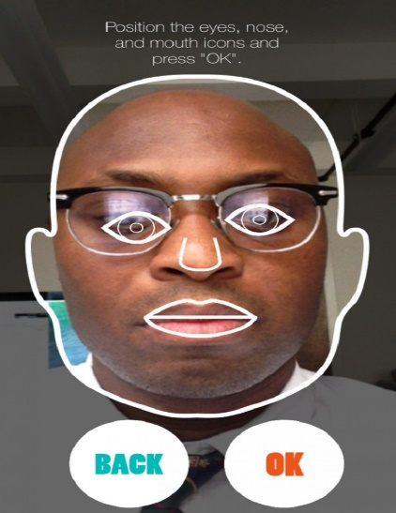
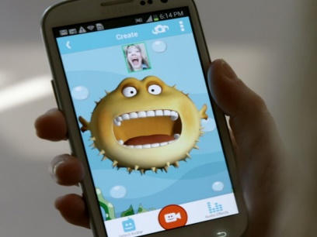
Introduction
Automated Facial Expression Detection:
    Useful for Real Time Security Surveillance Systems, Social Networks [1].
Challenges due to variations in:
    Pose
    Lighting
    Imaging distortions
    Expression
    Occlusions.
Motivation:
    Patched faces have better expression clustering performance than full faces.
    Clustering minimizes training data complexity.
Goal:
To design a network-based expression
classification system with low computational
time complexity.
Source:http://mostepicstuff.com/app-that-changes-your-facial-expression-to-cartoon-look/
Source:http://www.smithsonianmag.com/innovation/app-captures-emotions-real-time-180951878/?no-ist

Slide 4
Prior Work
Two categories of existing facial expression detection algorithms:
    Based on extracting feature vectors from parts of a face such as eyes, nose, mouth, and chin, with the help of deformable templates [2] [3].. High computational complexity
    Based on the information theory concepts such as principal component analysis method [4-6]. Not very effective. Large training data set required.
The proposed method involves:
  Guided patch creation followed by Isomap clustering of the patched Eigen-faces for unsupervised classification.
  Two classification tasks are performed:
    Classification of images with occlusions (mainly glasses and beards)
    Classification of smiling faces.
  Low computational time complexity:
      Unsupervised classification requires a runtime of less than 1 second for a dataset of 80 images of original dimension [112x92] each, in a 2.6GHz 2GB RAM Laptop.

Slide 5
Key Contributions
Facial Expression Network-based clustering requires only 2 training data samples for expression clustering.
Facial Expression Network analysis identifies the faces at the edge of the expression clusters as vital expression detectors. Network centrality and flow-based measures can further demonstrate the expression information flow in the networks.
Data Set: 80 images corresponding to the 1st and 10th image per person for 40 people [2x40=80 images] used from the ORL Data base of faces [7]. Each image of dimension [112x92] is resized to [90x90] for computational simplicity.

Slide 6
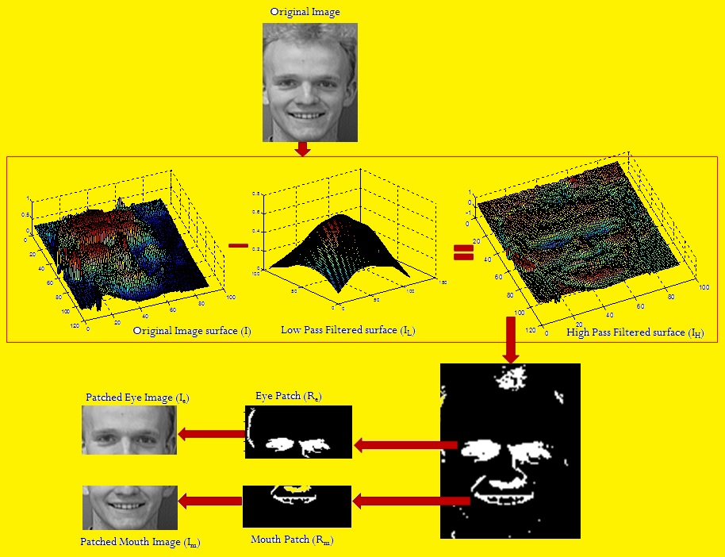
Facial Patch Creation
Fig 1: Extraction of high pass filtered regions of interest and face patches corresponding to the eye and mouth region, respectively.

Slide 7
Eigen-Face Creation [6]
For each image ‘I’, the Karhunen-Loeve expansion [4] is applied to find vectors that best represent the distribution of face images , where n=80 images.
The average face is the 0th Eigen vector computed as:
Difference of each face from the average are computed:
are subjected to PCA to find a set of ‘n’ orthonormal vectors
which best describe the distribution of images.
Method:
Let covariance matrix:
For computational feasibility:
Construct a matrix of dimension [nxn] as
‘n’ Eigen-vectors of `L’ ( ) are then extracted. These Eigen-vectors determine linear combinations of ‘n’ faces to form the Eigen-Faces ( ) .
where, .
Matrix ‘L’ represents signature of each face in terms of an ‘n’ dimensional vector.

Slide 8
Example of Eigen-Faces
Fig 2: The 0th Eigen vector followed by 15 Principal Eigen-Faces for the 1st face of 1st person in the ORL data set.

Slide 9
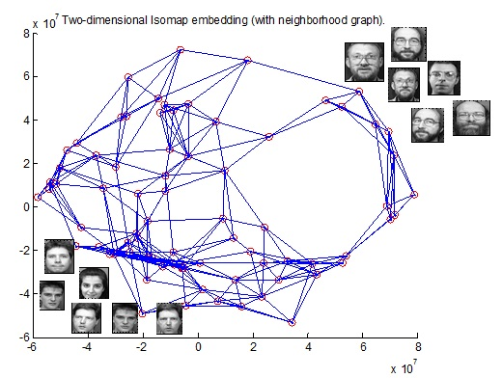
Isomap-based Clustering
For the matrix, Isomap [8] is used for lower dimension embedding using multidimensional scaling.
Matrix ‘L’ is reduced to an unweighted network (G), where each image ‘i’ is connected to ‘k’ Euclidean neighbors in high dimensional space.
Network G=(Y,E), where represent the signature of each Eigen-Face as a vertex/node. ‘E’ represents an edge matrix such that
Two faces (nodes) that have the largest Euclidean distance between them are selected as cluster representatives. i.e.,
If, represent the distance between nodes (i,j), then,
Such that Z₁ belongs to cluster 1 and Z₂ belongs to cluster 2.
Based on the distance of every other node from Z₁ or Z₂ , each node is assigned to the closest cluster.
Fig 3: Isomap-based clustering using full faces

Slide 10
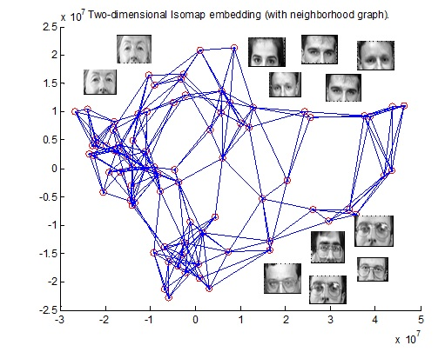
Results
Task 1: Eye occlusion detection (classification of faces with glasses)
  Comparison of Isomap-based clustering using full face Eigen-faces vs. Patched Eye (I_{e}) Eigen-Faces.
Fig 4a: Isomap-based clustering using full faces
Isomap created using k=5
Fig 4b: Isomap-based clustering using patched faces. Isomap created using k=5

Slide 11
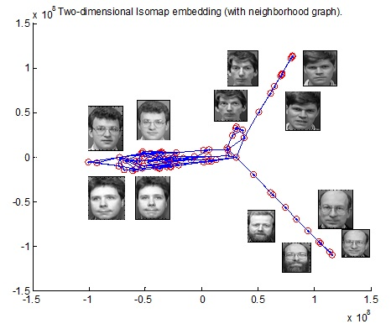
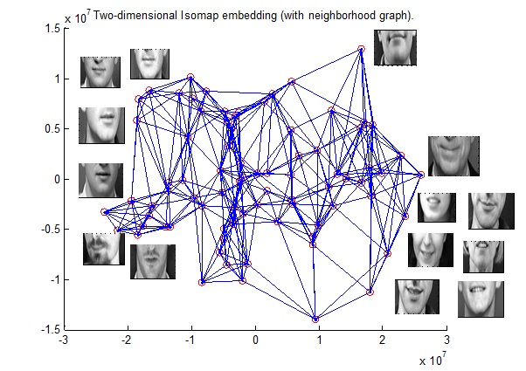
Task 2: Smile detection (classification of smiling faces)
  Comparison of Isomap-based clustering using full face Eigen-faces vs. Patched Eye (I_{e}) Eigen-Faces.
Fig 5a: Isomap-based clustering using full faces
Isomap created using k=3
Fig 5b: Isomap-based clustering using patched faces. Isomap created using k=7

Slide 12
Method | Sensitivity | Specificity | Accuracy | k | Isomap Residual | AUC
Task1: | Classification of facial occlusions
Full Face Eigen-Faces | 0.6896 | 0.7450 | 0.725 | 5 | 0.0603 | 0.7031
Patched Eigen-Faces | 0.7586 | 0.6862 | 0.725 | 5 | 0.0275 | 0.7245
Task 2: | Classification of smile
Full Face Eigen-Faces | 0.1428 | 0.8667 | 0.55 | 3 | 0.02605 | 0.5111
Patched Eigen-Faces | 0.75 | 0.5556 | 0.6625 | 7 | 0.0132 | 0.6319
Fig 6a: Clustering ROC for Task 1 by varying parameter ‘k’ from [3-21]
Fig 6a: Clustering ROC for Task 2 by varying parameter ‘k’ from [3-21]

Slide 13
Network Analysis
The nodes(faces) with top 2 highest betweenness centrality(B) and Eigen Centrality (EC) are identified for the Facial Networks.
Task 1: Full Face Network Patched Face Network
Patched faces have high centrality for occlusion clustering.
B₁=1154
B₂=1052
B₁=753.16
B₂=640.95
EC₁=0.27
EC₂=0.25
EC₁=0.3865
EC₂=0.3167

Slide 14
Task 2: Full Face Network Patched Face Network
B₁=2629
B₂=1588
B₁=703
B₂=664
EC₁=0.3058
EC₂=0.2632
EC₁=0.296
EC₂=0.292
Patched faces have high centrality for smile clustering.

Slide 15
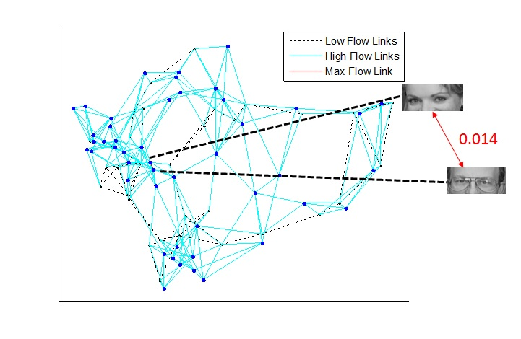
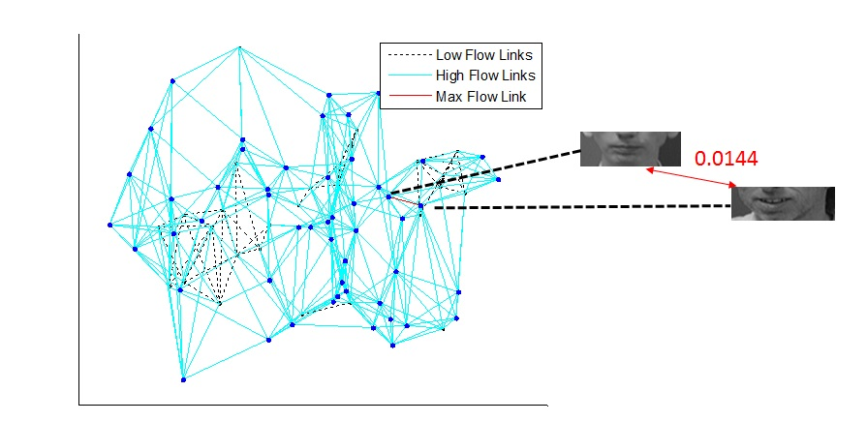
Information Flow in Patched Networks
Task 1: Highest flow in the Patched Face Network is between a non-occluded female eye and occluded male eye.
Fraction of entire flow through the network
Task 2: Highest flow in the Patched Face Network is between a non-smiling and partially smiling face

Slide 16
Conclusions
Patched Eigen-face networks have better clustering performance for eye occlusion and smile detection than networks generated with full faces.
The proposed patched Eigen-face based Isomap clustering technique achieves 75% sensitivity and 66-73% accuracy in classification of faces with occlusions and smiling faces.
Computational time is less than 1 second for a set of 80 images.
This method can be combined with supervised approaches to enhance the accuracy of existing facial expression detection algorithms.

Slide 17
References
[1] Al-modwahi, Ashraf Abbas M., et al. "Facial expression recognition intelligent security system for real time surveillance." Proc. of World Congress in Computer Science, Computer Engineering, and Applied Computing. 2012.
[2] Yuille, A. L., Cohen, D. S., and Hallinan, P. W., "Feature extraction from faces using deformable templates", Proc. of CVPR, (1989)
[3] Sim, Terence, Simon Baker, and Maan Bsat. "The CMU pose, illumination, and expression (PIE) database." Automatic Face and Gesture Recognition, 2002. Proceedings. Fifth IEEE International Conference on. IEEE, 2002.
[4] Kirby, M., and Sirovich, L., "Application of the Karhunen-Loeve procedure for thecharacterization of human faces", IEEE PAMI, Vol. 12, pp. 103-108, (1990).
[5] Turk, M., and Pentland, A., "Eigenfaces for recognition", Journal of Cognitive Neuroscience, Vol. 3, pp. 71-86, (1991).
[6] Agarwal, M.; Agrawal, H.; Jain, N.; Kumar, M., "Face Recognition Using Principle Component Analysis, Eigenface and Neural Network," Signal Acquisition and Processing, 2010. ICSAP '10. International Conference on , vol., no., pp.310,314, 9-10 Feb. 2010
[7] The Database of Faces. [Online] http://www.cl.cam.ac.uk/research/dtg/attarchive/facedatabase.html
[8] Rui-Fan Li, Hong-Wei Hao, Xu-yan Tu, Cong Wang, "Face recognition using KFD-Isomap," Proceedings of 2005 International Conference on Machine Learning and Cybernetics, vol.7, no., pp.4544,4548 Vol. 7, 18-21 Aug. 2005.

