Slide 1
Recommendation using Extended Paths in Complex Networks
Robin Burke Fatemeh Vahedian
Center for Web Intelligence School of Computing DePaul University
Chicago, Illinois USA

Slide 2
Other contributors
Bamshad Mobasher
Jonathan Gemmell
Thomas Schimoler
Yong Zheng
Ad for our group’s other presentations:
“Incorporating Context Correlation into Context-aware Matrix Factorization” IP workshop, Monday
“Adapting Recommendations to Contextual Changes Using Hierarchical Hidden Markov Models” Main conference, session SIST3, Friday

Slide 3
Outline
Historical background
Social tagging systems
Multi-component hybrid using metapaths
Multi-relational matrix factorization

Slide 4
Heterogeneous networks
No explanation needed for this audience
A variety of data sets in this work
social tagging systems
users, resources, tags
social media sites
users, businesses, locations, categories (Yelp)
informal education
students, schools, organizations, programs, offerings
scientific publications
authors, publications, venues, series
commercial
users, employers, job ads, applications, schools, etc.

Slide 5
Social Tagging Research
(Gemmell, et al. 2009, 2011)
Users apply tags to resources
Examples
delicious.com
Amazon.com
Last.fm

Slide 6
As a network
R1
U1
A1
T1
R2
A2
T2
U2
A3
T4
T3

Slide 7
Recommendation Options
Input | Output
User | Similar users Recommended resources Recommended tags
User, Tag | Recommended resources
User, Resource | Recommended tags

Slide 8
Resource Recommendation
Given a user
what resources to recommend
most analogous to “normal” recommendation
but little studied at the time

Slide 9
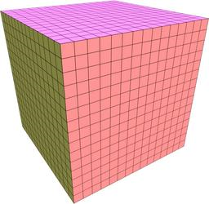
Two-Dimensional Projections
RT
UR
UT

Slide 10
Approach
Build weighted hybrids
Incorporate all reduced dimension views
Individual predictions P_{i}
scaled to 0..1 scale
weighted by α_{i}
α values sum to 1
combined to overall prediction P*
Learn α values through optimization

Slide 11
Typical results

Slide 12
Learned weights
Dataset | Pop | TagSim | kNN_{ur} | kNN_{ut} | kNN_{ru} | kNN_{rt}
Amazon | 0.053 | 0.254 | 0.419 | 0.001 | 0.131 | 0.147
Bibsonomy | 0.01 | 0.023 | 0.431 | 0.020 | 0.209 | 0.307
Delicious | 0.004 | 0.263 | 0.512 | 0.069 | 0.119 | 0.033
LastFM | 0.006 | 0.153 | 0.410 | 0.005 | 0.425 | 0.001
kNNur weights similar across datasets
kNNrt is inconsistent

Slide 13
Key findings
Hybrid always does better than any single component
kNN_{ur} also does well
makes sense since we are using users to predict resources
kNN_{ru} and kNN_{rt} inconsistent
compare Bibsonomy and LastFM
tags in LastFM are not good descriptors for resources
Not shown
Hybrid performs better than the well-known PITF algorithm
for tag recommendation

Slide 14
Extending to heterogeneous networks
(Burke and Vahedian, 2013; Burke, et al. 2014)
More types of nodes
More types of edges
Possible edges between nodes of the same type
Increased complexity but application-defined structure

Slide 15
Examples
user
location
user
position
author
biz
resume
paper
category
check-in
venue
company
keyword
keywords
Yelp
Career Builder
DBLP

Slide 16
Meta-paths
In a heterogeneous network
many choices for how to represent a user’s profile
in terms of items preferred
in terms of tags given to items
in terms of tags supplied by all users for their preferred
etc.
Represent all such options as meta-paths
classes of paths through the network
each link follows a characteristic typed edge from one node type to another

Slide 17
Meta-path example (UBLB)
Brunch
Barrio Cafe
Alice
UB
Mexican
Salty Sow
UBL
Bob
UBLB
Phoenix
American
Gallo Blanco
Carl
Bar
Tempe
Chelsea’s Kitchen
Tom
Burger
Bar Louie
John

Slide 18
Meta-path example (BCBU)
Brunch
Barrio Cafe
Alice
Mexican
Salty Sow
Bob
Phoenix
American
Gallo Blanco
Carl
BCB
Bar
Tempe
BCBU
Chelsea’s Kitchen
Tom
Burger
Bar Louie
BC
John

Slide 19
WHyLDR
Weighted Hybrid of Low-Dimensional Recommenders
Take the weighted hybrid approach from tag recommendation
Build two-dimensional components using meta-paths,
can be multiple steps through the network
instead of the one-step relations used in tagging work

Slide 20
Problem: Unbounded
Component generation is an unbounded process
Expensive
Not efficient
Some components make only a minor contribution
Weight optimization process is slowed by adding components
Solution: estimate component utility using information gain

Slide 21
Computing Information Gain 1
Start with probability
p(a) = probability of encountering node a (among the other nodes in class A)
= probability of a random walk encountering a
= (as length of walk -> ∞) degree of a
relative to other nodes in A

Slide 22
Computing information gain 2
Entropy of dimension A
Entropy of dimension A given B

Slide 23
Information gain
G(A,B) = H(A) – H(A|B)
If the gain is small
H(A) and H(A|B) are close
This means that knowing B
does not decrease the entropy of A
Example
knowing that a song is tagged “rock”
doesn’t decrease its entropy across user profiles in Last.fm
because the tag is used so loosely for almost everything

Slide 24
Example: Yelp
A = users
B = restaurants
A
B
User profile
 | Salty Sow | Barrio Cafe | Bar Louie
Bob | 1 | 2 | 0
Alice | 2 | 0 | 1
p(Bob)=1/2
p(Salty Sow|Bob)=1/3

Slide 25
Meta-paths in Yelp
Type | Meta-path
User-based | User-biz User-biz-category User-biz-category-biz User-biz-location User-biz-location-biz
Item-based | Biz-category Biz-user Biz-user-biz-category
user
location
biz
category
check-in

Slide 26
Hybrids
HM-1: User-based and item-based, paths of length 1 plus popularity
HM-2: HM-1 plus user-based and item-based, paths of lengths 2
HM-3: HM-2 plus cosine, paths of length 2
HM-4: HM-3 plus user-based, paths of length 3
HM-5: HM-4 plus item-based, paths of length 3

Slide 27
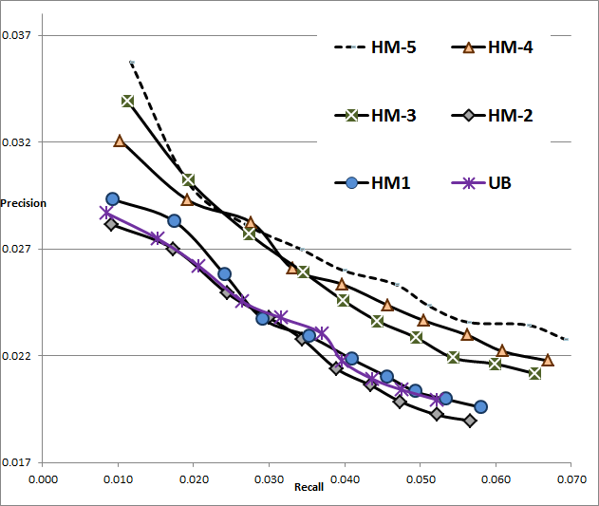
Results

Slide 28
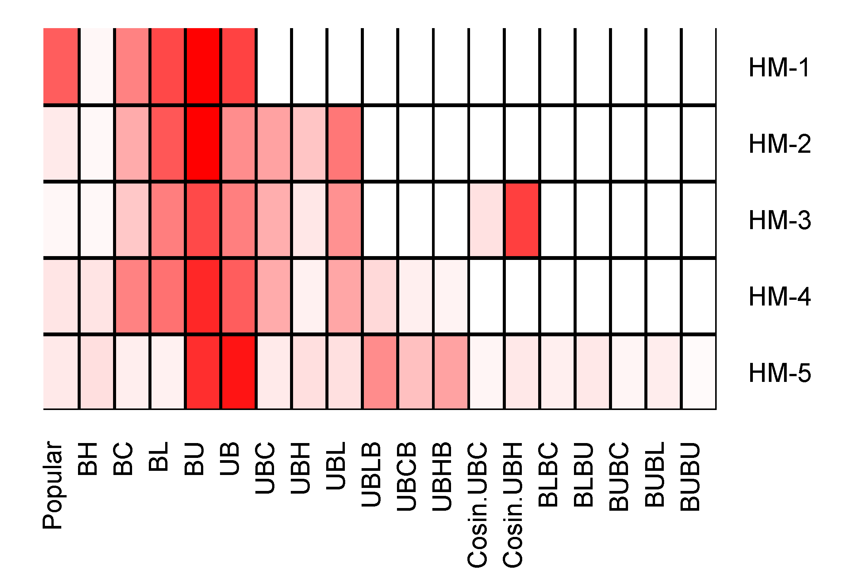
Component contribution

Slide 29
Correlation
Information gain vs learned weights
Other work
demonstrated that IG could be used to prune the set of components
improved learning time
without loss of accuracy
Model | HM-1 | HM-2 | HM-3 | HM-4 | HM-5
Correlation | 0.788 | 0.523 | 0.587 | 0.90 | 0.627

Slide 30
Alternative recommendation model
Multi-Relational Matrix Factorization (Drummond, 2014)
assume target relation (i.e. user – business)
and auxiliary relations (i.e. business – category)
Learn the factorization model parameters
by optimizing the sum over the loss functions on each relation
auxiliary relations act as regularization terms

Slide 31
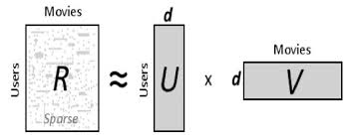
Single relation (from Krohn-Grimberghe, et al. 2012)

Slide 32
Multiple relations
Note that relations need not be direct associations
Can be generated by meta-paths
as in our weighted hybrid work

Slide 33
DMF / CATSMF (Drummond, et al. 2014)
DMF (Decoupled Target Specific Features Multi-Target Factorization)
different latent feature models are defined for each relation
factorization process in such a way that they are optimized for the best performance on each relation individually
CATSMF (Coupled Auxiliary and Target Specific Features Multi-Target Factorization)
proposed to improve the efficiency of the DMF model when applied to multiple targets
better accuracy than DMF in some domains

Slide 34
Methodology
Use 80% of the data as training set and the rest as test set
All meta-paths are generated based on training data
2 step and 3 step versions
Optimize the factorization model using BPR as loss function
Generate the list of 10 recommendations
Measure the recall and precision for top 10 recommendations

Slide 35
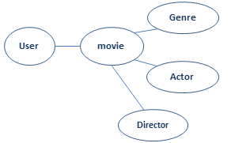
MovieLens Dataset Experiments
Target relation is UM
The user profile paths: UM, UMA, UMG, UMD, UMGM, UMDM, UMAM
The item profile paths: MG, MD, MA

Slide 36
Movie Recommendation Results
 | um | ma | md | mg | uma | umd | umg | umam | umdm | umgm
DMF
DMF1
DMF2
DMF3
DMF4
CATSMF
CATSMF2
precision
Recall

Slide 37
DBLP dataset Experiment
citation
Paper
Venue Recommendation to Author
APV is the target relation
Direct links: paper-author, paper-citation, paper-venue
Meta-paths: Author-paper-Author, Author-paper-citation
Citation Recommendation
Paper-citation is target relation
Direct links: paper-author, paper-citation, paper-venue
Meta-paths: paper-citation-venue
Author
Venue

Slide 38
Venue Recommendation Results
precision
 | APV | PA | PV | PC | APC | APA | VPA | VPC | APCA | APCV | APAP | APVP | VPAP | VPCP
DMF-1
DMF-2
DMF-3

Slide 39
Citation-Recommendation Results
precision
Recall
 | pc | pv | pa | cpc | cpv | cpa | pap | pcp | pca | pcv | papa | papc | papv | pcpv | pcpa
DMF
DMF-1
DMF-2
DMF-3

Slide 40
Conclusions
A heterogeneous network approach is valuable for recommendation
distant relations through the network can add accuracy
(and sometimes diversity)
Examples
weighted hybrid
multi-relational factorization
Information gain
correlates with component / relation utility
but is probably too simple
not sensitive to recommendation task
is also computationally intensive

Slide 41
Future work
Studying information gain-based pruning in multi-relational models
Better relation / component utility metric
MRF vs weighted hybrid
factorization is not always better
when / why

Slide 42
Conclusion and Future work
Recommendation using multi-relational matrix factorization in networked data can be enhanced through in the inclusion of relations derived from meta-path expansions
Longer meta-paths are not always good
Future work
Predicting the usefulness of generated meta-paths
Weighted meta-paths

